Slide 1



Research & Evaluations in HCI
Human-Computer Interaction Exercise
The following content is licensed under a Creative Commons Attribution 4.0 International license (CC BY-SA 4.0)

Slide 2
Research & Evaluations in HCI

Slide 3
Socrates
Karneades von Kyrene
Plato
Aristotle
Kopernikus
Zarathustra
Archimedes
Heraklit
Diogenes
Pythagoras
The School of Athens
Fresco by Raphael (1509-1511),
Apostolic Palace, Vatican City
Euclid
Image from https://en.wikipedia.org/wiki/The_School_of_Athens#/media/File:%22The_School_of_Athens%22_by_Raffaello_Sanzio_da_Urbino.jpg
Research & Evaluations in HCI

Slide 4
Philosophy
Rationalism
Empirism
Research / Science
The School of Athens
Fresco by Raphael (1509-1511),
Apostolic Palace, Vatican City
Image from https://en.wikipedia.org/wiki/The_School_of_Athens#/media/File:%22The_School_of_Athens%22_by_Raffaello_Sanzio_da_Urbino.jpg
Research & Evaluations in HCI

Slide 5
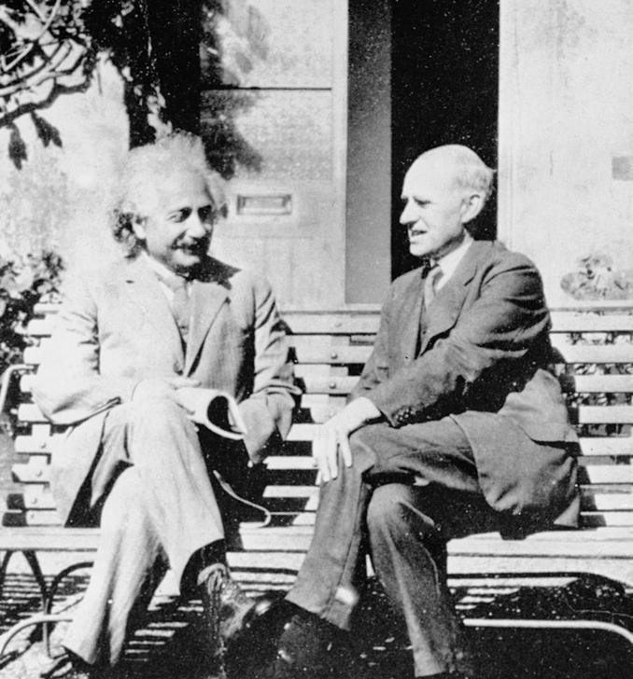

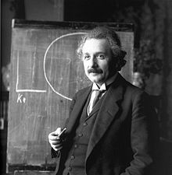
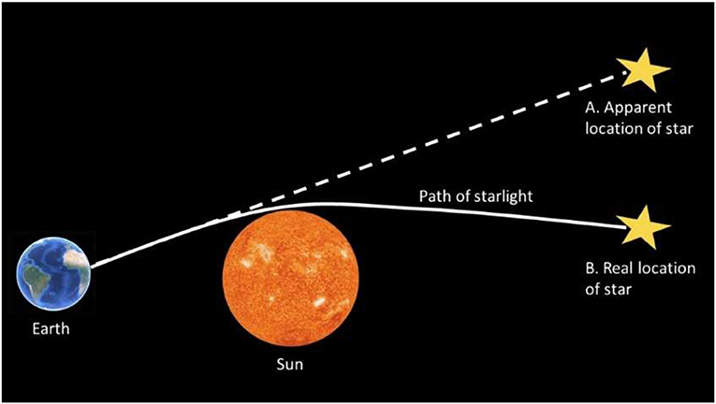
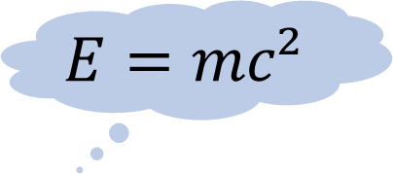
Circle of Science
$$E=mc²$$
confirmed by
Rationalism
Empirism
reasonal thinking as source of knowledge
sensory experience
as source of knowledge
confirmed by?
Image from https://kids.frontiersin.org/articles/10.3389/frym.2022.747040
Research & Evaluations in HCI

Slide 6
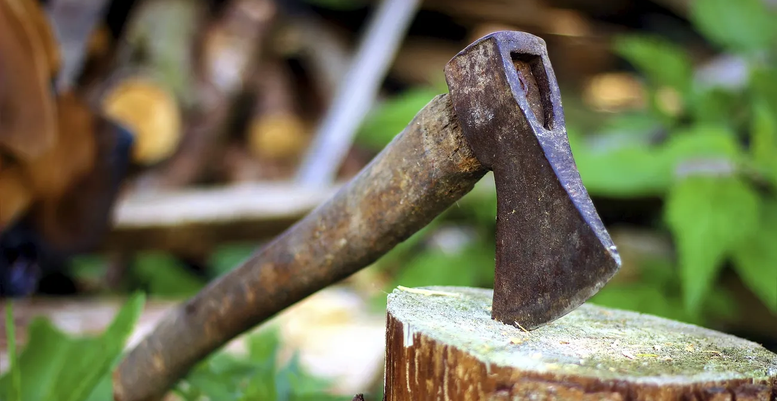
Free axe image, public domain equipment CC0 photo. https://www.rawpixel.com/image/5914225/image-public-domain-leaves-green
Research & Evaluations in HCI

Slide 7
Evaluating an axe
“If you want to evaluate a tool, say an axe, you might study the design of the bit, the weight distribution, the steel alloy used, the grade of hickory in the handle, etc., or you may just study the kind and speed of the cuts it makes in the hands of a good axeman.” [1]
Rationalists (Analysts) model the design characteristics and predict their impact
“How the handle must be designed to cut well?”
Empirics (Observers) measure the impact and understand the context
“If we change the handle, does it still cut well?”
[1] Scriven, M. (2013). Conceptual revolutions in evaluation. Evaluation roots, SAGE Publications, 167-179.
Research & Evaluations in HCI

Slide 8
What are evaluations?
Evaluation is a systematic determination and assessment of a subject's merit, worth and significance, using criteria governed by a set of standards
The application of scientific methods to assess the design, implementation, improvement, or outcomes of a subject [1]
A critical assessment to which extent a service or component fulfills stated goals [2]
A study to assist the assessment of an object's merit and worth [3]
Can demonstrate a system‘s impact
Assessment to improve the system design and implementation
[1] Ross, P.H.; Ellipse, M.W.; Freeman, H.E. (2004). Evaluation: A systematic approach (7th ed.). Thousand Oaks: Sage. ISBN 978-0-7619-0894-4.
[2] Scriven, M. (2013). Conceptual revolutions in evaluation. Evaluation roots, SAGE Publications, 167-179.
[3] Reeve, J; Paperboy, D. (2007). "Evaluating the evaluation: Understanding the utility and limitations of evaluation as a tool for organizational learning". Health Education Journal. 66 (2): 120–131. doi:10.1177/0017896907076750. S2CID 73248087.
[4] Hurteau, M.; Houle, S.; Mongiat, S. (2009). "How Legitimate and Justified are Judgments in Program Evaluation?". Evaluation. 15 (3): 307–319. doi:10.1177/1356389009105883. S2CID 145812003.
Research & Evaluations in HCI

Slide 9
Why do we need research or science to evaluate?
To gain objective knowledge we need standardized methods to measure predetermined concepts (e.g., the effectiveness of the axe)
Standardized methods to collect and evaluate data emerge from science
not from e.g., companies, governments, individuals, etc.
Only the correct application of scientific methods ensure that the results are comprehensible, reliable, replicable, and verifiable (validity and reliability)
Important when we iterate the design to improve our product: we can understand the impact of changes
How can we evaluate using scientific methods?
Ross, P.H.; Ellipse, M.W.; Freeman, H.E. (2004). Evaluation: A systematic approach (7th ed.). Thousand Oaks: Sage. ISBN 978-0-7619-0894-4.
Research & Evaluations in HCI

Slide 10
Evaluation Types
iterate, if required
Development Progress
planning
design
prototype
implementation
release
Formative
Summative
Evaluation Types
Test
Test
Test
Test
Test
Informal Questions
„How to design it?“
„How to improve it?“
„How good is it?“
“What are the requirements or design spaces?”
“How do possible solutions look like?”
“Can users achieve their objectives?”
“What is the predicted and actual effect?”
Research Questions
Methodology
identify design spaces
designing prototypes
prototype evaluation
impact evaluation
Analytical Evaluations
Data or model-driven analyses
Empirical Evaluations
Observations & measures in experimental user studies
Research & Evaluations in HCI

Slide 11
Evaluation Types
iterate, if required
Development Progress
planning
design
prototype
implementation
release
Formative
Summative
Evaluation Types
Test
Test
Test
Test
Test
Informal Questions
„How to design it?“
„How to improve it?“
„How good is it?“
“What are the requirements or design spaces?”
“How do possible solutions look like?”
“Can users achieve their objectives?”
“What is the predicted and actual effect?”
Research Questions
Methodology
identify design spaces
designing prototypes
prototype evaluation
impact evaluation
Data-Driven:
Ethnography
Personas
Cognitive Task Analysis
Hierarchical Task Analysis
Thematic Analysis
Grounded Theory
Data or model-driven analyses
Analytical Evaluations
Data or model-driven analyses
Model-Driven:
Requirement analysis
GOMS
KLM
Fitts‘ Law
Steering Law
Hicks Law
Pointing Law
Miller‘s Law
Empirical Evaluations
Observations & measures in experimental user studies
Research & Evaluations in HCI

Slide 12
Evaluation Types
iterate, if required
Development Progress
planning
design
prototype
implementation
release
Formative
Summative
Evaluation Types
Test
Test
Test
Test
Test
Informal Questions
„How to design it?“
„How to improve it?“
„How good is it?“
“What are the requirements or design spaces?”
“How do possible solutions look like?”
“Can users achieve their objectives?”
“What is the predicted and actual effect?”
Research Questions
Methodology
identify design spaces
designing prototypes
prototype evaluation
impact evaluation
Data-Driven:
Ethnography
Personas
Cognitive Task Analysis
Hierarchical Task Analysis
Thematic Analysis
Grounded Theory
Data or model-driven analyses
Analytical Evaluations
Data or model-driven analyses
Model-Driven:
Requirement analysis
GOMS
KLM
Fitts‘ Law
Steering Law
Hicks Law
Pointing Law
Miller‘s Law
Observations & measures in experimental user studies
Empirical Evaluations
Observations & measures in experimental user studies
Research & Evaluations in HCI

Slide 13
Empirical Evaluations in HCI
Development Progress
planning
design
prototype
implementation
release
Sample Size
Large
Ethnography
Field Surveys
Online/Auto Reviews
In-the-wild Studies
Guerrilla Sampling
Benchmark
Online Surveys
Online Studies
Focus Groups
Pluralistic Inspection
Think-Aloud
In-Situ/Field Studies
Affinity Diagramming
Cognitive Walkthrough
Post-Exp. Interviews
Experimental Lab Studies
Contextual Inquiries
Activity/Task Analysis
Longitudinal Studies/Experience Sampling
Sketching/Storyboarding
Heuristic Evaluation
Diaries
Participatory Design
Small
Case Study
Research & Evaluations in HCI

Slide 14
Qualitative and Quantitative Evaluations in HCI
Development Progress
planning
design
prototype
implementation
release
Sample Size
Qualitative
Quantitative
Large
Ethnography
Field Surveys
Online/Auto Reviews
In-the-wild Studies
Guerrilla Sampling
Benchmark
Online Surveys
Online Studies
Focus Groups
Pluralistic Inspection
Think-Aloud
In-Situ/Field Studies
Affinity Diagramming
Cognitive Walkthrough
Post-Exp. Interviews
Experimental Lab Studies
Contextual Inquiries
Activity/Task Analysis
Longitudinal Studies/Experience Sampling
Sketching/Storyboarding
Heuristic Evaluation
Diaries
Participatory Design
There are many, many more…!
Small
Case Study
Research & Evaluations in HCI

Slide 15
Qualitative and Quantitative Evaluations in HCI
Development Progress
planning
design
prototype
implementation
release
Sample Size
Qualitative
Quantitative
Large
Ethnography
Field Surveys
Online/Auto Reviews
In-the-wild Studies
Guerrilla Sampling
Benchmark
Online Surveys
Online Studies
Online Surveys
Online Studies
Focus Groups
Pluralistic Inspection
Think-Aloud
In-Situ/Field Studies
Think-Aloud
In-Situ/Field Studies
Affinity Diagramming
Cognitive Walkthrough
Post-Exp. Interviews
Experimental Lab Studies
Post-Exp. Interviews
Experimental Lab Studies
Contextual Inquiries
Activity/Task Analysis
Longitudinal Studies/Experience Sampling
Sketching/Storyboarding
Heuristic Evaluation
Diaries
We are often doing this. Why?
Participatory Design
Small
Case Study
Research & Evaluations in HCI

Slide 16

Experimental Evaluations
“An experiment is a methodical investigation for the empirical extraction of information (data)” [1] or “an ‘interrogation’ of nature” [2]
Experimental evaluations…
…are fundamental in HCI research
…allow us to assess the impact of a system on users
…allow us to improve a system
…can be quantitative or qualitative (or both!)
…must be carefully designed to draw no wrong conclusions!
…seek for high internal and external validity
[1] en.wikipedia.org/wiki/Experiment [2] Brockhaus Encyclopedia, 19th edition, Mannheim 1988, Keyword "experiment".
Research & Evaluations in HCI

Slide 17
Exercise
Find your method(s): https://hci-studies.org/methods-and-measures/
Justify whether and why it is the best for your study
Find a source (not Wikipedia) describing how it works
Read it and add it to your problem statement
Research & Evaluations in HCI

