Slide 1



Empirical Research in HCI
Human-Computer Interaction Exercise
The following content is licensed under a Creative Commons Attribution 4.0 International license (CC BY-SA 4.0)

Slide 2

Image from https://pxhere.com/en/photo/855019
Empirical Research

Slide 3
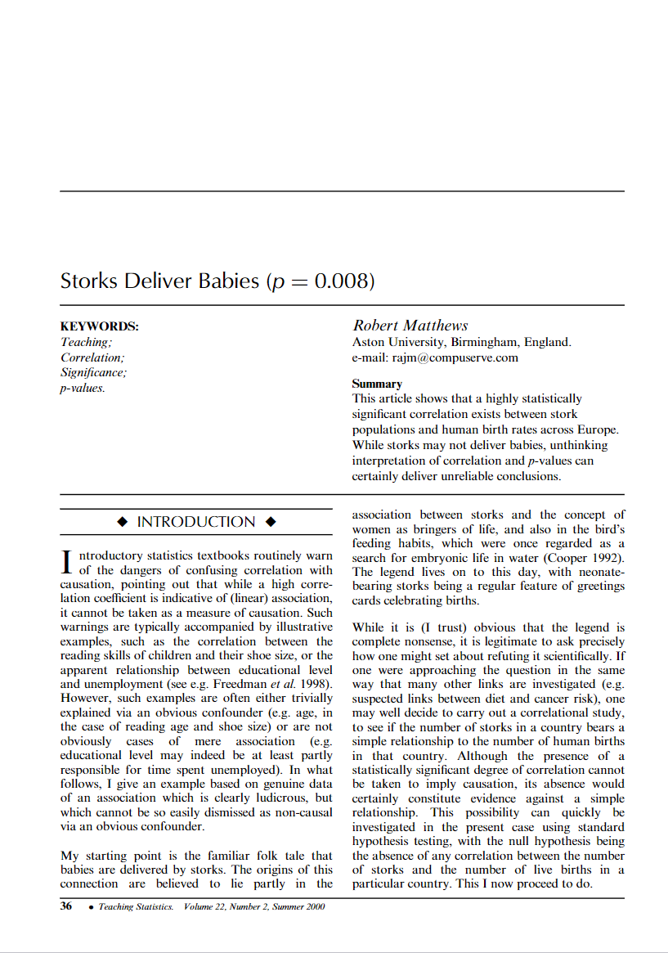
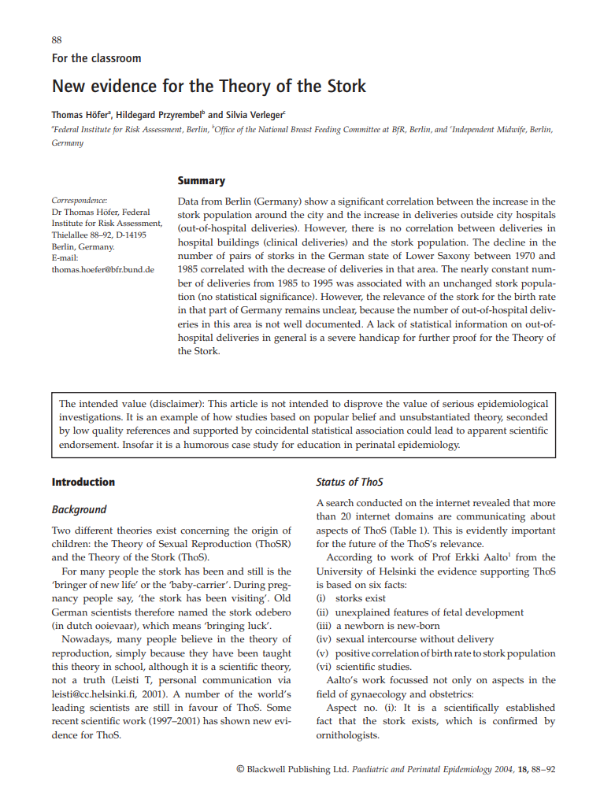
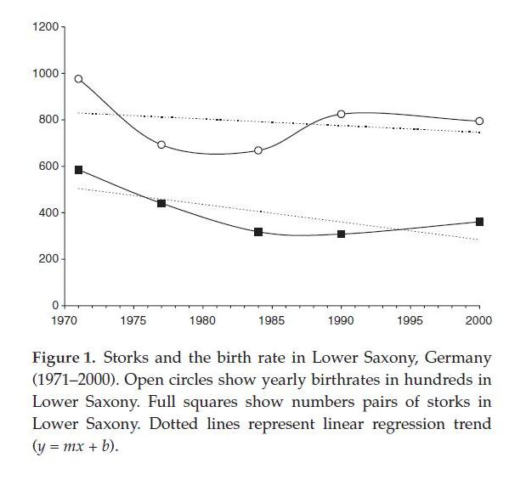
Storks Deliver Babies
Matthews, R. (2000), Storks Deliver Babies (p= 0.008). Teaching Statistics, 22: 36-38. doi:10.1111/1467-9639.00013
Höfer, Thomas & Przyrembel, Hildegard & Höfer, Silvia. (2004). New evidence for the Theory of the Stork. Paediatric and perinatal epidemiology. 18. 88-92. 10.1111/j.1365-3016.2003.00534.x.
Empirical Research

Slide 4


Image from https://pxhere.com/en/photo/855019
Empirical Research

Slide 5
Causation and Correlation
A correlation cannot separate cause from effect, however,…
… it’s still a fact: birthrate and number of stork correlate. Any implications?
Question: “If I want more babies, should I move to an area with many storks?”
more storks
more children
“Yes, do it!”
more children
more storks
“No. Let it be.”
more children
more storks
“Depends.”
“Tertium Quid”
Empirical Research

Slide 6
Everything starts with a research question…
Empirical Research

Slide 7
“If you want to increase the likeability to have more babies, should you move to an area with many storks?”
How would you answer the research question?
Empirical Research

Slide 8

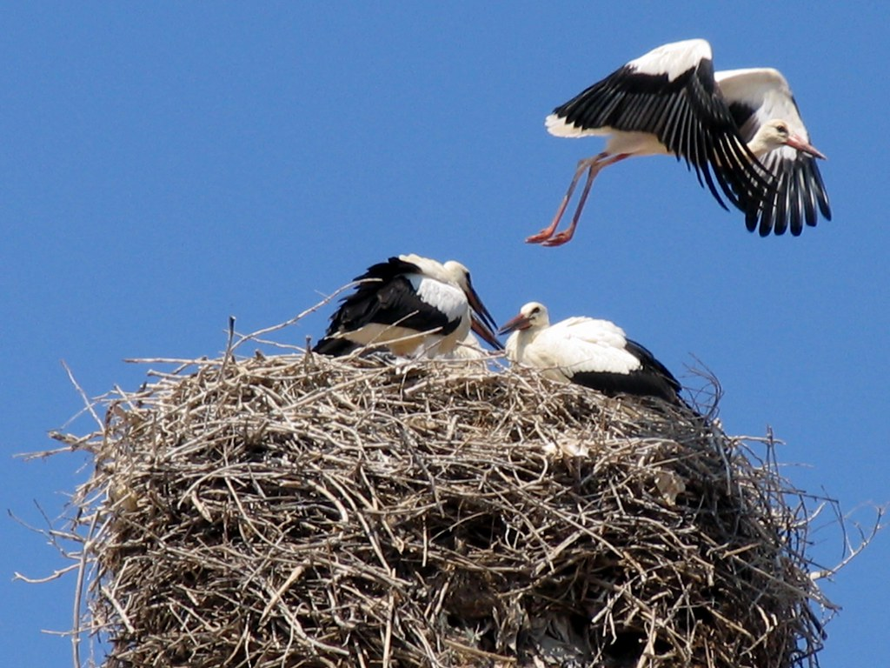
Test Group
25 babies / year
Control Group
25 babies / year
100 b/y
0
-2
-1
0
1
2 years
"Dieses Foto" von Unbekannter Autor ist lizenziert gemäß CC BY-NC-ND
Empirical Research

Slide 9
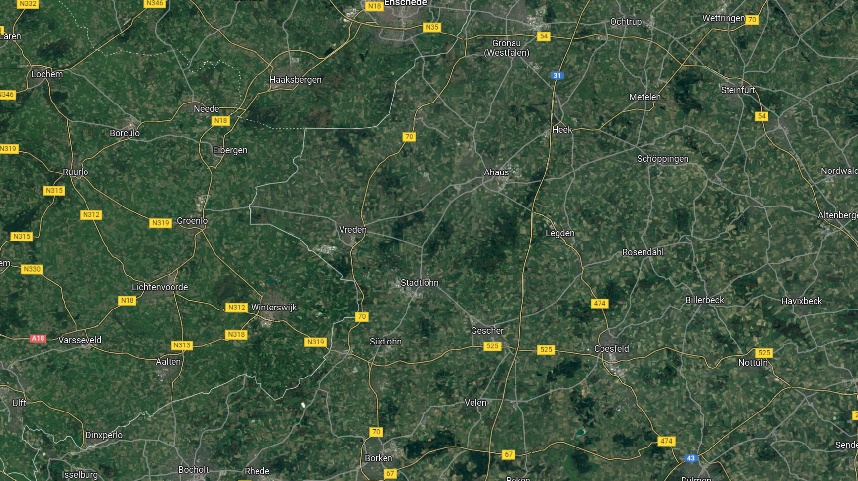
Control Group 25 babies / year
Control Group 13 babies / year
Control Group 15 babies / year
Test Group 15 babies / year
Test Group 15 babies / year
Control Group 35 babies / year
Test Group 15 babies / year
Test Group 25 babies / year
Control Group 25 babies / year
Control Group 12 babies / year
Test Group 15 babies / year
Test Group 15 babies / year
Test Group 15 babies / year
Control Group 25 babies / year
Test Group 15 babies / year
Test Group 15 babies / year
100 b/y
Test Group 15 babies / year
Control Group 27 babies / year
Control Group 26 babies / year
Now we need statistical tests! (which one will be discussed in the exercises)
Control Group 27 babies / year
Control Group 43 babies / year
Control Group 27 babies / year
-2
-1
0
1
2 years
Empirical Research

Slide 10
What the heck have storks to do with HCI?
100 WPM
New Keyboard Layout
Traditional Keyboard Layout
0
1
2 weeks
Discussion
The results are just numbers. Let‘s do it with keyboards…
Empirical Research

Slide 11
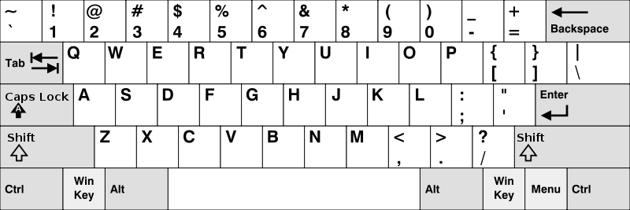
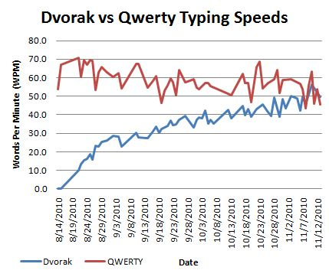
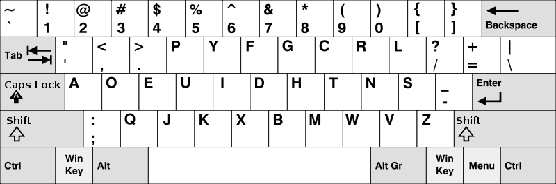
Let‘s test our new keyboard layout!
What is the problem when we develop new keyboard layouts?
QWERTY
DVORAK
3 months training!
Images from https://www.boundlessat.com/Keyboards-Mice/Alternative-Keyboards
Empirical Research

Slide 12
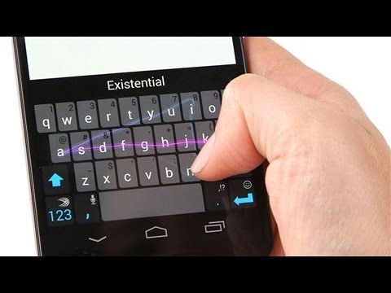
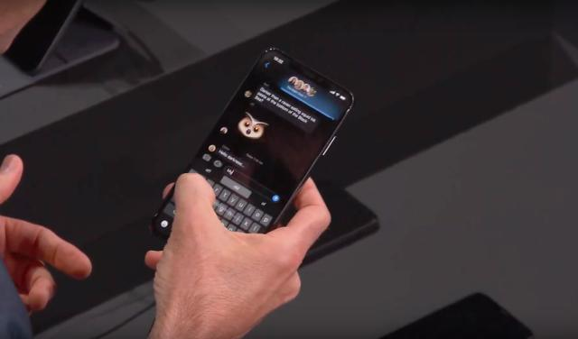
Inventing Swipe
Let‘s imagine we invented a gesture-based typing technique and call it SWIPE
https://www.youtube.com/watch?app=desktop&v=1dr068gL03g
https://www.engadget.com/2019-06-03-apple-ios-13-quickpath-swipe-keyboard.html

Slide 13
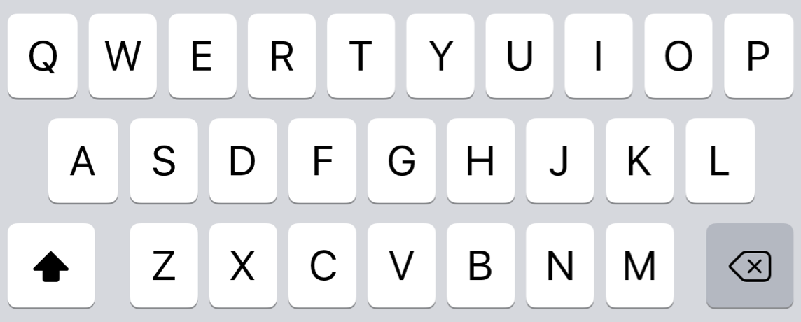
Inventing Swipe
First tests with us seem promising. But: Does it work with real participants?
Swipe
30 minutes training! Let‘s do a test with real participants…
No Swipe
Empirical Research

Slide 14
Let‘s design an empirical study…
The research question: “Does Swipe improve the typing performance on touch displays (compared to a regular smartphone keyboard)?”
Do we need a qualitative or quantitative research method?
Quantitative because of three reasons:
We can measure performance
We can formulate a hypotheses:
H1a: Swipe improves the typing performance.
… and we can falsify it (the null hypothesis):
H0a: Swipe does not improve the typing performance
Let‘s use a quantitative method and measure performance
We‘ll later learn, that qualitative methods can be great for our research, too.
Empirical Research

Slide 15
Swipe vs No Swipe – whats better?
We are assuming that “better” = “more performance”, which is not necessarily true.
No Swipe
Swipe
the standard or „control“
the factor we change
Empirical Research

Slide 16
Quantitative Studies
The factor you change is the Independent Variable
STORKS = SWIPE
Control Group = No Swipe (normal keyboard)
Test Group = Swipe (our technique)
Your measure is the Dependent Variable
Births per year = Words per minute (WPM)
But how can we ensure that only that factor is affecting our experiment?
By keeping all other factors in our experiment stable, but is that possible?
No. We always have Confounds that we cannot control and may distort our experiment.
Environment, weather, training, individual differences,…
The Independent Variable
The levels of the IV
?
The Dependent Variable
The Confounds
Empirical Research

Slide 17
Independent Variables (IV) and their Levels
An IV (here: SWIPE) must have at least 2 levels that allow us to control that factor
We define these levels. This is why we called it the „independent“ variable
Levels are (nominal) categories: e.g., No Swipe (normal), Swipe (our awesome technique)
We must assign these levels to our participants
When we do that, levels become conditions
Either we assign participants…
randomly to only one level of the IV (e.g., in A/B testing or medical treatments)
→ This is called a between-subject (or between-groups) variable
to each level of the IV (e.g., in surveys or many lab studies)
→ This is called a within-subject (or within-groups) variable
In some cases, within-subject IVs have indefinite levels and are numeric
„number x is a function of y“
The Condition
Empirical Research

Slide 18
The Dependent Variable
The thing that you measure (typically a metric or stuff you can count) should be part of your research question and hypothesis:
The reserach question: „Does swipe improve the typing performance on touch displays?”
H1a: „Swipe improves the typing performance.”
H0a: „Swipe does not improve the typing performance.”
H1b: „Swipe improves the usability.”
H0b: „Swipe does not improve the usability.”
The dependent variables are…
typing performance that can be measured by:
words per minute (WPM), characters per minute (CPM), error rate (number of wrong / number of total words, number of backspace presses / number of characters, etc.), …
usability that can be measured by:
System Usability Scale (SUS), NASA taskload index (TLX), …
„improves“ = directed hypothesis
„changes“ = undirected hypothesis
Empirical Research

Slide 19

The Confounds / The Covariates
In theory, we need to keep all confounding factors of the experiment (environment, weather, training, intelligence, mood, …) stable
This is not possible, but we can…
record and describe all confounds (also called covariates) in our experiment (gender, age, previous training, the location …) and
draw a random/representative sample (our participants) that must test both keyboards…
No Swipe
Swipe
Whats the problem?
Empirical Research
Carry-over effects!

Slide 20
Carry-Over Effects
Carry-over (or sequence) effects refer to the influence of a subsequent condition
These effects can be
physiological
psychological
behavioral
or may manifest as learning, fatigue, or sensitization
Carry-over effects are confounds and make it unclear whether the observed effects are due to the experimental manipulation or the effects of previous conditions
If you have them, your experiment is broken!
We have them when people are using our smartphone and learn to type two times.
How can we prevent carry-over effects?
Empirical Research

Slide 21
Designing a Study
We have two conditions (the two levels of our IV). To prevent carry-over effects we split them into two groups.
No Swipe
Swipe
The Control Group
The Test Group
Such designs are very common in clinical studies. But what is the problem with such designs?
We are poor. We don‘t have hundreds of participants.
Empirical Research

Slide 22
Counterbalancing
Typically, we want that our participants do both conditions.
Swipe
No Swipe
Participants with odd IDs
Participants with even IDs
No Swipe
Swipe
Empirical Research

Slide 23
Counterbalancing 2 Conditions
With two conditions we just keep continue switching the levels of the IV…
No Swipe
Swipe
 | Condition 1 | Condition 2
Participant #1 | Swipe | NoSwipe
Participant #2 | NoSwipe | Swipe
Participant #3 | Swipe | NoSwipe
Participant #4 | NoSwipe | Swipe
... | … | …
Continue switching…
Empirical Research

Slide 24

Let add a third level of the IV: VibroSwipe
Let‘s integrate some tactile feedback! How would you design the experiment now?
No Swipe
Swipe
VibroSwipe
1. Combination: No Swipe → Swipe → VibroSwipe
2. Combination: Swipe → No Swipe → VibroSwipe
3. Combination: No Swipe → VibroSwipe → Swipe
4. Combination: VibroSwipe → No Swipe → Swipe
5. Combination: Swipe → VibroSwipe → No Swipe
6. Combination: VibroSwipe → Swipe → No Swipe
 | Condition 1 | Condition 2 | Condition 3
Participant #1 | NoSwipe | Swipe | VibroSwipe
Participant #2 | Swipe | NoSwipe | VibroSwipe
Participant #3 | NoSwipe | VibroSwipe | Swipe
Participant #4 | VibroSwipe | NoSwipe | Swipe
Participant #5 | Swipe | VibroSwipe | NoSwipe
Participant #6 | VibroSwipe | Swipe | NoSwipe
Calculate the number of combinations:
N! → X:
2 → 2
3 → 6
4 → 24
5 → 120
6 → 720
… we should defintely avoid permutations with more than
4 conditions! Or…?
Empirical Research

Slide 25
Balanced Latin Square
A Latin square is an N × N array filled with n different symbols. They are useful to reduce order-effects when designing experiments with many conditions.
A condition will precede another exactly once (or twice when condition no. is odd)
Balanced Latin Square generator: https://hci-studies.org/balanced-latin-square/
 | Condition 1 | Condition 2 | Condition 3 | Condition 4 | Condition 5 | Condition 6
Participant #1 | A | B | F | C | E | D
Participant #2 | B | C | A | D | F | E
Participant #3 | C | D | B | E | A | F
Participant #4 | D | E | C | F | B | A
Participant #5 | E | F | D | A | C | B
Participant #6 | F | A | E | B | D | C
Empirical Research

Slide 26
More Indepedent Variables?
Controlled experiments are the only reliable mean to isolate cause (of the independent variable) from the effect (on the dependent variable)
What if there are potential two effects or if they potentially depend on each other?
Can we consider multiple IVs and observe effects on multipe DVs?
Controlled Experiment
Independent Variable
Dependent Variable
IV1
Controlled Experiment
DV1
IV2
DV2
Empirical Research

Slide 27
Full-Factorial Designs (2 Factors)
Only in controlled experiments, we can observe the effects of multiple factors at the same time
For example: SWIPE × VISUAL FEEDBACK
What does the Balanced Latin Square looks like?
No Swipe
Swipe
No Visual Feedback
With Visual Feedback
Empirical Research

Slide 28
Balanced Latin Square of a 2×2 Full-Factorial Design
The combination of each level becomes now a condition of the experiment…
 | Condition 1 | Condition 2 | Condition 3 | Condition 4
Participant #1 | NoSwipe-NoVisualFeedback | NoSwipe-VisualFeedback | Swipe-VisualFeedback | Swipe-NoVisualFeedback
Participant #2 | NoSwipe-VisualFeedback | Swipe-NoVisualFeedback | NoSwipe-NoVisualFeedback | Swipe- VisualFeedback
Participant #3 | Swipe-NoVisualFeedback | Swipe- VisualFeedback | NoSwipe-VisualFeedback | NoSwipe-NoVisualFeedback
Participant #4 | Swipe- VisualFeedback | NoSwipe-NoVisualFeedback | Swipe-NoVisualFeedback | NoSwipe-VisualFeedback
… | … | … | … | ...…
→ Repeat the Latin Square!
Empirical Research

Slide 29
Full-Factorial Designs (3 Factors)
Okay, now things are getting complicated: Can we observe the impact of 3 factors at once?
For example: SWIPE × VISUAL FEEDBACK × TACTILE FEEDBACK
Yes. But what does the balanced Latin square looks like?
No Tactile Feedback
With Tactile Feedback
No Swipe
Swipe
No Swipe
Swipe
No Visual Feedback
No Visual Feedback
With Visual Feedback
With Visual Feedback
Empirical Research

Slide 30
Balanced Latin Square of a 2×2×2 Full-Factorial Design
 | Condition 1 | Condition 2 | Condition 3 | Condition 4 | Condition 5 | Condition 6 | Condition 7 | Condition 8
Participant #1 | None-None-None | None-None-Visual | None-Tactile-None | None-Tactile-Visual | Swipe-None-None | Swipe-None-Visual | Swipe-Tactile-None | Swipe-Tactile-Visual
Participant #2 | None-None-Visual | None-Tactile-Visual | None-None-None | Swipe-None-Visual | None-Tactile-None | Swipe-Tactile-Visual | Swipe-None-None | Swipe-Tactile-None
Participant #3 | None-Tactile-Visual | Swipe-None-Visual | None-None-Visual | Swipe-Tactile-Visual | None-None-None | Swipe-Tactile-None | None-Tactile-None | Swipe-None-None
Participant #4 | Swipe-None-Visual | Swipe-Tactile-Visual | None-Tactile-Visual | Swipe-Tactile-None | None-None-Visual | Swipe-None-None | None-None-None | None-Tactile-None
Participant #5 | Swipe-Tactile-Visual | Swipe-Tactile-None | Swipe-None-Visual | Swipe-None-None | None-Tactile-Visual | None-Tactile-None | None-None-Visual | None-None-None
Participant #6 | Swipe-Tactile-None | Swipe-None-None | Swipe-Tactile-Visual | None-Tactile-None | Swipe-None-Visual | None-None-None | None-Tactile-Visual | None-None-Visual
Participant #7 | Swipe-None-None | None-Tactile-None | Swipe-Tactile-None | None-None-None | Swipe-Tactile-Visual | None-None-Visual | Swipe-None-Visual | None-Tactile-Visual
Participant #8 | None-Tactile-None | None-None-None | Swipe-None-None | None-None-Visual | Swipe-Tactile-None | None-Tactile-Visual | Swipe-Tactile-Visual | Swipe-None-Visual
Empirical Research

Slide 31
More Designs…
Crossed (Full Factorial)
Nested
Crossed and Nested
Swipe
Y
N
Swipe
Y
N
World
V
R
Visual Feedback
Y
N
Feedback
Y
N
Transparency
0
50
100
Tactile Feedback
Y
N
Type
T
V
Virtual Hands
A
R
P
NoSwipe-NoTactile-NoVisual
NoSwipe-NoTactile-Visual
NoSwipe-Tactile-Visual
Swipe-NoTactile-Visual
Swipe-Tactile-Visual
Swipe-Tactile-NoVisual
Swipe-NoTactile-NoVisual
NoSwipe-Tactile-NoVisual
NoSwipe-NoFeedback
Swipe-NoFeedback
Swipe-Feedback-Tactile
Swipe-Feedback-Visual
VR-0%Transparency-AbstractHands
VR-0%Transparency-RealisticHands
VR-0%Transparency-PointHands
VR-50%Transparency-AbstractHands
VR-50%Transparency-RealisticHands
VR-50%Transparency-PointHands
VR-100%Transparency
RealWorld
What‘s the problem?
We like that. And why can easily draw conclusions…
Alternative Design?
Empirical Research

Slide 32
Between vs Within-Subject Study Designs
Between-Subject Design
Participants are assigned to one level of the IV
Advantages: very simple, no sequence effects, required when it is impossible for an individual to participate in all conditions (e.g., gender)
Disadvantages: expense (time, effort, and number of participants), very insensitive to experimental manipulations
Within-Subject Design
Participants are assigned to each level of the IV
Advantages: economy, sensitiveness, cancelling out individual differences
Disadvantages: carry-over effects from previous conditions, conditions need to be counter-balanced or randomized
Empirical Research

Slide 33
Mixed Designs
Your experiment can also include both types of independent variables
between-subjects variable(s)
within-subjects variable(s)
e.g., in gender studies: do men or women type faster on my new swipe keyboard?
Important: Participants must be randomly assigned to each level of the between-subjects variable(s)
Gender is random by birth
All participants are exposed to each level of the within-subjects variable(s)
All men and women test my swipe keyboards. But, we must consider the order of conditions!
permutate the order (2 → 2, 3 → 6, 4 → 24, 5 → 120, 6 → 720, …)
counter-balancing using e.g., a balanced Latin-Square
fully random
Empirical Research

Slide 34
Great. Can we now evaluate what‘s better?
What do you understand regarding „better“?
Let‘s do the 8 conditions 4 times = 32 participants, measuring the WPM
What‘s still the problem here?
We need to be be more specific:
„Swipe improves the typing performance.“
Are words per minute are identical to performance?
What about „usability“?
No Tactile Feedback
With Tactile Feedback
No Swipe
Swipe
No Swipe
Swipe
No Visual Feedback
No Visual Feedback
With Visual Feedback
With Visual Feedback
Empirical Research

Slide 35
Operationalization: From Concepts to Measures
What is „performance“? What is „usability“? Measures can be ambigous!
Let‘s take „usability“
Concepts such as usability can contain or refer to other concepts
e.g., „workload“, „efficiency“, „satisfaction“
Concepts such as workload can be composed of different variables
e.g., „cognitive workload“ and „physical workload“
Variables need definitions or working definitions (when we are not sure)
e.g., „Cognitive workload refers to the amount of mental effort that is exerted or required while reasoning and thinking, to process information, make decisions, and solve problems.“ [3]
Finally, we need to operationalize the definition of a concept using scientific methods and consensus
e.g., NASA Taskload Index (TLX) [1], Cognitive Load Questionnaire [2]
And even cognitive load has more subconcepts: intrinsic, extraneaous, germane [3] (but we are happy with cognitive load)
[1] Hart, S. G., & Staveland, L. E. (1988). Development of NASA-TLX (Task Load Index): Results of empirical and theoretical research. In Advances in psychology (Vol. 52, pp. 139-183). North-Holland.
[2] Paas, F., Tuovinen, J. E., Tabbers, H., & Van Gerven, P. W. (2016). Cognitive load measurement as a means to advance cognitive load theory. In Cognitive Load Theory (pp. 63-71). Routledge.
[3] Skulmowski, Alexander; Rey, Günter Daniel (2020). "Subjective cognitive load surveys lead to divergent results for interactive learning media". Human Behavior and Emerging Technologies. 2 (2): 149–157. doi:10.1002/hbe2.184
Empirical Research

Slide 36
Standardized Tools
The process of defining the measurement for a concept that is not directly measurable (even objective measures such as “performance”)
Depends on theoretical definitions
Makes a fuzzy concept (e.g., “emotions”, “user experience”, “likeability”, “memorability”, “usability”, “health”, …) distinguishable, measurable, and understandable
Even helps infer the existence of a concept (e.g., realism) using a tool
If a standardized tool exist: take it
If multiple standardized tools exist: take the most appropriate or validated one
If no standardized tool exist: use own questions ← we’ll talk about that, later
Empirical Research

Slide 37
Can we now evaluate what‘s better? faster/more usable?
Important:
Each concept must be part of your research question (performance/usability)
Each dependent variable must be part of your hypothesis (WPM/CPM/error rate)
They can operationalized as objective measure such as performance: WPM, CPM, error rate
They can operationalized as subjective measure such as usability: SUS, TLX Score
Hypotheses should be precise!
H1a: „Typing using Swipe increases the WPM on a touch display of smartphone.“ H0a: „Typing using Swipe does not increase the WPM on a touch display of smartphone.“
H1b: „Typing using Swipe increases the SUS score on a touch display of smartphone.“ H0b: „Typing using Swipe does not increase the SUS score on a touch display of smartphone.“
What else do we need for our experiment?
Empirical Research

Slide 38
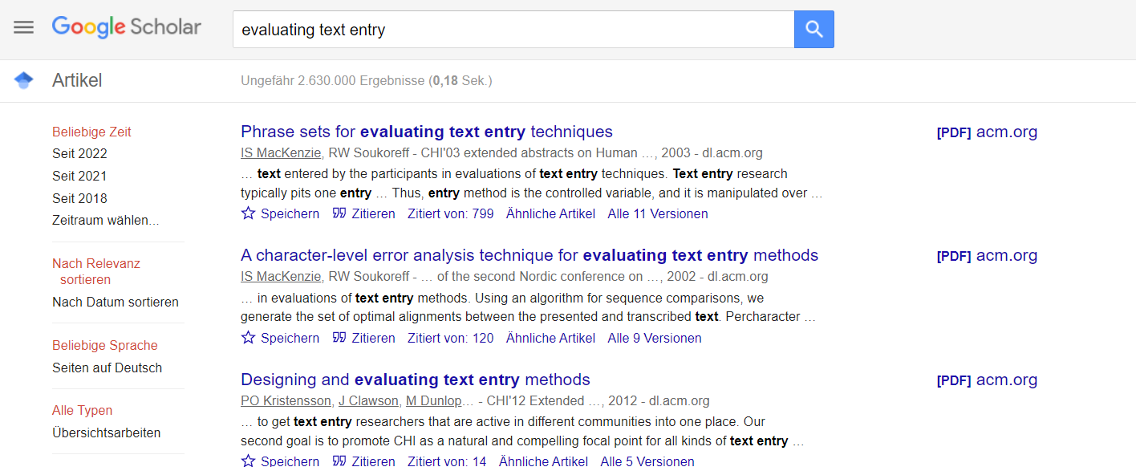
Tasks in HCI
In HCI/science there are standardized tasks for many things (not everything)
This is the point where you need help (or Google): „evaluating text entry“
We discuss this tool in „How to read a paper“ „How to review literature“
Empirical Research

Slide 39
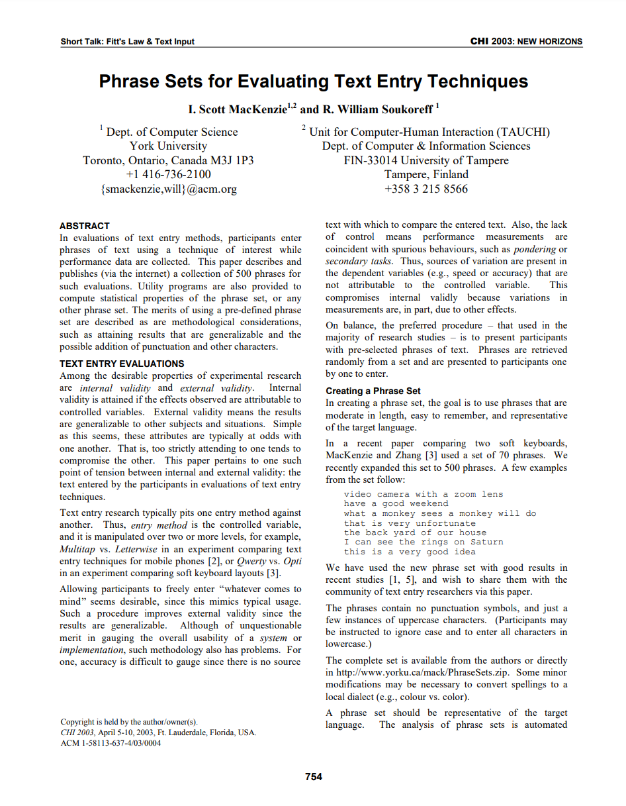
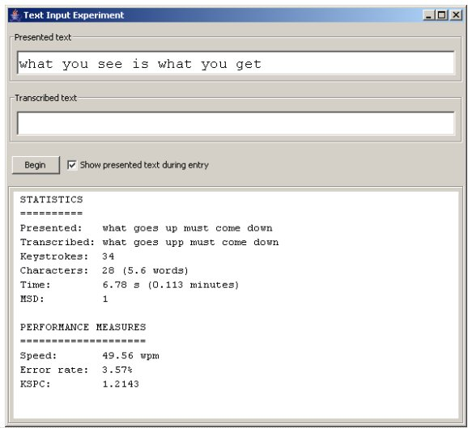
Science is strange, but nice, let‘s download it…
It‘s a Java program ☹ → we need that on a smartphone
Your task in your project would be to develop and log everything correctly.
Empirical Research

Slide 40
Can we now evaluate our keyboard?
2×2×2 Within-Subject Design, 8 Conditions, WPM, CPM, SUS, TLX, we have a task, …
What else can we do?
No Tactile Feedback
With Tactile Feedback
No Swipe
Swipe
No Swipe
Swipe
No Visual Feedback
No Visual Feedback
With Visual Feedback
With Visual Feedback
Outside
Inside
Quantitative Methods
Qualitative Methods
Empirical Research

Slide 41
Qualitative or Quantitative Method?
What? | Quantitative | Qualitative
When? | To confirm a hypothesis using a objectively or subjective measure. | Complex contexts, when little is known about the underlying mechanisms.
General Procedure | Selection of the quantitative methods Invitation of representative population Measurements in a controlled experiment Statistical analysis | Selection of the qualitative methods Selection of people (e.g., experts and/or users) Data collection of feedback and/or observation Transcription, translation, analysis
Data Analysis | Statistical (numerical data) | Interpretative (non-numerical data)
Method Examples | Controlled experiment, A-B testing | Semi-structured interview, group interviews (focus groups), field survey, observation, …
Advantages | Confirmation of important assumptions Objective, unbiased data and evaluation Standardized procedures | Generation of new knowledge Small sample is often sufficient Subjective, detailed, in-depth insights
Disadvantages | Needs larger samples No deeper insights into causes Often inconclusive | Often biased by the participant and researcher Needs interpretation by the researcher Researchers often tend to quantify feedback
We often need both!
Empirical Research

Slide 42
Question
Are there independent or dependent variables in qualitative research?
Do we need a Balanced Latin Square in qualitative research?
Empirical Research

Slide 43
IVs and DVs in Qualitative Studies?
While quantitative research aim to understand the cause-and-effect relationship, qualitative studies aim to understand more complex mechanisms behind
Consquently, the concept of IV and DV does not apply in the same manner
Qualitative research is not driven by hypotheses and focuses on exploring and open-ended results gained by the collected feedback or observations
Independent variables in qualitative research can be considered as the factor or “subject of the investigation”
The order of “discussion stimuli” should be counterbalanced, too (see: “How to conduct a user study”)
Dependent variables in qualitative research can be considered as the analyzed “outcome”, “feedback”, or “responses” from the participants
Results = DVs in quantitative studies = feedback or observations in qualitative studies
Empirical Research

Slide 44
Quantiative and Qualitative („Mixed“) Methods: Example
Let’s assume:
H1a: „Typing using Swipe improves the WPM on a touch display of smartphone.“
→ H1a confirmed
H1b: „Typing using Swipe decreases the SUS score on a touch display of smartphone.“
→ H1b not confirmed. The SUS score decreases. → Swipe has less usability!
Using quantitative methods we only learned that higher typing performance (objectively) is negatively correlated to usability (subjectively).
Using qualitative methods (e.g., in a semi-structured interview after each test) we would learn that there is a reason behind that mechanism:
„The analysis of the qualitative feedback from showed that the participants perceived Swipe as faster, however, mentally more demanding as its visual feedback was ‚distracting‘ (P1-P6, P8, and P12). P7 stated to need „more training“ to master the Swipe technique.“
→ They need higher mental workload because of the visual distraction and probably need more training.
Empirical Research

Slide 45
Study Designs
Our Study Design
Qualitative Analysis
Theory
To they support each other?
Experiment
Data
Quantitative Analysis
Model
Alternative Study Design
Experiment
Data
Qualitative Analysis
Theory
To they support each other?
Experiment
Data
Quantitative Analysis
Model
Empirical Research

Slide 46
Alternative Study Design
Qualitative Analysis
Theory
To they support each other?
Experiment
Data
Quantitative Analysis
Model
Qualitative Analysis
Theory
Experiment
Data
Quantitative Analysis
Model
Empirical Research

Slide 47
Alternative Study Design
Qualitative Analysis
Theory
To they support each other?
Experiment
Data
Quantitative Analysis
Model
„Evidence“
You can never prove theories.
You can only find evidence.
Qualitative Analysis
Theory
Experiment
Data
Quantitative Analysis
Model
Empirical Research

Slide 48
Data-Driven Model Validation in HCI
Experiment
Data
Machine Learning, Labelling, Annotation,…
Model
Experiment
Data
Quantitative Analysis
Model
Validation
Empirical Research

Slide 49
Objective Data (Examples)
Task Performance | Task Completion Time (TCT) Success Rate Throughput (e.g., Fitts‘ Law) Word/Character input speed (e.g., typing) Error rate, Corrected error rate Accuracy, Precision Distance, Movements, Taps,…
Arousal/ Stress/Relaxation | Galvanic Skin Response/Electrodermal Activity (GSR/EDA) Blood pressure/Heart rate (BP/HR) Electromyography (EMG)
Emotions | Face recognition Electroencephalography (EEG) Heart Rate Variation (HRV)
Gaze | Eye-Tracking Electroencephalography (EEG)
Sensual Acuity | Discrimination/Just-noticeable-difference (JND) Lateral/Sensory Inhibition
Fitness / Ergonomics | Grip Strength, ergometer Range Posture assessment
and many more…
Empirical Research

Slide 50
Subjective Data (Examples)
Workload | Nasa Task Load Index (TLX) Subjective Mental Effort Questionnaire (SMEQ)
User Experience | Usability Metric for User Experience (UMUX) Questionnaire for User Interaction Satisfaction (QUIS)
Usability | System Usability Scale (SUS) Computer System Usability Questionnaire
Hedonic/Pragmatic Quality | AttrakDIFF / AttrakDIFF mini
Acceptance | Technology Acceptance Model (TAM) Stereotype Content Model (SCM)
Emotions | Emotional Metric Outcomes (EMO) Differential Emotion Scale (DES) Positive and Negative Affect Schedule (PANAS)
Gaming Experience | Game Experience Questionnaire (GEQ)
Immersion | Presence Questionnaire (PQ) iGroup Presence Questionnaire (IPQ)
Motivation | Intrinisic Motivation Inventory (IMI) Motivation Questionnaire (MQ)
and many more…
Empirical Research

Slide 51
Qualitative Data (Examples)
Inquiries | Structured, Unstructured, Semi-structured Interviews Task analysis Focus Groups Questionnaires / Surveys
Prototyping | Rapid Prototyping / Paper Prototyping Tool Kit / Parts Kit
Observations | Think Aloud Protocol Cooperative Evaluation Contextual Inquiries Case Study Activity / Task Analysis
Longitudinal Observations | Experience Sampling Diary Studies
Inspections | Cognitive Walktrough / Heuristic Evaluation Card Sorting / Tree Tests Activity Analysis Pluralistic / Consistency Inspection
Elicitation | Agreement Rate (AR) Repertory Grid
and many more…
Empirical Research

Slide 52
Data Analysis
Qualitative
Text
Audio Video
Qualitative Analysis
Inquiries
Prototyping
Observations
Longitudinal Observations
Inspections
Elicitation
Thematic analysis
Discourse analysis
Narrative analysis
Grounded theory
Findings
Experiment
Data
Quantitative
Numeric Tables
Plots
Statistical Analysis
Subjective
Objective
Descriptive Statistics
Inferential Statistics
Workload
User Experience
Usability
Hedonic Quality
Social Acceptance
Emotions
Gaming Experience
Immersion
Motivation
Task Performance
Arousal / Stress / Relaxation
Emotions
Gaze / Attention
Sensual Acuity
Fitness / Ergonomics
Results Analysis
Qualitative + Quantitative Methods = „Mixed Methods“
Empirical Research

Slide 53
Data Analysis in HCI
You don't need to know all of the data collection methods - just the ones you need to answer your research question
Every measure needs a method for its analysis
Objective and subjective measures are being evaluated using statistical tests
Statistical tests depend on the hypothesis
We will talk about statistical tests later (you will love it)
Observations and qualitative feedback?
Thematical Analysis
Content Analysis
Narrative Analysis
Grounded Theory
…
Is there more we can analyze?
Empirical Research

Slide 54
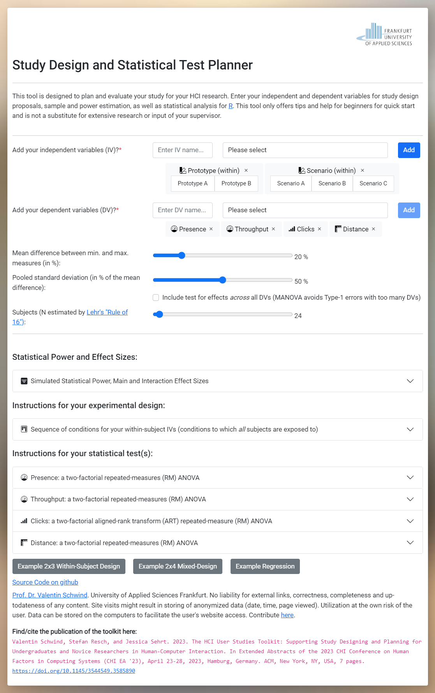
Exercise: Study Design Plan
Use our tool to find and plan your study design
Goto: https://hci-studies.org/study-design-planner/
Enter are your IVs, levels and DVs
Ignore the sliders and statistics
Go to “Instructions for your experimental design”
Discuss in your group:
What is the proposed study design of your study?
Does this work when you have a qualitative study?
Is that here important when you do a literature review?
Empirical Research

Slide 55
Tasks Next Time (TNT): Study Design / Study Plan
Update your problem statement, add a section called „Method“
Write down in your own words what you found in „Instructions for your experimental design” or explain in your own words your study plan
Update and upload your presentation (PDF) with a study design that includes:
The incorporated feedback and things you need to update
Your update research question(s) and describe the operationalization of your concept(s)
Describe your method in a few words. Depending on your research method …
quantitative: Name your IVs/DVs? within-subject? between-subject? levels? hypotheses?
qualitative: Name your method and study plan? (factor, desired feedback, … )
literature review: Explain what of the stuff here is important for you?
Draw your study design / study plan!
Empirical Research

