Slide 1



How to Read a Paper
Human-Computer Interaction Exercise
The following content is licensed under a Creative Commons Attribution 4.0 International license (CC BY-SA 4.0)

Slide 2
Preperation
Be in the university‘s subnet
If not: goto https://www.frankfurt-university.de/de/hochschule/bibliothek/fernzugriff/
Install VPN (Forticlient)
Later you will need and use a literature management system
You can use Zitavi or Zotero: https://www.frankfurt-university.de/de/hochschule/bibliothek/citavi-zotero/
Both are free (for you)
A ChatGPT Account is helpful
ChatGPT Plus is even more helpful
How to Read a Paper

Slide 3
Find your Keywords
Use your keywords from your research question to start searching for literature
Make a list of other keywords/annotations
Include each of the key concepts or variables you’re interested
Find synonyms and related terms
How to find keywords? Identify your research fields, theoretical frameworks, device categories, and measures (or methods)
Research field(s): “human-computer interaction“ (rarely required),…
Theoretical frameworks: “social acceptability“, „accessibility“, „ergonomics“, …
Device categories: “virtual reality“, „augmented reality“, „wearables“, „mobile devices“, …
Measures/Tasks: “target selection“, „Fitts‘ law“, “EMG“,“electromyography“, …
Be more specific, if required: “heart rate“, „privacy“, „face detection“, …
How to Read a Paper

Slide 4
Databases
Some useful databases to search for journals and conferences articles:
Google Scholar https://scholar.google.de/
ACM https://dl.acm.org/
IEEE https://ieeexplore.ieee.org/
Web of Science https://www.webofscience.com/
Scopus https://www.scopus.com/
The university’s library https://idp.hebis.de/
JSTOR (history) https://www.jstor.org/
Project Muse (humanities and social sciences) https://muse.jhu.edu
PubMed (life sciences and biomedicine) https://pubmed.ncbi.nlm.nih.gov/
How to Read a Paper

Slide 5

How to Read a Paper

Slide 6
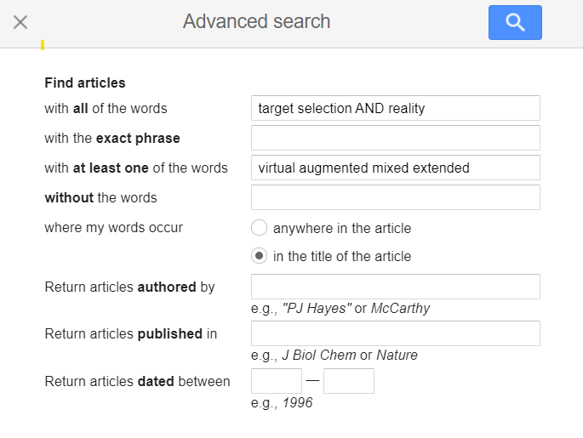

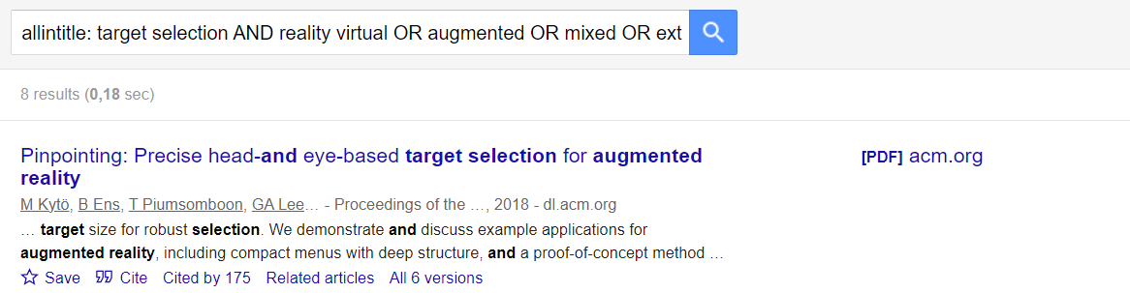
Refine your Query
Enter your keywords
How to Read a Paper

Slide 7
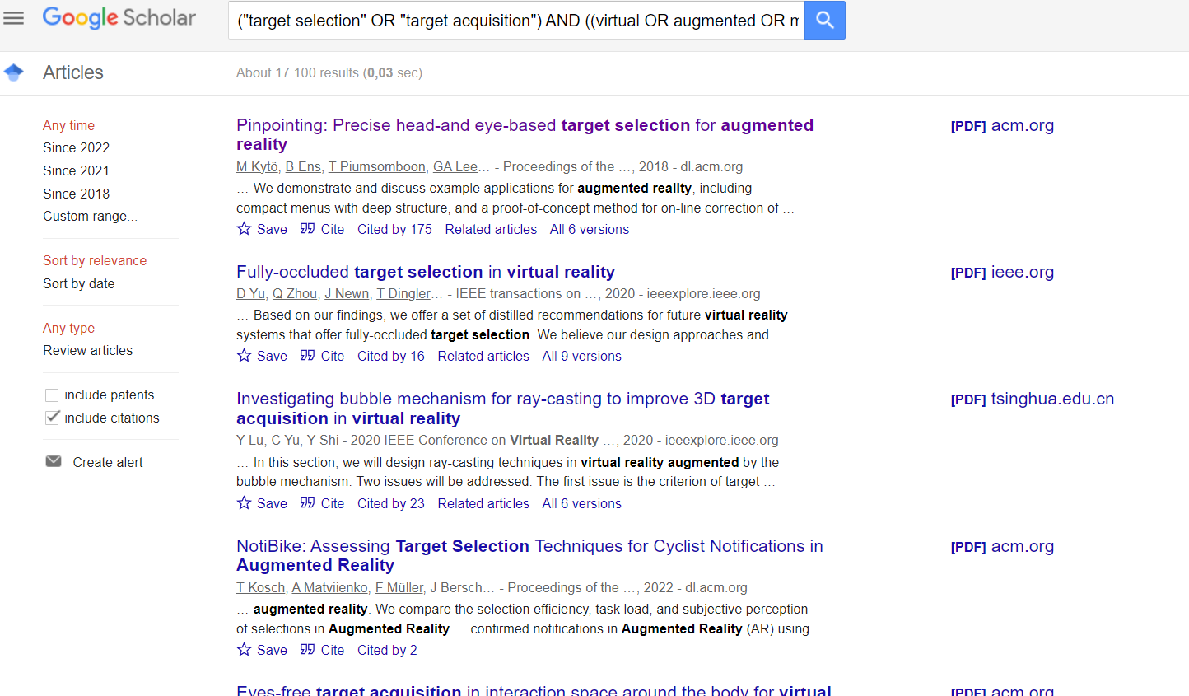
Google Scholar
Click
Highly cited. We love that
Click Later
How to Read a Paper

Slide 8

Very important place in HCI
Best paper award
Ensure login! Open it from the university network, you can download PDFs.
The title
The authors
The conference or journal
Highly cited
Read this
Remember this, this button will get very important for you
SCROLL DOWN!!!
How to Read a Paper

Slide 9
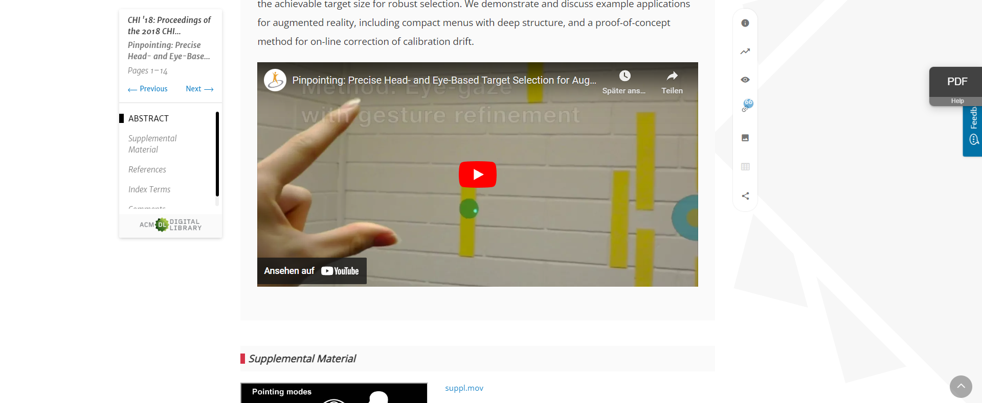
Digital Libraries
Video for people who don’t want to read the abstract
How to Read a Paper

Slide 10
Exercise: Find and describe a paper that measuring user experience in video games
1. Go to https://scholar.google.com …
2. Enter the related keywords
3. Click on results that seems to be relevant…
4. Find and open a paper (if not possible open the next one)…
5. Find and describe what they measured…
You have 5 minutes…
How to Read a Paper

Slide 11
Issues in Understanding Scientific Reports in HCI
What could you find?
How did you select the paper?
How did you ensure that you found a good paper?
Do you understand it?
What was your problem?
Why was is difficult to understand?
How to Read a Paper

Slide 12
Research Paper in HCI
Empirical Papers: Describes material and data used for an empirical user study, the methodologies applied to answer the research questions and the results obtained.
Case Study Papers: Used to describe the study of a certain person, group, location, event, or situation.
Methodology Papers: Describe a novel method which may be intended for use in research or practical settings (or both).
System/Data Papers: Describes material and design process of a system or data set. They contain no empirical user study.
Literature Reviews/Survey Papers: Provide insights and an overview about the field and have their own contribution
Theory/Position/White/Ontology Papers: Describe definitions, principles, concepts or models on which work in the field (empirical, experience, methodology).
Original Research / Primary Research
Secondary Research
Popular science
How to Read a Paper

Slide 13
The IMRAD Structure
IMRAD: Introduction, Methods, Results, and Discussion
All research articles (and yours) are typically structured in this order
Introduction – Why was the study undertaken? What was the research question, the tested hypothesis or the purpose of the research?
Related Work – What are findings of previous work before the study was undertaken?
Methods – When, where, and how was the study done? What materials were used or who was included in the study groups (patients, etc.)?
Results – What answer was found to the research question; what did the study find? Was the tested hypothesis true?
Discussion – What might the answer imply and why does it matter? How does it fit in with what other researchers have found? What are the perspectives for future research?
[1] https://en.wikipedia.org/wiki/IMRAD
How to Read a Paper

Slide 14

The Paper as an Hourglass
ABSTRACT
Problem
Method
Results
Findings
Basic Conclusions
TITLE + AUTHORS
ABSTRACT
INTRODUCTION
Motivation & Problem Statement
Theoretical Background
Research Question
Hypothesis
RELATED WORK
METHOD
Study Design
Independent Variables
Dependent Variables
Apparatus
Tasks
Procedure
Participants
RESULTS
Descriptive statistics
Inferential statistics (No interpretation!)
DISCUSSION
Brief summary of findings
Discussion/Interpretation of findings
Relation to previous/related work
Limitation of the study
CONCLUSION
(CONTRIBUTION)
(ACKNOWLEDGEMENTS)
INTRODUCTION
establish a territory
establishing a niche
occupying the niche
RELATED WORK
Logical Order
METHOD
RESULTS
DISCUSSION
summary and findings
evaluation and deeper analysis
recommendations
CONCLUSION
REFERENCES
Thematic Scope
Thematic Scope
How to Read a Paper

Slide 15
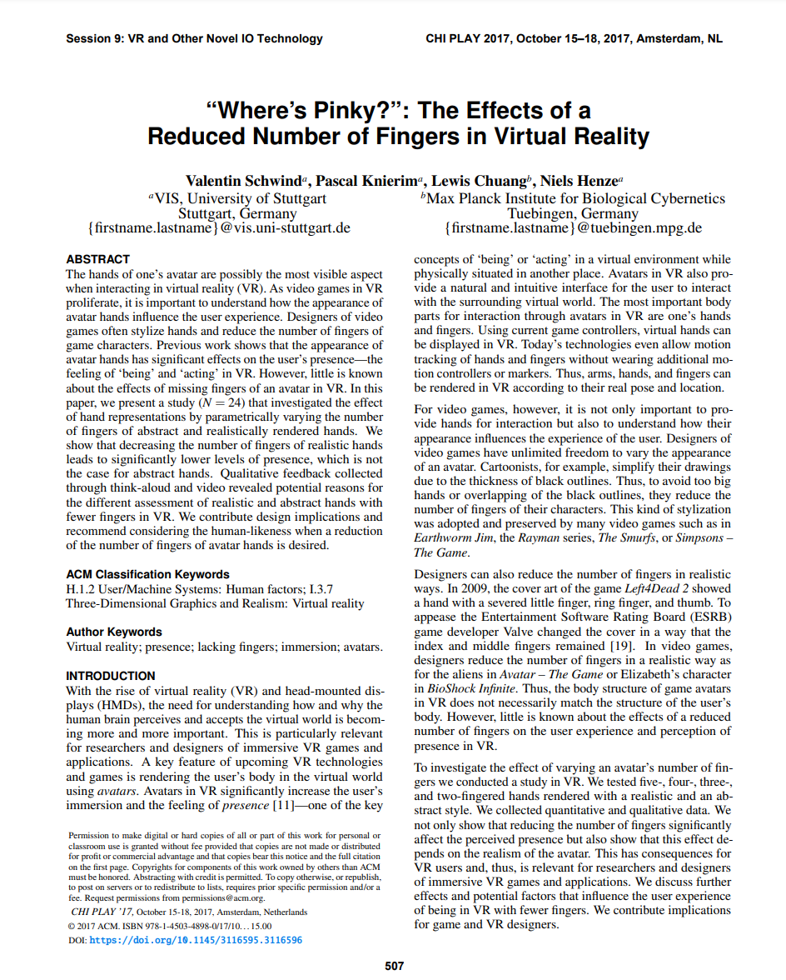
Example:
Valentin Schwind, Pascal Knierim, Lewis Chuang, and Niels Henze. 2017. "Where's Pinky?": The Effects of a Reduced Number of Fingers in Virtual Reality. In Proceedings of the Annual Symposium on Computer-Human Interaction in Play (CHI PLAY '17). Association for Computing Machinery, New York, NY, USA, 507–515. https://doi.org/10.1145/3116595.3116596

Slide 16
Example: Title and Authors
Sometimes papers have catchy titles or acronyms…
It‘s a conference paper and obviously from 2017
Obviously it‘s about missing fingers in VR
Authors
The affiliations
I still have a redirection on that mail
How to Read a Paper

Slide 17
Abstract
Typically, 150 - 250 words
Briefly introduces the reader to
motivation, problem, and relevance
the aims of the study and which methods were used
results and findings
conclusion & contribution
Ideally, each sentence deals about one section in your paper
The abstract always answers these four questions:
Why did you do this?
What did you do?
What did you find?
What do your findings mean?
ABSTRACT
Problem What is the problem and why is it important? For whom?
Method
How did the authors answered the RQ?
Results
What was the result? Any hypothesis confirmed?
Findings
What was the main finding and what is important to know about that?
Contribution / Conclusion
What are the implications and recommendations?
What ist the contribution of the paper?
How to Read a Paper

Slide 18
Abstract: Tips for reading
Reflect the structure of the paper
Bear in mind that there is a match between abstract and paper
Ideally, each section of your paper belongs to one sentence in the paper
Search for what they did and why
What did they developed?
How many participants were tested?
What happened during the study?
Find the contribution
What is the key benefit for readers?
For whom it is interesting?
How is the contribution articulated? (Which words are used, are there any ‘modulators’, e.g. ‘Perhaps … suggests … might … could …?)
How to Read a Paper

Slide 19
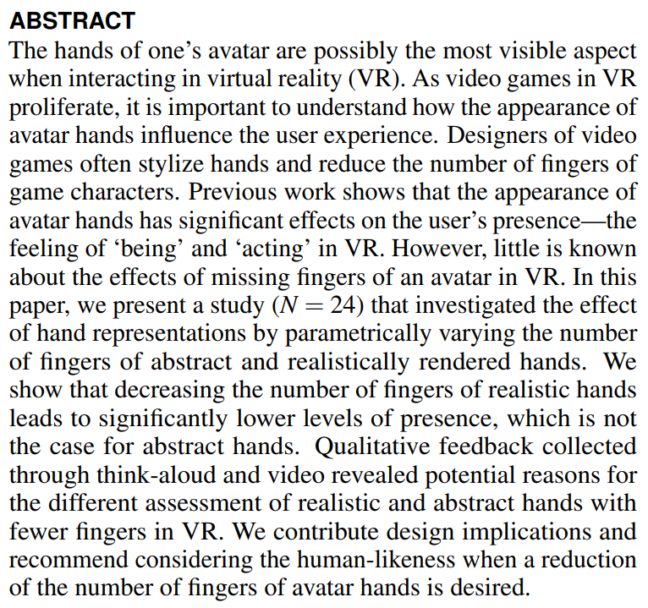
The Abstract
How to Read a Paper

Slide 20
The Keywords
How to Read a Paper

Slide 21
Dissecting the Abstract
RELEVANCE: The hands of one’s avatar are possibly the most visible aspect when interacting in virtual reality (VR). As video games in VR proliferate, it is important to understand how the appearance of avatar hands influence the user experience. Designers of video games often stylize hands and reduce the number of fingers of game characters.
PREVIOUS WORK: Previous work shows that the appearance of avatar hands has significant effects on the user’s presence—the feeling of ‘being’ and ‘acting’ in VR.
THE PROBLEM: However, little is known about the effects of missing fingers of an avatar in VR
THE STUDY: In this paper, we present a study (N = 24) that investigated the effect of hand representations by parametrically varying the number of fingers of abstract and realistically rendered hands.
RESULTS + FINDINGS: We show that decreasing the number of fingers of realistic hands leads to significantly lower levels of presence, which is not the case for abstract hands. Qualitative feedback collected through think-aloud and video revealed potential reasons for the different assessment of realistic and abstract hands with fewer fingers in VR.
INTEPRETATION, CONCLUSION, CONTRIBUTION: We contribute design implications and recommend considering the human-likeness when a reduction of the number of fingers of avatar hands is desired.
How to Read a Paper

Slide 22
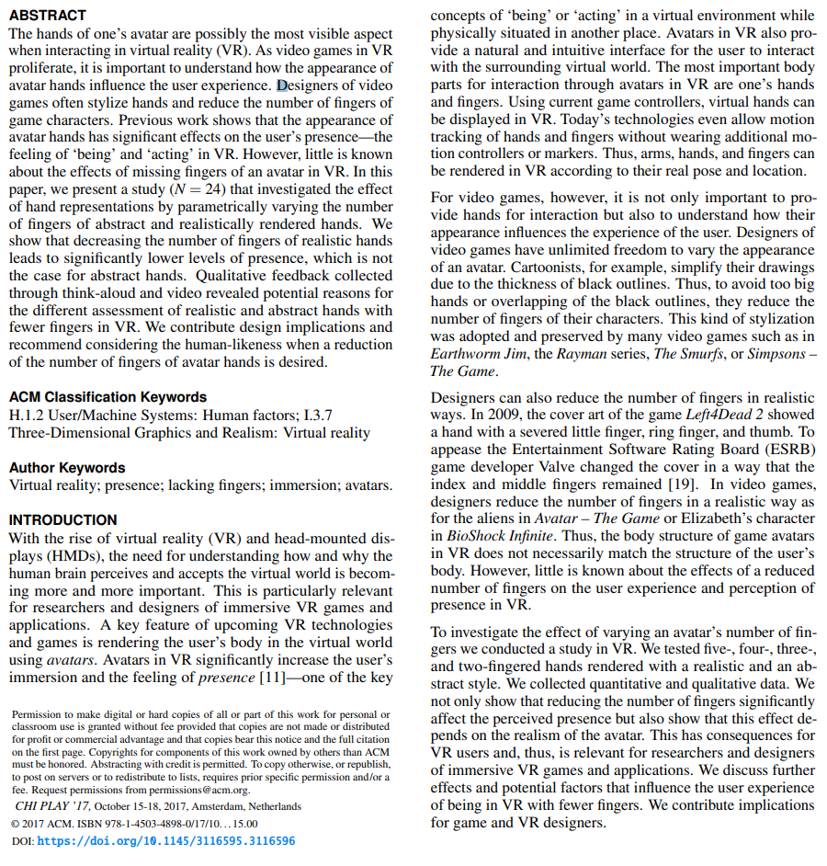
Introduction
The Relevance
The big picture
The statement problem
The audience
Brief background or relevant theory
Practices for the topic
Overall purpose, motivation
The research question and hypotheses
Overview about the rest of the paper
Findings and contribution
The problem & audience
Background & practices
The Topic
The research question and the findings
How to Read a Paper

Slide 23
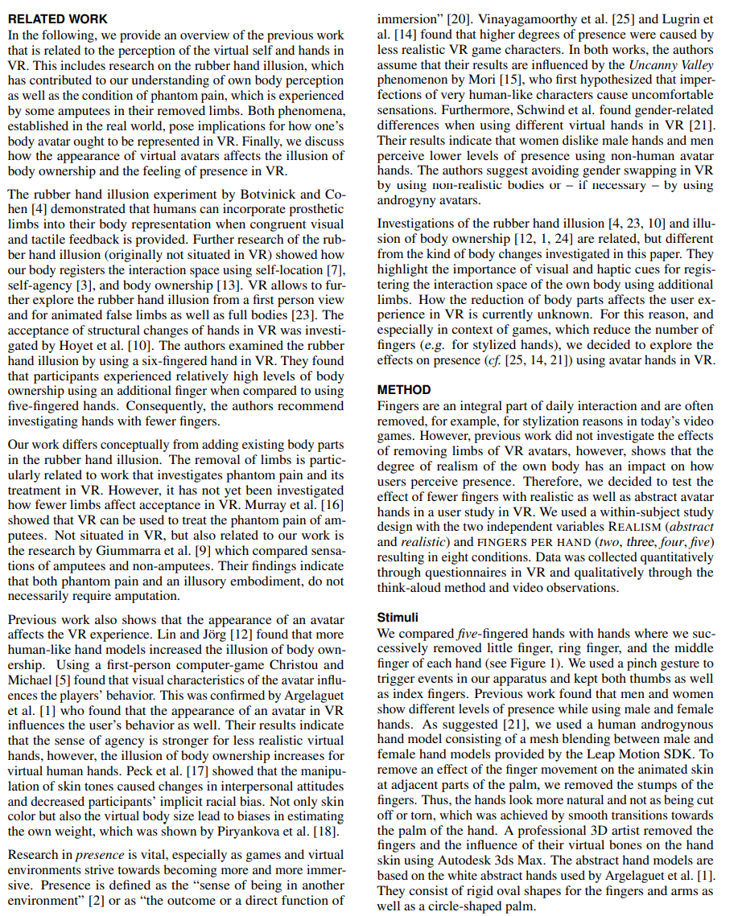
Related Work
Topic Category #3 (Concept we measured)
Summarizes and presents the state of knowledge using a simple narrative
Mostly structured by related fields
Conclusions that have been reached until today
Do all writers agree with each other?
Are the experiments comparable?
What is the quality of the studies?
Main issue and controversies around the problem
Summary at the end of the section
What do we read now?
Topic Category #1 (Rubber Hand Illusion)
Summary
Last paragraph summarizes the RW and definitions!
You can contrast your work: How is it related to the previous work?
Topic Category #2 (Virtual Hands)
How to Read a Paper

Slide 24
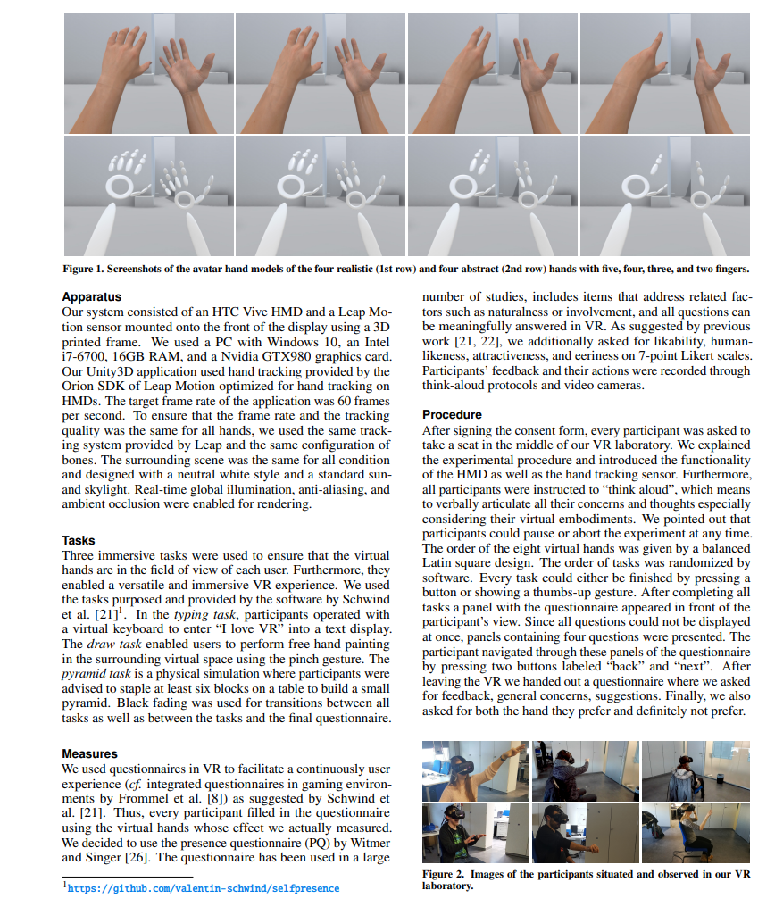
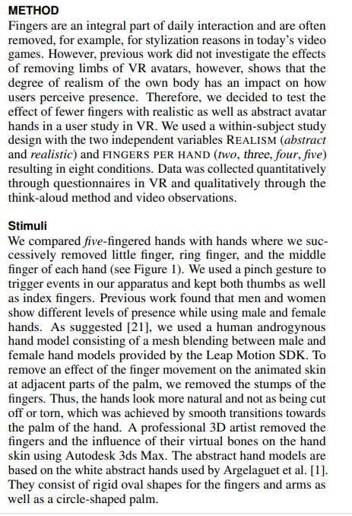
Method
What the participants saw
What has been developed?
dependent variables
Research question and study design
Experimental procedure
Stimuli creation
The tasks
The measures/
What the experimenter saw
How to Read a Paper

Slide 25
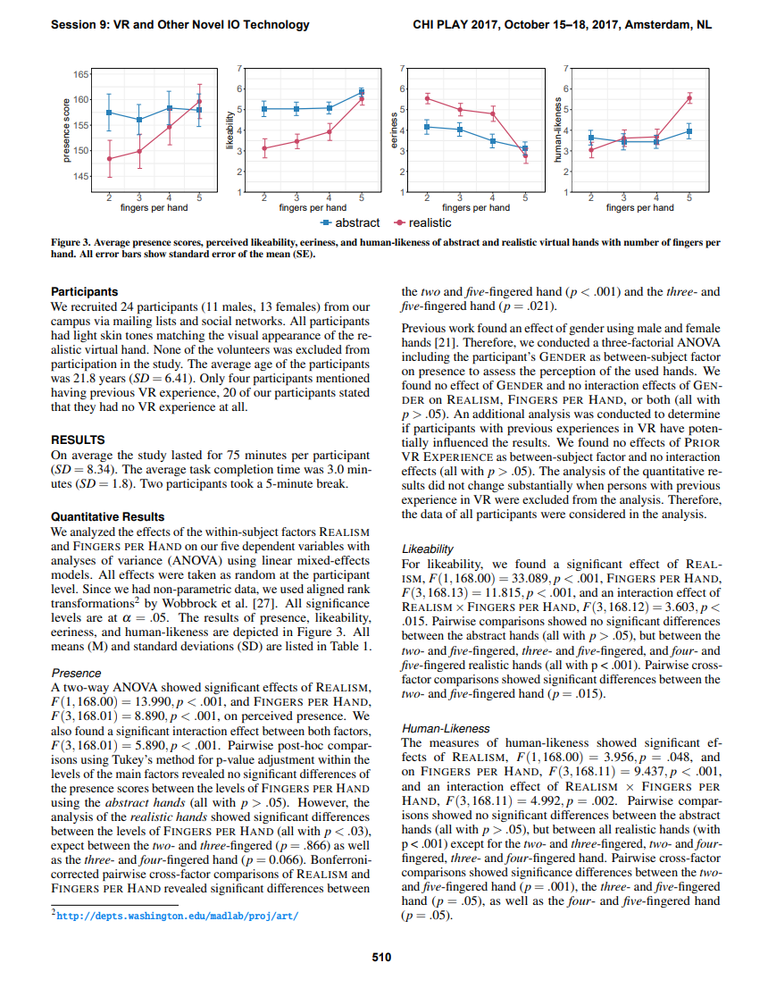
Method: Study Description
„How the authors answered the research question“
Typical Sections:
What the authors do?
What did they compare?
How did the authors to answer the research question?
Where can I find it, if I want to repeat the study?
What did the participants do?
What did the authors measure?
What was the experimental procedure?
Who were the participants?
What did the participants see?
What did the experimenters see?
How to Read a Paper

Slide 26
Method: Stimuli
„How the authors answered the research question“
Typical Sections:
What the authors do?
What did they compare?
How did the authors to answer the research question?
Where can I find it, if I want to repeat the study?
What did the participants do?
What did the authors measure?
What was the experimental procedure?
Who were the participants?
What did the participants see?
What did the experimenters see?
How to Read a Paper

Slide 27
Method: Apparatus
„How the authors answered the research question“
Typical Sections:
What the authors do?
What did they compare?
How did the authors to answer the research question?
Where can I find it, if I want to repeat the study?
What did the participants do?
What did the authors measure?
What was the experimental procedure?
Who were the participants?
What did the participants see?
What did the experimenters see?
How to Read a Paper

Slide 28
Method: Link to the repository
„How the authors answered the research question“
Typical Sections:
What the authors do?
What did they compare?
How did the authors to answer the research question?
Where can I find it, if I want to repeat the study?
What did the participants do?
What did the authors measure?
What was the experimental procedure?
Who were the participants?
What did the participants see?
What did the experimenters see?
How to Read a Paper

Slide 29
Method: Tasks
„How the authors answered the research question“
Typical Sections :
What the authors do?
What did they compare?
How did the authors to answer the research question?
Where can I find it, if I want to repeat the study?
What did the participants do?
What did the authors measure?
What was the experimental procedure?
Who were the participants?
What did the participants see?
What did the experimenters see?
How to Read a Paper

Slide 30
Method: Measures / Dependent Variables
„How the authors answered the research question“
Typical Sections:
What the authors do?
What did they compare?
How did the authors to answer the research question?
Where can I find it, if I want to repeat the study?
What did the participants do?
What did the authors measure?
What was the experimental procedure?
Who were the participants?
What did the participants see?
What did the experimenters see?
How to Read a Paper

Slide 31
Method: Procedure
„How the authors answered the research question“
Typical Sections:
What the authors do?
What did they compare?
How did the authors to answer the research question?
Where can I find it, if I want to repeat the study?
What did the participants do?
What did the authors measure?
What was the experimental procedure?
Who were the participants?
What did the participants see?
What did the experimenters see?
How to Read a Paper

Slide 32
Method: Participants
„How the authors answered the research question“
Typical Sections:
What the authors do?
What did they compare?
How did the authors to answer the research question?
Where can I find it, if I want to repeat the study?
What did the participants do?
What did the authors measure?
What was the experimental procedure?
Who were the participants?
What did the participants see?
What did the experimenters see?
How to Read a Paper

Slide 33
Method: Images
„How the authors answered the research question“
Typical Sections:
What the authors do?
What did they compare?
How did the authors to answer the research question?
Where can I find it, if I want to repeat the study?
What did the participants do?
What did the authors measure?
What was the experimental procedure?
Who were the participants?
What did the participants see?
What did the experimenters see?
How to Read a Paper

Slide 34
Method: Images
„How the authors answered the research question“
Typical Sections:
What the authors do?
What did they compare?
How did the authors to answer the research question?
Where can I find it, if I want to repeat the study?
What did the participants do?
What did the authors measure?
What was the experimental procedure?
Who were the participants?
What did the participants see?
What did the experimenters see?
How to Read a Paper

Slide 35
Study Design
What is the hypothesis and how do the authors want to answer it?
“[…] previous work did not investigate the effects of removing limbs of VR avatars, however, shows that the degree of realism of the own body has an impact on how users perceive presence. Therefore, we decided to test the effect of fewer fingers with realistic as well as abstract avatar hands in a user study in VR.”
What is the study design? What are the IVs?
We used a within-subject study design with the two independent variables REALISM (abstract and realistic) and FINGERS PER HAND (two, three, four, five) resulting in eight conditions.
Which data was collected? And how?
“Data was collected quantitatively through questionnaires in VR and qualitatively through the think-aloud method and video observations.”
How to Read a Paper

Slide 36
Method
Apparatus
There must be a picture → if not, search for the source code
What did they build ?
How did participants use it?
Often contain condensed: „To prevent motion sickness, we used an HMD with 90 FPS“
Tasks
What did the participants do?
Why/How did they do the tasks? And why?
Procedure
Describes what happened to every participant
e.g., How were stimuli ordered in the procedure („The order of the conditions was randomized for each participant.”)?
How to Read a Paper

Slide 37
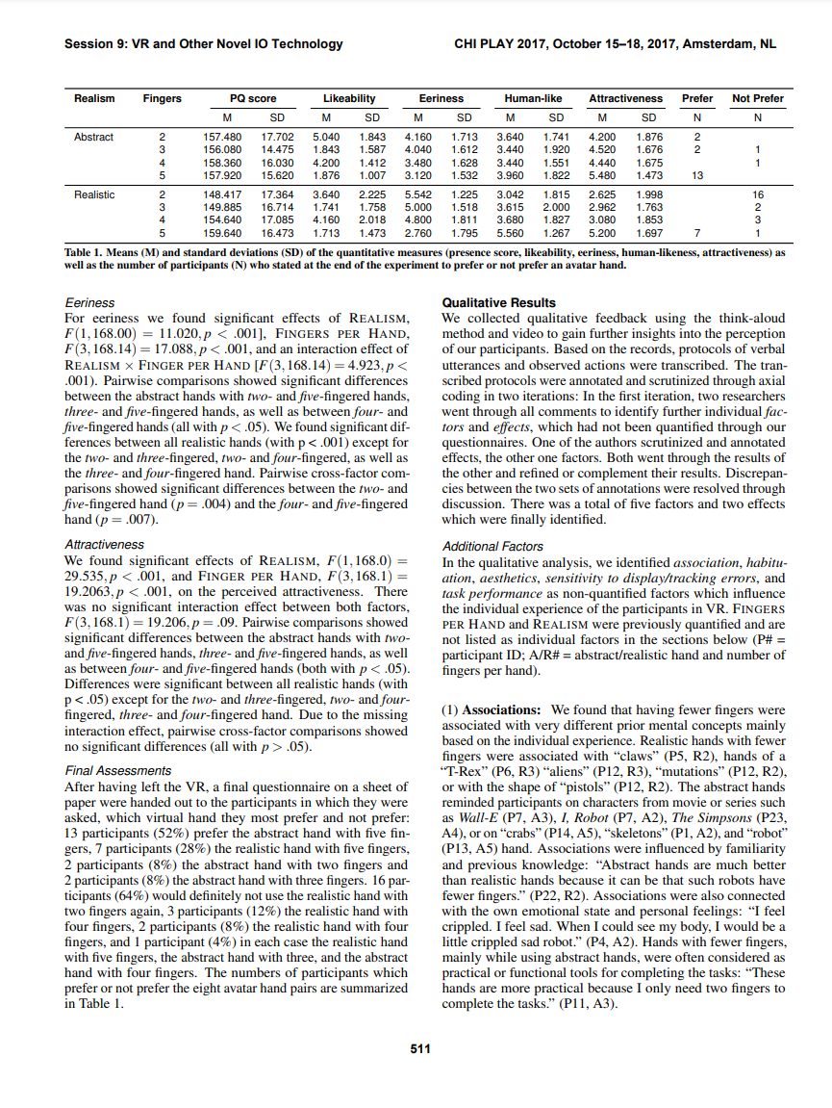
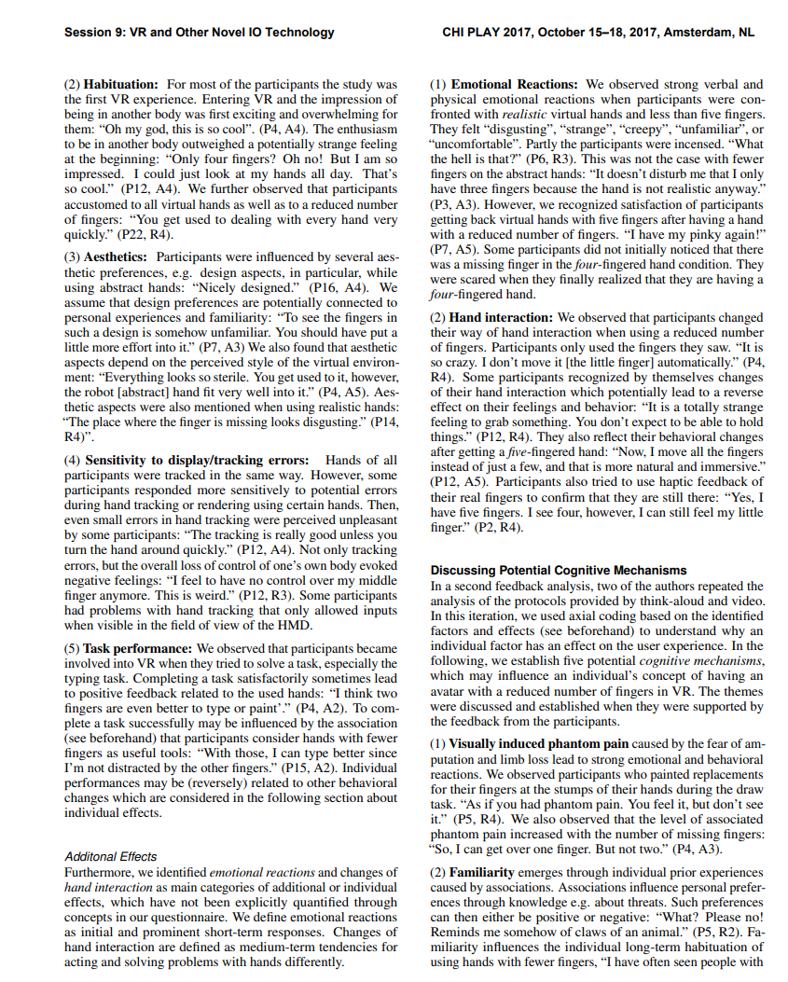
Results
Results are presented using figures!
Results are presented using tables!
Qualitative
Quantitative + Inferential Statistics
Currently, we have no idea whats going on here: http://statistics-help-for-students.com/
Important: How the data was analyzed?
How to Read a Paper

Slide 38
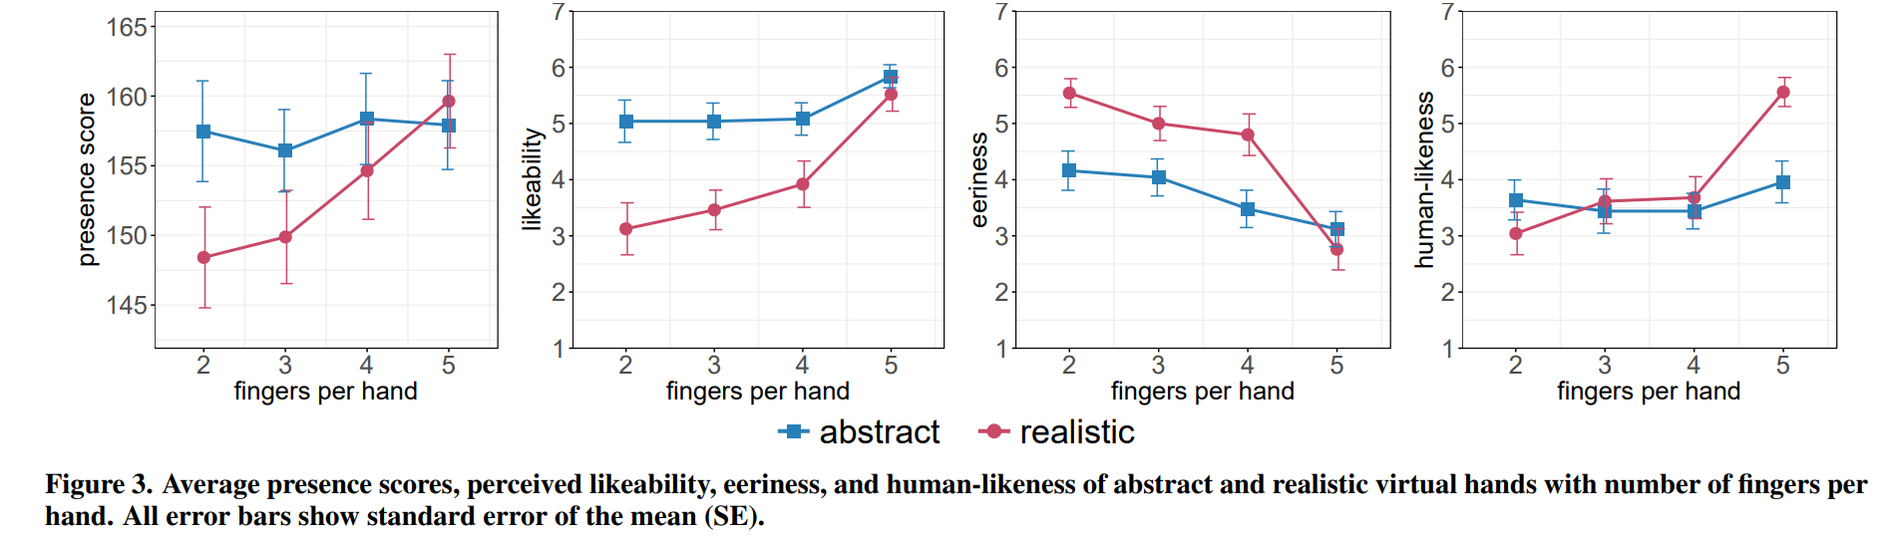
The Results
Objective findings of the research (not the interpretation!)
Main results are always plotted
How to Read a Paper

Slide 39
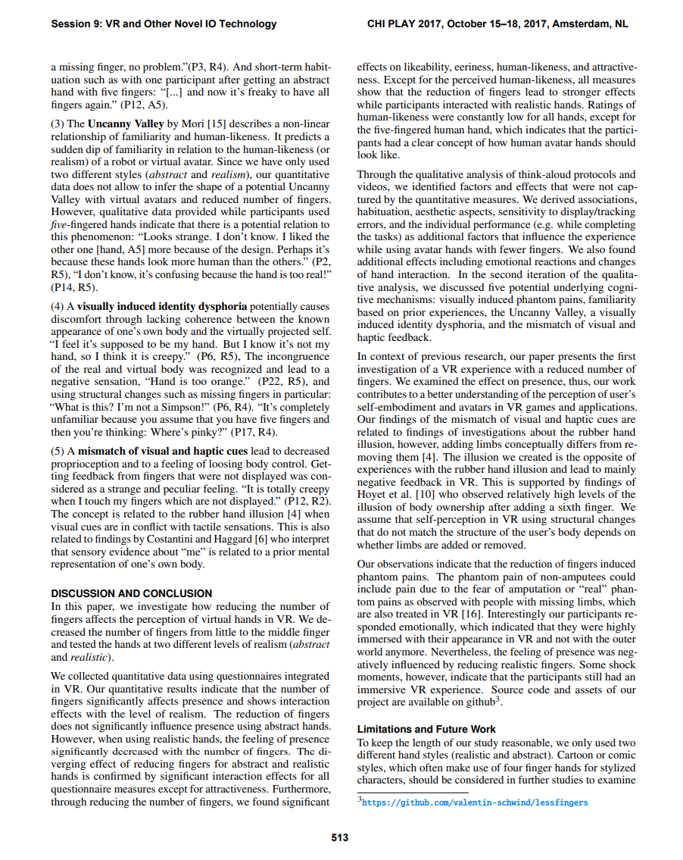
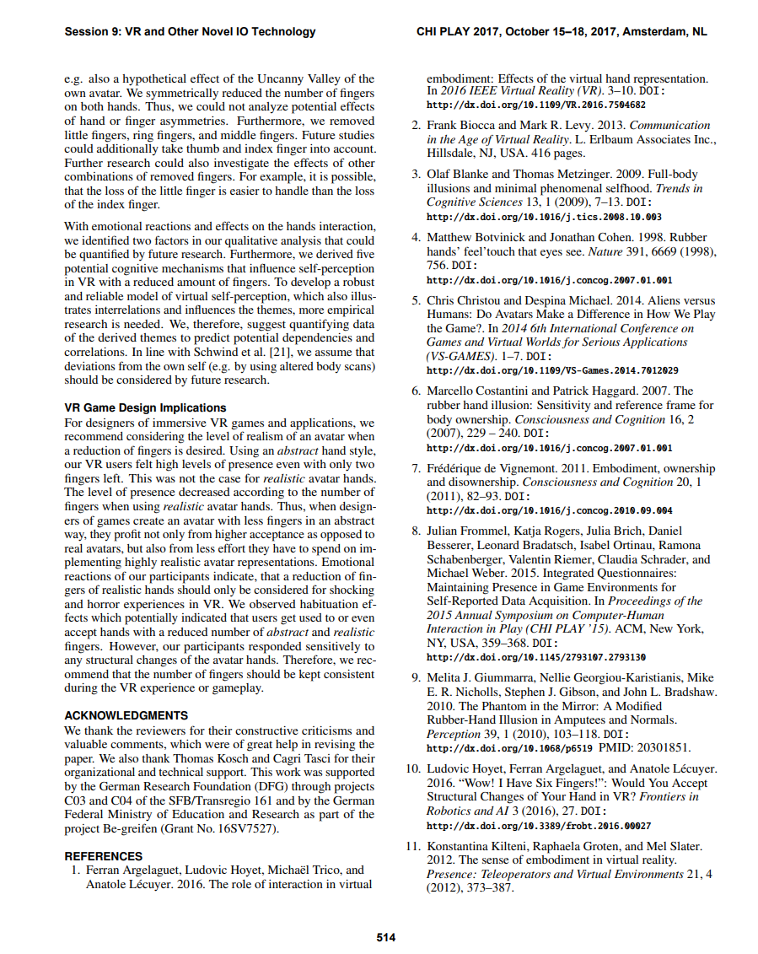
Discussion
The findings
The reason for those findings
The implications
Illustrate the limitations
Future Research
Oftenr provides clear design guidelines
General Discussion + Conclusion
Limitations + Future Work
Implications/Design Guidelines
How to Read a Paper

Slide 40
Discussion
A presentation of background information as well as recapitulation of the research aims of the study.
A brief summary of the results, whereas the focus lies on discussing and not recapitulating the results.
Explanation of the results for normal humans
A comparison of results with previously published studies
Conclusions or hypotheses drawn from the results, with summary of evidence for each conclusion
Proposed follow-up research questions and outlook on further work
Weaknesses? Non-significant results? Unexpected data?
If you are a non-scientist, where to find the interesting stuff?
How to Read a Paper

Slide 41
How I do read research papers…
Demonstration
How to Read a Paper

Slide 42
Future Work
What are the recommendations now?
Logical extension of the study: What comes next?
Replication of the study: Different setting?
Correction of limitations: Sample, apparatus, variable control, method
It is a great motiviation for you, when someone recommends to do your study
Happens sometimes
That is a great template
How to Read a Paper

Slide 43
Exercise: Find and describe a paper that is related to your research question
1. Go to https://scholar.google.com …
2. Enter the related keywords
3. Click on a result that seems to be relevant…
4. Try to open the paper (if not possible open the next one)…
5. Find and describe the technique…
You have 5 minutes…
How to Read a Paper

Slide 44
Questions
What is the paper about?
What did the authors do?
Why did they do it?
What are the independent variables?
What are the dependent variables?
What did they find out?
What did you learn?
How to Read a Paper

Slide 45
Using ChatGPT to summariz a paper…
Demonstration
Plugins: AI PDF
Summarize the paper, the findings, and method. Write one paragraph. Be concise. Do not hallucinate. Do not invent facts.
How to Read a Paper

Slide 46
Using ChatGPT to summariz multiple papers…
Demonstration
Plugins: ScholarAI, Consensus Research, MixerBox Scholar “What is the effect of latency on games? I want to conduct a study with artificial latency to simulate the effect. List and summarize in one paragraph about 3 related research papers that motivate the research around that topic. List and summarize in 3 papers that are related to that research question. List and summarize 3 research papers that use a similar method. Use all plugins. Ignore duplicates. Only use papers that have a DOI. Only summarize the main findings and method of the papers.”
How to Read a Paper

Slide 47
Task Next Time (1/2)
Each person in your group searches, reads, and summarizes at least 3 papers
Person 1: papers that motivate your research (can be from other disciplines!)
Person 2: papers closely related to your research question
Person 3: papers in your field using a similar method as you
No duplicates!
Research Motivation
Closely Related
Similar Method
How to Read a Paper

Slide 48
Task Next Time (2/2)
Update your problem statement (PDF)
Add a section called „Method“: Explain the your study plan and experimental procedure
Add a section called „Related Work“: Add the summary of the 9 papers
Update and upload your presentation (PDF)
Add/Change your slides according to the things you want to change
Your update research question(s) and describe the operationalization of your concept(s)
Describe your method in a few words. Depending on your research method …
Draw your study design / study plan!
Next time: Quick Presentation
How to Read a Paper

