Slide 1



How to Review Literature
Human-Computer Interaction Exercise
The following content is licensed under a Creative Commons Attribution 4.0 International license (CC BY-SA 4.0)

Slide 2
Literature Reviews
Original research (such as empirical papers or theses) typically have a related work section to:
  Ensure scientific standards and methodologies
  Demonstrate your familiarity and expertise around the topic and its scholarly context
  Develop a theoretical framework and methodology for your research
  Position yourself in relation to other researchers and theorists
  Show how your research addresses a gap or contributes to a debate
Extensive literature reviews (secondary research) can be stand-alone contributions
  They are called literature reviews, scoping reviews, survey paper, meta-analysis, meta-analysis of a meta-analysis
How to Review Literature

Slide 3
The Student‘s Approach
The process of conducting a literature review typically follows the same steps:
  Search for relevant keywords and databases
  Search, evaluate, and filter your results
  Find a structure (identify fields, themes, categories,…)
  Write your literature review
Not scientific, but we like this!
How to Review Literature

Slide 4
Find your Keywords
Make a list of keywords/annotations
  Include each of the key concepts or variables you’re interested
  Find synonyms and related terms
  Add new keywords later…
How to find keywords? Identify your research fields, theoretical frameworks, device categories, and measures (or methods)
  Research field(s): “human-computer interaction“ (rarely required),…
  Theoretical frameworks: “social acceptability“, „accessibility“, „ergonomics“, …
  Device categories: “virtual reality“, „augmented reality“, „wearables“, „mobile devices“, …
  Measures/Tasks: “target selection“, „Fitts‘ law“, “EMG“,“electromyography“, …
  Be more specific, if required: “heart rate“, „privacy“, „face detection“, …
How to Review Literature

Slide 5
Relevant Sources
Use your keywords to start searching for literature
Some useful databases to search for journals and conferences articles:
  Google Scholar https://scholar.google.de/
  ACM https://dl.acm.org/
  IEEE https://ieeexplore.ieee.org/
  The university’s library https://idp.hebis.de/
  JSTOR https://www.jstor.org/
  EBSCO https://www.ebsco.com/de-de
  Project Muse (humanities and social sciences) https://muse.jhu.edu
  PubMed (life sciences and biomedicine) https://pubmed.ncbi.nlm.nih.gov/
Record all your sources!
How to Review Literature

Slide 6
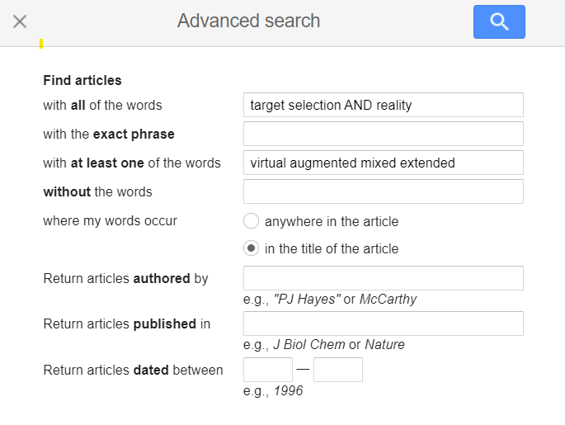
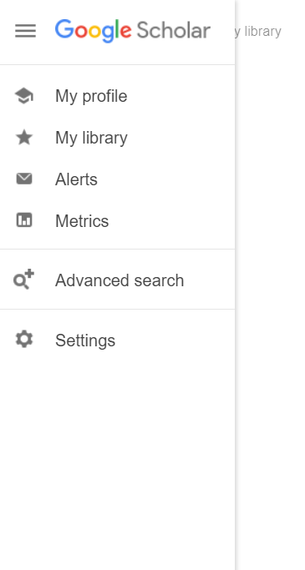
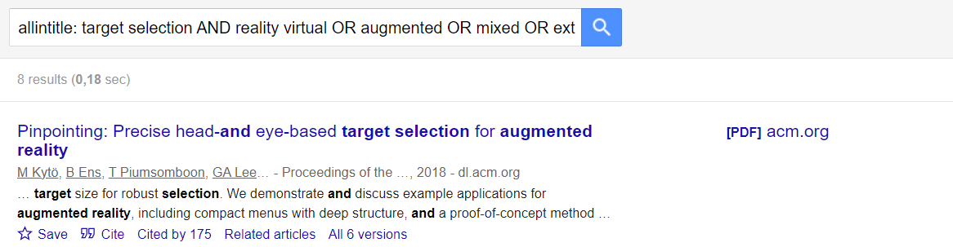
Know your Query
We got 3 results… let‘s improve the query
How to Review Literature

Slide 7
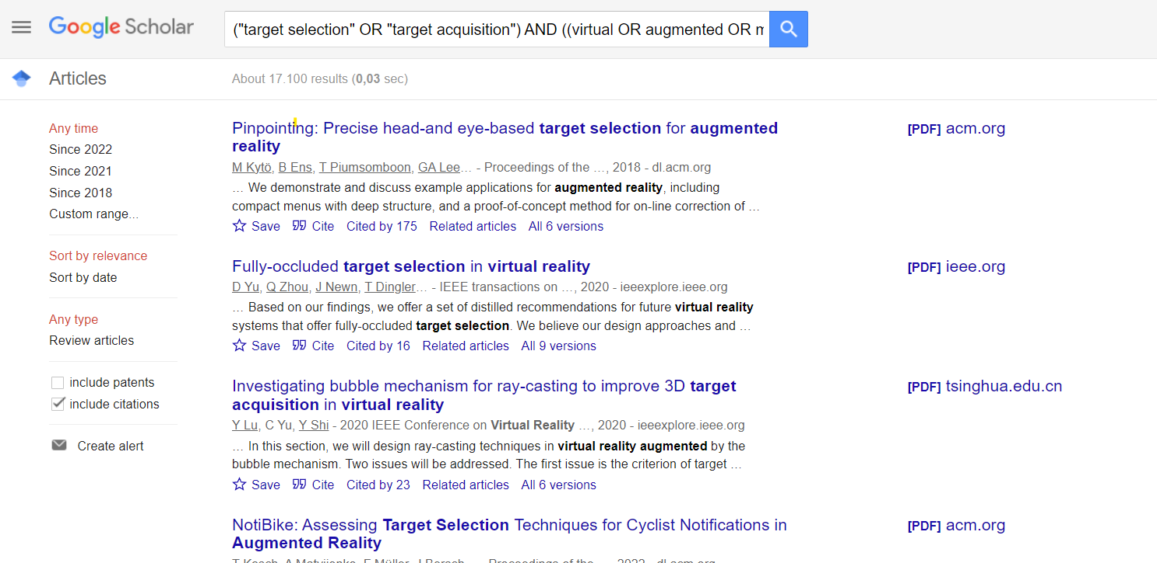
Improve your Query
("target selection" OR "target acquisition") AND ((virtual OR augmented OR mixed OR extended) AND (reality))
Awesome! ☺
How to Review Literature

Slide 8
Filtering
Top-down
Use “quotes” or (parentheses) to connect terms
Use boolean operators AND, OR, NOT
Read the title and abstract
Now you have three options
  Check all results and search for relevant publications (“bottom up”)
    Thorough but slow: important work is not highlighted
  Check the most cited publications (“top down by citations”)
    Fast but shallow: the most important publications are not necessarily those you are searching for (or your missed them)
  Check the newest publications (“top down by date”)
    Check their bibliography and their quality
Citations / date
Search results you found
Bottom-up
Irrelevant
Relevant
How to Review Literature

Slide 9
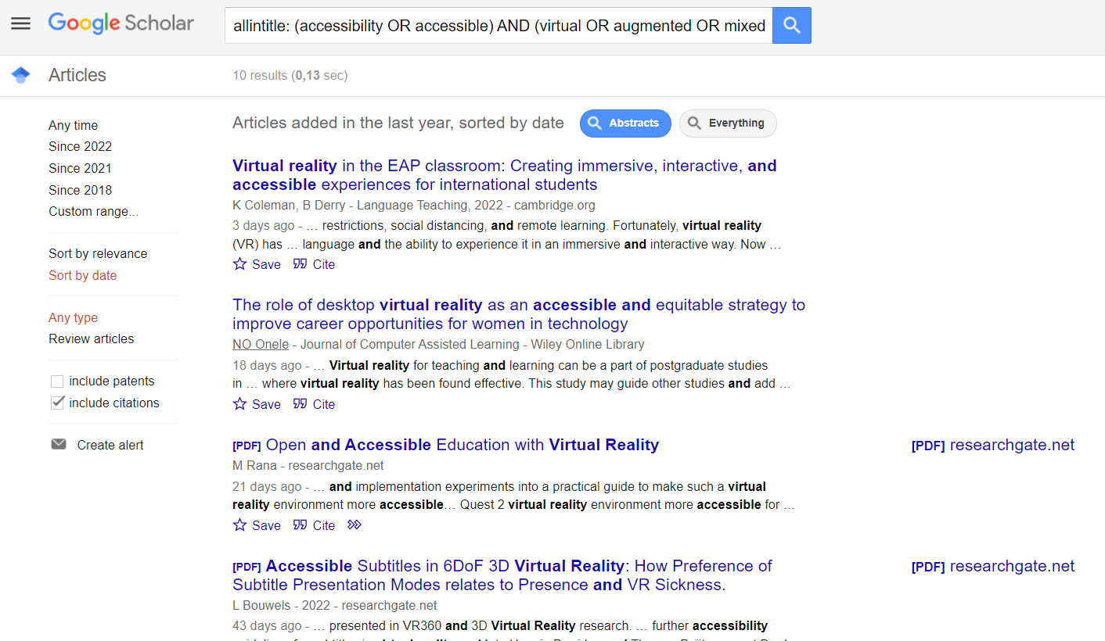
Another search term…
Be careful google dropped some
?
Awesome! But no PDF …
A master‘s thesis
(has no publisher)!
Click
How to Review Literature

Slide 10

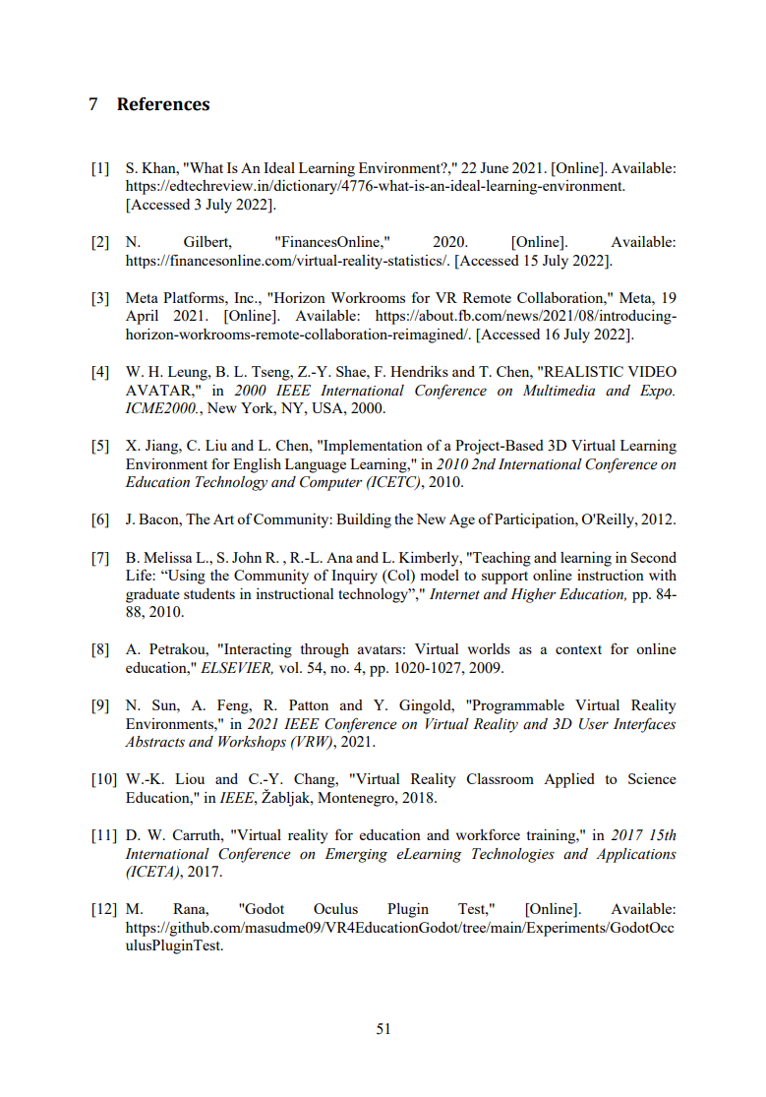
Let‘s check it…
Probably related to our topic!
(but not thorough and
no credible sources)
How to Review Literature

Slide 11
Credibility and Importance
Make sure the sources you use are credible, and make sure you read any landmark studies and major theories in your field of research
Find out how citations an article has – a high cited paper means the article has been influential in the field, and should certainly be included
Original reserach always has been peer-reviewed and published
  Search for publisher
    ACM
    IEEE
    Springer
    Elsevier (we don‘t like that)
    … there are more, but we don‘t like them, too
How to Review Literature

Slide 12
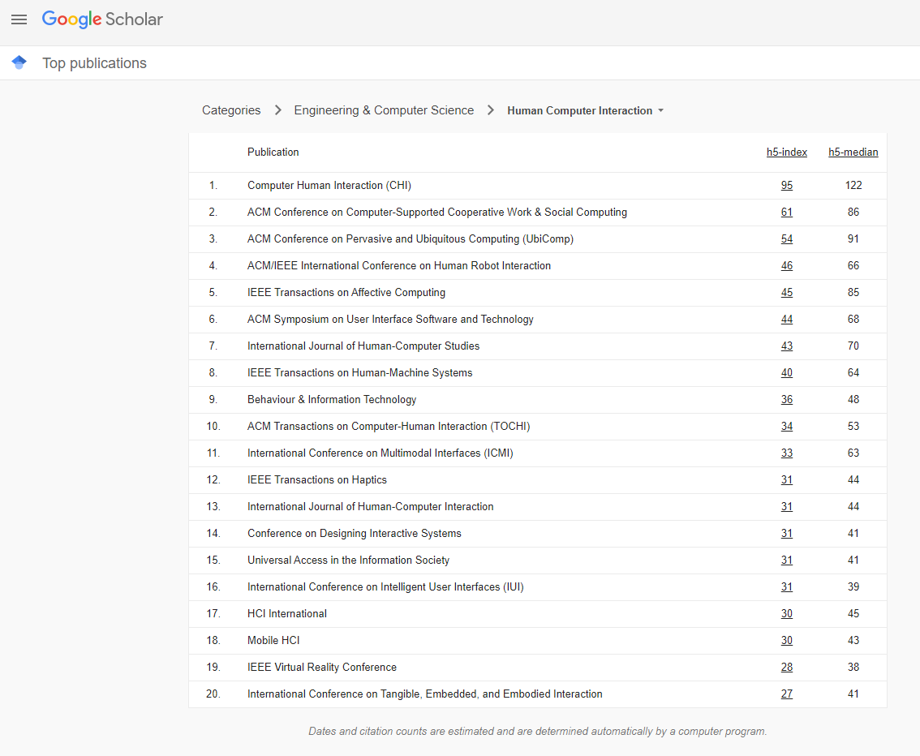
h-index
https://scholar.google.es/citations?view_op=top_venues&hl=en&vq=eng_humancomputerinteraction
The h-index (Hirsch index) is defined as the maximum value of h where the given author/journal has published h papers that have each been cited at least h times
h5-index is the h-index for articles published in the last 5 complete years
h5-median is the median number of citations for the articles that make up its h5-index
Published here (ACM, IEEE, Springer,
Elsevier, or similar venues)
indicates scientific standards
and reliablity of the work
How to Review Literature

Slide 13
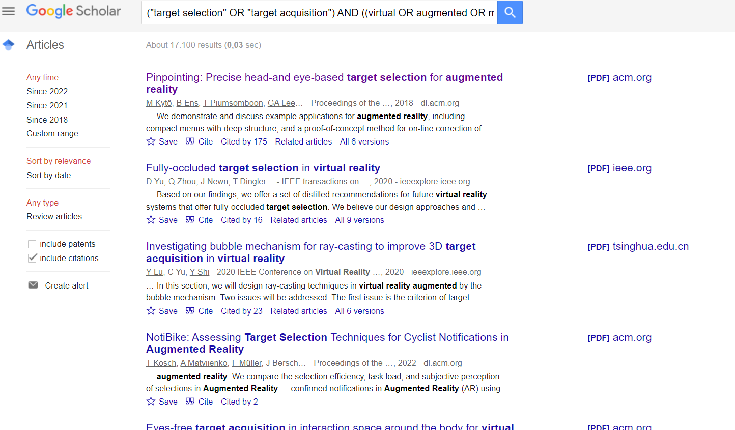
Google Scholar
Click
Highly cited. We love that
Click Later
How to Review Literature

Slide 14
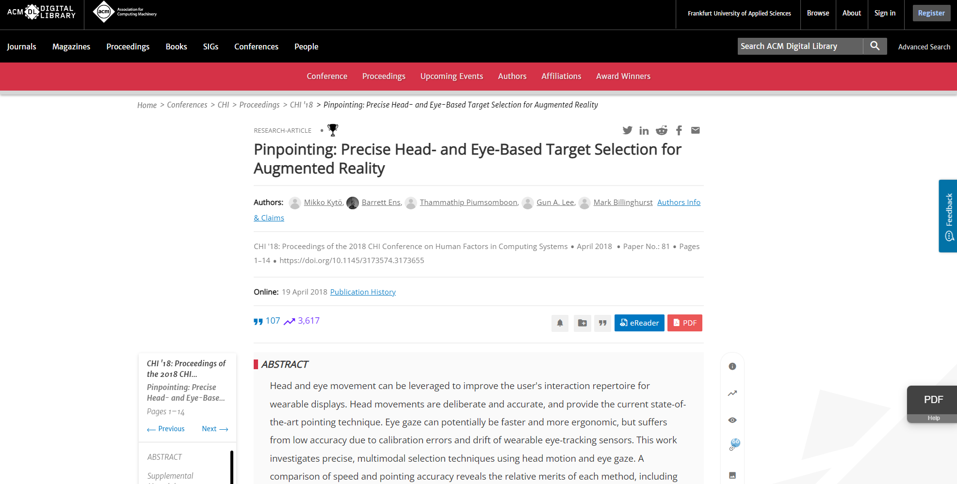
Very important place in HCI
Best paper award
Ensure login! Open it from the university network, you can download PDFs.
The title
The authors
The conference or journal
Highly cited
Read this
Remember this, this button will get very important for you
SCROLL DOWN!!!
How to Review Literature

Slide 15
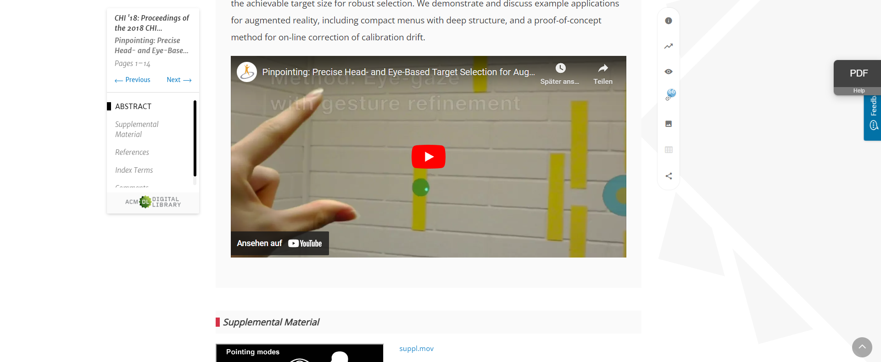
Video for people who don’t want to read the abstract
SCROLL DOWN!!!
How to Review Literature

Slide 16
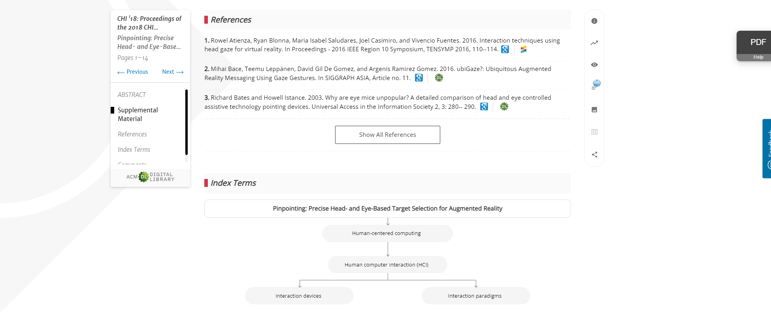
Click here
How to Review Literature

Slide 17
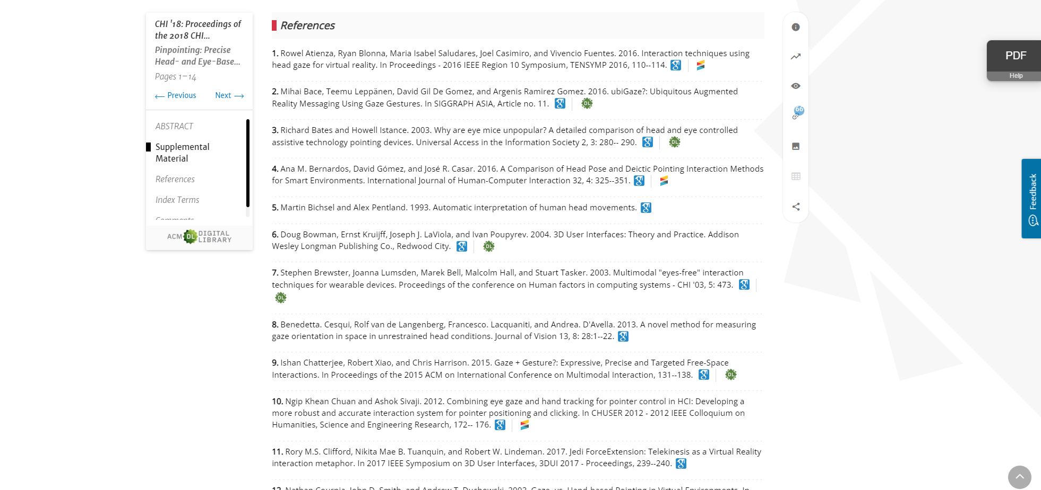
Related!
“snowballing”
better than google scholar!
How to Review Literature

Slide 18
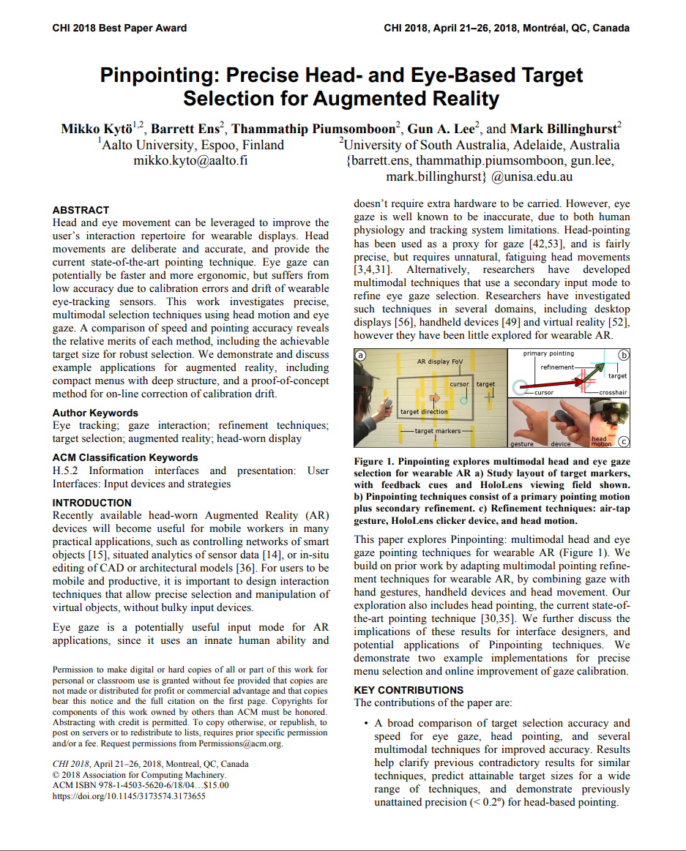
Fast Screening
look at everything that still seems related
Look if you can add more keywords to your list
read figures, abstract & graphs first
Mikko Kytö, Barrett Ens, Thammathip Piumsomboon, Gun A. Lee, and Mark Billinghurst. 2018. Pinpointing: Precise Head- and Eye-Based Target Selection for Augmented Reality. In Proceedings of the 2018 CHI Conference on Human Factors in Computing Systems (CHI '18). Association for Computing Machinery, New York, NY, USA, Paper 81, 1–14. https://doi.org/10.1145/3173574.3173655
How to Review Literature

Slide 19
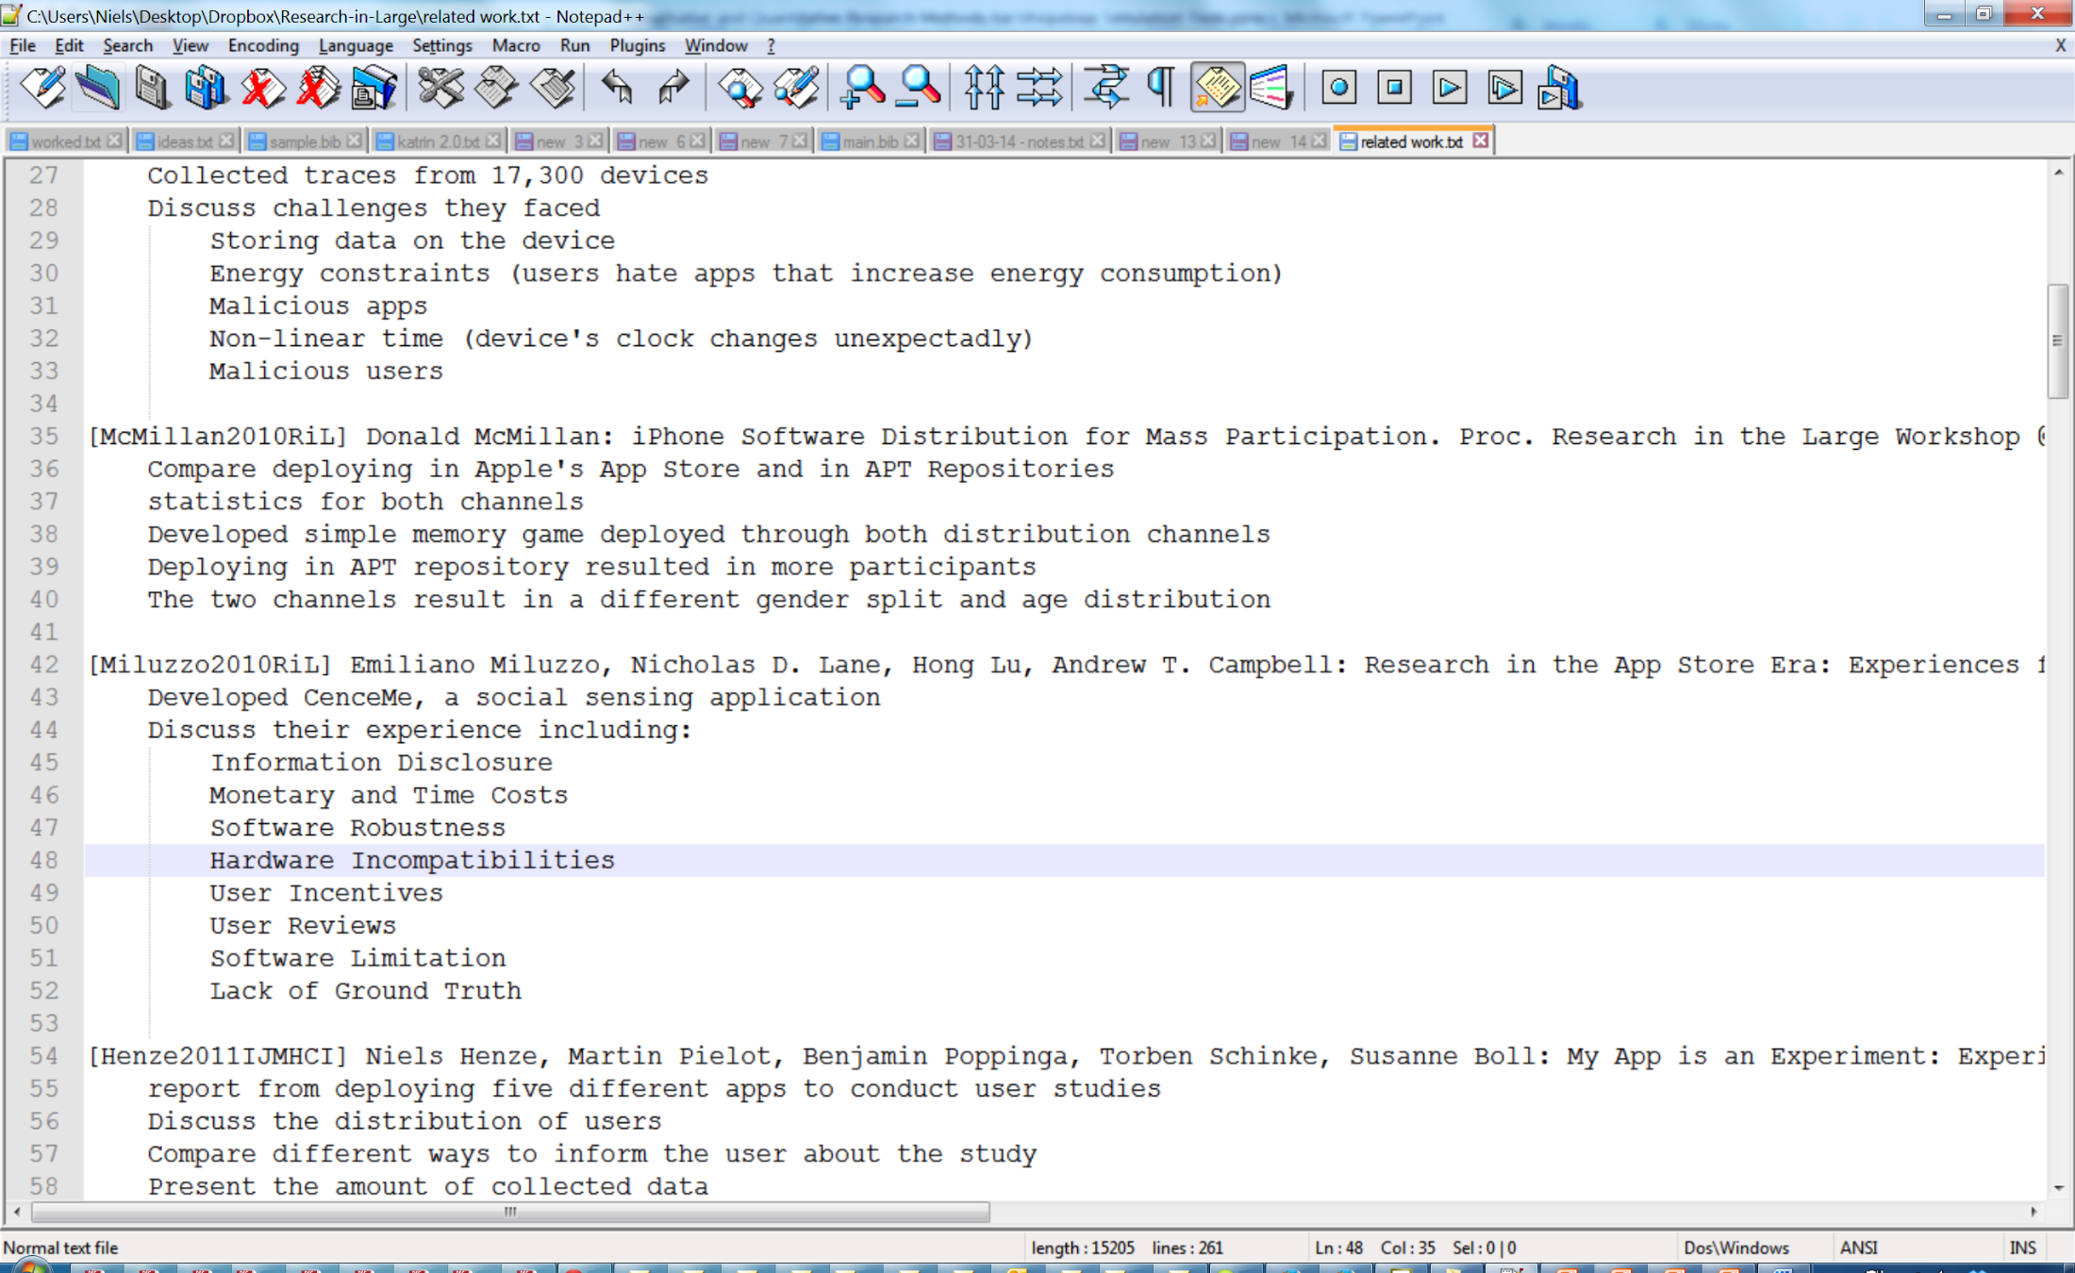
Manual Bibliography
Note down references and key aspects
How to Review Literature

Slide 20
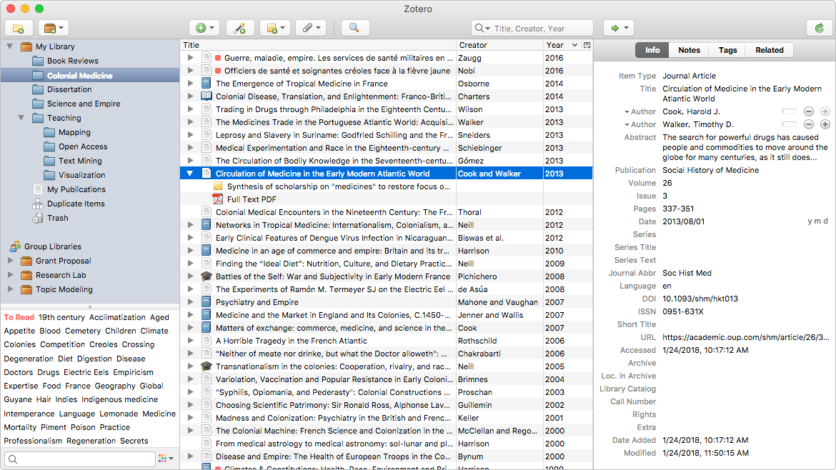
Bibliography Software: Zotero
Your Categories
Paper List
Detailed Description
Keywords, Annotations
https://www.zotero.org/
How to Review Literature

Slide 21
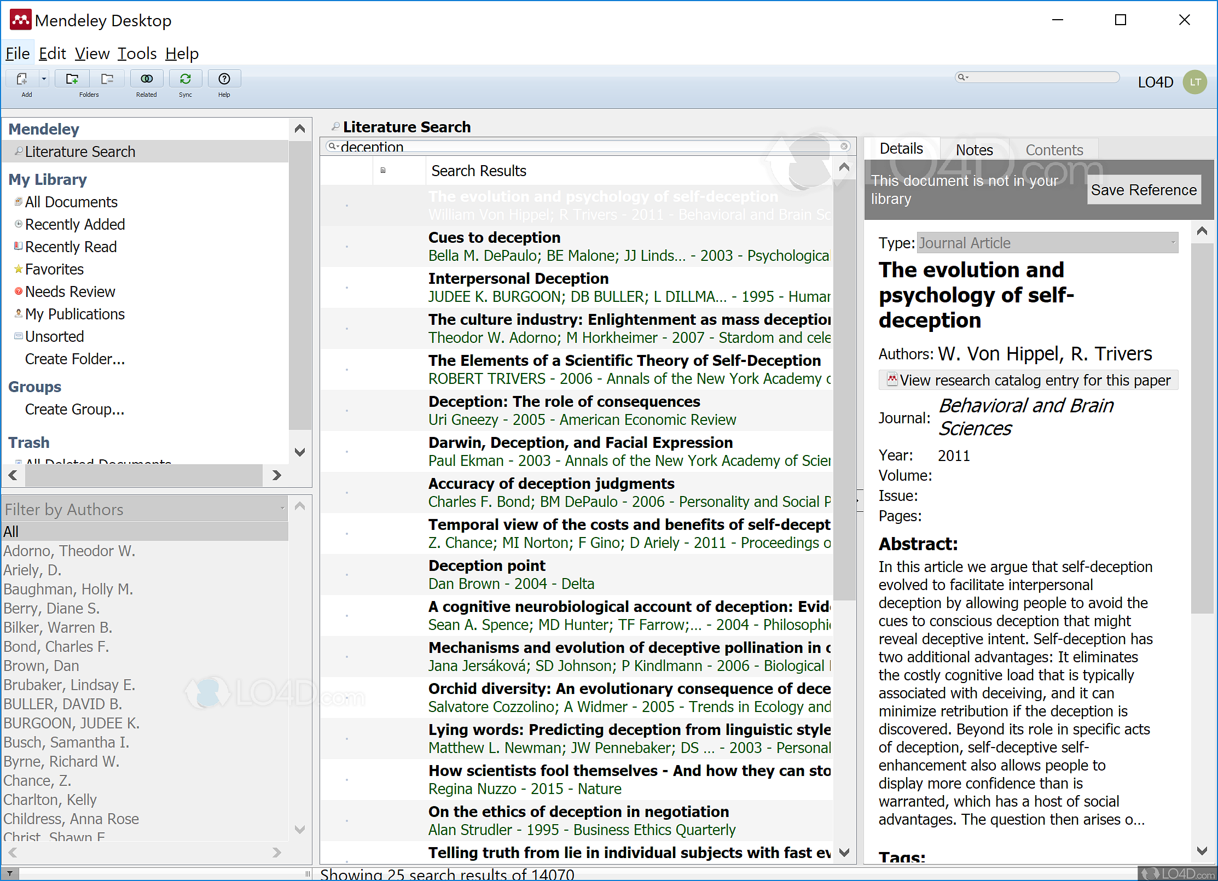
Bibliography Software: Mendeley
Your Categories
Paper List
Detailed Description
Keywords, Annotations
https://www.mendeley.com/
How to Review Literature

Slide 22
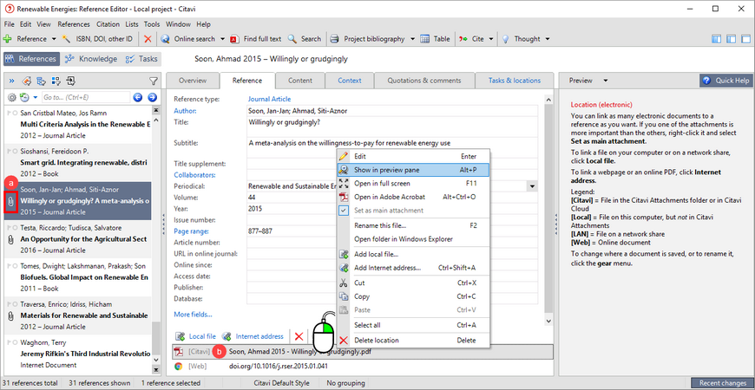
Bibliography Software: Citavi (we are paying for this!)
Your Categories
Paper List
Detailed Description
Keywords, Annotations
How to Review Literature

Slide 23
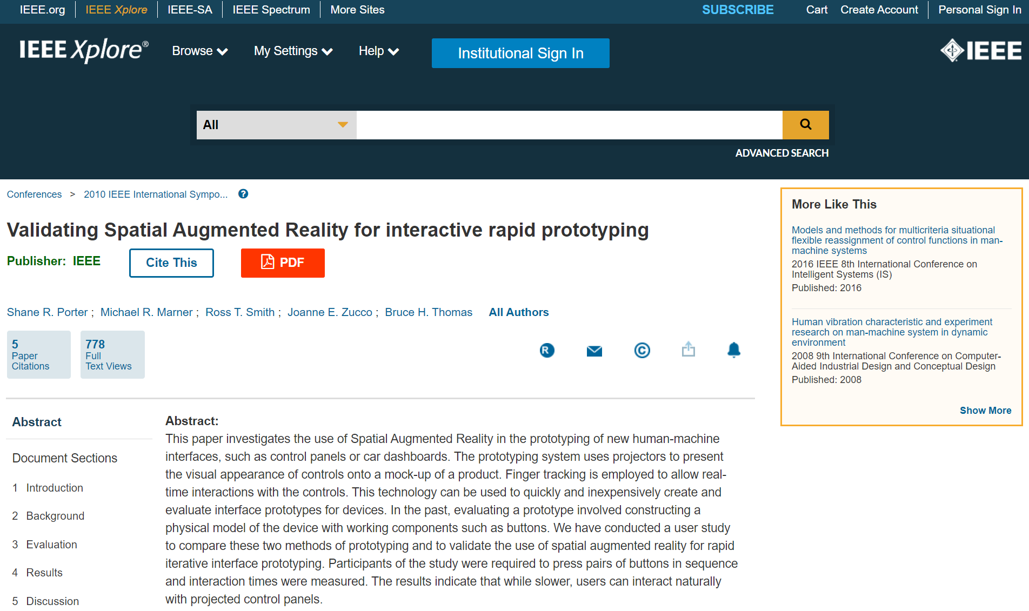
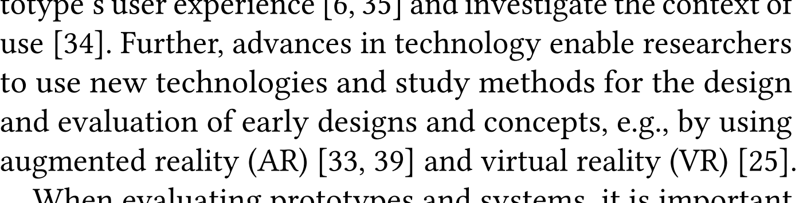
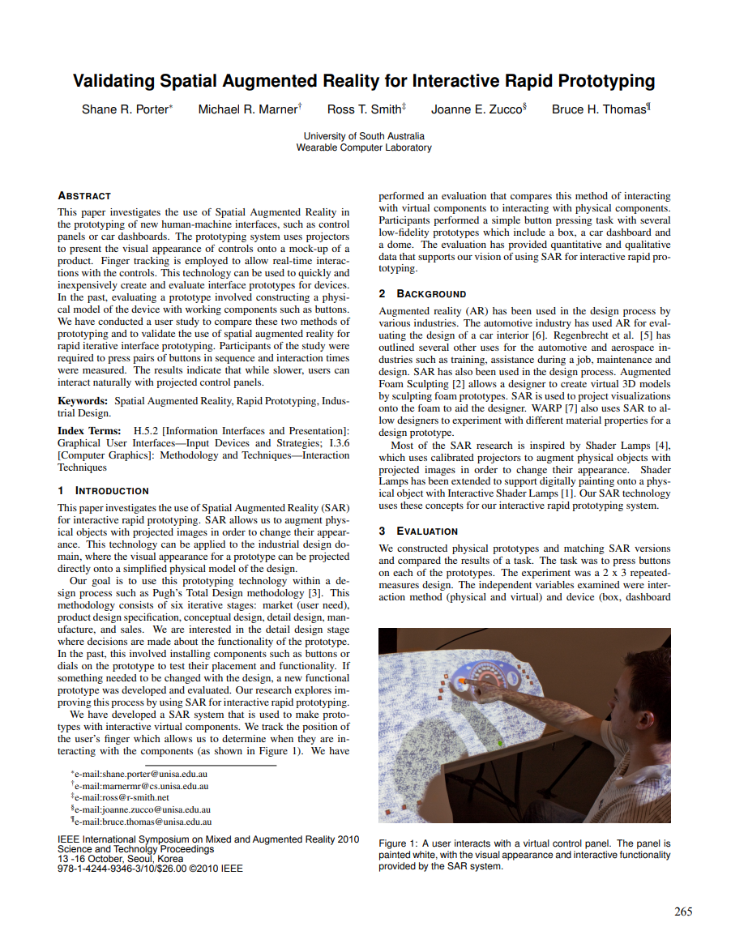
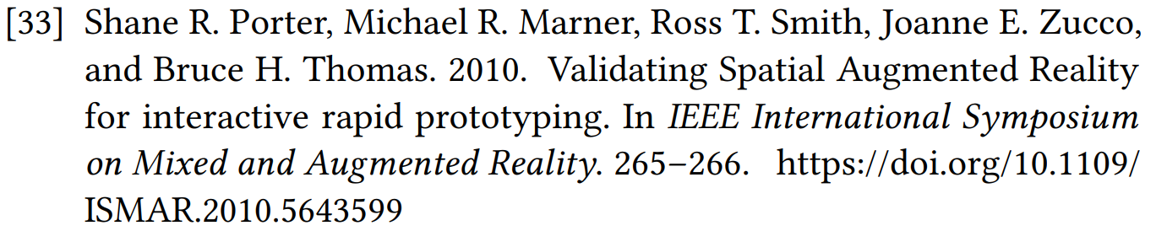
Understanding References
Use your institutional Sign-In (Frankfurt University of Applied Sciences)
Authors
Year of publishing
Title
Proceedings
Pages
DOI
How to Review Literature

Slide 24
Identify Themes, Debates, and Gaps
Understand the connections and relationships between the research sources: Who did what, why, and when?
Take notes:
  Trends and patterns (theory, method, results): do certain approaches become more or less popular over time?
  Themes: what questions or concepts recur across the literature?
  Debates, conflicts and contradictions: where do sources disagree?
  Pivotal publications: are there any influential theories or studies that changed the direction of the field?
  Research Gaps: what is missing from the literature? Are there weaknesses that need to be addressed?
How to Review Literature

Slide 25
About others’ Future Work
Examples:
  Many researches in computer sciences recommend to further investigate stuff like the effects of gender, culture, or age but never do this → why?
  Search for concise hints: “There is an increasing interest in the visual aspects of social media on young women. But there is still a lack of robust research on highly visual platforms like Instagram and Snapchat”
    Example: https://www.scribbr.com/dissertation/literature-review/
  HCI Researchers often found that their research highly depends on the task. Which categories of tasks are being used in the domain of HCI, how robust are they, and which provide high external validity?
How to Review Literature

Slide 26
Structure your Related Work
Depending on the length of your literature review, you can combine several of these strategies
  Chronological (not recommended in computer sciences)
  Thematic and Central Aspects (e.g., machine learning and adaptive user interfaces)
  Methodological (e.g., results in qualitative vs quantitative research)
  Theoretical Framework (e.g., theories, models, and definitions of key concepts)
    Theories, models, and definitions of key concepts can form the structure of your review
How to Review Literature

Slide 27
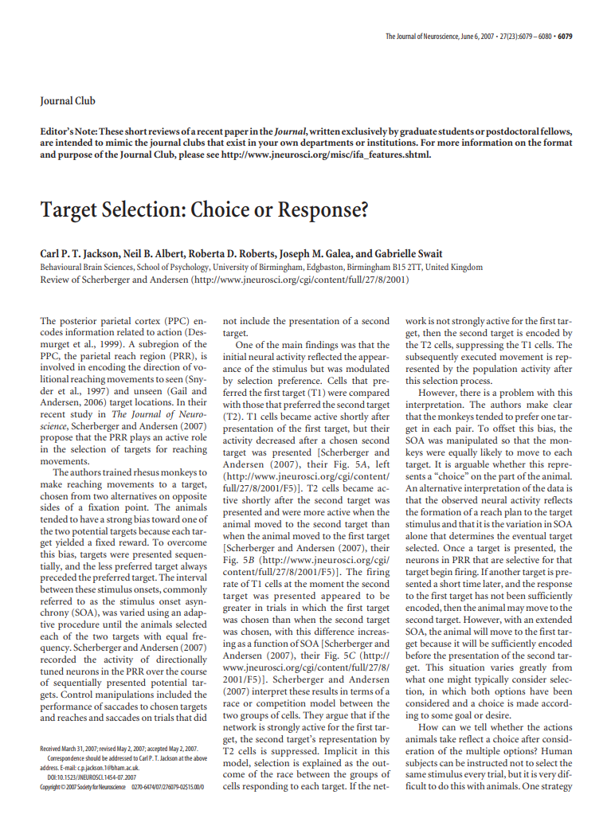
Finding Structures
nice
a
make
structure
!
Example: You develop and investigate a
target selection technique in virtual
reality using electromyography (EMG)
Target selection
techniques
Target selection
in virtual reality
Target selection/
input with EMG
How to Review Literature

Slide 28
Write your Related Work
Like any other academic text, your literature review should have:
  Very short introduction: establishes and motivates the focus and purpose of the literature review)
    Theses: provide a context, highlight a gap
    Literature Reviews: new insight you draw from the literature
  Main Body: divides the body into subsections, synthesize from their findings
    e.g., themes, frameworks, fields of research, time period, or methodological approaches
  Summary and Conclusion: summarizes the key findings you have taken from the literature and emphasize their significance
How to Review Literature

Slide 29
Writing Tips
Summarize and synthesize: give an overview of the main points of each source and combine them into a coherent whole
Analyze and interpret: don’t just paraphrase other researchers—add your own interpretations where possible, discussing the significance of findings in relation to the literature as a whole
Critically evaluate: mention the strengths and weaknesses of your sources
Write in well-structured paragraphs: use transition words and topic sentences to draw connections, comparisons and contrasts
How to Review Literature

Slide 30
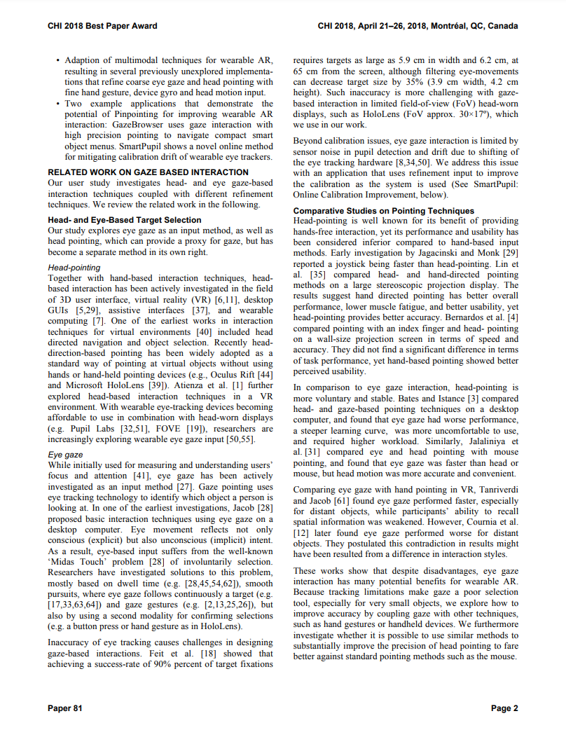
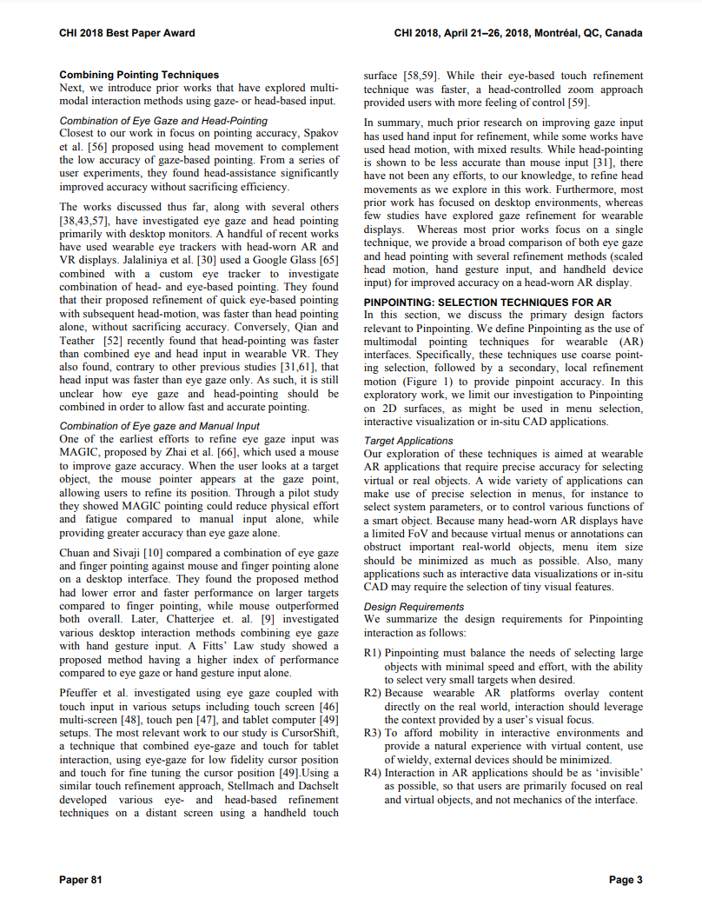
Example: A Related Work
Combining Pointing Techniques
Comparison of Pointing Techniques
Mikko Kytö, Barrett Ens, Thammathip Piumsomboon, Gun A. Lee, and Mark Billinghurst. 2018. Pinpointing: Precise Head- and Eye-Based Target Selection for Augmented Reality. In Proceedings of the 2018 CHI Conference on Human Factors in Computing Systems (CHI '18). Association for Computing Machinery, New York, NY, USA, Paper 81, 1–14. https://doi.org/10.1145/3173574.3173655
What we are reading and why?
Head- and Eye-Based Target Selection
Summary and Research Gap
Pointing with the head
Pointing with eye gaze
How to Review Literature

Slide 31
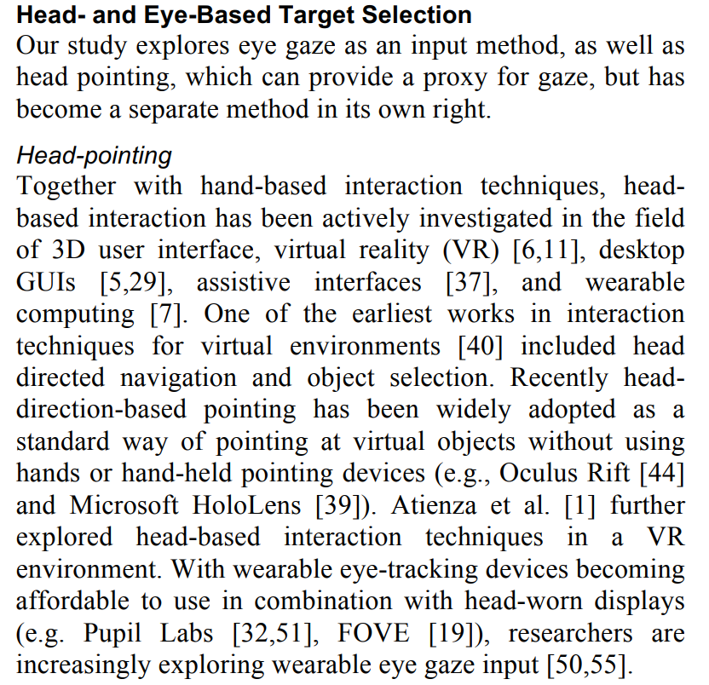
Example: A Related Work Section
Mikko Kytö, Barrett Ens, Thammathip Piumsomboon, Gun A. Lee, and Mark Billinghurst. 2018. Pinpointing: Precise Head- and Eye-Based Target Selection for Augmented Reality. In Proceedings of the 2018 CHI Conference on Human Factors in Computing Systems (CHI '18). Association for Computing Machinery, New York, NY, USA, Paper 81, 1–14. https://doi.org/10.1145/3173574.3173655
Here they are enumerating research activities and put the references behind them
Here, they do mention the authors (Lastname et al.)
Here, they refer to an acronym (a system) from another work
Mikko Kytö, Barrett Ens, Thammathip Piumsomboon, Gun A. Lee, and Mark Billinghurst. 2018. Pinpointing: Precise Head- and Eye-Based Target Selection for Augmented Reality. In Proceedings of the 2018 CHI Conference on Human Factors in Computing Systems (CHI '18). Association for Computing Machinery, New York, NY, USA, Paper 81, 1–14. https://doi.org/10.1145/3173574.3173655
How to Review Literature

Slide 32
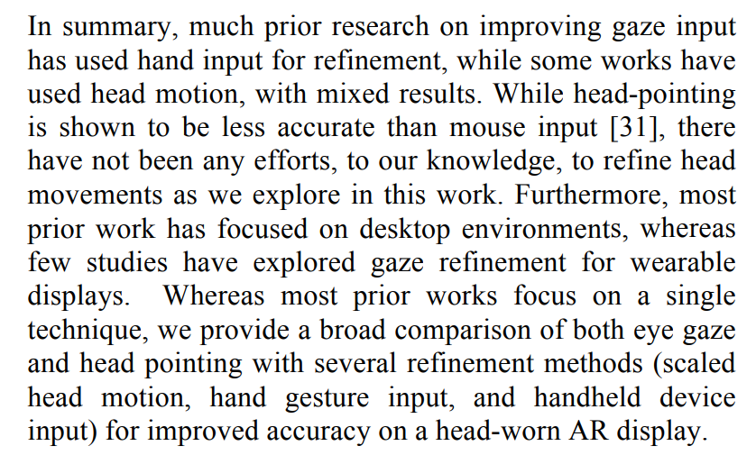
Example: A Related Work Summary
Related work is always great!
Mikko Kytö, Barrett Ens, Thammathip Piumsomboon, Gun A. Lee, and Mark Billinghurst. 2018. Pinpointing: Precise Head- and Eye-Based Target Selection for Augmented Reality. In Proceedings of the 2018 CHI Conference on Human Factors in Computing Systems (CHI '18). Association for Computing Machinery, New York, NY, USA, Paper 81, 1–14. https://doi.org/10.1145/3173574.3173655
A claim. Needs reference.
The research gap!
Another research gap!
What they address
„We are great, too!“
How to Review Literature

Slide 33
Summarizing the Student‘s Approach
Summary: 4 steps easy to follow:
  Search for relevant keywords and databases
  Search, evaluate, and filter your results
  Find a structure (identify fields, themes, categories,…)
  Write your literature review
The Student‘s Approach is mostly called Narrative Review
  No standards. Not scientific, but we like this!
Is there any scientific method?
How to Review Literature

Slide 34
The Scientific Approach
Writing literature reviews has its own scientific field:
  Empirical study of literature (Empirische Literaturwissenschaft)
  There are at least 14 literature review types [1]
The main types of literature reviews in HCI are
  Scoping Review
  Systematic Review
  Meta Review/Meta Analysis
Methodological literature review approaches depend on the discipline
  e.g., medicine != computer sciences
[1] Booth, A. (2009). A typology of reviews: An analysis of 14 review types and associated methodologies. Health Information and Libraries Journal, 26(2), 91-108.
How to Review Literature

Slide 35
Scoping Reviews
Serve to assess and provide and overview about the literature scope of a topic.
The scoping review can have multiple goals:
  Can provide and set definitions within a scope (“What is an intelligent user interface?”)
  Can answer general research questions (“What makes devices socially acceptable?”)
  Provide an (quantitative) overview of the existing evidence, regardless of its quality
  Often used in the field of computer science and engineering to quickly get a broader picture
    e.g., devices, systems, interactions, etc.
The search method can iteratively be adjusted to synthesize evidence
Two approaches
  The JBI Method (rather for engineers and systems) [1]
  The PRISMA-Sc Method (rather for original research) [2]
[1] https://journals.lww.com/ijebh/fulltext/2015/09000/guidance_for_conducting_systematic_scoping_reviews.5.aspx
[2] https://prisma-statement.org/Extensions/ScopingReviews
How to Review Literature

Slide 36
Systematic Review
Systematic reviews answer one specific research question and have a defined outcome
  e.g., the effectiveness of an intervention („How can VR support disabled people?“)
Contains a complete protocol and transparent approach
  A set of analytical methods to collect secondary data and analyze it
  Provides an exhaustive and complete summary
  Minimize biases, no iterations, paper selection performed independently by at least two review authors
    Discrepancies should be resolved by consensus or by the decision of a third review author
Three approaches
  The Kitchenham Procedure (rather for software engineers) [1]
  The PRISMA Method (rather for empirical research) [2]
  The APISSER Methodology (rather for medical sciences) [3]
[1] https://journals.lww.com/ijebh/fulltext/2015/09000/guidance_for_conducting_systematic_scoping_reviews.5.aspx
[2] https://prisma-statement.org/Extensions/ScopingReviews
[3] https://ieeexplore.ieee.org/document/9698182
How to Review Literature

Slide 37
Meta-Analysis
A meta-analysis is an exhaustive and complete summary of literature and performing a statistical analysis aggregating the results of scientific studies
  Looking for evidence of original research
  Meta-analysis systematically assesses the results of previous research to derive conclusions about that body of research
  Often, but not always, important part of a systematic review procedure
  Mainly conducted in medical research on clinical trials to find evidence of treatment
One main approach
  The PRISMA Method (rather for empirical research) [1]
[1] https://journals.lww.com/ijebh/fulltext/2015/09000/guidance_for_conducting_systematic_scoping_reviews.5.aspx
How to Review Literature

Slide 38
PRISMA
PRISMA = Preferred Reporting Items for Systematic Reviews and Meta-Analyses
Standard and state-of-the art procedure for literature reviews in science
An evidence-based set of items aimed at helping scientific authors to report a wide array of systematic reviews and meta-analyses [1]
The PRISMA methodology can be applied to
  Systematic Reviews
  Scoping Reviews (PRISMA-Sc)
  Meta Reviews / Meta Analysis
[1] https://www.prisma-statement.org
How to Review Literature

Slide 39
PRISMA: What you should know…
Review Time: 6-8 weeks, depending on: number of databases, complexity, papers
Resources: Appropriate research databases for the research question
Team: Three people required for screening
Searching strategy: exhaustive, comprehensive searching
Appraisal: determine inclusion/exclusion
Results synthesis: Typically, narrative (based on concepts) with tabular accompaniment
Analysis: Characterizes quantity and breadth of literature. Attempts to specify the viability of more focused reviews (what is known; recommendations for practice. what remains unknown; uncertainty around findings, recommendations for future research)
How to Review Literature

Slide 40
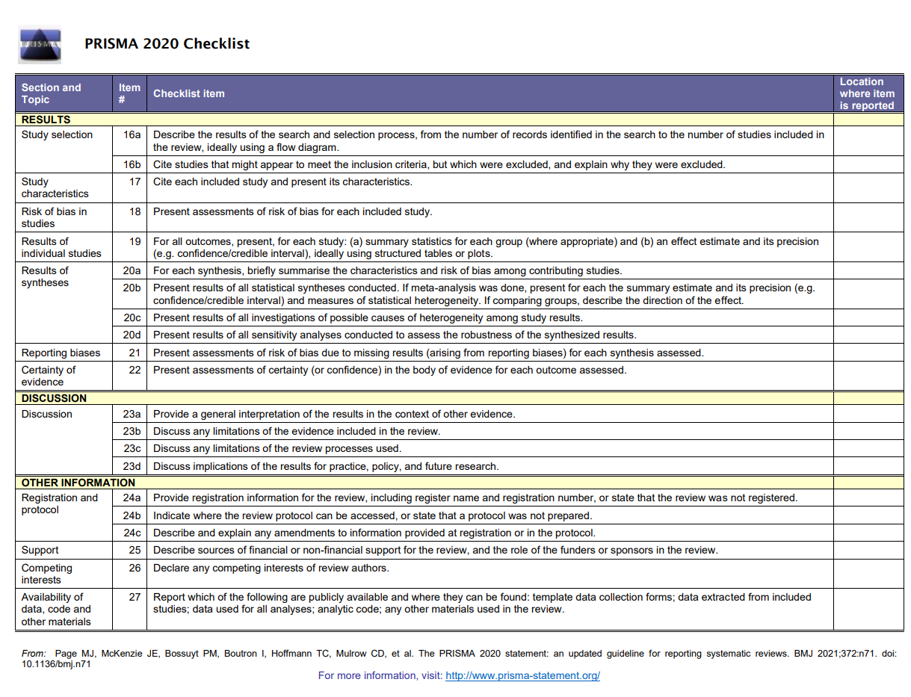
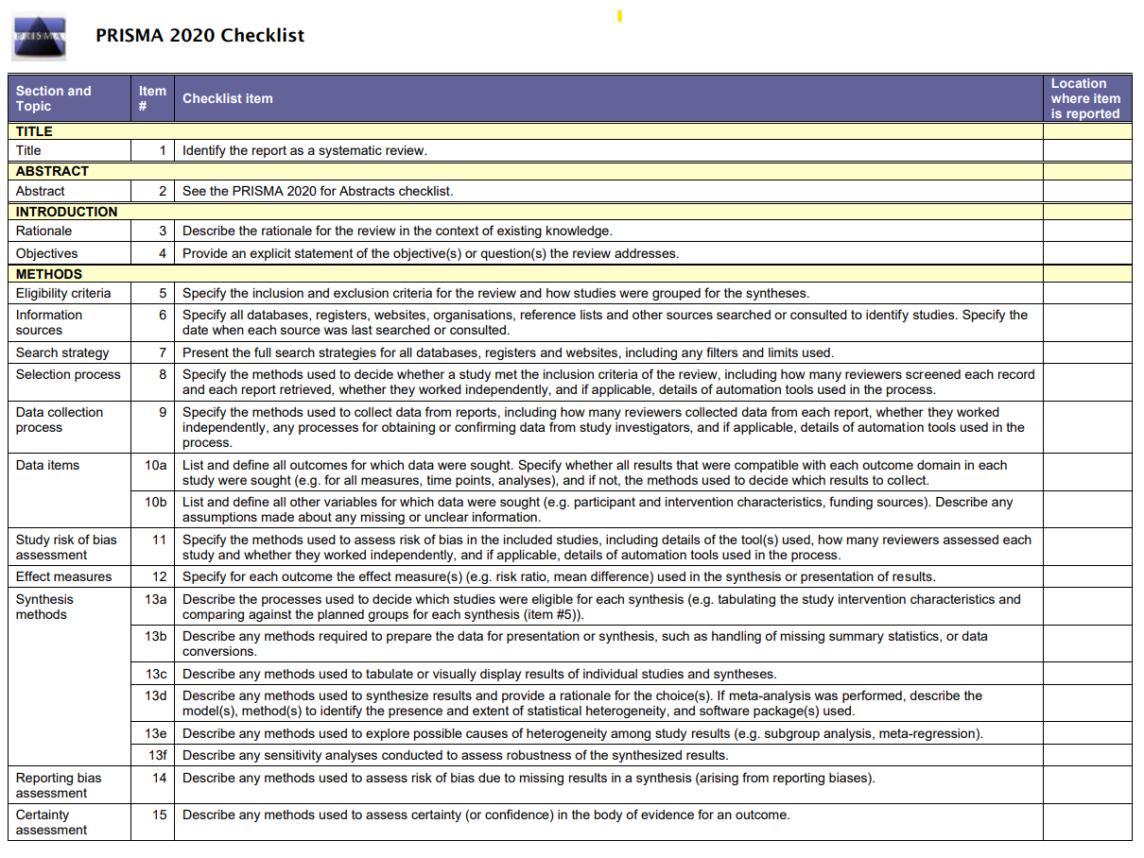
PRISMA Checklist
https://prisma-statement.org/documents/PRISMA_2020_checklist.pdf
How to Review Literature

Slide 41
PRISMA Items and Sections
There are 27 points in 7 sections in your checklist
  If you go through the checklist: you get your paper
PRISMA Sections:
  Title (Item #1)
  Abstract (Item #2)
  Introduction (Item #3-4)
  Method (Item #5-15)
  Results (Item #16-22)
  Discussion (Item #23)
  Other Information (Supplementary Material: Item #24-27)
https://www.prisma-statement.org/prisma-2020-checklist
How to Review Literature

Slide 42
PRISMA Items (1-4)
Title: Identify the report clearly as a systematic review, meta-analysis, or both, so readers can recognize its nature immediately.
    e.g., “The Effectiveness of Touch-Based Gesture Interactions: A Systematic Review”
Abstract: Provide a structured abstract that summarizes the key aspects: background, objectives, methods, results, and conclusions.
Rationale: Explain why the review was conducted and what research gap it aims to fill.
    e.g., “Despite widespread use of gesture-based interactions on touchscreens, there is limited synthesis of their actual effectiveness compared to traditional input methods.”
Objectives: Clearly state the specific research question(s) and the main objectives of the review.
    e.g., “To evaluate how touch-based gesture interactions affect user performance, satisfaction, and error rates across interactive systems, we conducted...”
https://www.prisma-statement.org/prisma-2020-checklist
How to Review Literature

Slide 43
PRISMA Items (5-9)
Eligibility criteria: Describe the inclusion and exclusion criteria for studies (e.g., population, intervention, outcome, study design).
    e.g., “Included empirical studies comparing touch-based gestures to other input modalities (e.g., tap, button, voice) in desktop, mobile, or public display contexts.”
Information sources: List all databases, registers, websites, and other sources used to identify studies, including the date of last search.
    e.g., “Searched ACM Digital Library, IEEE Xplore, and Web of Science from inception to April 2025.”
Search strategy: Provide a full search strategy (the “search query”!) for at least one database, allowing others to replicate it.
    e.g., “(gesture OR "touch gesture" OR "gesture interaction") AND (performance OR usability OR "user experience") AND (study OR experiment OR evaluation)”
https://www.prisma-statement.org/prisma-2020-checklist
How to Review Literature

Slide 44
PRISMA Items (8-10)
Selection process: Describe how studies were screened and selected, including how many reviewers were involved and how disagreements were resolved.
    e.g., “Two authors independently screened titles and abstracts, followed by full-text review; disagreements were resolved by discussion moderated by the third author.”
Data collection process: Explain how data were extracted from studies, by whom, and whether any automation tools were used.
    e.g., “ Extracted data included study design, gesture types, tasks, performance metrics, and user feedback.”
Data items: List and define all variables (e.g., keywords, terms, etc.) for which data were sought, including any assumptions or simplifications made.
    e.g., “Extracted data included study design, gesture types, tasks, performance metrics, and user feedback.”
https://www.prisma-statement.org/prisma-2020-checklist
How to Review Literature

Slide 45
PRISMA Items (11-14)
Study risk of bias assessment: Describe methods used to assess risk of bias.
    e.g., “Used a custom quality checklist adapted from HCI experimental design standards.”
Effect measures: Specify effect measures used for outcomes.
    e.g., “Reported mean differences in task time and error rate, and standardized effect sizes where available.”
Synthesis methods: Describe how data were synthesized and how heterogeneity was addressed.
    e.g., “A narrative synthesis was used due to heterogeneous tasks; OR: meta-analysis with random-effects models was conducted. OR a thematic analysis was conducted to extract the main categories.”
Reporting bias assessment: Describe how reporting bias was assessed.
    e.g., “Publication bias was explored using funnel plots and by comparing results across venues (journals vs. conferences).”
https://www.prisma-statement.org/prisma-2020-checklist
How to Review Literature

Slide 46
PRISMA Items (15-18)
Certainty assessment: Explain how the certainty of the evidence was judged.
    e.g., “Applied adapted GRADE criteria for HCI studies, considering consistency, precision, and study quality.”
Study selection: Report the number of studies screened, assessed, and included (ideally with a flow diagram).
    e.g., “Out of 1,280 records, 38 full-text studies were assessed; 14 studies met the inclusion criteria.”
Study characteristics: Present the characteristics of each included study.
    e.g., “Included studies ranged from lab experiments to field studies, with sample sizes between 12 and 96 participants.”
Risk of bias in studies: Summarize risk of bias across all included studies.
    e.g., “Common limitations included small sample sizes, lack of blinding, and inconsistent gesture training protocols.”
https://www.prisma-statement.org/prisma-2020-checklist
How to Review Literature

Slide 47
PRISMA Items (19-22)
Results of individual studies: Provide summary results for each study, ideally with confidence intervals.
    e.g., “Study A found gestures reduced task time by 15% compared to buttons (p < 0.05); Study B showed no significant difference.”
Results of syntheses: Present results of syntheses or meta-analyses.
    e.g., “Meta-analysis across 6 studies found a small but significant improvement in performance using gestures (Hedges’ g = 0.32, 95% CI: 0.10–0.55).”
Reporting biases: Present results of reporting bias assessments.
    e.g., “No clear evidence of publication bias was observed; however, funnel plot symmetry was limited by small sample sizes.”
Certainty of evidence: Summarize the certainty or confidence in the body of evidence for each outcome.
    e.g., “Overall certainty for performance outcomes rated moderate; low certainty for user satisfaction due to inconsistent measures.”
https://www.prisma-statement.org/prisma-2020-checklist
How to Review Literature

Slide 48
PRISMA Items (23-27)
Discussion: Interpret results in context of the literature, including strengths and limitations.
    e.g., Gesture interactions offer modest performance benefits in specific contexts but require careful design to avoid cognitive overload.
Limitations of the review processes: Describe limitations of the review process itself.
    e.g., Limited to English-language HCI studies and mostly academic publications; potential bias toward positive results.
Conclusions: Provide a general interpretation of the results and implications.
    e.g., “Touch-based gestures can enhance interaction in time-sensitive or spatial tasks, but are not universally superior.”
Funding: Disclose all funding sources and support.
Competing interests: Declare any potential conflicts of interest.
    e.g., “The authors declare no competing interests.”
https://www.prisma-statement.org/prisma-2020-checklist
How to Review Literature

Slide 49
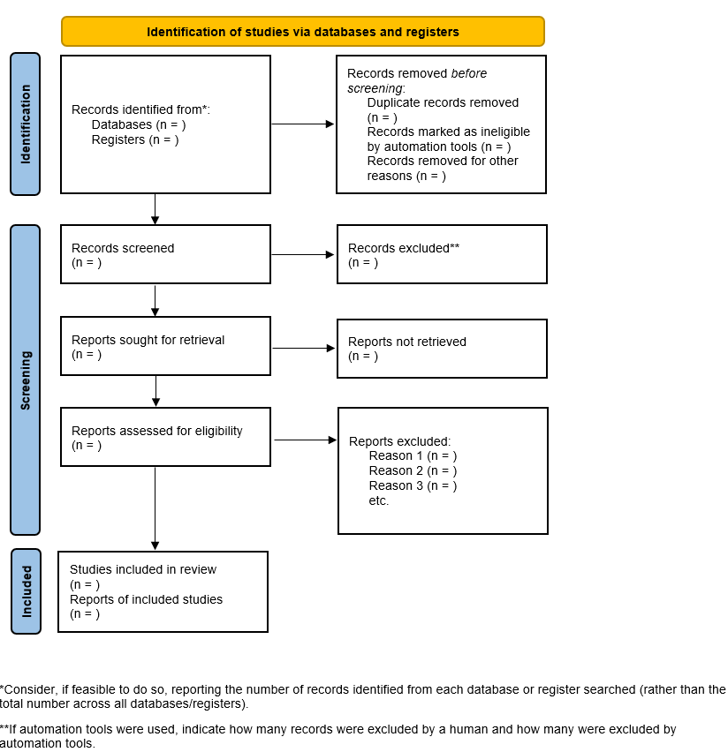
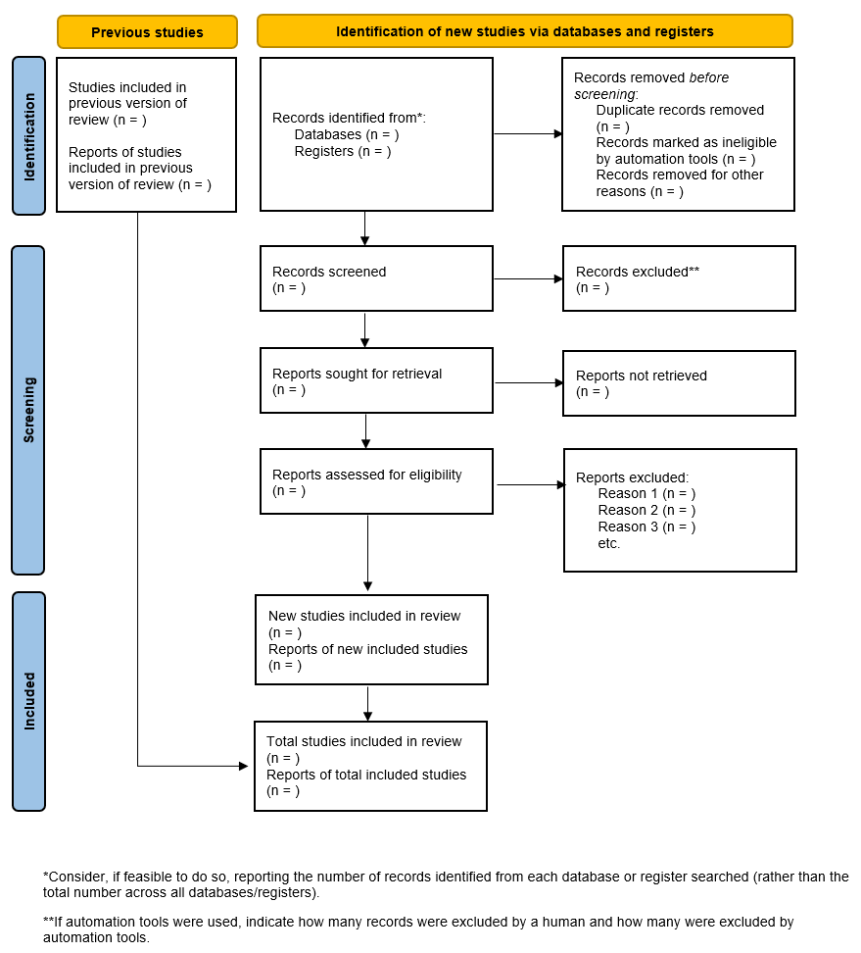
PRISMA Flow Diagram
https://prisma-statement.org/PRISMAStatement/FlowDiagram
How to Review Literature

Slide 50
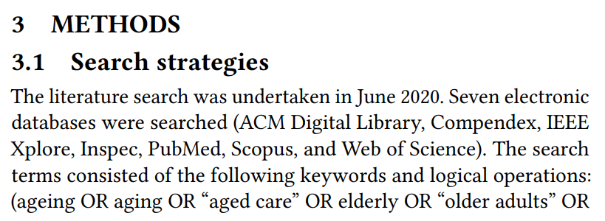
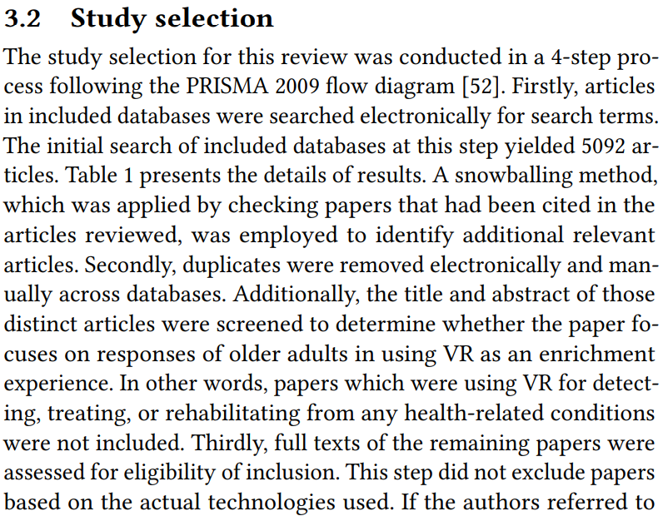
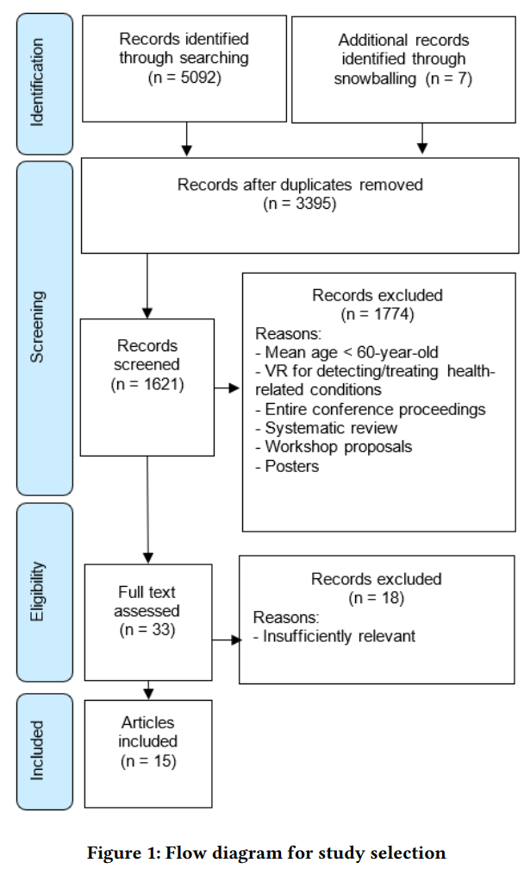
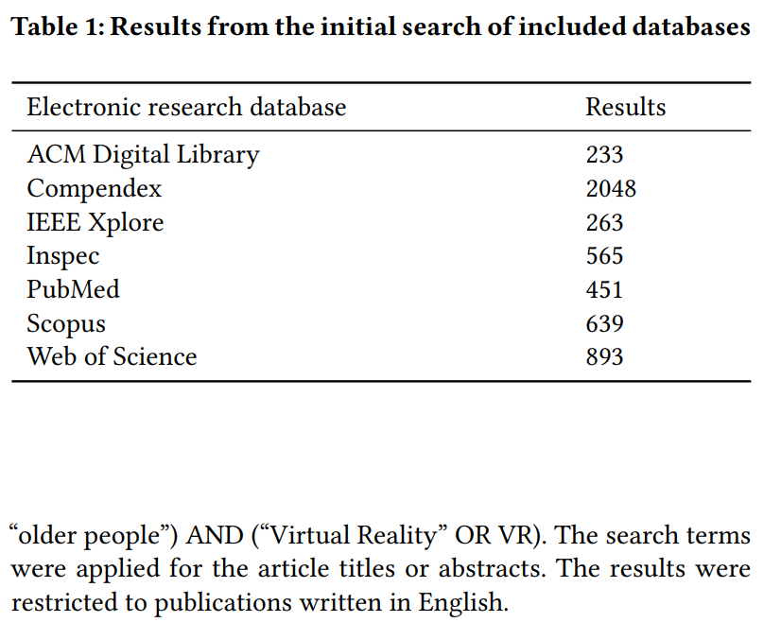
Example: Search Strategy & Study Selection: Example
Kong Saoane Thach, Reeva Lederman, and Jenny Waycott. 2020. How older adults respond to the use of Virtual Reality for enrichment: a systematic review. In Proceedings of the 32nd Australian Conference on Human-Computer Interaction (OzCHI '20). Association for Computing Machinery, New York, NY, USA, 303–313. https://doi.org/10.1145/3441000.3441003
How to Review Literature

Slide 51
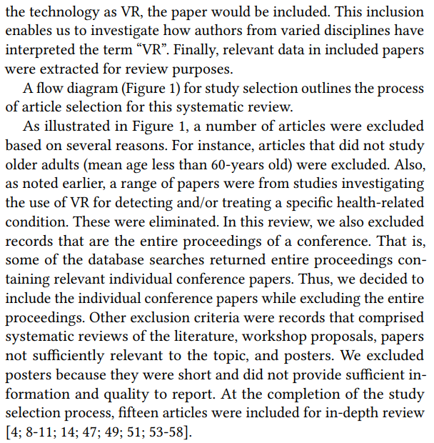
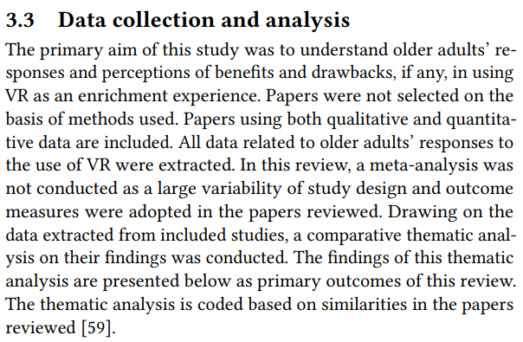
Example: Study Selection & Data Collection
Kong Saoane Thach, Reeva Lederman, and Jenny Waycott. 2020. How older adults respond to the use of Virtual Reality for enrichment: a systematic review. In Proceedings of the 32nd Australian Conference on Human-Computer Interaction (OzCHI '20). Association for Computing Machinery, New York, NY, USA, 303–313. https://doi.org/10.1145/3441000.3441003
How to Review Literature

Slide 52
Tasks
Projects with Empirical Papers
  Draft a section called „Related Work“: Add a narrative summary of the papers (the student approach)
Projects with Systematic Reviews (PRISMA)
  Define your protocol and search strategy: Clearly formulate your research question, specify inclusion/exclusion criteria, and document your full search queries across all databases.
  Use at least two independent reviewers for study selection and data extraction. Record reasons for exclusions and extract predefined data items consistently.
  Follow all 27 PRISMA items in your write-up. Include a flow diagram, summarize findings clearly, assess bias, and justify your conclusions based on the quality of evidence.
How to Read a Paper

Slide 53
References
https://www.scribbr.com/dissertation/literature-review/
Grant MJ, Booth A (June 2009). "A typology of reviews: an analysis of 14 review types and associated methodologies"
John Adams (1955), Research methods for graduate business and social science students
Phelps, Richard P. (2018). "To save the research literature, get rid of the literature review“
Cooper, Harris M. (1998). Synthesizing Research: A Guide for Literature Reviews. Applied Social Research Methods (3rd ed.). Thousand Oaks, California: SAGE Publications. ISBN 978-0761913481.
Bolderston, Amanda (2008). "Writing an Effective Literature Review". Journal of Medical Imaging and Radiation Sciences. 39 (2): 86–92.
How to Review Literature

