Slide 1

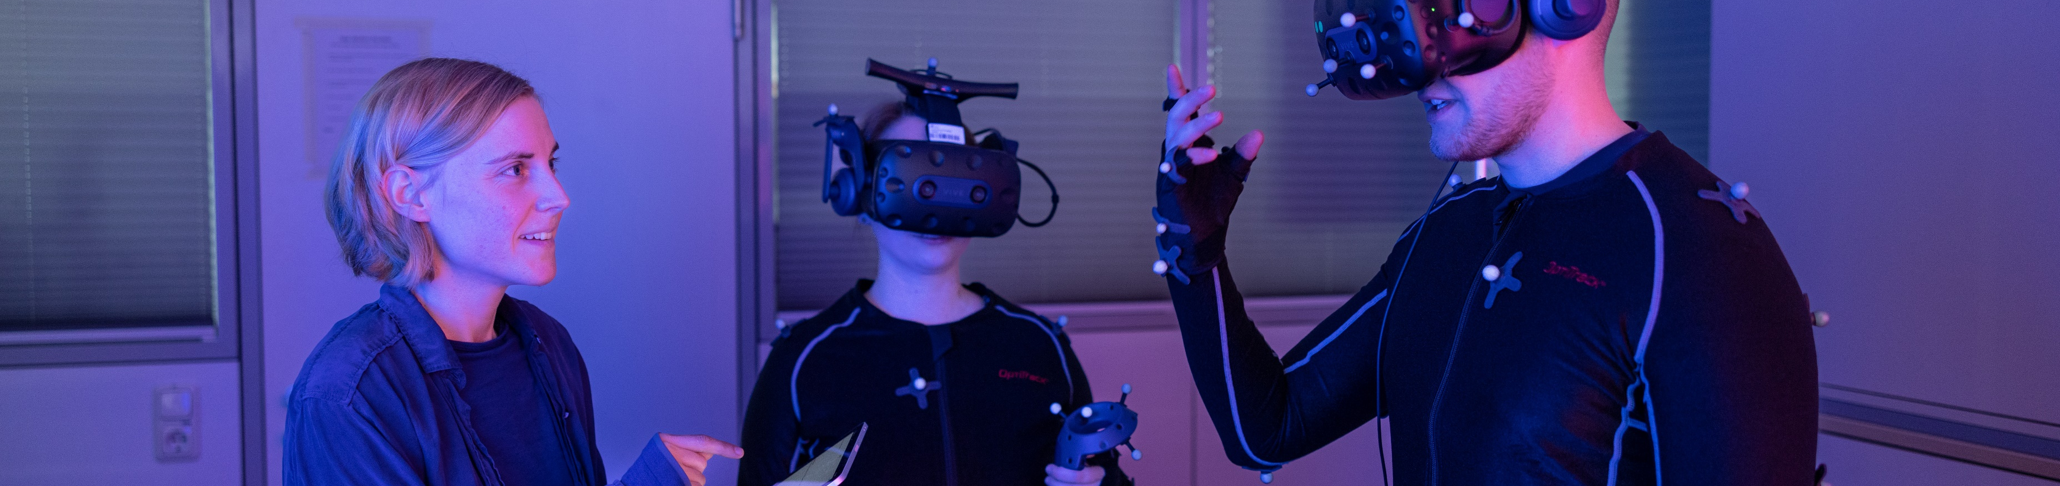

How to Conduct a User Study
Human-Computer Interaction Exercise
Image: Frankfurt University of Applied Sciences
The following content is licensed under a Creative Commons Attribution 4.0 International license (CC BY-SA 4.0)

Slide 2
Remember Your Method
How do you want to answer the research question?
Why is it the „best“ method to answer the research question?
Understand how your data must be collected
Planning needs:
Study Design (the important thing)
Stimuli/System/Prototype Creation (based on the factors changed)
Apparatus (the implemented testing system)
Tasks (hopefully a standardized one)
Procedure (the narrative of your plan)
Participants (this part can only be finished when the study is over)
Data Analyzes (filtering, transcription, etc.)
How to Conduct a User Study

Slide 3
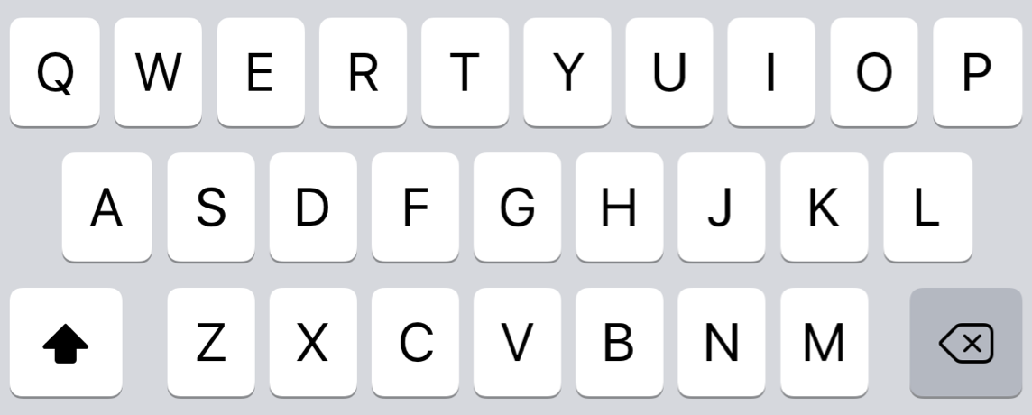

Recap: Swipe × Visual Feedback × Tactile Feedback
No Tactile Feedback
With Tactile Feedback
No Swipe
Swipe
No Swipe
Swipe
No Visual Feedback
No Visual Feedback
With Visual Feedback
With Visual Feedback
Quantitative or Qualitative?
How to Conduct a User Study

Slide 4
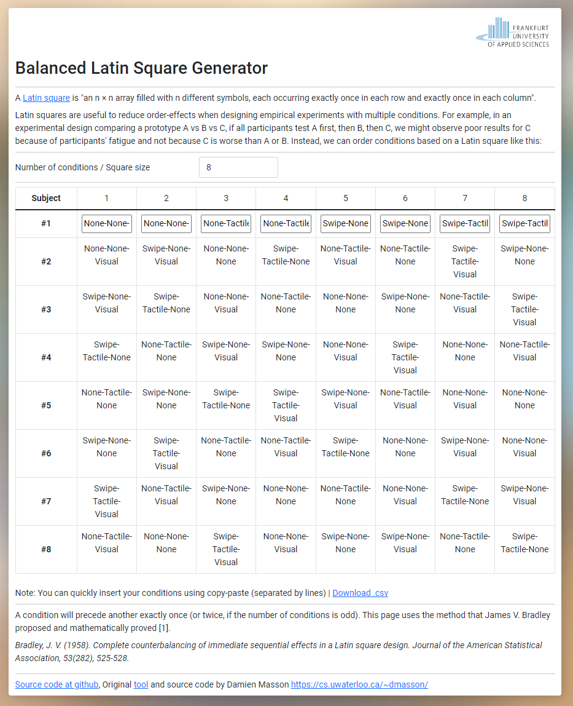
Plan your Study
Think about your independent and dependent variables
If you have some, use our tool to find your study plan
https://hci-studies.org/study-design-planner/
Enter your IVs and DVs
Adapt your number of conditions if necessary
What is your plan? How many participants do you need at least?
How to Conduct a User Study

Slide 5
Plan only the order
Think about your conditions
If you have some, use our tool to find your condition order
https://hci-studies.org/balanced-latin-square
Just enter your condition
Adapt your number of conditions if necessary
What is your plan? How many participants do you need at least?
Odd numbers need 2 latin squares
Save the plan
Download the CSV
How to Conduct a User Study

Slide 6
More about Planning
Latin Square Assignments: https://cs.uwaterloo.ca/~dmasson/tools/latin_square/
Block Plan (Permutation/Random) Assignments : http://www.jerrydallal.com/random/randomize.htm
More information on how to assign subjects: https://www.scribbr.com/methodology/experimental-design/
How to Conduct a User Study

Slide 7
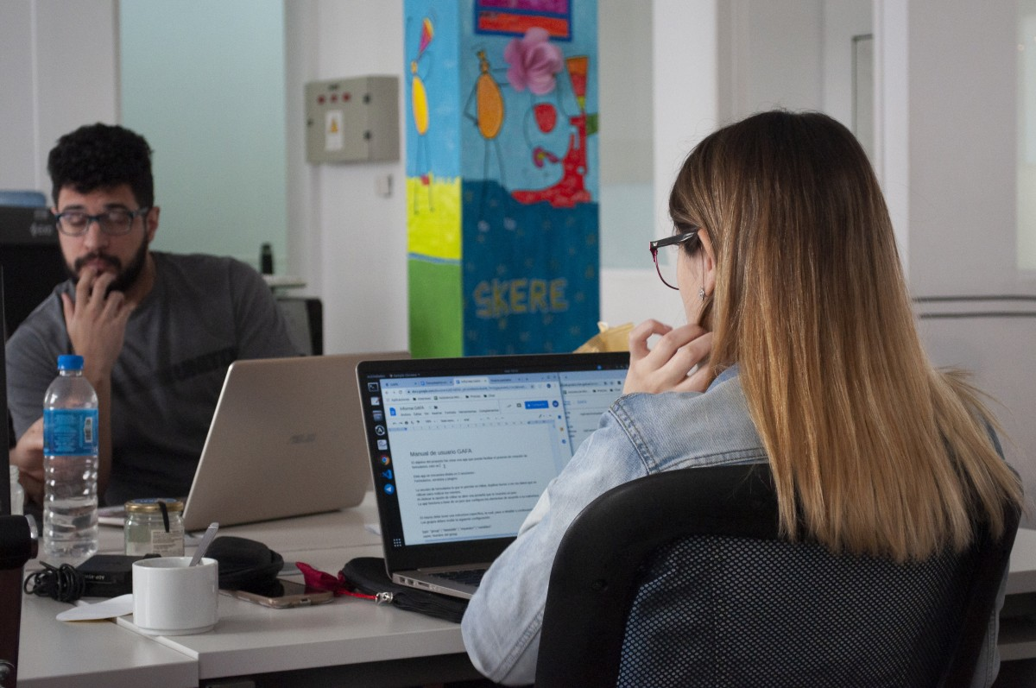
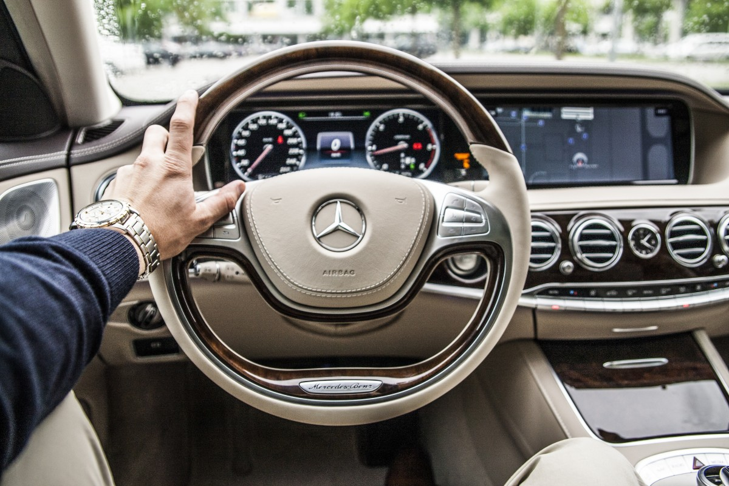
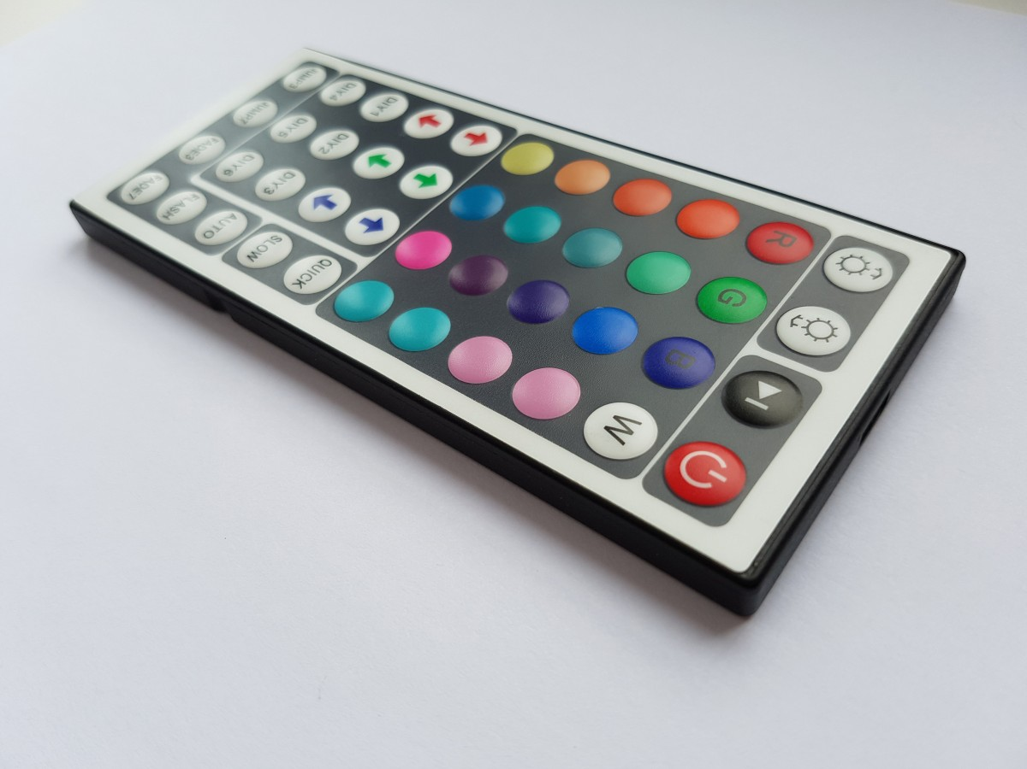

The Location
Lab
In Situ
Remote
Crowd
Images from: https://pxhere.com ID: 1599048, 718703, 802607, 700764
How to Conduct a User Study

Slide 8
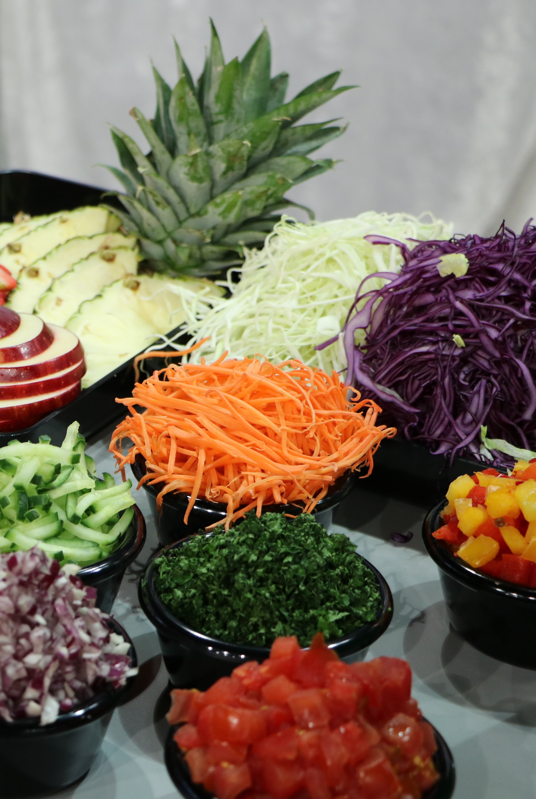
The Preparations
When we have a study design and a location, we can prepare the study…
There are 3 preparation phases:
Material (and location) check: final implementations, final setup, make sure that you have everything to run the experiment or survey, …
Pilot: test your apparatus with non-involved users (your supervisors, exercise members), final parameters, …
Recruitment phase: organization of participants, booking, invitation letter, …
Image from https://pxhere.com/de/photo/652278
How to Conduct a User Study

Slide 9
1. Material Check
1. Material Check
2. Pilot
3. Recruitment
Study Start
Check everything. Make things fix and safe. Be aware: after starting your experiment once, nothing can be changed anymore.
Ensure that the material of your study, system, or device are functioning properly
Finish your interview questions, questionnaires, material…
Make sure the location is safe and available
Last stakeholder meeting
Discuss fallback scenarios when things/users do random stuff
Discuss when the experimenter is supposed to intervene when the users are in trouble
Discuss inclusion/exclusion criteria for your participants with respect to your system/test/study
How to Conduct a User Study

Slide 10
2. Pilot
1. Material Check
2. Pilot
3. Recruitment
Study Start
The „dress rehearsal“ (dt. „Generalprobe“) of your study and carried out before large-scale research
A critical insight to the study design, recruitment, and sample size of participants
You can assess the statistical power and number of your participants needed
G-Power https://www.psychologie.hhu.de/arbeitsgruppen/allgemeine-psychologie-und-arbeitspsychologie/gpower
Test everything (Intro, Experiment, Debriefing) and assume that you have a real participant
After the pilot (and the feedback) you can adjust parameters
e.g., volume sound, length of the trials, parameters of your system
Pilot participants cannot participate in the study
How to Conduct a User Study

Slide 11

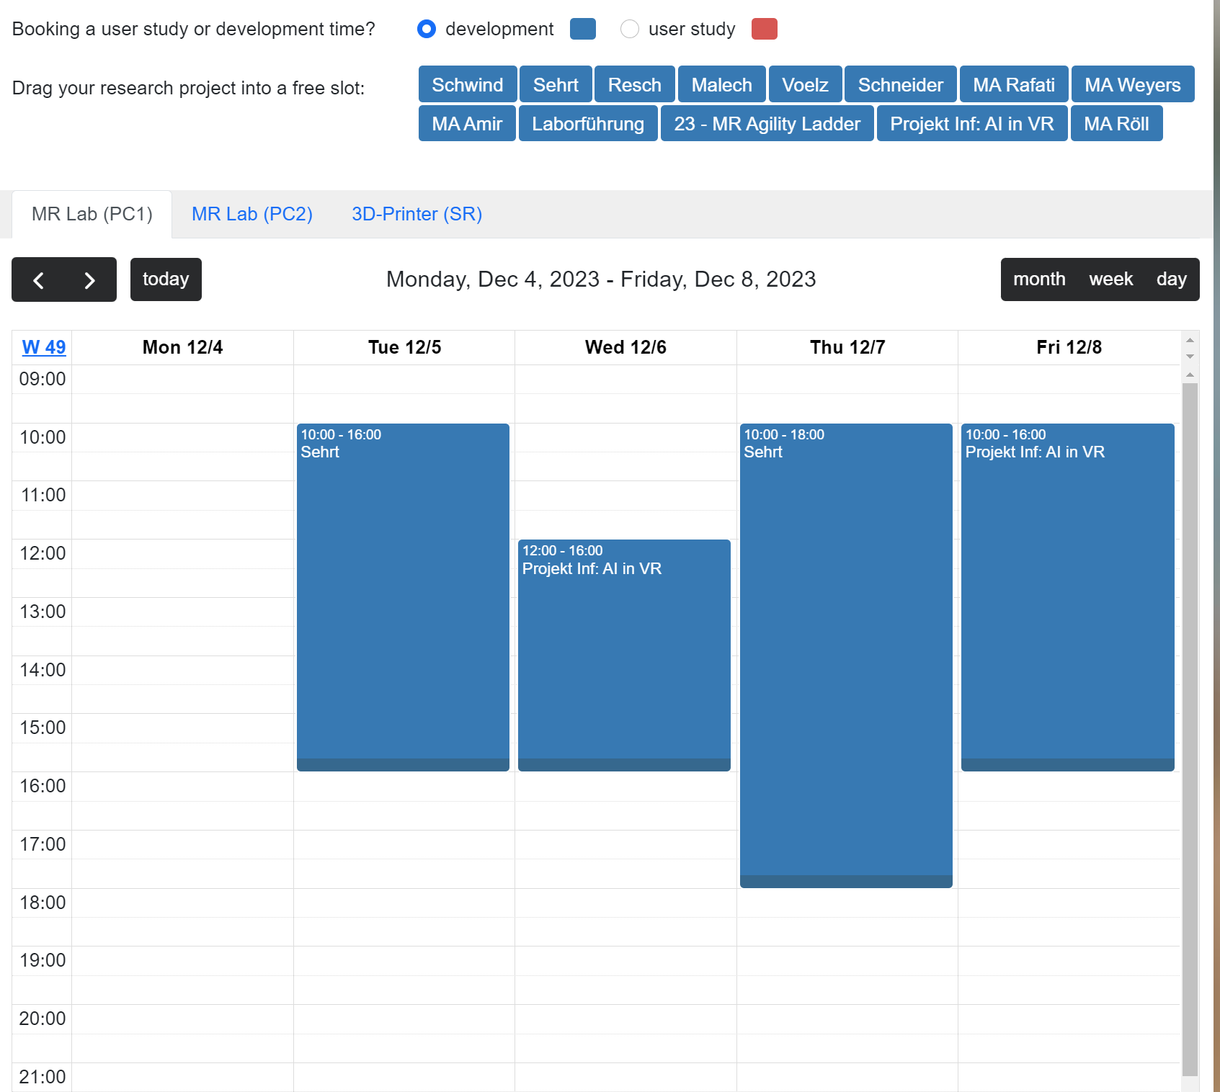
3. Recruitment
1. Material Check
2. Pilot
3. Recruitment
Study Start
Find your participants
course forum, advertising, mailing lists, social networks, crowdfunding (e.g., prolific.co)…
Find appointments
Book the Lab/Co-Working-Space/Printer
https://hci-studies.org/lab-booking-calendar/
Password + PIN on demand (write us!)
If not the lab:
https://doodle.de / https://terminplaner.dfn.de
Write your invitation letter
How to Conduct a User Study

Slide 12
The Invitation Letter
1. Material Check
2. Pilot
3. Recruitment
Study Start
Hi,
we are Tim, Malte, Jan und Isabela and we would like to invite you to participate in our research study on integration of EMG Bio-Feedback in Virtual Reality (VR)!
WHAT?
Our study consists in measuring the muscle response using EMG electrodes attached to the arm. The signals are used as input for a VR mini game to test different biofeedback methods (audio, visual and tactile).
HOW LONG?
The study duration is approximately 40 minutes for each participant (depending on your skill level 😉).
WHERE?
The study will take place in the House of Science and Transfer (HoST) building, second floor. However, you will be picked up at the entrance. Address: Hungener Str. 6, 60389 Frankfurt am Main Google-Maps: https://goo.gl/maps/wfBUJr6myFHGqyRt7
WHEN?
One slot between 27.07 and 06.08 between 10 AM and 6 PM - however, you can pick your own appointment in the Doodle poll provided below.
HOW TO REGISTER?
Please register in Doodle: https://doodle.com/meeting/participate/id/eElmGNNd Please book only one appointment per person. Please try to not leave any gaps, if possible - book appointments close to others. Further details about the event will be sent to you one week before the first appointment.
BIG REWARD!!!
As reward you will get 1 CP for the HMI lecture!!!!11eleven If you have any further questions, please reply on this post! Thank you very much! And see you in our study!
How to Conduct a User Study

Slide 13

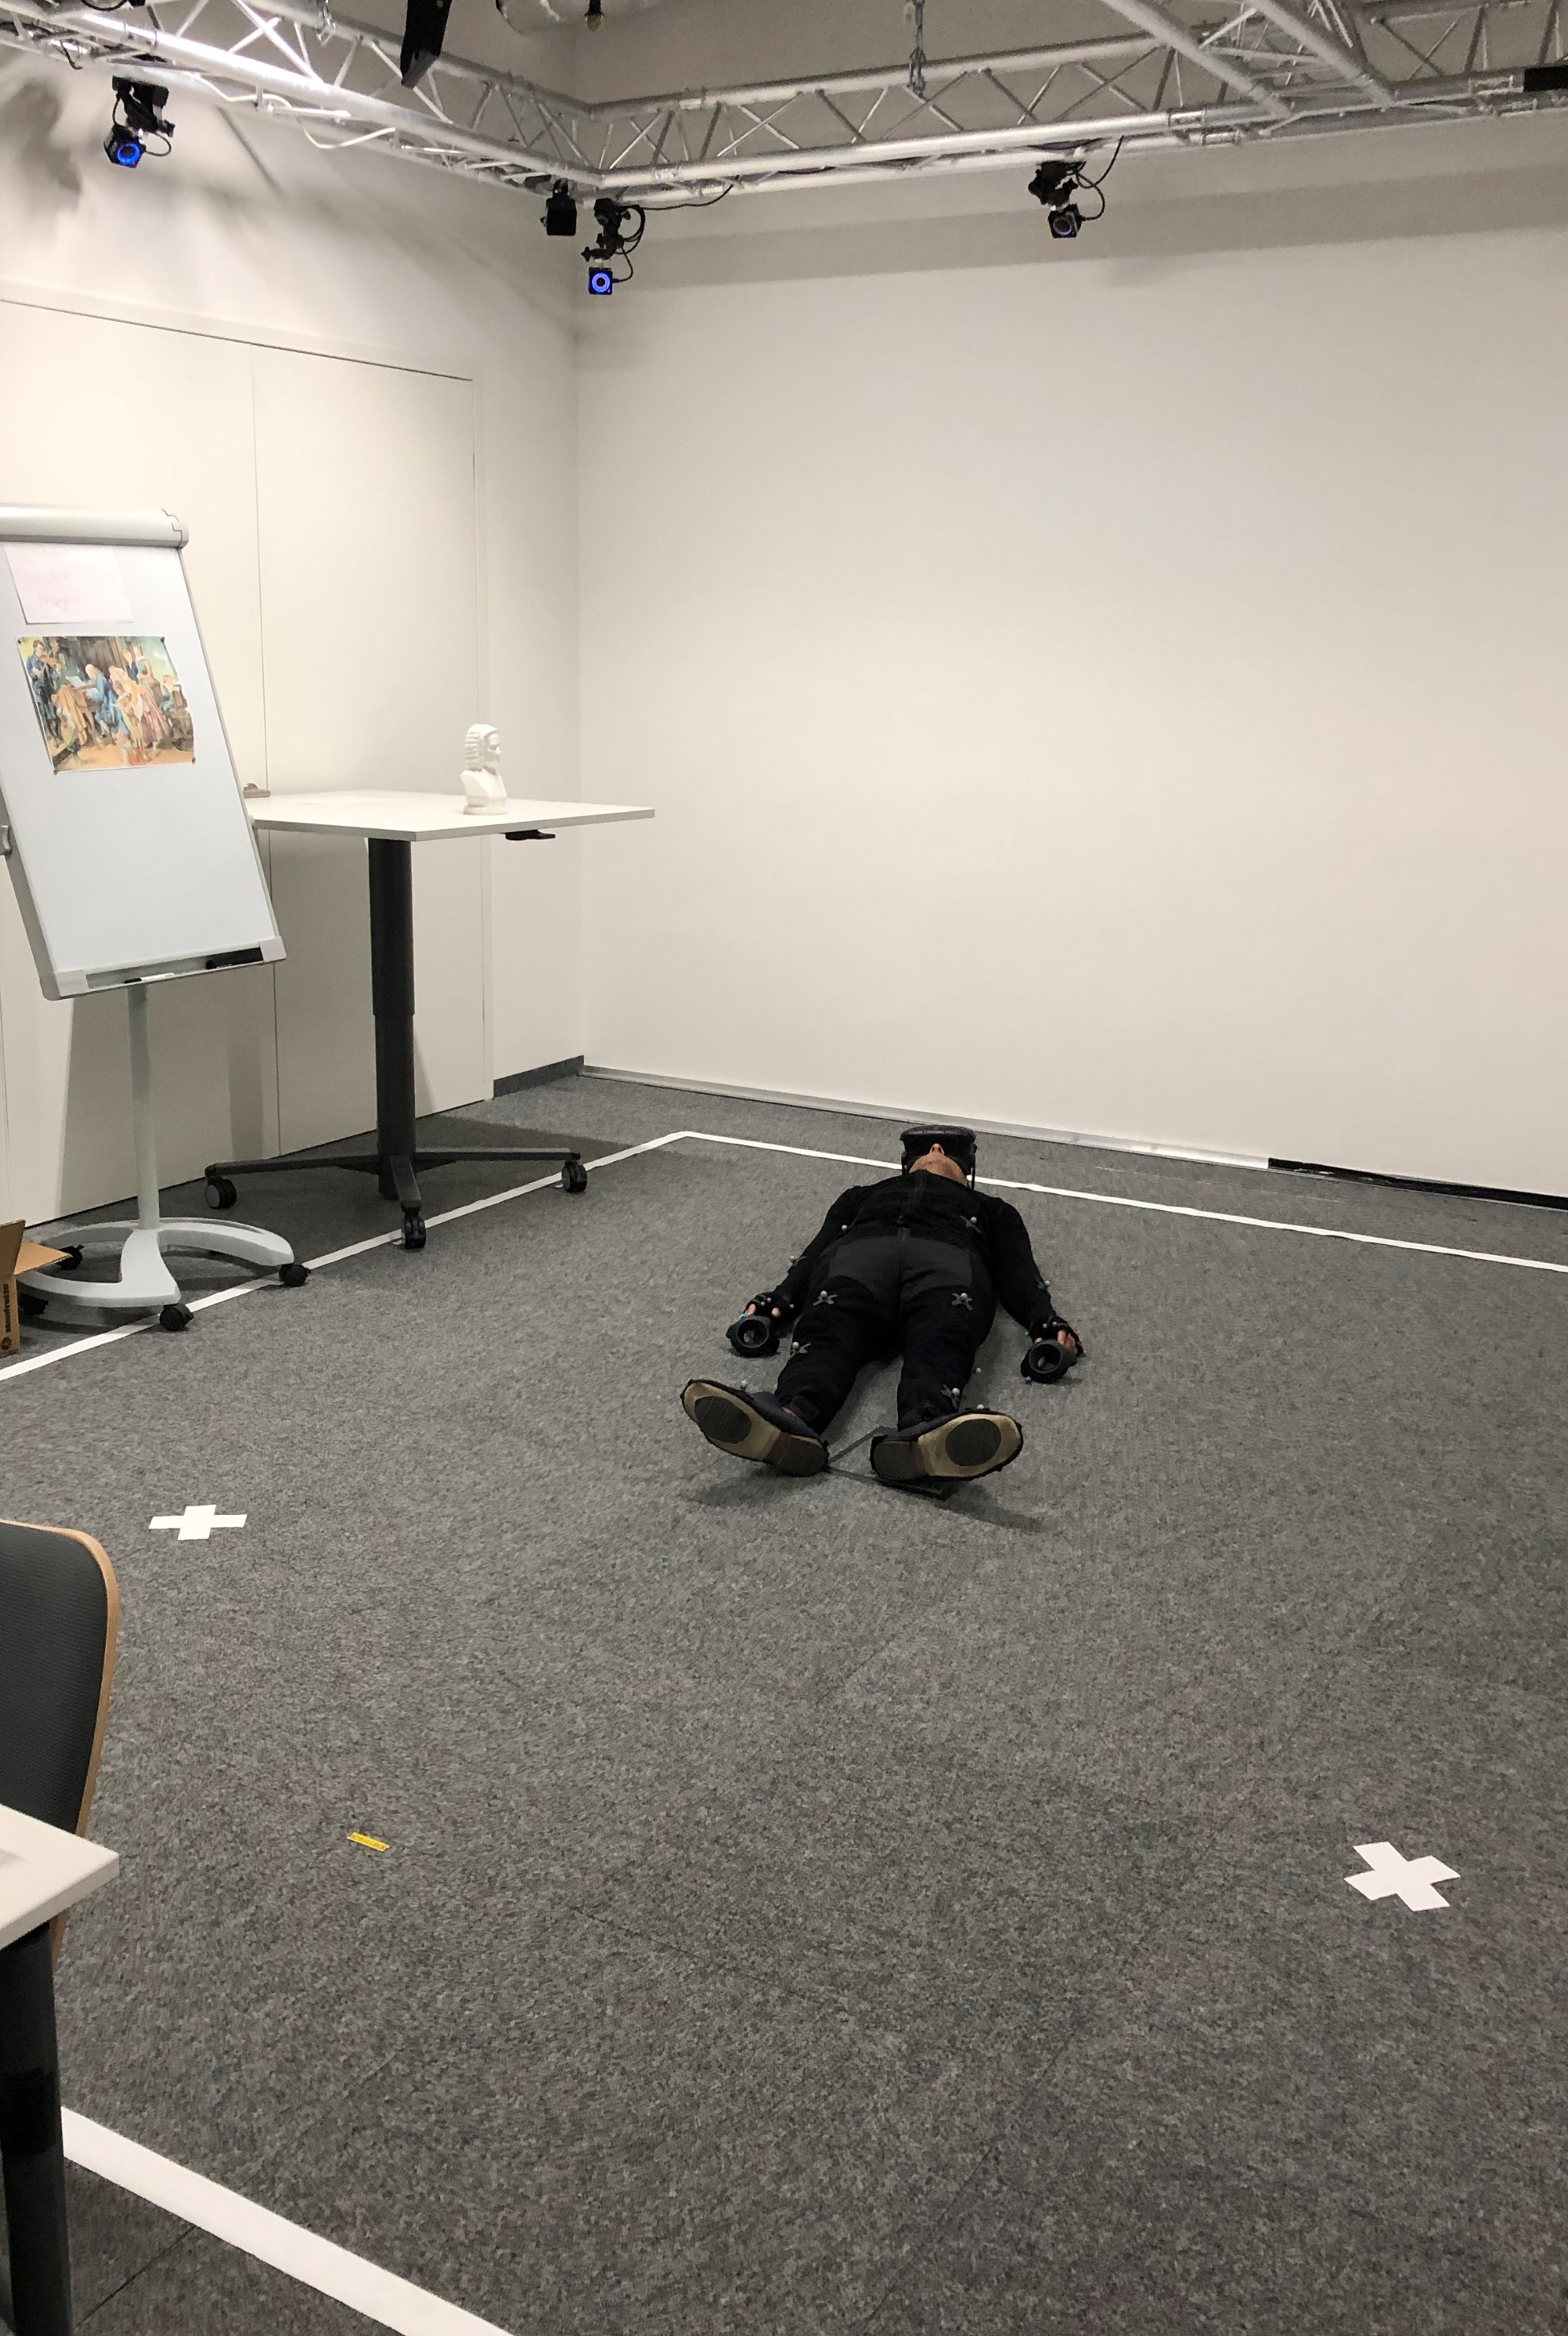
The Study
Study Start
1. Introduction
2. Experiment/ Survey
3. Debriefing
There are 3 study phases:
Introduction: Your participants are here! Give them
An explanation of the study
Their informed consent
Their demographic questionnaire
Experiment/Survey: Main part of your data collection…
Debriefing: Final question and answers, end of all records, participation confirmation…
Image from https://pxhere.com/de/photo/652278
How to Conduct a User Study

Slide 14
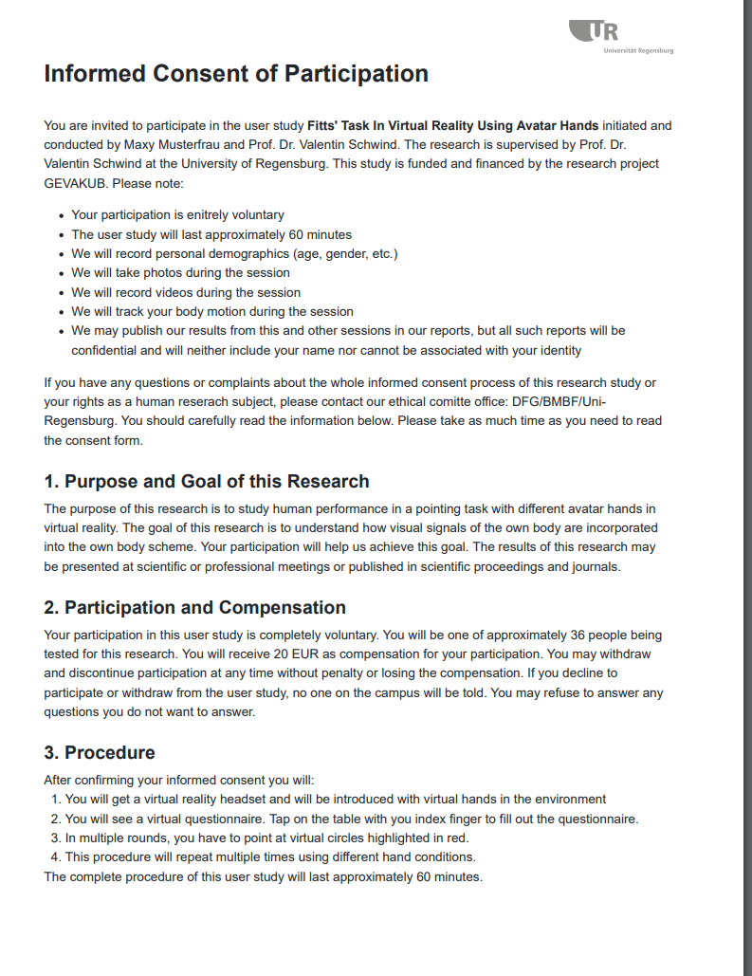
1. Introduction
Study Start
1. Introduction
2. Experiment/ Survey
3. Debriefing
Welcome the participant
„Only happy participants provide happy data“
In the lab: Inform about house rules, hygiene rules,…
Explain the purpose of the study
Give your subject the informed consent of participation
Give your subject the demographics questionnaire …
See Demographics: https://hci-studies.org/methods-and-measures/
Ask for the confounds…
Explain your study again, if necessary…
INFORMED WHAT???
How to Conduct a User Study

Slide 15
Informed Consent
Study Start
1. Introduction
2. Experiment/ Survey
3. Debriefing
A principle of science in ethics and law, that every subject (the user) must have sufficient information and understanding before making decisions about participating in a study
Valid informed consent in medicine has three components:
Disclosure requires the researcher to supply each prospective subject with the information necessary to make an autonomous decision and also to ensure that the subject adequately understands the information provided
Capacity pertains to the ability of the subject to both understand the information (signature)
Voluntariness refers to the subject's right to freely exercise his/her decision
INFORMED WHAT???
How to Conduct a User Study

Slide 16
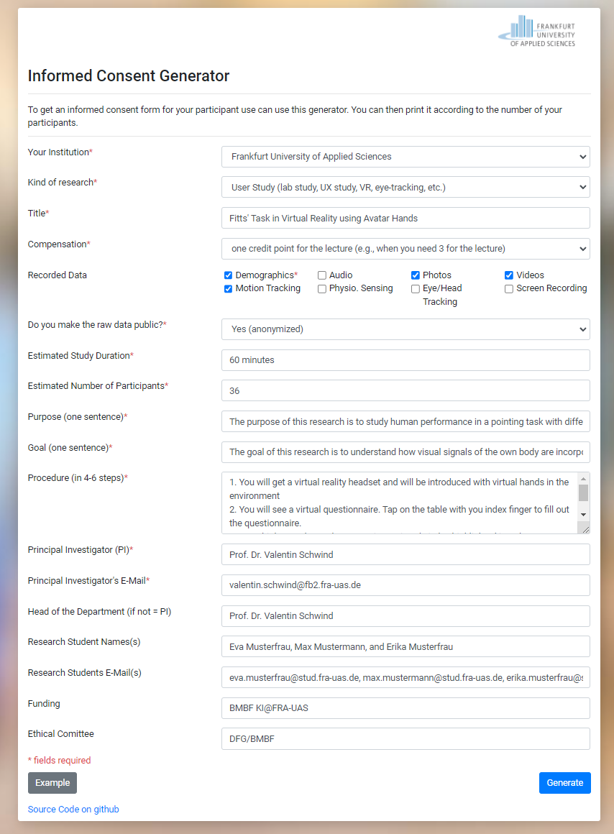
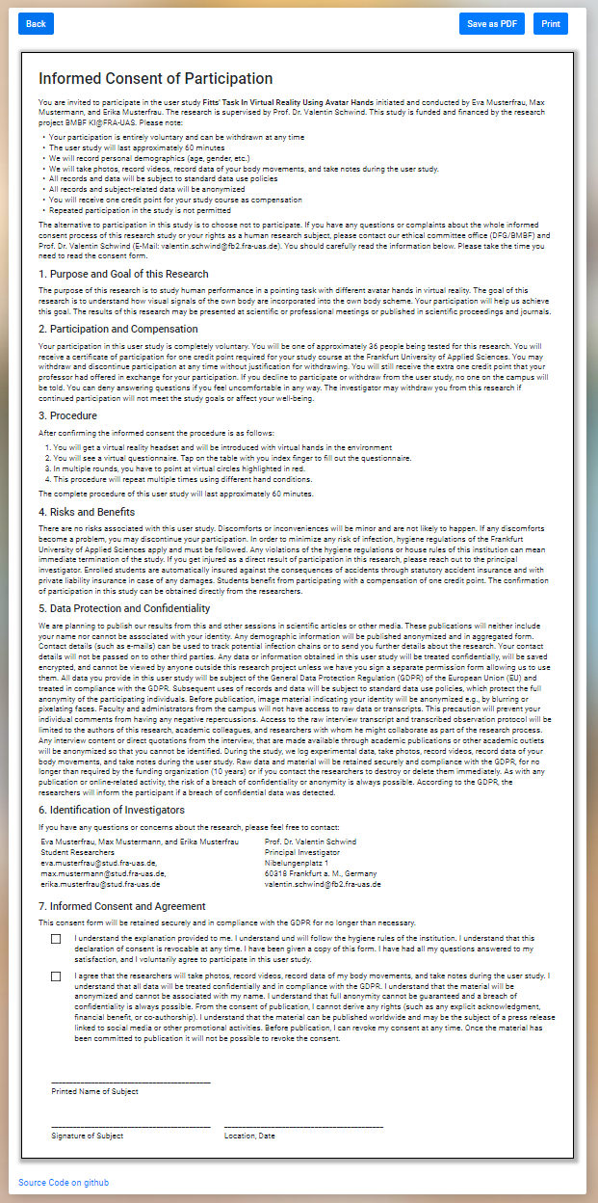
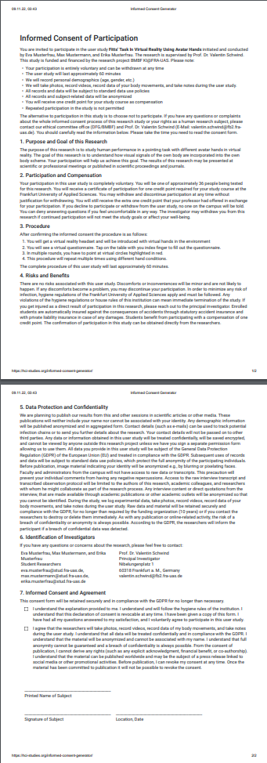
Informed Consent
Study Start
1. Introduction
2. Experiment/ Survey
3. Debriefing
Use the informed consent generator
https://hci-studies.org/informed-consent-generator/
Fill in all fields
Click on generate
Read the result
Check and adapt if necessary
Proceed…
Generate
Print
How to Conduct a User Study

Slide 17
Demographics
Study Start
1. Introduction
2. Experiment/ Survey
3. Debriefing
Gender: male, female, other, do not want do specify
Nationality: Afghanistan … Zimbabe → Click here, if you like to have all countries
Academic degree: None, Primary, Secondy, High school, Vocational, Bachelor, Master, Doctoral
Occupation: Management, Natural Sciences, Engineering, Health, Law & Order, Clerical, Health, Spiritual, Humanities, Services & Sales, Agrictulture & Food, Craft, Military, Others
Age: Numbers (not groups!)
What could be relevant for your research? Discuss your covariates…
How to Conduct a User Study

Slide 18
2. Experiment/Survey
Study Start
1. Introduction
2. Experiment/ Survey
3. Debriefing
 | Condition 1 | Condition 2 | Condition 3 | Condition 4 | Condition 5 | Condition 6 | Condition 7 | Condition 8
Participant #1 | None-None-None | None-None-Visual | None-Tactile-None | None-Tactile-Visual | Swipe-None-None | Swipe-None-Visual | Swipe-Tactile-None | Swipe-Tactile-Visual
Participant #2 | None-None-Visual | None-Tactile-Visual | None-None-None | Swipe-None-Visual | None-Tactile-None | Swipe-Tactile-Visual | Swipe-None-None | Swipe-Tactile-None
Participant #3 | None-Tactile-Visual | Swipe-None-Visual | None-None-Visual | Swipe-Tactile-Visual | None-None-None | Swipe-Tactile-None | None-Tactile-None | Swipe-None-None
Participant #4 | Swipe-None-Visual | Swipe-Tactile-Visual | None-Tactile-Visual | Swipe-Tactile-None | None-None-Visual | Swipe-None-None | None-None-None | None-Tactile-None
Participant #5 | Swipe-Tactile-Visual | Swipe-Tactile-None | Swipe-None-Visual | Swipe-None-None | None-Tactile-Visual | None-Tactile-None | None-None-Visual | None-None-None
Participant #6 | Swipe-Tactile-None | Swipe-None-None | Swipe-Tactile-Visual | None-Tactile-None | Swipe-None-Visual | None-None-None | None-Tactile-Visual | None-None-Visual
Participant #7 | Swipe-None-None | None-Tactile-None | Swipe-Tactile-None | None-None-None | Swipe-Tactile-Visual | None-None-Visual | Swipe-None-Visual | None-Tactile-Visual
Participant #8 | None-Tactile-None | None-None-None | Swipe-None-None | None-None-Visual | Swipe-Tactile-None | None-Tactile-Visual | Swipe-Tactile-Visual | Swipe-None-Visual
Repeat X-times
How to Conduct a User Study

Slide 19
Procedure
Study Start
1. Introduction
2. Experiment/ Survey
3. Debriefing
 | Condition 1 | Condition 2 | Condition 3
Participant #1 | None-None-None | None-None-Visual | None-Tactile-None
Questionnaires
Questionnaires
Questionnaires
Informed Consent
Demo-graphics
Condition 7 | Condition 8
Swipe-Tactile-None | Swipe-Tactile-Visual
Post experiment questionnaire
Time
Questionnaires
Questionnaires
How to Conduct a User Study

Slide 20
Custom Questionnaires
Study Start
1. Introduction
2. Experiment/ Survey
3. Debriefing
Questionnaires are subjective measures to get information about attitudes of people. They provide important qualitative and quantitative data:
Quantitative (“closed-ended“)
Dichotomous Items: Yes/No, True/False, Agree/Disagree ☑
Rank Order Items: e.g., sort from best to worst, 
Rating Items:
Semantic scales
Visual/Numeric rating scales
Likert scales
Qualitative (“open-ended”)
Open-ended responses („What do you see as more positive about the device?“)
How to Conduct a User Study

Slide 21
Custom Questionnaires
Study Start
1. Introduction
2. Experiment/ Survey
3. Debriefing
Questionnaires are subjective measures to get information about attitudes of people. They provide important qualitative and quantitative data:
Quantitative (“closed-ended“)
Dichotomous Items: Yes/No, True/False, Agree/Disagree ☑
Rank Order Items: e.g., sort from best to worst, 
Rating Items:
Semantic scales
Visual/Numeric rating scales
Likert scales
Qualitative (“open-ended”)
Open-ended responses („What do you see as more positive about the device?“)
Not recommended for statistical evaluation
Recommended for statistical evaluation
How to Conduct a User Study

Slide 22
Dichotomous Items
Study Start
1. Introduction
2. Experiment/ Survey
3. Debriefing
Please check, if yes
I would be concerned if the device would turn on the camera at any time | □
I noticed that the device turned the camera on | □
I would benefit from more training to learn how to use the device | □
I am skilled enough to use the device | □
15 participants = 15 data samples:
less meaningful,
no measure of variance, low validity.
How to Conduct a User Study

Slide 23

Rank Order Items
Study Start
1. Introduction
2. Experiment/ Survey
3. Debriefing
Please rank the following aspects of your mobile phone in order of importance to you, with 1 being the most important and 5 being the least important
1. Battery Life | ⬇
2. Camera Quality | ⬆⬇
3. Storage Capacity | ⬆⬇
4. Screen Size | ⬆⬇
5. Processor Speed | ⬆
Too many possibilities of sorting. No way to evaluate that.
How to Conduct a User Study

Slide 24
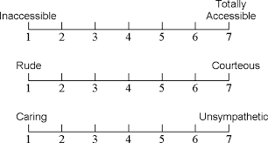
Semantic Differentials
Study Start
1. Introduction
2. Experiment/ Survey
3. Debriefing
Please evaluate the characteristics of the device by placing a mark on the line closest to your experience:
uncaring? cruel?
Don‘t do it by yourself
How to Conduct a User Study

Slide 25
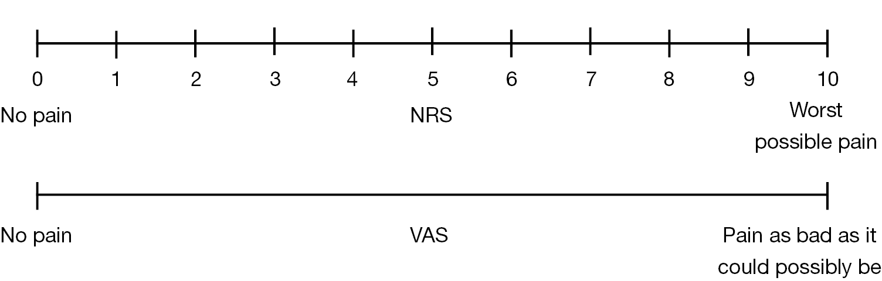
NRS/VAS Items
Study Start
1. Introduction
2. Experiment/ Survey
3. Debriefing
Numeric rating scales (NRS) and visual analogue scales (NRS), example: pain
Results of numeric rating and visual analogue scales correlate but do work not in parallel (they have different modes) [1]
Work written and orally
Only work written
Bielewicz, J., Daniluk, B., & Kamieniak, P. (2022). VAS and NRS, same or different? Are visual analog scale values and numerical rating scale equally viable tools for assessing patients after microdiscectomy?. Pain Research and Management, 2022.
How to Conduct a User Study

Slide 26
Likert Scale Items
Study Start
1. Introduction
2. Experiment/ Survey
3. Debriefing
Psychologists found that the least biased way to obtain a subjective measure on a rating scale is providing a set of statements based on response anchors
The most famous rating scales is the Likert scale [1]
If an app could turn on the camera at any time, I would be: [ ] Not at all concerned, [ ] Slightly concerned, [ ] Somewhat concerned, [ ] Moderately concerned, [ ] Extremely concerned
…or better:
To which extend to you agree with the statement that you would be concerned if an app could turn on the camera at any time: [ ] I strongly disagree, [ ] I disagree, [ ] Neither agree nor disagree, [ ] I agree, [ ] I strongly agree
…the more points you have, the easier to evaluate:
We prefer 7-point Likert scales asking for extent and agreement!
Likert, Rensis (1932). "A Technique for the Measurement of Attitudes". Archives of Psychology. 140: 1–55.
How to Conduct a User Study

Slide 27
Likert Scale Items
Study Start
1. Introduction
2. Experiment/ Survey
3. Debriefing
To which extend to you agree or disagree with the statement: | I completely disagree | I disagree | I somewhat disagree | Neither agree nor disagree | I somewhat agree | I agree | I completely agree
I would be concerned if the device would turn on the camera at any time | ○ | ○ | ○ | ○ | ○ | ○ | ○
I noticed that the device turned the camera on | ○ | ○ | ○ | ○ | ○ | ○ | ○
I would benefit from more training to learn how to use the device | ○ | ○ | ○ | ○ | ○ | ○ | ○
I am skilled enough to use the device | ○ | ○ | ○ | ○ | ○ | ○ | ○
Likert, Rensis (1932). "A Technique for the Measurement of Attitudes". Archives of Psychology. 140: 1–55.
How to Conduct a User Study

Slide 28
Likert Scale Items
Study Start
1. Introduction
2. Experiment/ Survey
3. Debriefing
To which extend to you agree or disagree with the statement: | I completely disagree | I disagree | I somewhat disagree | Neither agree nor disagree | I somewhat agree | I agree | I completely agree
I would be concerned if the device would turn on the camera at any time | ○ | ○ | ○ | ○ | ○ | ○ | ○
I noticed that the device turned the camera on | ○ | ○ | ○ | ○ | ○ | ○ | ○
I would benefit from more training to learn how to use the device | ○ | ○ | ○ | ○ | ○ | ○ | ○
I am skilled enough to use the device | ○ | ○ | ○ | ○ | ○ | ○ | ○
Likert, Rensis (1932). "A Technique for the Measurement of Attitudes". Archives of Psychology. 140: 1–55.
Response anchors
How to Conduct a User Study

Slide 29
Likert Scale Items
Study Start
1. Introduction
2. Experiment/ Survey
3. Debriefing
To which extend to you agree or disagree with the statement: | I completely disagree | I disagree | I somewhat disagree | Neither agree nor disagree | I somewhat agree | I agree | I completely agree
I would be concerned if the device would turn on the camera at any time | ○ | ○ | ○ | ○ | ○ | ○ | ○
I noticed that the device turned the camera on | ○ | ○ | ○ | ○ | ○ | ○ | ○
I would benefit from more training to learn how to use the device | ○ | ○ | ○ | ○ | ○ | ○ | ○
I am skilled enough to use the device | ○ | ○ | ○ | ○ | ○ | ○ | ○
Likert, Rensis (1932). "A Technique for the Measurement of Attitudes". Archives of Psychology. 140: 1–55.
1
<
2
<
3
<
4
<
5
<
6
<
7
The scale has an order and every anchor can have a numeric value!
How to Conduct a User Study

Slide 30
Likert Scale Items
Study Start
1. Introduction
2. Experiment/ Survey
3. Debriefing
To which extend to you agree or disagree with the statement: | I completely disagree | I disagree | I somehwat disagree | Neither agree nor disagree | I somewhat agree | I agree | I completely agree
I would be concerned if the device would turn on the camera at any time | ○ | ○ | ○ | ○ | ○ | ○ | ○
I noticed that the device turned the camera on | ○ | ○ | ○ | ○ | ○ | ○ | ○
I would benefit from more training to learn how to use the device | ○ | ○ | ○ | ○ | ○ | ○ | ○
I am skilled enough to use the device | ○ | ○ | ○ | ○ | ○ | ○ | ○
Thus, You can easily compare and evaluate them!
How to Conduct a User Study

Slide 31
Likert Scale Items
Study Start
1. Introduction
2. Experiment/ Survey
3. Debriefing
To which extend to you agree or disagree with the statement: | I completely disagree | I disagree | I somewhat disagree | Neither agree nor disagree | I somewhat agree | I agree | I completely agree
I am satisfied with using the product. | ○ | ○ | ○ | ○ | ○ | ○ | ○
I enjoyed using the product. | ○ | ○ | ○ | ○ | ○ | ○ | ○
Concept: Agreement in Satisfaction
You always need a concept
(here: agreement in something)
Concept: Agreement in Enjoyment
How to Conduct a User Study

Slide 32
Likert Scale Items
Study Start
1. Introduction
2. Experiment/ Survey
3. Debriefing
Likert scales are most useful when you are measuring subjective concepts
In addition to measuring the level of agreement on something, Likert scales can also measure other spectrums, such as frequency, satisfaction, or importance.
Agreement | Frequency | Satisfaction | Difficulty | Importance | Quality | Reflection
Strongly disagree Disagree Somewhat disagree Neither agree nor disagree Somewhat agree Agree Strongly agree | Never Rarely Occasionally Sometimes Frequently Usually Always | Very dissatisfied Dissatisfied Slightly dissatisfied Neutral Slightly satisfied Satisfied Very satisfied | Very easy Easy Somewhat easy Neutral Somewhat hard Hard Very hard | Very unimportant Unimportant Rather unimportant Neutral Rather important Important Very important | Very poor Poor Below average Average Above Average Good Excellent | Very untrue of me Untrue of me Somewhat untrue of me Neutral Somewhat true of me True of me Very true of me
How to Conduct a User Study

Slide 33
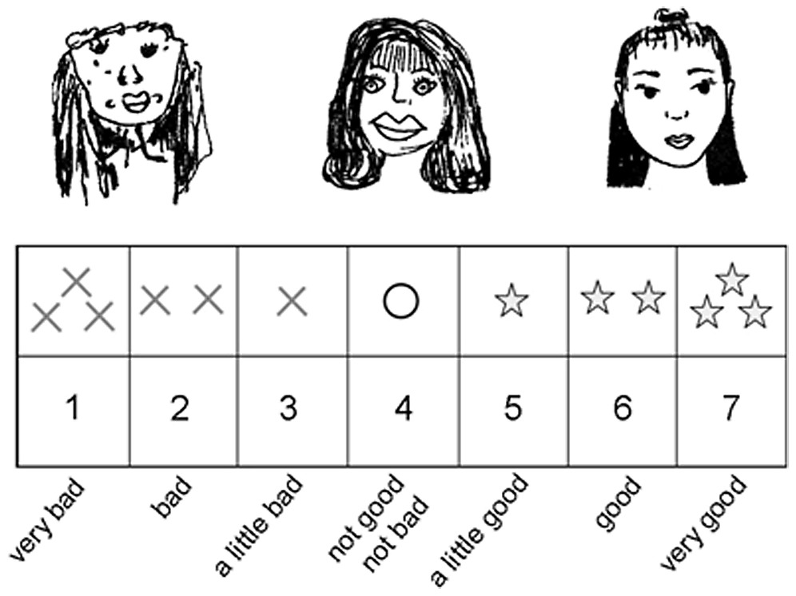
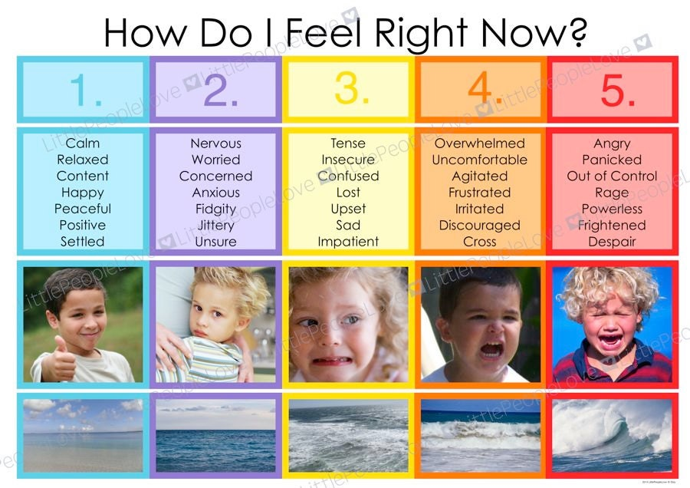
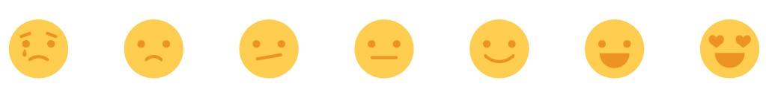
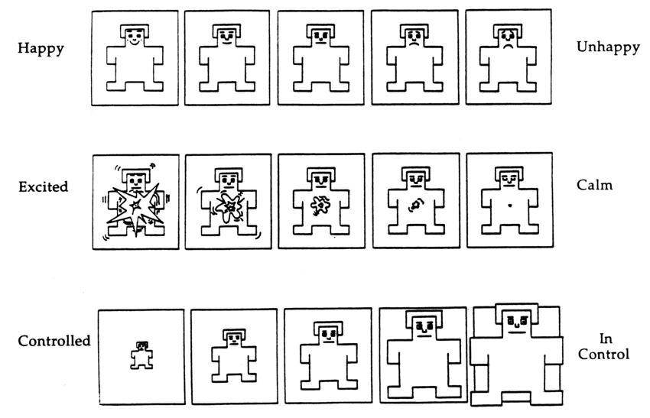
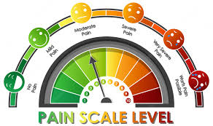

Other Items
Study Start
1. Introduction
2. Experiment/ Survey
3. Debriefing
Yes. It‘s a standardized Questionnaire :)
How to Conduct a User Study

Slide 34
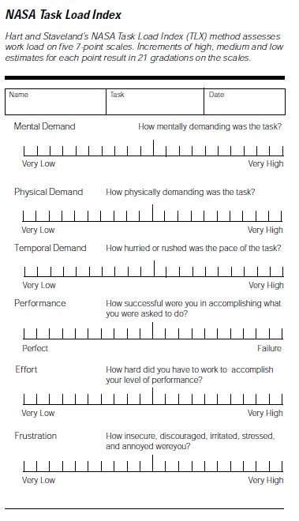
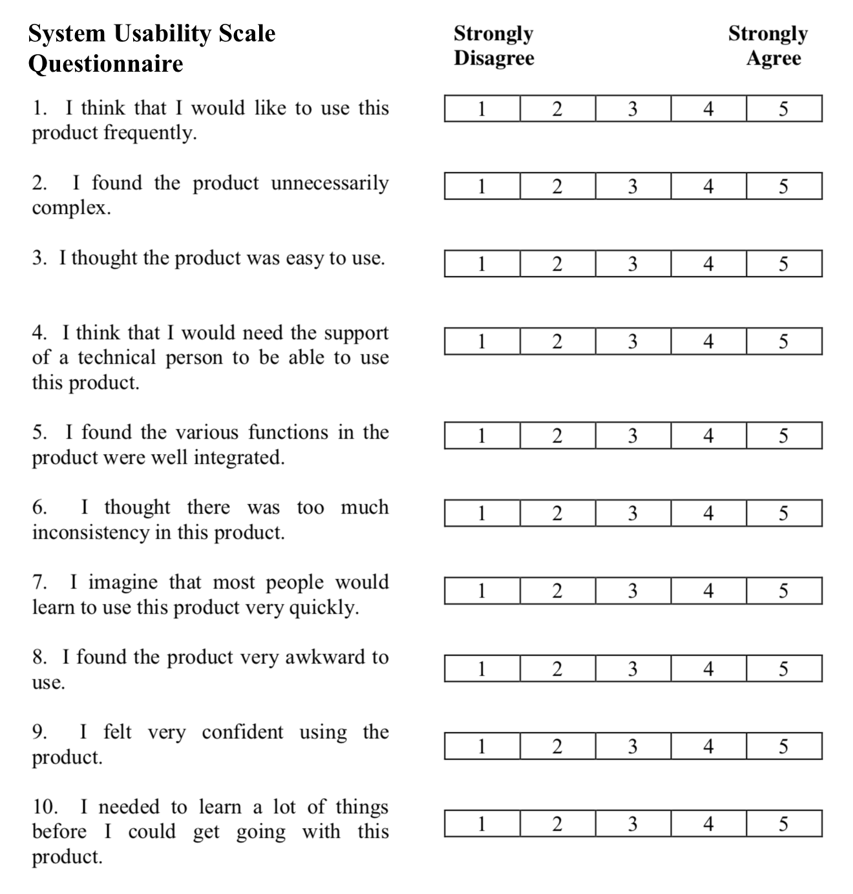
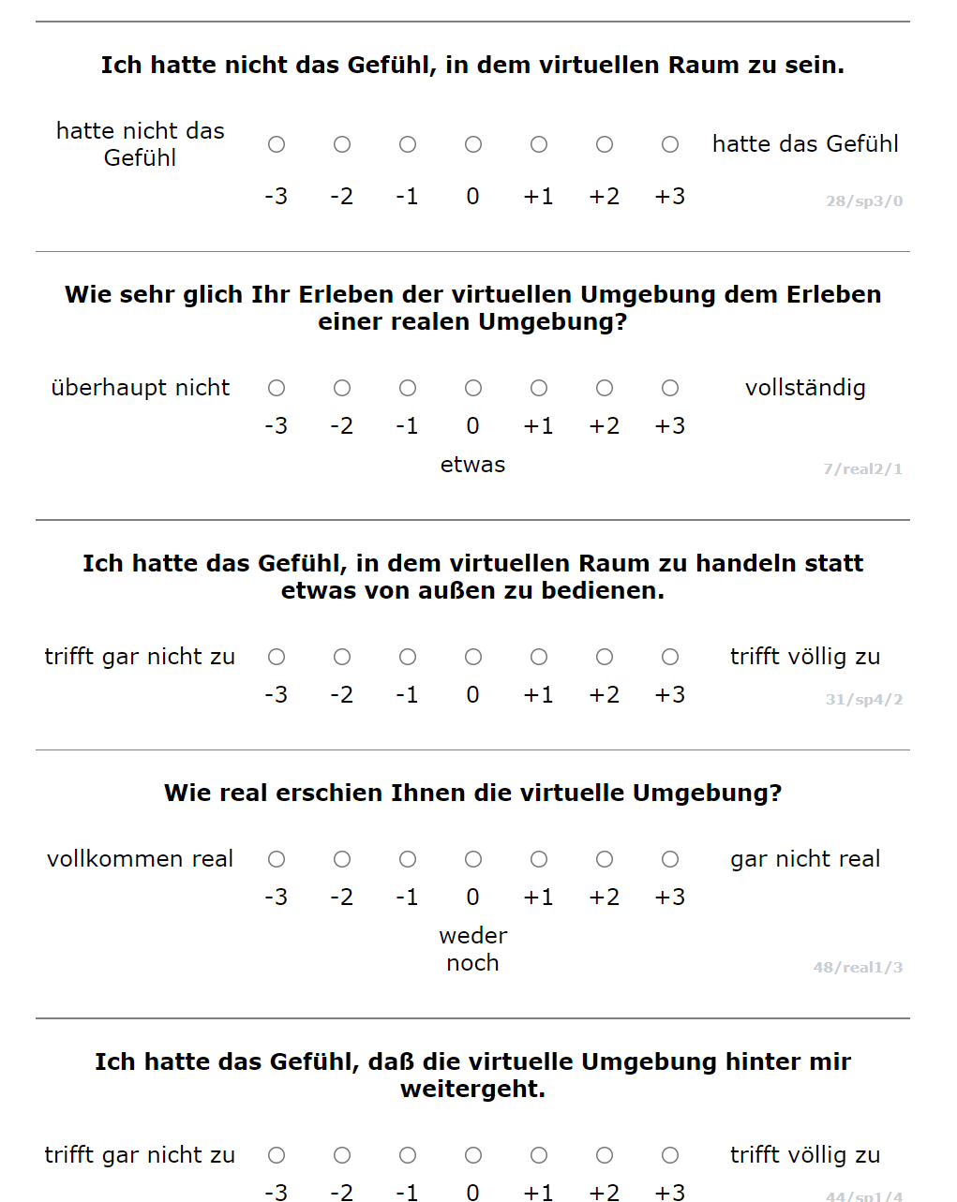
Standardized Questionnaires
Study Start
1. Introduction
2. Experiment/ Survey
3. Debriefing
Our all-time favs:
We love standardized questionnaires.
Why?
NASA-TLX
SUS
IPQ
How to Conduct a User Study

Slide 35
Standardized Questionnaires
Study Start
1. Introduction
2. Experiment/ Survey
3. Debriefing
Our all-time favs:
For all standardized questionnaires:
Never!!!!!!!!!!!!!!!!!!!!!!!!!!!!!!!!!!!!!!!!!!! change/translate/rearrange/reorder
any items!
Unless the original work explicitly allows it and you can refer to it.
NASA-TLX
SUS
IPQ
How to Conduct a User Study

Slide 36
Questionnaires
Study Start
1. Introduction
2. Experiment/ Survey
3. Debriefing
Are you allowed to change any items on a standardized questionnaire even when it does not make sense in your experiment?
NO!!!!!!!!!!!!!!!!!!!!!!!!!!!!!!!!!!!!!!!!!!! Unless the original work explicitly allows it and you can refer to it.
How to Conduct a User Study

Slide 37
Questionnaires
Study Start
1. Introduction
2. Experiment/ Survey
3. Debriefing
Are you allowed to remove any items on a standardized questionnaire even when it does not make sense in your experiment?
NO!!!!!!!!!!!!!!!!!!!!!!!!!!!!!!!!!!!!!!!!!!! Unless the original work explicitly allows it and you can refer to it.
How to Conduct a User Study

Slide 38
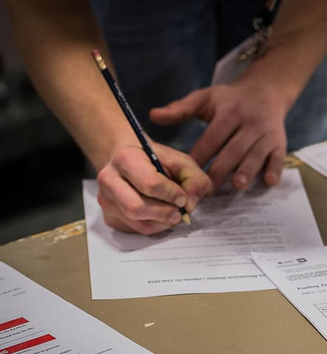
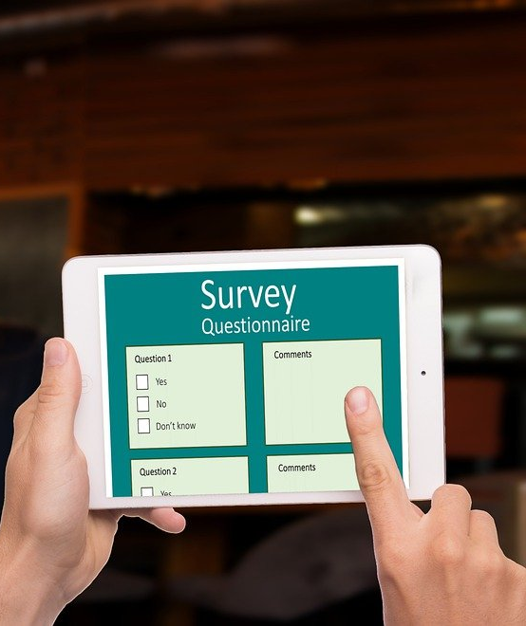
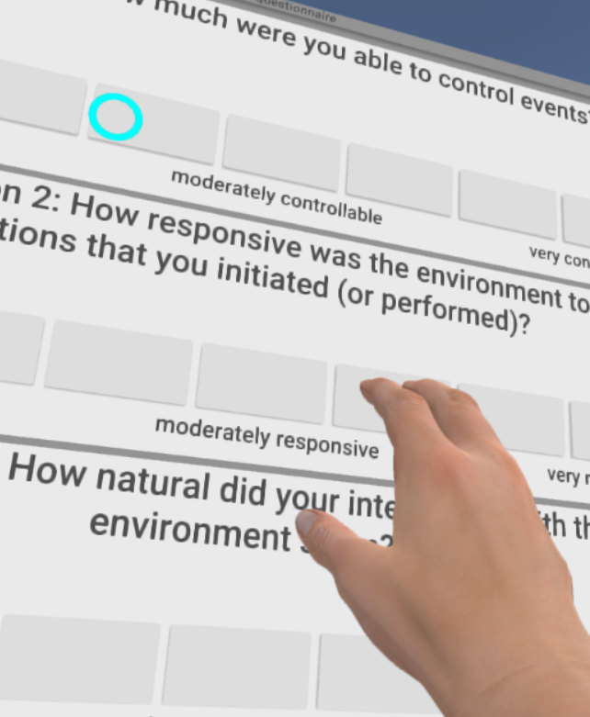
Questionnaires
Study Start
1. Introduction
2. Experiment/ Survey
3. Debriefing
Allowed hand-out devices
How to Conduct a User Study

Slide 39
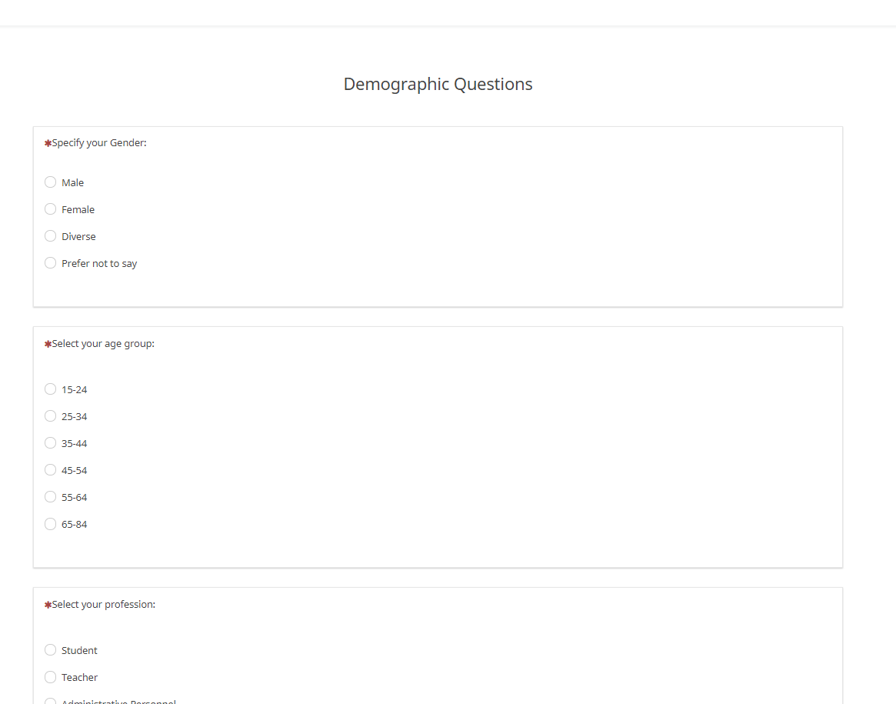
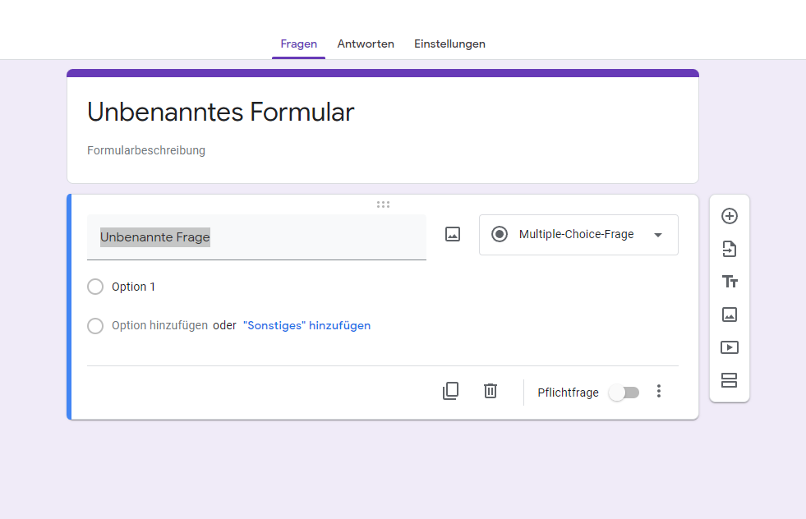
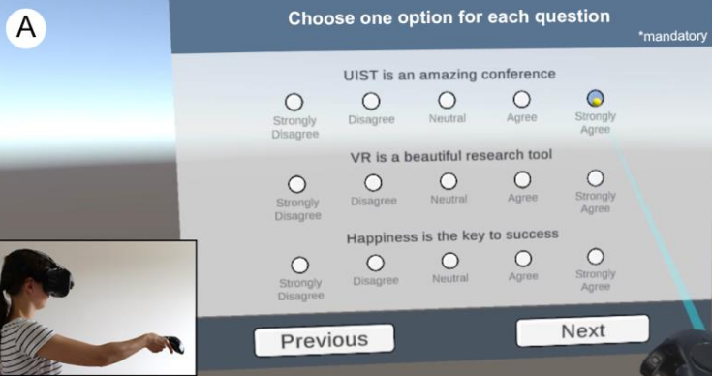


Surveying
Study Start
1. Introduction
2. Experiment/ Survey
3. Debriefing
Survey Systems
LimeSurvey https://hci-studies.org/limesurvey/
Google Forms https://docs.google.com/forms
VR Questionnaire Toolkit [1] https://github.com/MartinFk/VRQuestionnaireToolkit
Admin Usability
Admin Usability
Admin Usability
Features
Features
Features
Feick, M., Kleer, N., Tang, A., & Krüger, A. (2020, October). The Virtual Reality Questionnaire Toolkit. UIST EA (pp. 68-69).
How to Conduct a User Study

Slide 40
Objective Measures
Study Start
1. Introduction
2. Experiment/ Survey
3. Debriefing
 | Condition 1 | Condition 2 | Condition 3
Participant #1 | None-None-None | None-None-Visual | None-Tactile-None
Logging
Logging
Logging
Questionnaires
Questionnaires
Questionnaires
Informed Consent
Demo-graphics
Tutorial
Condition 7 | Condition 8
Swipe-Tactile-None | Swipe-Tactile-Visual
Post experiment questionnaire
Logging
Logging
Time
Questionnaires
Questionnaires
How to Conduct a User Study

Slide 41
Logging
Study Start
1. Introduction
2. Experiment/ Survey
3. Debriefing
The purpose of logging is to track objective data in your experiment
The term “logging” can refer both to the practice of event logging or to the actual log files
Log files can contain continuous or discrete events over time during application or system in your experiment:
Implies that you log the time (time stamp)
Think about:
What objective data can I log?
How can I log the data?
Important: Logging must not affect the user!
In which intervals do I log?
Can I evaluate the data (e.g., is it a table?)
How to Conduct a User Study

Slide 42
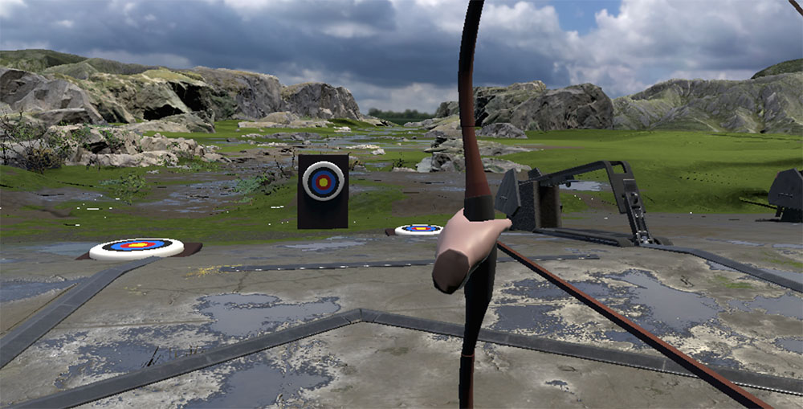
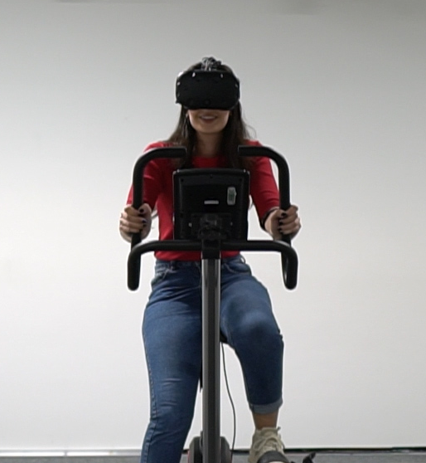
Logging Types
Study Start
1. Introduction
2. Experiment/ Survey
3. Debriefing
Discrete logging
only the events are recorded
fast and easy to evaluate
useful to count stuff (e.g., events, button clicks,…)
Continous logging
useful to measure stuff over time (e.g., motions, tracks, audio,…)
you need a (constant) sampling rate
can be lot of data
Every sample needs a time stamp
A number – not a date
Example: Discrete events (Accuarcy, Precision)
Example: Continous events (Speed, movement)
How to Conduct a User Study

Slide 43

Logging: Example
Study Start
1. Introduction
2. Experiment/ Survey
3. Debriefing
Logging
How to Conduct a User Study

Slide 44
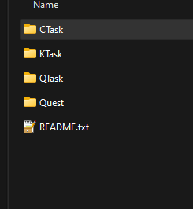
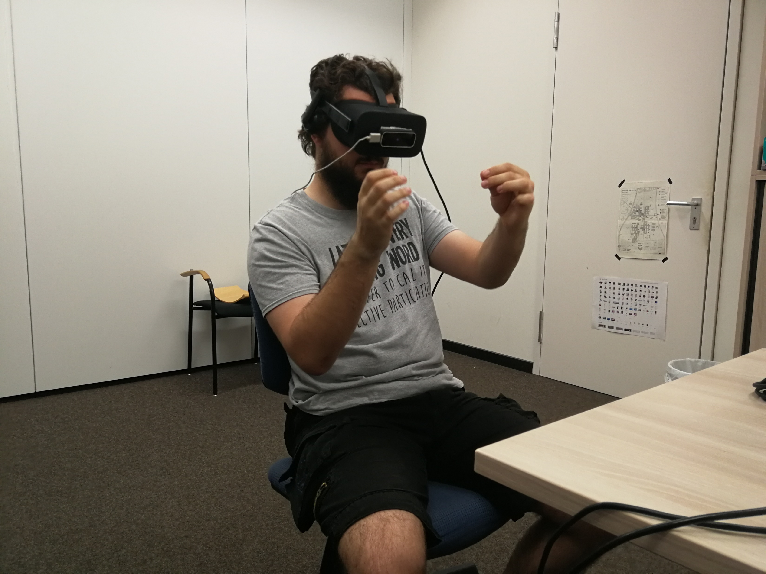
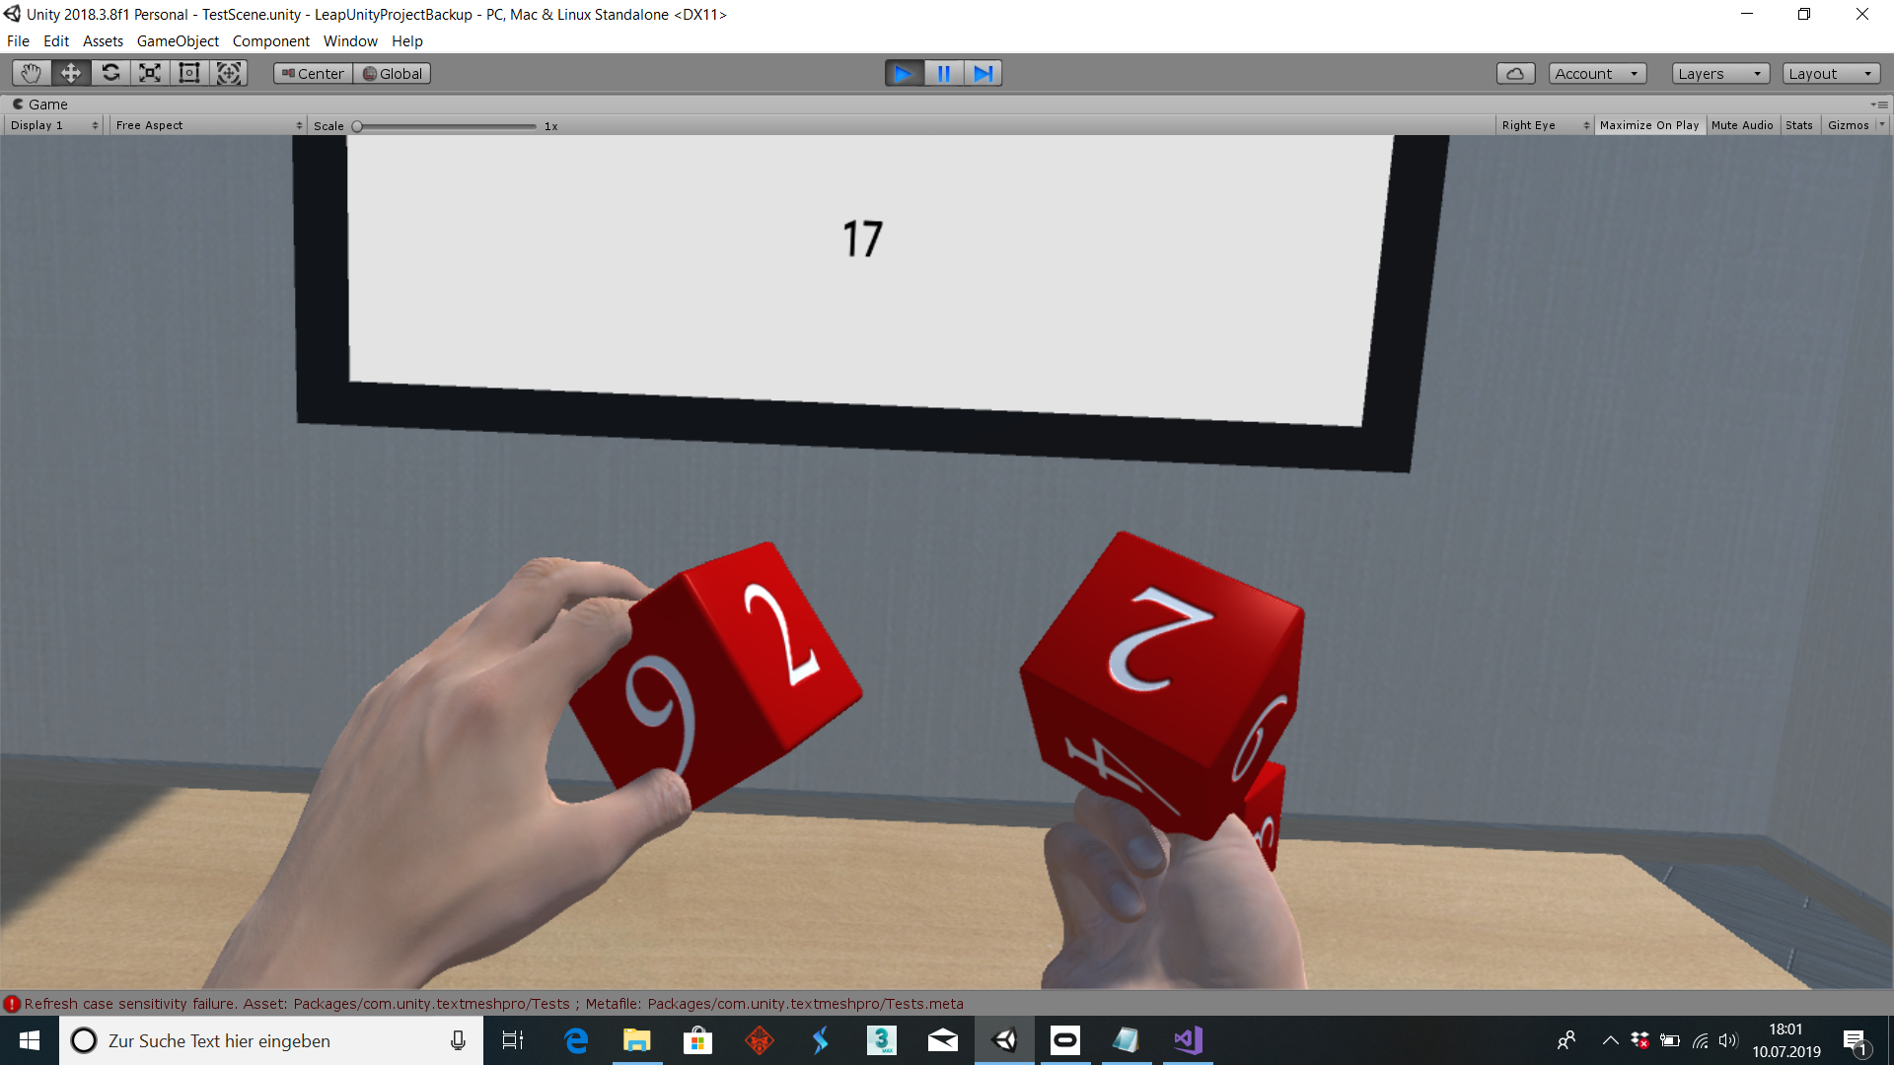
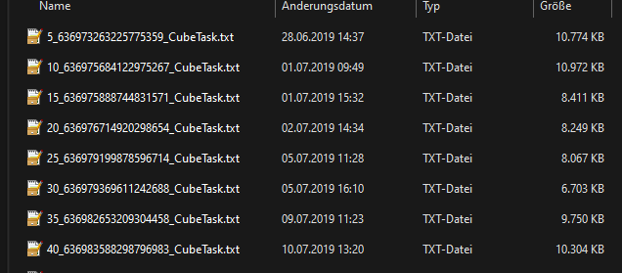
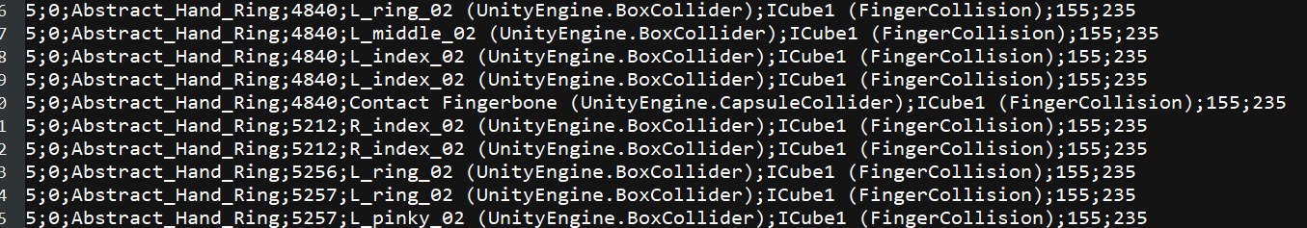
Logging: Example
Study Start
1. Introduction
2. Experiment/ Survey
3. Debriefing
Time Stamps / Stopwatches EVERYWHERE! DateTime.Now.Ticks
How to Conduct a User Study

Slide 45
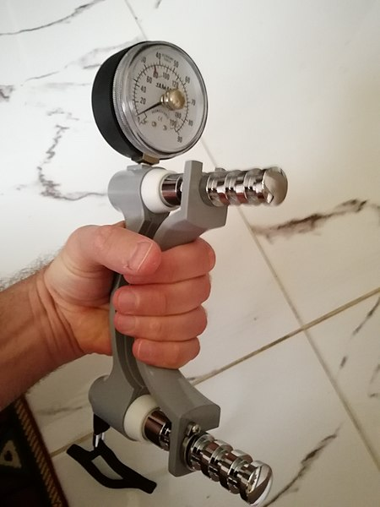

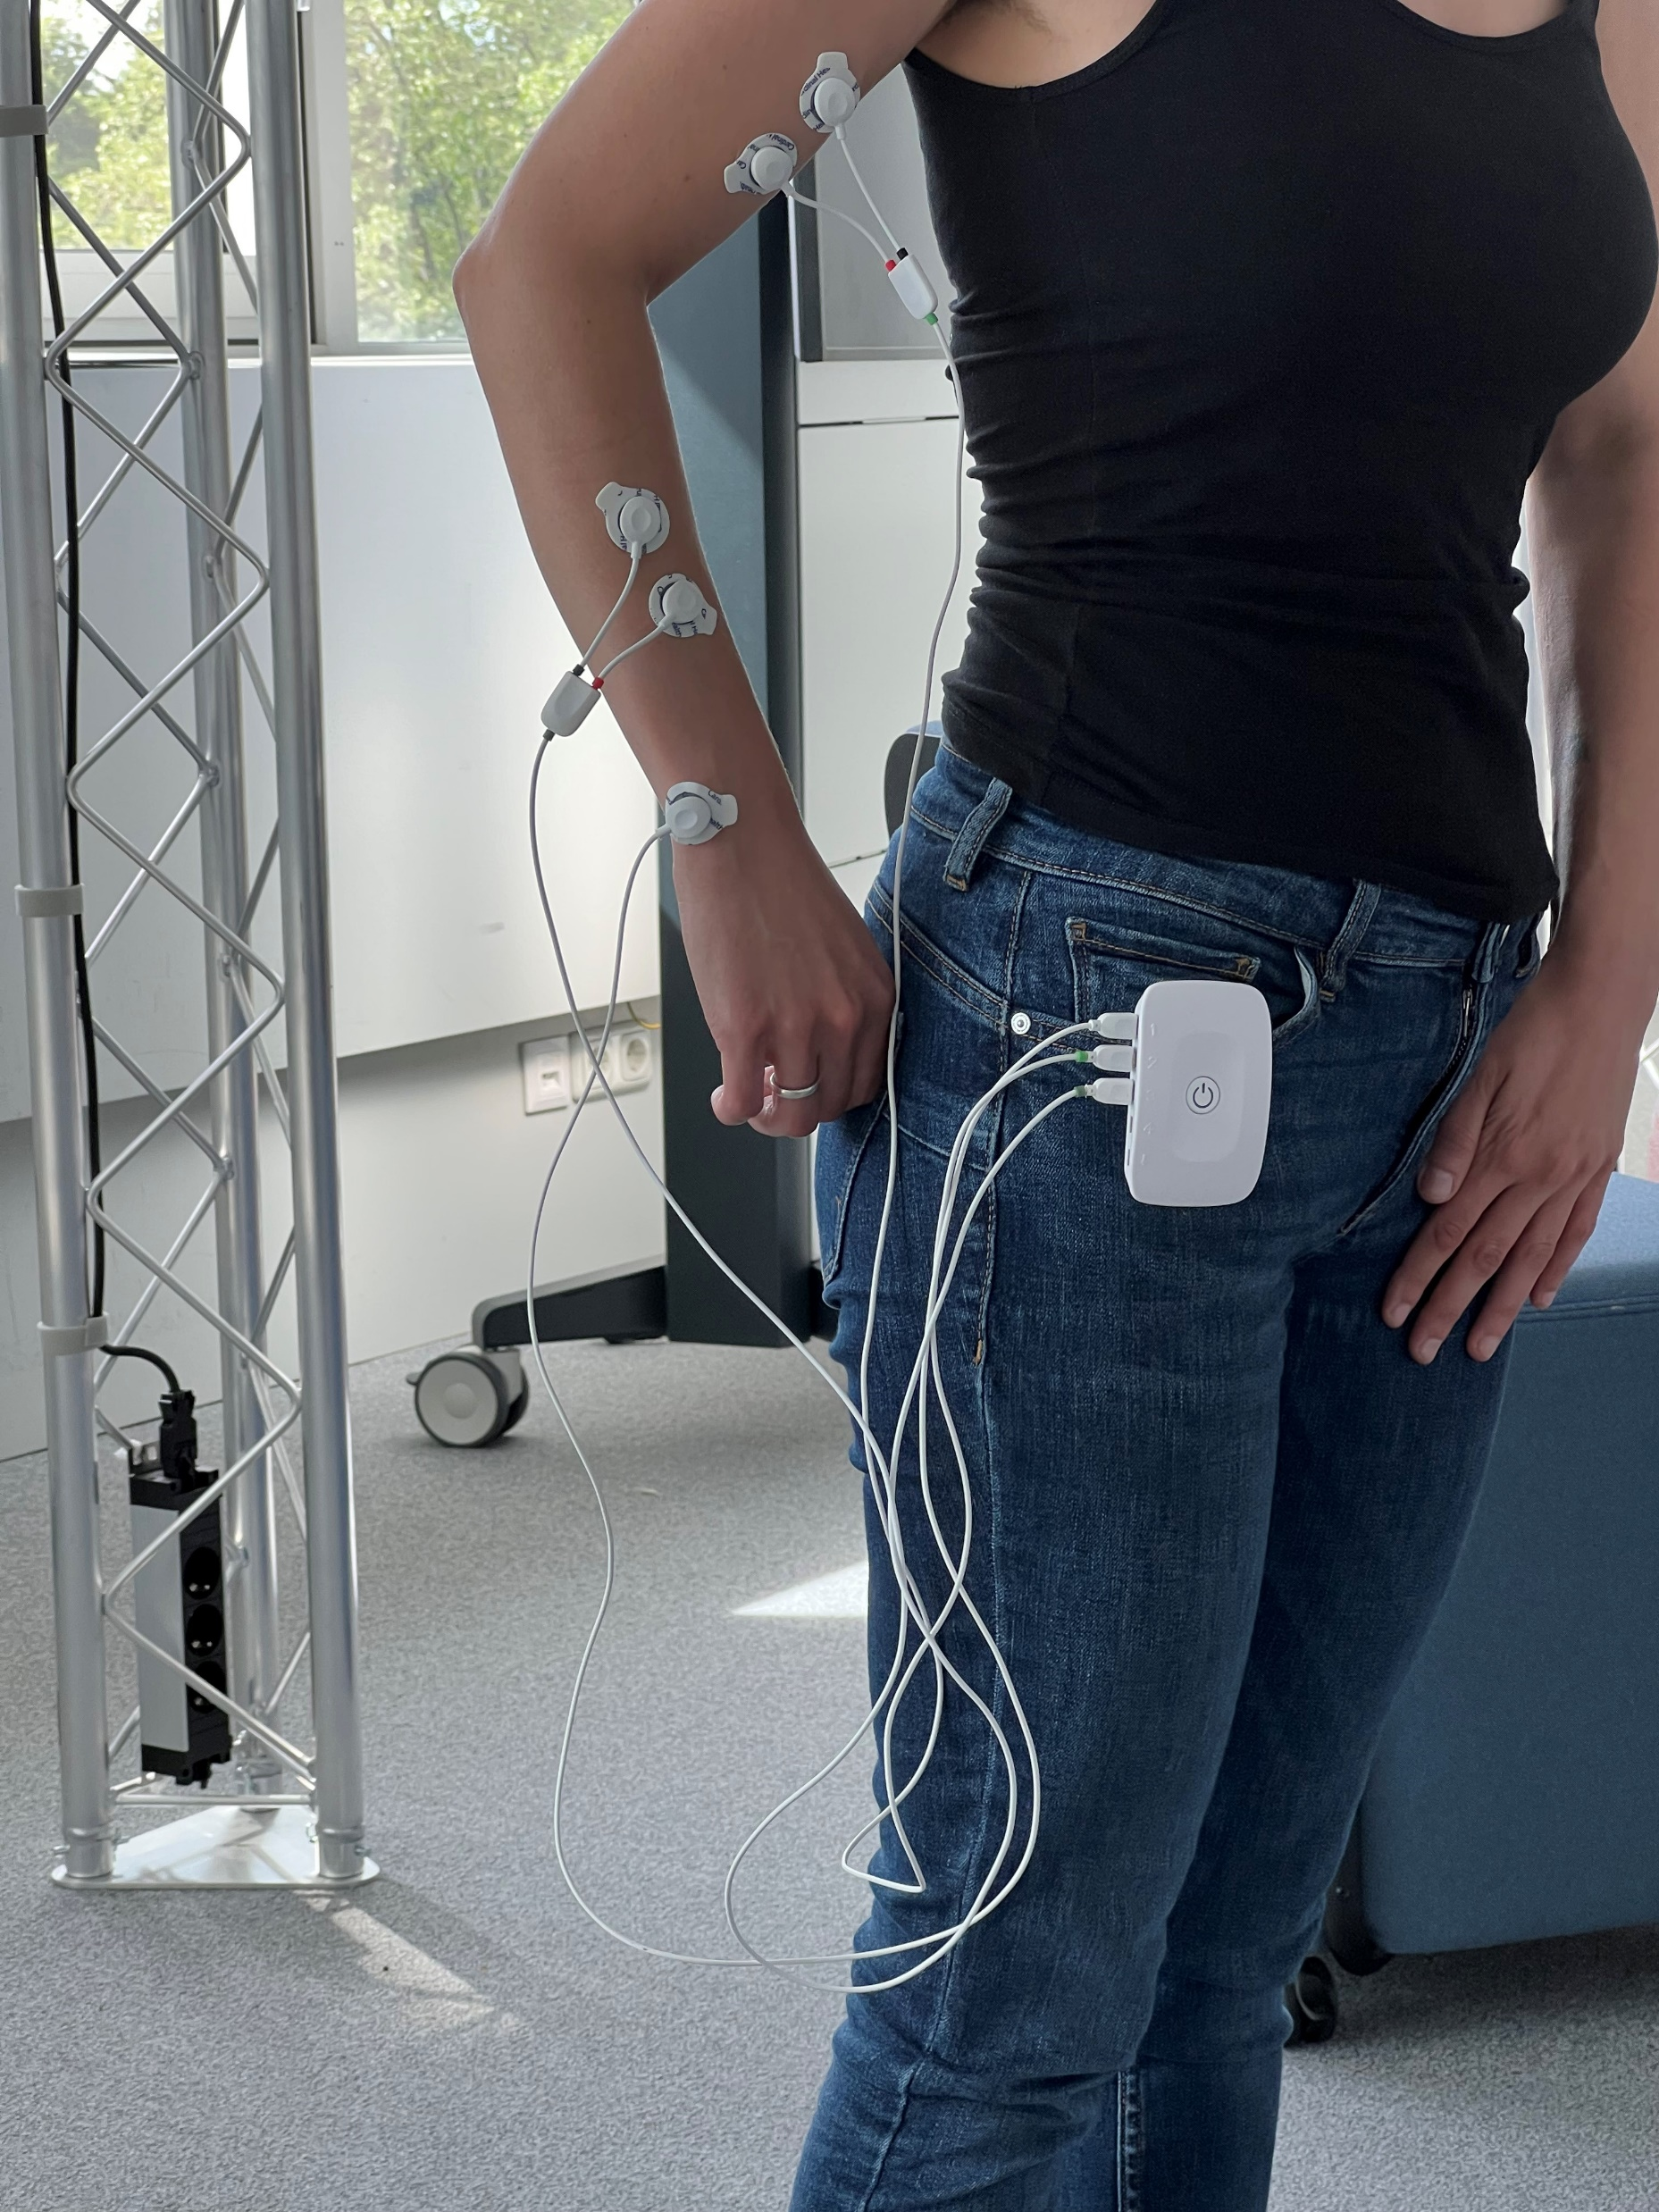
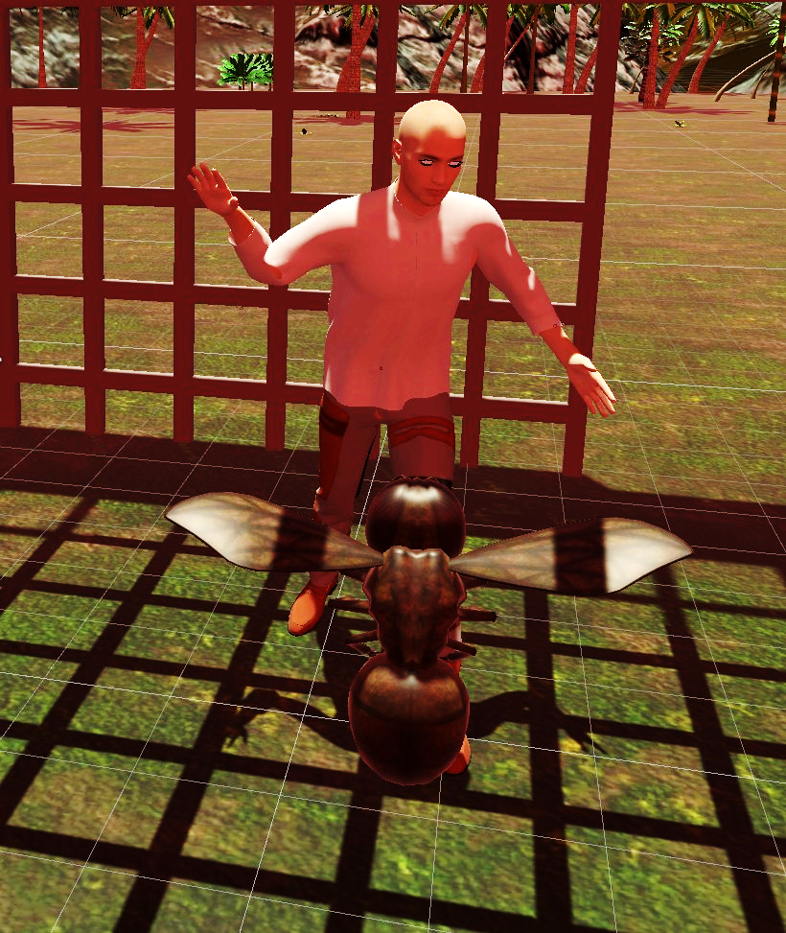
Other Measures…
Study Start
1. Introduction
2. Experiment/ Survey
3. Debriefing
Grip Strength (Dynamometer)
Task Completion Time (Stopwatch)
Physiological Sensors (Electrodes)
Game Scores
There are thousands of methods, tasks, and measures to obtain objective data! We will talk about that later…
How to Conduct a User Study

Slide 46
About Measures
Study Start
1. Introduction
2. Experiment/ Survey
3. Debriefing
BUT: NEVER FORGET THE MEASURE(S) ANSWERING YOUR RESEARCH QUESTION(S)
How to Conduct a User Study

Slide 47
Experiment
Study Start
1. Introduction
2. Experiment/ Survey
3. Debriefing
 | Condition 1 | Condition 2
Participant #1 | None-None-None | None-None-Visual
Logging
Logging
Informed Consent
Demo-graphics
Questionnaires
Tutorial
How to Conduct a User Study

Slide 48
Experiment
Study Start
1. Introduction
2. Experiment/ Survey
3. Debriefing
Think about
a „tutorial“ or unbiased „training“ to make participants familiar with their task
a „warm-up phase“ before you start with the experiment (e.g., physiological sensors)
explanations during the trial
automated instructions and integrated questionnaires
e.g., InVR-Questionnaires https://github.com/MartinFk/VRQuestionnaireToolkit [1]
instructions that help participants to do the next step without your help
randomness (e.g., random assignments)
fatigue of the participants
keeping participants motivated without killing the study
[1] Martin Feick, Niko Kleer, Anthony Tang, and Antonio Krüger. 2020. The Virtual Reality Questionnaire Toolkit. In Adjunct Publication of the 33rd Annual ACM Symposium on User Interface Software and Technology (UIST '20 Adjunct). Association for Computing Machinery, New York, NY, USA, 68–69. https://doi.org/10.1145/3379350.3416188
How to Conduct a User Study

Slide 49
Experiment
Study Start
1. Introduction
2. Experiment/ Survey
3. Debriefing
 | Condition 1 | Condition 2
Participant #1 | None-None-None | None-None-Visual
Logging
Logging
Informed Consent
Demo-graphics
Tutorial
Questionnaires
Interview
How to Conduct a User Study

Slide 50

Planning Qualitative Research
Study Start
1. Introduction
2. Experiment/ Survey
3. Debriefing
Unravel your research question
What are the related questions that could be answered with qualitative methods?
Who, When, What, Why or How questions (= open questions)
Make a protocol!!!!
Choose data collection method
Textual feedback, audio (for text transcript), video (behavioral observations)
Determine a sampling approach
Feedback/Observation method, target group, location and time frame
Integrate comparative aspects
Discussions arise when there is disagreement
How to Conduct a User Study

Slide 51

Conducting an Interview
Study Start
1. Introduction
2. Experiment/ Survey
3. Debriefing
Central instrument of qualitative research
Various forms of interviews depending on the specification of the questions/content of the interview:
Unstructured (candid) interview (very rich, unbiased)
Structured interview (easy to evaluate, no follow-up questions)
Semi-structured interview (balance between structure and flexibility, we highly recommend that)
Advantages and disadvantages of more structure:
+ Comparability and consistency of the interviews in terms of length, topics, …
+ Easier to evaluate
+ Can be automated
- Potential biases through the questions
- Restriction of perspective
- May miss context
How to Conduct a User Study

Slide 52
The Semi-Structured Interview
Study Start
1. Introduction
2. Experiment/ Survey
3. Debriefing
Interview based on a predefined protocol (a list of questions or topics to cover)
Ensures that the same general areas are covered with each participant
Makes the data and analysis more comparable than fully unstructured interviews
Interviewers are free to deviate based on the interviewee's responses
Ask follow-up questions to clarify or expand on points made by the interviewee (probing)
The format enables interviewers to probe interesting areas that emerge during the interview, which are not in the protocol.
Allow deep exploration of the interviewee's thoughts, feelings, and beliefs, providing rich qualitative data.
Questions can be adapted to suit the context of the conversation or the specific respondent
Interviewers can gain a better understanding of the context
Can reveal inconsistencies within the interviewee's thoughts
How to Conduct a User Study

Slide 53
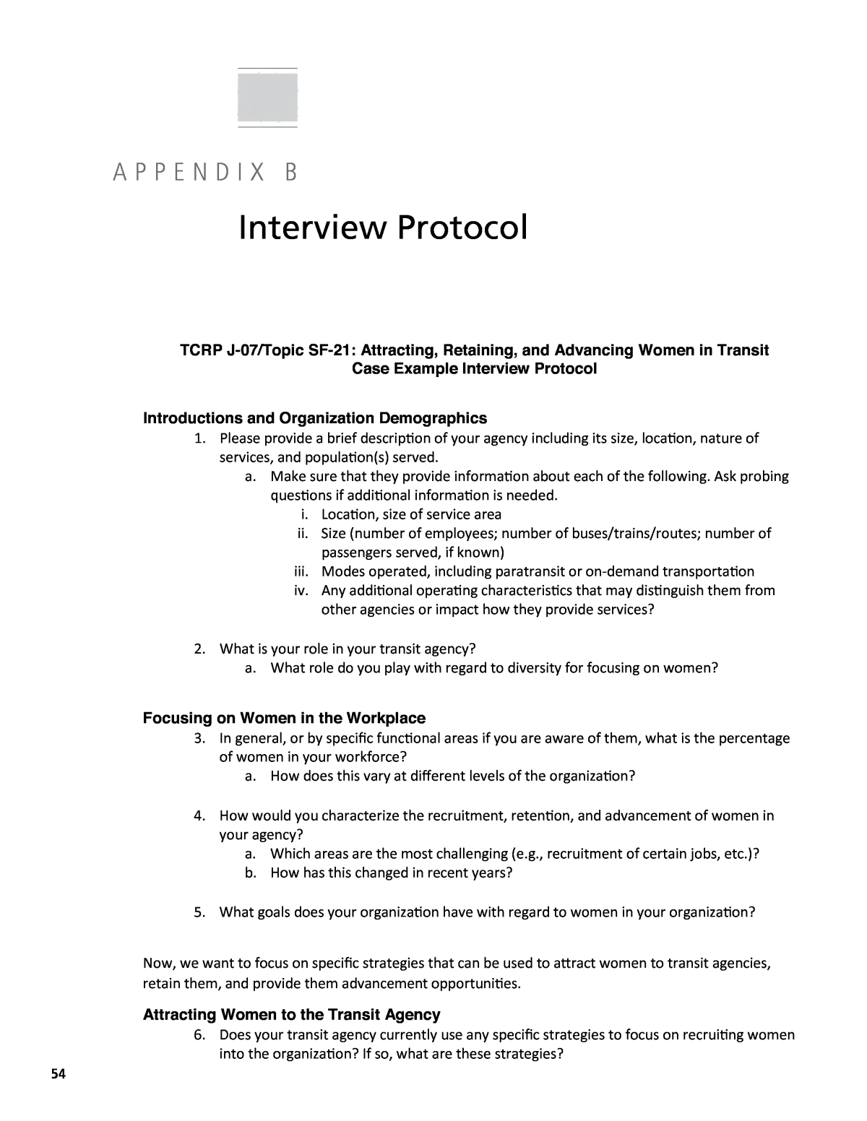
The Interview Protocol
Study Start
1. Introduction
2. Experiment/ Survey
3. Debriefing
A numerical ordered set of questions and follow-up questions
Every qualitative research needs one
Main questions:
Directly asks your research question: "What have been the biggest challenges you've faced while working remotely?“
Probing questions:
"What strategies have you used to overcome remote work challenges?“
Follow-up questions:
“Can you tell me more about that?”
“Can you give another example?”
…
Must be part
of your paper (Appendix!)
How to Conduct a User Study

Slide 54
The Semi-Structured Interview
Study Start
1. Introduction
2. Experiment/ Survey
3. Debriefing
Establish a connection with the participant to facilitate open communication
Warm-up questions or tasks: "Can you tell me a bit about your current work as expert for security?"
Establish common ground and provides context (events, situations) and initial questions
“Image you are going for a walk in a park with your new fitness tracker…”
Open-ended questions around the research question
Questions are designed to encourage detailed and expansive answers
Allows interviewees to express their perspectives and experiences
Enables “active listening”
More questions to go deeper
Repeat the interview with all conditions/concepts/scenarios…
How to Conduct a User Study

Slide 55
How to go deeper…
Study Start
1. Introduction
2. Experiment/ Survey
3. Debriefing
Active listener tries to grasp the content of the answers and to establish the connection to research questions & to clarify inconsistencies or ambiguities
Expand what has been said with “Can you tell us more about it?”, “Can you give an example?”
Find out why with "Can you tell me why you reacted?" "Why do you think you reacted that way"
Ask for effects/consequences with "What happened next?" "What effect did that have on you?"
Underlying values experienced with "Why was that important to you?" "Why did you react so strongly to it?"
How to Conduct a User Study

Slide 56
Think-Aloud
Study Start
1. Introduction
2. Experiment/ Survey
3. Debriefing
Participants think aloud while they are performing a set of specified tasks
Participants are asked to say whatever comes into their mind during they complete the task
Include open-ended and allows follow-up questions (typically semi-structured)
Include what participants are: seeing, thinking, doing, feeling, …
Very efficient, but not always possible (e.g., audio tasks)
Task-Centered User Interface Design: A Practical Introduction, by Clayton Lewis and John Rieman.
How to Conduct a User Study

Slide 57
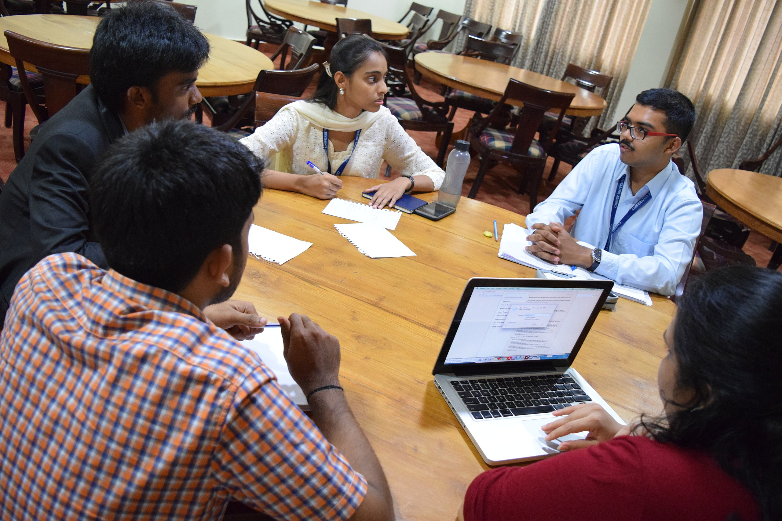
Focus Groups
Study Start
1. Introduction
2. Experiment/ Survey
3. Debriefing
An interview with group of participants (3-10) directed by one or more researchers
Typically, you have 3-4 focus groups per study
Participants typically have common goals, traits, experiences, etc.
Goals can be to…
improve a prototype (“How would you make it better?”)
solve problems (“What would you do?”)
explore design options („How would you design it?“)
get a broad variety of solutions
By NSaad (WMF) - Own work, CC BY-SA 4.0, https://commons.wikimedia.org/w/index.php?curid=67092238
How to Conduct a User Study

Slide 58

https://pxhere.com/de/photo/1447013
How to Conduct a User Study

Slide 59

Focus Lenses (Examples)
Study Start
1. Introduction
2. Experiment/ Survey
3. Debriefing
Designs Exploration
Explore the design spaces/design options with your focus group
Brainstorm solutions
Prototype Test
Test the concept for a product
Test reactions to a mock-up physical or digital
Opinion Gathering
After a product is already out in the world
Determine how people feel about it or how they make use of it
Slides adapted from Dr Kami Vaniea https://www.inf.ed.ac.uk/teaching/courses/hci/1718/lects/Lecture11_focus_groups.pdf
How to Conduct a User Study

Slide 60


Pros/Cons of Focus Groups
Study Start
1. Introduction
2. Experiment/ Survey
3. Debriefing
Pros
Get group opinion about issues
Efficient way to test early ideas/designs
Good way to identify issues or areas of conflict
Multi-constituent discussion
Cons
Can be taken over by assertive individuals
Focus on people’s opinions not actual behaviors
Limited sample size
Slides adapted from Dr Kami Vaniea https://www.inf.ed.ac.uk/teaching/courses/hci/1718/lects/Lecture11_focus_groups.pdf
How to Conduct a User Study

Slide 61
Plan and Discussion Stimuli
Study Start
1. Introduction
2. Experiment/ Survey
3. Debriefing
Goal is to get valuable information about the potential and design spaces of an artifact
To encourage the members to talk more freely early prototype (discussion stimuli) can be presented
In HCI, focus groups have typically brainstorming phases Explain what is going to happen to the participants (example)
1. Explain what is going to happen to the participants
2. Ask the attendees to introduce themselves and share their last app experience
3. Hand out discussion stimuli and associated questions
4. Ask participants to try and use the stimuli to answer the questions silently by themselves
5. Ask participants to discuss the answers and explore options
6. Ask participants how they would improve the discussion stimuli (brainstorming session)
Slides adapted from Dr Kami Vaniea https://www.inf.ed.ac.uk/teaching/courses/hci/1718/lects/Lecture11_focus_groups.pdf
How to Conduct a User Study

Slide 62

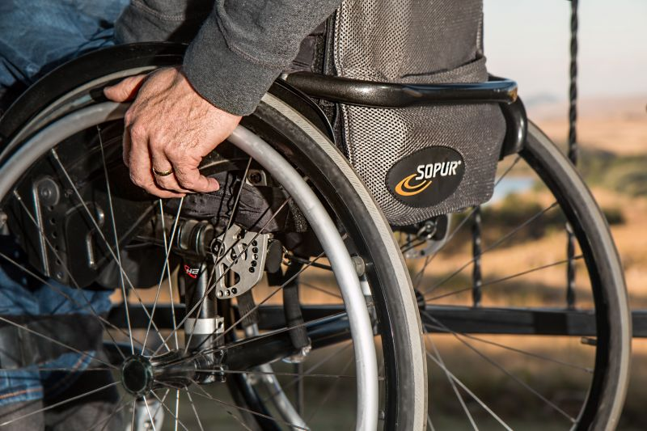
Examples: Qualitative Studies
Study Start
1. Introduction
2. Experiment/ Survey
3. Debriefing
Example: „We describe a qualitative study investigating the acceptability of Google Glass eyewear computer to People with Parkinson`s disease (PD.)“ [2]
Study on the possible uses and acceptance of Google Glass in Parkinson's patients
Example: “[…] we present the findings from multiple design sessions […] exploring the placement and form factor possibilities for input and output on a power wheelchair.” [1]
General question, design aspects should be explored
[1] Patrick Carrington, Amy Hurst, and Shaun K. Kane. 2014. Wearables and chairables: inclusive design of mobile input and output techniques for power wheelchair users. In Proceedings of the SIGCHI Conference on Human Factors in Computing Systems (CHI '14). Association for Computing Machinery, New York, NY, USA, 3103–3112. https://doi.org/10.1145/2556288.2557237
[2] McNaney, R., Vines, J., Roggen, D., Balaam, M., Zhang, P., Poliakov, I., & Olivier, P. (2014). Exploring the Acceptability of Google Glass As an Everyday Assistive Device for People with Parkinson’s
Images from: https://pxhere.com/de/photo/732815 and https://movingthroughglass.org/
How to Conduct a User Study

Slide 63
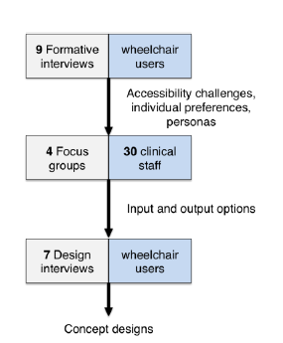
Example: Wheel chair users…
Study Start
1. Introduction
2. Experiment/ Survey
3. Debriefing
Survey methods
3 different methods: interviews, focus groups, design interviews
Sample
Heterogeneous sample of a certain group
Wheelchair users and clinical staff
Time frame
Period studied: habits, problems in using systems
Several examination times to further process & check results
[1] Patrick Carrington, Amy Hurst, and Shaun K. Kane. 2014. Wearables and chairables: inclusive design of mobile input and output techniques for power wheelchair users. In Proceedings of the SIGCHI Conference on Human Factors in Computing Systems (CHI '14). Association for Computing Machinery, New York, NY, USA, 3103–3112. https://doi.org/10.1145/2556288.2557237
How to Conduct a User Study

Slide 64
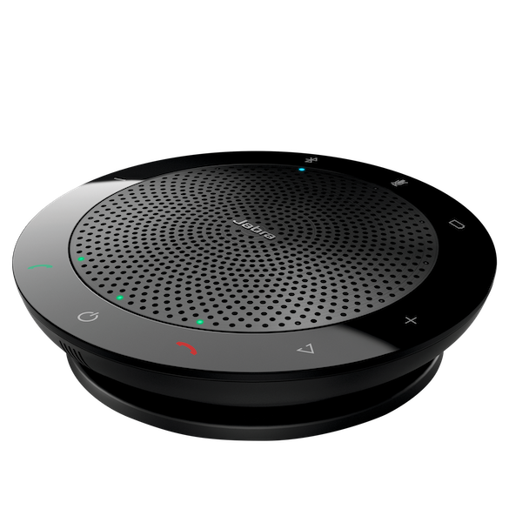
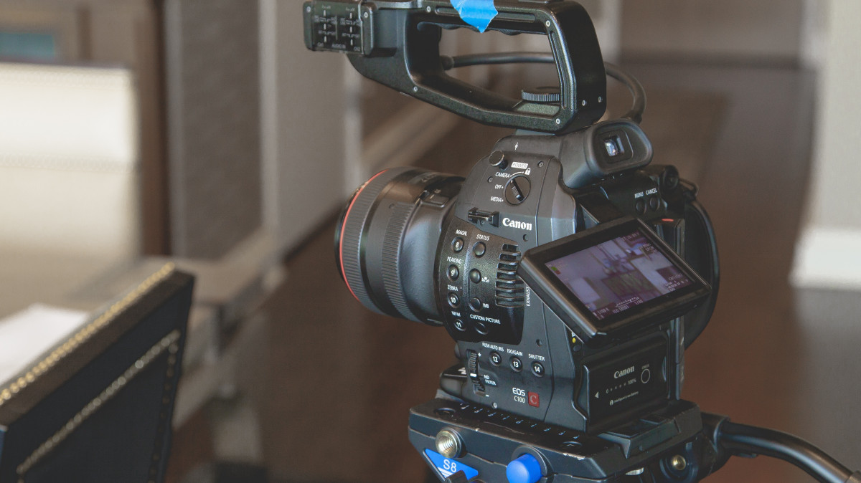
Data Collection
Study Start
1. Introduction
2. Experiment/ Survey
3. Debriefing
Interview protocols
Live protocol
Focus group output
Video observations
Audio records
Existing data: Ethnography
Diaries
Textual feedback forms
How to Conduct a User Study

Slide 65
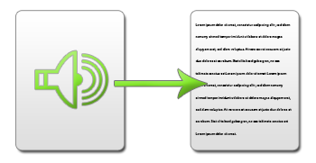
Record & Log Events
Study Start
1. Introduction
2. Experiment/ Survey
3. Debriefing
Event Log
Recorded and observed events during the study
Key data of the interview: interviewer, ID of the subject, location of the interview, start and end times of the interview
Transcription
in audio-recorded interviews, what is said is written down true to its meaning = transcribed
1 hour audio/video =
8 hours transcription
Or you use youtube.com – auto comment detection
How to Conduct a User Study

Slide 66
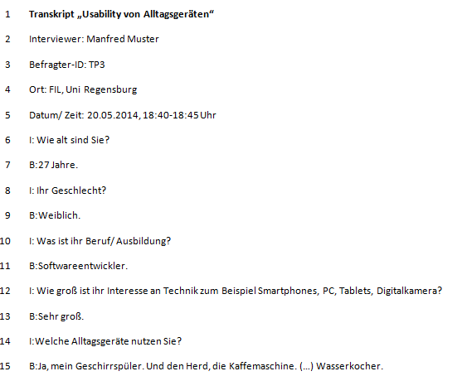
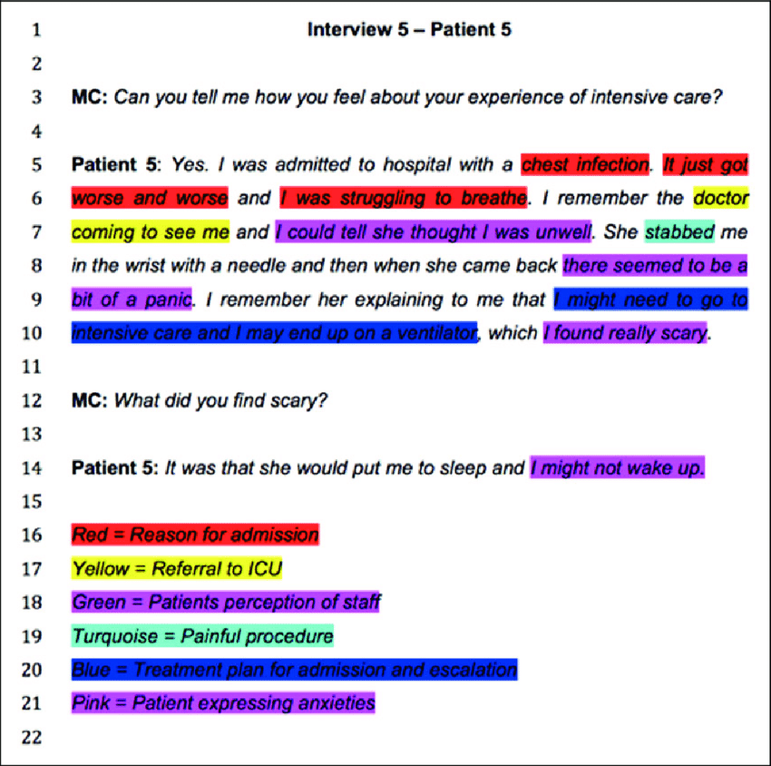
Transcript Examples
Study Start
1. Introduction
2. Experiment/ Survey
3. Debriefing
Meta Data
Demographics
Codes
https://www.researchgate.net/publication/282427988_Qualitative_research_in_critical_care_Has_its_time_finally_come/figures?lo=1&utm_source=google&utm_medium=organic
How to Conduct a User Study

Slide 67
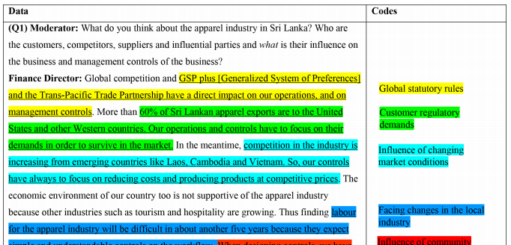
Transcript Examples
Study Start
1. Introduction
2. Experiment/ Survey
3. Debriefing
https://i.sstatic.net/vPdQ2.png

Slide 68
Using Time
Study Start
1. Introduction
2. Experiment/ Survey
3. Debriefing
You can use time as “object of investigation or manipulation”
Before/during/after an event (e.g., before, while, or after using a system)
The order determines biases (counter-balance if required)
Study Episodes
Single Episode
Multiple Episodes
Capture different points in time
Use of different methods to capture different aspects (context, frequency of use, emotions, problems)
Example: Diary study to capture the user experience of a streaming platform
How to Conduct a User Study

Slide 69
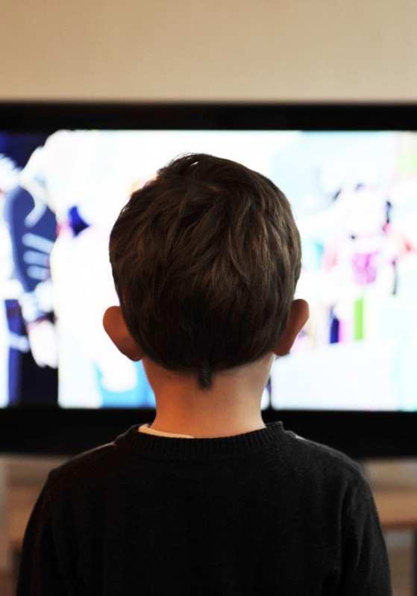
Example: Streaming Platform
A diary study capturing the UX of an online streaming platform
First contact interview
“Your expectations?”
“Your first impression of the start page?”
Diary study on the use of the system
“What are your entries in weblog (tabular, free text)
More questions about usability
Post follow-up interviews
Summary
Perceived user experience curves
How to Conduct a User Study

Slide 70
Mixed Methods
Study Start
1. Introduction
2. Experiment/ Survey
3. Debriefing
 | Condition 1 | Condition 2 | Condition 3
Participant #1 | None-None-None | None-None-Visual | None-Tactile-None
Logging
Logging
Logging
Questionnaires
Questionnaires
Questionnaires
Interview
Interview
Interview
Informed Consent
Demo-graphics
Condition 7 | Condition 8
Swipe-Tactile-None | Swipe-Tactile-Visual
Post experiment interview
Post experiment questionnaire
Logging
Logging
Time
Nice but needs a lot of time!
Questionnaires
Questionnaires
Interview
Interview
How to Conduct a User Study

Slide 71
Mixed Methods
Study Start
1. Introduction
2. Experiment/ Survey
3. Debriefing
 | Condition 1 | Condition 2 | Condition 3
Participant #1 | None-None-None | None-None-Visual | None-Tactile-None
Logging
Logging
Logging
Questionnaires
Questionnaires
Questionnaires
Informed Consent
Demo-graphics
Condition 7 | Condition 8
Swipe-Tactile-None | Swipe-Tactile-Visual
Post experiment interview
Post experiment questionnaire
Logging
Logging
Time
Still okay (but not really „Mixed-Methods“)!
Questionnaires
Questionnaires
How to Conduct a User Study

Slide 72
Mixed Methods
Study Start
1. Introduction
2. Experiment/ Survey
3. Debriefing
 | Condition 1
Participant #1 | None-None-None
Logging
Logging
Think aloud
Think aloud
Think aloud interview protocols must not affect the interaction
Neither on participant nor on experimenter site!
Be careful with your experiment, but it can be very helpful
How to Conduct a User Study

Slide 73

Ethnography
„[...] the art and science of describing a human group – its institutions, interpersonal behaviors, material productions, and beliefs“ [1]
Emerged from the field of anthropology that served the study of non-Western cultures field research
Researcher shares (actively) the everyday life of the people
Researchers observe them, make field notes,
from which patterns and meanings are then deductively evaluated
See the work by e.g. Bronisław Malinowski
Other methods: photography, videos, audio,…
http://hilobrow.com/2012/04/07/bronislaw-malinowski/
[1] Angrosino, M. (2007). Doing ethnographic and observational research. SAGE Publications Ltd, https://dx.doi.org/10.4135/9781849208932
How to Conduct a User Study

Slide 74
Ethnography = Technology Biography
“Technology Biography”: hardly “real” ethnography in the sense of long-term field research
Example: a field study into technology use by three households was examined [1]
Method used: Technology Biography
Technology Tour: devices are shown
Last Time Questions: Questions e.g., “When was a household task fun?”
Personal History: “How did habits develop?”
Three wishes for new products
Results
Enjoyability
Recodification-Gendered Design
Inclusivity
Blythe, M., & Monk, A. (2002). Notes Towards an Ethnography of Domestic Technology
How to Conduct a User Study

Slide 75


Rapid Ethnography (Guerilla Sampling)
Real ethnography is too “expensive”, broad spectrum of observation, long duration of observation
Let’s shorten it: guerrilla sampling
Guerilla sampling:
Refer to a specific question and find information in the field
Can be in-situ: e.g., asking habits of car drivers at parking slots
Use as many digital recording methods as possible (audio, video, photos, etc.)
Collaborative evaluation (possibly also tool-supported)
David R. Millen. 2000. Rapid ethnography: time deepening strategies for HCI field research. In Proceedings of the 3rd conference on Designing interactive systems: processes, practices, methods, and techniques (DIS '00). Association for Computing Machinery, New York, NY, USA, 280–286. https://doi.org/10.1145/347642.347763
How to Conduct a User Study

Slide 76
Case Study
„The essence of a case study, the central tendency among all types of case study, is that it tries to illuminate a decision or set of decisions: why they were taken, how they were implemented, and with what result.“ [1]
Detailed and in-depth analysis of one or more occasions
Research questions are how and why
when a topical phenomenon is examined (in our case: a new device, domain, application, form of interaction)
certain factors or events cannot be controlled (e.g., due to realism or novelty)
mostly for innovative developments, new methods
[1] Schramm, W. (1971). Notes on Case Studies of Instructional Media Projects.
How to Conduct a User Study

Slide 77


Fake (Case) Study: „Quantified Cats“ [1]
Example: Quantification of Pets
Discussing fiction and speculative prototypes (websites) in focus groups with pet owners & animal behavior experts
Prototypes, descriptions and websites for various products
Pet owners want to understand their pet:
„Sometimes you think is she just barking to protect me. But then sometimes you’re not 100% sure...if you knew she wasn't a threat [with EmotiDog], you'd probably be more relaxed” [1]
[1] Lawson,S., Kirman,B., Linehan,C., Feltwell,T., & L. Hopkins (2015) Problematising Upstream Technology through Speculative Design: The Case of Quantified Cats and Dogs
How to Conduct a User Study

Slide 78
The Art of Case Studies: Drawing Conclusions
“Beyond the human-animal relationship, our study suggests implications for the quantified-self movement more generally. As mentioned, our participants were fascinated by the utility offered by our products, without any concern for how they worked. This issue goes beyond our own case study: if there is little incentive for ensuring a consistent level of scientific accuracy in quantified data interpretation, it seems unlikely that companies would bother to engage in the expensive and time consuming trials necessary to demonstrate this.” [1]
[1] Lawson,S., Kirman,B., Linehan,C., Feltwell,T., & L. Hopkins (2015) Problematising Upstream Technology through Speculative Design: The Case of Quantified Cats and Dogs
How to Conduct a User Study

Slide 79

Diaries
Fill the gap between direct observation & interrogation
Form
Paper, digital via blogs, email, mobile app, online account etc.
Open questions/entries versus tabular form
With additional media such as photo, video, comments
Elicitation Diary
Notes on use (e.g., in the form of photos and comments)
Follow-up interviews clarify questions about usage
Feedback Diary
Answer usage questions (at the end of each tag or usage)
How to Conduct a User Study

Slide 80
Why Diaries?
Advantages
Phenomena can be captured in context & with a personal view Participants are less disturbed than with an observation/ethnography
Disadvantages
Accuracy of recording can be highly variable (motivation, time resources of participants) Interpretability of described phenomena → Interviews for clarification, method. Triangulation
How to Conduct a User Study

Slide 81
Avoiding Biases in Qualitative Research
Use multiple people to transcribe and code the data
If there is consistency between your interpretation and that of others, it is more likely that there is some truth by agreement in your interpretations
Have participants review your results
Ask the people who provided the data whether your interpretations seem to reflect their opinions
Verify data sources (Triangulation)
If you can find other sources of data that support your interpretations, then you can have more confidence that what you've found is legitimate
Check for alternative explanations
Consider whether there are other reasons why you obtained your data. If you can rule out or account for alternative explanations, your interpretations will be stronger.
Review findings with peers
Ask others to review your conclusions. Sometimes others will see things that you missed or can identify gaps in your argument that need to be addressed
How to Conduct a User Study

Slide 82
Summary
You need a plan for quantitative and qualitative research
The research must answer your research question
Distinguish research from practice: valid, reliable and dependable results
Should correspond to one of the three research approaches:
Quantitative, qualitative, mixed methods
Less is more
The aim is not to explore as many aspects as possible or as generally as possible
Examine a few specific aspects very thoroughly and closely
Read, read, read
Good examples provide clues for interesting questions, methodologies, study designs,…
How to Conduct a User Study

Slide 83
Task Next Time
Present your project and your method
Introduction (explain the topic, its relevance, for whom it‘s relevant, and why)
Your update research question(s) and describe the operationalization of your concept(s)
A very brief overview on related work (adress the gap in a few words)
Explain your method
Describe your research method (quantitative, qualitative, literature review)
Your research/study/experimental plan
IV, DV, Procedure, Apparatus, Tasks, …
Update and upload your problem statement
Introduction Section
Related Work Section
Method Section
How to Conduct a User Study

Slide 84
References
Elo & Kyngäs (2008). The qualitative content analysis process. Journal Advanced Nursing. 62(1):107-15.
Eliot, Susan (2011). Using Excel for Qualitative Data Analysis. Retrieved from http://www.qualitative-researcher.com/qualitative-analysis/using-excel-for-qualitative-data-analysis/
Charmaz, K. (2006). Constructing Grounded Theory. A Practical Guide Through Qualitative Analysis. London: Sage.
Glaser, B. & Strauss, A.(2010). Grounded Theory. Strategien qualitativer Forschung. Bern: Huber.
Hof, C. & Weingarten (1979). Qualitative Sozialforschung. Stuttgart: Klett.
Mayring, P. (2008). Qualitative Inhaltsanalyse. Grundlagen und Techniken. Weinheim: Beltz.
McNaney, R., Vines, J., Roggen, D., Balaam, M., Zhang, P., Poliakov, I., & Olivier, P. (2014). Exploring the Acceptability of Google Glass As an Everyday Assistive Device for People with Parkinson’s. In Proceedings of the SIGCHI Conference on Human Factors in Computing Systems (pp. 2551–2554). New York, NY, USA: ACM. doi:10.1145/2556288.2557092
Krippendorf , K. (1980). Content Analysis. An Introduction to its methodology. Newbury Park: Sage Publications.
Razavi, M. N., & Iverson, L. (2006). A grounded theory of information sharing behavior in a personal learning space. Proceedings of the 2006 20th Anniversary Conference on Computer Supported Cooperative Work - CSCW ’06, 459. doi:10.1145/1180875.1180946
References

