Slide 1



How to Evaluate Results
Human-Computer Interaction Exercise
The following content is licensed under a Creative Commons Attribution 4.0 International license (CC BY-SA 4.0)

Slide 2
Results and the Research Question
All results need a research question
A research question is a question (no theory, no answer, no assumption,…)
In quantitative studies, you ask for one (or more) measures
e.g., “What is the effect of Swipe on the users’ typing speed/error rate/workload…?”
A hypothesis gives the answer (only quantitative studies!):
e.g., „Swipe increases the users‘ typing speed.”
„Explorative“ user studies can have multiple hypotheses:
In qualitative studies you have no hypothesis (yet)
You are interested in thoughts, opinions, concepts, ideas, suggestions,…
e.g., “How would users improve Swipe?”
In mixed methods studies (quantitative and qualitative methods), you can combine them!
e.g., “How do users perceive Swipe?” (e.g., by ratings and interviews)
How to Evaluate Results

Slide 3

Research Question
Recap: A RQ must ask for new knowledge
You write the results because you are the only one with this knowledge!
It can be
answered in whole
answered in part or under certain circumstances
rejected as unanswerable
only an apparent problem
question to a theory
Image from: https://www.pcmag.com/encyclopedia/term/swipe-typing
How to Evaluate Results

Slide 4
Hypothesis vs Theory
A theory…
is an abstract and generalized thinking about a phenomenon
contains a group of logical explanations based on empirical data
A hypothesis…
is a proposed explanation (for a phenomenon)
is a logical consequence („if… then“…)
can be tested and falsified
A working hypothesis…
is your hypothesis that is provisionally accepted as a basis for further research
What is a hypothesis?
How to Evaluate Results

Slide 5
Internal & External Validity
Internal Validity
Quality criteria: objectivity, reproducibility, documentation, and elimination of confounds
High, when there are no alternative explanations for your results
The variation of your dependent variable is caused by the variation of your independent variable
Low, when there when experimental effects can be explained otherwise
The variation of your dependent variable can by explained by the variation of confounds
External Validity / Ecological validity
The extent to which results can be generalized
High, when results of the study can be transferred to the real world
e.g., does the sample represent the general population?
Low when the results cannot be applied to the population or real-life situations outside of the research setting
Research & Evaluations in HCI

Slide 6
Internal vs. External Validity
Do internal and external validity contradict each other?
Internal validity: “You have to control all interfering variables”
External validity: “You establish an artificial, experimental setting”
Theories are being tested deductively, not inductively
Theories are always based on the assumption of falsification
Does the observation of an experiment with high internal validity contradicts the theory?
If yes: irrelevant if the results are “representative”
→ The theory must be discarded or refined
If no: the experiment supports the theory
→ The theory must be further tested
Research & Evaluations in HCI

Slide 7
What‘s next?
Evaluating Quantitative Data: objectively report the
Descriptive and Inferential Statistics
Descriptive statistics are easy: text, plot, or table
Inferential statistics are horror for students: There are thousands of inferential statistical tests and the challenge is to find the correct one for your study
Running this one test is super easy!
Evaluating Qualitative Data: subjectively analyze the feedback and observations
Thematic Analysis or Grounded Theory
Both need time but grounded theory needs more time than thematic analysis
If you have only qualitative feedback in your study it is highly recommended to perform grounded theory to extent the contribution
In mixed-method designs: thematic analysis is okay
How to Evaluate Results

Slide 8

Evaluating Quantitative Data
Human-Computer Interaction Exercise
The following content is licensed under a Creative Commons Attribution 4.0 International license (CC BY-SA 4.0)

Slide 9
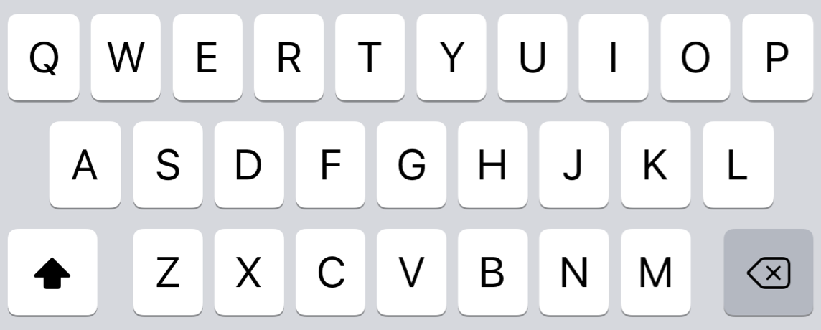
Let‘s Test Our New Swipe Feature
Swipe
No Swipe
How to Evaluate Results

Slide 10

How to Evaluate Results

Slide 11
Example
Swipe users type very fast
Typing with Swipe increases the typing performance (H1) and decreases workload (H2) compared to typing without Swipe.
Typing performance can operationalized by
words per minute (WPM)
characters per minute (CPM)
error rate
number of wrong / number of total words
number of backspace presses / number of characters
Workload can be operationalized by
NASA Taskload Index TLX, Quantitative Workload Inventory QWI, CarMen-Q Questionnaire,…
Do you assume an effect on…. all measures?
How to Evaluate Results

Slide 12


The Hypothesis
You consider the hypothesis as an explanation
Statisticans consider the hypothesis as a signal (or its probability distribution)
Thus, to assess the meaning of a signal (and the hypothesis) we need a comparison
$$H_{1}$$
$$H_{0}$$
How to Evaluate Results

Slide 13


Comparing Hypotheses
Alternative Hypothesis (“H1”, “H2”…)
e.g., “There is a difference in typing speed between males and females“
Directional Hypothesis („H1a”):
e.g., “Males have a lower typing speed than females“
Null hypothesis (“H0”)
e.g., “There is no difference in typing speed between males and females“
$$S_{men}$$
$$S_{women}$$
difference statistically significant?
How to Evaluate Results

Slide 14

Comparing Two Prototypes
Within-subject: Counter-balanced order
Swipe → No Swipe
No Swipe → Swipe
Swipe
No Swipe
Participants with even IDs
No Swipe
Swipe
Participants with odd IDs
How to Evaluate Results

Slide 15
How to Evaluate Results

Slide 16
Comparing Two Prototypes
R
Means and Standard Deviations
# | No Swipe | Swipe
1 | 44.559 | 75.381
2 | 42.951 | 76.255
3 | 44.398 | 93.795
4 | 25.026 | 82.015
5 | 54.82 | 55.238
6 | 44.034 | 70.151
7 | 50.782 | 75.997
8 | 55.549 | 88.35
9 | 56.425 | 63.869
10 | 43.983 | 68.029
11 | 30.747 | 77.1
12 | 46.634 | 87.327
mean(swipe)
R
mean(no_swipe)
Words per minute (WPM)
No Swipe
Swipe
How to Evaluate Results

Slide 17
Comparing Two Prototypes
R
Means and Standard Deviations
# | No Swipe | Swipe
1 | 44.559 | 75.381
2 | 42.951 | 76.255
3 | 44.398 | 93.795
4 | 25.026 | 82.015
5 | 54.82 | 55.238
6 | 44.034 | 70.151
7 | 50.782 | 75.997
8 | 55.549 | 88.35
9 | 56.425 | 63.869
10 | 43.983 | 68.029
11 | 30.747 | 77.1
12 | 46.634 | 87.327
mean(swipe)
R
mean(no_swipe)
Mean = 76.126
Words per minute (WPM)
Mean = 44.992
No Swipe
Swipe
How to Evaluate Results

Slide 18
Comparing Two Prototypes
R
Means and Standard Deviations
# | No Swipe | Swipe
1 | 44.559 | 75.381
2 | 42.951 | 76.255
3 | 44.398 | 93.795
4 | 25.026 | 82.015
5 | 54.82 | 55.238
6 | 44.034 | 70.151
7 | 50.782 | 75.997
8 | 55.549 | 88.35
9 | 56.425 | 63.869
10 | 43.983 | 68.029
11 | 30.747 | 77.1
12 | 46.634 | 87.327
mean(swipe)
sd(swipe)
R
mean(no_swipe)
sd(no_swipe)
Mean = 76.126
SD = 10.917
Words per minute (WPM)
Mean = 44.992
SD = 9.454
No Swipe
Swipe
How to Evaluate Results

Slide 19
Descriptive Statistics: Text, Plot, or Table
„The average WPM without Swipe was M = 44.992 (SD = 9.454) while the average WPM using Swipe was M = 76.126 (SD = 10.917).“
Text
Keyboard | Mean WPM | SD WPM
No Swipe | 44.992 | 9.454
Swipe | 76.126 | 10.917
Table
Figure 3: Average typing speeds of Swipe and typing without. Error bars show standard deviation.
Combine visual with text or table
Plot
How to Evaluate Results

Slide 20
Comparing Two Prototypes
statistically significant difference/effect?
# | No Swipe | Swipe
1 | 44.559 | 75.381
2 | 42.951 | 76.255
3 | 44.398 | 93.795
4 | 25.026 | 82.015
5 | 54.82 | 55.238
6 | 44.034 | 70.151
7 | 50.782 | 75.997
8 | 55.549 | 88.35
9 | 56.425 | 63.869
10 | 43.983 | 68.029
11 | 30.747 | 77.1
12 | 46.634 | 87.327
Mean = 76.126
SD = 10.917
Words per minute (WPM)
Mean = 44.992
SD = 9.454
No Swipe
Swipe
How to Evaluate Results

Slide 21
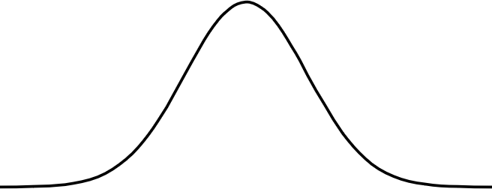
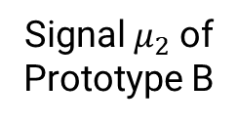
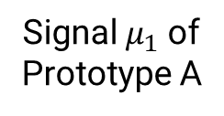
Statistical Significant Difference/Effect
statistically significant difference/effect?
Probability
Effect
= “What is the probability that the data is in favor of the alternative hypothesis (H1) and more likely to occur under the model including an effect than the model without it (H0)”?
Signal $μ_{1}$ of Prototype A
Signal $μ_{2}$ of Prototype B
How to Evaluate Results

Slide 22
Statistical Significant Difference/Effect
statistically significant difference/effect?
Probability
Effect
= “What is the probability that the data is in favor of the alternative hypothesis (H1) and more likely to occur under the model including an effect than the model without it (H0)”?
p < 0.05
α
Signal $μ_{1}$ of Prototype A
Signal $μ_{2}$ of Prototype B
How to Evaluate Results

Slide 23
Statistical Significance
A statistically significant effect (or difference) exists if the probability that the difference occurred is below a certain significance level
Significance level (α)
Lower significance level means higher evidence
Arbitrary, but typical significance level: α = 0.05
Significant results (p < α)
Null hypothesis can be rejected
“There is a statistically significant effect (or difference)”
Non-Significant results (p >= α)
Null hypothesis cannot be rejected
“We cannot conclude anything!”
How to Evaluate Results

Slide 24
Type I & Type II Errors
Let‘s say we have p = .028
Type I error (False Positive) non-existing effect found 2.8% |  | true | Effect found
 |  | false
false | true
Effect exists
How to Evaluate Results

Slide 25
Type I & Type II Errors
Let‘s say we have p = .028
Type I error (False Positive) non-existing effect found 2.8% | Correct (True Positive) existing effect was found 97.2% | true | Effect found
 |  | false
false | true
Effect exists
How to Evaluate Results

Slide 26
Type I & Type II Errors
Let‘s say we have p = .028
Type I error (False Positive) non-existing effect found 2.8% | Correct (True Positive) existing effect was found 97.2% | true | Effect found
Correct (True Negative) no effect exists, no effect found |  | false
false | true
Effect exists
How to Evaluate Results

Slide 27
Type I & Type II Errors
Let‘s say we have p = .028
Type I error (False Positive) non-existing effect found 2.8% | Correct (True Positive) existing effect was found 97.2% | true | Effect found
Correct (True Negative) no effect exists, no effect found | Type II error (False Negative) effect exists, but is not found | false
false | true
Effect exists
How to Evaluate Results

Slide 28
Type III and Type IV Errors
Type III: “Wrong hypothesis, right answer”
Researcher is either focusing on theory or on evaluation but not on the reasoning chain
Incorrect operationalization of variables
Poor theory (e.g., ad hoc explanations of findings)
Mis-identifying causal architecture
e.g.: focusing on inter-individual factors (gender- or age-related differences) rather than structural factors
Type IV: “Right hypothesis, wrong answer”
Collinearity among predictors
Aggregation bias
Wrong test
How to Evaluate Results

Slide 29
Statistical Power
Statistical power of a binary hypothesis test is the probability that a statistical test correctly rejects the null hypothesis (in %) when a specific alternative hypothesis is true.
Aspects that increase the statistical power
increase the statistical significance criterion (α = 0.05)
→ You need a justification why you increased α. Almost impossible because it is consensus.
more conditions
→ Statisticians have a trick to get around this
more measures
→ You need a justification why a measure is part of the research question
higher sample size
→ Invite more participants
higher effect size
→ Make something impactful (we like that)
reducing noise in your data
→ Decrease the variance to get statistically significant results
How to Evaluate Results

Slide 30
Statistical Power
Statistical power of a binary hypothesis test is the probability that a statistical test correctly rejects the null hypothesis (in %) when a specific alternative hypothesis is true.
Aspects that increase the statistical power
increase the statistical significance criterion (α = 0.05)
→ You need a justification why you increased α. Almost impossible because it is consensus.
more conditions
→ Statisticians have a trick to get around this
more measures
→ You need a justification why a measure is part of the research question
higher sample size
→ Invite more participants
higher effect size
→ Make something impactful (we like that)
reducing noise in your data
→ Decrease the variance to get statistically significant results
be very careful!
optimize for that!
How to Evaluate Results

Slide 31
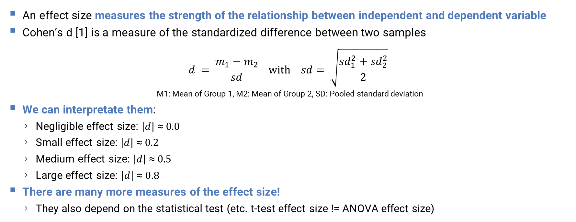
Estimate the Effect Size
An effect size measures the strength of the relationship between independent and dependent variable
Cohen’s d [1] is a measure of the standardized difference between two samples
$$d = \frac{m_{1}−m_{2}}{sd} with sd= \sqrt{\frac{{sd}_{1}^{2}+{sd}_{2}^{2}}{2}}$$ M1: Mean of Group 1, M2: Mean of Group 2, SD: Pooled standard deviation
We can interpretate them:
Negligible effect size: $\left|d\right| \text{≈} 0.0$
Small effect size: $\left|d\right| \text{≈} 0.2$
Medium effect size: $\left|d\right| \text{≈} 0.5$
Large effect size: $\left|d\right| \text{≈} 0.8$
There are many more measures of the effect size!
They also depend on the statistical test (etc. t-test effect size != ANOVA effect size)
[1] J. Cohen: Statistical Power Analysis for the Behavioral Sciences. 2. Auflage. Lawrence Erlbaum Associates, Hillsdale 1988, ISBN 0-8058-0283-5.
How to Evaluate Results

Slide 32
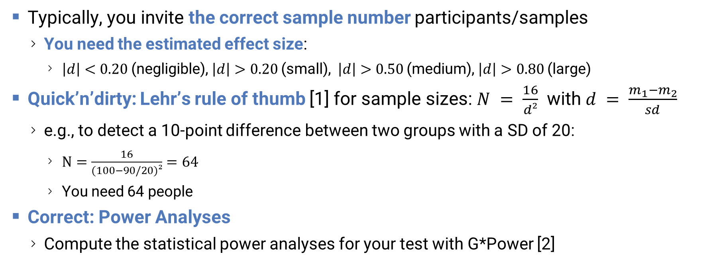
Estimate the Sample Size
Typically, you invite the correct sample number participants/samples
You need the estimated effect size:
$\left|d\right|<0.20$(negligible), $\left|d\right|>0.20$(small), $\left|d\right|>0.50$(medium), $\left|d\right|>0.80$(large)
Quick’n’dirty: Lehr’s rule of thumb [1] for sample sizes: $N = \frac{16}{d²}$ with $d = \frac{m_{1}−m_{2}}{sd}$
e.g., to detect a 10-point difference between two groups with a SD of 20:
$N=\frac{16}{(100−90/20)²}=64$
You need 64 people
Correct: Power Analyses
Compute the statistical power analyses for your test with G*Power [2]
[1] Robert Lehr (1992), "SixteenS-squared overD-squared: A relation for crude sample size estimates", Statistics in Medicine (in German), vol. 11, no. 8, pp. 1099–1102, doi:10.1002/sim.4780110811, ISSN 0277-6715
[2] https://www.psychologie.hhu.de/arbeitsgruppen/allgemeine-psychologie-und-arbeitspsychologie/gpower
How to Evaluate Results

Slide 33
Statistical Tests
We need a statistical tests to find statistically signficant effects
Before you start with any experimental research:
Ensure that there is a statistical test for your design
Determine the correct statistical test for your design
Experiment with placeholder data (e.g., from earlier or hypothetical experiments) if the test can be performed correctly:
The kind of data your dependent and independent variable
No Swipe
Swipe
How to Evaluate Results

Slide 34
Kind of Data
Kind | Continuous |  |  | Discrete
Data Type | Ratio Data | Interval Data | Ordinal Data | Nominal Data
Quantity | Devided numbers | Numbers with fixed intervals | Numbers you can sort | Things in categories
Examples | scores, bandwidth, speed, rates, throughput, words per minute… | distance in meters, time, temperature in C°, weight, … | marks in school (1,2,3,4,5,6), counts, ranks, orders, … | gender, countries, animals, groupsprototypes, scenarios…
Better, more generalizable
Data Properties | Parametric | Nonparametric Data
Variance | Homogeneous (equal) | Homo- and Hetereogeneous
Relationships | Independent | Any
Central Measure | Means Standard Deviation Standard Error 95% Confidence Interval | Median 25/50/75/95% Quantiles
Distribution | Normal | Any
Plot | Line Chart, Bar chart, etc. | Boxplot, Violinplot
Benefits | Generalizeable Can draw more conclusions | Simpel Robust against outliers
The tricky part
How to Evaluate Results

Slide 35
Statistical Test Checklist
Which test is the correct for my design? Depends on
The number of dependent variables in my hypothesis: ?
The kind of dependent variables: ?
The number of independent variables: ?
The kind of independent variables: ?
The levels of the independent variable: : ?
Are the independent variable between/within-subjects/both: ?
Is the DV really parametric data: ?
No Swipe
Swipe
How to Evaluate Results

Slide 36
Statistical Test Checklist
Which test is the correct for my design? Depends on
The number of dependent variables in my hypothesis: WPM → 1
The kind of dependent variables: words per minute → continous
The number of independent variables: Keyboard → 1
The kind of independent variables: Swipe, No Swipe → discrete
The levels of the independent variable: : Swipe, No Swipe → 2
Are the independent variable between/within-subjects/both: within
Is the DV really parametric data: ???
We have no idea unless we ran the study. There are different tests for parametric and non-parametric data!
No Swipe
Swipe
How to Evaluate Results

Slide 37
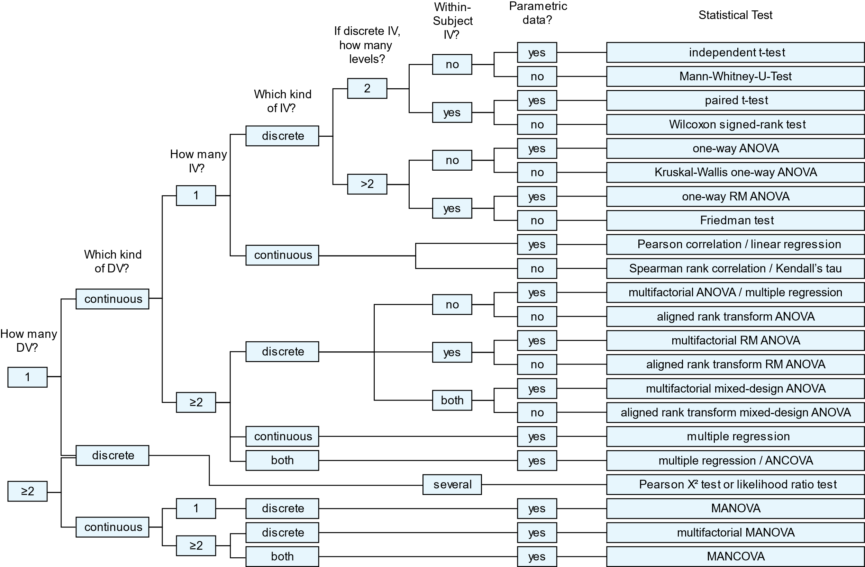
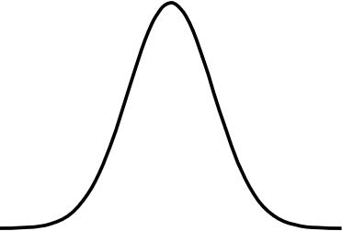
Test Selection
No Swipe
Swipe
Normally Distributed?
How to Evaluate Results

Slide 38













Parametric Data = Normal Distributed Data
99.73%
Probability
95.43%
68.27%
$$φ\left(x\right)= \frac{1}{\sqrt{2π}}e^{−\frac{1}{2}x²}$$
Parametric tests assume that this formula is true
$$x$$
$$\text{−5}\text{σ}$$
$$\text{−4}\text{σ}$$
$$\text{−3}\text{σ}$$
$$\text{−2}\text{σ}$$
$$\text{−1}\text{σ}$$
$$μ_{1}$$
$$\text{1}\text{σ}$$
$$\text{2}\text{σ}$$
$$\text{3}\text{σ}$$
$$\text{4}\text{σ}$$
$$\text{5}\text{σ}$$
Standard Deviation
How to Evaluate Results

Slide 39
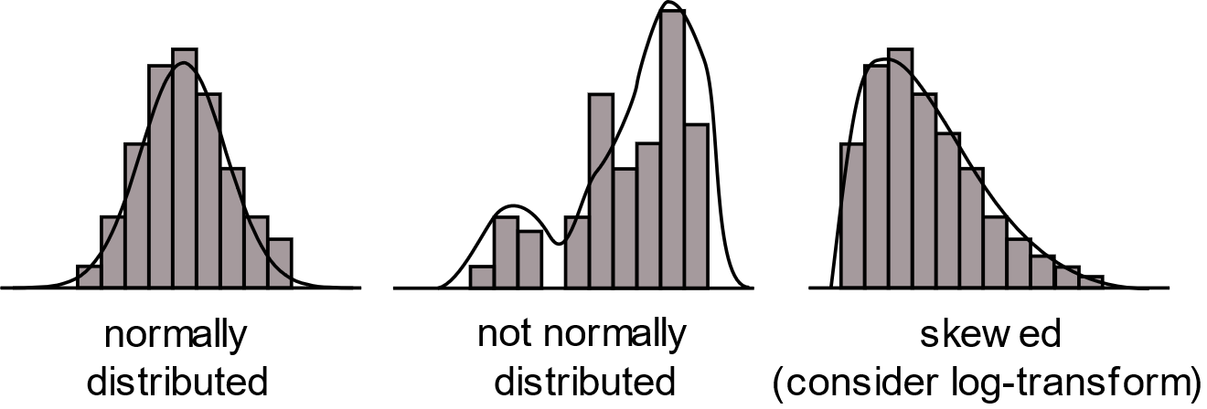
Normality
We try to convert it using log²( )…
R
log_a <- log(a)
normally distributed
not normally distributed
skewed (consider log-transform)
Parametric
Non-Parametric
Non-Parametric
How to Evaluate Results

Slide 40
Normality Test
Many statistical tests such as correlation, regression, t-test, and analysis of variance (ANOVA) require the data to follow a normal distribution or Gaussian distribution
These tests are called parametric tests, because their validity depends on the distribution of parametric data
Before using a parametric test, we must perform a test on normal distribution to make sure that the test assumptions are met
If not, non-paramatric tests are needed
There are non-parametric test, but not for every study design
Parametric tests allow less conclusions (e.g., on the significance of absolute values)
How to Evaluate Results

Slide 41
Shapiro-Wilk Normality Test
R
swipe <- c(44.559, 42.951, 44.398, 25.026, 54.82, 44.034, 50.782, 55.549, 56.425, 43.983, 30.747, 46.634)
no_swipe <- c(75.381, 76.255, 93.795, 82.015, 55.238, 70.151, 75.997, 88.35, 63.869, 68.029, 77.1, 87.327)
wpm <- c(swipe,no_swipe)
conditions <- c(rep("swipe",12),rep("no swipe",12))
tapply(wpm, conditions, shapiro.test)
normality test for each condition!
Probability
Effect
$`no swipe` Shapiro-Wilk normality test
W = 0.97899, p-value = 0.9793 $swipe Shapiro-Wilk normality test
W = 0.88793, p-value = 0.1108
both tests are not significant = normality of the data can be assumed
Signal $μ_{1}$ of Prototype A
Signal $μ_{2}$ of Prototype B
How to Evaluate Results

Slide 42
Test Selection
No Swipe
Swipe
Yes! Normally Distributed!
How to Evaluate Results

Slide 43

Paired t-Test
also called „dependent t-test“
is: $p < α$?
yes: $p =3.926 ∙ {10}^{−05}< 0.05 < 0.001$
The null hypothesis („that no statistical significant effect occured“) can be rejected (we like that)
What is „t“? What is„df“?
t = the test-statistic: the difference presented in units of the standard errors (the higher, the better)
df = N - 1: the degree of freedom
# | No Swipe | Swipe
1 | 44.559 | 75.381
2 | 42.951 | 76.255
3 | 44.398 | 93.795
4 | 25.026 | 82.015
5 | 54.82 | 55.238
6 | 44.034 | 70.151
7 | 50.782 | 75.997
8 | 55.549 | 88.35
9 | 56.425 | 63.869
10 | 43.983 | 68.029
11 | 30.747 | 77.1
12 | 46.634 | 87.327
R
t.test(swipe, no_swipe, paired = TRUE) Paired t-test
data: swipe and no_swipe
t = -6.5882, df = 11, p-value = 3.926e-05
alternative hypothesis: true difference in means is not equal to 0
Yes! Statistically significant!
How to Evaluate Results

Slide 44
Descriptive and Inferential Statistics: Text, Plot, and Table
„The average WPM without Swipe was M = 44.992 (SD = 9.454) while the average WPM using Swipe was M = 76.126 (SD = 10.917). A paired t-test revealed that the difference between them was statistically significant, t(7) = -6.589, p < .001.”
Text
p < .001
Pairwise Comparison | t(13) | p
No Swipe - Swipe | -6.589 | < .001
Table makes sense when you have more than one comparison…
Figure 3: Average typing speeds of Swipe and typing without. Error bars show standard deviation.
Plot
How to Evaluate Results

Slide 45
Descriptive and Inferential Statistics: Text, Plot, and Table
„The average WPM without Swipe was M = 44.992 (SD = 9.454) while the average WPM using Swipe was M = 76.126 (SD = 10.917). A paired t-test revealed that the difference between them was statistically significant, t(11) = -6.589, p < .001.”
Text
***
Asterisk Interpretation ns → not sig. * → p < .05
** → p < .01
*** → p < .001
Pairwise Comparison | t(11) | p
No Swipe - Swipe | -6.589 | < .001
Table makes sense when you have more than one comparison…
Figure 3: Average typing speeds of Swipe and typing without. Error bars show standard deviation.
Plot
How to Evaluate Results

Slide 46

But…
https://pxhere.com/de/photo/1582787
How to Evaluate Results

Slide 47
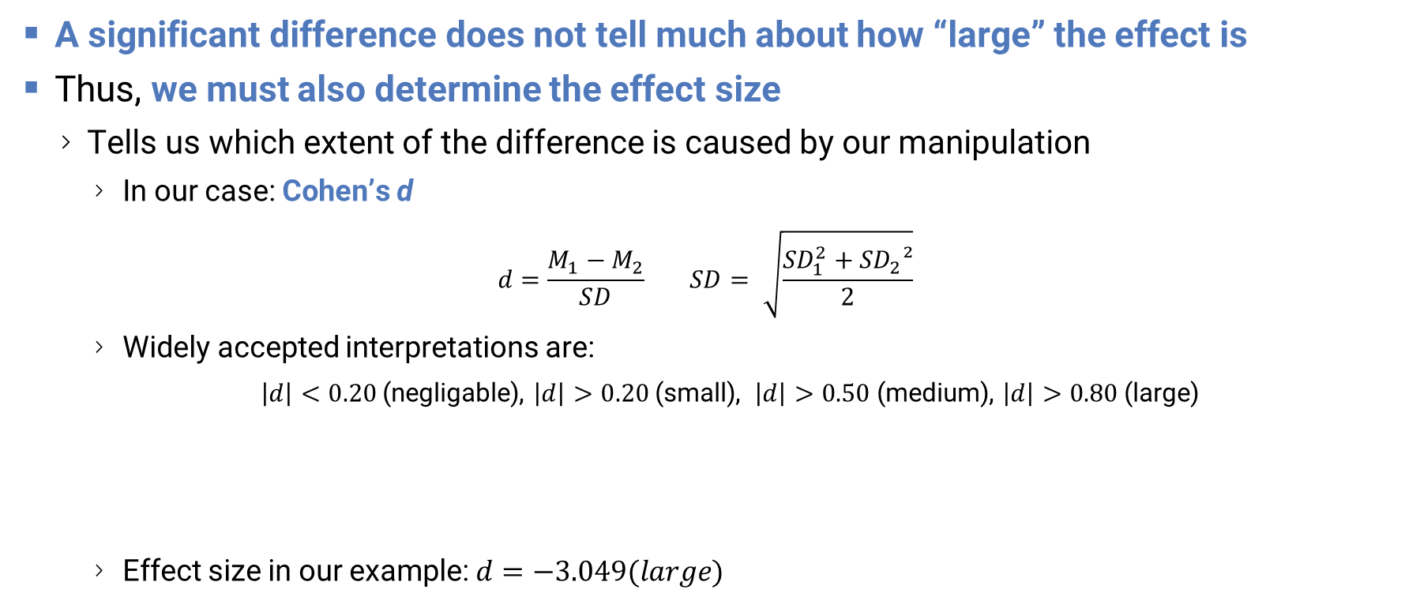
Statistically significant – but also important?
A significant difference does not tell much about how “large” the effect is
Thus, we must also determine the effect size
Tells us which extent of the difference is caused by our manipulation
In our case: Cohen’s d
$$d=\frac{M_{1}−M_{2}}{SD} SD= \sqrt{\frac{{SD}_{1}^{2}+{SD}_{2}²}{2}}$$
Widely accepted interpretations are:
$\left|d\right|<0.20$(negligable), $\left|d\right|>0.20$(small), $\left|d\right|>0.50$(medium), $\left|d\right|>0.80$(large)
Effect size in our example:$d=−3.049(large)$
R
(mean(swipe) - mean(no_swipe)) / sqrt((sd(swipe)^2 + sd(no_swipe)^2) / 2)
How to Evaluate Results

Slide 48
Descriptive and Inferential Statistics: Text, Plot, and Table
„The average WPM without Swipe was M = 44.992 (SD = 9.454) while the average WPM using Swipe was M = 76.126 (SD = 10.917). A paired t-test revealed that the difference between them was statistically significant, t(11) = -6.589, p < .001, and had a large effect size (d=−3.049).”
Text
***
Pairwise Comparison | t(13) | p | d
No Swipe - Swipe | -6.589 | < .001 | −3.049
Table makes sense when you have more than one comparison…
Figure 3: Average typing speeds of Swipe and typing without. Error bars show standard deviation.
Plot
How to Evaluate Results

Slide 49

https://pxhere.com/de/photo/781480
How to Evaluate Results

Slide 50

The Number of Tests
No Swipe
Swipe
VibroSwipe
How to Evaluate Results

Slide 51
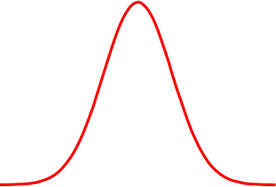
Adding a third condition…
R
# | No Swipe | Swipe | VibroSwipe
1 | 44.559 | 75.381 | 88.695
2 | 42.951 | 76.255 | 95.79
3 | 44.398 | 93.795 | 75.601
4 | 25.026 | 82.015 | 95.237
5 | 54.82 | 55.238 | 94.21
6 | 44.034 | 70.151 | 58.038
7 | 50.782 | 75.997 | 73.444
8 | 55.549 | 88.35 | 53.036
9 | 56.425 | 63.869 | 83.062
10 | 43.983 | 68.029 | 71.641
11 | 30.747 | 77.1 | 72.46
12 | 46.634 | 87.327 | 75.809
swipe <- c(44.559, 42.951, 44.398, 25.026, 54.82, 44.034, 50.782, 55.549, 56.425, 43.983, 30.747, 46.634)
no_swipe <- c(75.381, 76.255, 93.795, 82.015, 55.238, 70.151, 75.997, 88.35, 63.869, 68.029, 77.1, 87.327)
vibro_swipe <- c(88.695, 95.79, 75.601, 95.237, 94.21, 58.038, 73.444, 53.036, 83.062, 71.641, 72.46, 75.809)
wpm <- c(swipe, no_swipe, vibro_swipe)
conditions <- c(rep("No Swipe",12), rep("Swipe",12), rep("Vibro Swipe",12))
tapply(wpm, conditions, shapiro.test)
$`no swipe` Shapiro-Wilk normality test
W = 0.88793, p-value = 0.1108 $Swipe Shapiro-Wilk normality test
W = 0.97899, p-value = 0.9793 $`Vibro Swipe` Shapiro-Wilk normality test
W = 0.92701, p-value = 0.3495
Normally Distributed
How to Evaluate Results

Slide 52
Test Selection
No Swipe
Swipe
VibroSwipe
Also normally distributed
How to Evaluate Results

Slide 53
One-Way RM-ANOVA
One-Way = One Factor (your keyboard)
RM = Repeated Measures (every participant was exposed to every condition)
ANOVA = Analysis of Variance (the most used statistical test in the world)
RM-ANOVAs musk first ask for: „Are the variances of the differences between the within-subject conditions are equal?”
If yes: „sphericity“ can be assumed
→ you can proceed
If not: no „sphericity“ can be assumed
→ you need a kind of correction, to prevent an inflation of the F-ratio (the quality of how well the model fits the data)
How to Evaluate Results

Slide 54
WTF? Sphericity?
# | No Swipe | Swipe | VibroSwipe | A-B | A-C | B-C
1 | 44.559 | 75.381 | 88.695 | 44.559 | 75.381 | 88.695
2 | 42.951 | 76.255 | 95.79 | 42.951 | 76.255 | 95.79
3 | 44.398 | 93.795 | 75.601 | 44.398 | 93.795 | 75.601
4 | 25.026 | 82.015 | 95.237 | 25.026 | 82.015 | 95.237
5 | 54.82 | 55.238 | 94.21 | 54.82 | 55.238 | 94.21
6 | 44.034 | 70.151 | 58.038 | 44.034 | 70.151 | 58.038
7 | 50.782 | 75.997 | 73.444 | 50.782 | 75.997 | 73.444
8 | 55.549 | 88.35 | 53.036 | 55.549 | 88.35 | 53.036
9 | 56.425 | 63.869 | 83.062 | 56.425 | 63.869 | 83.062
10 | 43.983 | 68.029 | 71.641 | 43.983 | 68.029 | 71.641
11 | 30.747 | 77.1 | 72.46 | 30.747 | 77.1 | 72.46
12 | 46.634 | 87.327 | 75.809 | 46.634 | 87.327 | 75.809
Variances |  |  |  | 267,975 | 348,607 | 406,672
OR?
Comparable?
How to Evaluate Results

Slide 55
Creating a Table („data frame“) with Subject IDs…
R
swipe <- c(44.559, 42.951, 44.398, 25.026, 54.82, 44.034, 50.782, 55.549, 56.425, 43.983, 30.747, 46.634)
no_swipe <- c(75.381, 76.255, 93.795, 82.015, 55.238, 70.151, 75.997, 88.35, 63.869, 68.029, 77.1, 87.327)
vibro_swipe <- c(88.695, 95.79, 75.601, 95.237, 94.21, 58.038, 73.444, 53.036, 83.062, 71.641, 72.46, 75.809)
wpm <- c(swipe, no_swipe, vibro_swipe)
keyboard <- c(rep("No Swipe",12), rep("Swipe",12), rep("Vibro Swipe",12))
# normality check
tapply(wpm, keyboard, shapiro.test)
# to perform an RM-ANOVA, we need subject IDs (typically we have already a CSV with subject IDs
subjectID <- rep(seq(12, length=12),times=3)
# create the table / data frame with subject IDs and conditions as fixed factors
df <- data.frame(subjectID = as.factor(subjectID), conditions= as.factor(conditions), wpm)
# if not installed add: install.packages("rstatix")
library(rstatix) # load the library
# run the ANOVA
anova <- anova_test(data = df, dv = wpm, wid = subjectID, within = keyboard, effect.size = "pes")
# automatically does the sphericity correction if necessary (we like that)
get_anova_table(anova, correction = "auto")
Please note:
the data frame (df) has now this strange „long“ format
subjectID | keyboard | wpm
<fct> | <fct> | <dbl>
1 | swipe | 75.381
1 | noswipe | 86.255
2 | noswipe | 93.795
2 | swipe | 61.435
How to Evaluate Results

Slide 56
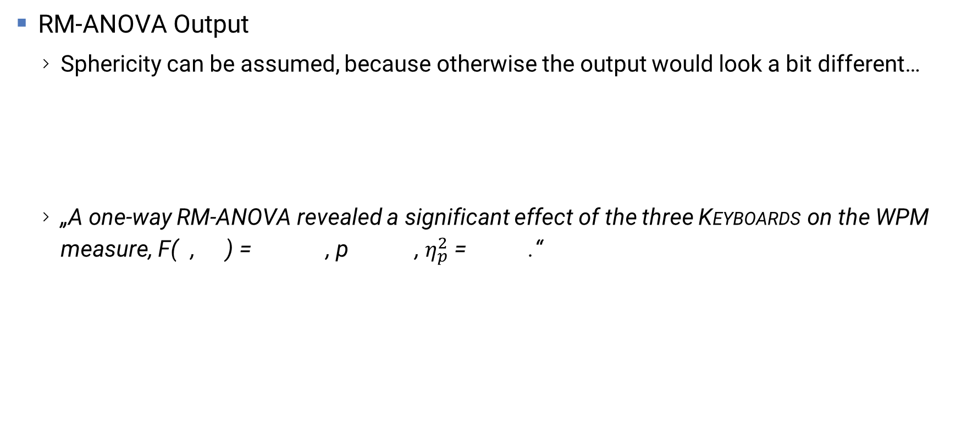
Reporting the RM-ANOVA Output
RM-ANOVA Output
Sphericity can be assumed, because otherwise the output would look a bit different…
„A one-way RM-ANOVA revealed a significant effect of the three Keyboards on the WPM measure, F(2, 26) = 25.124, p < .001, $η_{p}^{2} \text{=} \text{0.659}$.“
 | Effect | DFn | DFd | F | p | p<.05 | pes
1 | keyboard | 2 | 22 | 24.225 | 2.73e-06 | * | 0.688
How to Evaluate Results

Slide 57

Reporting the RM-ANOVA Output
RM-ANOVA Output
Sphericity can be assumed, because otherwise the output would look a bit different…
„A one-way RM-ANOVA revealed a significant effect of the three Keyboards on the WPM measure, F(2, 22) = 24.225, p < .001, $η_{p}^{2} \text{=} \text{0.6}\text{88}$.“
 | Effect | DFn | DFd | F | p | p<.05 | pes
1 | conditions | 2 | 22 | 24.225 | 2.73e-06 | * | 0.688
How to Evaluate Results

Slide 58
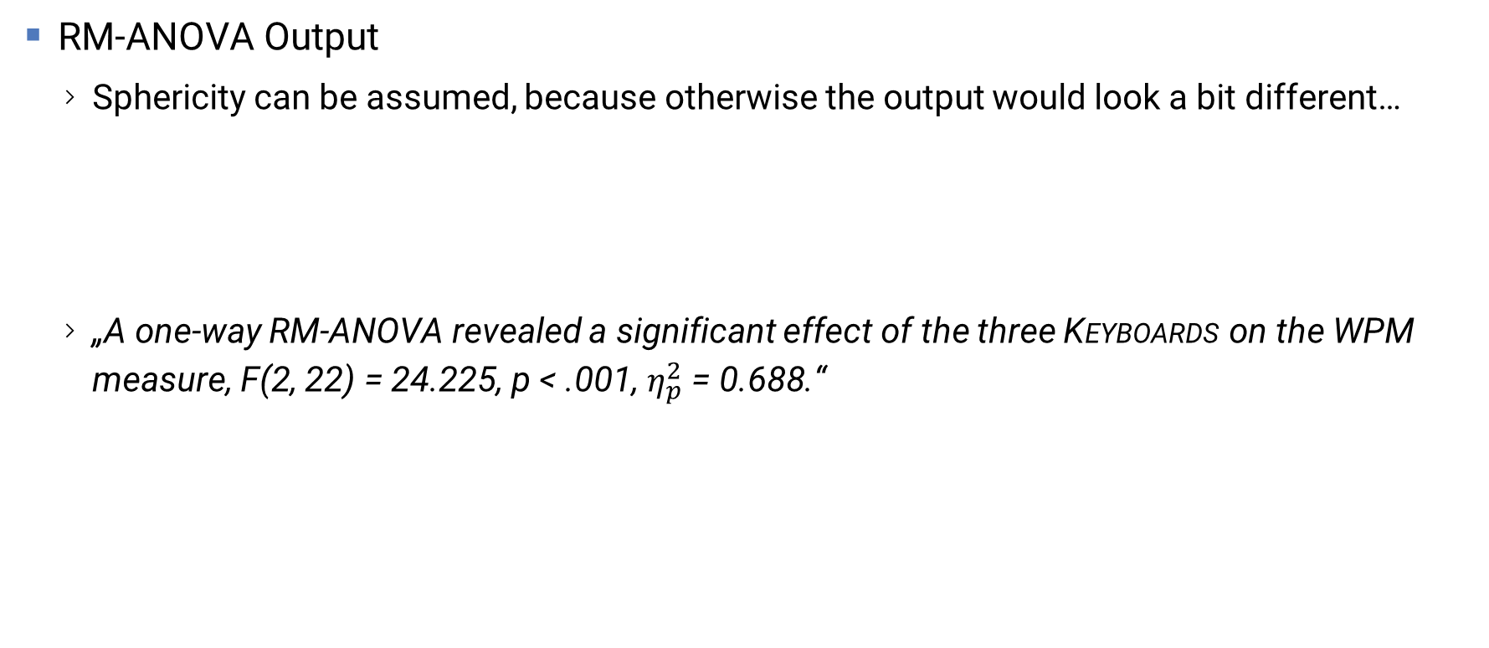
Reporting the RM-ANOVA Output
RM-ANOVA Output
Sphericity can be assumed, because otherwise the output would look a bit different…
„A one-way RM-ANOVA revealed a significant effect of the three Keyboards on the WPM measure, F(2, 22) = 24.225, p < .001, $η_{p}^{2} \text{= 0.688}$.“
 | Effect | DFn | DFd | F | p | p<.05 | pes
1 | keyboard | 2 | 22 | 24.225 | 2.73e-06 | * | 0.688
How to Evaluate Results

Slide 59
Reporting the RM-ANOVA Output
RM-ANOVA Output
Sphericity can be assumed, because otherwise the output would look a bit different…
„A one-way RM-ANOVA revealed a significant effect of the three Keyboards on the WPM measure, F(2, 22) = 24.225, p < .001, $η_{p}^{2} \text{= 0.688}$.“
 | Effect | DFn | DFd | F | p | p<.05 | pes
1 | conditions | 2 | 22 | 24.225 | 2.73e-06 | * | 0.688
Effect!
But between which conditions?
Probability
How to Evaluate Results

Slide 60
Post Hoc Analysis
When the ANOVA revealed an effect, we can run post hoc analysis to show between which conditions significant differences exists
(We must still consider if we need parametrical or nonparametrical tests)
Parametrical data: paired t-tests
Nonparametrical data: paired Wilcoxon signed-rank tests
R
pairwise.t.test(wpm, conditions, paired = TRUE)
BIG PROBLEM!!!
How to Evaluate Results

Slide 61
The Number of Tests
No Swipe
Swipe
VibroSwipe
Test #1
Test #2
Test #3
= 3 TESTS!
How to Evaluate Results

Slide 62
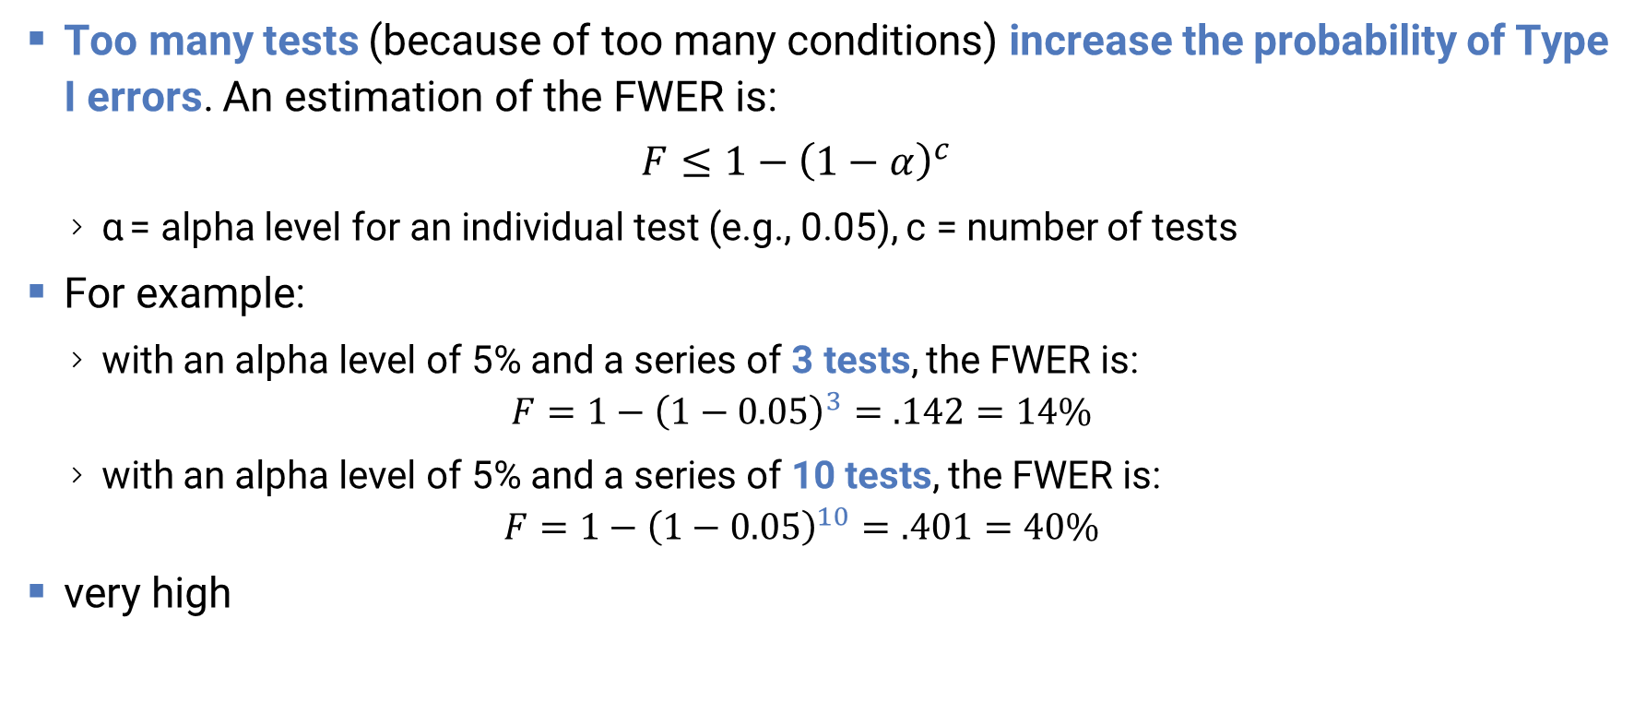
Familywise Error Rate (FWER)
Too many tests (because of too many conditions) increase the probability of Type I errors. An estimation of the FWER is:
$$F≤1−{\left(1−α\right)}^{c}$$
α = alpha level for an individual test (e.g., 0.05), c = number of tests
For example:
with an alpha level of 5% and a series of 3 tests, the FWER is: $F=1−{\left(1−0.05\right)}^{3}=.142=14\%$
with an alpha level of 5% and a series of 10 tests, the FWER is: $F=1−{\left(1−0.05\right)}^{10}=.401=40\%$
very high
How to Evaluate Results

Slide 63
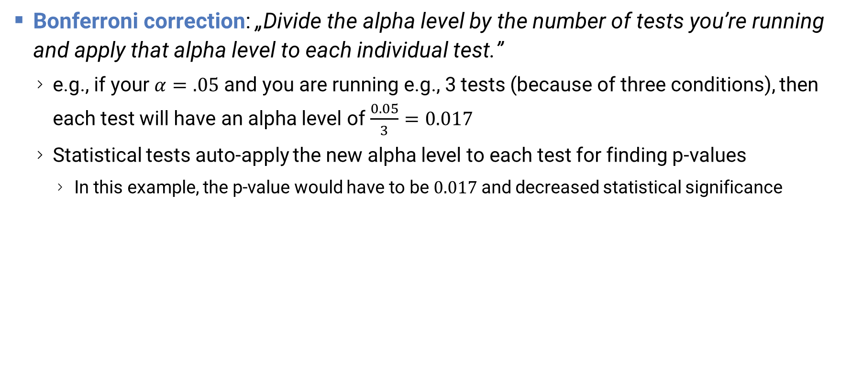
Statisticians must correct this….
Bonferroni correction: „Divide the alpha level by the number of tests you’re running and apply that alpha level to each individual test.”
e.g., if your $α=.05$ and you are running e.g., 3 tests (because of three conditions), then each test will have an alpha level of $\frac{0.05}{3}=0.017$
Statistical tests auto-apply the new alpha level to each test for finding p-values
In this example, the p-value would have to be $0.017$ and decreased statistical significance
R
pairwise.t.test(wpm, conditions, p.adj = "bonf", paired = TRUE)
multiple tests means: we need Bonferroni correct p-value adjustment
How to Evaluate Results

Slide 64
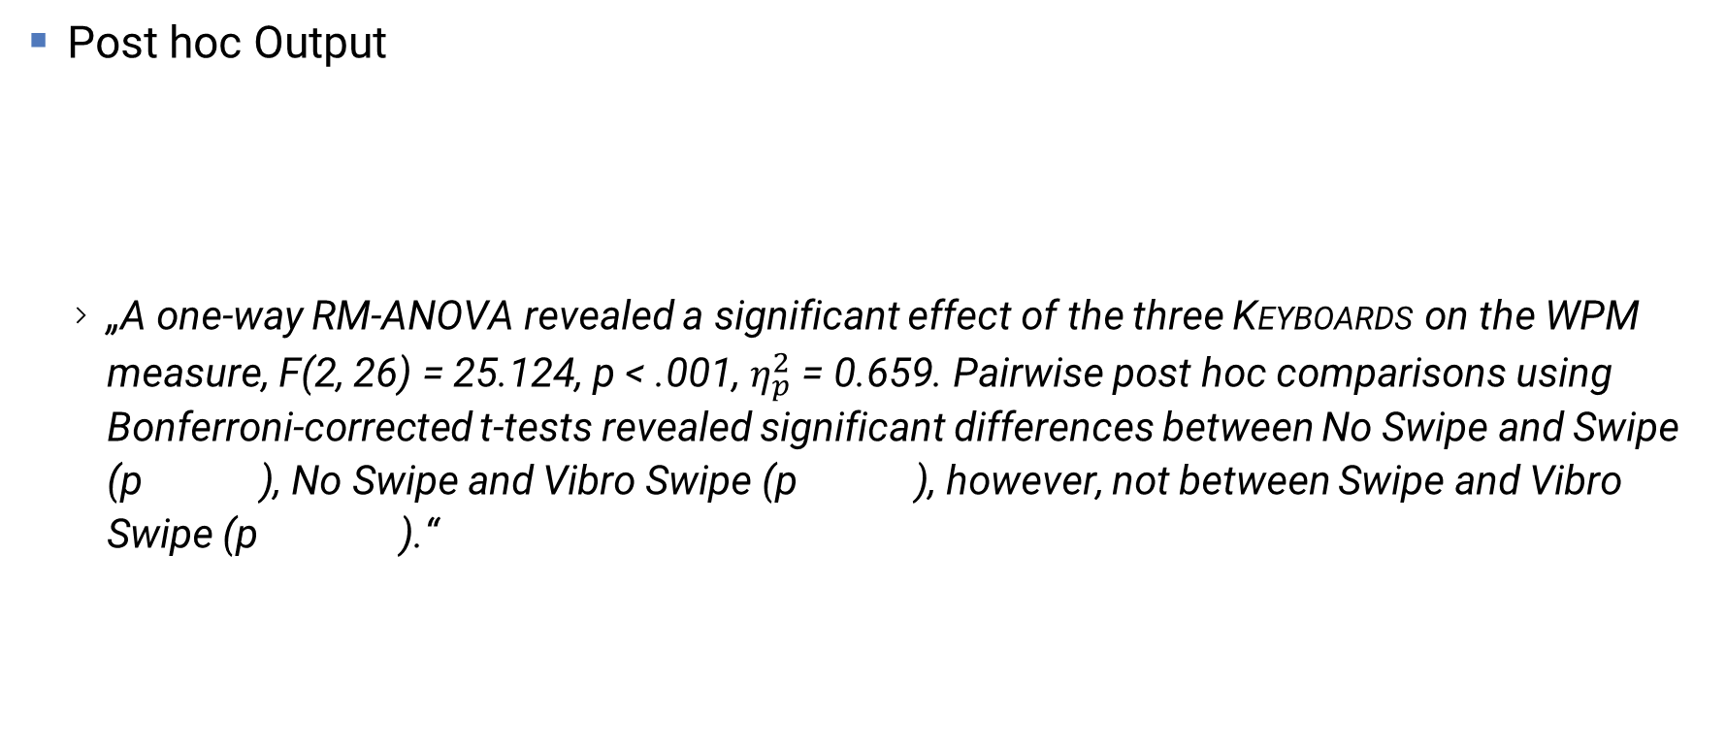
Reporting the RM-ANOVA and Post hoc test
Post hoc Output
„A one-way RM-ANOVA revealed a significant effect of the three Keyboards on the WPM measure, F(2, 26) = 25.124, p < .001, $η_{p}^{2} \text{=}\text{ 0.659}$. Pairwise post hoc comparisons using Bonferroni-corrected t-tests revealed significant differences between No Swipe and Swipe (p < .001), No Swipe and Vibro Swipe (p < .001), however, not between Swipe and Vibro Swipe (p = 1.000).“
 | No Swipe | Swipe
Swipe | 0.00012 | -
Vibro Swipe | 0.00022 | 1.00000
How to Evaluate Results

Slide 65
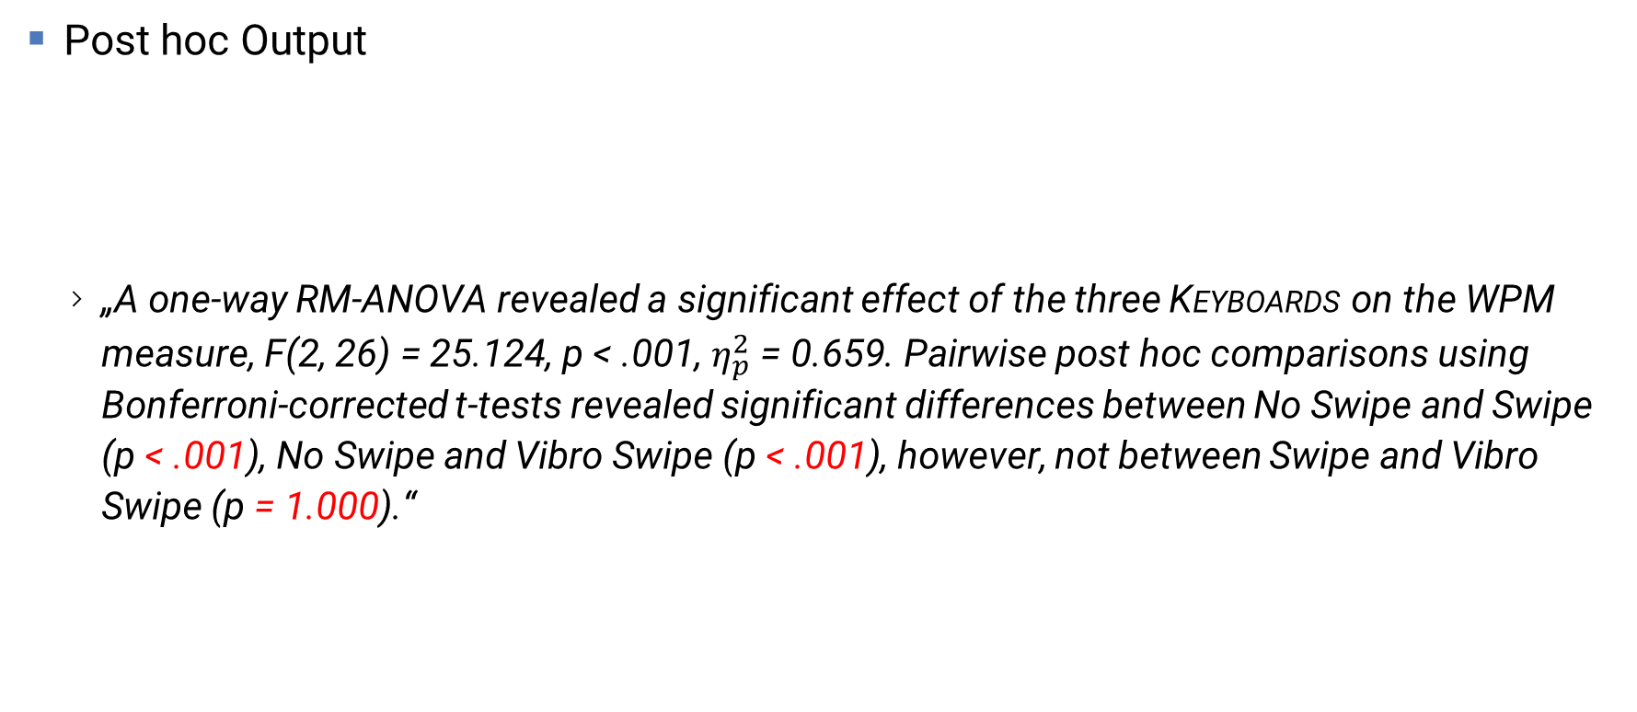
Reporting the RM-ANOVA and Post hoc test
Post hoc Output
„A one-way RM-ANOVA revealed a significant effect of the three Keyboards on the WPM measure, F(2, 26) = 25.124, p < .001, $η_{p}^{2} \text{=}\text{ 0.659}$. Pairwise post hoc comparisons using Bonferroni-corrected t-tests revealed significant differences between No Swipe and Swipe (p < .001), No Swipe and Vibro Swipe (p < .001), however, not between Swipe and Vibro Swipe (p = 1.000).“
 | No Swipe | Swipe
Swipe | 0.00012 | -
Vibro Swipe | 0.00022 | 1.00000
How to Evaluate Results

Slide 66
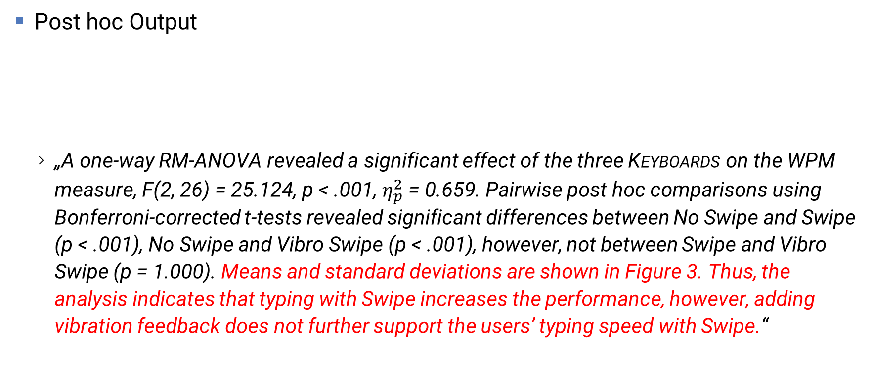
Reporting the RM-ANOVA and Post hoc test
***
***
Post hoc Output
„A one-way RM-ANOVA revealed a significant effect of the three Keyboards on the WPM measure, F(2, 26) = 25.124, p < .001, $η_{p}^{2} \text{=}\text{ 0.659}$. Pairwise post hoc comparisons using Bonferroni-corrected t-tests revealed significant differences between No Swipe and Swipe (p < .001), No Swipe and Vibro Swipe (p < .001), however, not between Swipe and Vibro Swipe (p = 1.000). Means and standard deviations are shown in Figure 3. Thus, the analysis indicates that typing with Swipe increases the performance, however, adding vibration feedback does not further support the users’ typing speed with Swipe.“
 | No Swipe | Swipe
Swipe | 0.00012 | -
Vibro Swipe | 0.00022 | 1.00000
Figure 3: Average typing speeds without Swipe, with Swipe, and with VibroSwipe. Error bars show standard deviation.
How to Evaluate Results

Slide 67
Multi-Factorial Study Design
Next example: SWIPE × VISUAL FEEDBACK × TACTILE FEEDBACK
16 participants in a balanced Latin square
What is the effect on typing performance? Can we evaluate this?
No Tactile Feedback
With Tactile Feedback
No Swipe
Swipe
No Swipe
Swipe
No Visual Feedback
No Visual Feedback
With Visual Feedback
With Visual Feedback
How to Evaluate Results

Slide 68
Test Selection
How to Evaluate Results

Slide 69
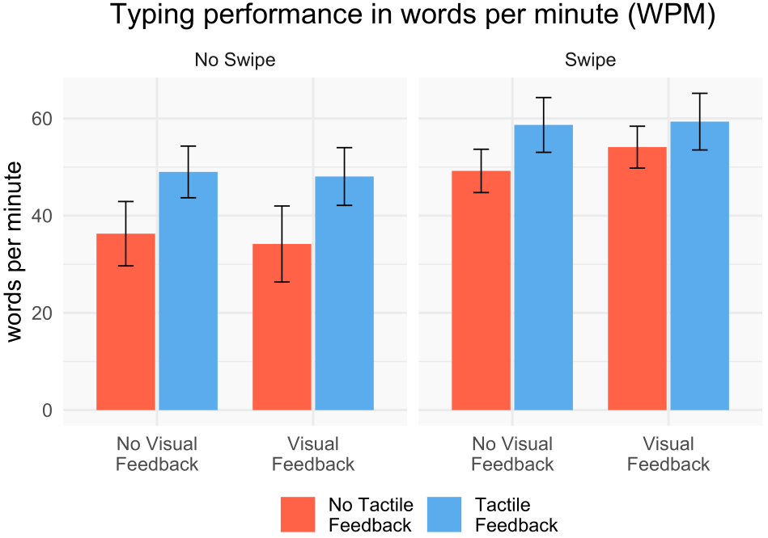
Three-Way RM ANOVA
R
library(rstatix)
anova <- anova_test(data = df, dv = wpm, wid = subjectID, within = c(swipe, visual, tactile), effect.size = "pes")
get_anova_table(anova, correction = "auto")
Effect | DFn | DFd | F | p | p<.05 |  | pes
1 | swipe | 1 | 15 | 63.590 | 8.96e-07 | * | 0.809
2 | visual | 1 | 15 | 0.145 | 7.09e-01 |  | 0.010
3 | tactile | 1 | 15 | 21.494 | 3.23e-04 | * | 0.589
4 | swipe:visual | 1 | 15 | 0.952 | 3.45e-01 |  | 0.060
5 | swipe:tactile | 1 | 15 | 7.227 | 1.70e-02 | * | 0.325
6 | visual:tactile | 1 | 15 | 0.132 | 7.22e-01 |  | 0.009
7 | swipe:visual:tactile | 1 | 15 | 0.308 | 5.87e-01 |  | 0.020
Main Effect of Swipe. Main Effect of Tactile. No main effect of Visual.
Interaction Effect: Swipe and Tactile combined increases the WPM! Higher effect size: Swipe
How to Evaluate Results

Slide 70
Three-Way RM ANOVA
R
library(rstatix)
anova <- anova_test(data = df, dv = wpm, wid = subjectID, within = c(swipe, visual, tactile), effect.size = "pes")
get_anova_table(anova, correction = "auto")
Effect | DFn | DFd | F | p | p<.05 | pes
1 | swipe | 1 | 15 | 63.590 | 8.96e-07 | * | 0.809
2 | visual | 1 | 15 | 0.145 | 7.09e-01 |  | 0.010
3 | tactile | 1 | 15 | 21.494 | 3.23e-04 | * | 0.589
4 | swipe:visual | 1 | 15 | 0.952 | 3.45e-01 |  | 0.060
5 | swipe:tactile | 1 | 15 | 7.227 | 1.70e-02 | * | 0.325
6 | visual:tactile | 1 | 15 | 0.132 | 7.22e-01 |  | 0.009
7 | swipe:visual:tactile | 1 | 15 | 0.308 | 5.87e-01 |  | 0.020
Once you have your study design, you later only need to change the dependent variable!
-Of course, you check again for data type and normal distribution, etc.
Main Effect of Swipe. Main Effect of Tactile. No main effect of Visual.
Interaction Effect: Swipe and Tactile combined increases the WPM!
How to Evaluate Results

Slide 71
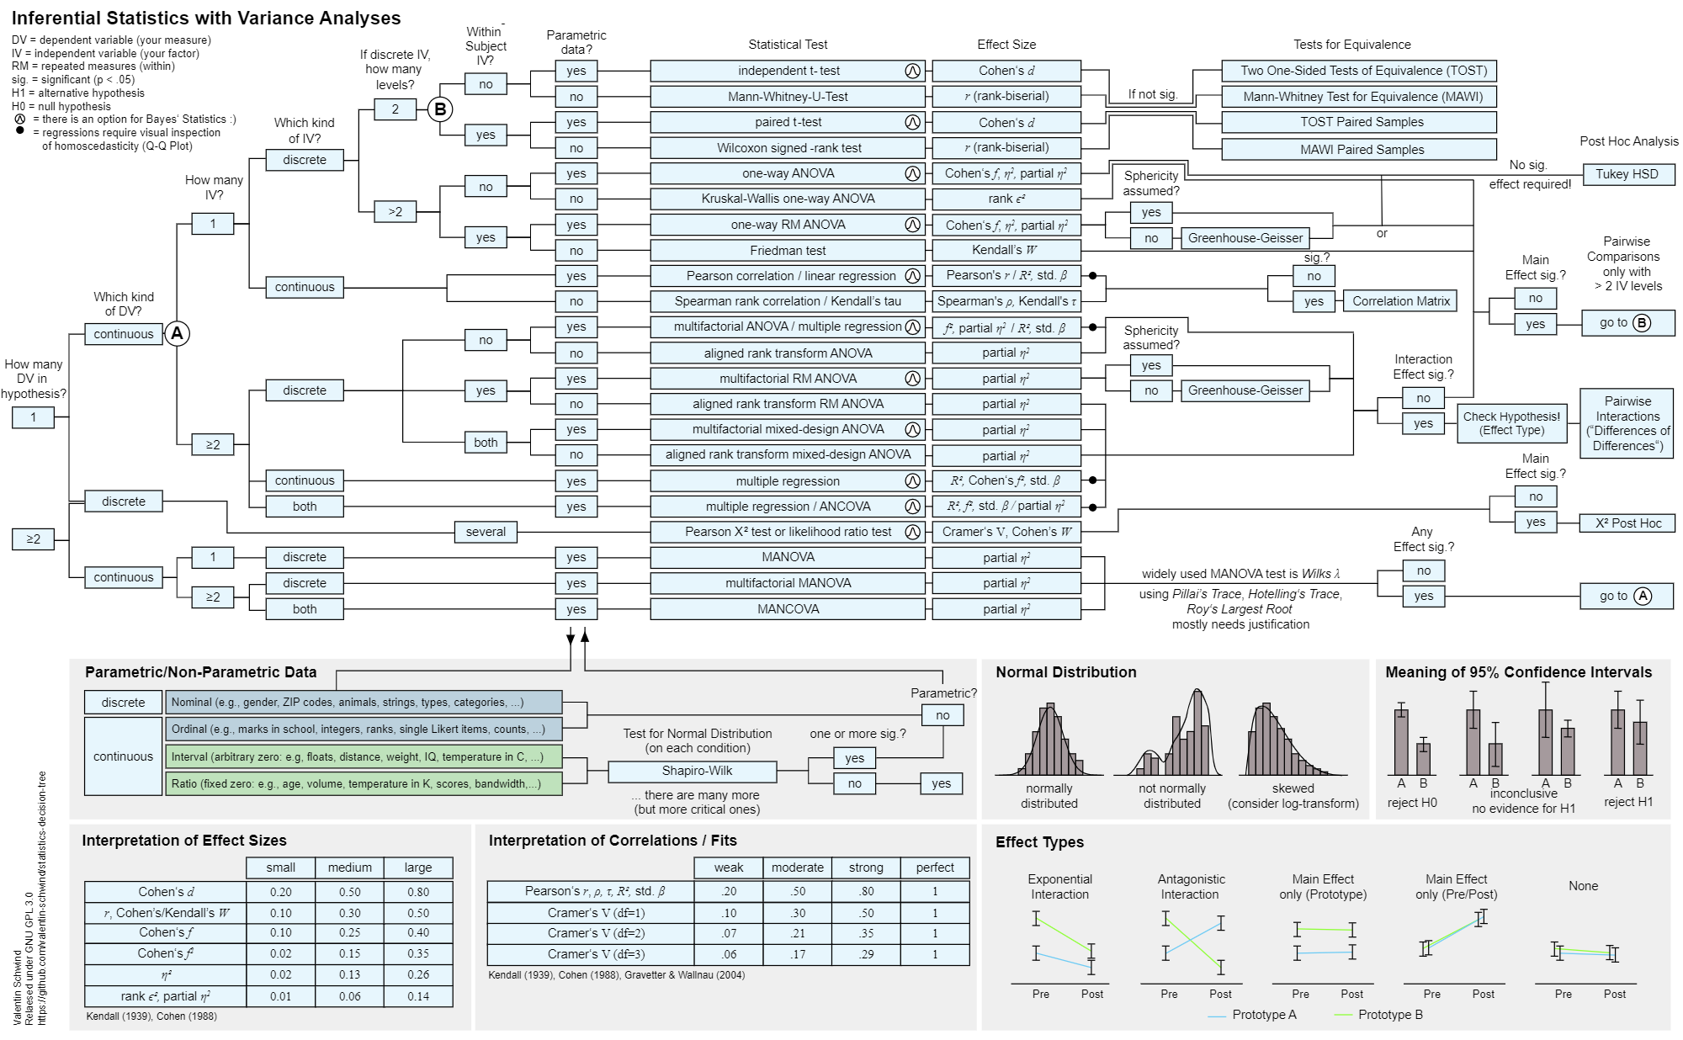
How to Evaluate Results

Slide 72
Exercise: Find your Test
When you want answer your research question with quantitative methods, use our statistical decision tree to find your test
https://hci-studies.org/ → Statistical Decision Tree
The tree is the ultimate thing
Discuss in your team:
Which measures do you have?
Which statistical test is the correct one for the measure?
Write down all the tests (e.g., „Friedman test“)
Google the tests (e.g., „Friedman test in R“)
https://www.datanovia.com/en/lessons/friedman-test-in-r/
If there is a result, you can be sure that you can evaluate your user study!
How to Evaluate Results

Slide 73
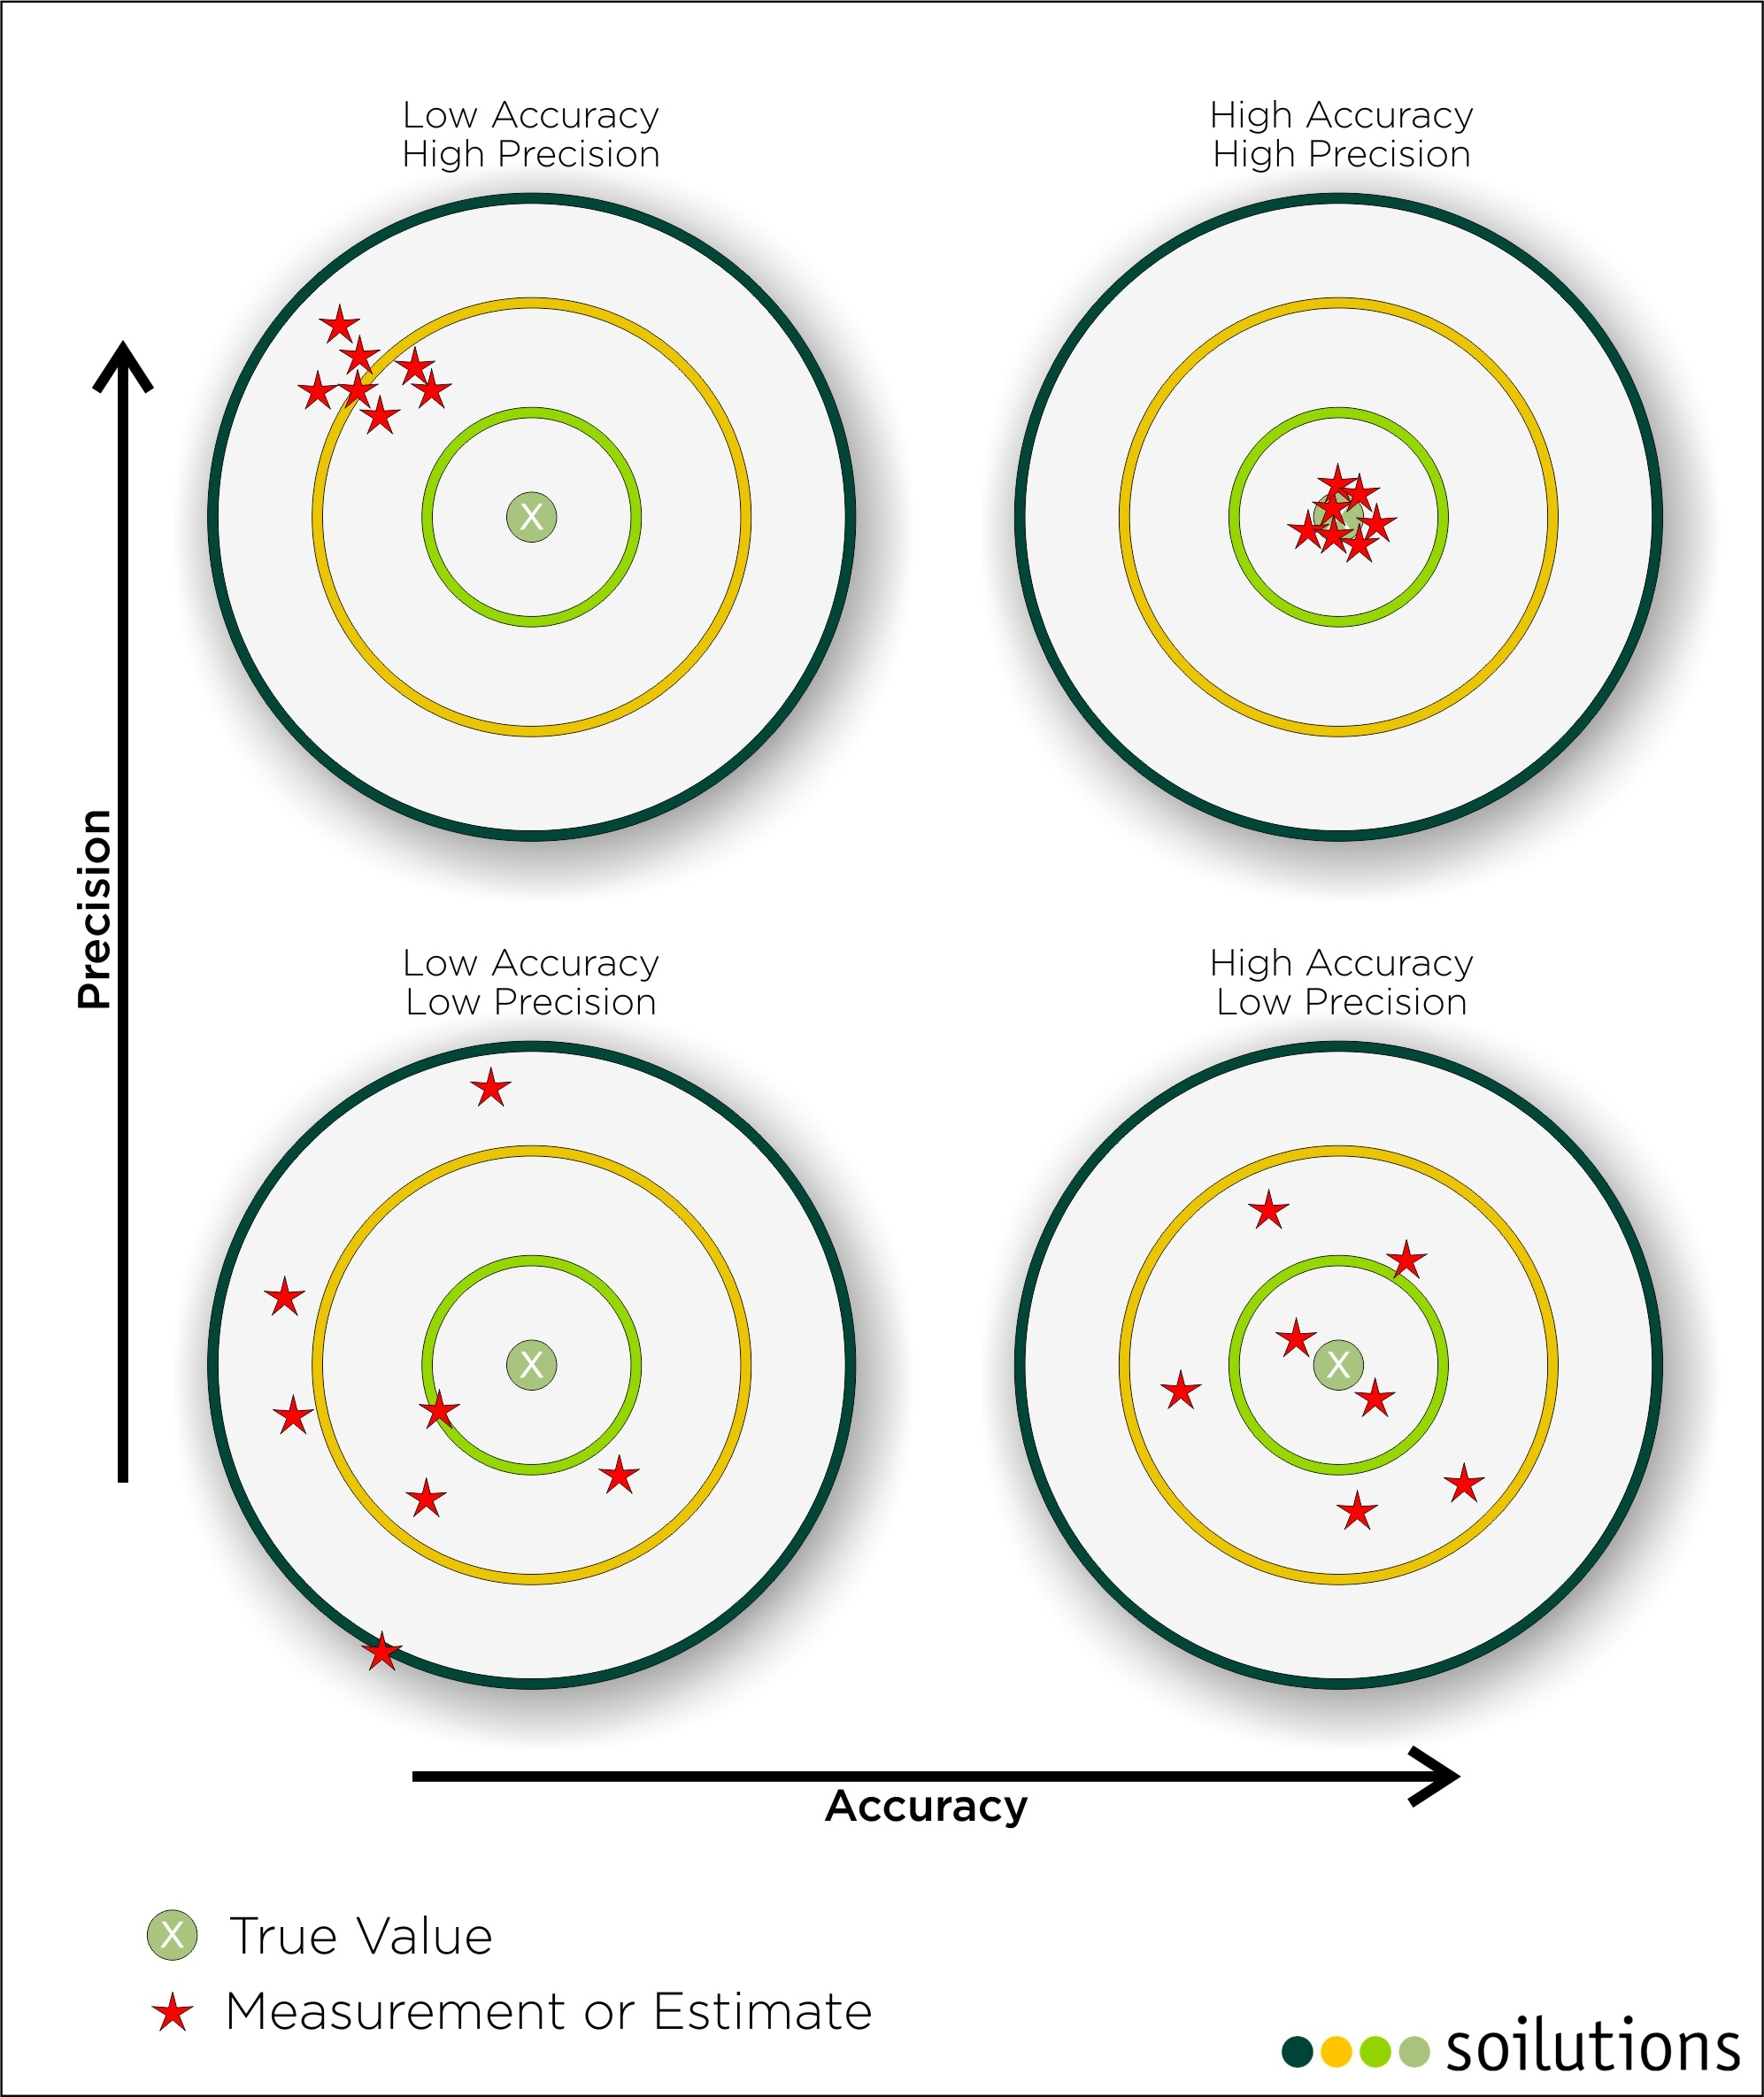
What‘s next? – An Example
Precision vs Accuarcy
Why is low accuracy better than low precision?
What can we do with that knowledge?
Image from: https://www.soilutions.co.uk/tag/precision-verses-accuracy/
How to Evaluate Results

Slide 74
Did we forget something?
How to Evaluate Results

Slide 75

Evaluating Qualitative Data
Human-Computer Interaction Exercise
The following content is licensed under a Creative Commons Attribution 4.0 International license (CC BY-SA 4.0)

Slide 76
Qualitative Data
Are not based on hypotheses and cannot be tested with quantitative methods
You can „count“ stuff (e.g., opinions, answers, words, utterances, observations, …) but this belongs to a quantitative evaluations or additionally include a content analysis!
Contain
feedback: perspectives, opinions, thoughts, subjective impressions, anticipations, …
observations: behavior, gestures, emotions, person-object or person-person relations,…
Explain
why something happens
what people think
relationsships in your data
Important: the analysis does not discriminate how often (or rarely) cases in the data occur!
How to Evaluate Results

Slide 77
Qualitative Data Analysis
Text
Audio Video
Findings
Experiment
Data
Qualitative
Qualitative Analysis
Thematic/Content analysis
Grounded theory
All records, trancscipts must be analyzed. Be careful with transcription effort!
There are more, but we do this…
How to Evaluate Results

Slide 78
Thematic/Content Analysis vs Grounded Theory
Thematic Analysis
Grounded Theory
Text
Audio Video
Transcription
Categories, Themes, Relations
Highly recommended when you have a pure qualitative study
Text
Audio Video
Transcription
Categories, Themes, Relations
Theory / Model
How to Evaluate Results

Slide 79
Transcribing
Only transcripts can be coded and analyzed
sentence-wise, line-wise, paragraph-wise
Speech must be transcripted as clear, readable verbatim text
e.g., audio raw data → [timecode, participant, condition, text] → table
Observations must be annotated
e.g., video raw data → [timecode, participant , condition, annotation] → table
Transcribed text must be translated into English
You can translate while transcription – but be consistent
You can translate after transcription e.g., automatically by a native speaker or professional program
but someone who can speak English must proofread it
More Tips: http://www.qualitative-researcher.com/qualitative-analysis/using-excel-for-qualitative-data-analysis/
How to Evaluate Results

Slide 80
Transcribed Video Protocol: Example
Add translation, codes, themes
ID | Time | Q/R | SubjectID | Gender | Condition | Transcribed Utterance (Video) | Observed Action (Video)
…
130 | 13:12 | R | 4 | m | Male | Unterseite der männlichen Hände wirkt sehr überzeugend. Sie wirken wie die eigenen. | Turning arms around several times.
131 | 13:13 | R | 4 | m | Male | Die Behaarung der Hände bricht die Überzeugung. | Grabs the underside of the right arm.
132 | 13:13 | R | 4 | m | Male | Die Sounds steigern Immersion immens.
…
137 | 13:28 | R | 4 | m | Toon Hands | Die Hände gefallen eher mittelmäßig. Schlechter als die Männerhände. Fühlen sich überhaupt nicht an wie die eigenen Hände. Hände werden nach kurzer zeit "ausgeblendet". Leap bugs irritieren stark. | Shake hands in between.
…
153 | 13:32 | R | 4 | m | Abstract Hands | Abstraktionsgrad fühlt sich unnatürlich an. Nicht als eigene Hände akzeptierbar. Fehlende Flächen innerhalb der Hand irritieren enorm. Die schwebende Kugel innerhalb der Hand irritiert: da nicht befestigt.
154 | 13:33 |  | 4 | m | Abstract Hands |  | Pausing to take off glasses.
…
167 | 13:46 | R | 4 | m | Robot Hands | Besser als die Kapseln und Toonhände, dank dem „Volumen" der Hände. Zwischen abstrakt und realistisch. Männerhände fühlen sich echter an.
…
177 | 13:57 | R | 4 | m | Androgyne Hands | Glaubwürdiger, da näher an eigenen Händen.
…
187 | 13:05 | R | 4 | m | Female Hands | Wirken weniger glaubwürdig als androgyne. Fingernägel irritieren enorm. Sogar weniger glaubwürdig als Robohände. Sound zur implikation.
How to Evaluate Results

Slide 81
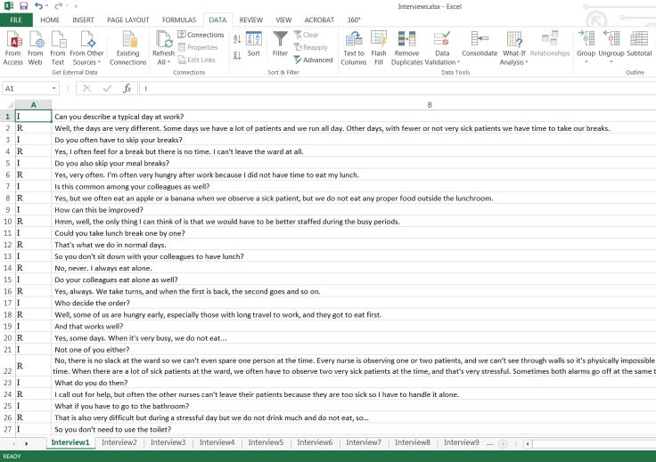
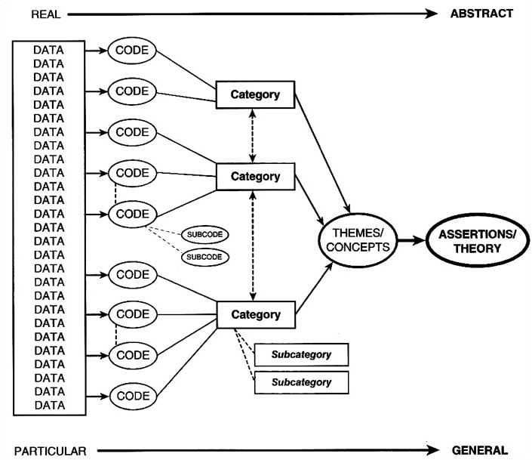
Example of Coding in Excel
Ose, S. O. (2016). Using Excel and Word to Structure Qualitative Data. Journal of Applied Social Science, 10(2), 147–162. https://doi.org/10.1177/1936724416664948
Saldaña, J. (2015). The coding manual for qualitative researchers (Third ed.): Sage.
How to Evaluate Results

Slide 82
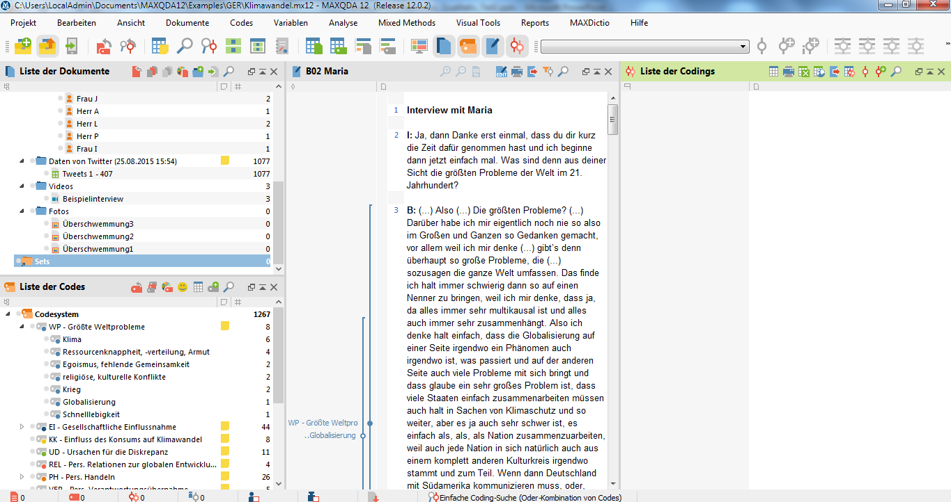
MAXQDA (Expensive)
How to Evaluate Results

Slide 83
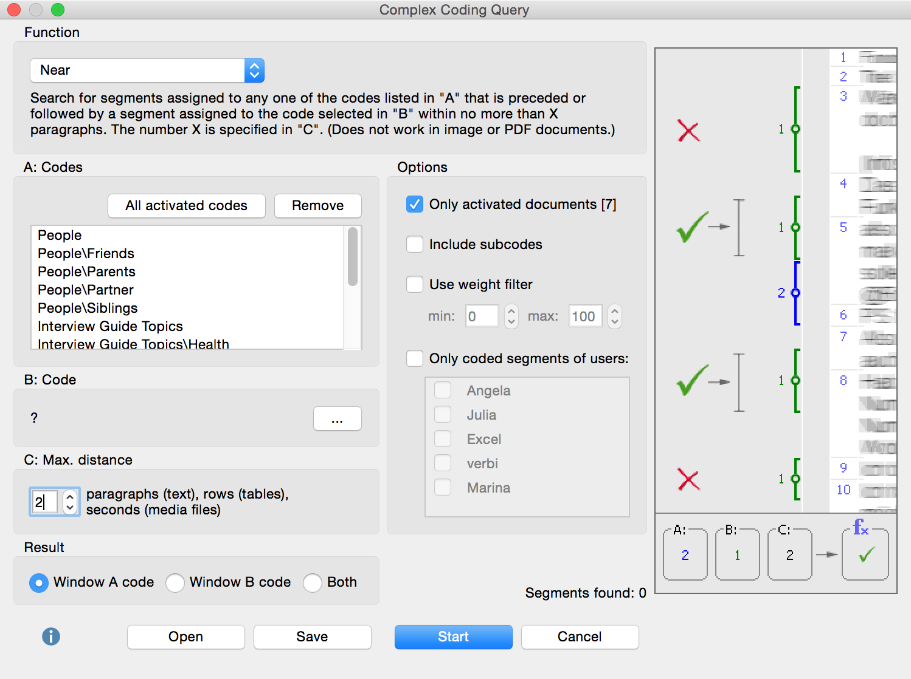
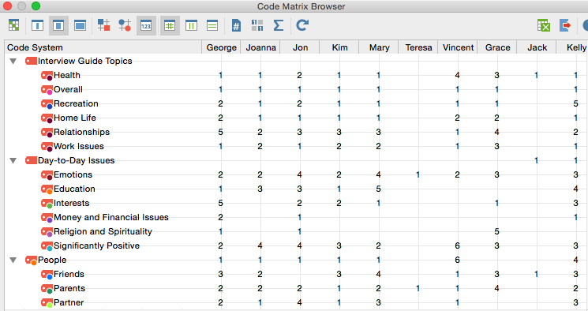
MAXQDA: Code-Matrix-Browser
How to Evaluate Results

Slide 84
Inductive vs Deductive Approach
Text
Audio Video
Inductive Analysis
Very easy and the traditional qualitative anaylsis approach
Categories are derived from the data
You do not need any prior knowledge
Deductive Analysis
Structure of the analysis & categories based on prior knowledge
Mostly used to test a theory
To test a hypothesis, we must gain a quantified outcome (e.g., a categorization matrix)
If prior knowledge (or the theory) does not match, we need an inductive analysis again
Text
Audio Video
How to Evaluate Results

Slide 85
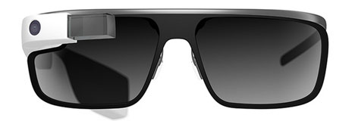
Example: Inductive Analysis
P3 (m): “my voice wasn’t always working…it came up saying ‘try again’”
A qualitative study investigating the acceptability of the Google Glass eyewear computer to people with Parkinson’s disease (PD) [1]
‘Hands on the Glass’ workshop: 5 patients, 2 therapeutists
5-day field study with 4 patients: 5 tasks, interviews on the experiences (via phone)
The workshop and interviews were audio recorded, which were transcribed and anonymised for later analysis.
Target concept: acceptability
Target group: people with parkinson
P5 (f): “the fact that it wasn’t recognising what I
wanted was very irritating and very frustrating”
P2 (m): “it’s better than a phone. With Parkinson’s you can’t text because you can’t hit the buttons. With the glass you would just talk, you can see what you’re doing, it’s just instant”
[1] McNaney, R., Vines, J., Roggen, D., Balaam, M., Zhang, P., Poliakov, I., & Olivier, P. (2014). Exploring the Acceptability of Google Glass As an Everyday Assistive Device for People with Parkinson’s. https://dl.acm.org/doi/10.1145/2556288.2557092
How to Evaluate Results

Slide 86
Example: Inductive Analysis
“We conducted an inductive thematic analysis [4] on transcribed data by coding it at the sentence to paragraph level and drawing out themes across the data set. The quotes used to describe themes illustrate themes drawn across all participants and data, with the exception of instances where we focus on individual differences (e.g., the ‘Wearing the Glass out and about’ section).” [1]
Workshop findings:
Issues and Frustrations, Confidence and Safety, Security and Vulnerability, Privacy
Field study findings:
Wearing Glass while ‘Out and About’, Frustrations, Appreciating Glass Wearing
Code common themes of the data set: Overview about the findings
[1] McNaney, R., Vines, J., Roggen, D., Balaam, M., Zhang, P., Poliakov, I., & Olivier, P. (2014). Exploring the Acceptability of Google Glass As an Everyday Assistive Device for People with Parkinson’s. https://dl.acm.org/doi/10.1145/2556288.2557092
How to Evaluate Results

Slide 87
Deductive Analysis
Categories are given
e.g., by another researcher, the theory, the research question
Allocation of the answers to the codes (“categories” or “themes”)
a categorization matrix can quantify the outcome
see repertory grid
useful in elicitation studies
see agreement rate
What to do with content that is not in the matrix?
Create extra categories analogous to the inductive procedure and repeat
Ignore it
How to Evaluate Results

Slide 88
Quality Criteria
Everything is recorded, clearly documented, and justified (process steps and code criteria)
Path from data to criteria is transparent (traceability)
Multiple data sources confirm codes (triangulation)
Intra-encoder Reliability: Consistency when the encoder encodes the same data again
Inter-encoder Reliability: Consistency when different encoders encode the same data
Dimensions of Quality Assessment
Agreement : Matched Cases / Total Cases
Cohen's Kappa: Agreement relativized by the coincidence that is possible by chance
Κ = (Pa - Pc)/(1 - Pc)
Pa = Percentage of Matches
Pc = Percentage of matches that can come about by chance

Slide 89
Example: Deductive Analysis
Part of an ongoing project: LGBTQ+ individuals’ information behaviour in online communities
“We applied the method of deductive thematic analysis informed by Aronson [1]. Deductive thematic analysis was chosen because it facilitates the interpretation of identifiable themes and patterns of behaviour. The data corpus was read a number of times and were copied into a document. A detailed reading was carried out where initial thoughts were noted. These notes are related to concepts and phrases that the researcher considered relevant to relatedness needs. The initial notes were transformed into the main themes of each posts and a list of specific themes were generated. At this stage the data were given to another rater who also generated a list of themes from the data. The two raters then discussed and negotiated the findings until an agreement was reached as to the validity and appropriateness of each theme. The data were again re-read and the themes were refined into more specific clusters based on RMT. Statements from the raw data were extracted to provide evidence of the existence of each theme within certain categories.” [2]
[1] Aronson, J. 1994. A pragmatic view of thematic analysis. Qualitative Report, 2(1), 1-3.
[2] Romy Menghao Jia, Jia Tina Du and Yuxiang Chris Zhao. 2021. Needs for Relatedness: LGBTQ+ Individuals’ Information Seeking and Sharing in an Online Community. In Proceedings of 2021 ACM SIGIR Conference on Human Information Interaction and Retrieval (CHIIR’21), March 2021, Canberra, Australia. ACM, New York, NY, USA, 4 pages. https://doi.org/10.1145/ 3406522.3446040
How to Evaluate Results

Slide 90
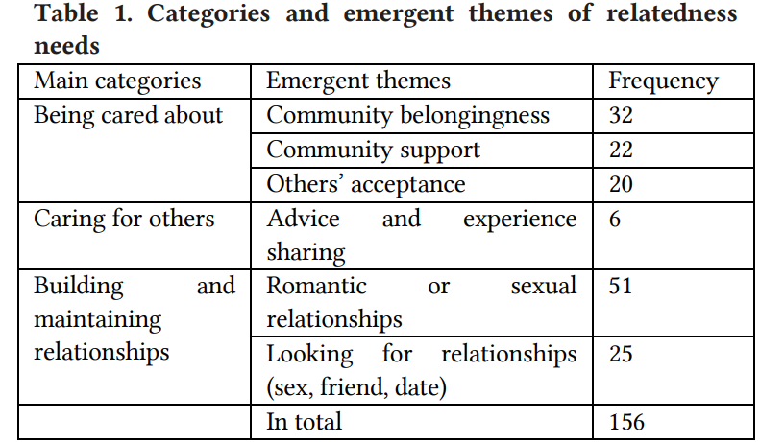
Example: Deductive Analysis
Romy Menghao Jia, Jia Tina Du and Yuxiang Chris Zhao. 2021. Needs for Relatedness: LGBTQ+ Individuals’ Information Seeking and Sharing in an Online Community. In Proceedings of 2021 ACM SIGIR Conference on Human Information Interaction and Retrieval (CHIIR’21), March 2021, Canberra, Australia. ACM, New York, NY, USA, 4 pages. https://doi.org/10.1145/ 3406522.3446040
How to Evaluate Results

Slide 91
Trustworthiness
Evaluators can have different interpretations of the data
Ways of establishing trustworthiness:
member check, interviewer corroboration, prolonged engagement, peer debriefing, negative case analysis
…
Concepts on which the researchers do not agree with each other can be resolved through discussion, a third researcher, or left open
How to Evaluate Results

Slide 92
Grounded Theory
Not a „theory“ but a methodology (≠ method)
→ a systematic, theoretical analysis of qualitative (and sometimes even quantative) data
Mostly used in the field of data analysis of qualitative feedback
Grounded theory is the process of deriving a high level of conceptual abstraction by assigning general concepts (codes) to singular incidences, relating, and identifying the core concept.
The goal of grounded theory is to systematically derive a clear and testable hypothesis or well-grounded theory
How to Evaluate Results

Slide 93
Grounded Theory and Thematic Analysis
In both, you take a body of data, such as
interview transcripts, observations, research literature, any protocols, videos, audio, images, social media posts, observation, posts, articles, research papers,…
In both, you search for
Opinions, phenomenons, artifacts in the data, events, data patterns
Any sampling does not depend on how often or how rarely cases in the data occur!
One single incidence can lead to a new theory!
In both, you identify common categories or themes in your data
Grounded Theory continues the process inductively and deductively to derive relationship and a new theory and more meaning around the related categories or themes
Requires a high level of abstraction
How to Evaluate Results

Slide 94
Analysis Process
Grounded theory analysis involves the following basic steps:
Data Collection and Transcription
Open Coding: Conceptual Labeling and Coding text
Axial Coding: Finding Relationships between the Categories
Selective Coding: Selection of Core Phenonenom and Theory
Text
Audio Video
Transcription
Open Coding
Axial Coding
Selective Coding
You can go back!
[1] Strauss, A., & Corbin, J. M. (1997). Grounded theory in practice. Sage.
How to Evaluate Results

Slide 95
Analysis Process: Example
RQ: „Why do people not click on some buttons on my interface?“
#1 „I did not click on the button because it has no functionality in this moment.“
#2 „The button seemed to be useless.“
Code: UI Element Visibility (CF) Code: Context awareness (CA)
Button should communicate functionality or must be invisible.
The button should only be visible if needed.
(Mini/Sub-Theory)
CF required when CA confirmes functionality. Visibility signals functionality.
Theoretical framework: “We only need the functionality in an interface that we need during the interaction.”
(Core Concept)
Text
Audio Video
Transcription
Open Coding
Axial Coding
Selective Coding
How to Evaluate Results

Slide 96
Open Coding
Segment data into meaningful expressions and describe them in a concept or theme
Existing annotations and concepts are attached to these expressions or create new relations (open coding)
Break down, understand the concept and develop categories using open (W) questions
What? - Identify the underlying issue and the phenomenon
Who? - Identify the actors involved and the roles they play
How? - Identifying the aspects of phenomenon
When? How long? Where? - Time, course, location
How much? How long? - The intensity or duration
Why? - Identifying the reasons causing the phenomenon
How to Evaluate Results

Slide 97
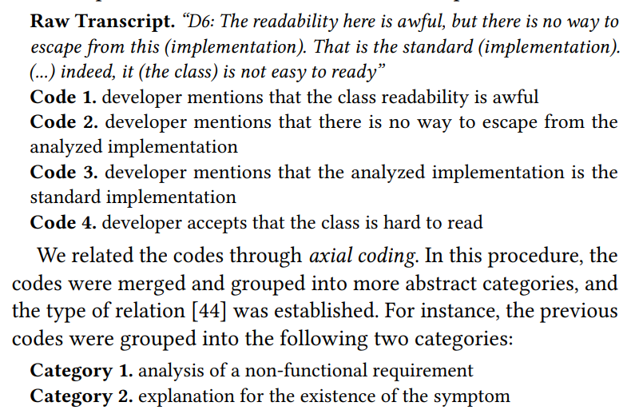
Axial Coding
Deductive analysis and focusing on the phenomenon(s) under study using a template
Name all conditions and incidences related to that phenomenon
Context and structural conditions
Causes
Exceptions
Assign all actions and interactional strategies directed at managing or handling the phenomenon
Consequences of the actions/interactions related to the phenomenon
Leonardo Sousa, Anderson Oliveira, Willian Oizumi, Simone Barbosa, Alessandro Garcia, Jaejoon Lee, Marcos Kalinowski, Rafael de Mello, Baldoino Fonseca, Roberto Oliveira, Carlos Lucena, and Rodrigo Paes. 2018. Identifying design problems in the source code: a grounded theory. In Proceedings of the 40th International Conference on Software Engineering (ICSE '18). Association for Computing Machinery, New York, NY, USA, 921–931. https://doi.org/10.1145/3180155.3180239
How to Evaluate Results

Slide 98
Example: Axial Coding of Pain
Broken Leg
Dancing in the gym
Cause
Context
Pain
Intervention
Consequences
Strategies
Going to the next hospital asap
Leg Treatment immobilisation
Pain Reduction Medication e.g. Ibuprofen
Healing
Prevention
Leg Cast
Removing obstacles in the gym
See Strauss/Corbin 1990, 99-107
How to Evaluate Results

Slide 99
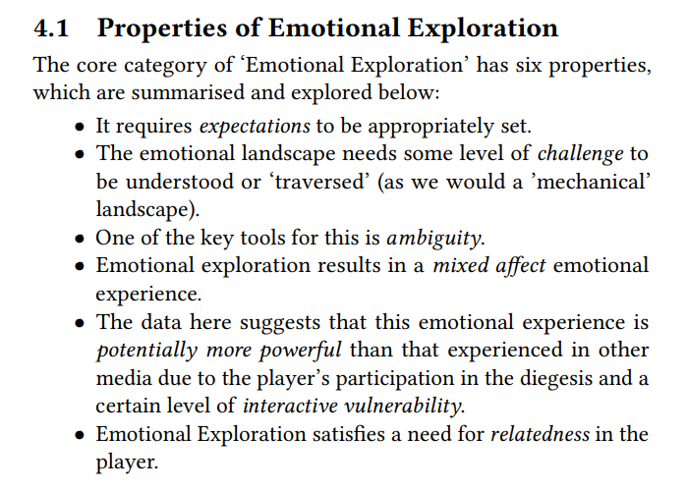
Selective Coding
Integrate the different categories that have been developed during axial coding into one cohesive theory or framework
Results from axial coding are further elaborated, integrated, and validated on an abstract level
Is there an overarching theory?
What is the overarching theory?
Choose the core category and relate it with the other categories from axial coding
If the core category is found, the story line of the research is set, and the researcher knows the central phenomenon of the research and can finally answer the research question and name the theory.
Leonardo Sousa, Anderson Oliveira, Willian Oizumi, Simone Barbosa, Alessandro Garcia, Jaejoon Lee, Marcos Kalinowski, Rafael de Mello, Baldoino Fonseca, Roberto Oliveira, Carlos Lucena, and Rodrigo Paes. 2018. Identifying design problems in the source code: a grounded theory. In Proceedings of the 40th International Conference on Software Engineering (ICSE '18). Association for Computing Machinery, New York, NY, USA, 921–931. https://doi.org/10.1145/3180155.3180239
How to Evaluate Results

Slide 100
When Grounded Theory?
If you want to derive theories and even testable hypotheses:
„Compared to the smartphone application, the voice interface improves the user experience, but increases the frustration level when errors occur.”
“Women perceive higher levels of immersion than men with decreasing levels of avatar realism in virtual reality.”
“Our machine-learning based model outperforms linear prediction in terms of precision and accuracy.”
If you want to derive a theoretical framework
When you have a mixed-method study and no idea how to structure the feedback
No. Then do a thematic analysis.
When you only have a qualitative study and no idea what your contribution is
Yes. Then do it.
How to Evaluate Results

Slide 101
Summary
Evaluating the results is an essential part of your study
Report all results and measures
Quantitative Data: objectively are being reported in descriptive and inferential statistics
Descriptive Statistics: text, plot, or table
Inferential Statistics: the correct statistical test and post hoc comparison for each of your measure
Qualitative Data: subjectively analyze the feedback and observations using
Thematic Analysis: okay in mixed-methods
Grounded Theory: highly recommended to extent the contribution
How to Evaluate Results

Slide 102
Exercise: Find your Qualitative Analysis
Do you want to answer your research questions using qualitative methods?
Which concepts do you investigate?
Create an example transcript fitting to your user study.
How do you analyze the result?
Who will be responsible for transcribing, coding, counter-checking?
Discuss in your team
How to Evaluate Results

Slide 103
References
Elo & Kyngäs (2008). The qualitative content analysis process. Journal Advanced Nursing. 62(1):107-15.
Eliot, Susan (2011). Using Excel for Qualitative Data Analysis. Retrieved from http://www.qualitative-researcher.com/qualitative-analysis/using-excel-for-qualitative-data-analysis/
Charmaz, K. (2006). Constructing Grounded Theory. A Practical Guide Through Qualitative Analysis. London: Sage.
Glaser, B. & Strauss, A.(2010). Grounded Theory. Strategien qualitativer Forschung. Bern: Huber.
Hof, C. & Weingarten (1979). Qualitative Sozialforschung. Stuttgart: Klett.
Mayring, P. (2008). Qualitative Inhaltsanalyse. Grundlagen und Techniken. Weinheim: Beltz.
McNaney, R., Vines, J., Roggen, D., Balaam, M., Zhang, P., Poliakov, I., & Olivier, P. (2014). Exploring the Acceptability of Google Glass As an Everyday Assistive Device for People with Parkinson’s. In Proceedings of the SIGCHI Conference on Human Factors in Computing Systems (pp. 2551–2554). New York, NY, USA: ACM. doi:10.1145/2556288.2557092
Krippendorf , K. (1980). Content Analysis. An Introduction to its methodology. Newbury Park: Sage Publications.
Razavi, M. N., & Iverson, L. (2006). A grounded theory of information sharing behavior in a personal learning space. Proceedings of the 2006 20th Anniversary Conference on Computer Supported Cooperative Work - CSCW ’06, 459. doi:10.1145/1180875.1180946
References

