Slide 1

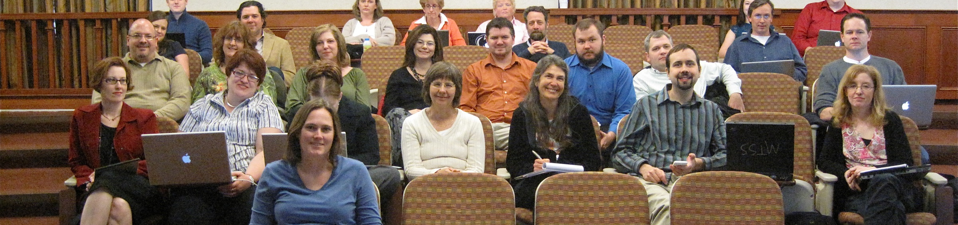


How to Give a Good Scientific Presentation
Human-Computer Interaction Exercise
Image from: https://pxhere.com/de/photo/234130
The following content is licensed under a Creative Commons Attribution 4.0 International license (CC BY-SA 4.0)

Slide 2
Agenda
Why bothering in giving talks
How to structure your talk
How to make your slides
How to give your talk
Examples
Infos for PhDs
Slides are based on slides from
  Arnaud Legout (Inria, Sophia Antipolis)
  Niels Henze (University of Regensburg)
  Sven Mayer (LMU Munich)
How to Give a Good Scientific Presentation

Slide 3
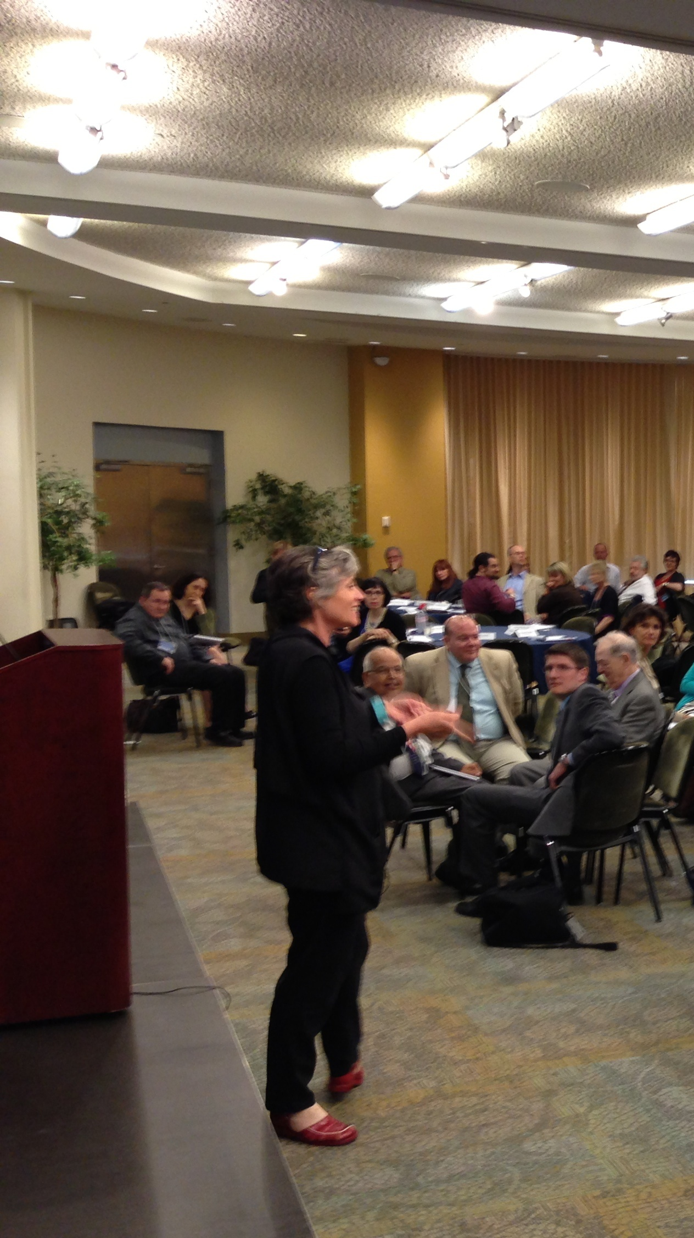
Why should you bother doing talks?
Presentations are a fundamental part of research excellence and in industry
Everyone must learn how to sell their work to…
  the community: visibility, impact
  students: attract graduate students
  commissions: funding, promotion
  the public: increase attraction of your field, fame
And lectures?
  …. aren’t good presentations!
https://pxhere.com/de/photo/349010
How to Give a Good Scientific Presentation

Slide 4

Goals of a Presentation
Convey your message
Show that your work can have impact
  Even when the audience is not aware of!
Build relationsship and reputations
Get feedback
The ability to give great presentations can be a big plus in your career
  A poor presentation can kill an application to a new position
  Each talk is a job interview!
https://pxhere.com/de/photo/1652048
How to Give a Good Scientific Presentation

Slide 5
Tell a Clear and Convincing Story
How to Give a Good Scientific Presentation

Slide 6

Define First Your Message
The audience will remember at most one single message
  Which message you want to audience to remember?
  Can you express this message in less than a minute in an elevator?
Tailor, you talk according to this message
Don’t sell more, but sell it well
Emphasize connection over content
  Engage listeners from an emotional place rather than from the content
https://pxhere.com/de/photo/631638
How to Give a Good Scientific Presentation

Slide 7
Never Present Too Much!
Common pitfall
  “They must be impressed. I did a lot and I will present every single bit of my work!”
    Presenting too much only shows you are unable to deliver a message
Never ever consider simplicity and clarity as a proof of weakness: this is talent
  Do not hesitate to cut your presentation and focus on the message
  Better to present 10% the entire audience than 90% nobody understand
Adapt to the Audience
  The entire audience must understand your talk
    Better to explain notions a part of the audience already knows than to lose another part during the talk
  Do not over- or underestimate the knowledge of the audience in your field
How to Give a Good Scientific Presentation

Slide 8
Think Like Your Audience
Identify your audience
  A professor
  Some students
  Some experts your field?
  Non-scientists?
When speaking to experts, you should focus less on background and more on data
When presenting to non-scientists, speak more broadly about your interests without boring anyone with highly detailed data. Tailor your talk to your audience.
How to Give a Good Scientific Presentation

Slide 9
Stay Focused
Give a background
  Bring examples and adapt to the audience
  Increase / descrease the technical granularity of your presentation
  Make it fun and catchy
Motivate your work
  Why is the subject important and interesting?
Focus of your work
  What is this presentation/work about in a single sentence?
  What is the problem?
  What is the research questions?
  Why is it important?
How to Give a Good Scientific Presentation

Slide 10
Outlining
Giving an outline/agenda is very common
  But not necessary when you don’t have time
  You can give it first before or after (better) the background
  Repeat the outline before each new part
  Use color to show where you are
Tell a story from the background to the conclusion
  No need to go too deep into related work (some examples are okay!)
    Your contributions must be the core
  But, be prepared to discuss related work
Make clear the structure of your talk to the audience
  No suspense
How to Give a Good Scientific Presentation

Slide 11
Before you start preparing slides…
What is my goal?
What is my single message?
What is my audience?
  Background, knowledge, size, expectations
How much time do I have?
  For the talk?
  For the questions?
Room characteristics?
  Size, position of the screen, my position
Adapt your talk and material to each context
How to Give a Good Scientific Presentation

Slide 12

Clarity and Simplicity
You give the talk. Slides support it.
Never compete with slides. You will lose.
https://pxhere.com/de/photo/1993
How to Give a Good Scientific Presentation

Slide 13
But why do you have so much text in your slides?
I am giving a lecture. There is no message.
There is just content you must learn.
How to Give a Good Scientific Presentation

Slide 14
The Structure
Say who you are, what are you doing (e.g., study course, PhD,…), and your project
Motivate your work with a common problem
Motivate through background and related work
Show the research questions
Show the methodology and tools
Show the results
Clearly highlight your contribution
Conclude with a summary of findings and implications
Highlight when you are done and when you are ready for questions
How to Give a Good Scientific Presentation

Slide 15
The Template
Avoid overloaded templates
  No animations, no progress bars, no fancy shit…
Sometimes if you have to consider the graphical identity
  Many institutions do not care about good templates but force you to use theirs anyway
Unless you have a graphical talent, keep it simple
  Make a clear distinction between the title and the rest
  Do not use complex headers or footers
  No need to use the presentation title, affiliation, full authors list, company logo, etc. on each slide
Use slide numbers
How to Give a Good Scientific Presentation

Slide 16
Explain All Slides
Never present a slide you do not explain in detail
Present a slide for more than 30 seconds or drop them
Spend time on
  complex figures or drop them
  on equations or drop them
Talk on transition slides (e.g., outline reminders) or drop them
Use transition to summarize the previous part and introduce the next one
How to Give a Good Scientific Presentation

Slide 17
Wall of Text
First, we analyzed the IPQ questionnaire [48] (scale: from −3 to 3) to determine whether ROLE or CORRECTION significantly influenced the presence in VR in one of the two tasks. Therefore, we conducted two univariate two-way ANOVAs. In the validation task, the analysis revealed a significant effect for ROLE (F1,22 = 12.79, p < .001, η2 = .334). However, we found no significant effect for CORRECTION (F1,22 = 1.614, p > .217, η2 = .010) and also no significant interaction effect (F1,22 = .078, p > .782, η2 < .001). The mean IPQ score was M = .28 (SD = .62) for the Pointer and M = −.89 (SD = 1.02) for the Observer in the validation task. In the apple-picking task, the analysis revealed a significant effect for ROLE (F1,22 = 6.441, p < .019, η2 = .212). However, we found no significant effect for CORRECTION (F1,22 = .534, p > .472, η2 = .002) and also no significant interaction effect (F1,22 = .382, p > .542, η2 = .001). The mean IPQ score was M = .76 (SD = .68) for the Pointer and M = −.11 (SD = 1.) for the Observer in the apple task.
Sven Mayer, Jens Reinhardt, Robin Schweigert, Brighten Jelke, Valentin Schwind, Katrin Wolf, and Niels Henze. 2020. Improving Humans' Ability to Interpret Deictic Gestures in Virtual Reality. In Proceedings of the 2020 CHI Conference on Human Factors in Computing Systems (CHI '20). Association for Computing Machinery, New York, NY, USA, 1–14. https://doi.org/10.1145/3313831.3376340
How to Give a Good Scientific Presentation

Slide 18
Be Concise
Remove uncessary words that you don‘t need in sentences and only include information that is important for the reader to know
How to Give a Good Scientific Presentation

Slide 19
Be Concise
Remove uncessary words that you don‘t need in sentences and only include information that is important for the reader to know
How to Give a Good Scientific Presentation

Slide 20
Be Concise
Remove uncessary words that you don‘t need in sentences and only include information that is important for the reader to know
You can add content successively
But write small sentences
  Highlight a message with bold text and/or a color
  Be simple in your explanations
  One bullet at a time?
    Perfectly fine to show the entire slide if it is concise
    But, if you feel you compete with your slides, show some bullets
      Rule of thumb: do not animate bullets (or block of bullets) on which you discuss less than 20 to 30s
Use pictures whenever possible
How to Give a Good Scientific Presentation

Slide 21

All the people killed by walls of text...
https://pxhere.com/de/photo/1993
How to Give a Good Scientific Presentation

Slide 22

The Title of Your Scientific Report
Max Mustermann, Barbara Musterfrau, John Doe
Image from: https://pxhere.com/de/photo/234130
The following content is licensed under a Creative Commons Attribution 4.0 International license (CC BY-SA 4.0)

Slide 23
THE BIG PICTURE
How to Give a Good Scientific Presentation

Slide 24
Introduction
Address the problem
  What‘s the issue?
  For whom its revelant?
  What are the consequences if don‘t solve it?
Provide background
  What do we know?
  What is the gap of knowledge?
  How do you want to address it?
  Why will your solution work?
How to Give a Good Scientific Presentation

Slide 25
Related Work
No need to go too deep into related work
Your contributions must be the core
Show that you are familiar with it
Show the latest findings
Some examples are okay!
Always be prepared to discuss related work
How to Give a Good Scientific Presentation

Slide 26
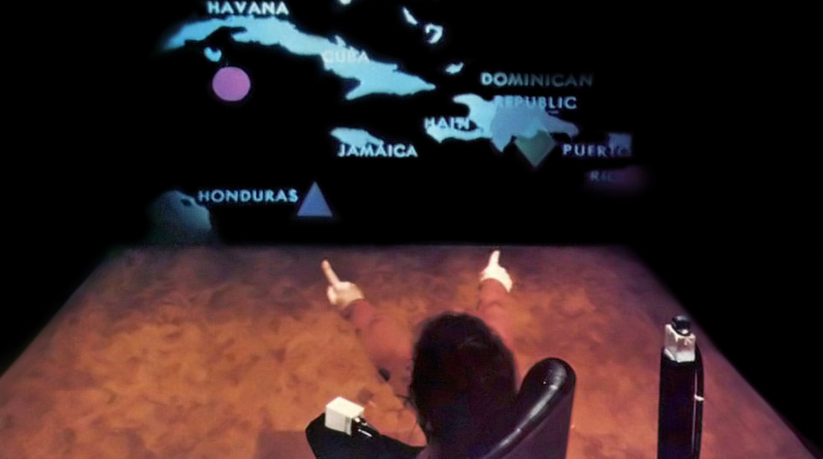
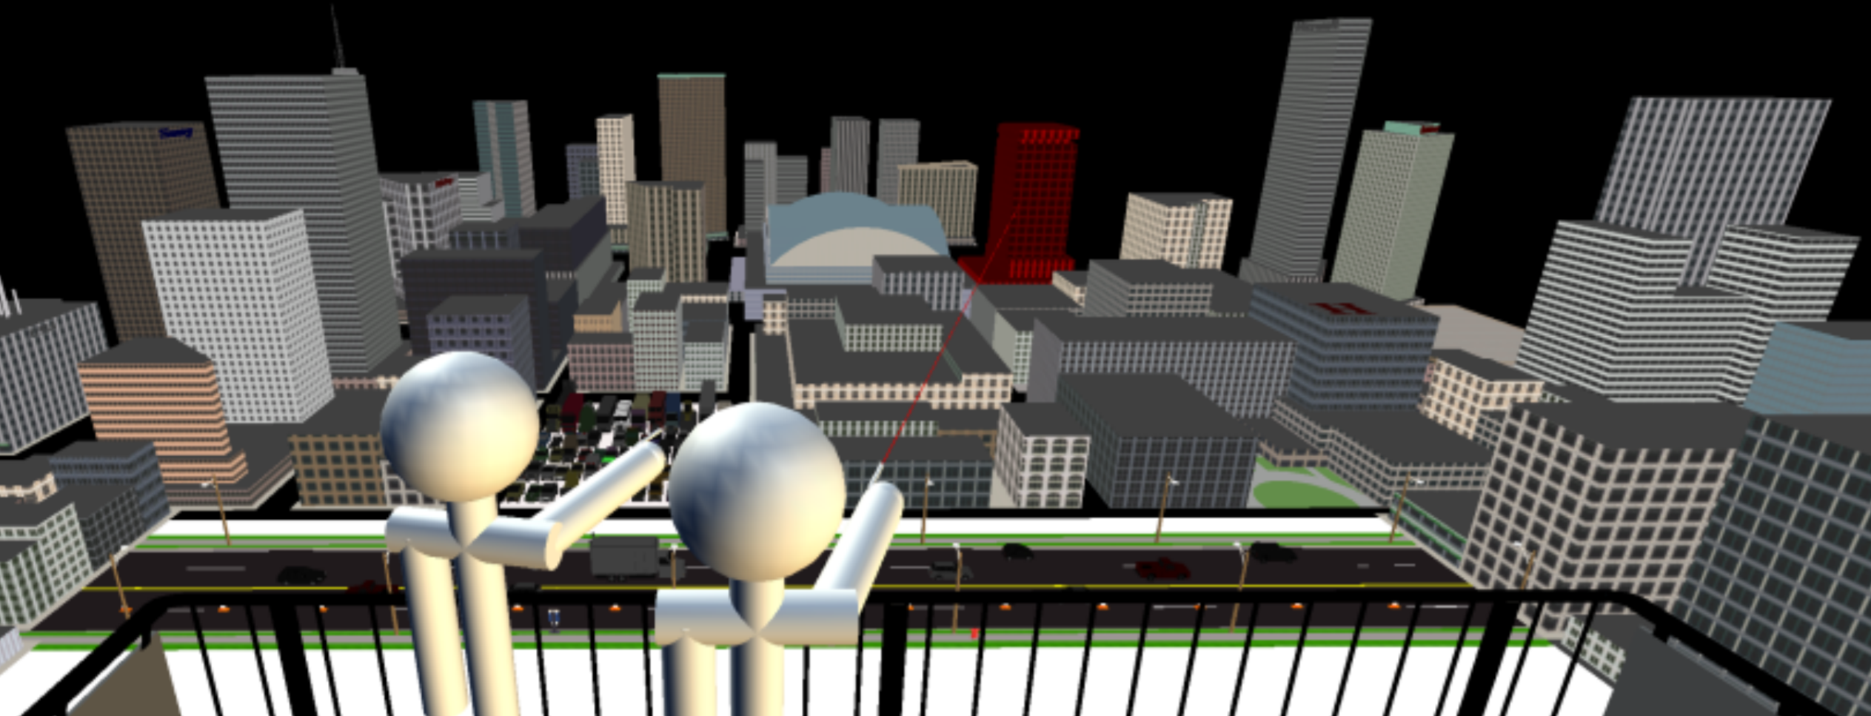
Related Work
Seated, not correcting
Standing, In VR, not correcting
Richard A. Bolt. 1980. “Put-that-there”: Voice and gesture at the graphics interface. In Proc. of SIGGRAPH '80. DOI: http://dx.doi.org/10.1145/800250.807503
Always cite directly on the slide not at the end!!!!
Nelson Wong and Carl Gutwin. 2014. Support for deictic pointing in CVEs: still fragmented after all these years'. In Proc. of CSCW '14. DOI: https://doi.org/10.1145/2531602.2531691
How to Give a Good Scientific Presentation

Slide 27
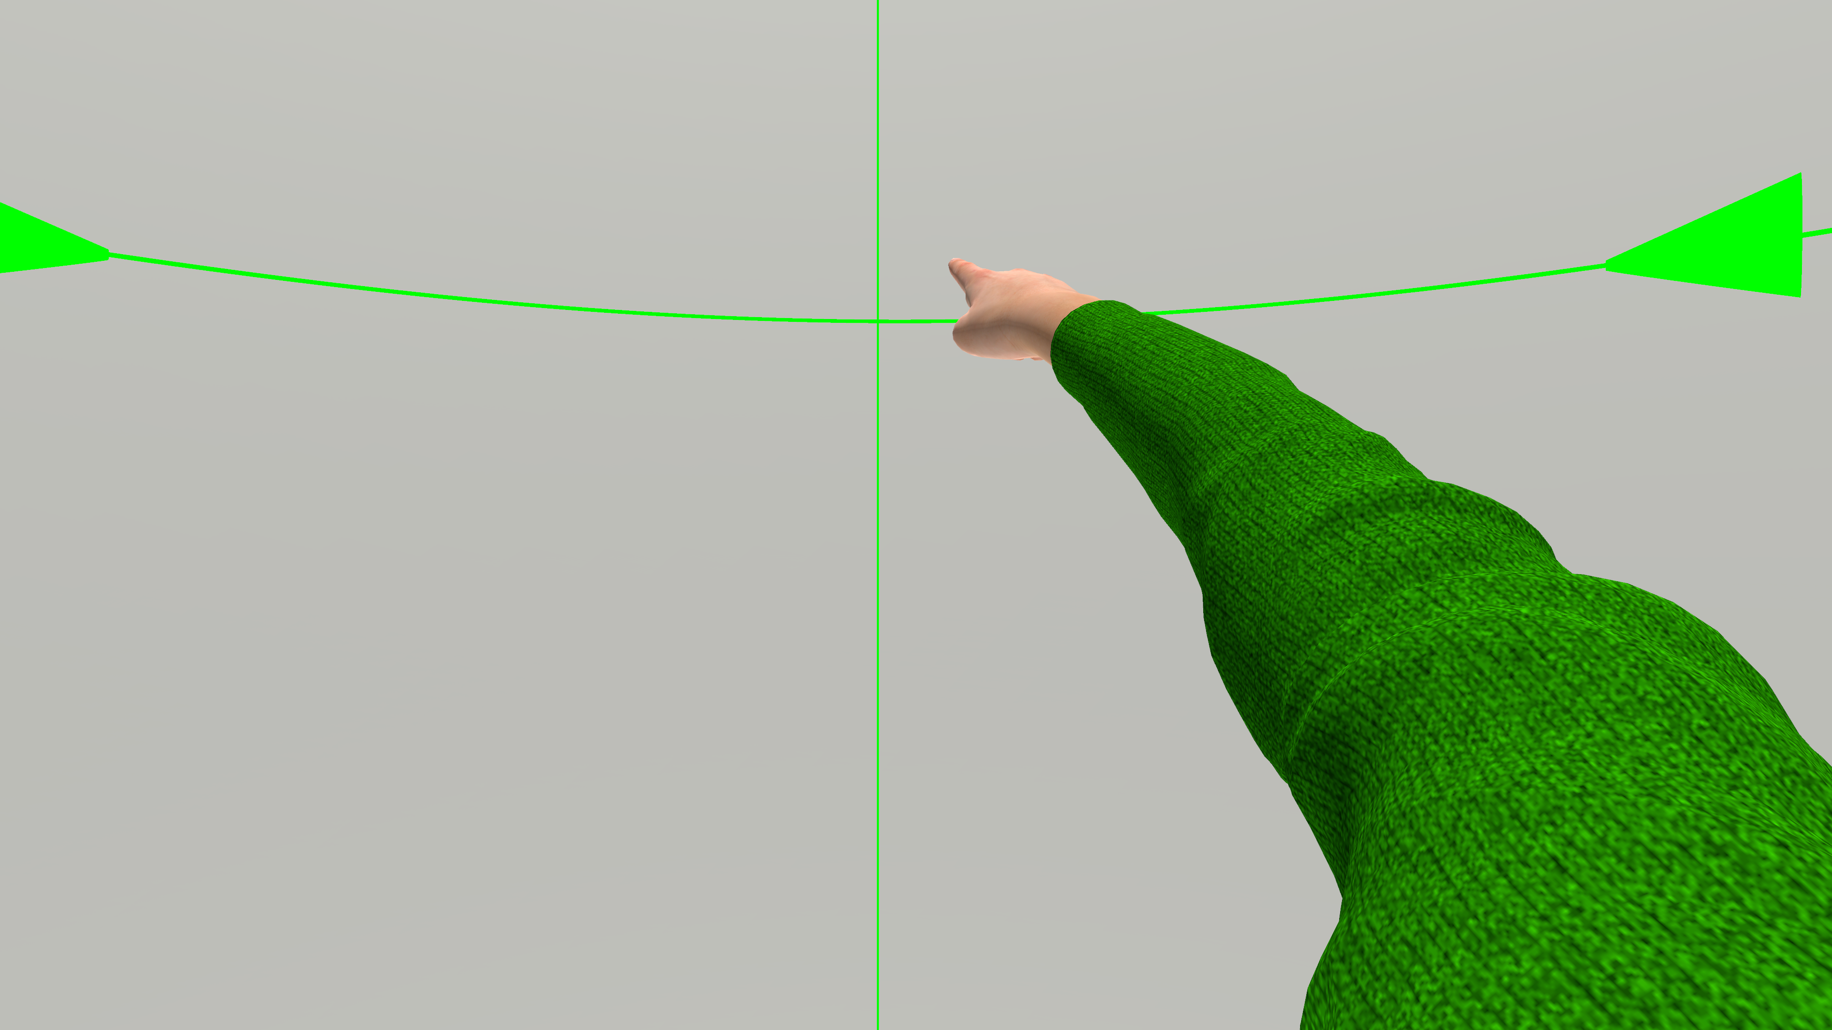
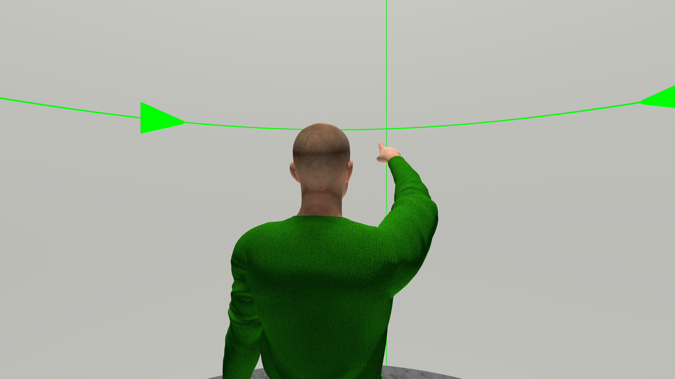
Method
Presenter‘s view
Explain the Setup
System concept
Observer‘s view
How to Give a Good Scientific Presentation

Slide 28
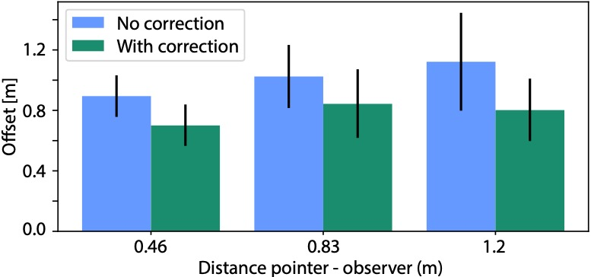
Results
significant reduction (p < 0.001)
How to Give a Good Scientific Presentation

Slide 29
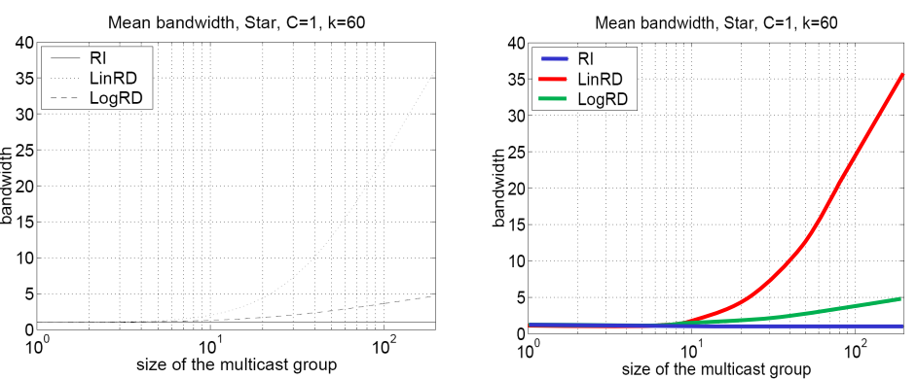
Results
How to Give a Good Scientific Presentation

Slide 30
Results
Interesting!
How to Give a Good Scientific Presentation

Slide 31
Discussion and Findings
Deictic gestures are fundamental expressions in non-verbal communication
Virtual Reality can be used to “override” one's appearance
We developed a model to improve deictic gestures in VR
The model cannot affect immersion (it is only being displayed for the observer)
Accuracy improvement of 28% when using the model
The Title of Your Scientific Report

Slide 32
Q&A Part
Q&A are part of every talk
  Never underestimate its importance
    In science, people in the audience are well-prepared to ask you questions
  Never
    lie, aggress, or complain
  Prepare backup slides (very impressive when it works!)
    You can put technical details or results you did not have time to address in them
Be prepared to answer questions
  Be prepared to very hard questions
  Some questions might be aggressive, stupid (most of the time, such questions show you made a poor presentation), hard to answer, showing you are wrong
Rehearse with colleagues
How to Give a Good Scientific Presentation

Slide 33
Infos for Doctoral Students
Human-Computer Interaction Exercise
Image from: https://pxhere.com/de/photo/234130
The following content is licensed under a Creative Commons Attribution 4.0 International license (CC BY-SA 4.0)

Slide 34
Preparing Slides
Define your story before making any slide
You need a clear structure, devide that structure into message units
  Scientific presentations are often based exactly on the structure of the paper
    It has a structure
    Not recommended to copy it 1:1 when you like to give a good talk
Each slide has a single message unit
  Explicitly state that message on the slide
Simple conceptual diagrams and figures
  No tables
How to Give a Good Scientific Presentation

Slide 35
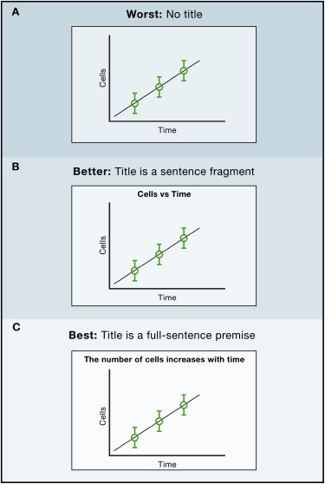
Use Meaningful Titles
A slide with no title is a challenge to the audience
  Be sure when you want to do that
The title should summarize the slide content
  Do not use a same title with an increasing number
    Introduction 1/5
    Introduction 2/5
    Poor variant “cont.”
A short full-sentence premise helps the audience get the main idea at a glance
How to Give a Good Scientific Presentation

Slide 36
Limit Words on Slides; Use Visuals!
Avoid death by PowerPoint
  where the presenter reads off slide after slide after slide after slide like me in a lecture
Use images
  And a few words when you need them
Think about pathways
  If you do have slides with words: enlarge the font and aim to limit each sentence to one line
Describe dense information verbally in enough detail that words on your slide are more-or-less unnecessary
Avoid the wall of text
How to Give a Good Scientific Presentation

Slide 37
Use Slide Numbers
Used to ask questions
Helpful for the audience to make notes
In some cases, it is useful to also add the total number of slides
  For a defense or a short talk
    Easy way for the jury or the audience to assess whether you are close to the conclusion and will not exceed your allocated time
  For longer talks don’t show the total number
    A large number of remaining slides might be discouraging
How to Give a Good Scientific Presentation

Slide 38
No Serif Fonts!
Serif fonts are hard to read
  Line width is not uniform
  Thin lines may not render well with all
  projector types
  Hard to read from the back
Use non-serif fonts instead (Arial, Helvetica, I use Roboto [1])
  look formal and scientific
  very (may be too) popular
No Comic Sans MS
  https://linktr.ee/bancomicsans
[1] https://fonts.google.com/specimen/Roboto
How to Give a Good Scientific Presentation

Slide 39
No Punctuation Marks
No punctuation mark
  At the end of sentences
    Period (.)
    Colon (:)
    Semi-colon (;)
    Comma (,)
Apart from
  Question marks (?)
  Exclamation marks (!)
How to Give a Good Scientific Presentation

Slide 40
Colors and Bold Text
No more than three colors on a slide
Here I have four
Use colors or text to emphasize an important word
  I always use both
May be used to remind you to develop keypoints
Never use light colors or low contrast They may not render well
Never use light colors or low contrast They may not render well
Never use light colors or low contrast They may not render well
Never use red on blue
How to Give a Good Scientific Presentation

Slide 41
Black is okay
Don’t use thin fonts against black: They may not render well
Ugly with figures with a white background
I don’t have much experience with this background
  Seems to become more popular
  Maybe better for the projector lamps and if you want to safe CO²
  Try it and make your own opinion
How to Give a Good Scientific Presentation

Slide 42
Be neaT
Do YOU like
    slides with sppell check erors
    Inconsistant bullats:
      Capitalisation
      Bullet.
        Random Struture,
      font;
    Ugly slides
    poor use of symbol !!!
  Poor layout
How to Give a Good Scientific Presentation

Slide 43
Be Neat
Or do you like
  Slides with spell check errors
  Consistent bulleting
    Capitalization
    Bullets
    Structure
    Font
  Clear slides
  Decent use of symbols
  Clear layout
How to Give a Good Scientific Presentation

Slide 44
Be Concise
Do not write complete sentences when they make your message obfuscated in long lines of text
Never forget that nobody can read your slides and listen to you at the same time
  Unless you are reading what is in your slides
  But you must not read your slides, this is boring
Omit technical details, there is no chance to explain everything in a single presentation
  Instead, you should make the audience eager to read your work
Do not believe complexity will impress your audience, it will simply make you look unable to express your idea
How to Give a Good Scientific Presentation

Slide 45
Poor Example: Solar System
8 planets
  Mercury
  Venus
  Earth
  Mars
  Jupiter
  Saturn
  Uranus
  Neptune
How to Give a Good Scientific Presentation

Slide 46
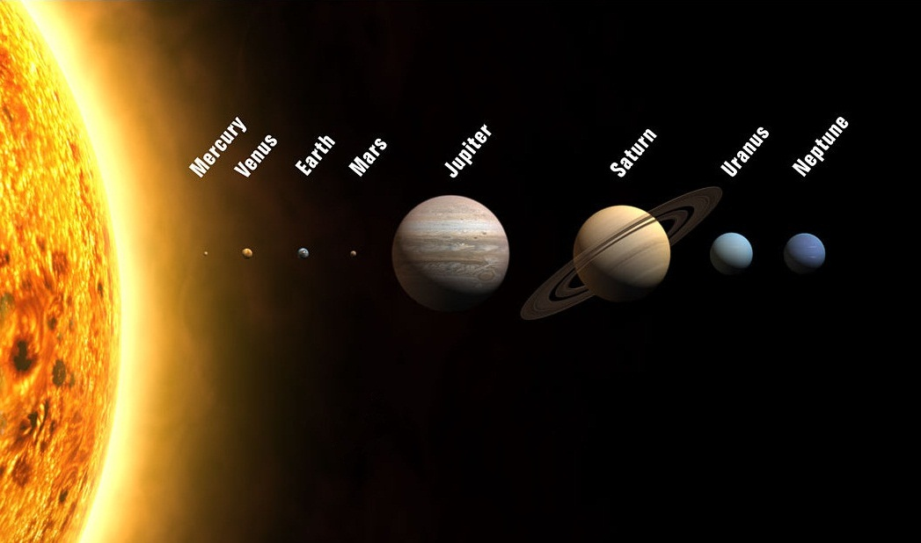
Still Poor Example: Solar System
8 planets
  Mercury
  Venus
  Earth
  Mars
  Jupiter
  Saturn
  Uranus
  Neptune
How to Give a Good Scientific Presentation

Slide 47
Still Poor Example: Solar System
8 planets
  Mercury
  Venus
  Earth
  Mars
  Jupiter
  Saturn
  Uranus
  Neptune
The Solar System
How to Give a Good Scientific Presentation

Slide 48

Pictures
Insert pictures whenever possible!
  Show the setup
  High quality and full screen
  Illustrate the idea
  Always use a figure instead of a table
  Participants interacting with your system are great
  Show details
  Annotate/label when possible
  When the picture is not yours cite it [1]
[1] Image from Frankfurt University of Applied Sciences
Stefan
How to Give a Good Scientific Presentation

Slide 49




Illustrations
Never use
  Irrelevant illustrations
  Weak metaphors
  Semantic Animations
  Animated images
  Bad GIFs
  Poor quality graphics
Avoid redundancy with your text
How to Give a Good Scientific Presentation

Slide 50
Animations
Animations must make complex idea simple to grasp
  No magic, it is a lot of work to make
Think about that you want the make PDFs
  Avoid any overlapping
You can use neat animations
Do Not Over Animate
  It is disturbing
  Annoying
  Useless
How to Give a Good Scientific Presentation

Slide 51
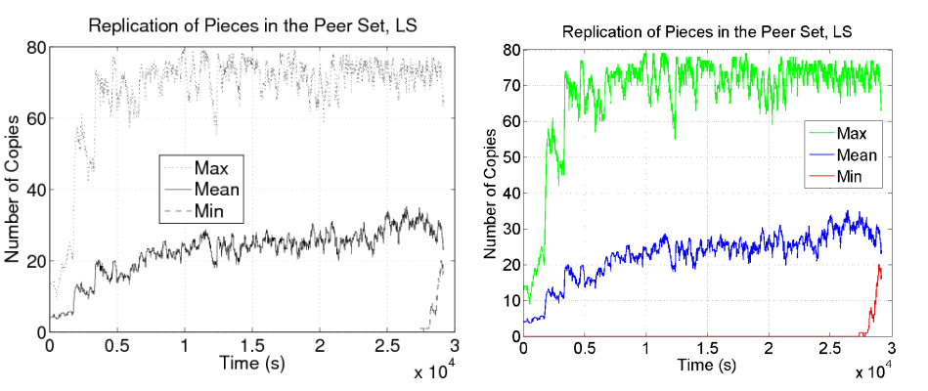
Using Plots
How to Give a Good Scientific Presentation

Slide 52
No Pie, No 3D, No 3D Pie, Never
How to Give a Good Scientific Presentation

Slide 53
Figures
Photos must be anonymized
For each plot you must
  Give for each of the x-axis and y-axis
  Label: unit, scale (if log scale)
  Give the legend
  Take an example to illustrate a specific point in the figure
    Very useful if the figure is complex
Never change the aspect ratio of an image
***
***
How to Give a Good Scientific Presentation

Slide 54
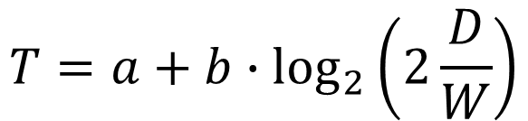
Equations
You can user equations
  But explain the variables
  Explain all symbols
Distance
Time
$$T=a+b∙\log_{2}\left(2\frac{D}{W}\right)$$
Coefficients
Width
How to Give a Good Scientific Presentation

Slide 55
Design and Presentation Zen
Should you focus on the design of the slides?
  Question of time and money
  Address issues by order of priority
  A well defined and clear message
  A well structured (and fun) story
  Adapt to the audience
  Tell your story with passion (you are already top 1%)
  Make beautiful slides
Slides are not the talk, they just support it
How to Give a Good Scientific Presentation

Slide 56
Testing
Test the slides with a projector
  Can you read it at the end of the room?
  Are the colors correct?
  Are the fonts readable?
Find a second screen
Use a clicker (remote controller)
If you have no time for testing
  make them black & white with one decent key color
How to Give a Good Scientific Presentation

Slide 57

Dress Well
Dress a bit better than the audience
  Show that you have a kind of respect towards the audience
  If you don’t care for your presentation or of the audience, how will you dress?
    As every day!
But don’t be overdressed
  Ask the dressing convention of your community/audience
Women have more choices when it comes to dresses, but that doesn't make things any easier for them
Men have fewer choices when it comes to dresses, but that doesn't make things any easier for them, too
How to Give a Good Scientific Presentation

Slide 58

Giving a Talk
…and how to survive a scientific conference
How to Give a Good Scientific Presentation

Slide 59
Introduce and Summarize Slides
In the beginning, introduce yourself. Thank and name all co-authors. Do not skip the first slide.
For each slide
  Say a one sentence introduction
  What you are going to discuss now
  Say a one sentence summary
If the audience has to remember a single sentence it is this one
For very important results, show the take home message
Be Redundant
  Repeat several times: “I’m going to explain…”, “Our explanation is…“, “As I just explained…”
  Never too much redundancy
How to Give a Good Scientific Presentation

Slide 60
How to Show Something on a Slide?
Don’t touch the projection screen
Don’t shake the hand 5 meters in front of the screen
  Screen might be too high or too far
Hard in online lectures
Hard in lectures
Try to avoid laser pointers (people are bad to see it)
There is no professional solution
  But think about using slides to point
How to Give a Good Scientific Presentation

Slide 61
How to Show Something on a Slide?
Don’t touch the projection screen
Don’t shake the hand 5 meters in front of the screen
  Screen might be too high or too far
Hard in online lectures
Hard in lectures
Try to avoid laser pointers (people are bad to see it)
There is no professional solution
  But think about using slides to point
Important
How to Give a Good Scientific Presentation

Slide 62
One Slide = One-Two Minutes
10 minutes = 5 - 10 slides
20 minutes = 10 - 20 slides
You can violate this rule if
  You have time to explain in detail all slides
  You will not exceed your allocated time
  You generally speak slower/faster
  But never less than 30 seconds (really short)
  And never more than 3 minutes (start to be boring)
Never go back to a previous slide
  If you forgot something, just tell it
  Navigating within slides will lose your audience
  Some will force you to go back in the Q&A. If they desire: do it
How to Give a Good Scientific Presentation

Slide 63
Never Exceed Your Allocated Time
This is a lack of respect for the audience and the next speakers
  Not admissible, not professional
Should never happen if you are well prepared
Look for a timer
  On a room wall, in front of you
    So that you can see it, but not the audience
  On your desk
    Digital one with large enough numbers
  On PowerPoint: Presenter mode
    Very convenient, you can get comments and a few slides before and after the current one
How to Give a Good Scientific Presentation

Slide 64
Q&A Part
Reformulate questions after somebody asked
  Make sure you understood them
  Make sure everybody hear them
Be concise in your answer
Do not start a larger discussion
  “I propose to continue this interesting discussion during the break. Another question?”
Never bluff or lie
  Acknowledge when you don’t have the answer
  “Thank you for that point, I don’t have an answer now. We will definitely look at it.”
How to Give a Good Scientific Presentation

Slide 65
Use Your Body And Location
Use eye contact
  Do not stare (no more than 10 seconds)
  Do not avert or switch fast
Use your hands
  To support visually what you say
You can walk, but
  Do not stand in front of your slides
  Do not continuously walk along a line
  Walk on a triangle to focus and stop at each vertex
Smile, but never laugh
Audience Oriented
Laptop
Inwards Oriented
Slide Oriented
Projection Wall
Does not work in every setting
How to Give a Good Scientific Presentation

Slide 66
Use Your Voice
Make a short pause before each important message
  In the order of a few seconds
  Pauses are even more effective than raising voice
  The rhythm of the speech is what makes a big difference to catch the attention
Vary your voice level
  Speaking softly catch better the attention than speaking even louder
  Alternating loud and soft speech catch the best the attention
  You need to practice a lot to find the right balance
Never read from your slides or notes (as long as you cite someone)
How to Give a Good Scientific Presentation

Slide 67
Second Screen and Remote Controller
Use a second screen! Do not look at your slides on the primary screen
  Place it appropriately
  You must not show your back to the audience
  Hard to keep the eye contact this way
Use a remote controller! It seamlessly synchronize your talk with your slides
  Freedom to move and most professional
  Forward, backward, hide slides (black screen)
  Small enough to fit well in the hand
  No laser pointer
  Never use a wireless mouse
  Do not shake or point-toward-the-slides the hand when you switch slides
How to Give a Good Scientific Presentation

Slide 68

Show Enthusiasm
If you don’t show enthusiasm presenting your own work, do you really believe that the audience will be enthusiastic about your work?
  They are listening to you
  They are reading your work
  They will invite you
  They will discuss with you
The star of the presentation is not on your slides
  IT’S YOU
Modulate voice and speed
https://pxhere.com/de/photo/747065
How to Give a Good Scientific Presentation

Slide 69
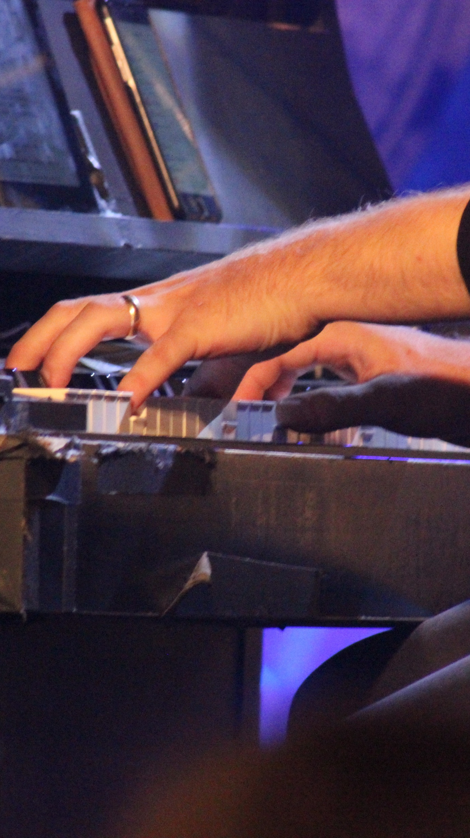
Practicing
Record yourself!!!
Best speakers practice the most
  No improvisation or spontaneity
  To look spontaneous, you even need the most practice
Stand up and speak with loud voice to practice
  Practice at least once using a projector
Practice with colleagues (once well trained)
The shorter the talk the more you have to practice
Be prepared to answer hard/aggressive questions
https://pxhere.com/de/photo/544035
How to Give a Good Scientific Presentation

Slide 70
Avoid Bad Surprises
Sleep well
Ask before your talk to your session chair or organizer
Make backup copies of your slides on two different supports
  Make your slides available on-line
  Check that all copies are the last version of your presentation
Arrive early in the conference room
  Introduce yourself to the session chair or organizer well before your talk begins
Test your presentation and laptop
  Connections, Batteries
Test the remote controller
  Connections, Batteries
How to Give a Good Scientific Presentation

Slide 71
Some Facts on the Audience
They sometimes want to be elsewhere
  Early in the morning: in their bed
  Around noon: eating
  Early in the afternoon: sleeping at the swimming pool
  Late in the afternoon: dinner or social event
  In the middle: waiting for the coffee break
They have already ingested a lot of boring presentations
  RESPECT IT
How to Give a Good Scientific Presentation

Slide 72
Some Facts on the Audience
They don’t know you
They don’t know your work
They don’t know your field
They have no reason to like your work
They have no reason to listen to you
No need for a flat joke
Show that you are happy to be here, and people will listen!
You have to wake them up and catch their attention
How to Give a Good Scientific Presentation

Slide 73
Losing People
They are laptop addicts
  They are reading their emails, browsing the web, reading online newspapers, skyping, etc.
  You have to wake them up and catch their attention
People that are leaving
  You lost them, so work for the ones you haven’t lost yet
  Don’t repeat what you feel the lost audience didn’t get
    You will lose the last ones that follow you
Nasty people (aggressive, commenting, …)
  Focus on other people
  Don’t give them the opportunity to disrupt you even more
How to Give a Good Scientific Presentation

Slide 74
THE FRAME:
BRING PEOPLE BACK TO
THE BIG PICTURE
How to Give a Good Scientific Presentation

Slide 75
Wonderful Examples
Scott Shenker: The Future of Networking, and the Past of Protocols, Open Networking Summit 2011
  http://www.youtube.com/watch?v=YHeyuD89n1Y
Hans Rosling: Stats that reshape your worldview, TED 2006.
  http://www.ted.com/talks/hans_rosling_shows_the_best_stats_you_ve_ever_seen.html
  http://www.gapminder.org/
Elizabeth Gilbert on nurturing creativity:
  http://www.ted.com/talks/elizabeth_gilbert_on_genius.html
D. A. Patterson, R, Riedi, J. Ousterhout, T. Anderson: How to give a bad talk?
  https://cel.archives-ouvertes.fr/cel-00529505v2/file/HowToGiveATalk.ppt
How to Give a Good Scientific Presentation

