Slide 1



Human-Computer Interaction
Introduction
The following content is licensed under a Creative Commons Attribution 4.0 International license (CC BY-SA 4.0)

Slide 2
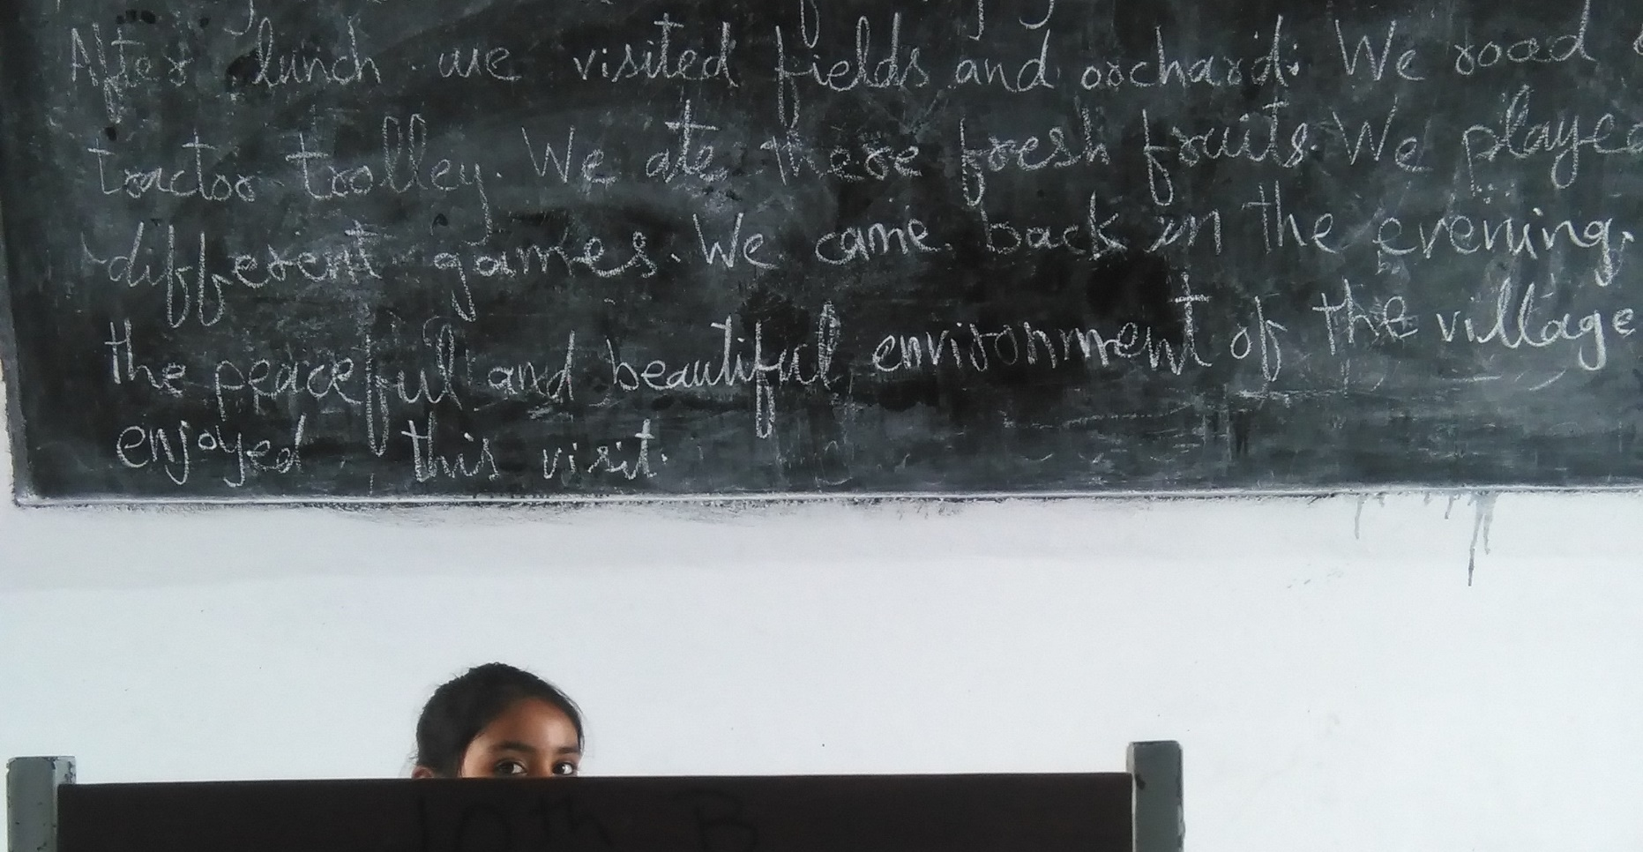
Welcome
Photo: https://pxhere.com/de/photo/691835
Introduction to Human-Computer Interaction

Slide 3


About
Prof. Dr. Valentin Schwind
Professor for Human-Computer Interaction
valentin.schwind@fb2.fra-uas.de More information: www.valentin-schwind.de
Introduction to Human-Computer Interaction

Slide 4
About the Course
Compulsory module (No. 25): Human-Computer Interaction
2 SWS Lecture
2 SWS Exercise
Skills: advanced level, 5th Semester Computer Sciences
Module Examination: Portfolio (Project + Exam)
Workload: 150 hours in total
Recommended prerequisites:
Advanced Programming → “You can develop something”
Schlüsselkompetenzen → “You can talk with people”
Statistics → “You know what means and standard deviations are”
Introduction to Human-Computer Interaction

Slide 5
New Moodle: campUAS
<ENTER LINK>
<ENTER PASSWORD>
Course material (slides, papers, videos, etc.) will be available online
After each block (or some days after)
No recordings or live streams
Introduction to Human-Computer Interaction

Slide 6
Your Grade
The Lecture
60 min (50%)
Exam
Grade
The Research Project
Presentation
Research Project
Paper
(25%)
(25%)
Introduction to Human-Computer Interaction

Slide 7
Semester Plan
time
Today
X-Mas
End of Lecture Period
The Lecture
HCI Basics in Theory
You do that alone, please
Exam, 60 min (50%)
The Project
Exercises Workshops Presentations
User Study
Team project (3 persons)
Major Milestone:
(You start your study)
Presentation (25%)
Paper (25%)
Random feelings
Yay, a new lecture!
Damn, a topic
Fun, we are doing random research
WTF, I need more time
…nice… I know stuff
Introduction to Human-Computer Interaction

Slide 8
Your Grade
The Lecture
Knowledge
The Research Project
Presentation
Research Project
Paper
(50%)
(50%)
Introduction to Human-Computer Interaction

Slide 9
Semester Plan
time
Today
X-Mas
End of Lecture Period
The Lecture
HCI Basics in Theory
The Project
Exercises Workshops Presentations
User Study
Team project (3 persons)
Major Milestone:
(You start your study)
Presentation (50%)
Paper (50%)
Random feelings
Yay, a new lecture!
Damn, a topic
Fun, we are doing random research
WTF, I need more time
…nice… I know stuff
Introduction to Human-Computer Interaction

Slide 10
Week Schedule (Human-Machine Interfaces)
 | From | To | Monday | Tuesday | Wednesday | Thursday | Friday
1 | 08:15 | 09:45 |  | Human-Machine Interfaces Lecture (ImA5) 1-129
2 | 10:00 | 11:30
3 | 11:45 | 13:15
4 | 14:15 | 15:45
5 | 16:00 | 17:30 |  | Human-Machine Interfaces Exercise (ImA5) 1-252 (Jessica Sehrt)
6 | 17:45 | 19:15
Lecture
Jessica‘s Thema (Wearables?)
Introduction to Human-Computer Interaction

Slide 11
Week Schedule (Human-Machine Interfaces)
 | From | To | Monday | Tuesday | Wednesday | Thursday | Friday
1 | 08:15 | 09:45 |  |  | Human-Computer Interaction Exercises (IBIS5A), 1-236 | Human-Computer Interaction Exercises (IBIS5B), 1-248
2 | 10:00 | 11:30 |  | Human-Computer Interaction Lecture (EBIS5/IBIS5) 4-8 | Human-Computer Interaction Exercises (IBIS5A), 1-236
3 | 11:45 | 13:15 |  |  | Human-Computer Interaction Exercises (IBIS5B), 1-236
4 | 14:15 | 15:45 |  |  |  |  | Human-Computer Interaction Exercises (EBIS5), 1-248 (Stefan Resch)
5 | 16:00 | 17:30
6 | 17:45 | 19:15
Games
Mixed Reality
Lecture
Mixed Methods
Intelligent User Interfaces
Stefan‘s Thema (3D-Prototyping?)
Introduction to Human-Computer Interaction

Slide 12
Week Schedule (Human-Machine Interaction)
 | From | To | Monday | Tuesday | Wednesday | Thursday | Friday
1 | 08:15 | 09:45
2 | 10:00 | 11:30 |  |  |  | Human-Machine Interaction Lecture (AI/ID1/HIS) 1-234
3 | 11:45 | 13:15 |  |  |  | Human-Machine Interaction Exercise (AI/ID1/HIS) 1-234
4 | 14:15 | 15:45
5 | 16:00 | 17:30
6 | 17:45 | 19:15
Lecture
???
Introduction to Human-Computer Interaction

Slide 13
Week Schedule
 | From | To | Monday | Tuesday | Wednesday | Thursday | Friday
1 | 08:15 | 09:45
2 | 10:00 | 11:30 |  |  | HCI Exercise IBIS5-2B Raum: 1-250
3 | 11:45 | 13:15 |  | HCI Exercise IBIS5-1A+IBIS5-1B Raum: 1-249 | HCI Exercise IBIS5-2A Raum: 1-250
4 | 14:15 | 15:45 |  | HCI Exercise EBIS5 Raum: 1-249 | Lecture EBIS5/IBIS5 Raum: 4-8
5 | 16:00 | 17:30
6 | 17:45 | 19:15
Experiences in Mixed Reality
Questions on Methodologies
Mixed Reality & Physiological Sensing
3D-Prototyping
Lecture
Introduction to Human-Computer Interaction

Slide 14
Exercise Planning
Tuesday 11:45 - 13:15: Questions on Methodologies
Tuesday 14:15 - 15:45: 3D-Prototyping
Wednesday 10:00 - 11:30: Experiences in Mixed Reality
Wednesday 11:45 - 13:15: Mixed Reality and Physiological Sensing
You are free to choose which exercise course you would like to attend!
24 slots per Room!
first comes first serves
After Oct. 21th no changes will be longer possible.
Introduction to Human-Computer Interaction

Slide 15
Week Schedule
 | From | To | Monday | Tuesday | Wednesday | Thursday | Friday
1 | 08:15 | 09:45 |  |  |  |  | IPR3 ID3 Raum: 1-143
2 | 10:00 | 11:30 |  |  | HCI Exercise IBIS5-2B Raum: 1-250 |  | IPR3 ID3 Raum: 1-143
3 | 11:45 | 13:15 |  | HCI Exercise IBIS5-1A+IBIS5-1B Raum: 1-249 | HCI Exercise IBIS5-2A Raum: 1-250 |  | IPR3 ID3 Raum: 1-143
4 | 14:15 | 15:45 | MMI ID1/INF-M1 Raum: 1-252 | HCI Exercise EBIS5 Raum: 1-249 | Lecture EBIS5/IBIS5 Raum: 4-8
5 | 16:00 | 17:30 | MMI ID1/INF-M1 Raum: 1-252
6 | 17:45 | 19:15
Experiences in Mixed Reality
14-täg.
Questions on Methodologies
Lecture
Mixed Reality & Physiological Sensing
Biofeedback & Accessible Living Spaces
3D-Prototyping
Lecture
Multimodal Systems
Introduction to Human-Computer Interaction

Slide 16

Lecture
User Studies
Photo: Frankfurt UAS
Photo: https://pxhere.com/de/photo/783701
Introduction to Human-Computer Interaction

Slide 17
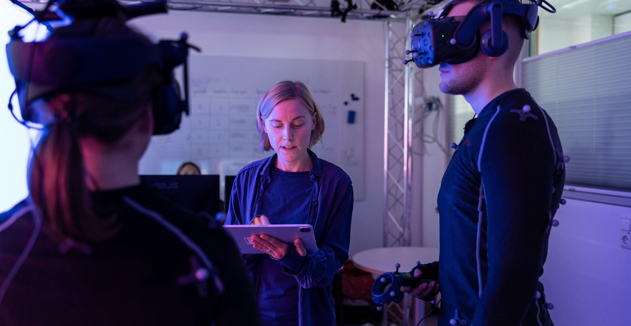
Research Project
Photo: Frankfurt UAS
Introduction to Human-Computer Interaction

Slide 18
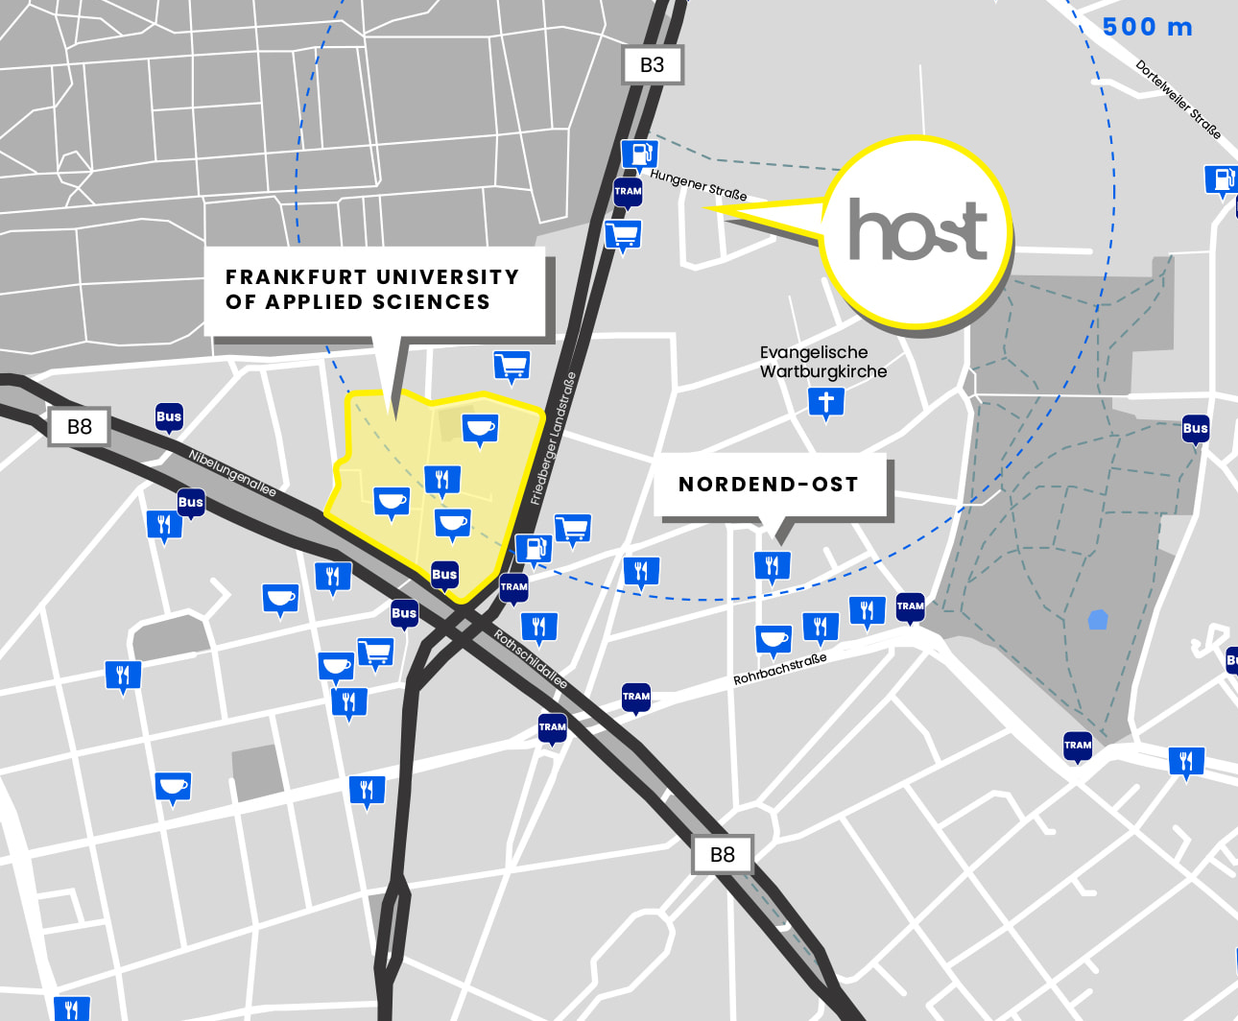

The House of Science and Transfer - HoST
We are here (Building B, 2nd floor)
Entrance PRESS THE BUTTON!
~5 mins
https://host-ffm.com Hungener Str. 6
Introduction to Human-Computer Interaction

Slide 19
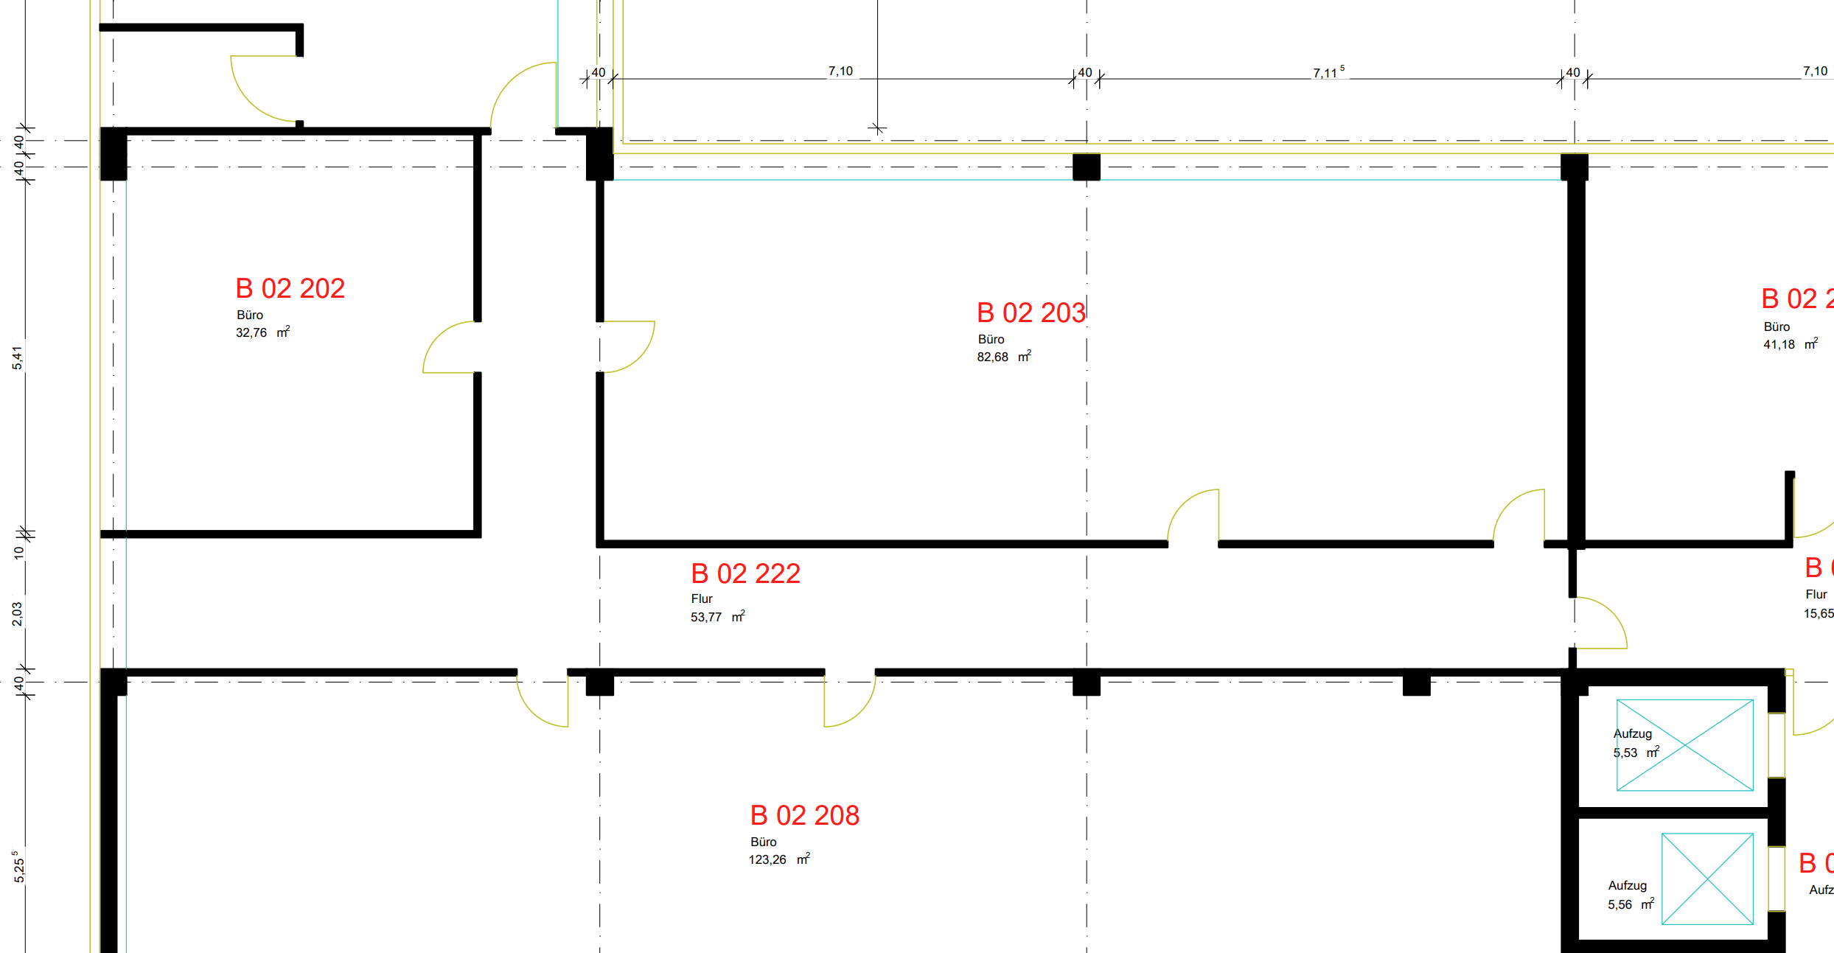
Our Lab
Mixed Reality Lab
50 m²

Slide 20
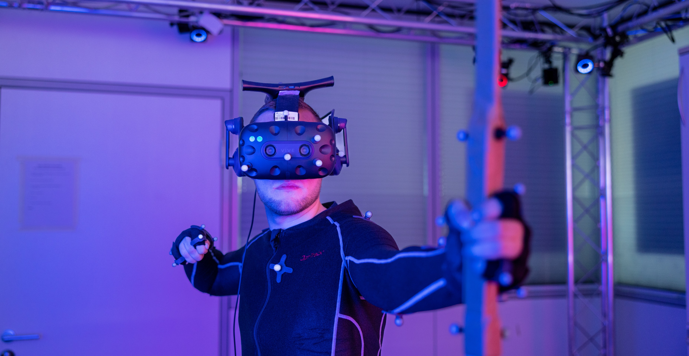
Mixed Reality Lab
https://www.frankfurt-university.de/mixed-reality-lab
Introduction to Human-Computer Interaction

Slide 21
Your are not only experimenter, but also participant!
Your must participate in at least three studies of the other exercises
Ideally, you do not tell anyone the purpose/procedure of your study
Experiences in Mixed Reality
Participate in 3 studies!
Mixed Reality & Physiological Sensing
Questions on Methodologies
Not from your own exercise!
3D-Prototyping
Introduction to Human-Computer Interaction

Slide 22

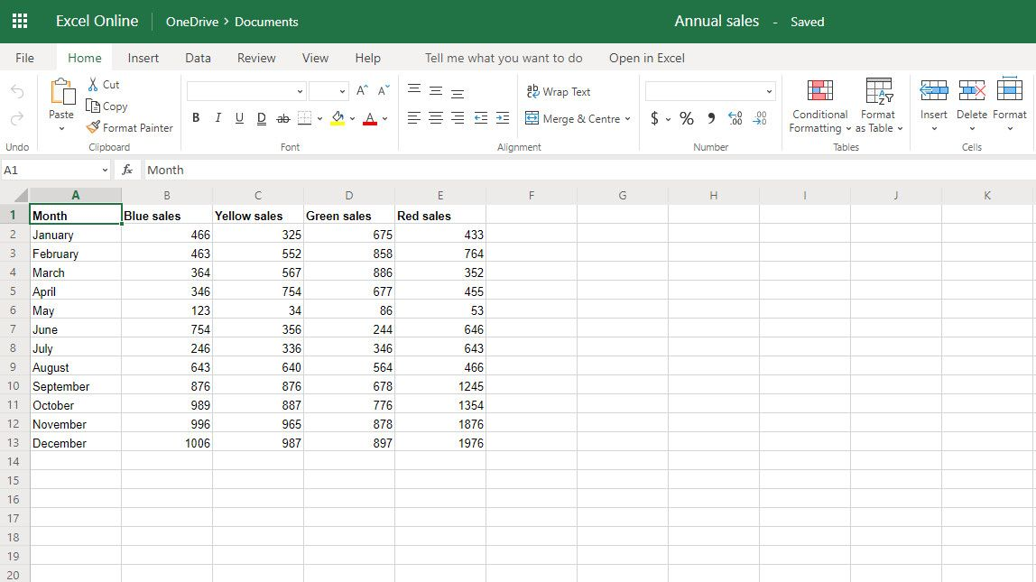
Your Participation
Participation is voluntary (not as in other universities) and you decide in which three studies you want to participate
However, this course only works if everyone participates in user studies!
Not participating in user studies means that
someone does not participate in your own study and you get no results
you do not learn how a user study works
that we don't like you
We will counter check
User Study List
Participation Confirmation
Introduction to Human-Computer Interaction

Slide 23
Learning Human-Computer Interaction
Introduction to Human-Computer Interaction

Slide 24

Humans
Introduction to Human-Computer Interaction

Slide 25

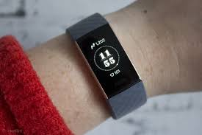


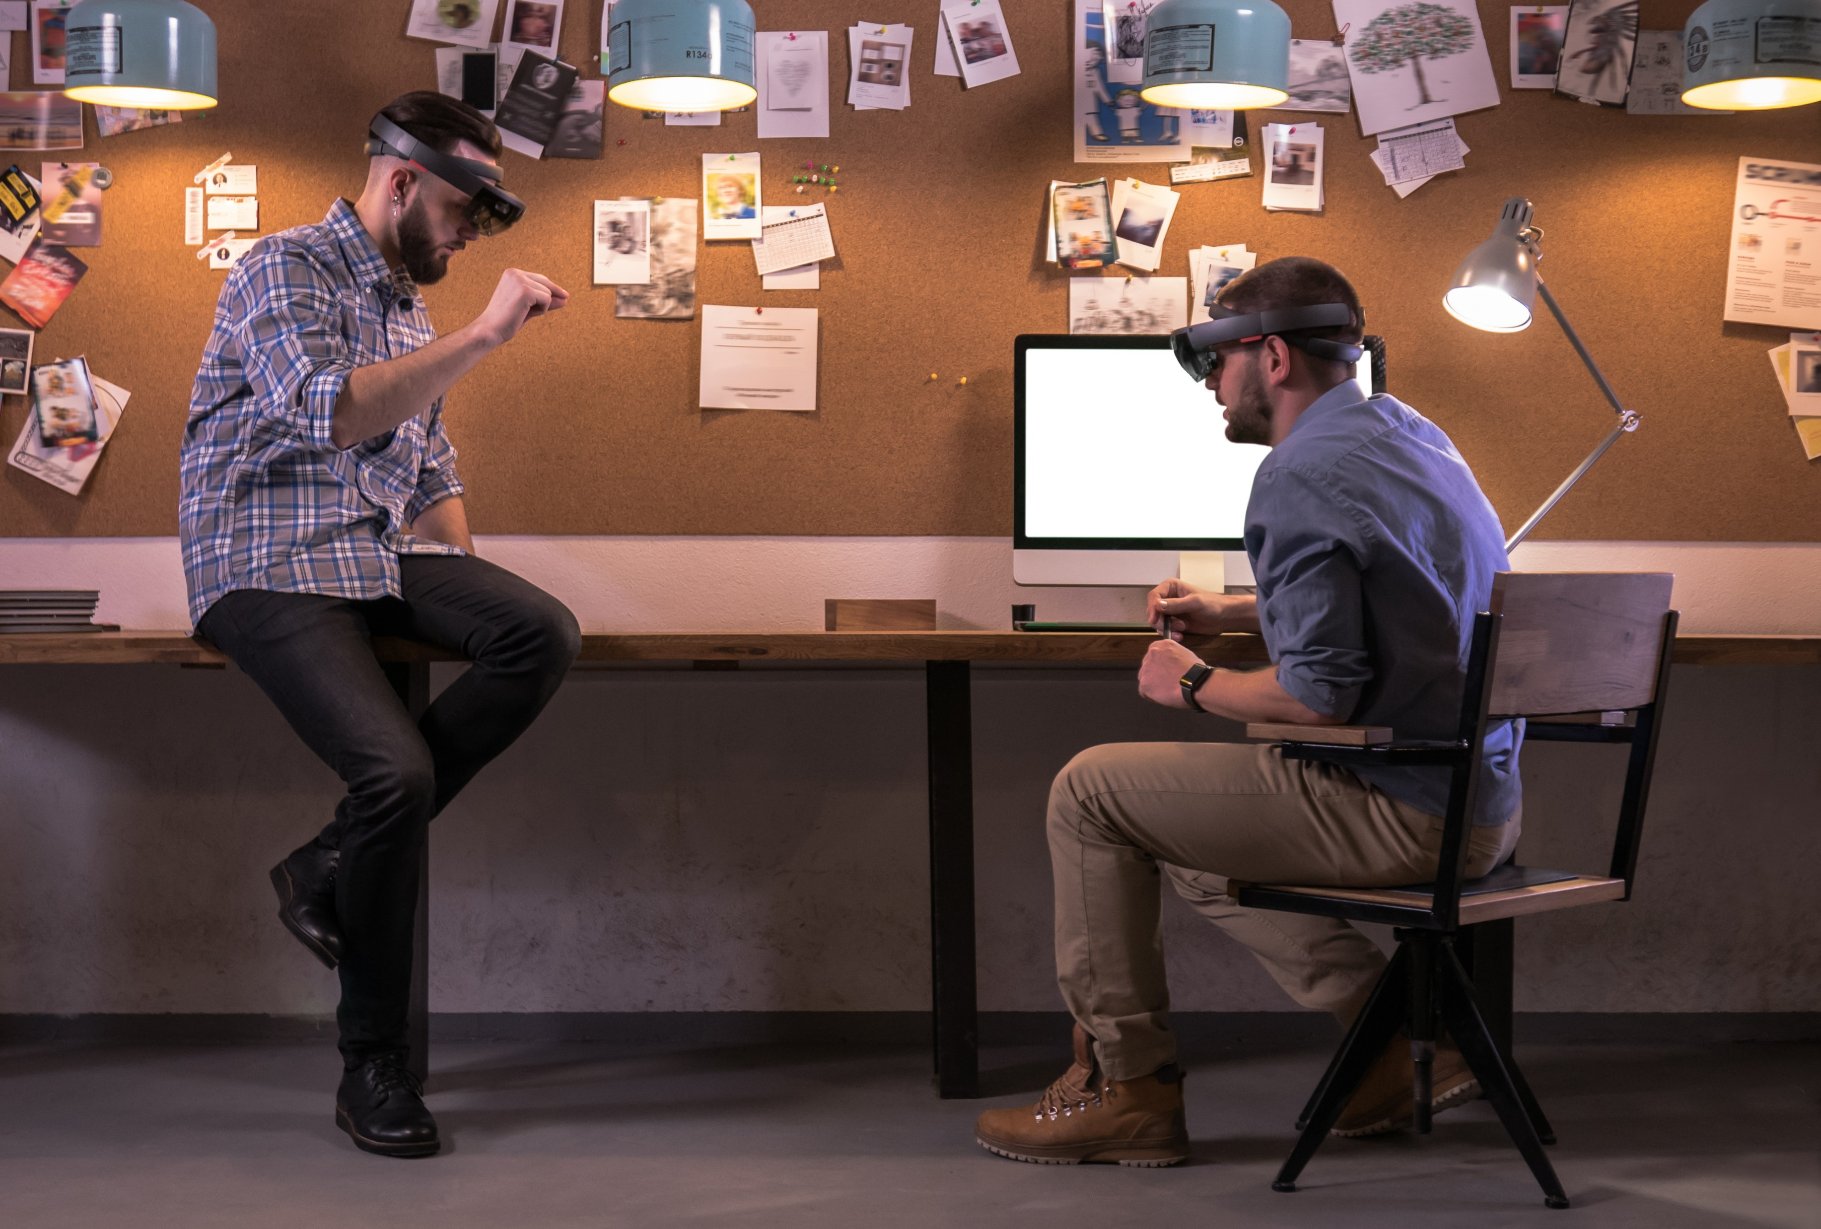

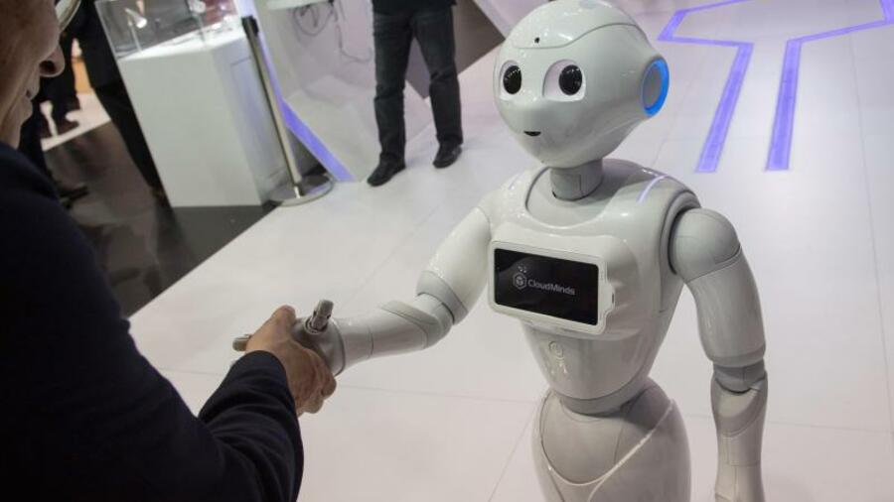

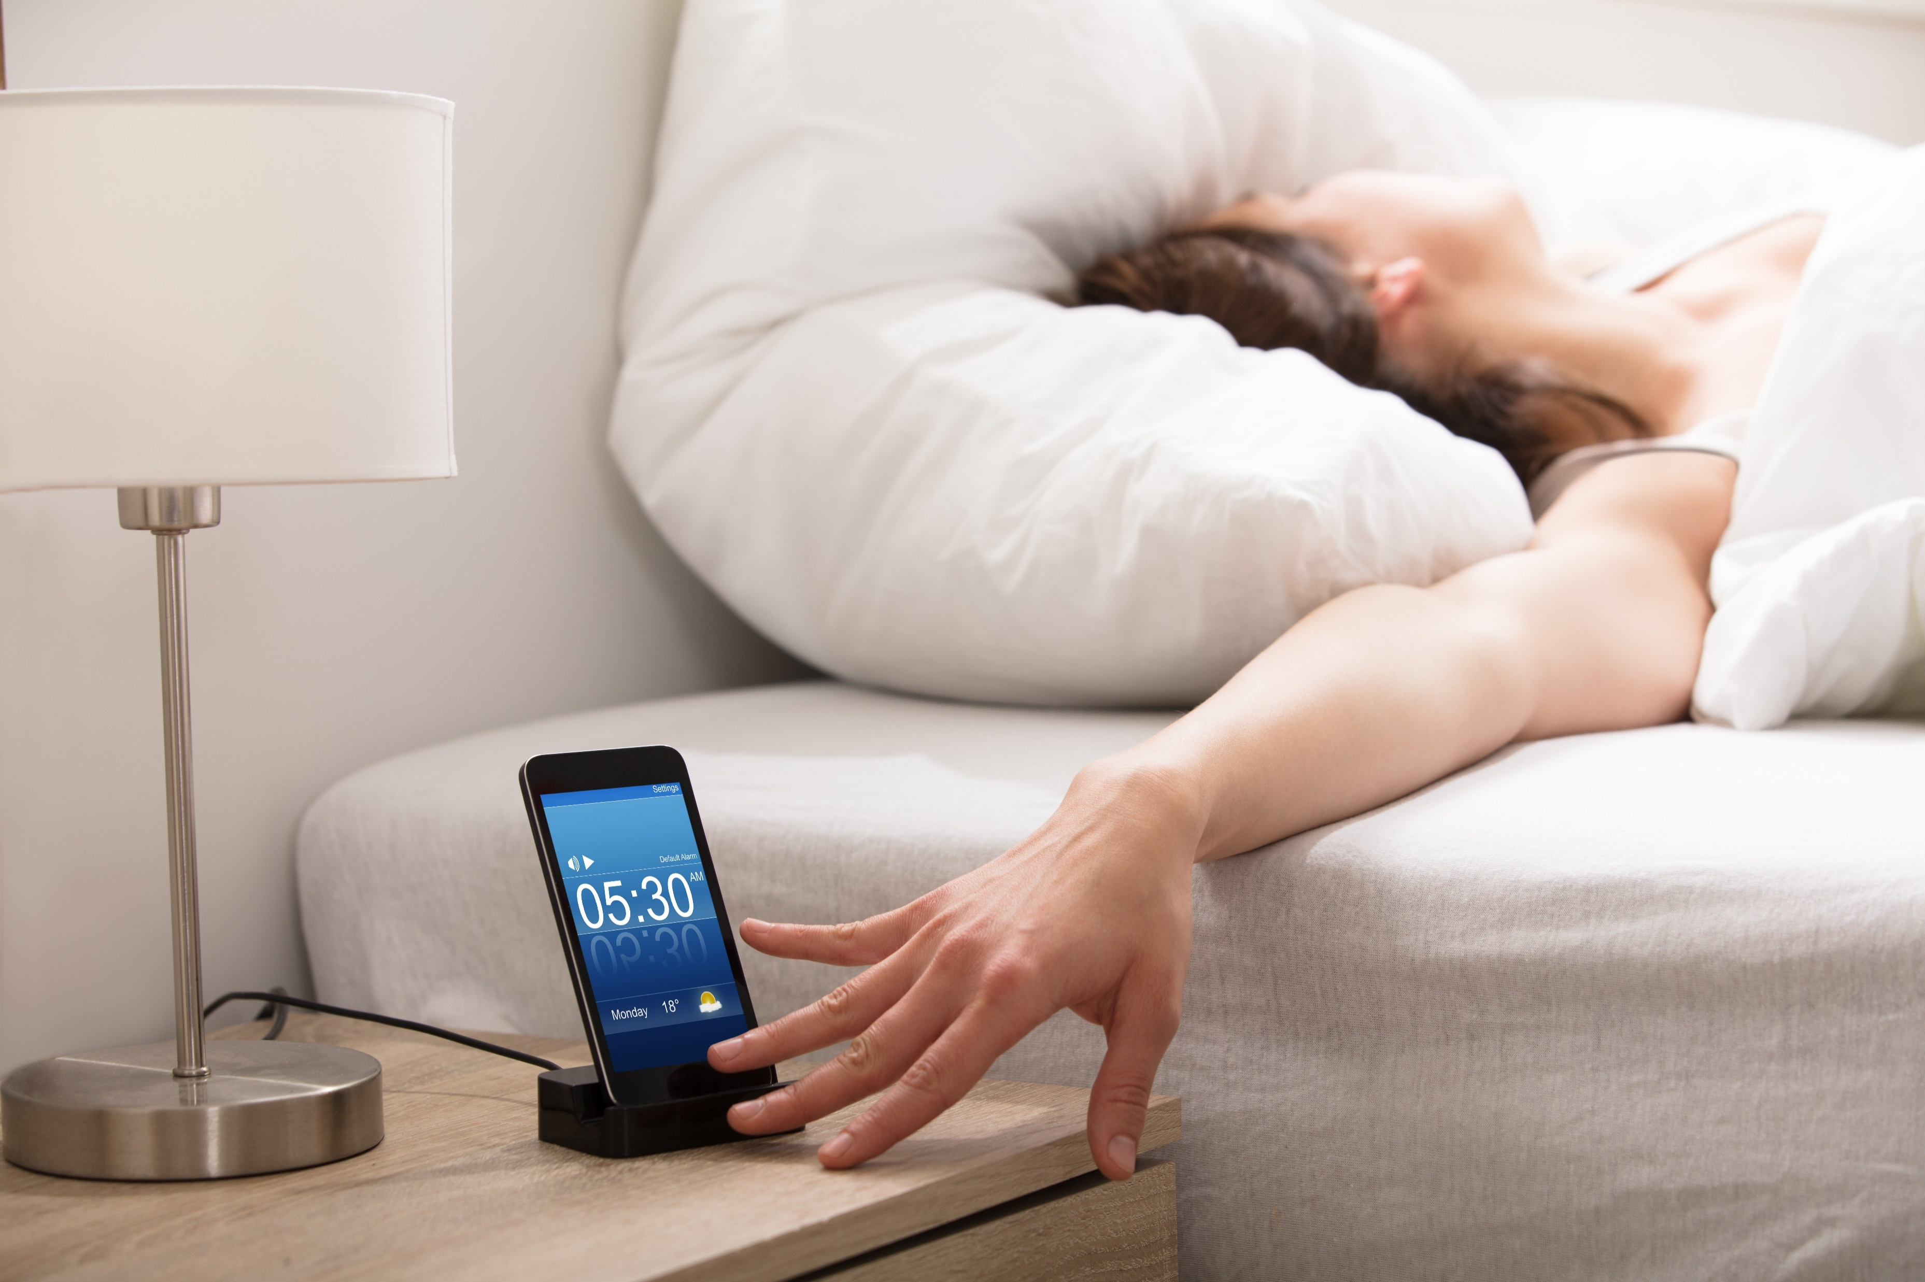
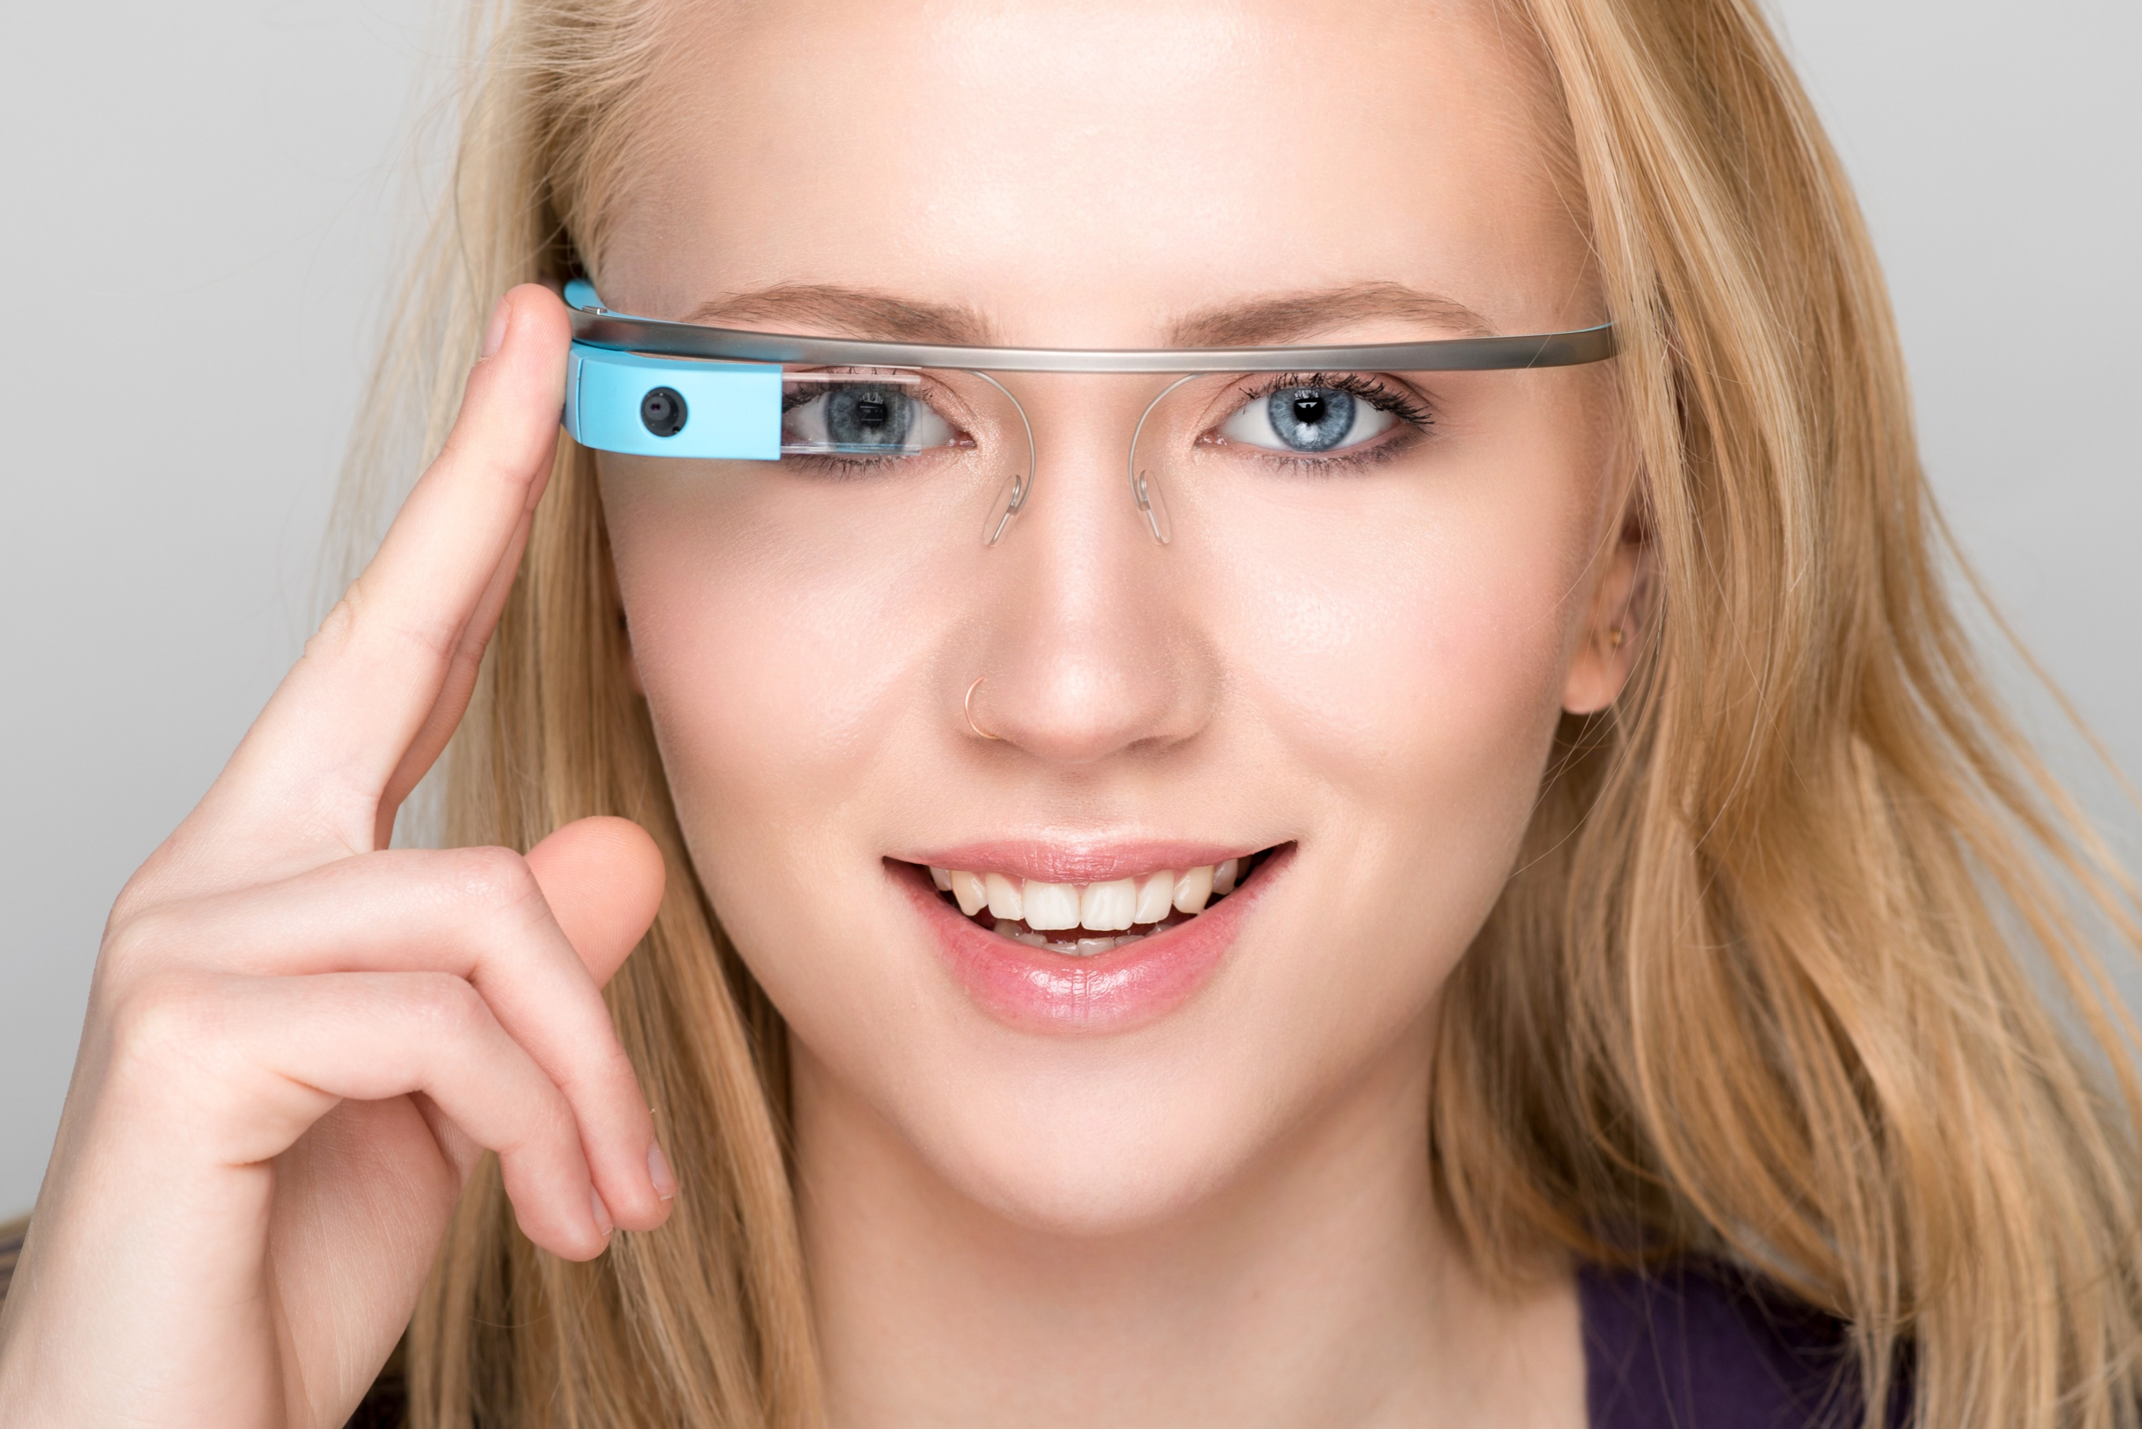


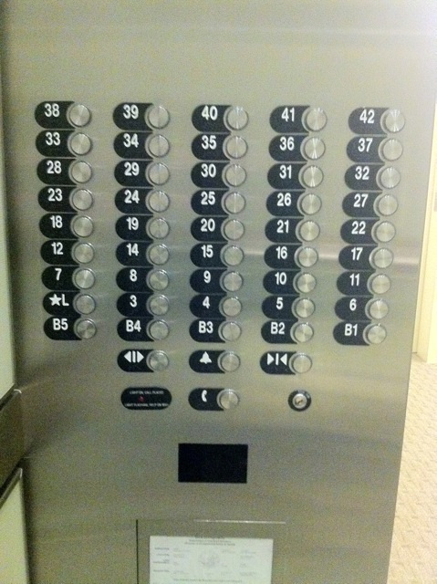
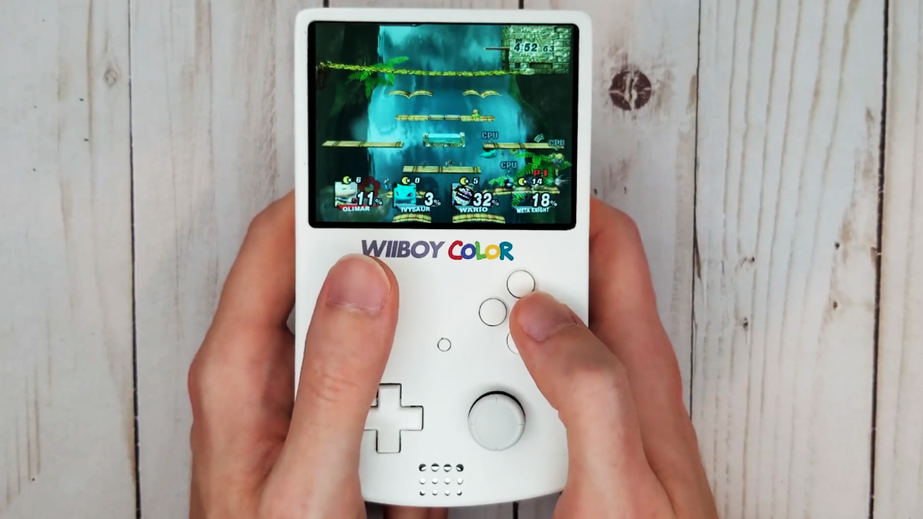
Computers
Photos from PxHere.com/shutterstock.com
Introduction to Human-Computer Interaction

Slide 26

Human-Computer Interaction
Introduction to Human-Computer Interaction

Slide 27

Interaction? What is interaction?
Introduction to Human-Computer Interaction

Slide 28
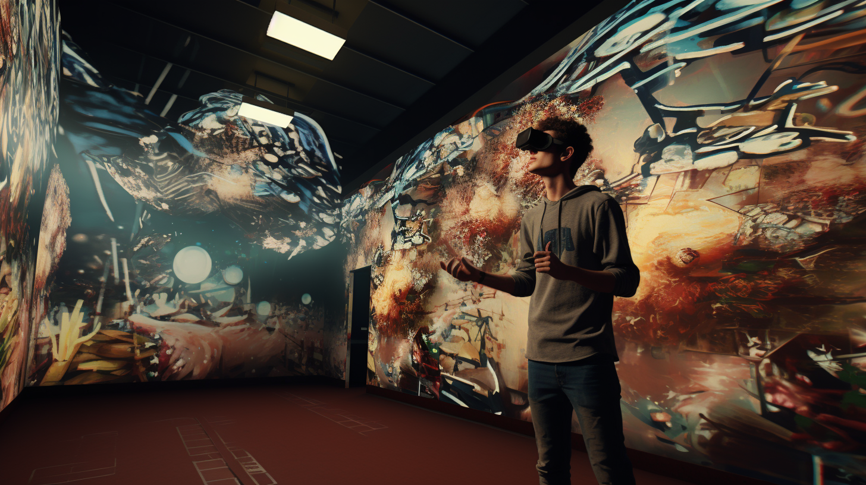
How can we understand how an interaction works?
Introduction to Human-Computer Interaction

Slide 29
Understanding Interactive Systems
The students evaluate, discuss and present the effects of interactive systems on users with empirical methods of HCI within a team and specified time frame.
you will design, conduct and evaluate a user study
you will work in a team, coordinating and reflecting on difficulties
you will examine and provide feedback on the results documentation
you will deeply analyze a specific research topic
you will present the study results and inform other about your findings.
Goal is that students will be able to test computer systems for their user experience and able to examine their usability with quantitative and qualitative research methods
Research?
Introduction to Human-Computer Interaction

Slide 30
Research – A Definition
[Research is] “creative and systematic work undertaken to increase the stock of knowledge, including knowledge of humans, culture and society, and the use of this stock of knowledge to devise new applications“ [1].
Conducting and presenting the findings from empirical user studies is essential in HCI science and evaluation o interactive systems
Only new findings or original work can be published
We do not reproduce work that has already been published
We aim for original research (also called “primary research”)
You conduct a user study gaining new knowledge
Sometimes, we conduct secondary research (reviewing literature) with new findings
[1] UNESCO Definition - Research and development https://stats.oecd.org/glossary/detail.asp?ID=2312
Introduction to Human-Computer Interaction

Slide 31
You will…
… not copy stuff that exist – why redoing it?
… focus on new systems
… not answer boring research questions just because it is easy (e.g., who has the better user interface: amazon or ebay?)
… implement (or evaluate) aspects that are only at the core of your research question and evaluation
… not put too much effort in developing something when you can fake it
… do a scientific evaluation (not: “yeah the participants liked our stuff”)
… document your complete progress: we want text, photos, and videos!
Introduction to Human-Computer Interaction

Slide 32
You will…
do empirical user studies to answer research questions that are:
strange
risky or provocative
interesting
promising
adapt your concept if necessary
make use of your special abilities
conduct studies where you learn something
conduct studies where you don’t know the results
learn that faking, prototyping, and testing systems is essential in HCI
Introduction to Human-Computer Interaction

Slide 33
Seminar Classes
A basic lecture
Stuff you need to know
A number of exercise workshops
Reading & writing HCI papers (yes, you will read papers and write one)
How to write a literature review (yes, everyone must look into literature)
People who do a literature review do that more extensive
How give a good scientific presentation (yes, you must present your stuff)
How to use Latex (yes, you will use it)
How to use R (yes, you have to do statistics)
Designing and conducting a user study (yes, you will do one)
Introduction to Human-Computer Interaction

Slide 34
Potential Lecture Content
Basics
Users
Usability
Perception
Cognition
Aesthetics
Models
Input
Output
Prototyping
Games
Accessibility
Introduction to Human-Computer Interaction

Slide 35
Recent Streams in HCI
User Experience and Usability
Specific Applications Areas
Learning, Education, and Families
Interaction Beyond the Individual
Games and Play
Privacy and Security
Visualization
Health, Accessibility and Aging
Design
Building Devices: Hardware, Materials, and Fabrication
Interacting with Devices: Interaction Techniques & Modalities
Blending Interaction: Engineering Interactive Systems & Tools
Understanding People: Theory, Concepts, and Methods
Critical Computing, Sustainability, and Social Justice
Computational Interaction
What is the most visited research field in HCI?
Introduction to Human-Computer Interaction

Slide 36
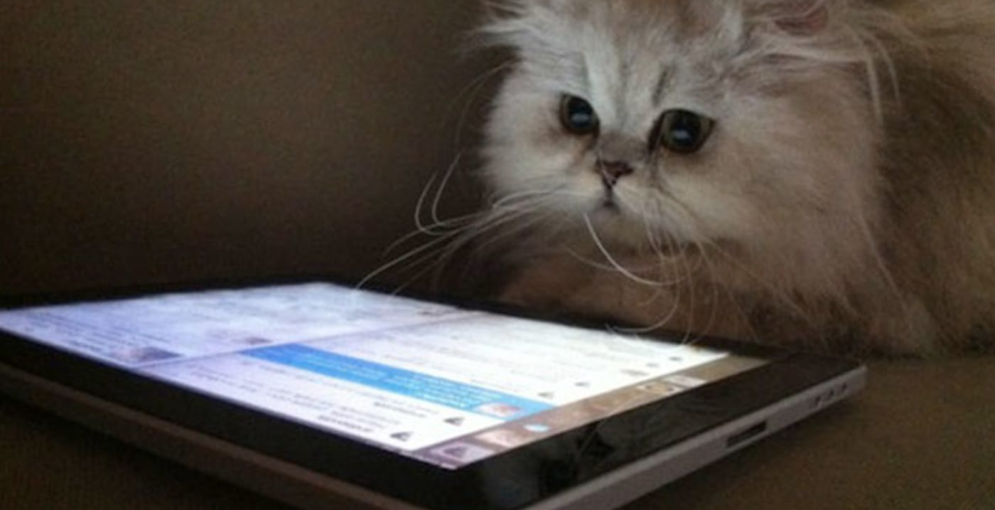
There is no „DAU“. You only ran too few studies!
Introduction to Human-Computer Interaction

Slide 37
Studies?
Studies! There are methods (we will discuss each method in detail):
Prototype testing in a lab study
(Web/Mobile) app, websites, downloadable desktop software
Field & online surveys
Diaries (took probably too long)
Expert Interviews (when you can find them)
Literature Review (gaining new scientific insights)
User Studies? WTF? Do I need to develop something? … Not necessarily …
HCI researchers are smart, they fake everything they can…
Many prototypes already exist, but nobody has tested them….
Introduction to Human-Computer Interaction

Slide 38


What do you need to evaluate „Alexa?“
„Alexa? Play some music!“
„Here are some songs for you“
Idea: Talking with a computer would be awesome
Test it!
Introduction to Human-Computer Interaction

Slide 39
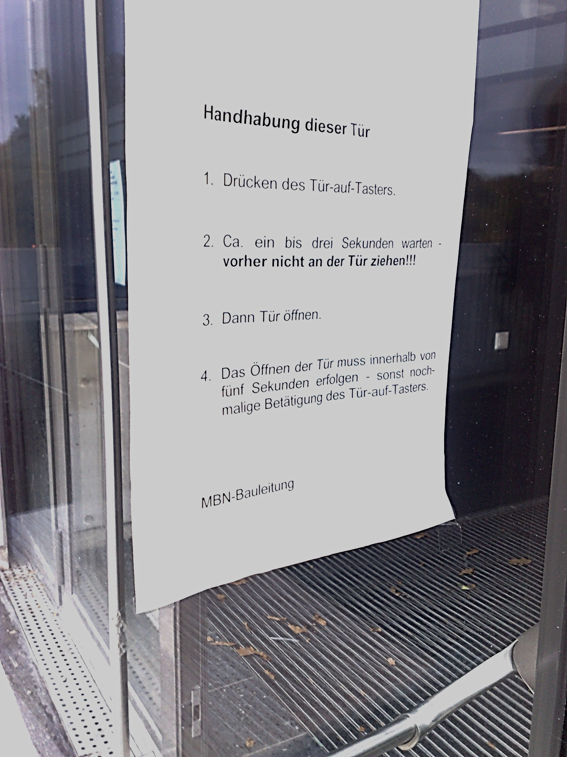
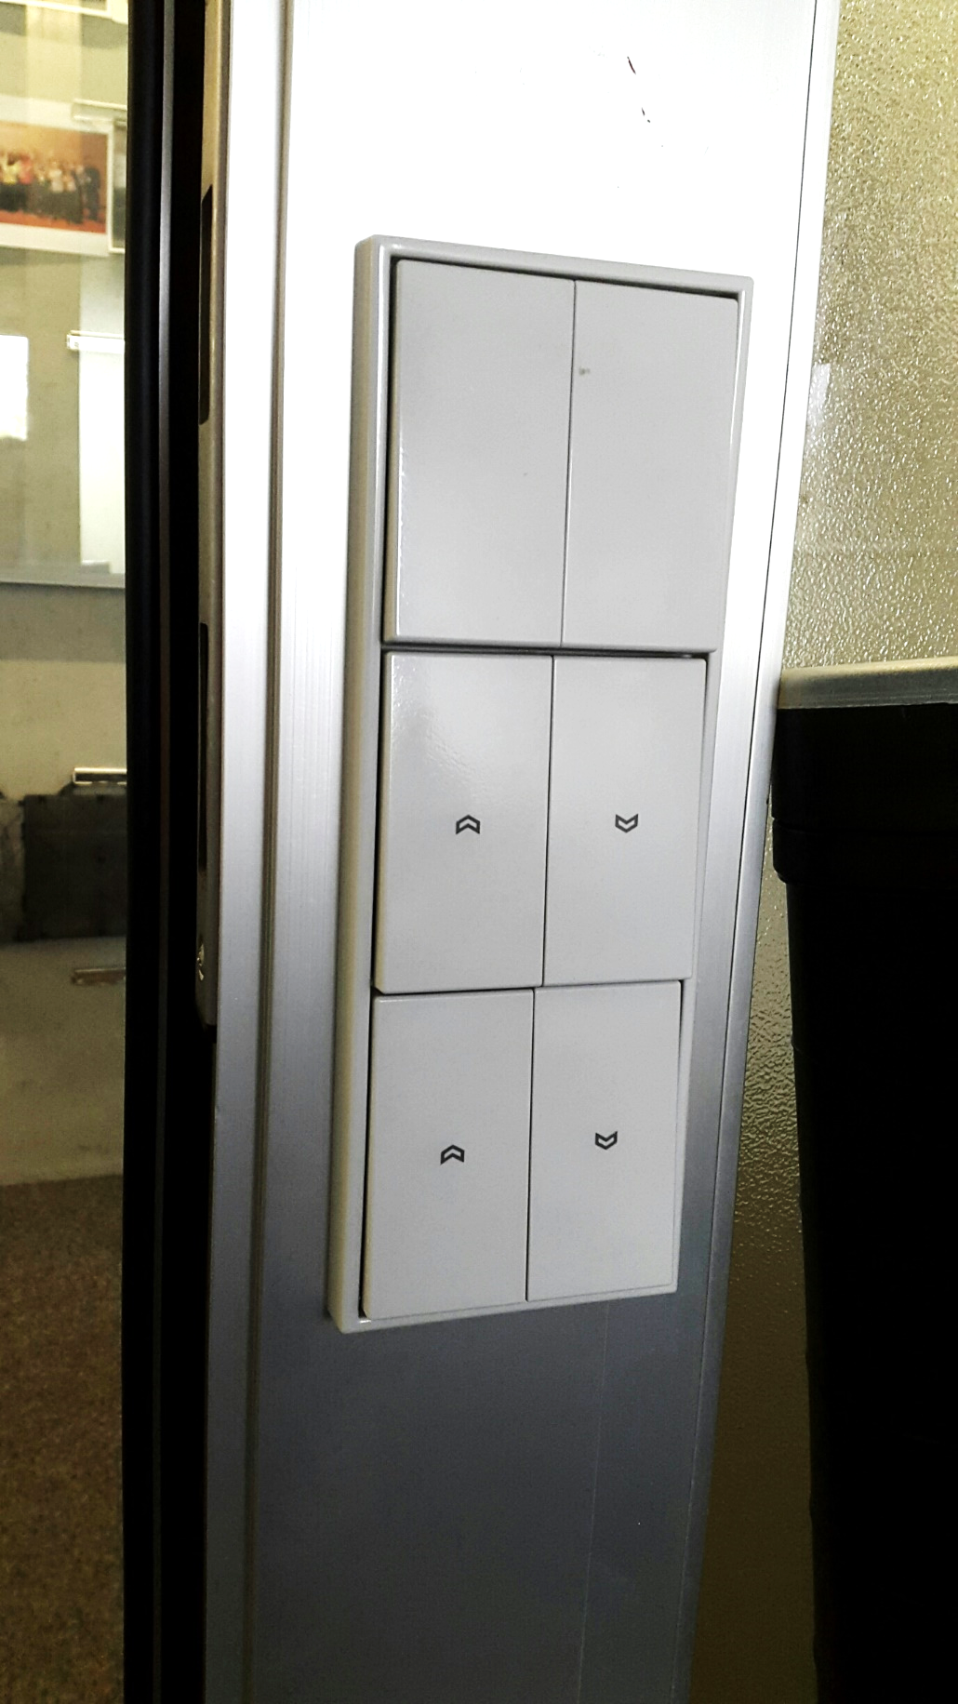
Idea: Putting a manual to open a door is awesome
No need to test it, because it’s stupid!
Introduction to Human-Computer Interaction

Slide 40
Teams
Allowed group size: 3 persons (no < 3, no > 3)
Each group presents the progress of their project as a whole
The group will be rated as a whole (default, but you can change that)
Group conflicts
First, try to solve conflicts internally but…
If a conflict persists and you see that at least one person is getting into trouble
→ contact me!
Introduction to Human-Computer Interaction

Slide 41
Mountain of Code Complexity
When you need a project complexity metric
Abstraction
Get over it
Design Patterns
code complexity
We like that
Super Simple Code („quick and dirty“)
OOP
And if even this is too much, fake it!
Adapted from https://twitter.com/flaviocopes/status/1580227345612689408
years of experience
Introduction to Human-Computer Interaction

Slide 42
The Main Reason Why People Fail
You think you can do it alone → Nope, you cannot run a research project alone
You think that it‘s easier to not participate → Nope, you are wrong. Though, there is no requirement of attendance, however, the course is hard.
You still think that this course is super easy → Nope.
The course is really hard.
Introduction to Human-Computer Interaction

Slide 43
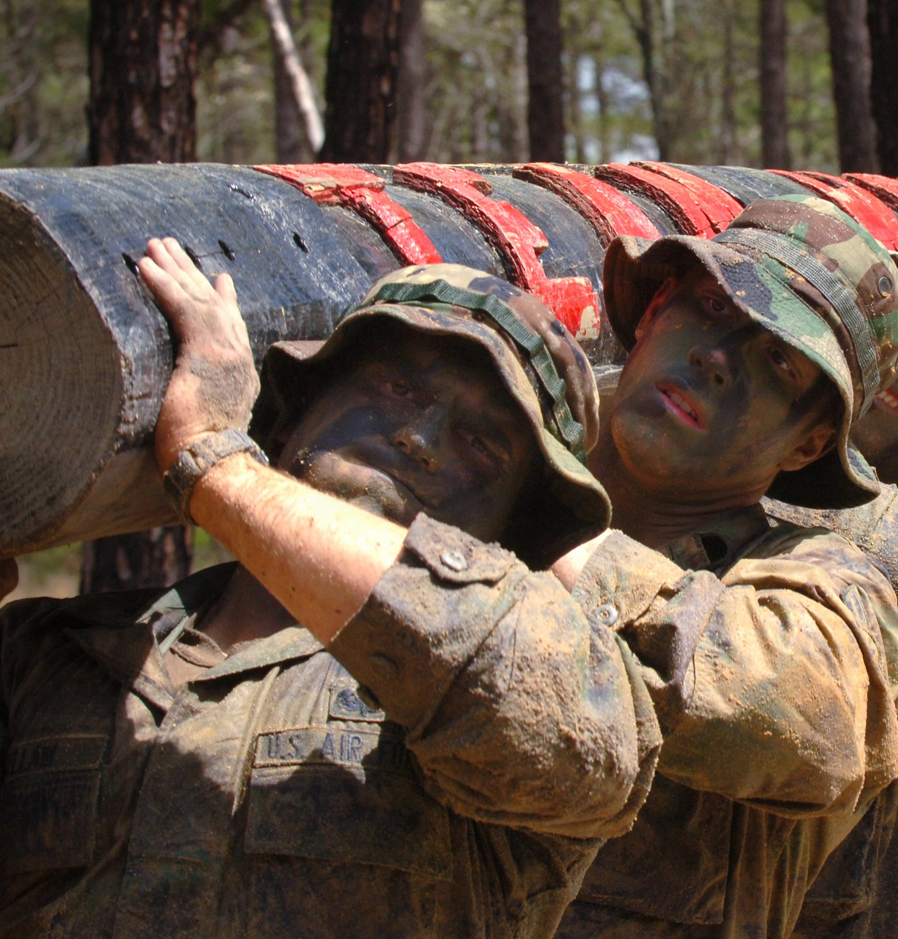

Work hard
Be clever
Photo: https://pxhere.com/de/photo/45794 https://pxhere.com/de/photo/754409
Introduction to Human-Computer Interaction

Slide 44
Other Reasons Why You Fail…
You think you can start with your project at the end → Nope. Start now.
You are doing repetitive tasks → Automate it.
You started the study without using your brain → Use your brain. Or talk to us.
You don't talk to each other → Establish social competence. Be open.
Your measure wasn’t properly recorded → Test your own prototype before starting.
You’re implementing too much → Focus on your research question. Drop fancy features.
You have no participants → All people in this course must attend at least three studies.
You don't have the right equipment → Talk to us. You will get it.
You have more important things to do → We don’t care.
You found original research doing the same → Adapt your research question. Talk to us.
Introduction to Human-Computer Interaction

Slide 45
In a perfect world your research project…
…has a story: convincing, relevant, structured, focused, a “message”
…is novel: original, creative, strange, interesting
…is correct: scientific, unbiased, objective, replicable, reproduceable
…is founded: correct methodology, brought into context with related work
…is structured: systematic, organized, planned
…is understandable: clear, logical, throrough (claim → reason → evidence)
…subtly highlights your skills: programming, social, management, graphics
…properly reports: clear and concise language, no blah blah (!)
…is ready for publishing: even when you have no findings
Introduction to Human-Computer Interaction

Slide 46
General Project Procedure
Find a group & choose a topic (we set them!)
Prepare the topic & screen important literature
Identify and motivate your research question, establish hypotheses
Implement a prototype, artifact or stimuli
Design and conduct a (1) user study or (2) field or online survey
Analyze and evaluate your results
Present your findings
Write a scientific paper (6 - 10 pages excl. references)
Release your data and source code on github (open science)
Introduction to Human-Computer Interaction

Slide 47
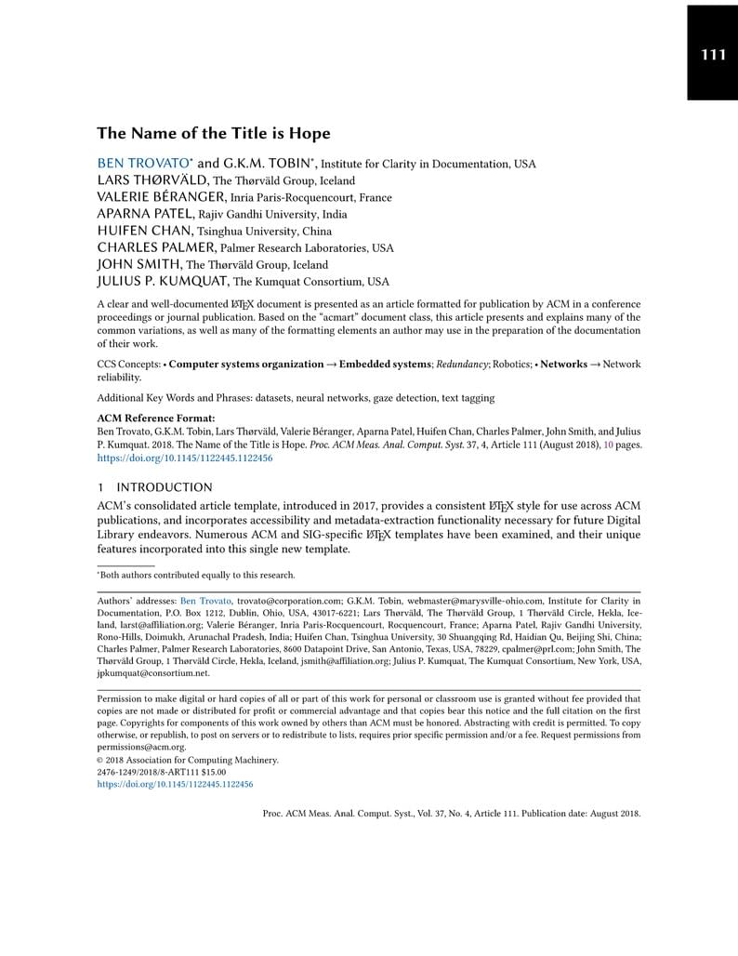
Your Paper
Scientific report of your evaluation (your project)
You will learn and use Latex
\documentclass[manuscript,screen,review]{acmart}
Papers may be submitted in German & English
Paper length: 6 pages (excluding references)
Template: ACM Single Column Master Template https://www.overleaf.com/latex/templates/association-for-computing-machinery-acm-large-1-column-format-template/fsyrjmfzcwyy
Additional materials
Private GitHub repository with
complete project & source code
anonymized datasets
Introduction to Human-Computer Interaction

Slide 48
Three Types of Evaluations
Summative Evaluations (e.g., experimental user studies in the lab)
Formative Evaluations (e.g., qualitative interviews / focus groups)
Literature Reviews (e.g., a scoping review)
Most projects have overlaps with the other types (a summative evaluation can also have formative components, literature reviews can occur in both, etc.)
Please decide based on: personal interests, skills and within the team
The three evaluation types in HCI are different. However, they basically require the same amount of time and effort.
Introduction to Human-Computer Interaction

Slide 49
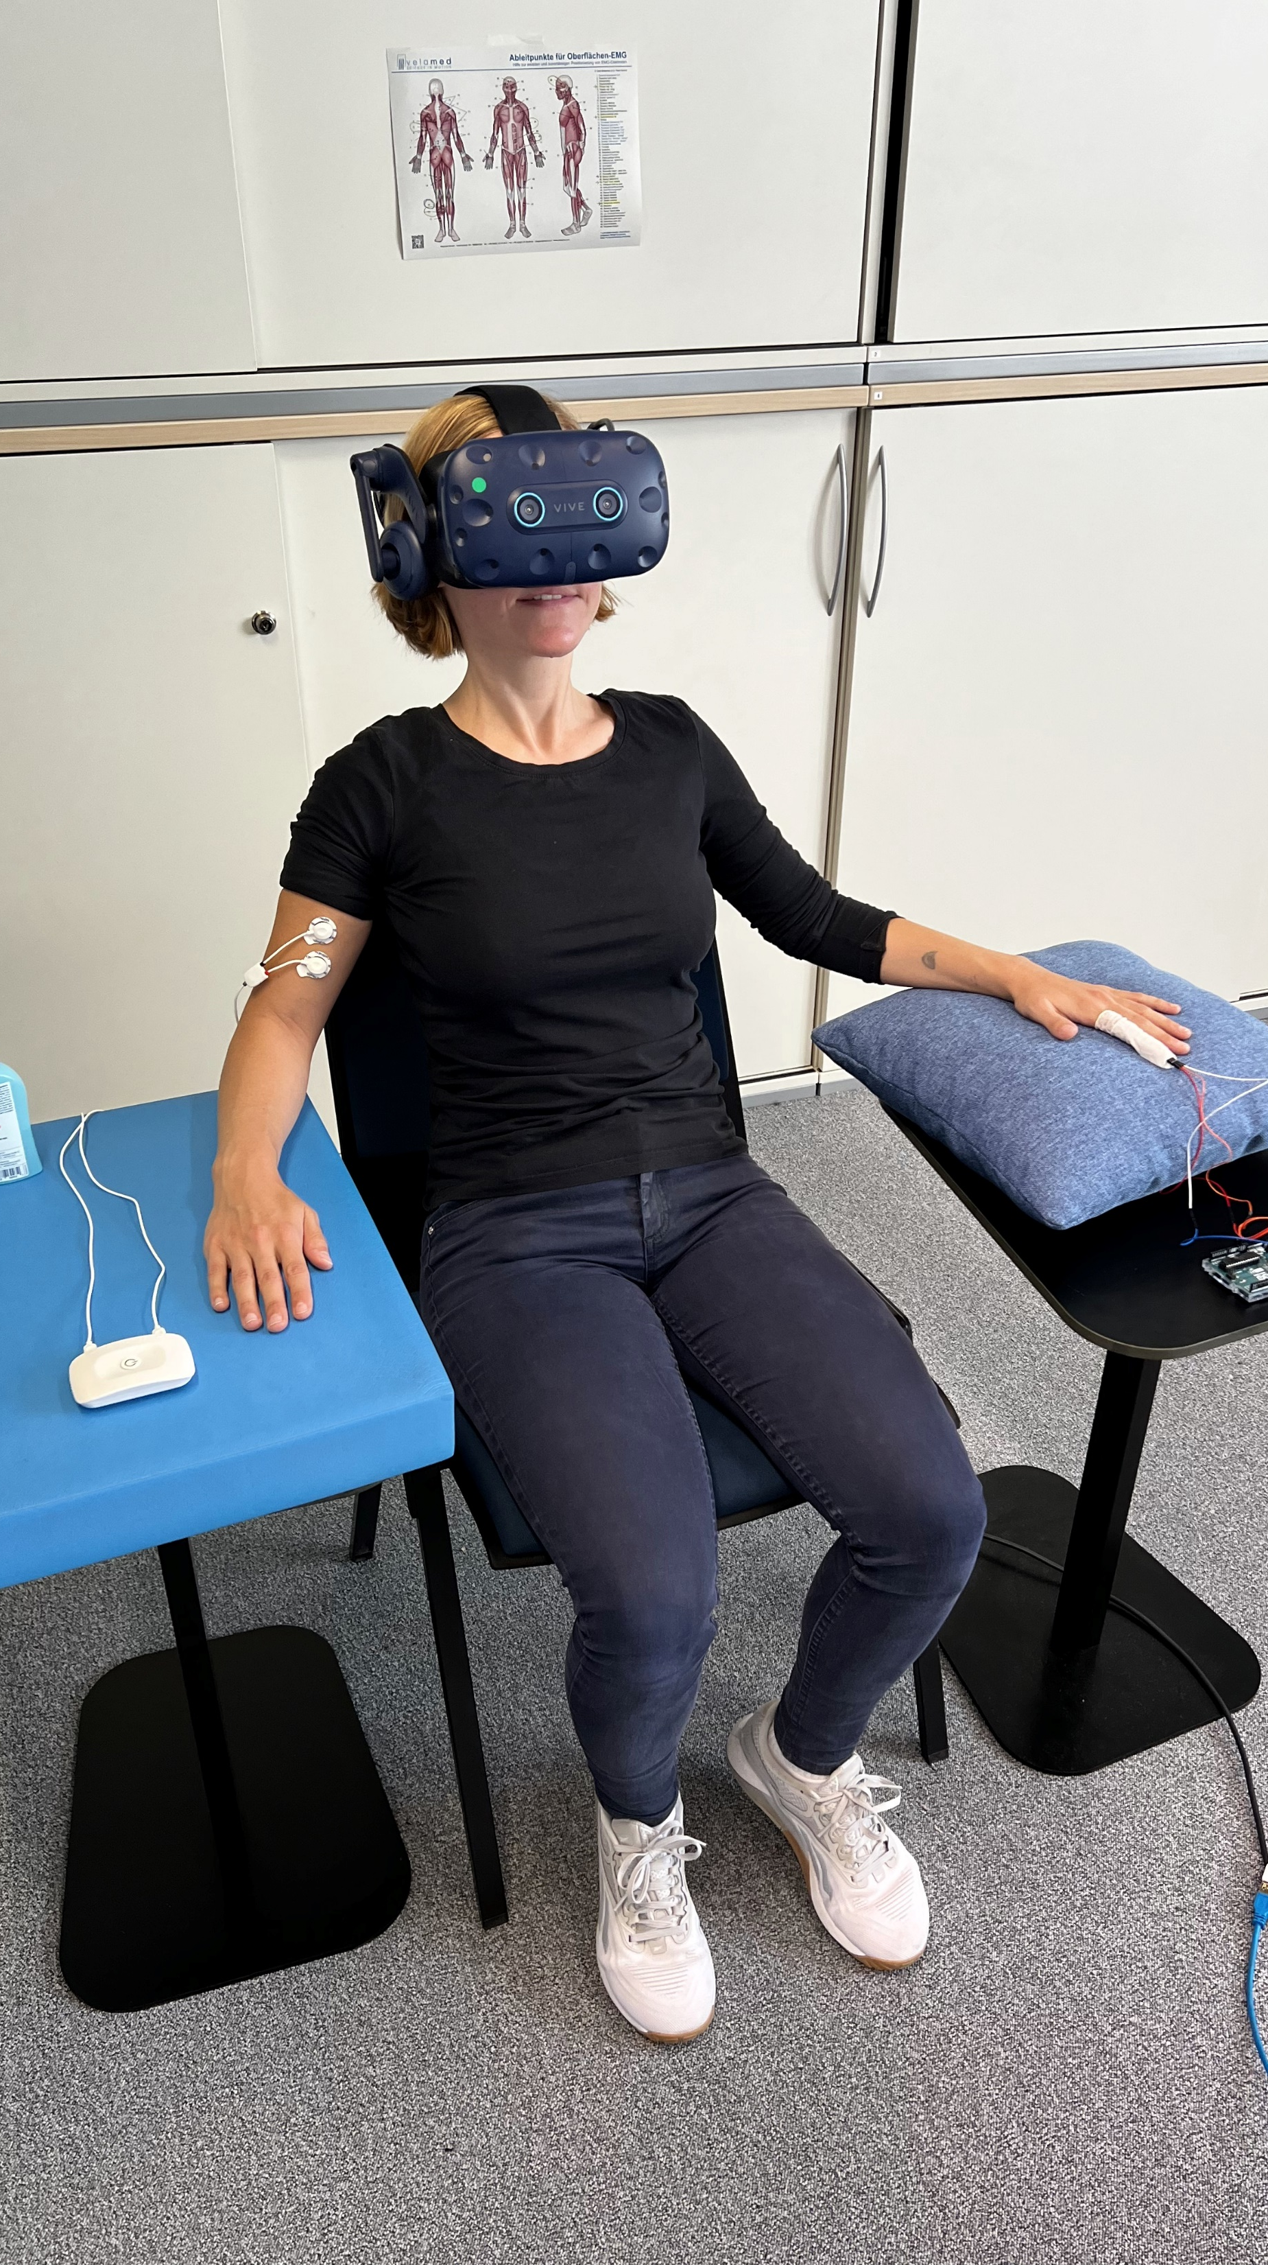
Summative Evaluations
Quantitatively assess the objective and/or subjective measures
Typically controlled environments or surveys
Collection of empirical data that can be statistically analyzed to draw conclusions
This approach is crucial for validating hypotheses about how design decisions impact user performance and satisfaction
Pros: highest impact, highest reputation
Cons: careful study designs, statistical analysis
Introduction to Human-Computer Interaction

Slide 50

Formative Evaluations
In single or group interviews, researchers can gain deep insights into the personal experiences, preferences, opinions, and challenges faced by users
Generate ideas, understand requirements, foster discussions that can reveal commonalities and differences in user needs and expectations
Develop and understand the design of low-level prototypes and design spaces
Pros: deep insights, flexible study designs
Cons: interpretation of data, difficult synthesis
Introduction to Human-Computer Interaction

Slide 51
Literature Reviews
Systematic or scoping reviews, play a foundational role in synthesizing existing research findings and identifying gaps in the literature
Understand and overview the current state of knowledge on a particular topic
Map the field and identify key concepts, theories, and sources of evidence, which can inform future research directions and methodologies.
Pros: get a broad overview, very resource efficient
Cons: information overload, difficult synthesis
Introduction to Human-Computer Interaction

Slide 52
Research Projects Examples
Introduction to Human-Computer Interaction

Slide 53
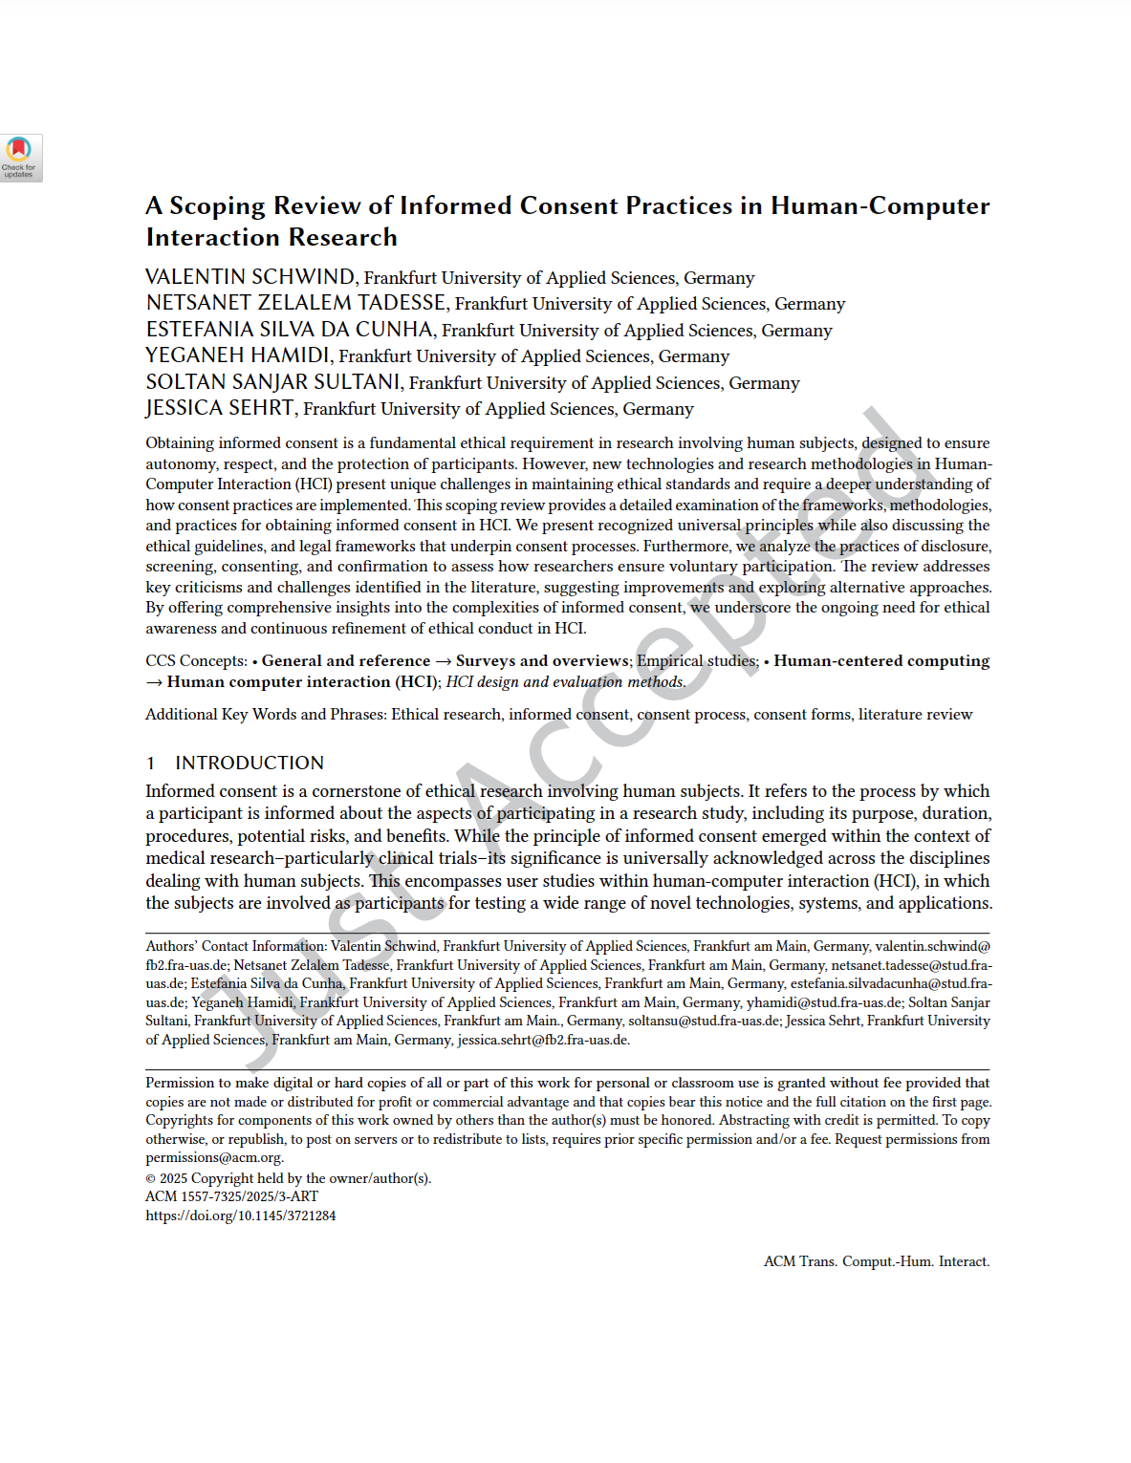
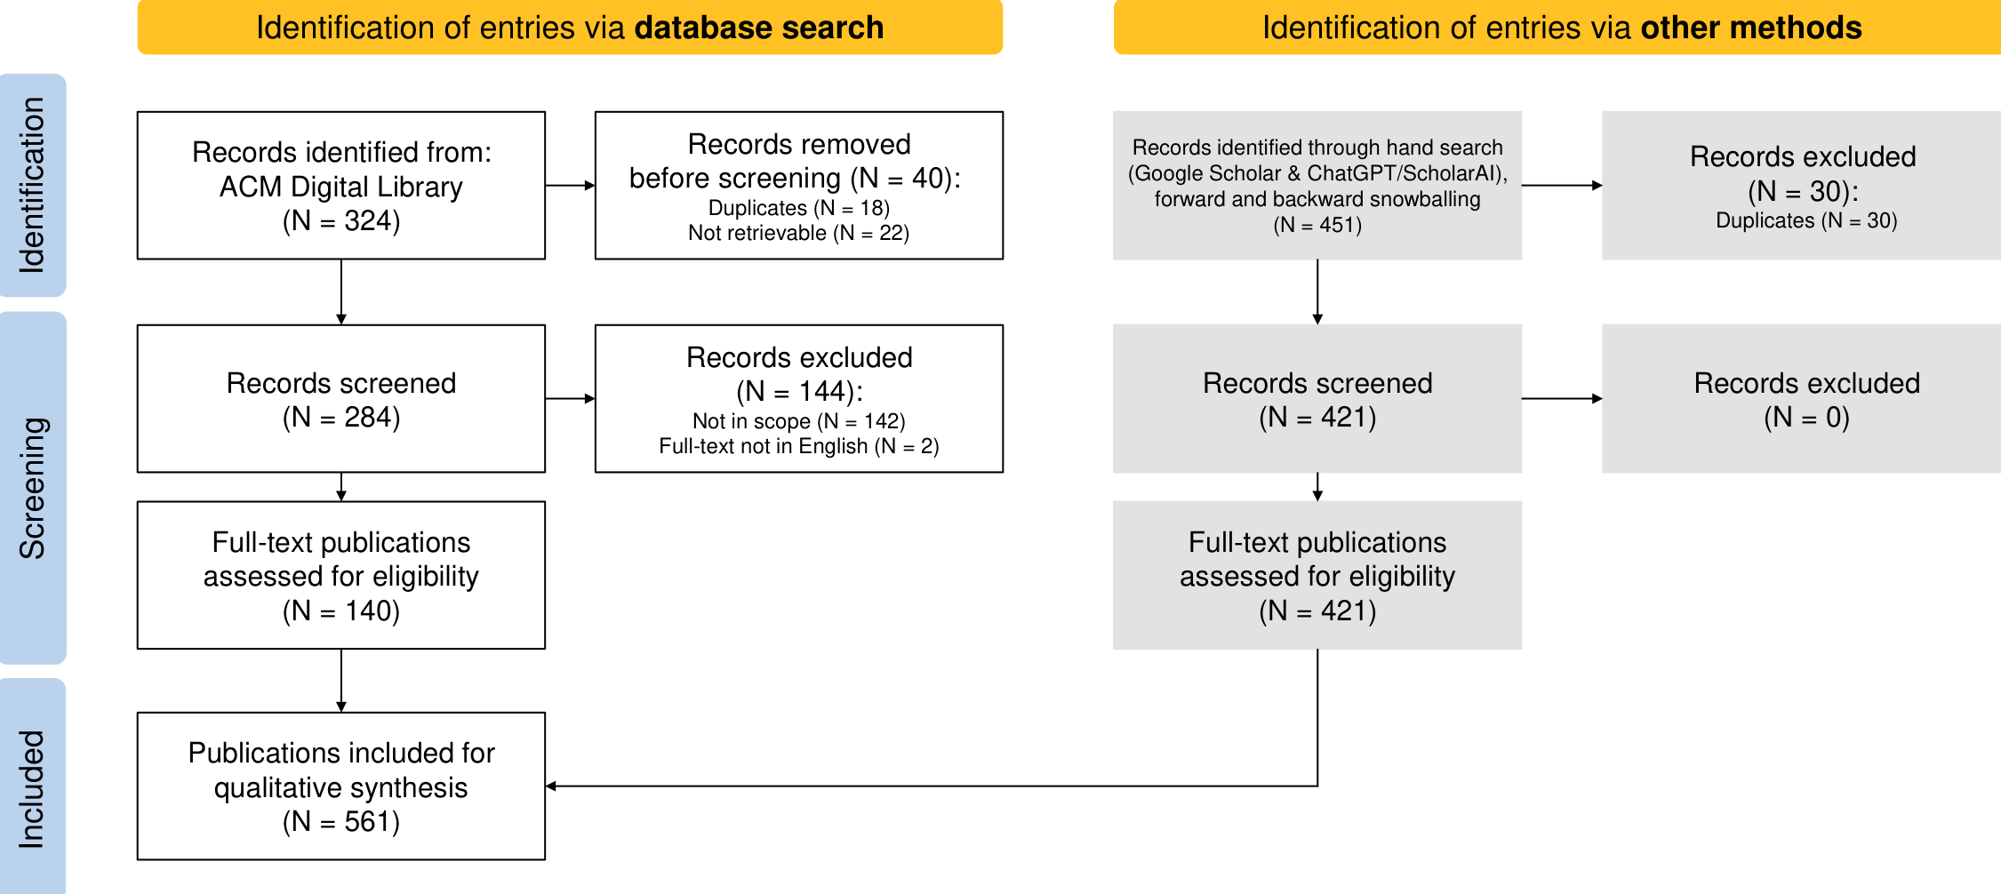
Example: Literature Review of Informed Consent
Literature Review
Introduction to Human-Computer Interaction
Notes:
EMG biofeedback can help users to focus on their own muscle tension. However, which sensory cues are suitable for rendering EMG signals and closing a biofeedback loop is currently unknown. As humans have a limited set of resources available for mental processes, we hypothesized that task performance based on biofeedback from multiple cues can cause difficulties.
%Thus, we investigated three feedback modalities, which were Visual, Auditory and Tactile. We conducted a three-way fullfactorial within-subject design study in VR and with 40 participants. Due to the low variance of the throughput in the first study, its observability during the experiment to ensure isometric contractions, and its relevance in related literature, we used the Biceps brachii, at the front of the upper arm, for EMG input in our second study.

Slide 54
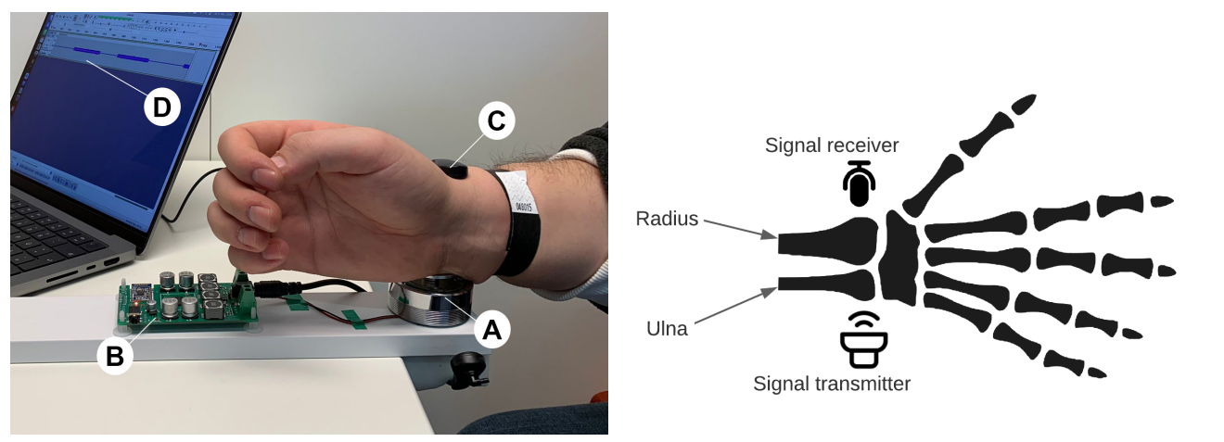
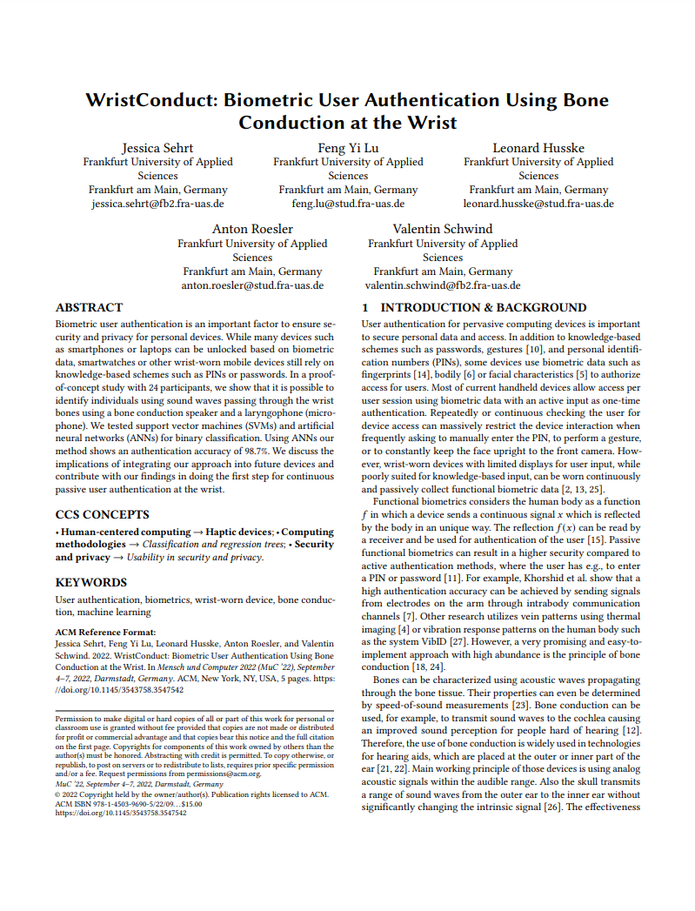
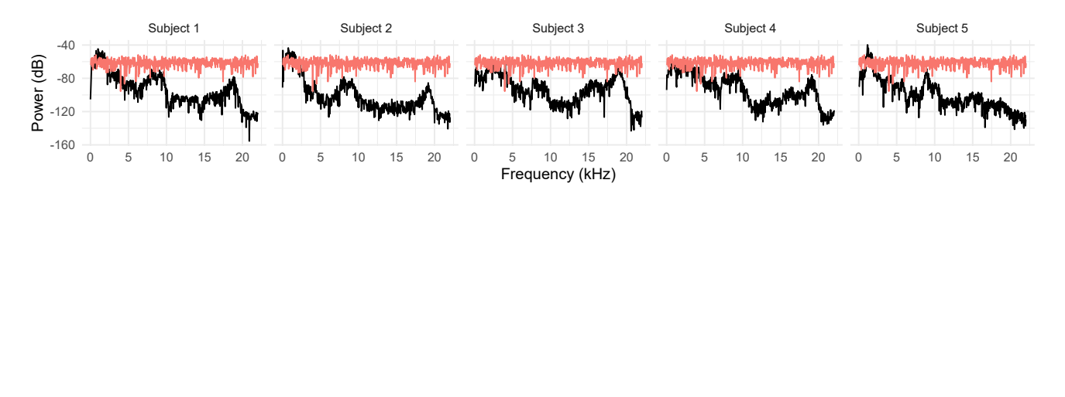
Example: WristConduct
Summative Evaluation
WristConduct: Biometric User Authentication Using Bone Conduction at the Wrist. Jessica Sehrt, Feng Yi Lu, Leonard Husske, Anton Roesler, and Valentin Schwind. In Mensch und Computer 2022 (MuC ’22), September 4-7, 2022, Darmstadt, Germany, New York, NY, USA, 2022. ACM. ISBN 978-1-4503-9690-5/22/09. https://doi.org/10.1145/3543758.3547542
Introduction to Human-Computer Interaction

Slide 55
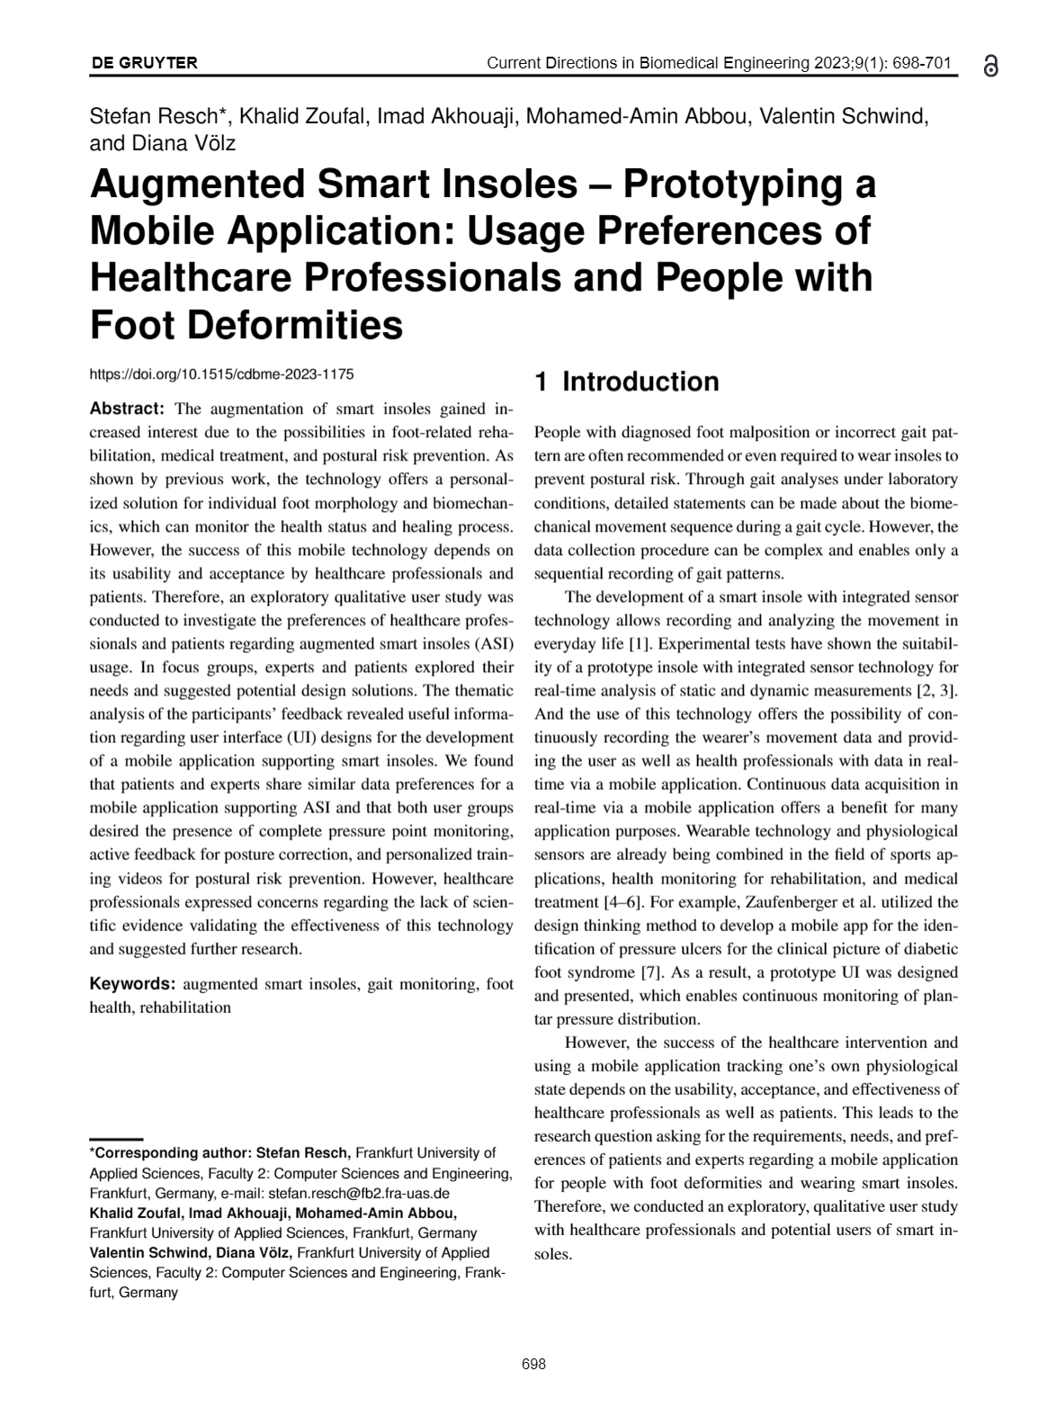
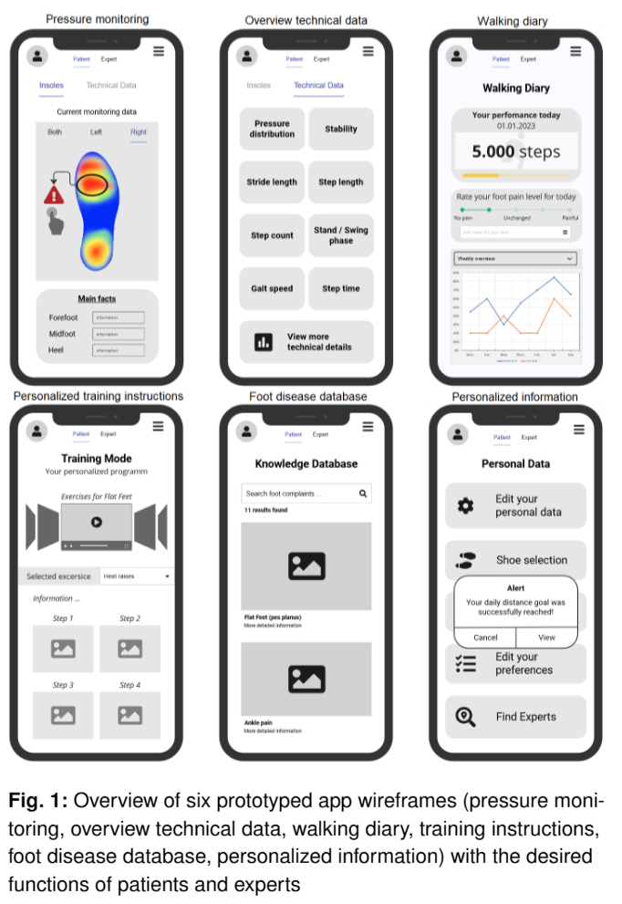
Example: Augmented Smart Insoles
Formative Evaluation

Slide 56
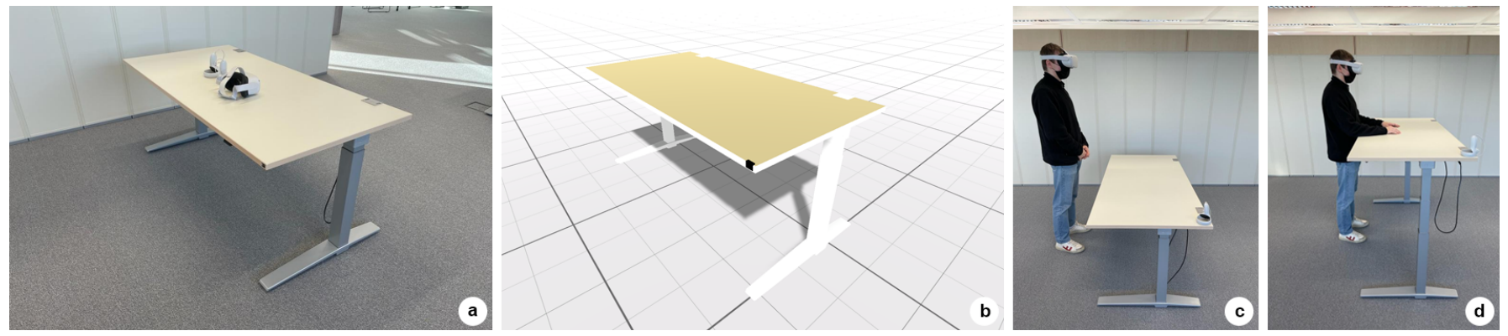
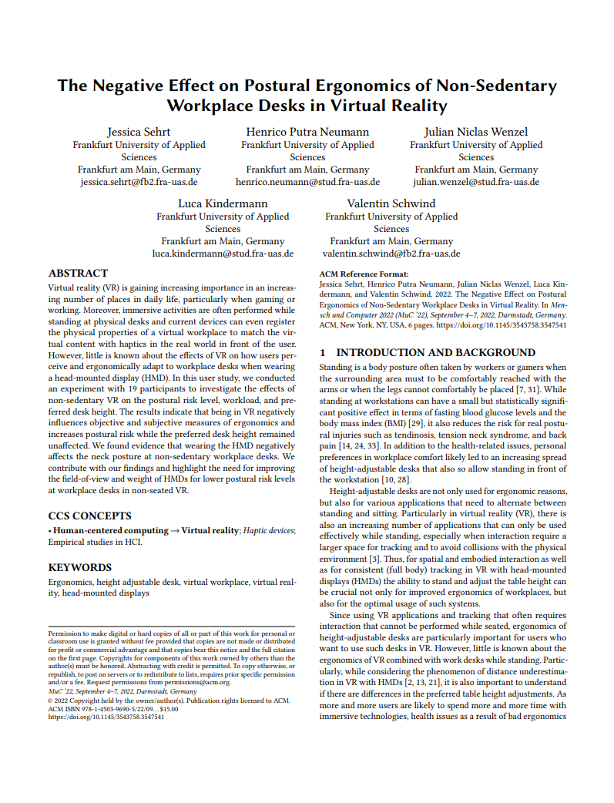
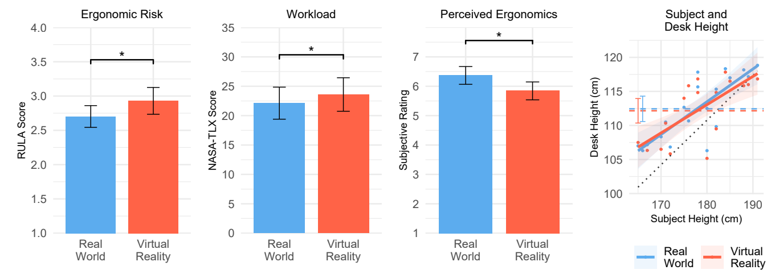
Example: Ergonomics at Virtual Desks
Summative Evaluation
The Negative Effect on Postural Ergonomics of Non-Sedentary Workplace Desks in Virtual Reality. Jessica Sehrt, Henrico Putra Neumann, Julian Niclas Wenzel, Luca Kindermann, and Valentin Schwind. In Mensch und Computer 2022 (MuC ’22), New York, NY, USA, 2022. ACM. ISBN 978-1-4503-9690-5/22/09.
https://doi.org/10.1145/3543758.3547541
Introduction to Human-Computer Interaction

Slide 57
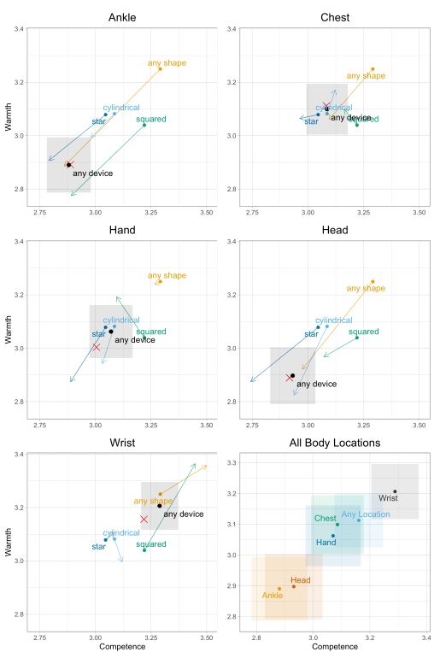
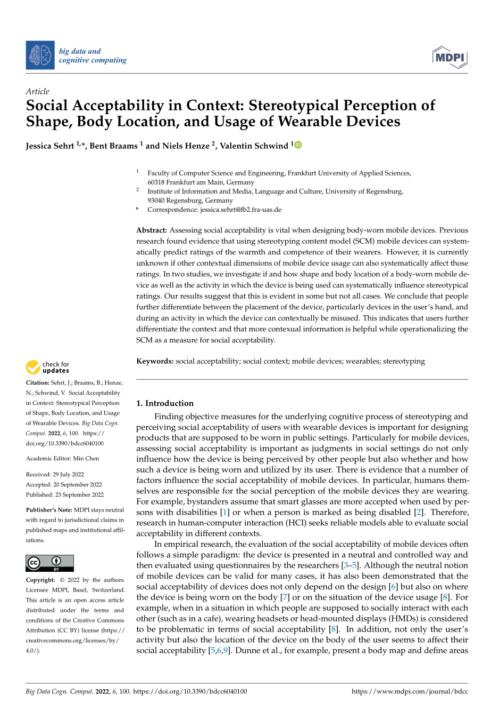
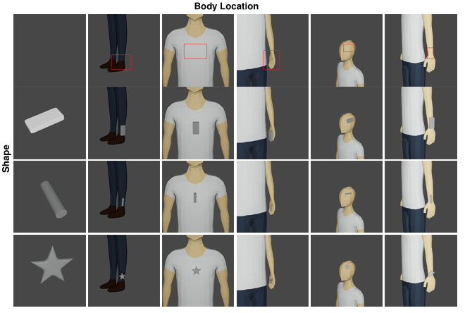
Example: Social Acceptability of Body Locations
Summative Evaluation
Sehrt, Jessica, Bent Braams, Niels Henze, and Valentin Schwind. 2022. "Social Acceptability in Context: Stereotypical Perception of Shape, Body Location, and Usage of Wearable Devices" Big Data and Cognitive Computing 6, no. 4: 100. https://doi.org/10.3390/bdcc6040100
Introduction to Human-Computer Interaction

Slide 58
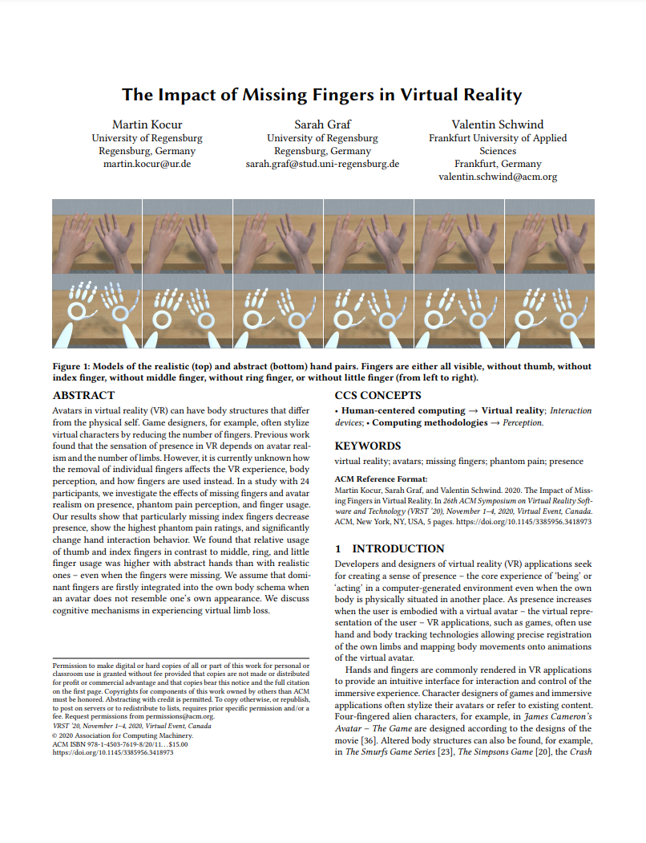
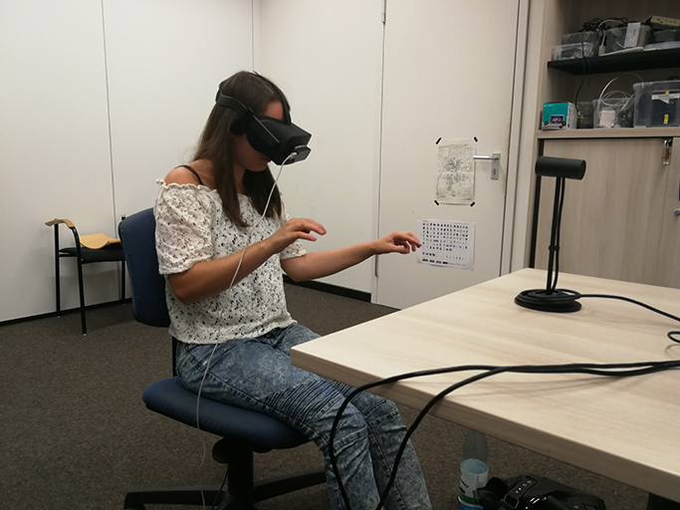
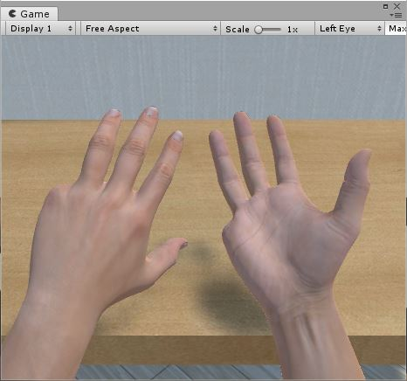
Example: Less Fingers in Virtual Reality
Summative Evaluation
Martin Kocur, Sarah Graf, and Valentin Schwind. 2020. The Impact of Missing Fingers in Virtual Reality. In 26th ACM Symposium on Virtual Reality Software and Technology (VRST '20). Association for Computing Machinery, New York, NY, USA, Article 4, 1–5. DOI:https://doi.org/10.1145/3385956.3418973
Introduction to Human-Computer Interaction

Slide 59
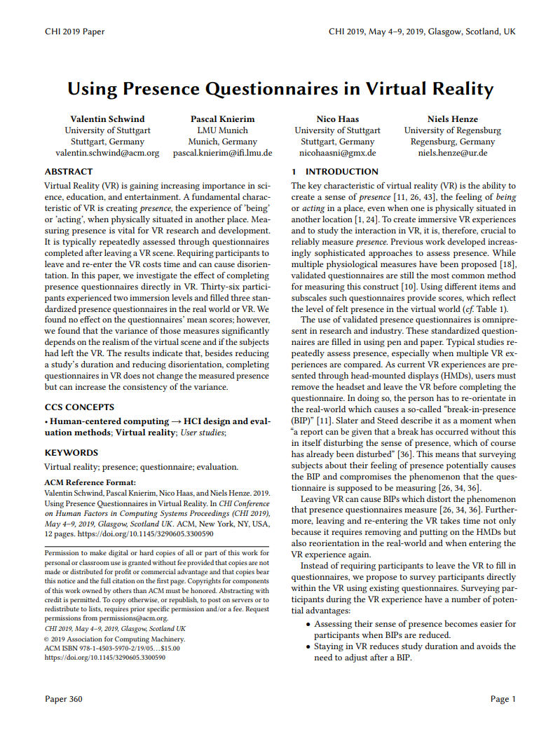
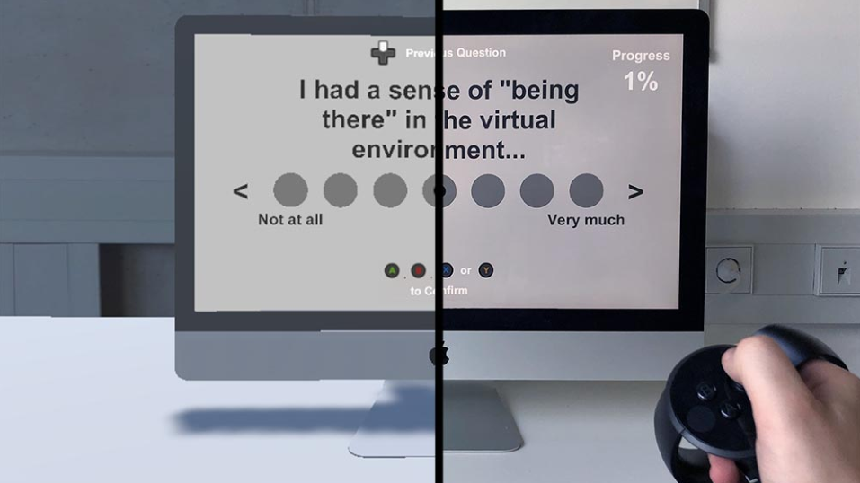
Example: Questionnaires in Virtual Reality
Summative Evaluation
Virtual Reality Questionnaire
Real World Questionnaire
Valentin Schwind, Pascal Knierim, Nico Haas, and Niels Henze. 2019. Using Presence Questionnaires in Virtual Reality. Proceedings of the 2019 CHI Conference on Human Factors in Computing Systems. Association for Computing Machinery, New York, NY, USA, Paper 360, 1–12. DOI:https://doi.org/10.1145/3290605.3300590
Introduction to Human-Computer Interaction

Slide 60
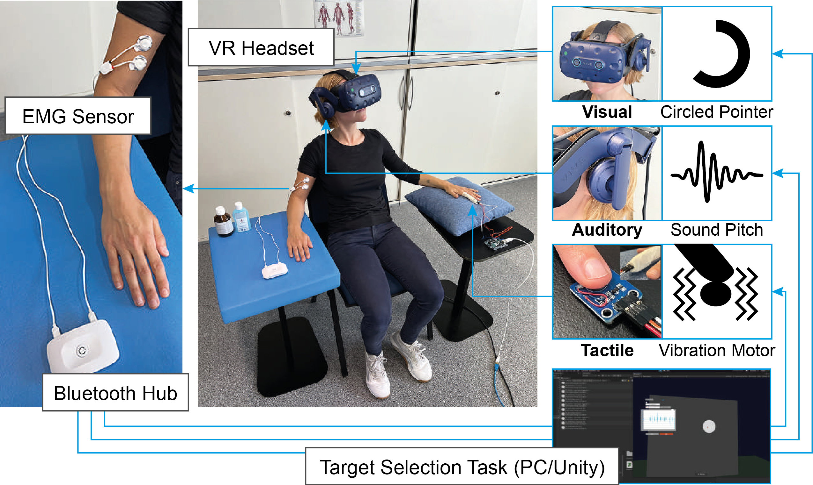
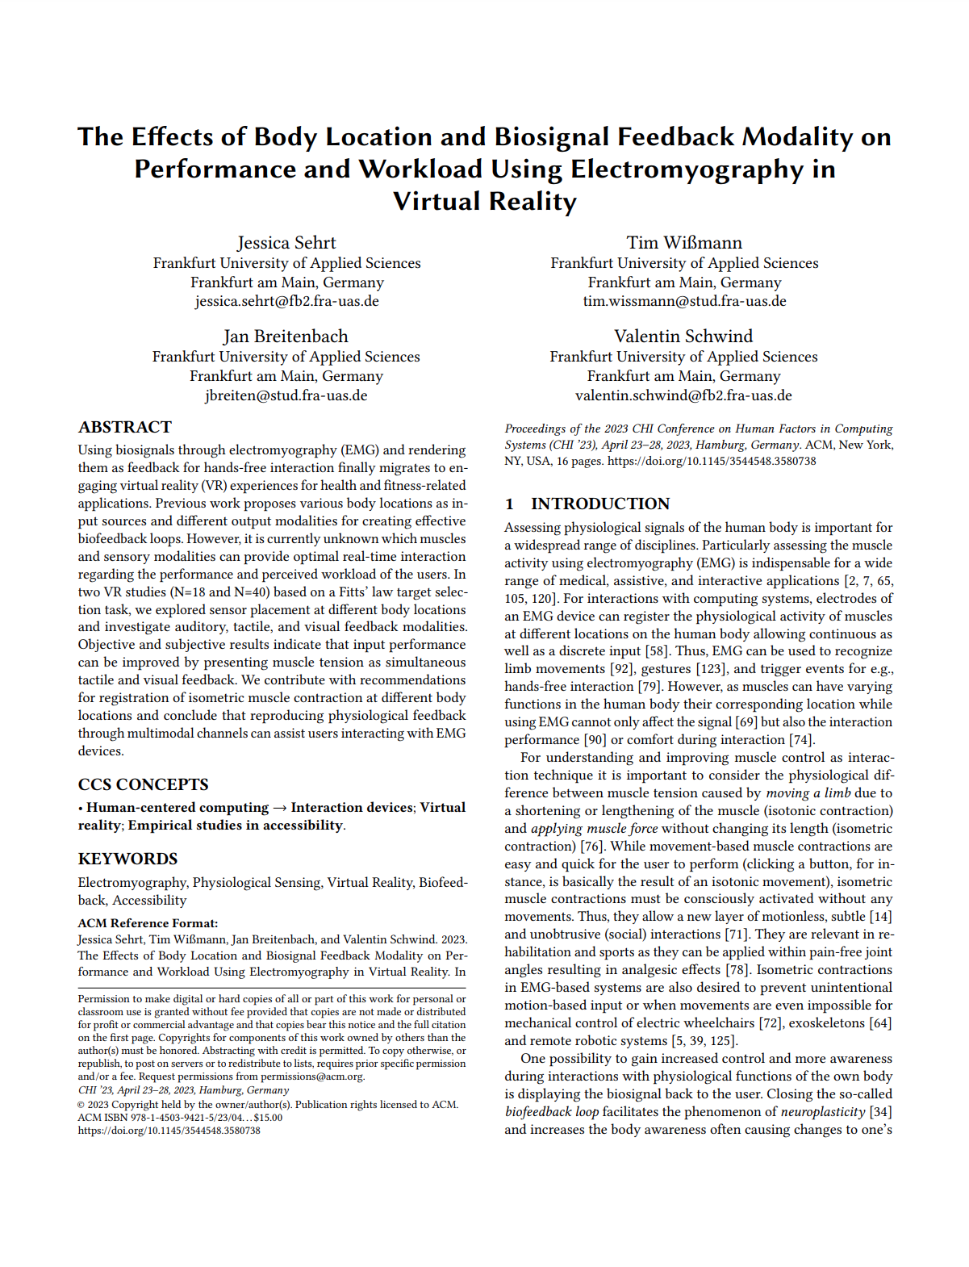
Example: Biofeedback Modalities and EMG Interaction
Summative Evaluation
Introduction to Human-Computer Interaction
Notes:
EMG biofeedback can help users to focus on their own muscle tension. However, which sensory cues are suitable for rendering EMG signals and closing a biofeedback loop is currently unknown. As humans have a limited set of resources available for mental processes, we hypothesized that task performance based on biofeedback from multiple cues can cause difficulties.
%Thus, we investigated three feedback modalities, which were Visual, Auditory and Tactile. We conducted a three-way fullfactorial within-subject design study in VR and with 40 participants. Due to the low variance of the throughput in the first study, its observability during the experiment to ensure isometric contractions, and its relevance in related literature, we used the Biceps brachii, at the front of the upper arm, for EMG input in our second study.

Slide 61
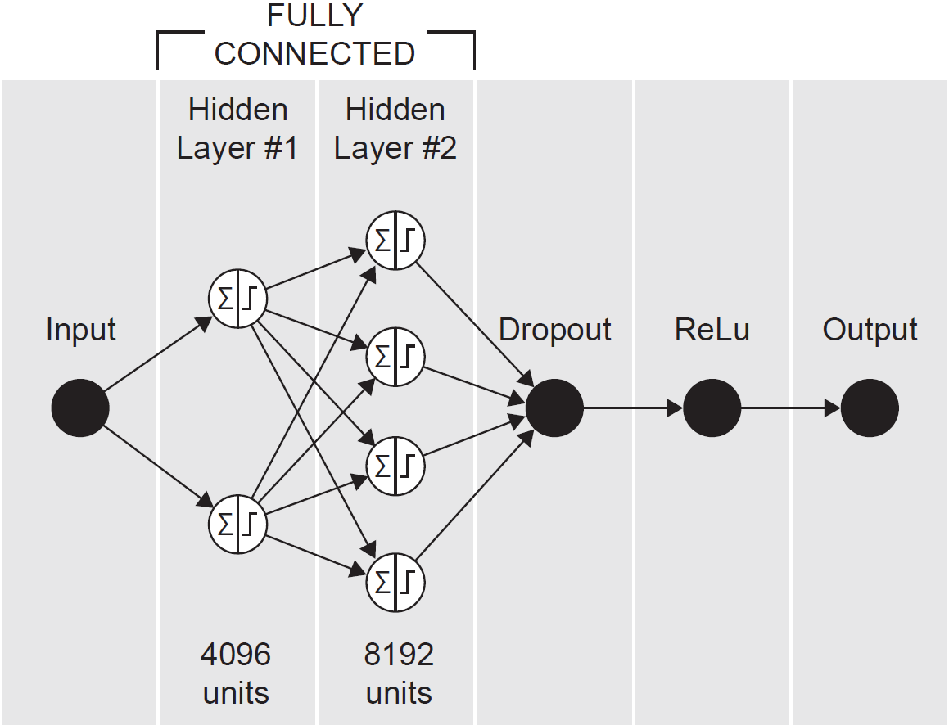
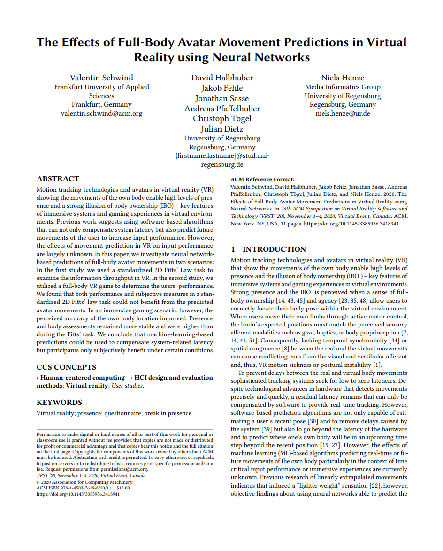
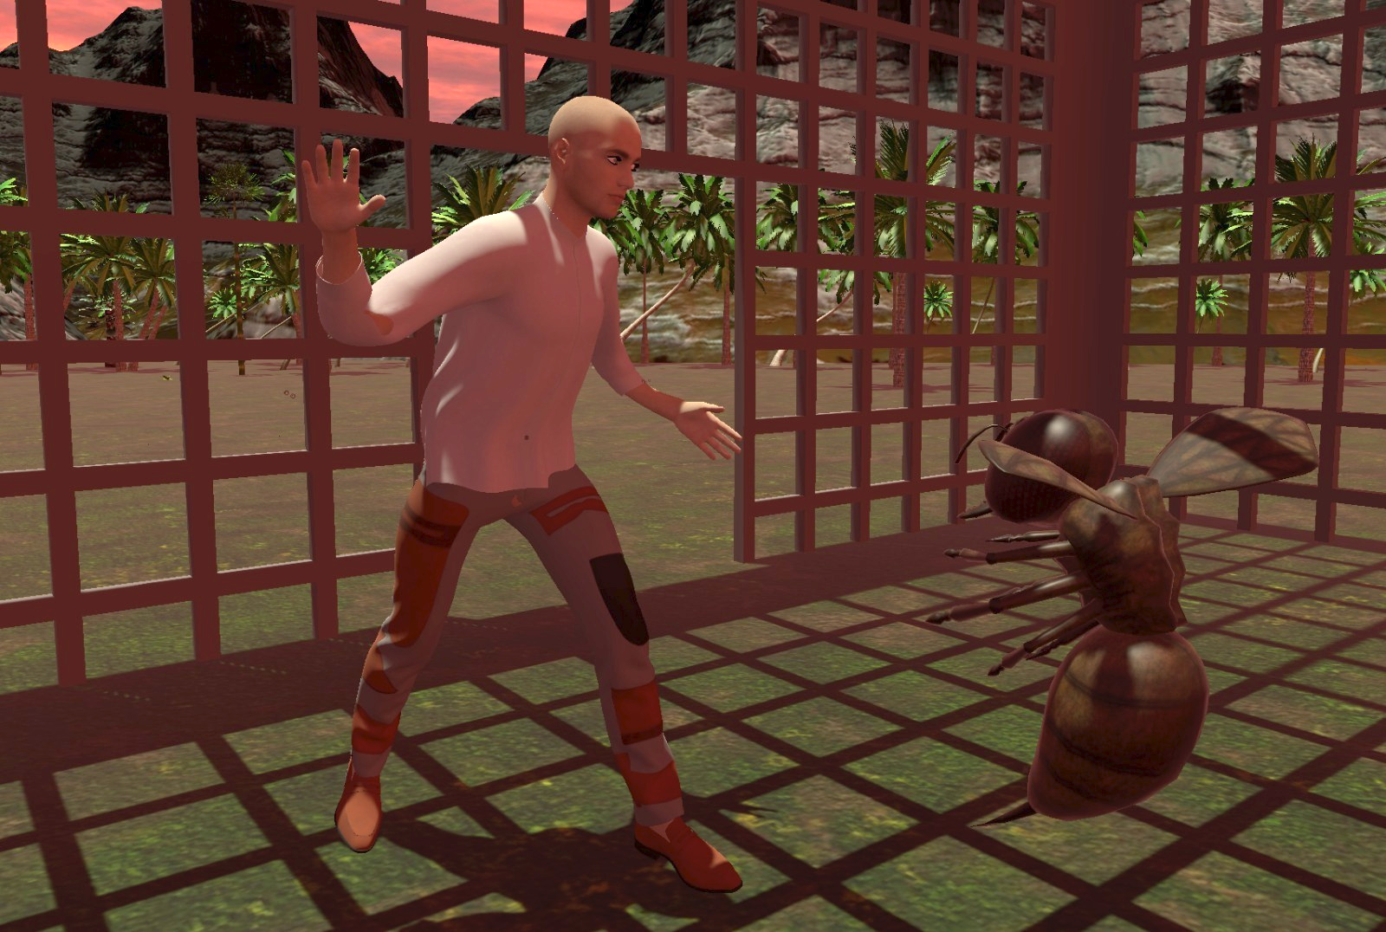
Example: Full Body Motion Prediction in VR
Summative Evaluation
Valentin Schwind, David Halbhuber, Jakob Fehle, Jonathan Sasse, Andreas Pfaffelhuber, Christoph Tögel, Julian Dietz, and Niels Henze. 2020. The Effects of Full-Body Avatar Movement Predictions in Virtual Reality using Neural Networks. In 26th ACM Symposium on Virtual Reality Software and Technology (VRST '20). Association for Computing Machinery, New York, NY, USA, Article 28, 1–11. DOI:https://doi.org/10.1145/3385956.3418941
Introduction to Human-Computer Interaction

Slide 62
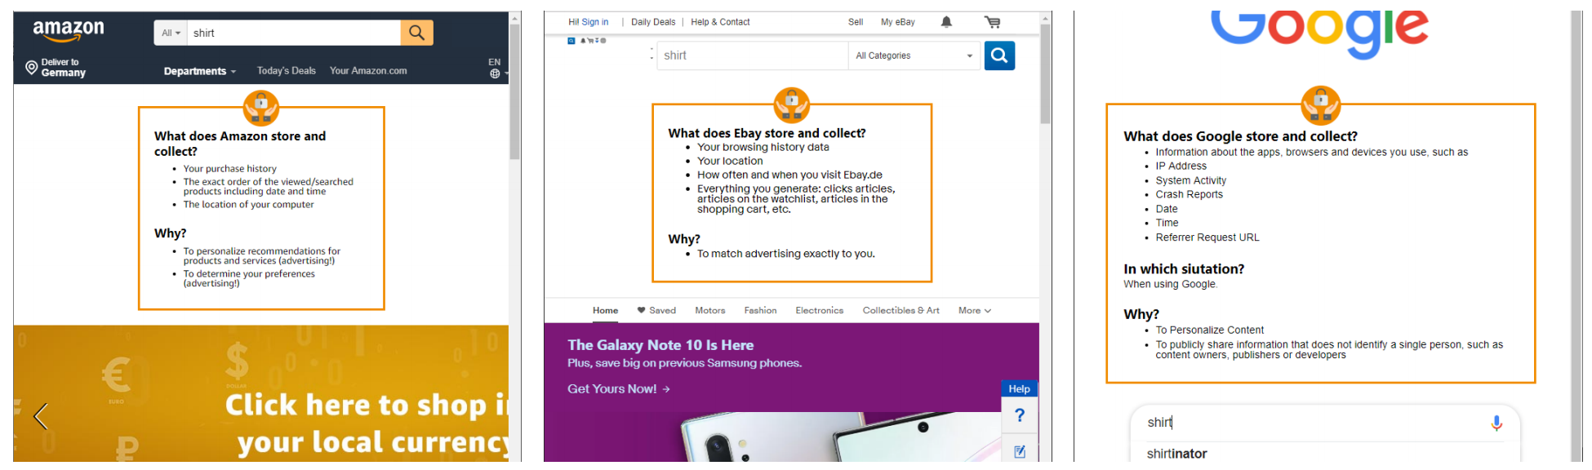
Example: Contextual Privacy Policies
Formative Evaluation
Anna-Marie Ortloff, Maximiliane Windl, Valentin Schwind, and Niels Henze. 2020. Implementation and In Situ Assessment of Contextual Privacy Policies. In <i>Proceedings of the 2020 ACM Designing Interactive Systems Conference</i> (<i>DIS '20</i>). Association for Computing Machinery, New York, NY, USA, 1765–1778. DOI:https://doi.org/10.1145/3357236.3395549
Introduction to Human-Computer Interaction

Slide 63
The Research Projects
IBIS5A: Wednesday 8:15 - 9:45, Room 1-236
IBIS5A: Wednesday 10:00 - 11:30, Room 1-236
IBIS5B: Wednesday 11:45 - 13:15, Room 1-236
IBIS5B: Thursday 8:15 - 9:45, Room 1-248
EBIS5: Thursday 14:15 - 15:45, Room 1-248 (Stefan Resch)
Introduction to Human-Computer Interaction

Slide 64
Please note
We determine the research topics
Specific competences, research interests, laboratories, and equipment
We have an idea what original research is and what could be published
You do not have time to conduct an initial research
Teams are free to choose the following fields and topics
You choose a topic, but you are free to design your study (of course you choose the best)
Teams can do the same topic
But focus on different aspects of the research question
No change of groups or topics after the first presentation
We will create groups after your first presentation
Introduction to Human-Computer Interaction

Slide 65
< PROJECT PROPOSAL >
< PROJECT DESCRIPTION >
< PROJECT TITLE >

Slide 66
Questions?
Project Discussion
Introduction to Human-Computer Interaction

Slide 67
Tasks next Time (TNT)
Find a group (3 people, no more, no less)
Choose a topic (you can pick up the proposals presented)
Find and read three papers on that topic (check out your proposals)
Write a problem statement (PDF, title, names, 150-200 words, submit in Moodle)
Give a kick-off presentation next time (PDF, 5 slides)
Title: Project & You (1 slide)
Background: Motivation & problem (1 slide)
Related Work: What has been done by previous work (1 slides)
Your Research Question (1 slides)
Method: How do you want to answer the question? (1 slide)
Introduction to Human-Computer Interaction

Slide 68
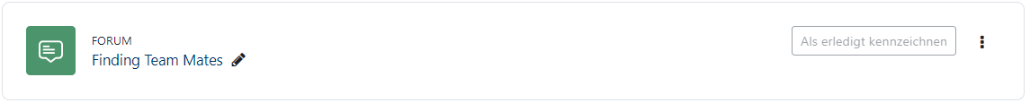
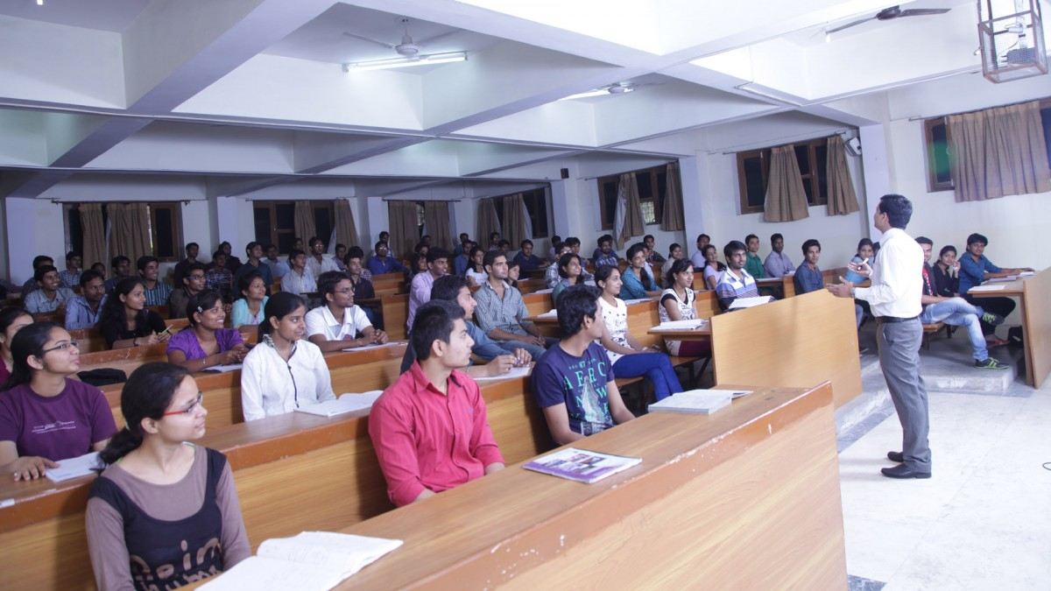

Find a group
Online
<ENTER LINK>
Offline
Talk with real people
Introduction to Human-Computer Interaction

Slide 69
Example of a Problem Statement
Authors….
Title: Effect of Gender on the Perception of Avatar Hands in Virtual Reality
Text: Displaying the user’s hand as the primary body part for interaction enables natural user interactions with the virtual world and has different effects on interaction. For example, Argelaguet et al. [1] found that hand realism has an influence on the sense of agency, which is stronger for less realistic virtual hands. A study by Lin and Jörg [2] showed that the sense of ownership increases for human virtual hands. However, it is unclear whether and how the human-likeness of user controlled virtual hands influence the perceived sensation of presence [3] in VR. Furthermore, it is unknown if virtual hands are perceived differently by men and women, especially when avatar hands from another gender are used. Therefore, we want to conduct a user study to investigate the effect of realism and gender on the perception of presence.
[1] Ferran Argelaguet, Ludovic Hoyet, Michaël Trico, and Anatole Lécuyer. 2016. The role of interaction in virtual embodiment: Effects of the virtual hand representation. Proceedings - IEEE Virtual Reality 2016-July (2016), 3–10. DOI: http://dx.doi.org/10.1109/VR.2016.7504682
[2] Lorraine Lin and Sophie Jörg. 2016. Need a Hand?: How Appearance Affects the Virtual Hand Illusion. In Proceedings of the ACM Symposium on Applied Perception (SAP ’16). ACM, New York, NY, USA, 69–76. DOI: http://dx.doi.org/10.1145/2931002.2931006 [3] Bob G. Witmer and Michael J. Singer. 1998. Measuring Presence in Virtual Environments: A Presence Questionnaire. Presence: Teleoperators and Virtual Environments 7, 3 (1998), 225–240. DOI: http://dx.doi.org/10.1162/105474698565686
Introduction to Human-Computer Interaction

Slide 70
Example of a Problem Statement
Authors….
Title: The Effects of Full-Body Avatar Movement Predictions in VR using Neural Networks
Text: Motion tracking technologies and avatars in virtual reality (VR) showing the movements of the own body enable high levels of presence and a strong illusion of body ownership (IBO) [1]. However, any motion tracking or VR headset suffers from latency, which can cause motion sickness in users [2]. To overcome latency, previous work suggests to user prediction algorithms that can not only compensate system latency but also predict future movements. For example, linearly extrapolated movements can induce a “lighter weight” sensation [3], however, objective findings about the user performance while using sophisisticated neural networks able to predict the own movements in VR or input measures are currently unknown. In a standardized input performance task and a full-body gaming experience, we aim to investigate the effects of full-body avatar movement predictions using neural networks in VR.
[1] Andrea Serino, Adrian Alsmith, Marcello Costantini, Alisa Mandrigin, Ana Tajadura-Jimenez, and Christophe Lopez. 2013. Bodily ownership and selflocation: Components of bodily self-consciousness. Consciousness and Cognition 22, 4 (2013), 1239 – 1252. https://doi.org/10.1016/j.concog.2013.08.013
[2] Sotaro Shimada, Yuan Qi, and Kazuo Hiraki. 2010. Detection of visual feedback delay in active and passive self-body movements. Experimental Brain Research 201, 2 (2010), 359–364. https://doi.org/10.1007/s00221-009-2028-6
[3] Shunichi Kasahara, Keina Konno, Richi Owaki, Tsubasa Nishi, Akiko Takeshita, Takayuki Ito, Shoko Kasuga, and Junichi Ushiba. 2017. Malleable Embodiment: Changing Sense of Embodiment by Spatial-Temporal Deformation of Virtual Human Body. Proceedings of the 2017 CHI Conference on Human Factors in Computing Systems - CHI ’17 (2017), 6438–6448. https://doi.org/10.1145/3025453.3025962
Introduction to Human-Computer Interaction

Slide 71
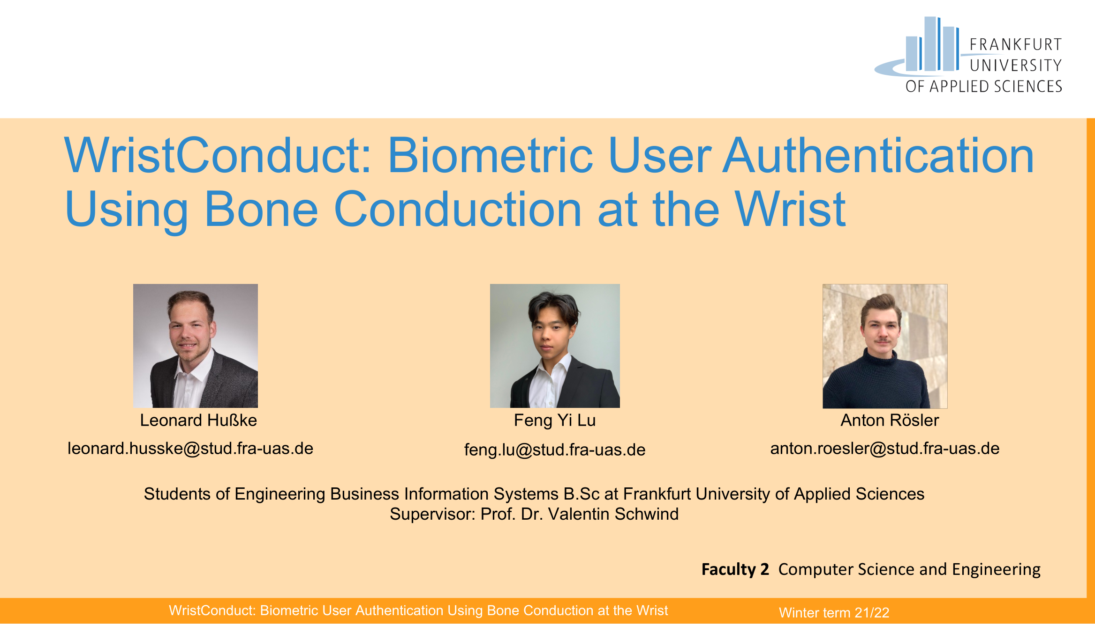
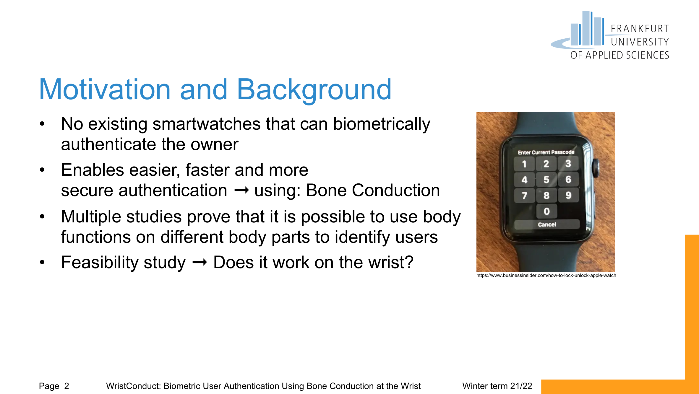
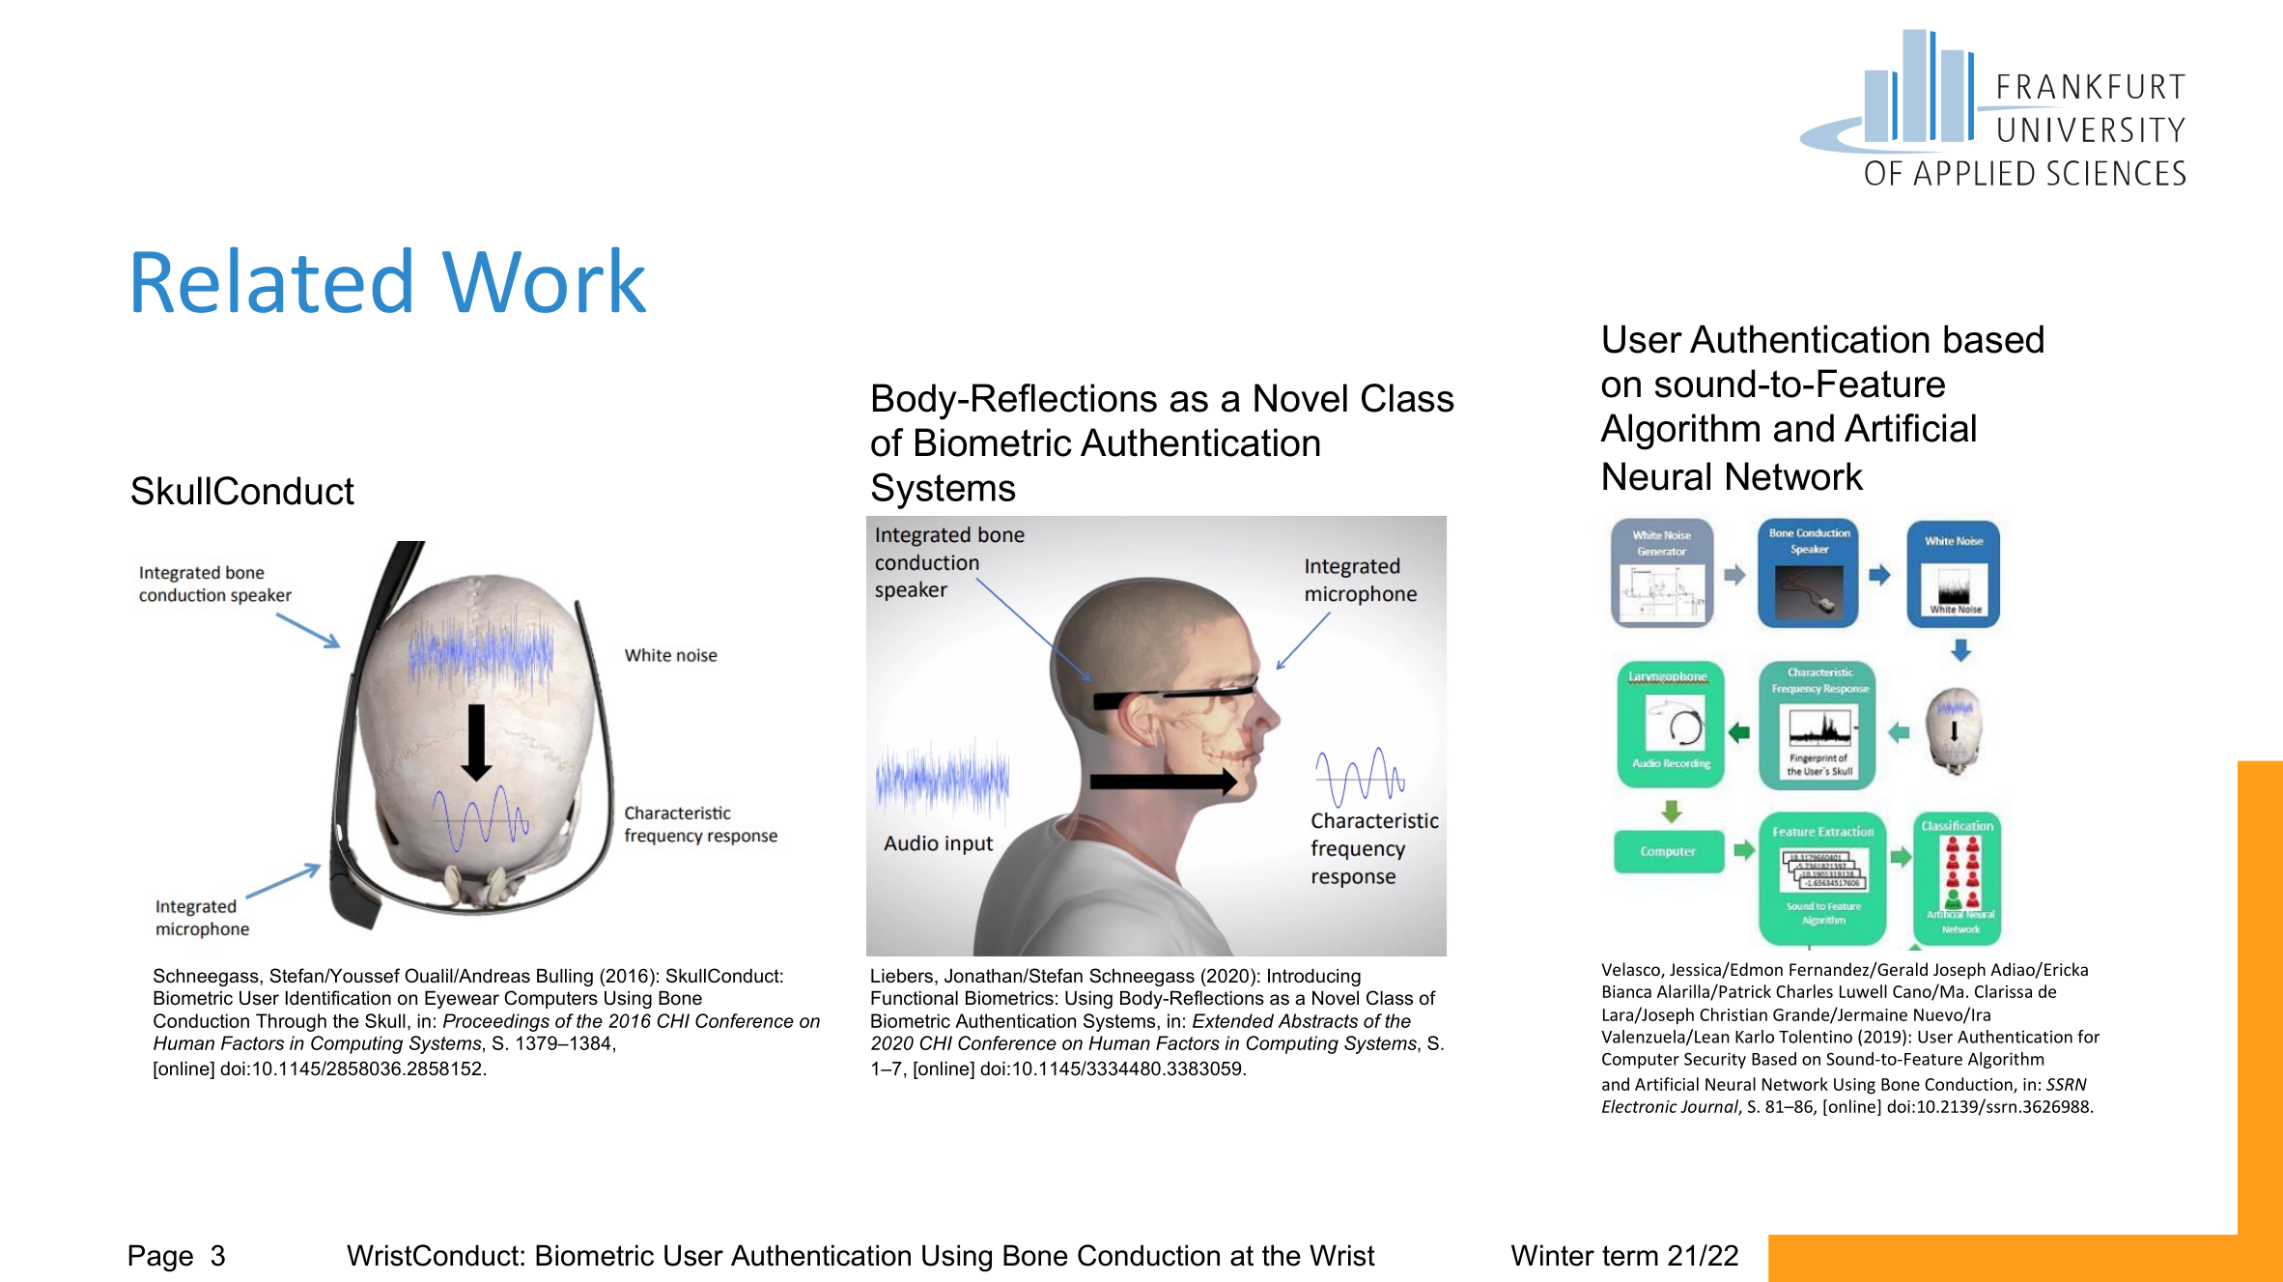
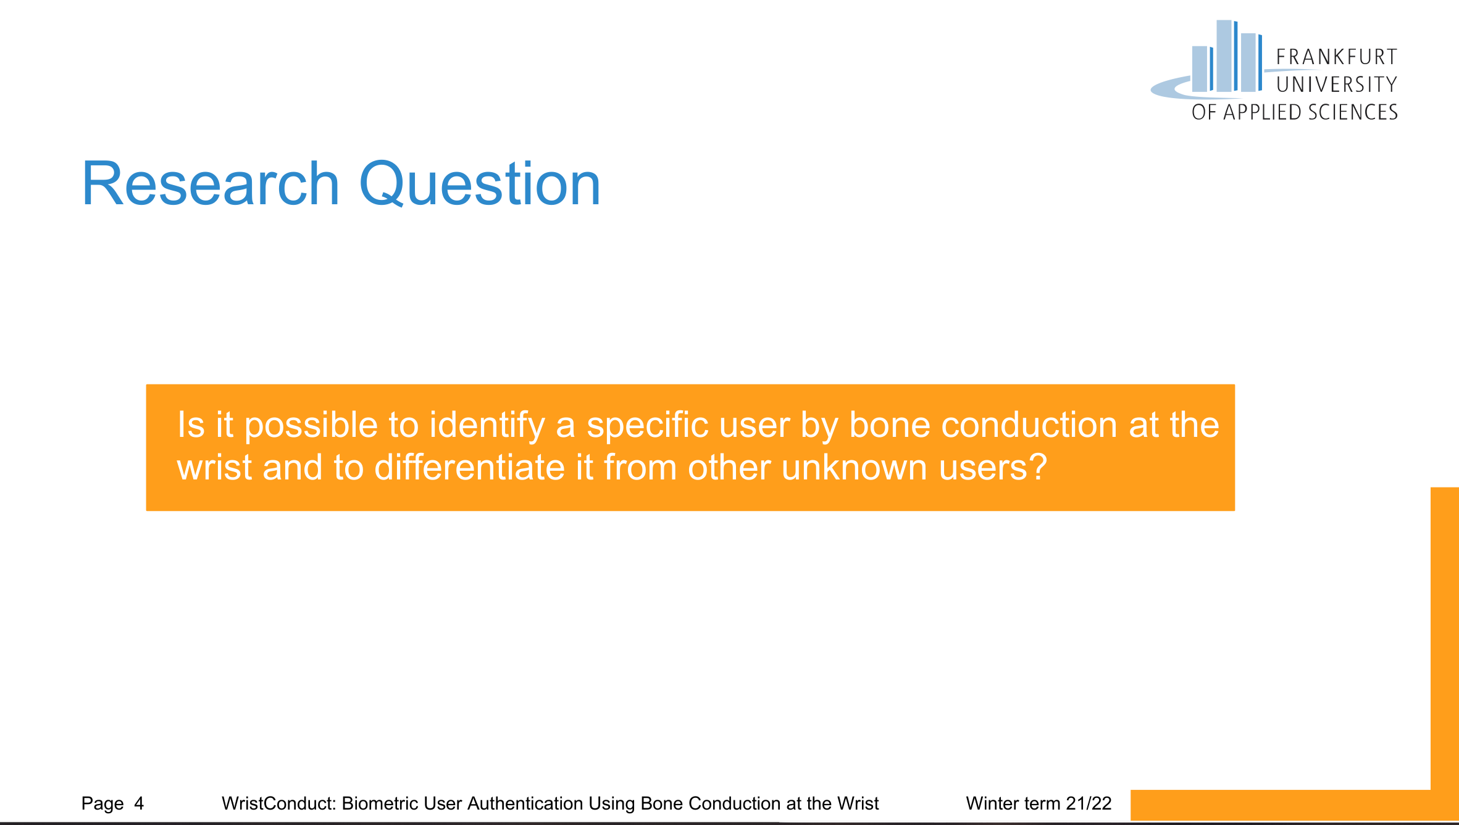

Example of a Kick-Off Presentation
Introduction to Human-Computer Interaction

Slide 72

Moodle Submission
Submit 2 PDFs until Oct 26:
A single page (PDF) with your problem statement. One submission per group: title, names, 150-200 words.
Your presentation slides (PDF): (1) title & names, (2) background, motivation (3) related work (4) research question, (5) how do you want to answer that question?
Introduction to Human-Computer Interaction

Slide 73

How to write E-mails
Always indicate who you are, what you study, your course, and your group
Think before you write. If you want something, give reasons and the benefits of it
To salutate your supervisor, only mention the latest degree (everything else is totally embarrassing)
Whenever you reply on one of our mails: Press „Reply All“
Subject: Request !
Subject: Request to change the group in the HCI course
Dear Mr. Prof. Dr. Schwind
can I change the group?
MfG ...
Dear Prof. Schwind
I study Computer Science in the Nth semester and I am in your HCI course. I am in Group X. As all my team members dropped out this semester, I would like to change the group from X to Y. Since the topic of the group (...) is closely related to my previous one (...), I can greatly contribute with my knowledge and abilities.
I look forward to hearing from you.
Best regards
...
Wrong
Correct
put all persons who need to know that information into CC
Click here
Introduction to Human-Computer Interaction

Slide 74
Questions?
Introduction to Human-Computer Interaction

