Slide 1

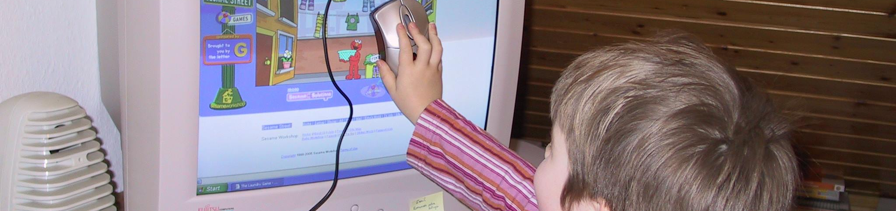

Basics of Human-Computer Interaction
Human-Computer Interaction Lecture
Slides adapted from hci-lecture.org (A. Schmidt, N. Henze, K. Wolf, V. Schwind), Image from: Albrecht Schmidt
The following content is licensed under a Creative Commons Attribution 4.0 International license (CC BY-SA 4.0)

Slide 2
Human-Computer Interaction
HCI determines how humans use computer systems
For examples, it impacts…
what we can do with products and services
how easy or hard it is to work with a software or device
how quickly you can learn to use a system
how a system can support and augment human abilities
how safe a product is
HCI is the central discipline how we feel and what we experience while interacting with digital technologies
Basics of Human-Computer Interaction

Slide 3
Which disciplines are related to HCI?
Discussion
Basics of Human-Computer Interaction

Slide 4
Related Disciplines
Computer Science
AI
Ergonomics
Computer Vision
Design
Digital Imaging
Machine Learning
Language
Social Sciences
HCI
Engineering
Health
GUIs
Usability
Art
Cognition/ Perception
Displays
Games
Typography
Printing/ Plotting
Psychology
Biology
Videos
Color Management
Languages
Basics of Human-Computer Interaction

Slide 5
Related HCI Disciplines
Computer Science
AI
Ergonomics
Computer Vision
Design
Digital Imaging
Machine Learning
Language
Social Sciences
HCI
Engineering
Health
GUIs
Usability
Art
Cognition/ Perception
Displays
Games
Typography
Printing/ Plotting
Psychology
Biology
Videos
Color Management
Languages
Basics of Human-Computer Interaction

Slide 6
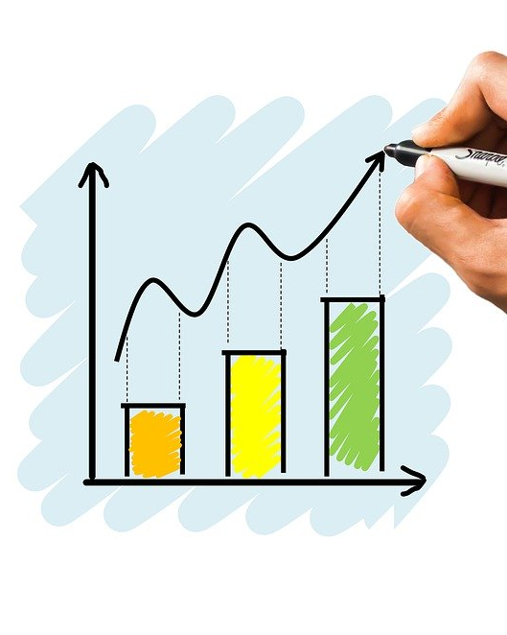
Why is Usability important?
Improving usability can…
increase productivity of users
reduce costs (support, efficiency)
increase sales/revenue (web shop)
enhance customer loyalty
win new customers
Usability is often considered as sign of quality and value
Usability gives a competitive advantage
https://pixabay.com/de/photos/grafik-diagramm-investitionen-4737109/
Basics of Human-Computer Interaction

Slide 7
When usability is so important why no one cares?
Discussion
Basics of Human-Computer Interaction

Slide 8
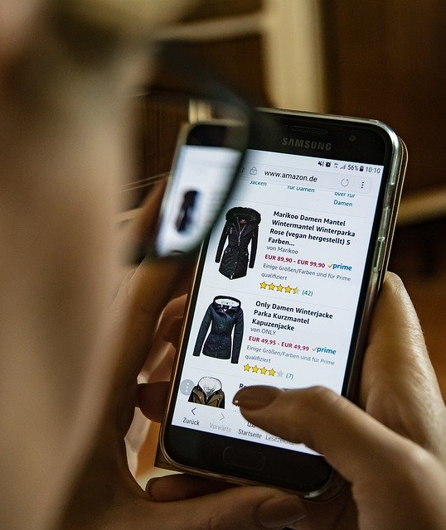
The Value of Products
Typical product discrimination is done by
Price
Functionality/Features
Why should a customer pick you, if systems of competitors offer similar functions (e.g., messaging services) with similar prices (e.g., payed by advertising)?
Is your system easier to use?
Can you do tasks faster?
Does your system provide more fun when you are doing something?
https://pixabay.com/de/photos/online-shopping-kleidung-handy-2900303/
Basics of Human-Computer Interaction

Slide 9
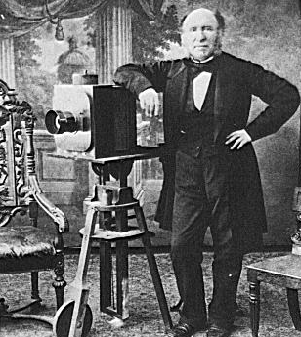
Why Focusing on User and Interaction?
It becomes harder to discriminate technology
Availability of bandwidth, storage and processing
New input and output technologies
Computing becomes part of many traditional devices
Willingness for training or learning applications decreases
Life-style technologies are more and more digital
Broad and diverse user groups
Majority of users is not interested in technology
New understanding of computing
→ Book by Ben Shneiderman: Leonardo's Laptop (2002)
The old question: What can computers do?
The new question: What can humans do with computers?
https://commons.wikimedia.org/wiki/File:Photographer1850s.png
Basics of Human-Computer Interaction

Slide 10

Economic Dimensions of Usability?
User Interface is often the central discriminating factor
Often the same product/service is sold at very similar prices
Competition is very close (just another app, browser tab, …)
Comparison is easily possible, Examples: Online-Shop
Users who cannot find the product in the shop cannot buy it
Users who can fill in the payment form are not going to buy
Users who worry if the item fits them are less likely to buy
Typically a direct correlation between usability and sales
“Bad Usability is Like a Leaky Pipe”
https://90percentofeverything.com/2006/11/13/bad-usability-is-like-a-leaky-pipe/
Basics of Human-Computer Interaction

Slide 11

Why do physical stores go broke?
Discussion
Basics of Human-Computer Interaction

Slide 12

Example: Zalando
Basics of Human-Computer Interaction

Slide 13
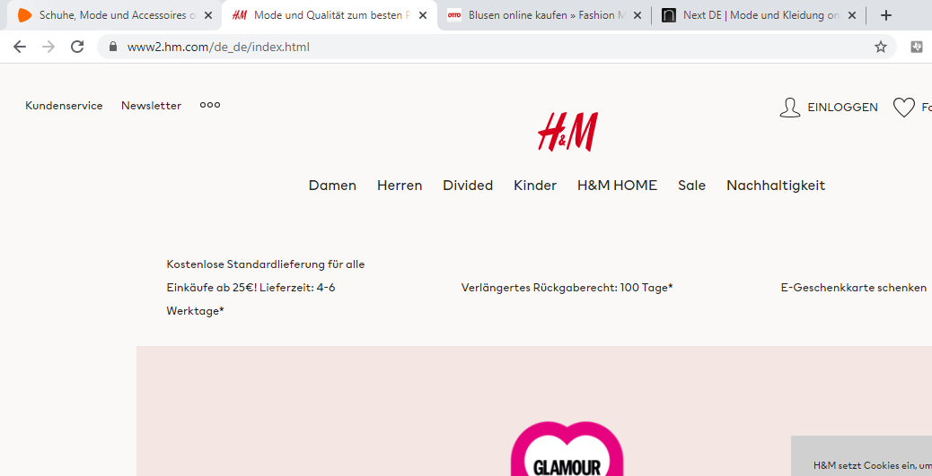
Example: H&M
Basics of Human-Computer Interaction

Slide 14
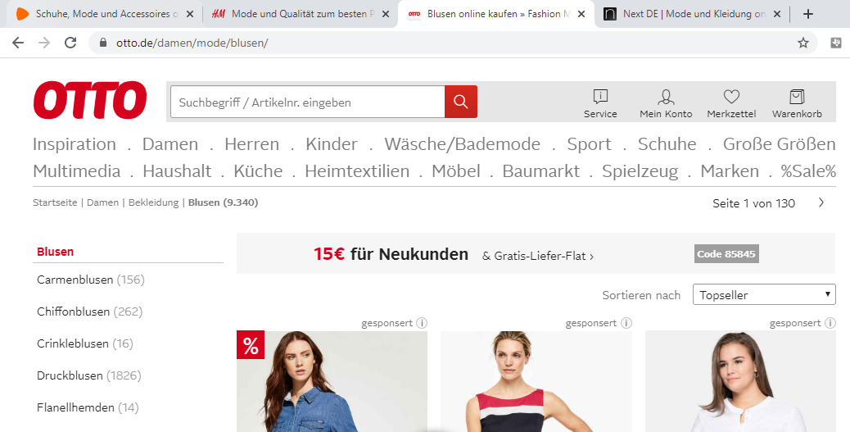
Example: Otto
Basics of Human-Computer Interaction

Slide 15

Example: Next
Basics of Human-Computer Interaction

Slide 16
Concerns in Human-Computer Interaction
Science, engineering, and design
Psychology and biases
The joint performance of tasks by humans and machines
The structure of communication between humans and machines
Human capabilities to use machines (including the learnability of interfaces)
Engineering concerns that arise in designing and building interfaces
The process of specification, design, and implementation of interfaces
Design trade-offs
Algorithms and programming of the user interface itself
Basics of Human-Computer Interaction

Slide 17

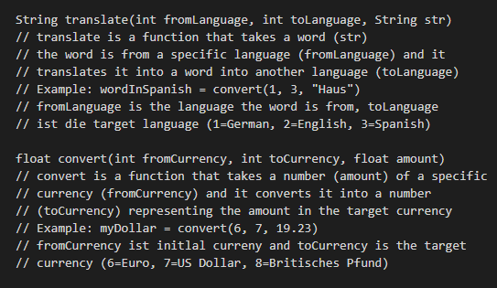
Discussion: Sketching an Interface
Basics of Human-Computer Interaction

Slide 18
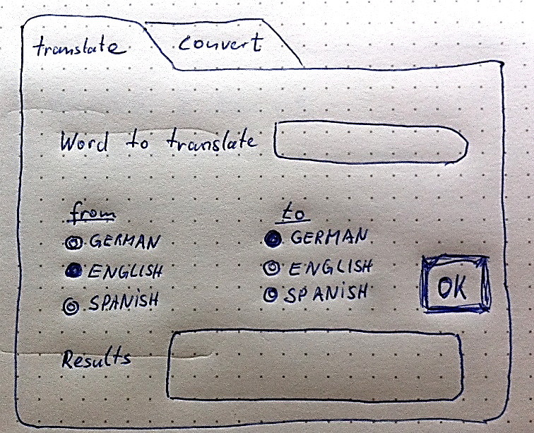
Sketching an interface (1)
Basics of Human-Computer Interaction

Slide 19
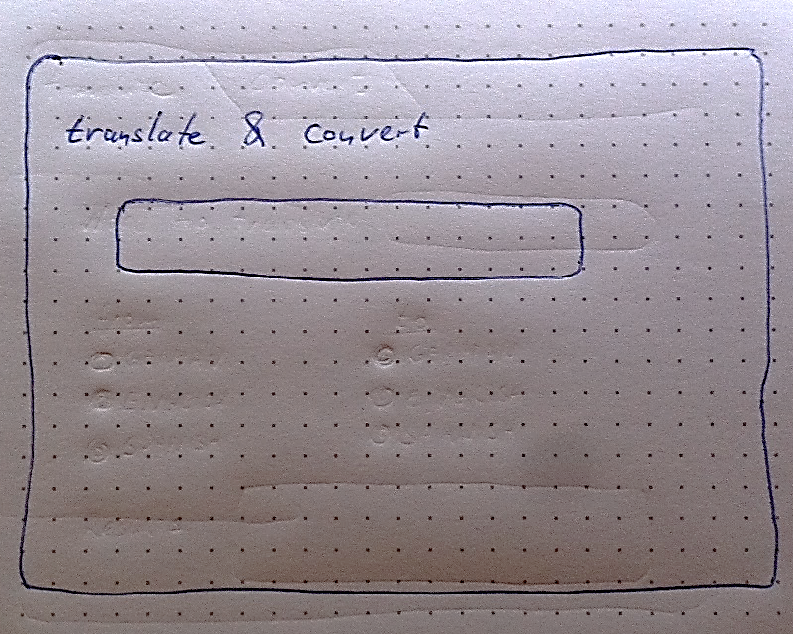



Sketching an interface (2)
€366,00 : £299,56 : $482,80
€447,18 : £366,0 : $589,92
€277,46 : £227,08 : $366,00
Basics of Human-Computer Interaction

Slide 20



One Interface for Everything
Basics of Human-Computer Interaction

Slide 21
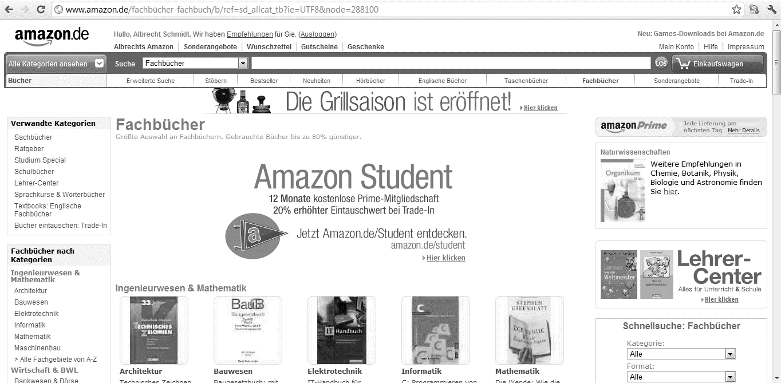
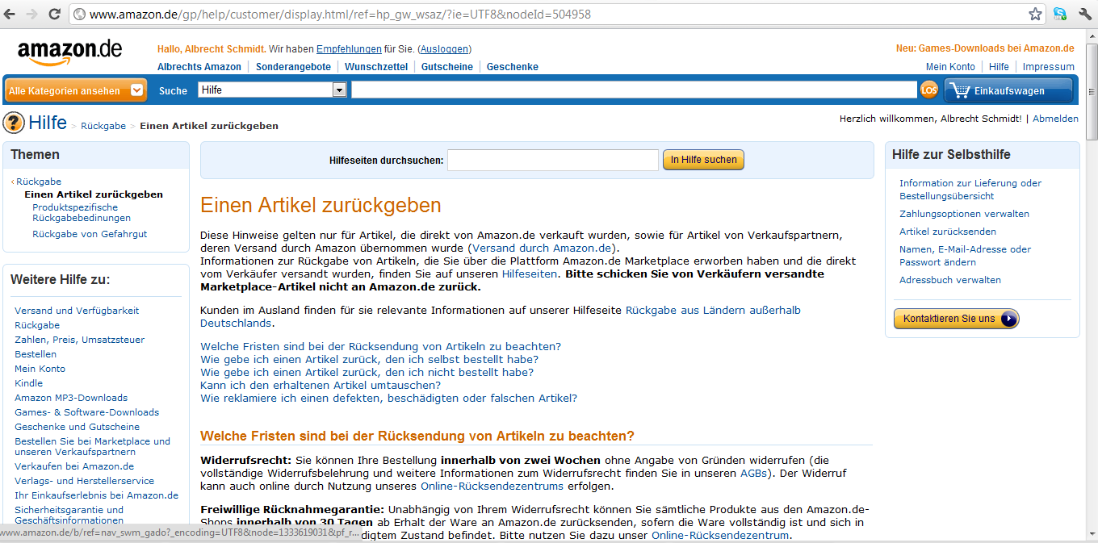
It is NOT only about the user interface!
Basics of Human-Computer Interaction

Slide 22
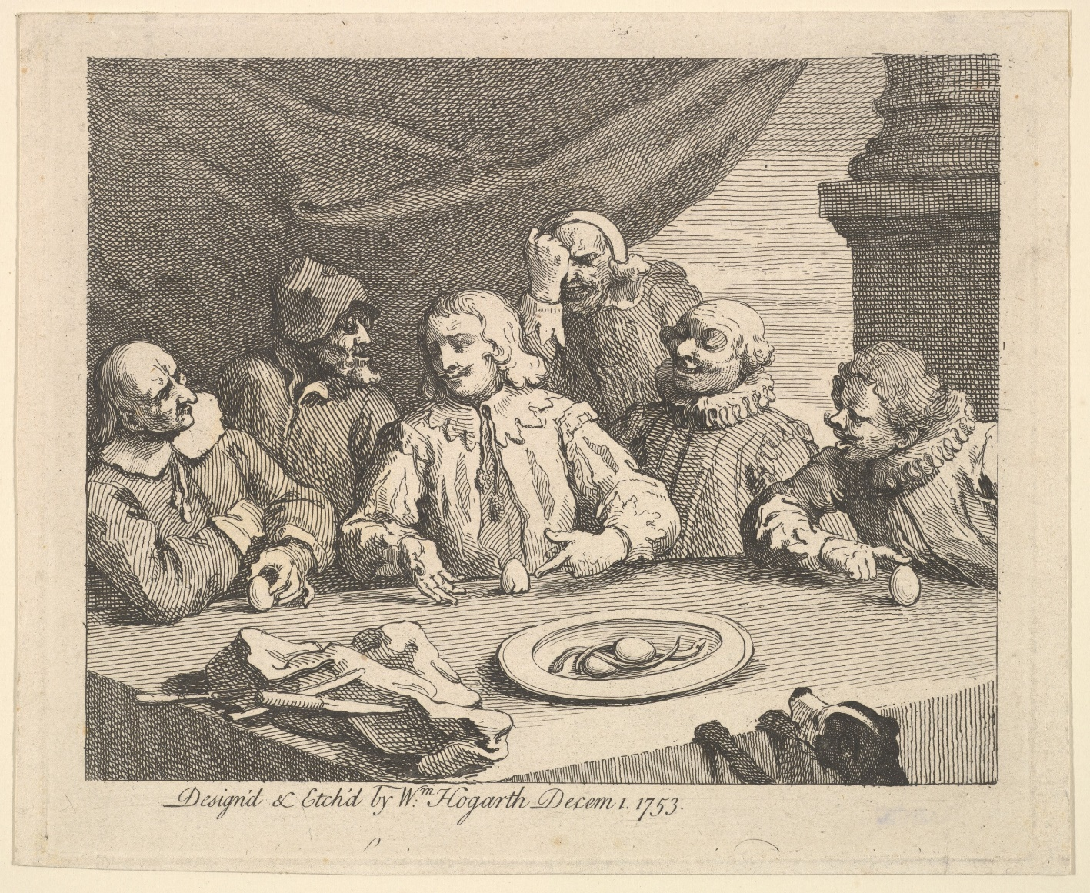
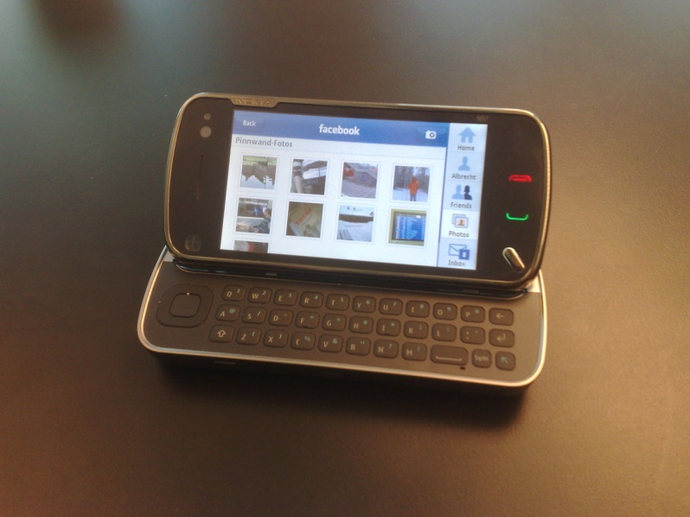
The Problem with Problems
Problems
no need to solve them because of reasons…
often not seen as problem before there is a solution
if problems are identified, are they typically easy to understand?
Solutions
once a solution is there, people will generally not remember that there was a problem
good and in particular great solutions often appear obvious
However, the step from problem to solution is not trivial
often forgotten, once there is a solution
https://www.metmuseum.org/art/collection/search/398598
Basics of Human-Computer Interaction

Slide 23
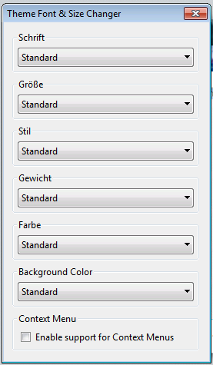
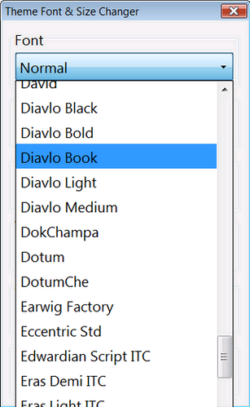
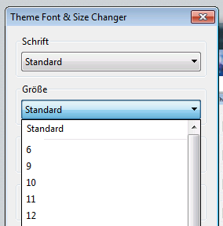
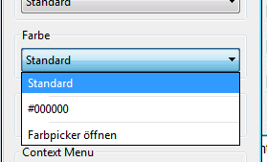
Selection/Menu for Fonts (1)
Is there a Problem? How to improve it?
Basics of Human-Computer Interaction

Slide 24
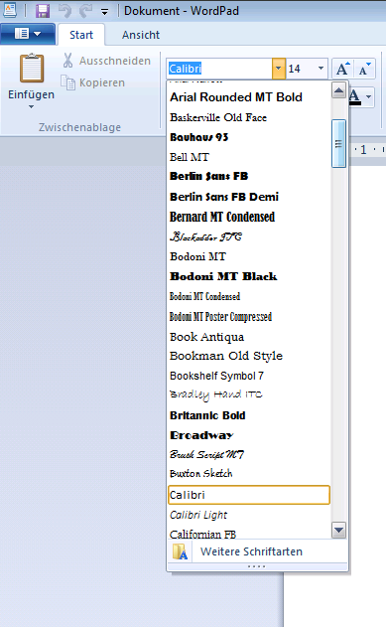
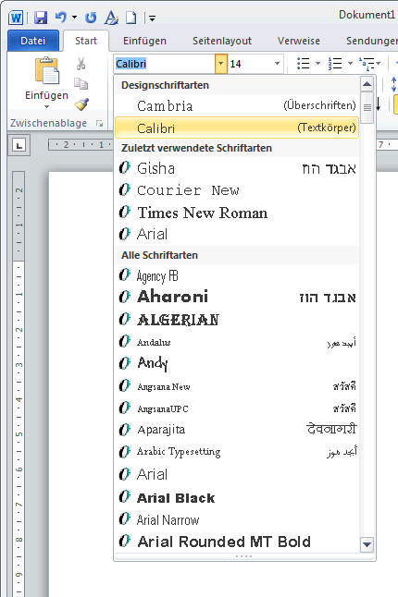
Selection/Menu for Fonts (2)
https://addons.mozilla.org/en-US/firefox/addon/theme-font-size-changer/
WordPad/Win7
Basics of Human-Computer Interaction

Slide 25
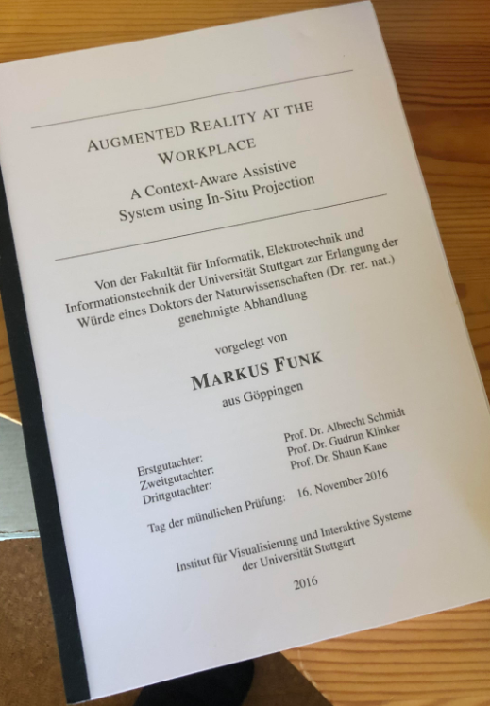
Writing a Thesis
Assume the following:
Your thesis will have 40.000 words
The average typing speed for physical keyboards is ca. 50 words per minute (WPM)
13.3 hours (you are done in 2 days!)
Your typing speed for phone keyboard is ca. 35 words per minute
19.0 hours (you are also done in 2 days!)
Can you write a thesis in 2 days?
Why does this calculation make no sense?
What are we missing here?
What help you more? A new keyboard or two monitors?
Basics of Human-Computer Interaction

Slide 26
Summary
Interfaces and interaction design
define how we can use devices, services, and applications
impact the performance of the user
It is important to understand the way how people use a system as a tool to achieve their goals
Understanding aspects of human-computer interaction is relevant as it becomes harder to differentiate products based on features and can have huge social impact
Good usability is economically important
Innovations in HCI are highly visible
Basics of Human-Computer Interaction

Slide 27
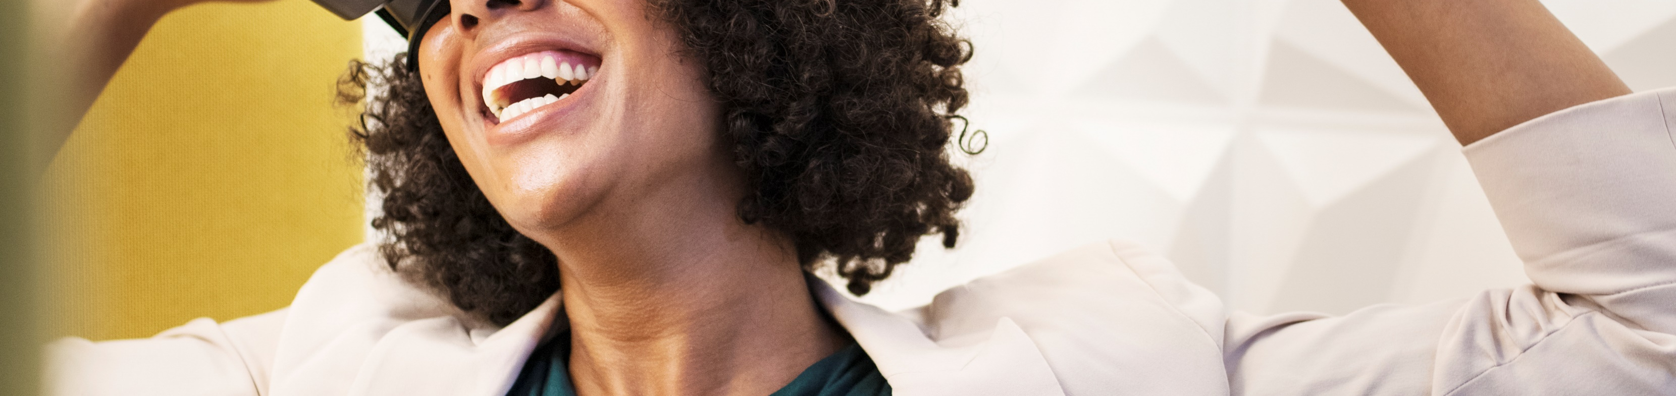
Terms and Definitions
Human-Computer Interaction Lecture
Image from: pxhere.com
The following content is licensed under a Creative Commons Attribution 4.0 International license (CC BY-SA 4.0)

Slide 28
Human-Computer Interaction
Definition by Wikipedia [1]:
“Human–computer interaction (HCI) is research in the design and the use of computer technology, which focuses on the interfaces between people (users) and computers. HCI researchers observe the ways humans interact with computers and design technologies that allow humans to interact with computers in novel ways. A device that allows interaction between human being and a computer is known as a "Human-computer Interface (HCI)".
Definition in the ACM SIGCHI Curricula for HCI, 1992 [2]:
“Human-computer interaction is a discipline concerned with the design, evaluation and implementation of interactive computing systems for human use and with the study of major phenomena surrounding them.”
[1] https://en.wikipedia.org/wiki/Human%E2%80%93computer_interaction
[2] Thomas T. Hewett, Ronald Baecker, Stuart Card, Tom Carey, Jean Gasen, Marilyn Mantei, Gary Perlman, Gary Strong, and William Verplank. 1992. ACM SIGCHI Curricula for Human-Computer Interaction. Technical Report. Association for Computing Machinery, New York, NY, USA.
Terms and Definitions

Slide 29
Interactive Systems
An interactive system is a computational system that allows users to interact in real-time.
Interactions provide instant feedback visible to the user.
The term interactive computing is used in a similar way, with a focus that is less on the systems aspect. Examples:
Graphical user interfaces, such as Windows 10 or MacOS
Mobile devices, such as an Android phone
Gaming consoles, such as Xbox with Kinect or Nintendo Switch
Ticket vending machines, such as the DB-ticket machine
Command line interfaces, such as an SSH console
Terms and Definitions

Slide 30
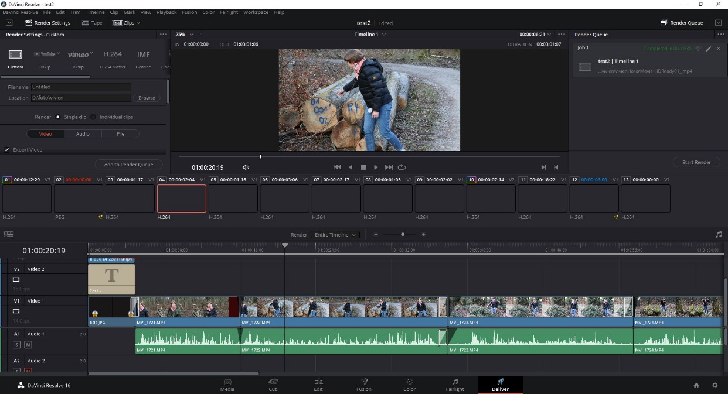
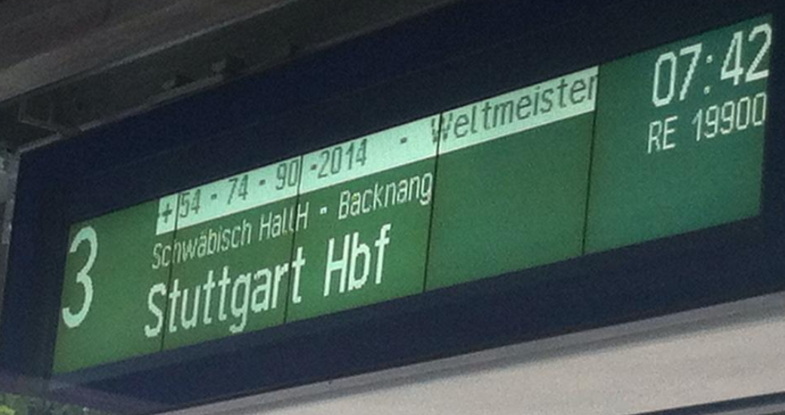
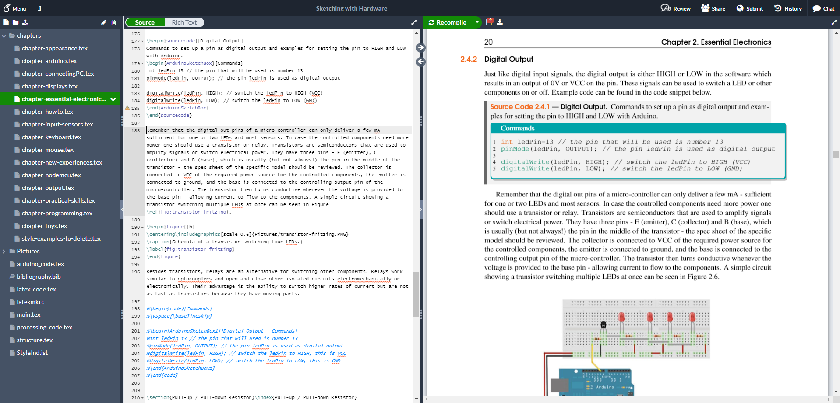
Discussion: What is an Interactive System?
Which of the following devices and applications can be considered an interactive system?*
Why can they be considered an interactive systems?
Why may they be not considered an interactive system?
Discuss one of the following
Professional video editing tool
Electronic signage at the railway station
Latex text processing system
*There may be not ‘yes’ or ‘no’ answer. Consider different aspects and think how the design impacts whether or not this is perceived as an interactive system.
Terms and Definitions

Slide 31
Discussion: What is an Interactive System? (1)
Terms and Definitions

Slide 32
Discussion: What is an Interactive System? (2)
Terms and Definitions

Slide 33
Discussion: What is an Interactive System? (3)
Terms and Definitions

Slide 34
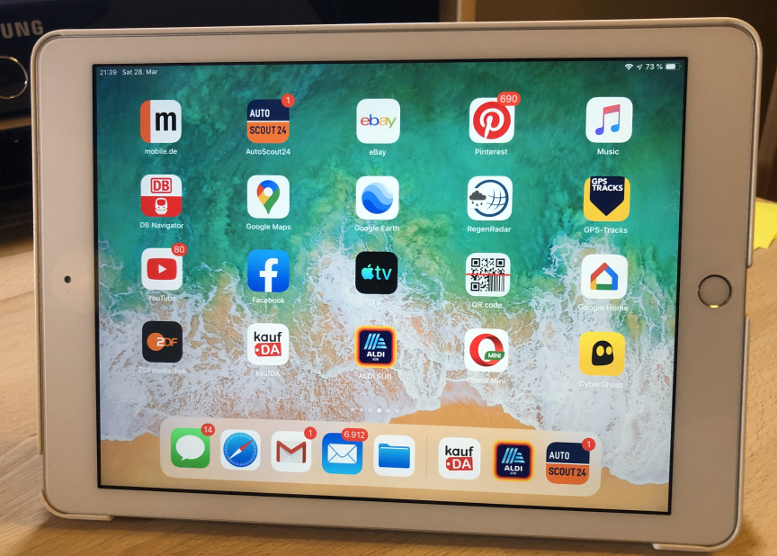
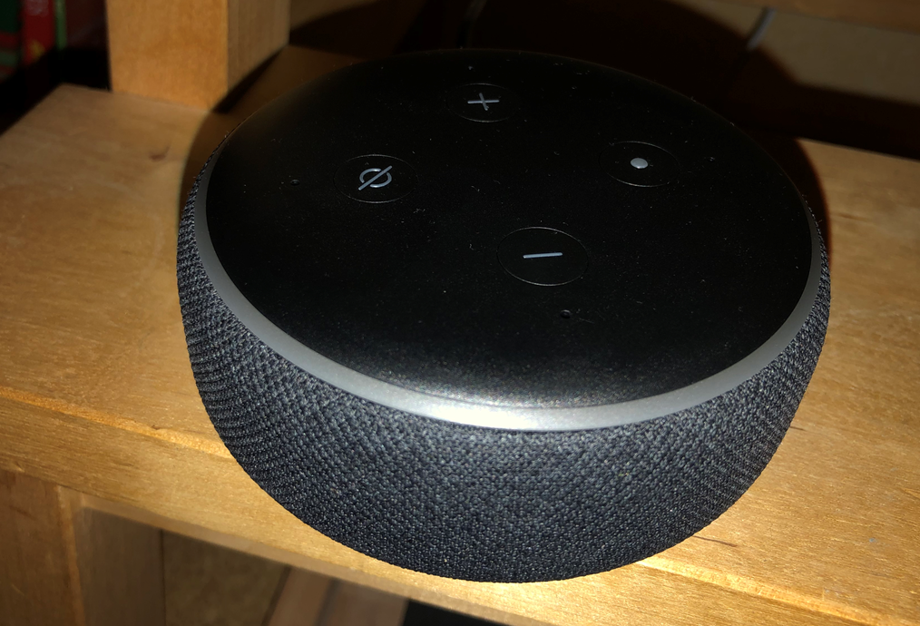
The User Interface (in HCI)
The part of a system where a user can interact with a system, device or application. The user interfaces can support input, output or both.
Synonyms:
Human-computer interface
Man-machine interface
Human-Machine-Interface
Examples:
Graphical user interface (GUI) on a web page
Voice user interface in a smart speaker (e.g., Alexa)
Buttons, switches, wheels, and levers in a cockpit
Terms and Definitions

Slide 35
More Terms
User: the person who interacts with a system, product or service.
Context of Use: the combination of users, goals and tasks, resources, and environment.
Interactive System: the combination of hardware and/or software and/or services and/or people that users interact with in order to achieve specific goals.
Usability: extent to which a system, product or service can be used by specified users to achieve specified goals with effectiveness, efficiency and satisfaction in a specified context of use.
Human-Centered Design: approach to systems design and development that aims to make interactive systems more usable by focusing on the use of the system and applying human factors/ergonomics and usability knowledge and techniques.
[1] ISO 9241-210:2019 Ergonomics of human-system interaction — Part 210: Human-centred design for interactive systems https://www.iso.org/standard/77520.html
Terms and Definitions

Slide 36
More Terms
User Experience: user’s perceptions and responses that result from the use and/or anticipated use of a system, product or service.
The main goal of almost every interaction design
Difficult but important to measure
Utility: a product can be used to reach a certain goal or to perform a certain task. This is essential!
Likeability: this may be related to utility and usability but not necessarily. People may like a product for any other reason…
Affordance: what the system offers to an individual or the “functional tinting” of a perceiver with respect to its stimuli.
[1] ISO 9241-210:2019 Ergonomics of human-system interaction — Part 210: Human-centred design for interactive systems https://www.iso.org/standard/77520.html
[2] Jakob Nielsen's Alertbox, August 25, 2003: Usability 101: Introduction to Usability https://www.nngroup.com/articles/usability-101-introduction-to-usability/
Terms and Definitions

Slide 37
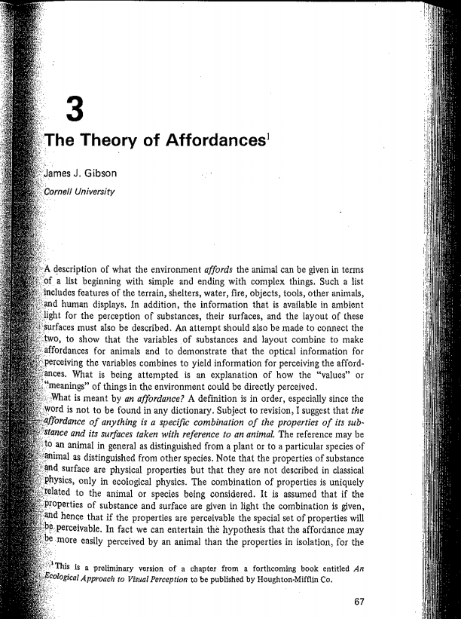
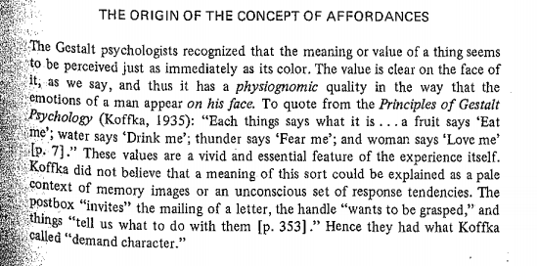
Affordance
“A fruit says ‘Eat me’; water says ‘Drink me’; thunder says ‘Fear me’…”
77
J. J. Gibson (1975). 'Affordances and behavior'. In E. S. Reed & R. Jones (eds.), Reasons for Realism: Selected Essays of James J. Gibson, pp. 410-411. Lawrence Erlbaum, Hillsdale, NJ, 1 edn.
Terms and Definitions

Slide 38
Affordance and Signifiers
Donald Norman brought the concept of affordance and signifiers into HCI [1]
Affordances determine what actions are possible
Signifiers communicate where the action should take place
William Gaver divided affordance into three categories [2]:
A false affordance is an apparent affordance that does not have any real function, meaning that the actor perceives nonexistent possibilities for action (“placebo button”)
A hidden affordance is when there are possibilities for action, but these are not perceived by the actor (“open a wine bottle using a shoe”)
A perceptible affordance is when there is information available such that the actor perceives and can then act upon the existing affordance.
[1] Norman, Donald (2013). The Design of Everyday Things: Revised and Expanded Edition (2nd ed.). Basic Books.
[2] Gaver, William W. (1991). "Technology affordances". Proceedings of the SIGCHI conference on Human factors in computing systems Reaching through technology - CHI '91. pp. 79–84. doi:10.1145/108844.108856. ISBN 978-0-89791-383-6. S2CID 13171625.
Terms and Definitions

Slide 39
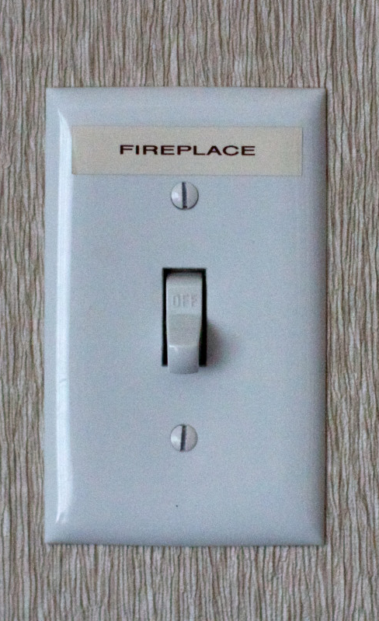
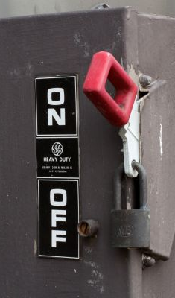
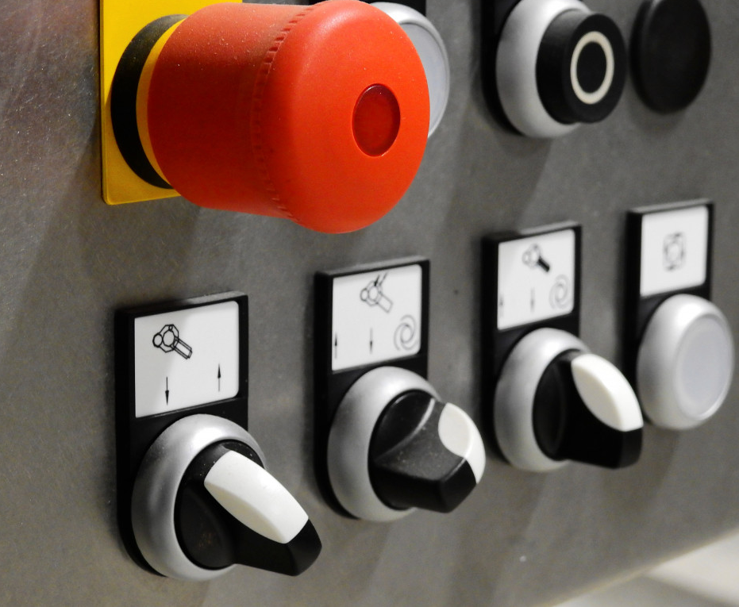
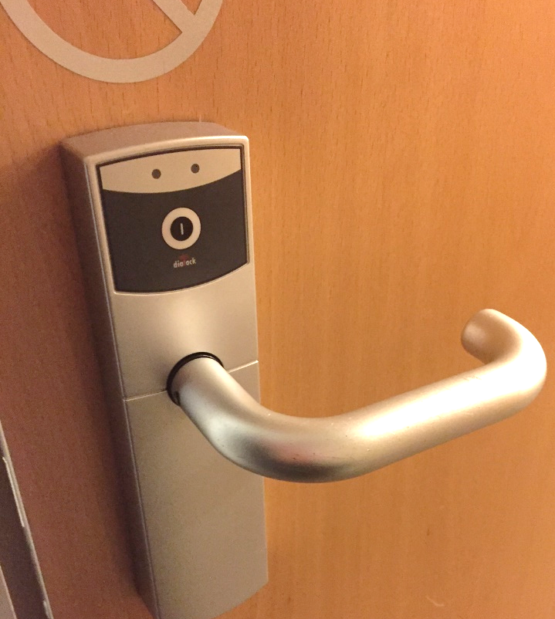
How to tell the user how to use it? (1)
How to make things that are obvious to use?
Is there something like an intuitive user interface?
Images: Albrecht Schmidt, https://pxhere.com/de/photo/204205, https://pxhere.com/de/photo/217090 , https://pxhere.com/de/photo/1213730
Terms and Definitions

Slide 40
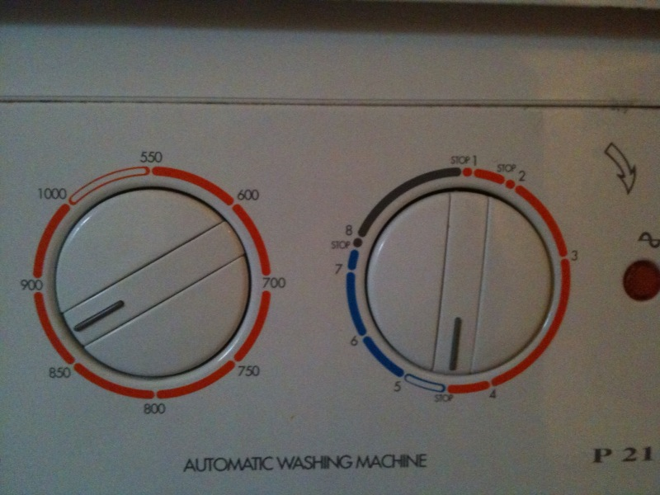
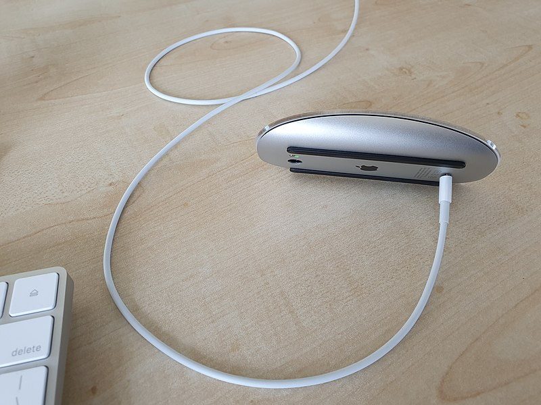
How to tell the user how to use it? (2)
Images: john allspaw https://www.flickr.com/photos/allspaw/4589119190/ , https://commons.wikimedia.org/wiki/File:Bad_design_-_Apple_Magic_Mouse_2,_unusable_when_charging_2.jpg
Terms and Definitions

Slide 41
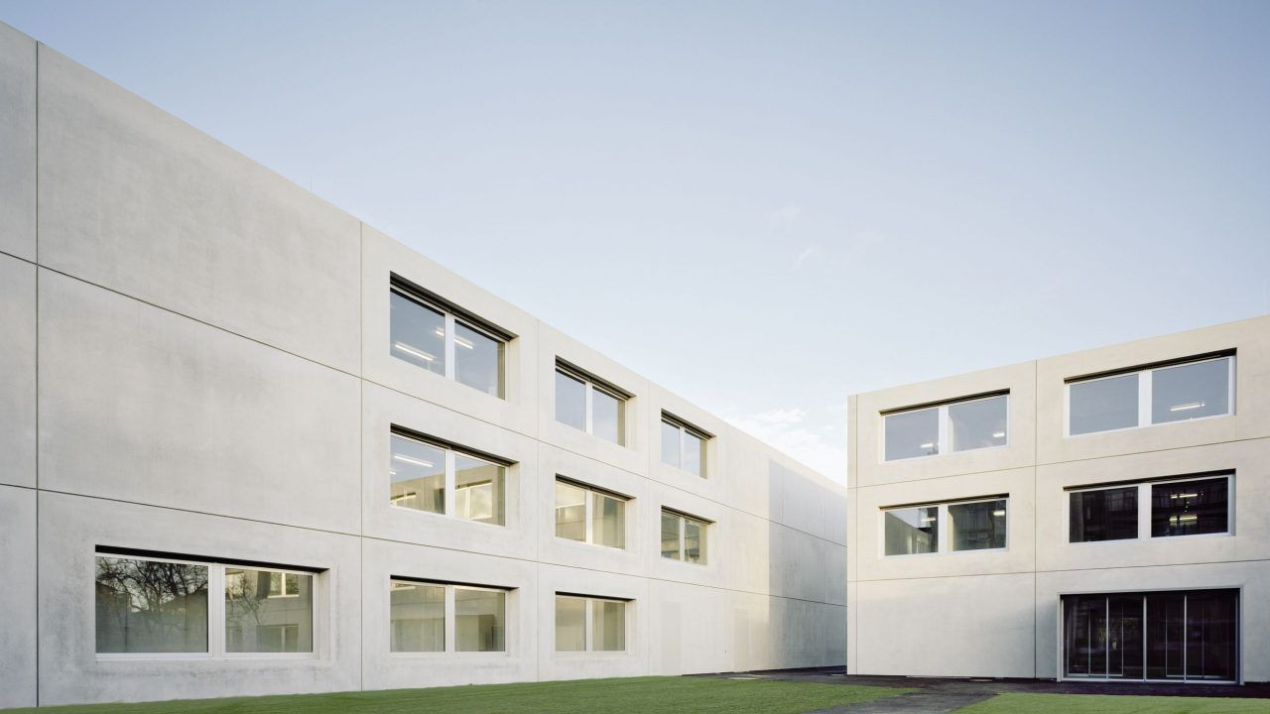
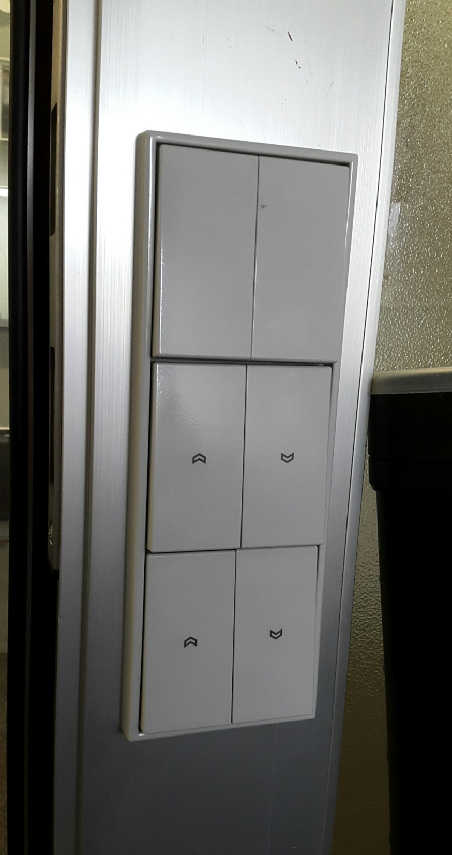
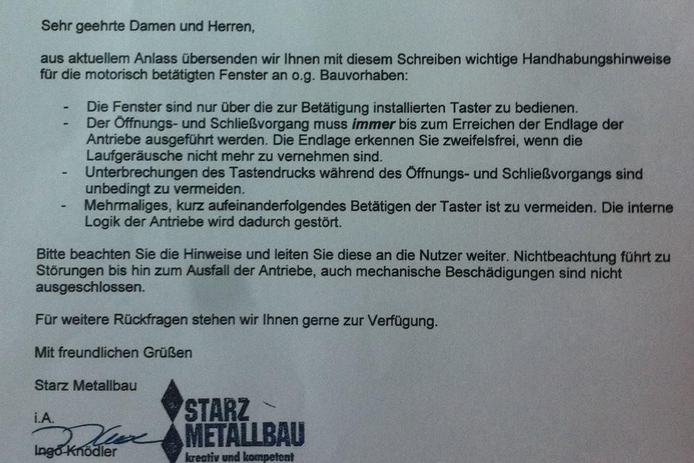
How to tell the user how to use it? (3)
Terms and Definitions

Slide 42
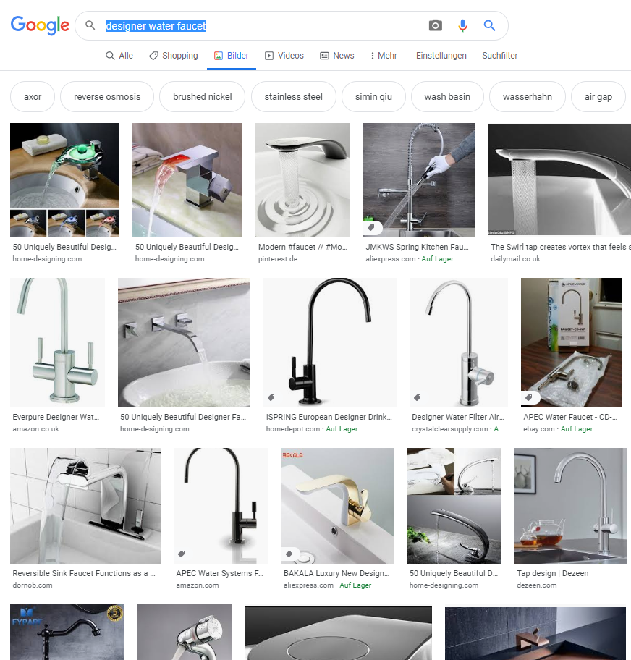
Affordance and Perceived Affordance
Task: Perform a google image search for
designer water faucet
find examples of products where it is NOT clear how to use them.
Why do people design things that are not obvious to use?
Terms and Definitions

Slide 43
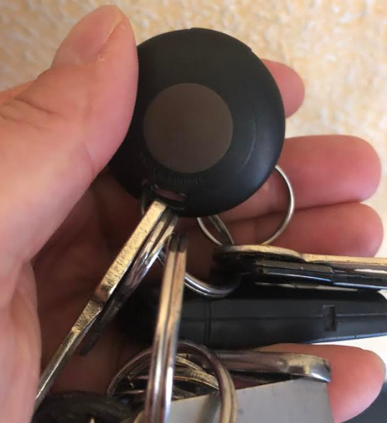
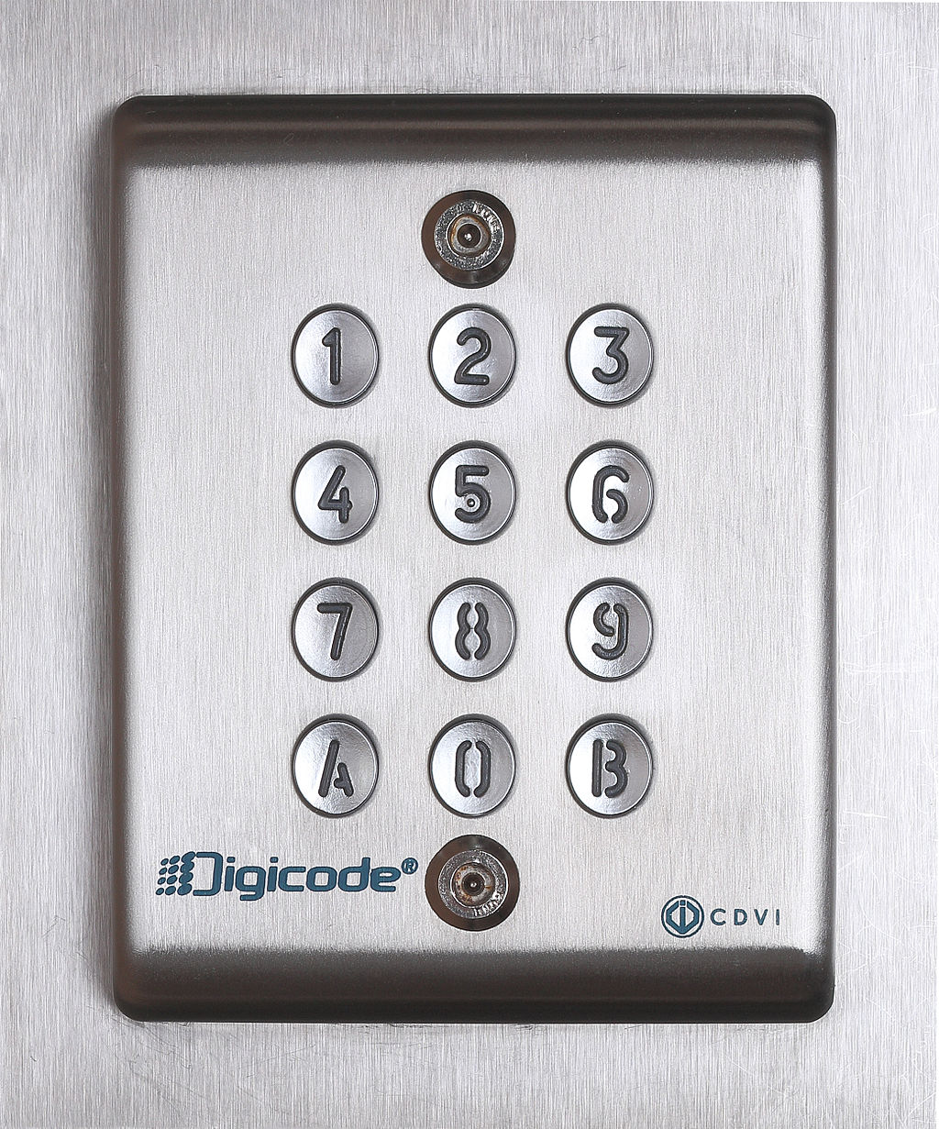
Usable Security
Scenario:
You have one lock to a room which holds expensive equipment
Room is shared by 20+ people from one department, who need to access it infrequently (typically every few weeks)
People from other departments should not get into the room
Currently solution: there is one key that can be borrowed from the caretaker and 5 out of the 20+ people have personal key to this room
Design a better solution:
Replace the old lock by something else
What is you design?
What are positive and negative aspects of your proposal?
Photo by D4m1en, CC BY-SA 3.0 https://commons.wikimedia.org/w/index.php?curid=34336655
Terms and Definitions

Slide 44
Usability has five quality components
Learnability: How easy is it for users to accomplish basic tasks the first time they encounter the design?
Efficiency: Once users have learned the design, how quickly can they perform tasks?
Memorability: When users return to the design after a period of not using it, how easily can they reestablish proficiency?
Errors: How many errors do users make, how severe are these errors, and how easily can they recover from the errors?
Satisfaction: How pleasant is it to use the design?
Jakob Nielsen's Alertbox, August 25, 2003: Usability 101: Introduction to Usability https://www.nngroup.com/articles/usability-101-introduction-to-usability/
Terms and Definitions

Slide 45
Interaction Design vs User Experience Design
Interaction Design (IxD): the design of interactive products and services in which a designer’s focus goes beyond the item in development to include the way users will interact with it.
User Experience Design (UxD): the more holistic approach in designing the experience a person will encounter when interacting with a devices, system or application. It considers the user interface design in the broader context of use.
User Interface Design (UID): refers to the conception and design of the user interface, including the choice of modalities, selection of interface elements, and their placement in the interface.
https://www.interaction-design.org/literature/topics/interaction-design
Terms and Definitions

Slide 46
4 Dimensions of Interaction Design
1-D: includes words and poetry. […]
2-D: languages that interaction design can borrow from include painting, typography, diagrams, and icons. […]
3-D: languages are those of physical, sculptural form. […] If something has a handle, for example, we know we are meant to grab it […]
4-D: is time. The 4-D languages include sound, film, and animation.
Foreword “What is Interaction Design?”. Interview with Gillian Crampton Smith. Moggridge, Bill, and Bill Atkinson. Designing interactions. Vol. 17. Cambridge, MA: MIT press, 2007. page xvii
Terms and Definitions

Slide 47
5 Dimensions of Interaction Design
Originally by Gillian Crampton Smith (4 dimensions); Kevin Silver added a fifth.
1-D: words should be meaningful and simple to understand.
2-D: visual representations supplement the words used to communicate information to users.
3-D: physical objects or space looks at what physical objects do users interact with the product (laptop, mouse, touchscreen, phones, etc.)? These all affect the interaction between the user and the product.
4-D: time refers to media that changes with time (e.g. animation, videos, sounds).
5-D: behaviour includes the mechanism of a product. How do users perform actions?
https://www.interaction-design.org/literature/article/what-is-interaction-design
Terms and Definitions

Slide 48
User Experience and Interaction Design
Design
Interaction Design
is part of
influences
Context of Use
Utility: “The what”
User Experience
Usability: “The how”
Likeability: “The emotion”
Affordance: “The intuition”
Users’ Skills and Expectations
Terms and Definitions

Slide 49
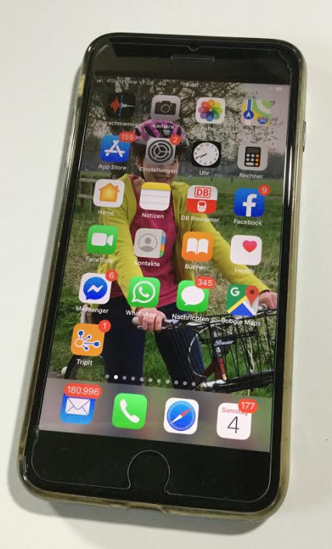
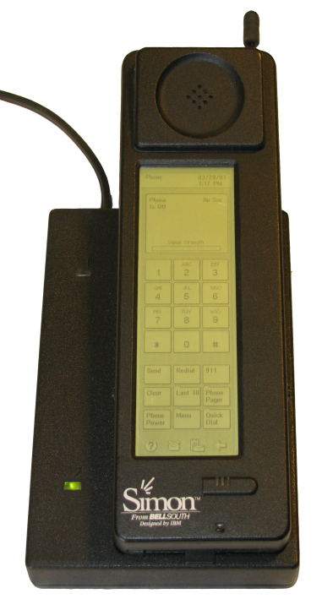
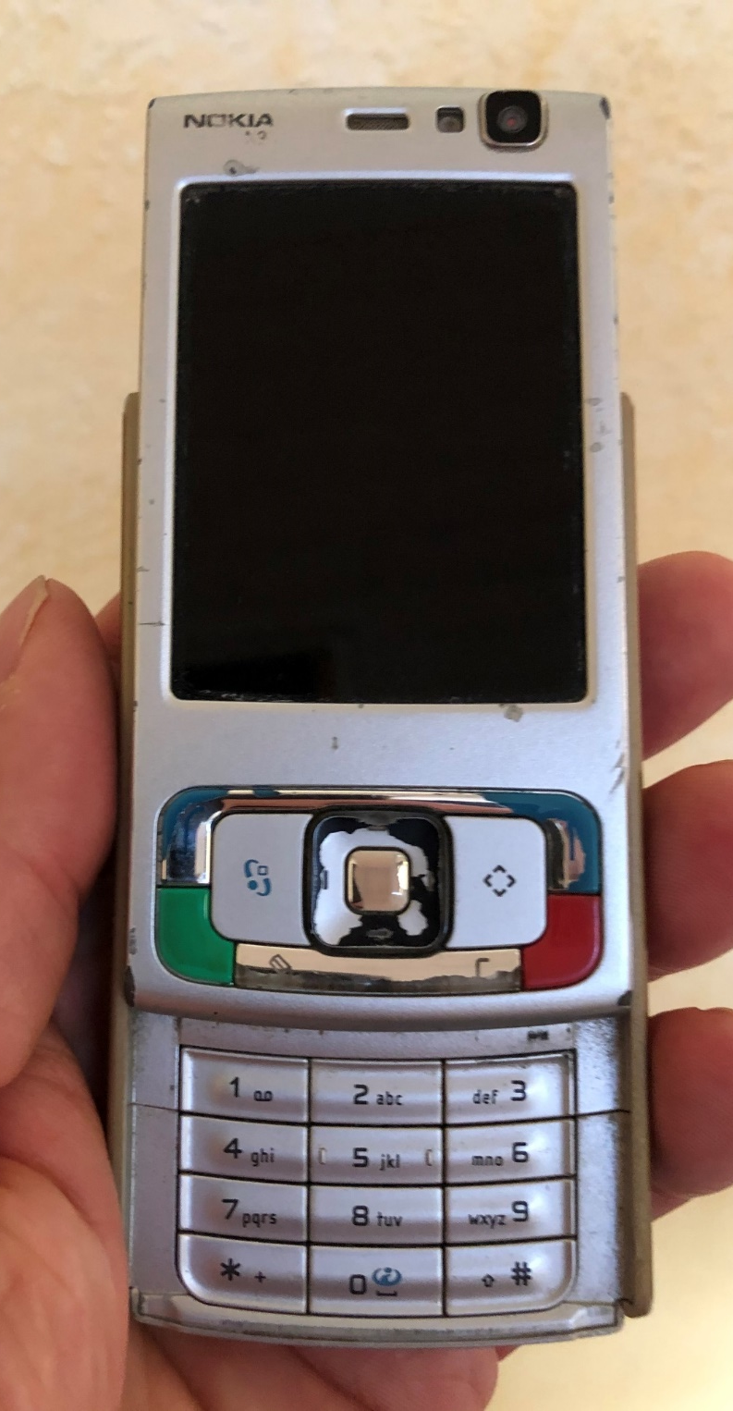
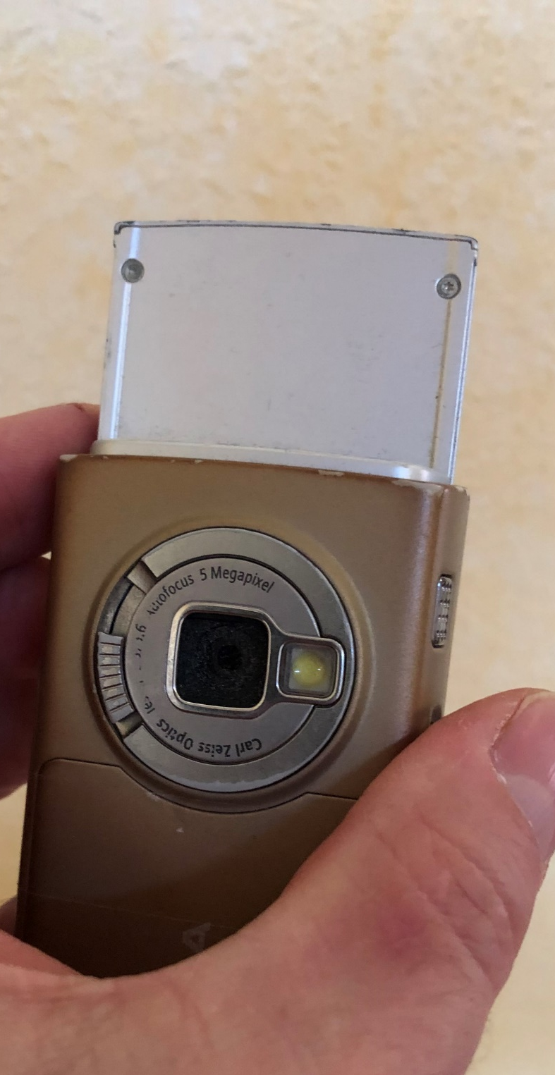
Usable Fashion
Photo by Bcos47 (public domain) http://en.wikipedia.org/wiki/File:IBM_Simon_Personal_Communicator.png
Terms and Definitions
Notes:
How long does an interface look “new”? What is “timeless”?

Slide 50
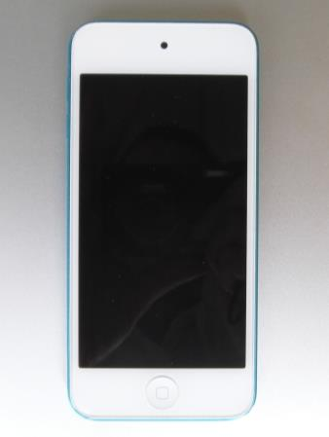
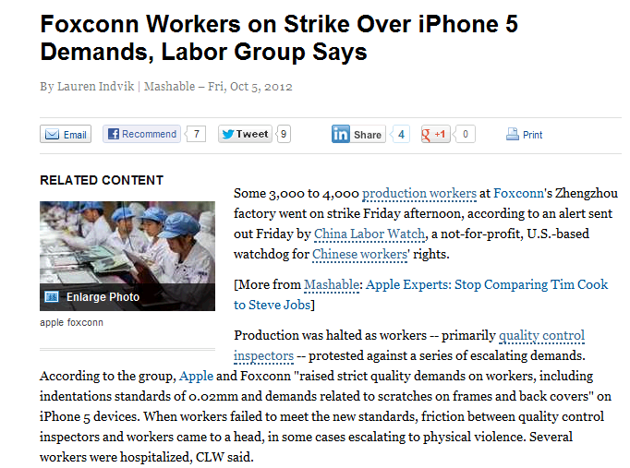
Experiences never “stand alone”
Terms and Definitions

Slide 51
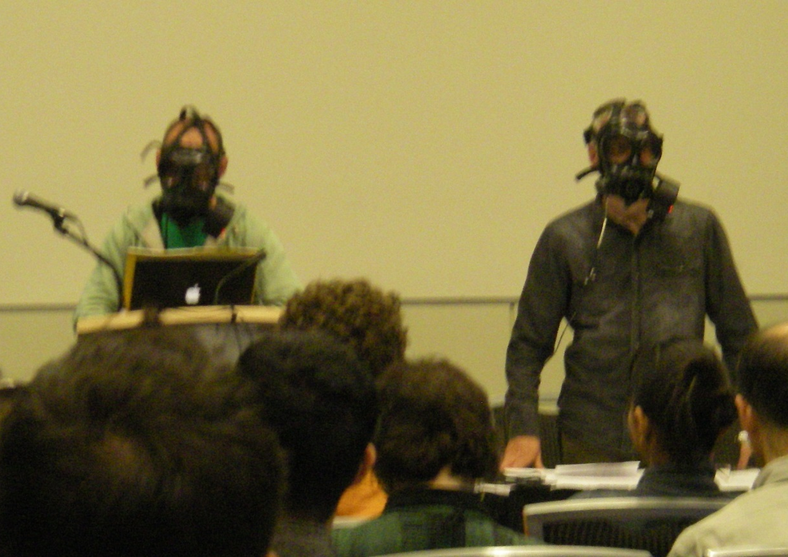
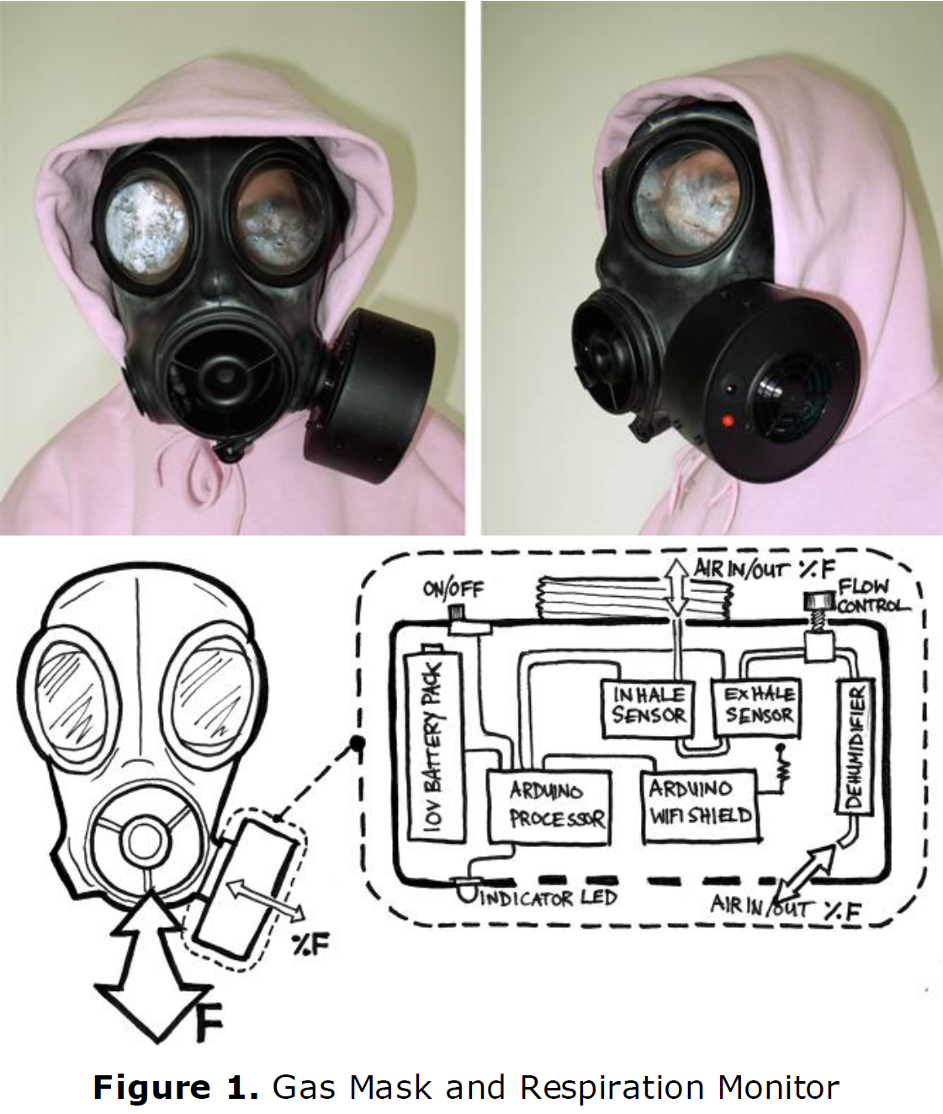
Altered Perception of Reality (2011)
Image from: http://www.cs.nott.ac.uk/~jqm/?p=501
Marshall, Joe, et al. "The gas mask: a probe for exploring fearsome interactions." CHI'11 Extended Abstracts on Human Factors in Computing Systems. ACM, 2011.
Terms and Definitions

Slide 52
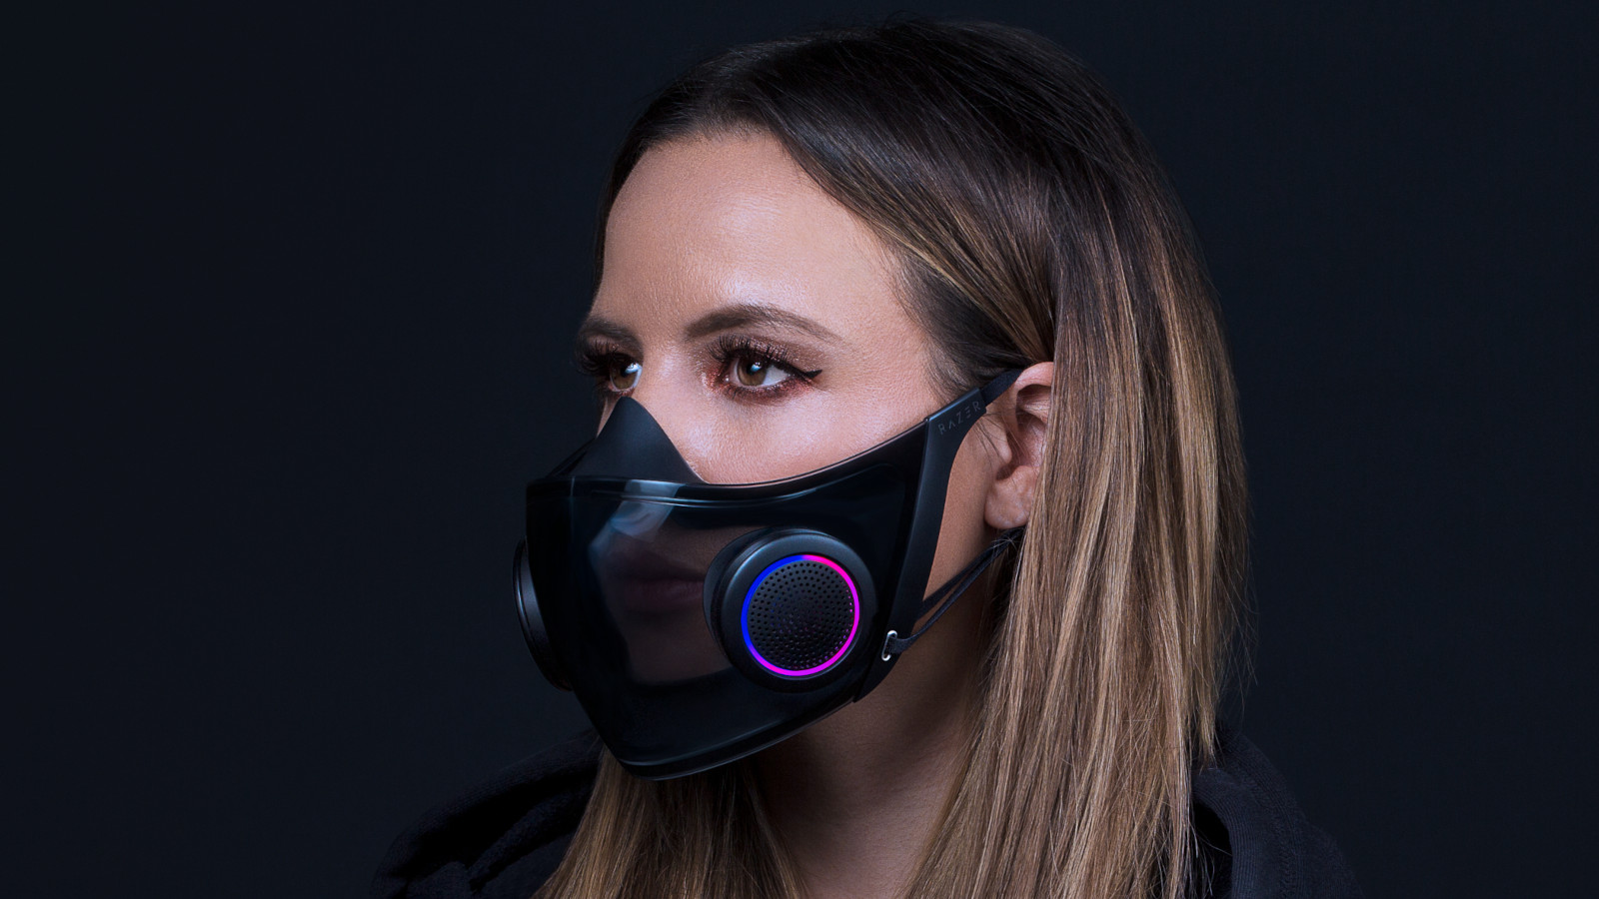
Razer Face Mask
Image credit: Razer, CES 2021

Slide 53
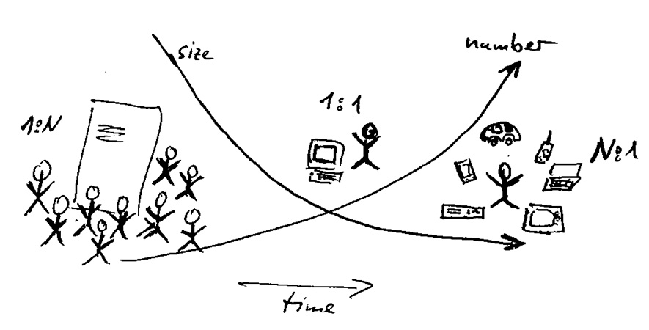
Mobile Computing
Mark Weiser. 1999. The computer for the 21st century. SIGMOBILE Mob. Comput. Commun. Rev. 3, 3 (July 1999), 3–11. DOI:https://doi.org/10.1145/329124.329126
Terms and Definitions

Slide 54
Ubiquitous Computing
Ubiquitous computing emphasizes the creation of a human-computer interface that can interpret and support the users’ intentions based on all devices in their surroundings
As we interact with these anonymous devices, they will adopt our information personalities and understand the context [1]
Privacy is likely the most often-cited criticism of ubiquitous computing and may be the greatest barrier to its long-term success [2]
Instead of escaping the physical world and entering a cyberspace, ubiquitous computing rather brings computers and communications to us [3]
[1] Weiser, Mark (1991). "The Computer for the 21st Century". Archived from the original on 22 October 2014.
[2] Hong, Jason I.; Landay, James A. (June 2004). "An architecture for privacy-sensitive ubiquitous computing" (PDF). Proceedings of the 2nd international conference on Mobile systems, applications, and services - MobiSYS '04. pp. 177=189. doi:10.1145/990064.990087. ISBN 1581137931. S2CID 3776760
[3] Winter, Jenifer (December 2008). "Emerging Policy Problems Related to Ubiquitous Computing: Negotiating Stakeholders' Visions of the Future". Knowledge, Technology & Policy. 21 (4): 191–203. doi:10.1007/s12130-008-9058-4. hdl:10125/63534. S2CID 109339320.
Terms and Definitions

Slide 55
Internet of Things (IoT)
Internet of things (IoT) refers to the network of physical objects or "things" embedded with sensors, software, and other technologies to collect and exchange data with other devices and systems over the Internet.
These objects can range from everyday household items like refrigerators and thermostats to industrial machinery and healthcare devices.
The primary aim of IoT is to create a smarter and more efficient world by enabling seamless interaction and data sharing between devices.
This paradigm is also described as pervasive computing or ambient intelligence
As constraints are removed when moving from mechanical to digital the interaction design human factors play a bigger role.
[1] Bashir, R. N., Qadri, S., Saleem, R. M., Naeem, M., & Ghafoor, Y. (2014). Human computer interaction (hci) in ubiquitous computing. International Journal of Innovation and Applied Studies, 9(2), 534.
Terms and Definitions

Slide 56
Artificial Intelligence (AI)
Artificial Intelligence (AI) is a related to a subfield of computer science that aims to create machines capable of performing tasks that would normally require human intelligence.
These tasks include learning, reasoning, problem-solving, perception, and natural language understanding.
Two main types:
Narrow or Weak AI: designed to perform specific tasks and limited to those tasks (chatbots, image recognition systems, and machine learning algorithms that predict consumer behavior)
General or Strong AI: A theoretical form of AI that would possess human-like cognitive abilities, allowing it to understand, learn, and apply new knowledge, have consciousness, and have emotional understanding.
"Artificial Intelligence: A New Synthesis" by Nils J. Nilsson
Terms and Definitions

Slide 57
Artificial Intelligence (AI) Components
Machine Learning is a subset of algorithms that enables systems to learn and recognize patterns from given data.
Deep Learning is a specialized subset of machine learning, which is itself a branch of artificial intelligence (AI) and automatically learns to represent data by training on a large dataset, generally without task-specific rules.
They achieve this through artificial neural networks with three or more layers.
Natural Language Processing (NLP) enables machines to understand and respond to human language
Robotics focuses on the creation of robots that can perform tasks in the real world.
Computer Vision enables machines to interpret and make decisions based on visual data.
Ellen Thro, The Artificial Intelligence Dictionary (Lance A. Leventhal Microtrend Series)
Terms and Definitions

Slide 58
Intelligent User Interface (IUI) and Context Awareness
An Intelligent User Interface (IUI) is a type of user interface that use AI or machine learning algorithms to improve the user experience.
IUIs are often designed to be aware of the context in which they are used, including the user's current task, location, and time, to provide more relevant and timely assistance.
The aim is to create systems that are more effective, efficient, and personalized, by understanding and predicting the user's needs, preferences, and behavior.
IUIs are increasingly common in a variety of domains, including healthcare, automotive design, and smart homes.
IUIs can adapt to individual user needs and preferences, often in real-time, to provide a personalized experience.
Terms and Definitions

Slide 59
Human-Centered Artificial Intelligence (HCAI)
Human-Centered Artificial Intelligence is “AI that seeks to augment the abilities of, address the societal needs of, and draw inspiration from human beings.”
It is an interdisciplinary approach to AI design and deployment that prioritizes human values, needs, and capabilities.
It aims to create AI systems that are not only technically robust but also ethically responsible, transparent, and aligned with human objectives.
Researchers assume that achieving a good HCAI will dramatically increase human performance, while supporting human self-efficacy, mastery, creativity, and responsibility [1].
[1] Shneiderman, B. (2020). Human-Centered Artificial Intelligence: Reliable, Safe & Trustworthy. International Journal of Human–Computer Interaction, 495–504. doi: 10.1080/10447318.2020.1741118
Terms and Definitions

Slide 60

Amazon Go
Video: https://www.youtube.com/watch?v=NrmMk1Myrxc
Terms and Definitions

Slide 61
Summary
HCI is widely relevant to the development of interactive technologies.
The interaction and interface design determines how people can and will use an object, device, or application.
A “good” user experience is the key to every “good” interaction
Interaction design requires an overarching understanding of how perceived affordances must be created.
The goal is to make an interface or interaction design that intuitively communicates how the system is being used or that completely hides the system among physical objects (ubiquitous computing) or intelligent user interfaces
To create intelligent user interfaces AI and HCAI plays a bigger role.
Terms and Definitions

Slide 62
References
B. Shneiderman (2002). Leonardo's Laptop: Human Needs and the New Computing Technologies. http://mitpress.mit.edu/main/feature/leonardoslaptop/index.html
B. Buxton (2010). Sketching user experiences: getting the design right and the right design. Morgan Kaufmann.
Harry Brignull (2006). Bad usability is like a leaky pipe. https://90percentofeverything.com/2006/11/13/bad-usability-is-like-a-leaky-pipe/
Paula Zuccotti (2015): Every Thing We Touch: A 24-hour Inventory of Our Lives. Penguin UK. https://www.theguardian.com/society/2015/nov/06/its-the-little-things-everything-i-touched-today
Nina Runge, Johannes Schöning, Rainer Malaka, and Alberto Frigo (2016): You Can Touch This: Eleven Years and 258218 Images of Objects. In Proceedings of the 2016 CHI Conference Extended Abstracts on Human Factors in Computing Systems (CHI EA '16). ACM, New York, NY, USA, 541-552. DOI: https://doi.org/10.1145/2851581.2892575
James J. Gibson (1977): The theory of affordances. Hilldale, USA 1.2 https://monoskop.org/images/2/2c/Gibson_James_J_1977_The_Theory_of_Affordances.pdf
Don Norman (2008): Affordances and Design, jnd.org https://jnd.org/affordances_and_design/
Norman, D. A. (2013): The design of everyday things: Revised and expanded edition. New York: Doubleday
Terms and Definitions

Slide 63

A Brief History of HCI
Human-Computer Interaction Lecture
Image from: Computermuseum, Fakultät Informatik, Universität Stuttgart
The following content is licensed under a Creative Commons Attribution 4.0 International license (CC BY-SA 4.0)

Slide 64

RKS
A Brief History of HCI

Slide 65
Timeline of Important Technologies
1945: Vannevar Bush: “As We May Think”, MEMEX
1950: Whirlwind with cathode ray tube (CRT)
1955: SAGE Radar with CRT and light pen
1962: “Spacewar”: video game on a PDP-1 computer with joystick
1963: I. Sutherland’s “Sketchpad” (interactive 2D CAD system)
1968: D. Engelbart: computer supported cooperative work (CSCW)
1969: I. Sutherland: virtual reality (VR), head-mounted display (HMD)
1973: Xerox Alto – implementation of a graphical user interface
1981: Xerox Star – Fully functional graphical user interface
1982: Apple Lisa
1984: Apple Mac – first commercially successful GUI
1984: X Window system
A Brief History of HCI

Slide 66




Early Computer Operators and Engineers
Images from: http://www.computerhistory.org
A Brief History of HCI

Slide 67
Timeline in HCI – The User’s Perspective
1950: Experimental computers, specific tasks interface at the hardware level for engineers (switch panels)
1960, 1970: Batch / offline mode; punch cards / printer interface at the programming level (COBOL, FORTRAN)
1970, 1980: Timesharing / text terminals (IBM 3270, DEC VT100) interface at the terminal level (command languages)
1980, 1990: Raster graphics / GUI on PCs / workstations interface at the interaction dialogue level (GUIs, multimedia)
2000: Multimedia: graphics, video, and audio; internet, interface at the work setting (networked systems, groupware)
2010: Mobile, Wearable, Embedded, Ubiquitous interface is pervasive, everywhere, and more and more Natural
A Brief History of HCI

Slide 68


Vannevar Bush
As we may think (1945): an article in Atlantic Monthly
Sees the problem of storing, accessing, distributing, and annotating information
Understands the wealth of large amounts of information and easy access to it
Identifies organization of information as key issue
“Consider a future device … in which an individual stores all his books, records, and communications, and which is mechanized so that it may be consulted with exceeding speed and flexibility. It is an enlarged intimate supplement to his memory.” - by Vannevar Bush
Video explaining the concept:
http://www.youtube.com/watch?v=c539cK58ees
Recommended further reading:
http://www.theatlantic.com/magazine/archive/1945/07/as-we-may-think/3881/
A Brief History of HCI

Slide 69


Ivan Sutherland
SketchPad (1963)
Drawing package
User interface included:
icons,
copying,
light-pen input
Development based on “OO”-principles
Many ideas are still in use
3D Head-Mounted Display (1965-1970)
3D “visualization” (very basic)
Large apparatus
A Brief History of HCI

Slide 70


Ivan Sutherland: Sketchpad
Part 1 of 2
http://www.youtube.com/watch?v=USyoT_Ha_bA
Part 2 of 2
http://www.youtube.com/watch?v=BKM3CmRqK2o
Sketchpad, A Man-Machine Graphical Communication System
Ivan Sutherland's Ph.D. Thesis from Massachusetts Institute of Technology 1963. Republished by University of Cambridge in 2003 as Technical Report Number 574
http://www.cl.cam.ac.uk/TechReports/UCAM-CL-TR-574.pdf
A Brief History of HCI

Slide 71

Douglas Engelbart: The Mother of All Demos (1968)
The Mother of All Demos, presented by Douglas Engelbart (1968)
A Brief History of HCI

Slide 72


Douglas Engelbart: Augmenting Human Intellect
A Conceptual Framework for Augmenting Human Intellect (SRI Report, 1962)
Provides an understanding of the need for collaborative (several potentially distributed people together) and immediate problem solving
A key issue is to improve peoples' abilities to make use of information
A Brief History of HCI

Slide 73



Rainer Mallebrein: RKS
Image: Computermuseum, Fakultät Informatik, Universität Stuttgart
Der SIG-100 mit Rollkugel
Image: Computerschausammlung der FH Kiel
Die Computer Maus - eine deutsche Erfindung - Interview mit Rainer Mallebrein
https://www.youtube.com/watch?v=Pja-_ytuk_s
A Brief History of HCI

Slide 74



Hiroshi Ishii: Tangible Bits / Radical Atoms
Tangible Bits: Towards Seamless Interfaces between People, Bits and Atoms. (Hiroshi Ishii and Brygg Ullmer – MIT Media Laboratory – Tangible Media Group)
Radical Atoms: Beyond the "Pixel Empire" | Hiroshi Ishii | TEDxTokyo
https://www.youtube.com/watch?v=9mFw5uQsjpA
A Brief History of HCI

Slide 75


Albrecht Schmidt: Amplifying Perception
A. Schmidt, "Augmenting Human Intellect and Amplifying Perception and Cognition," in IEEE Pervasive Computing, vol. 16, no. 1, pp. 6-10, Jan.-Mar. 2017, doi: 10.1109/MPRV.2017.8.
A Brief History of HCI

Slide 76


Marc Hassenzahl: User Experience in Detail
Hassenzahl, Marc (2013): User Experience and Experience Design. In: Soegaard, Mads and Dam, Rikke Friis (eds.). "The Encyclopedia of Human-Computer Interaction, 2nd Ed.". Aarhus, Denmark: The Interaction Design Foundation. http://www.interaction-design.org/encyclopedia/user_experience_and_experience_design.html
Effie Lai-Chong Law, Virpi Roto, Marc Hassenzahl, Arnold P.O.S. Vermeeren, and Joke Kort. 2009. Understanding, scoping and defining user experience: a survey approach. In Proceedings of the 27th international conference on Human factors in computing systems(CHI '09). ACM, New York, NY, USA, 719-728. DOI=10.1145/1518701.1518813 http://doi.acm.org/10.1145/1518701.1518813
A Brief History of HCI

Slide 77
HCI Domains

Slide 78
Approaches to Human-Computer Interaction
Programming level
Command language level
Dialogue level (forms, questions & answers)
Direct manipulation of digital elements
Tangible interaction
Cognition and perception
Human-Robot Interaction
Cooperation & Collaboration
A Brief History of HCI

Slide 79
More People in HCI
J.C.R. Licklider
man-computer symbiosis (1960)
Interactive computing
Alan Kay
Vision of a notebook computer Dynabook (1969)
Mockup to convey the idea
Computing for everyone
Jakob Nielsen
Usability principles
Dan Norman
“People are so adaptable that they are capable of shouldering the entire burden of accommodation to an artifact, but skillful designers make large parts of this burden vanish by adapting the artifact to the users.”
A Brief History of HCI

Slide 80
Lessons Learned from History
Technology drives new user interface concepts and interaction metaphors
New user interfaces create new applications
Interaction designs and user interface concepts evolve
You can not hide the user interface - good ideas spread out
User will never ignore the user interface
The first to come out with a new user interface is not necessarily the most successful
A Brief History of HCI

