Slide 1

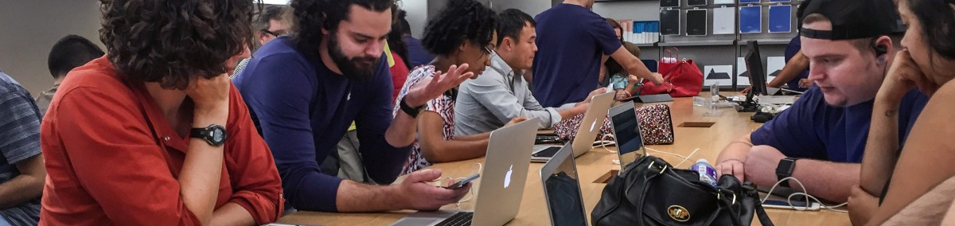

Users
Human-Computer Interaction Lecture
Slides adapted from hci-lecture.org (A. Schmidt, N. Henze, K. Wolf, V. Schwind), Image from: Robert Couse Baker/pxhere.com
The following content is licensed under a Creative Commons Attribution 4.0 International license (CC BY-SA 4.0)

Slide 2
Learning Goals
Understand …
how users see a user interface and the user’s illusion
why it is hard for developers to spot usability issues
mental models of the users, designers and developers
the Human-Centered Design Process
patterns of users and tasks
Be able to explain …
to use describe the concept of a user and to improve a user interface or interaction
the principle of mental models
Users

Slide 3
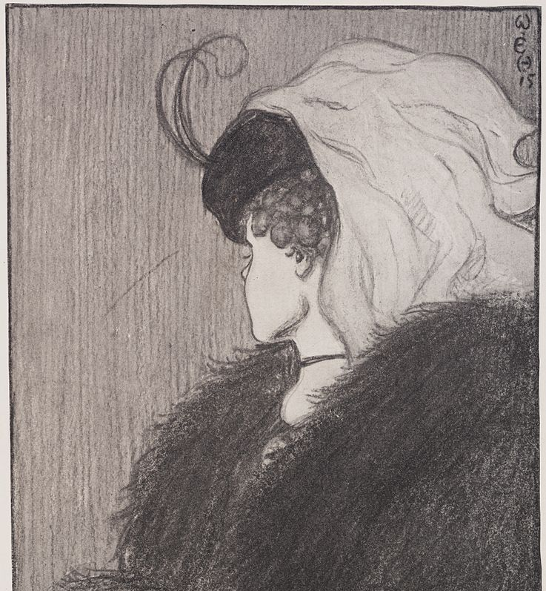
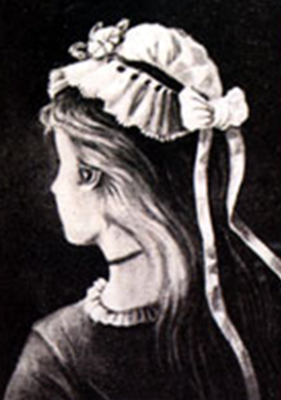
We see what we want to see (1)
Images from https://commons.wikimedia.org/wiki/File:My_Wife_and_My_Mother-in-Law.jpg
and https://commons.wikimedia.org/wiki/File:German_postcard_from_1888.png
Users

Slide 4
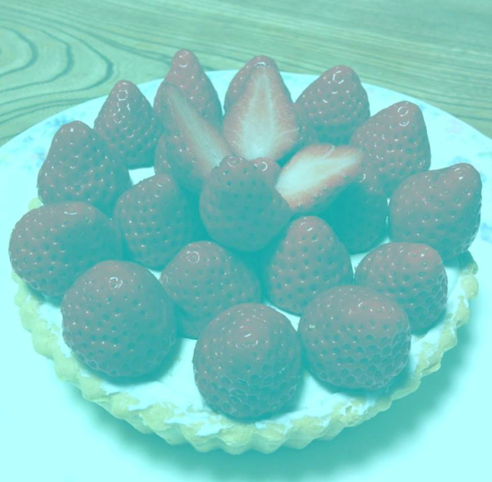
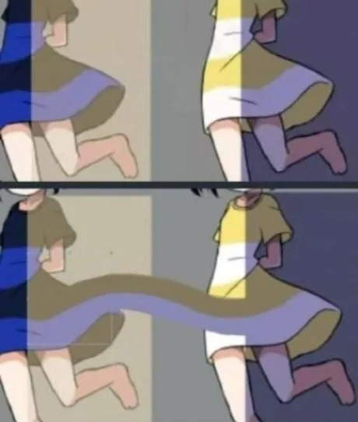
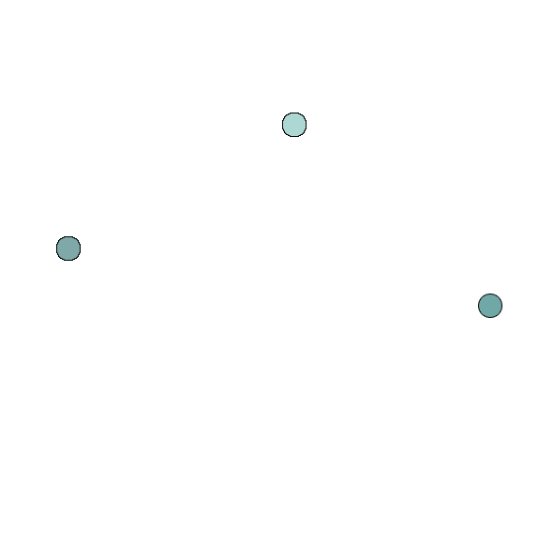
We see what we want to see (2)
http://www.michaelbach.de/ot/col-strawbsNotRed/index.html
Images from Kitaoka A (2015) Apparent reddish strawberries. ECVP contribution Hansen T, Okkonen M, Gegenfurtner K (2006) Memory modulates color appearance https://michaelbach.de/ot/col-strawbsNotRed/index.html and https://www.thesun.co.uk/living/3496637/optical-illusion-dresses-colour-change/
Users

Slide 5
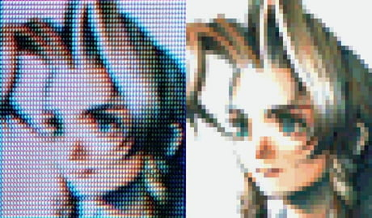
We see what we want to see (3)
Image posted by user earendilll 10 Apr 22 at 9gag.com
Users

Slide 6
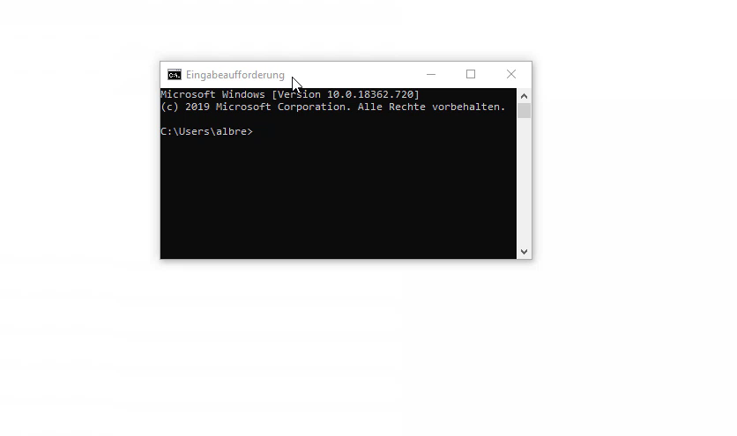
We see what we want to see (4)
Video by Albrecht Schmidt
Users

Slide 7
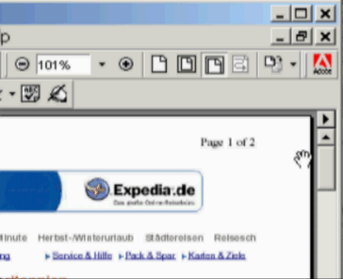
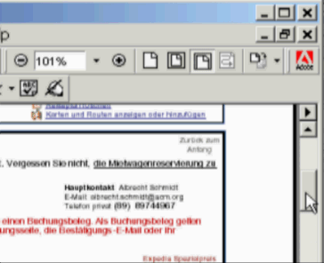

We see what we want to see (5)
Videos by Albrecht Schmidt
Users

Slide 8
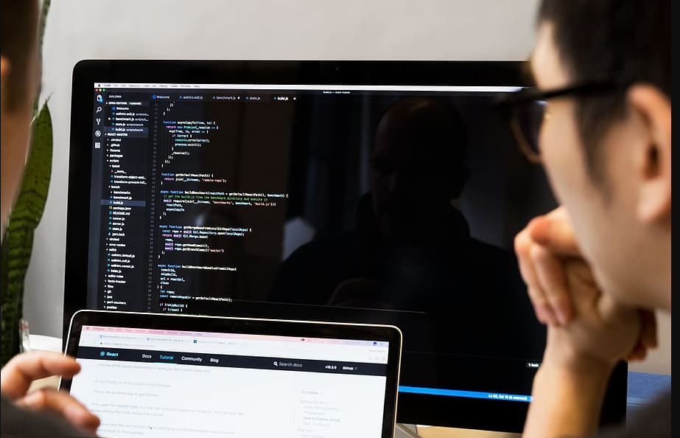
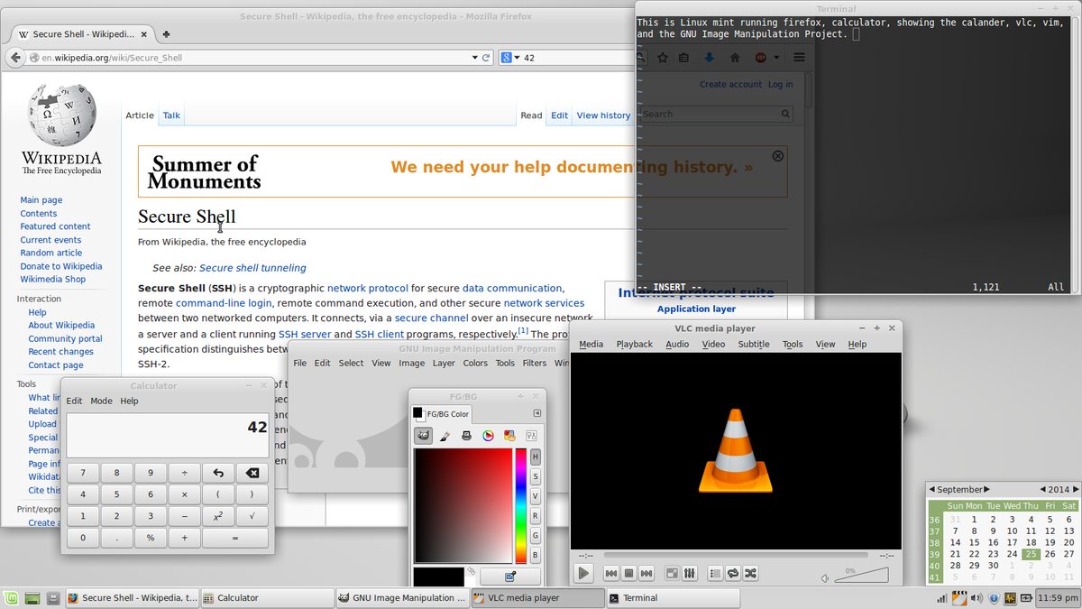
Why do developers have no usability issues?
Images from https://www.piqsels.com/en/public-domain-photo-zbszp and https://en.wikipedia.org/wiki/Free_and_open-source_software
Users

Slide 9
End Users vs. Developers
Developers know almost everything about their development
End users have little idea about
system and software architecture
remote database connections
state transitions and dependencies
internal query syntax
application context
system restrictions
…
… and the do not care about it – and they should not need to care about it!
Users

Slide 10
Why are users not supposed to care about software issues?
Discussion
Users

Slide 11
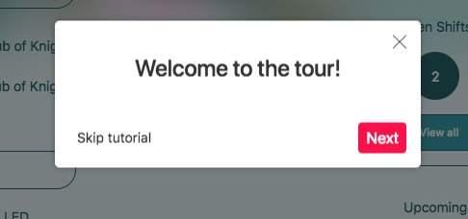
Why do we always skip the tutorial?
Image from: https://github.com/JobCore/employer-web-client/issues/20
Users

Slide 12
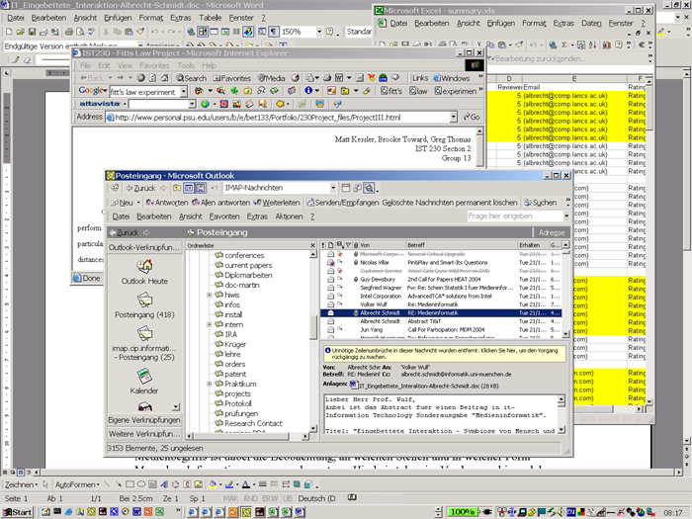
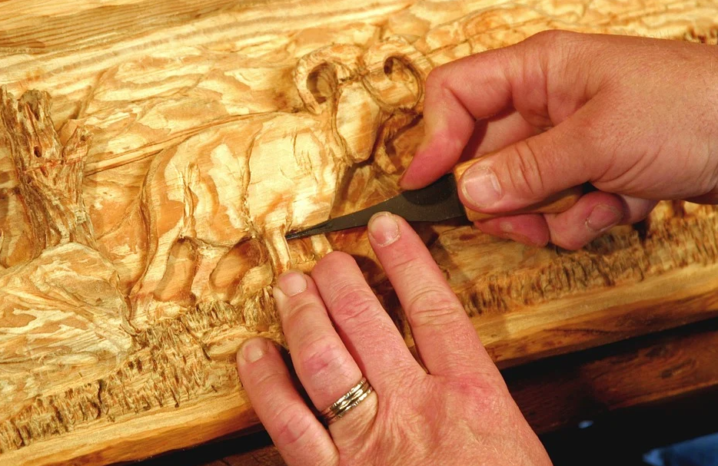
The Difference between Developers and Users
Developers want to complete the system
Users want to complete tasks with your system
Once caught in a task, users will try to keep the „flow“ until their task is completed
Images from Albrecht Schmidt and https://pixabay.com/de/photos/schnitzen-holz-mantel-h%C3%A4nde-96088/
Users

Slide 13



The Corridor of Options and the Users‘ Flow
Corridor of options
Less options increase the flow
The User
The problem
The solution
Many options slow down the task flow
The users‘ path to solve the problem = task flow (composed of one or more tasks)
Users

Slide 14
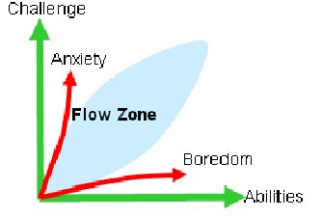
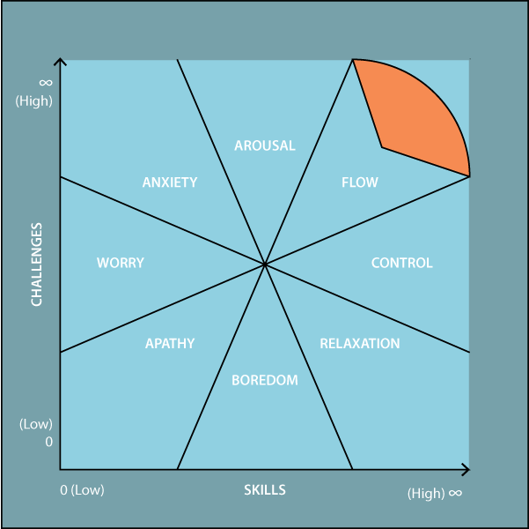
The Users‘ Flow
Refers to a mental state of absorption in an activity, leading to a heightened sense of focus, positive fulfillment and productivity
People in flow are more likely to come up with solutions and ideas
Flow is an important requirement to be immersed (movies, games, etc.)
Thus, the “flow” is a special case of user experience
Biochemically, flow is associated with neurotransmitter activity, including elevated levels of dopamine and endorphins, as well as regulated cortisol levels able to handle positive stress (“eustress”)
Csikszentmihalyi, Mihaly. Flow: The Psychology of Optimal Experience. New York: Harper & Row, 1990. 74.
Csikszentmihalyi, Mihaly. Finding Flow: Psychology of Engagement with Everyday Life. New York: Basic, 1997. 31.
Guillon, B., Monteiro, J.-L., Checoury, C., Archambault, D., & Burger, D. (2004). Towards an Integrated Publishing Chain for Accessible Multimodal Documents. . doi: 10.1007/978-3-540-27817-7_75
Sawyer, R. K. (2006). Explaining creativity: The science of human innovation. Oxford University Press
Users

Slide 15
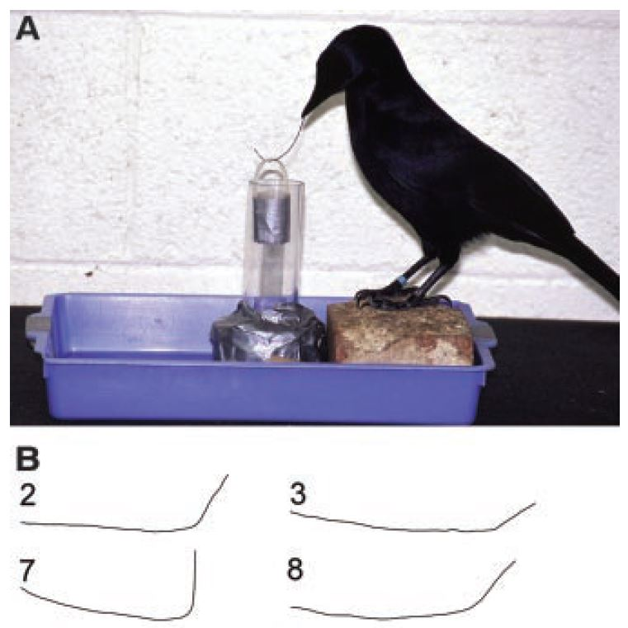
About Using Tools
From the perspective of a user: every user interface is a tool (or utility)
“The way humans make and use tools is perhaps what sets our species apart more than anything else. Now scientists are more and more uncovering the forces that drove our lineage to our heights of tool use — and how tool use, in turn, might have influenced our evolution.” [1]
The right tool influence evolution
[1] Charles Q. Choi. 2009. Human Evolution: The Origin of Tool Use Live Science, November 11, 2009.
[2] Weir, A.A., Chappell, J. and Kacelnik, A., 2002. Shaping of hooks in New Caledonian crows. Science, 297(5583), pp.981-981
Users

Slide 16
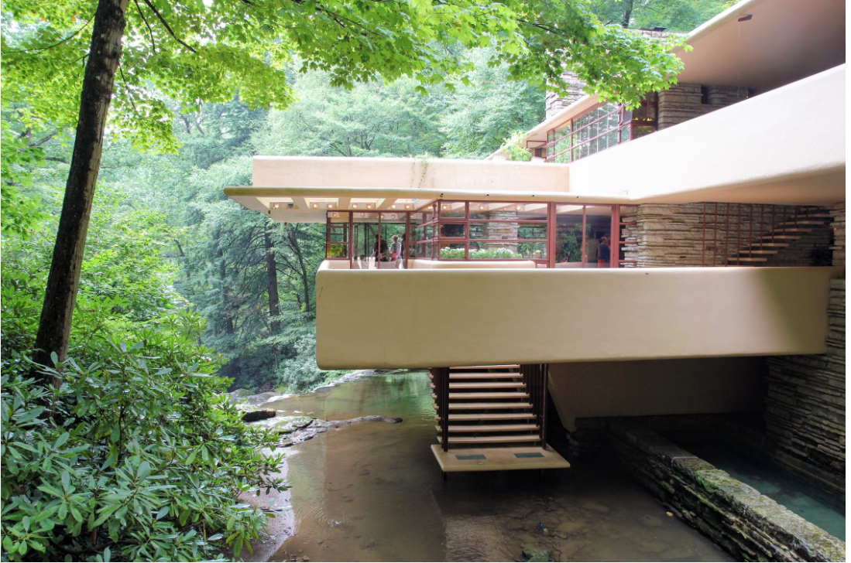
About Creating Complex Systems
“You can use an eraser on the drafting table or a sledgehammer on the construction site.” - Frank Lloyd Wright
Creating the user interface at the end of the project will not work – it has to be considered from the very beginning
Make Mistake Early and Recognize Them!
Making changes and corrections to early address the user needs is considerably easier and less costly during the planning or design phase than after the implementation or release phase.
Images from https://www.pexels.com/de-de/foto/fallendes-wasserhaus-frank-lloyd-wright-moderne-architektur-2695872/ New York World-Telegram and the Sun staff photographer: Al Ravenna / Public domain https://commons.wikimedia.org/wiki/File:Frank_Lloyd_Wright_portrait.jpg
Users

Slide 17
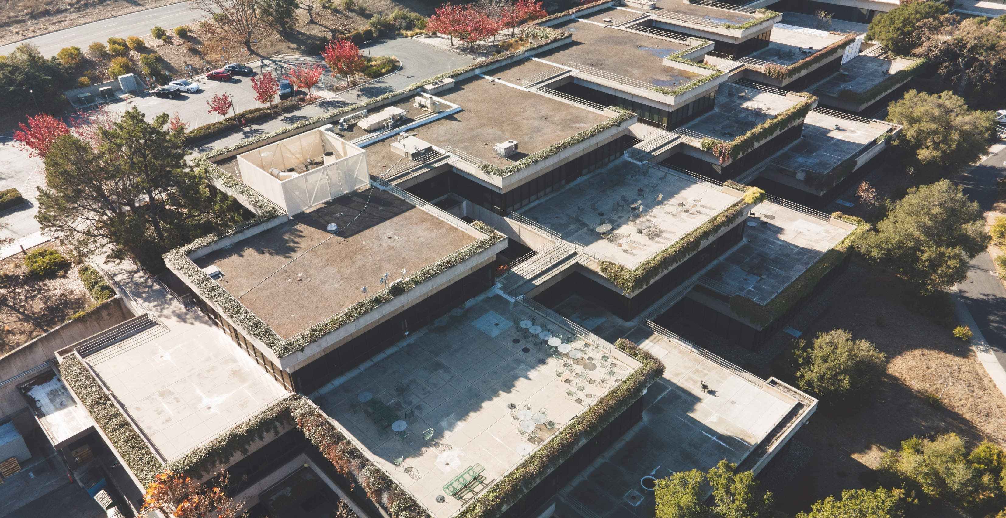
Xerox PARC
Birthplace of the printer, ethernet, many programming languages, graphical user interfaces, and entrepeneurs (Bill Gates, Steve Jobs, …)
Image from Xerox PARC in 2020 by Christopher Michel https://commons.m.wikimedia.org/wiki/File:Xerox_PARC_01.jpg
Users

Slide 18
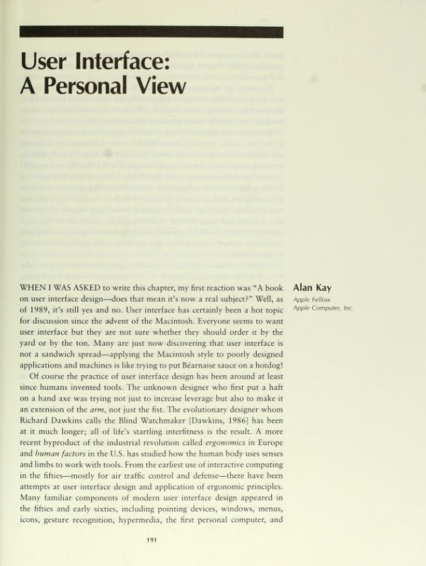
User Illusion and Metaphors
“At PARC we coined the phrase user illusion to describe what we were about when designing the user interface. There are clear connotations to the stage, theatrics, and magic - all of which give strong hints as to the direction to be followed. For example, the screen as "Paper to be marked on" is a metaphor that suggests pencils, brushes, and typewriting. Fine as far as it goes. But it is the magic - understandable magic - that really counts. Should we transfer the paper metaphor so perfectly that the screen is as hard as paper to erase and change? Clearly not.” (p. 199)
Kay, A. (1990). User interface: A personal view. In B. Laurel, (Ed.), The art of human computer interface design (pp. 191–207). Reading , MA : Addison‐Wesley.
Users
Notes:
„Bei PARC haben wir den Begriff Benutzerillusion geprägt, um zu beschreiben, worum es uns beim Design der Benutzeroberfläche ging. Es gibt klare Konnotationen zu Bühne, Theatralik und Magie – die alle starke Hinweise auf die zu verfolgende Richtung geben. Zum Beispiel ist der Bildschirm als "Papier zum Markieren" eine Metapher, die Bleistift, Pinsel und Schreibmaschine suggeriert. Gut so weit es geht. Aber es ist die Magie – verständliche Magie – die wirklich zählt. Sollten wir die Papiermetapher so perfekt übertragen, dass der Bildschirm so schwer zu löschen und zu verändern ist wie Papier? Ganz sicher nicht." (S. 199)

Slide 19

User Illusions and Magic
User illusion describes the perfect “magical” experience or the optimal illusion you want to create
The idea is that users do not need to understand the intricate details of how a system works; they only need a "useful illusion" that allows them to interact effectively with it.
Implies that hiding unnecessary complexities and only exposing users to essential functionalities, the system becomes more user-friendly
The primary goal of creating a “User Illusion” is to facilitate smooth interaction between the user and the system.
Discussion:
What supports/enables the user illusion?
What breaks the user illusion?
Image from https://www.pxfuel.com/en/free-photo-jgfkb
Users

Slide 20
Metaphors
Metaphors are figures of speech that describe an object or action as something other than what it is, usually by drawing a comparison between two seemingly unrelated entities.
For example:
“Desktop”: used in many operating systems helps users understand the functions of a computer by likening it to a familiar physical workspace
“Trash Can”/“Recycle Bin”: used to represent the deletion of files. Just like throwing away physical trash, files can be "dragged" into a virtual trash can or recycle bin.
“Surfing”: "surfing" the web likens the experience to riding waves on a surfboard, capturing the sense of freedom and exploration.
“Streams”/”Feeds”: used in social media and news platforms to describe the continuous flow of information, much like a river stream or a news feed.
Users

Slide 21
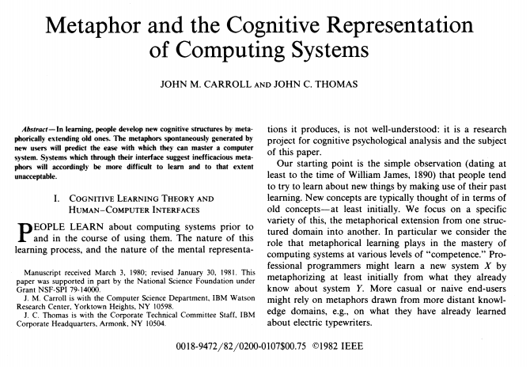
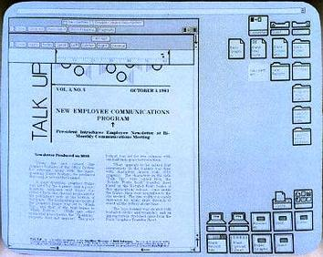
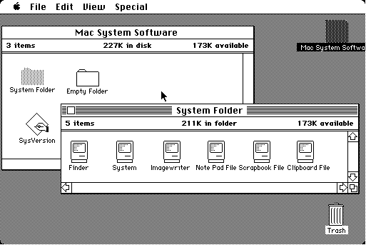
Metaphors
“If people employ metaphors in learning about computing systems, the designers of those systems should anticipate and support likely metaphorical constructions to increase the ease of learning and using the system.” [1]
Desktop Metaphor – Alan Kay at Xerox Parc
[1] Carroll, J. M., & Thomas, J. C. (1982). Metaphor and the cognitive representation of computing systems. IEEE Transactions on systems, man, and cybernetics, 12(2), 107-116.
Mental Models
Notes:
„Wenn Menschen beim Erlernen von Computersystemen Metaphern verwenden, sollten die Entwickler dieser Systeme mögliche metaphorische Konstruktionen vorhersehen und unterstützen, um das Erlernen und die Verwendung des Systems zu erleichtern.“ [1]

Slide 22
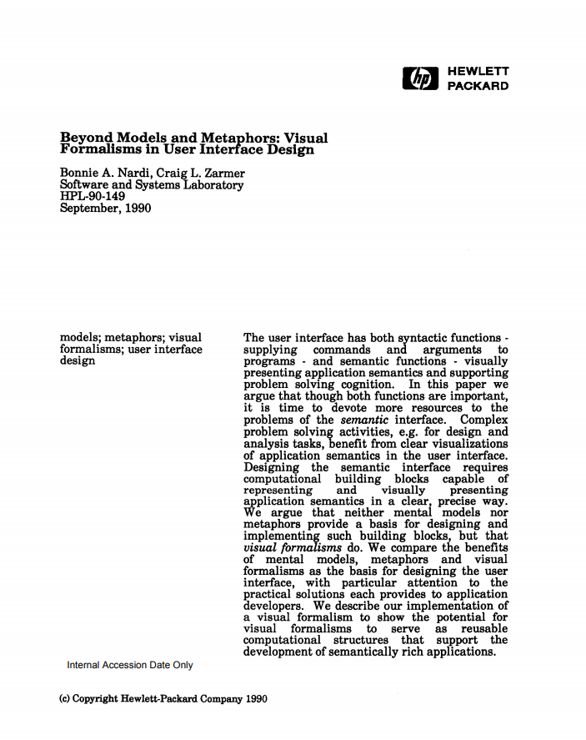
Metaphors can cause problems
“However, metaphors suffer from numerous problems that make them unsuitable for expressing rich application semantics, and inappropriate for the reusable computational structures we seek. […] Metaphors are slippery things, and not just because they contain irrelevancies (do we set the trash can out for garbage pick-up on Friday mornings?) and incompletenesses with respect to the domain they are meant to represent. […] Metaphors tempt us to over-generalize and to forget distinctions that we should be remembering.” [1]
[1] Nardi, B. A., & Zarmer, C. L. (1993). Beyond models and metaphors: Visual formalisms in user interface design. Journal of Visual Languages & Computing, 4(1), 5-33.
Mental Models
Notes:
„Metaphern weisen jedoch zahlreiche Probleme auf, die sie ungeeignet machen, um eine umfassende Anwendungssemantik auszudrücken, und ungeeignet für die wiederverwendbaren Rechenstrukturen, die wir suchen.“ […] Metaphern sind heikle Dinge, und das nicht nur, weil sie Irrelevanz (stellen wir am Freitagmorgen den Mülleimer zur Müllabfuhr bereit?) und Unvollständigkeiten in Bezug auf den Bereich, den sie darstellen sollen, enthalten. […] Metaphern verleiten uns dazu, zu sehr zu verallgemeinern und Unterscheidungen zu vergessen, an die wir uns erinnern sollten.“ [1]

Slide 23
Focus on Technology or User?
Thomas Alva Edison (1880)
Emil Berliner (1887)
Users
Notes:
Der Besucher drehte ohne jede Zeremonie an der Kurbel, und die Maschine sagte: "Guten Morgen. Wie geht es Ihnen? Wie gefällt Ihnen der Phonograph?" Die Maschine sprach also für sich selbst und machte bekannt, dass es der Phonograph war..."
Edisons frühe Phonographen nahmen auf einem dünnen Metallblech, normalerweise Stanniol, auf, das vorübergehend um einen spiralförmig gerillten Zylinder gewickelt war, der auf einer entsprechenden Gewindestange montiert war, die von Gleit- und Gewindelagern getragen wurde. Während der Zylinder gedreht wurde und sich langsam entlang seiner Achse fortbewegte, vibrierte der Luftschall eine Membran, die mit einem Stift verbunden war, der die Folie in die Nut des Zylinders eindrückte, wodurch die Vibrationen als "Berg-und-Tal"-Variationen der Tiefe der Vertiefung aufgezeichnet wurden . Edisons frühe Patente zeigen, dass er wusste, dass Schall als Spirale auf einer Scheibe aufgezeichnet werden konnte, aber Edison konzentrierte seine Bemühungen auf Zylinder, da die Rille an der Außenseite eines rotierenden Zylinders dem Stift in der Rille eine konstante Geschwindigkeit verleiht Edison hielt es für "wissenschaftlich korrekter".
Scheiben können gestempelt werden weniger Speicherplatz benötigt erlauben doppelseitige Aufnahmen
T

Slide 24
Users will win…
Benefits of a disc
Easy mass-production
Less storage space
Easier shipping
Allows double-sided recordings
Better marketing (front and back face)
People can collect them
Emil Berliner (1887)
Users

Slide 25
Why caring about the user-friendly design?
You are surrounded by some misconceptions:
If I (the developer) can use it, everyone can use it
If our non-technical staff can use it, everyone can use it
Good designs/user interfaces are applied common sense
A system is usable if all standards, norms, and style guidelines are met
Users will/must understand what I (the developer) meant
Users will/must adapt
→ That is why a process is required
However, if you do not care about a users and userfriendly design, your product will fail.
Users

Slide 26
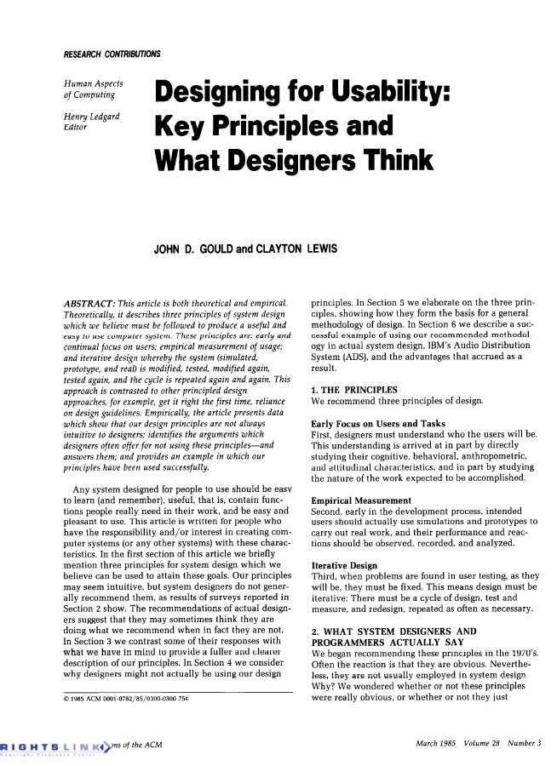
Designing for Users
“Any system designed for people to use should be easy to learn (and remember], useful, that is, contain functions people really need in their work, and be easy and pleasant to use.”
“…three principles of system design which we believe must be followed to produce a useful and easy to use computer system […] “
Early focus on users and tasks
Empirical measurement
Iterative design
Key Principles by Gould and Lewis, 1985
Users

Slide 27
Four Basic Activities of Interaction Design
We must understand computers (limitations, capacities, tools, platforms)
We must understand people (psychological, social aspects, human error)
Interactions between computers vs people are too complex
Identifying needs and establishing requirements for the user experience
Developing alternative designs that meet those requirements
Building interactive versions of the designs
Evaluating what is being built throughout the process and the user experience it offers
Understanding the Context
Protoyping the Designs
Development of Designs
Evaluation of the Designs
Users

Slide 28
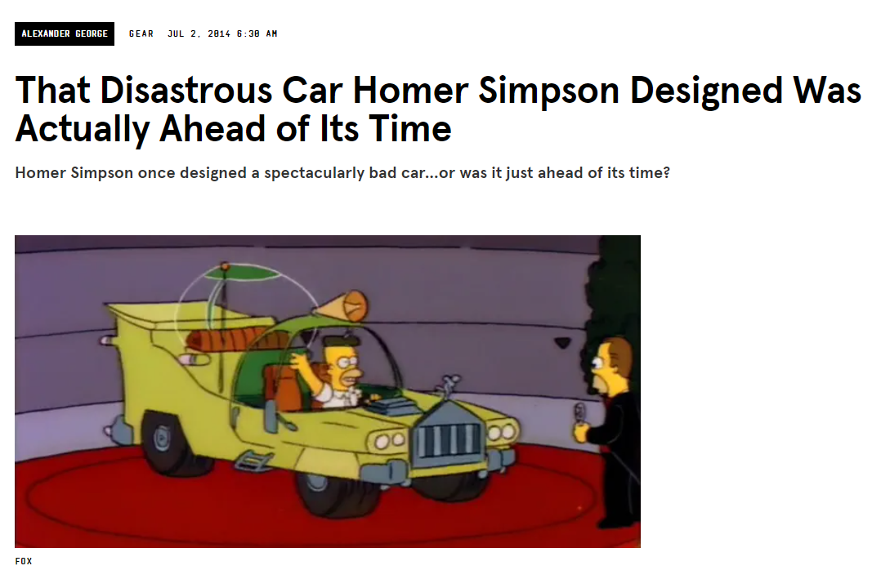
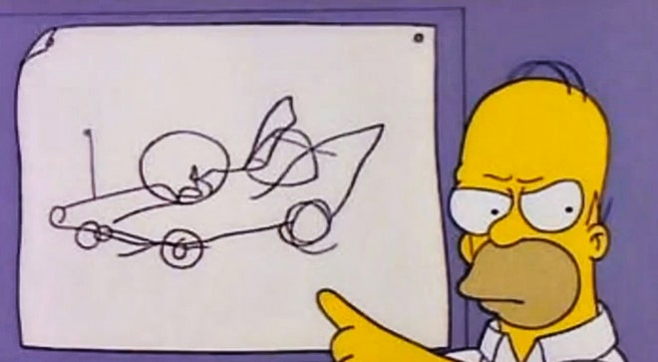
Asking the Users?
Screenshots from https://www.wired.com/2014/07/homer-simpson-car/ Images from FOX STUDIOS
Users
Notes:
INIn der Simpsons- Folge „Oh Bruder, wo bist du?“ wird Homer gebeten, ein Auto für die Firma seines längst verschollenen Bruders zu entwerfen, und scheitert so spektakulär, dass er ihn aus dem Geschäft treibt. Es ist eine brillante Folge, weil sie nicht nur urkomisch ist, sondern auch die Automobilzukunft vorhersagt: Einige der Merkmale, die Homers Auto so schrecklich machten, sind in Fahrzeugen des 21. Jahrhunderts tatsächlich alltäglich.
Eine Kugel auf der Antenne (erinnern Sie sich daran?), damit Sie sie auf einem Parkplatz finden können.
Mehrere Hupen, die alle „La Cucaracha“ ertönen.
Eine separate schallisolierte Kuppel für Kinder, mit optionalen Rückhaltesystemen und Maulkörben.
Ein Motor, der die Leute denken lässt: „Die Welt geht unter.“
, Riesige Getränkehalter für die Limonadenbecher von Kwik-E-Mart.
Schalldichte Innenräume
Bonus: Ein Powell-Mitarbeiter schlägt ein „integriertes Videospiel“ vor. Wir sind uns nicht sicher, ob es in The Homer enthalten ist
Shag-Teppichboden.

Slide 29
User Needs
Functional Needs: Task-oriented needs, specifying what the system should do
Usability Needs: The “ease of use” of a system and encompass factors like affordance, intuition, and efficiency
Emotional Needs: The psychological aspects of interaction, such as enjoyment, trust, and aesthetics
Informational Needs: Users often seek specific information or wish to accomplish certain goals to gain knowledge
Accessibility Needs: The system should be accessible with handicaps or disabilities
Social and Cultural Needs: These needs take into account the social and cultural context in which the system will be used
Norman, D. A. (1988). The Design of Everyday Things. Basic Books.
Rubin, J., & Chisnell, D. (2008). Handbook of Usability Testing: How to Plan, Design, and Conduct Effective Tests. Wiley.
Users

Slide 30
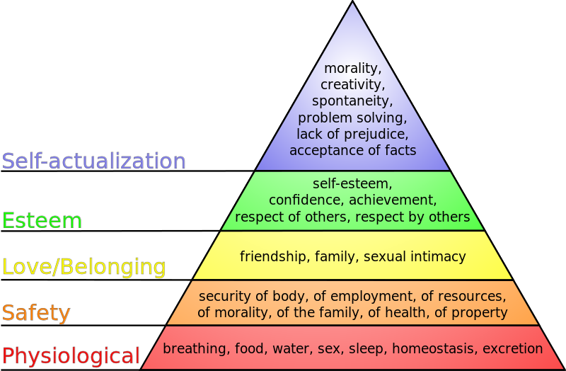
Maslow‘s Hierarchy of Needs
Instagram? Tinder?
TikTok?
Photoshop?
Amazon?
Google?
LinkedIn?
DeviantArt?
J. Finkelstein / CC BY-SA (http://creativecommons.org/licenses/by-sa/3.0/) https://commons.wikimedia.org/wiki/File:Maslow%27s_hierarchy_of_needs.svg
Users

Slide 31
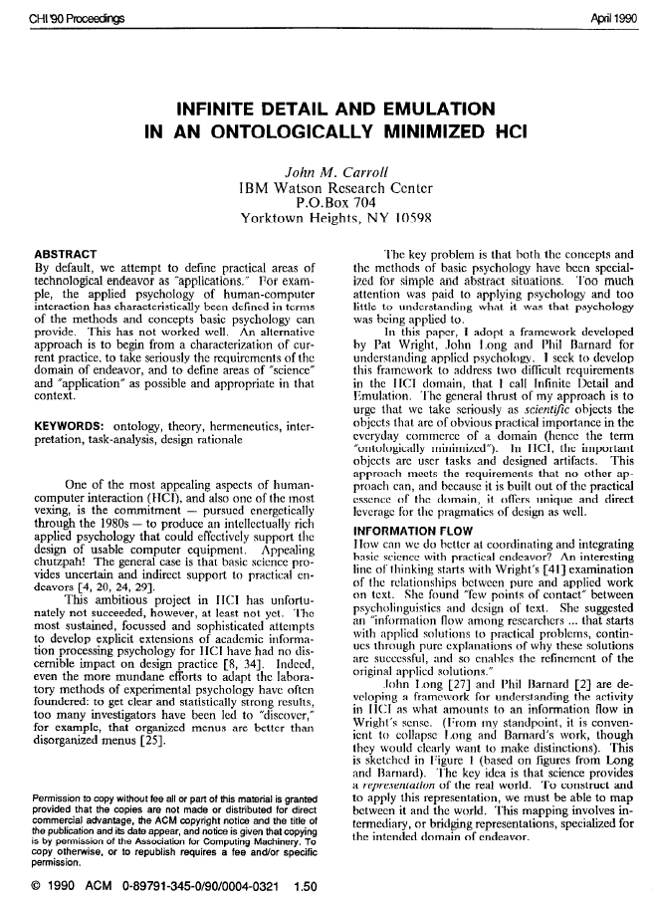
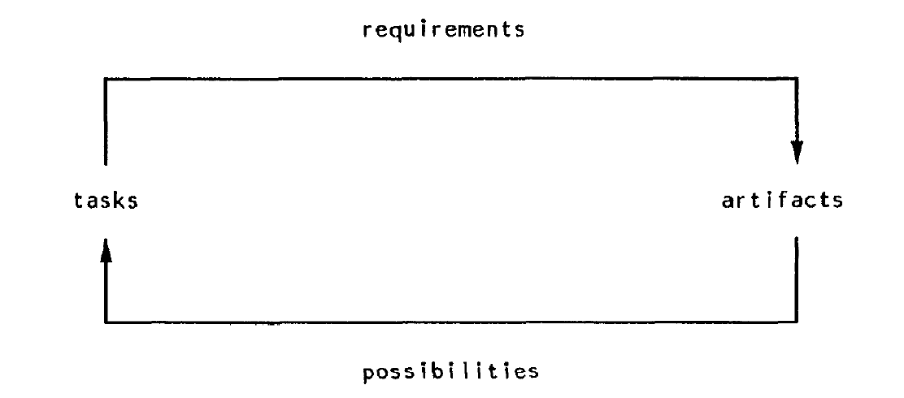
Task-Artifact Cycle
Humans have changing needs and preferences
Technologies are created once to suit these needs
As and when humans use the technologies needs and preferences change
John M. Carroll. 1990. Infinite detail and emulation in an ontologically minimized HCI. In Proceedings of the SIGCHI Conference on Human Factors in Computing Systems (CHI ’90). Association for Computing Machinery, New York, NY, USA, 321–328. DOI:https://doi.org/10.1145/97243.97303
Users

Slide 32
Key Principles
Early Focus on Users and Tasks: First, designers must understand who the users will be. […] studying their cognitive, behavioral, anthropometric, and attitudinal characteristics, and in part by studying the nature of the work expected to be accomplished.
Empirical Measurement: Second, early in the development process, intended users should actually use simulations and prototypes to carry out real work, and their performance and reactions should be observed, recorded, and analyzed.
Iterative Design: Third, when problems are found in user testing, as they will be, they must be fixed. This means design must be iterative: There must be a cycle of design, test and measure, and redesign, repeated as often as necessary.
Key Principles by Gould and Lewis, 1985
Users

Slide 33
Summary
Humans have their own perception and a basic set of needs
Customization is a good way for personalized experiences, however, asking the user is not sufficient to reveal the user needs, goals, and economic solutions
Maslow states a hierarchy of needs (physiological needs, safety needs, love needs, esteem needs, need for self-actualization)
The task-artifact cycle describes how humans use the technologies changes needs
In real world scenarios it is likely that user needs are conflicting
Understanding user needs is essential, but this is not sufficient to create a successful product
User Needs

Slide 34
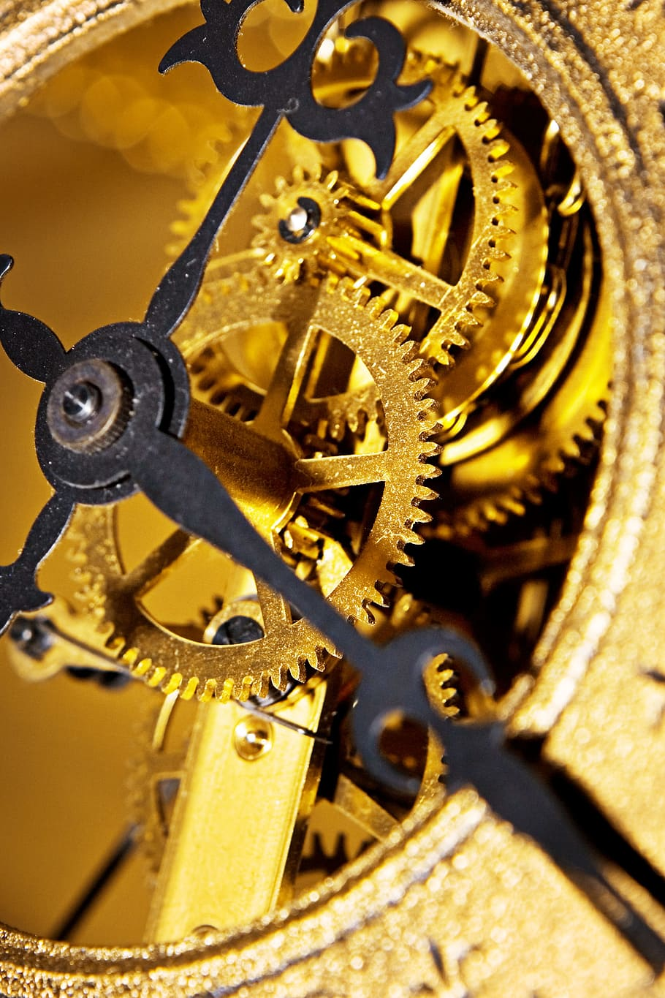
Mental Models
Human-Computer Interaction Lecture
The following content is licensed under a Creative Commons Attribution 4.0 International license (CC BY-SA 4.0)

Slide 35
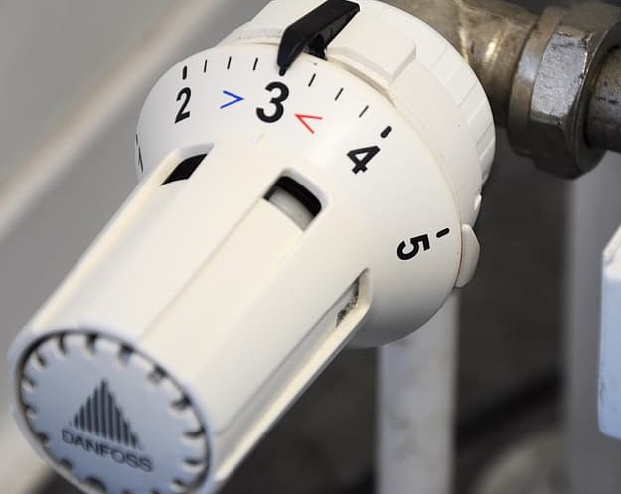

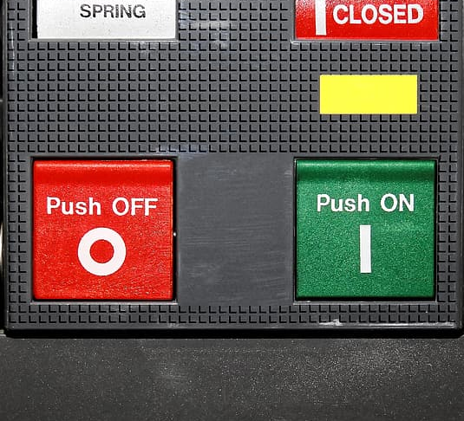
The Mental Model of Room Heating
You came back and it is only 15°C in your room. You want a room temperature of 21°C. What do you do?
You put the thermostat to 21°C and wait
You put the thermostat to max (=35°) and switch it back to 21° once it is warm?
What different mental models do people have who chose strategy 1 or 2?
William Hudson. Mental Models, Metaphor and Design (2003).UK UPA and HCI2003 http://www.syntagm.co.uk/design/articles/mmmad.pdf
Mental Models

Slide 36
How the user reasons and understands
Kenneth Craik (1943): “the mind constructs ‘small-scale models’ of reality that it uses to anticipate events, to reason, and to underlie explanation”
Users acquire mental models by
Interaction / observation
Explanation
Two types
Functional – users know what to do, but not why
Structural – users know why to do something
William Hudson. Mental Models, Metaphor and Design (2003).UK UPA and HCI2003 http://www.syntagm.co.uk/design/articles/mmmad.pdf
Mental Models

Slide 37
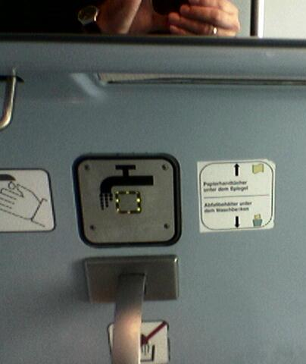
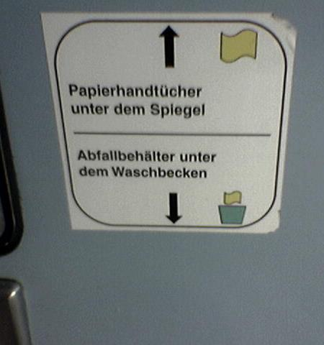
Learning from Failures
Signs and explanations are an indicator for a potential design problem
Images from Albrecht Schmidt
Mental Models

Slide 38
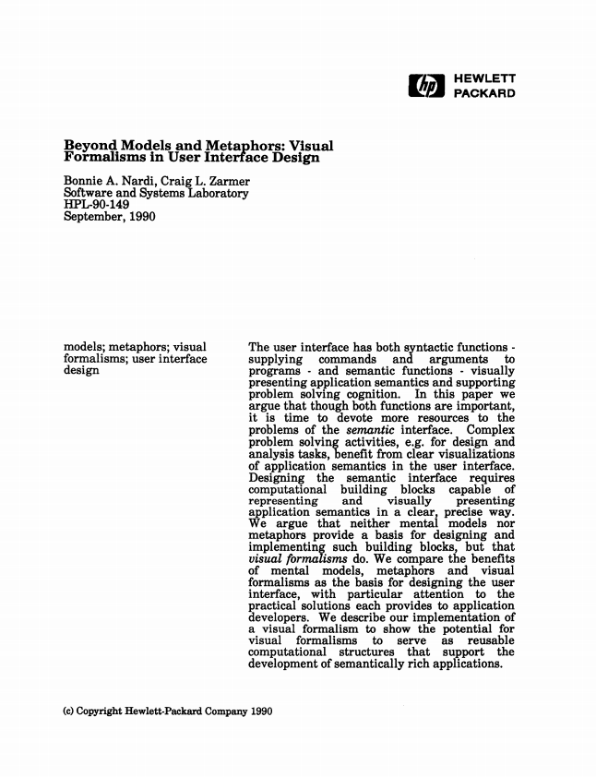
What is a Mental Model?
„In human-computer interaction research, the notion of “mental models” has come to be a very general catch-phrase for anything having to do with end users' knowledge of an application (van der Veer, 1990). There is a feeling that if we could "capture" mental models, then we could build good interfaces […] But many […] are much less convinced of the alleged benefits of mental models and of our ability to use them for reasoning or other complex cognition. […] Researchers who have investigated mental images have been struck by how incomplete and inflexible they are…” [1]
[1] Nardi, B. A., & Zarmer, C. L. (1993). Beyond models and metaphors: Visual formalisms in user interface design. Journal of Visual Languages & Computing, 4(1), 5-33.
Mental Models
Notes:
„In der Mensch-Computer-Interaktionsforschung ist der Begriff „mentaler Modelle“ zu einem sehr allgemeinen Schlagwort für alles geworden, was mit dem Wissen des Endbenutzers über eine Anwendung zu tun hat (van der Veer, 1990). Man hat das Gefühl, wenn wir mentale Modelle "einfangen" könnten, dann könnten wir gute Interfaces bauen […] Aber viele […] sind viel weniger überzeugt von den angeblichen Vorteilen mentaler Modelle und von unserer Fähigkeit, sie zum Denken oder für andere Zwecke zu verwenden komplexe Erkenntnis. […] Forscher, die mentale Bilder untersucht haben, sind beeindruckt, wie unvollständig und unflexibel sie sind…“

Slide 39
Mental Model by Jakob Nielson
A mental model is what the user believes about the system at hand
“A mental model is based on belief, not facts: that is, it's a model of what users know (or think they know) about a system such as your website. Hopefully, users' thinking is closely related to reality because they base their predictions about the system on their mental models and thus plan their future actions based on how that model predicts the appropriate course.”
“It's a prime goal for designers to make the user interface communicate the system's basic nature well enough that users form reasonably accurate (and thus useful) mental models.”
Jakob Nielsen. Mental Models on October 17, 2010 https://www.nngroup.com/articles/mental-models/
Mental Models

Slide 40
Three Mental Models
Conceptual Model = Designer Model: “A conceptual model is a high-level description of how a system is organized and operates.” [1]
is deliberately designed
it allows to user to understand and operate the UI
it draws on prior knowledge of the user
is communicated through the interface and interaction design
Mental Model = User Model = User’s Conceptual Model
System Model = Programmer’s Conceptual Model = Programmer’s Model = Implementation Model
[1] Johnson, J., & Henderson, A. (2002). Conceptual models: begin by designing what to design. interactions, 9(1), 25-32.
Mental Models

Slide 41
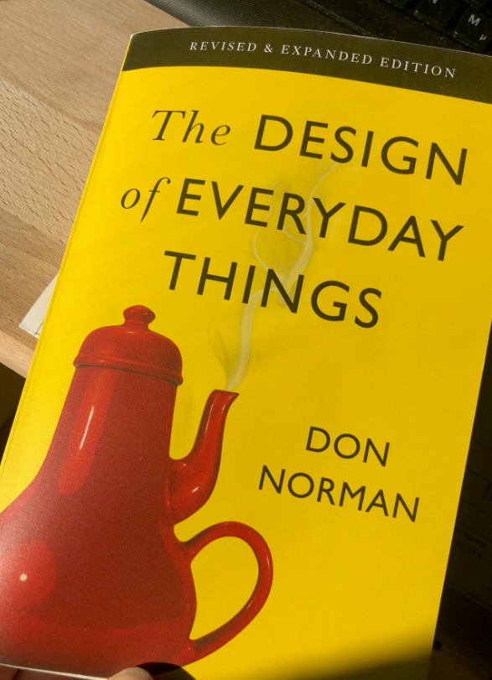
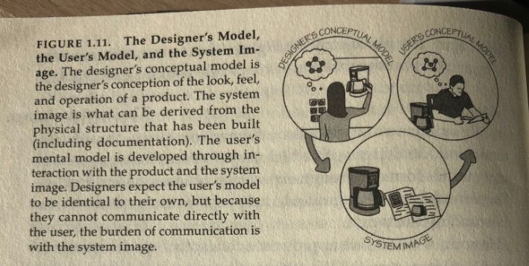
Conceptual Model
The model the designers wants the user to have
The conceptual model
is deliberately designed
allows to user to understand and operate the UI
draws on prior knowledge of the user
is communicated through the interface and interaction design
“A conceptual model is a high-level description of how a system is organized and operates.” [1]
[1] Johnson, J., & Henderson, A. (2002). Conceptual models: begin by designing what to design. interactions, 9(1), 25-32.
[2] Norman, D. A. (2013). The design of everyday things: Revised and expanded edition. New York: Doubleday.
Mental Models

Slide 42
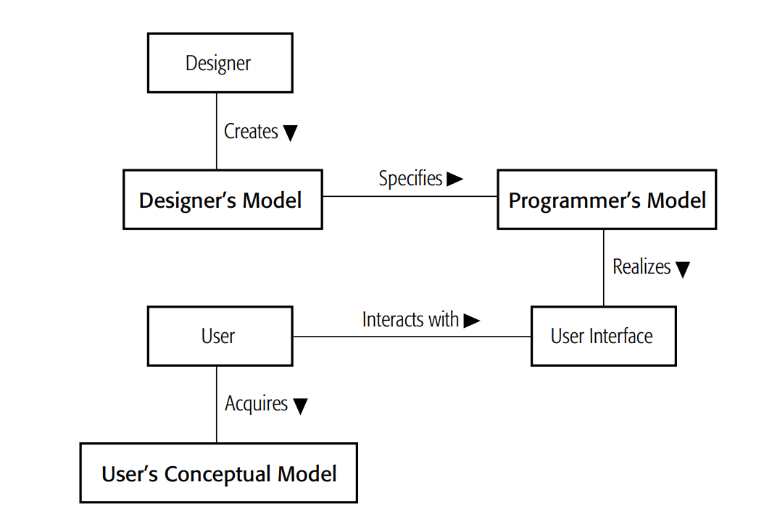
Mental Models for Designers, Programmers, Users
Mental Models
Hudson, W. (2001). Toward unified models in user-centered and object-oriented design. Object Modeling and User Interface Design: Designing Interactive Systems, 313-362.
Mental Models

Slide 43
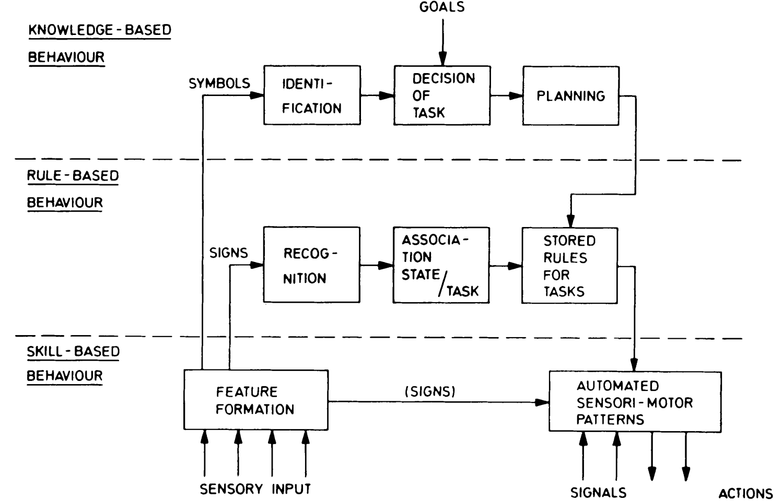
Three Levels of Performance
Jens Rasmussen: Skills, rules, and knowledge; signals, signs, and symbols, and other distinctions in human performance models. IEEE Trans. Systems, Man, Cybernetics, SMC-13 (1983), pp. 257–266
Mental Models

Slide 44

Human-Centered Design (ISO 9241-210)
Human-Computer Interaction Lecture
Image from: https://pxhere.com/de/photo/1451435
The following content is licensed under a Creative Commons Attribution 4.0 International license (CC BY-SA 4.0)

Slide 45


The Human, the Person, and the User
Image from https://pixabay.com/de/photos/frau-alte-faltig-alte-frau-portr%c3%a4t-1795054/
Human-Centered Design (ISO 9241-210)

Slide 46
User-Centered Design or Human-Centered Design ?
Human-centered is the more modern term
The terms user-centered design and human-centered are used interchangeable.
Human-centered focus on the person as a whole and not only the role of the human as a user
The ISO 9241-210 Human-centered design for interactive systems addresses the rationale for adopting human-centered design
Enforces a separation between interaction design and technical realization
Human-Centered Design (ISO 9241-210)

Slide 47


ISO Standards and DIN Norms
Images from: https://pixabay.com/de/photos/industrie-bolzen-verschluss-3075420/ https://pixabay.com/de/photos/schraube-schraubenmutter-metall-2117600/
Human-Centered Design (ISO 9241-210)

Slide 48
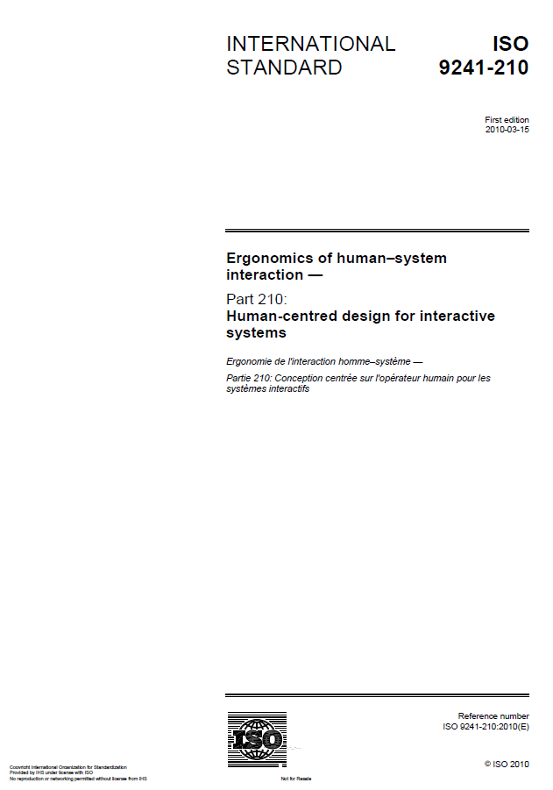
ISO 9241 - Ergonomics of Human–System Interaction
100 series: Software ergonomics
200 series: Human system interaction processes
300 series: Displays and display related hardware
400 series: Physical input devices - ergonomics principles
500 series: Workplace ergonomics
600 series: Environment ergonomics
700 series: Application domains - Control rooms
900 series: Tactile and haptic interactions
ISO 9241 Ergonomics of human–system interaction
Human-Centered Design (ISO 9241-210)

Slide 49
Part 210: Human-Centered Design for Interactive Systems
Table of Contents
Scope
Terms and definitions
Rationale for adopting human-centered design
Principles of human-centered design
Planning human-centered design
Human-centered design activities
Sustainability and human-centered design
Conformance
ISO 9241 Ergonomics of human–system interaction
Human-Centered Design (ISO 9241-210)

Slide 50
3. Rationale for adopting human-centered design
“Using a human-centered approach to design and development has substantial economic and social benefits for users, employers and suppliers. Highly usable systems and products tend to be more successful both technically and commercially.“
“Systems designed using human-centred methods improve quality, for example, by:
a) increasing the productivity of users and the operational efficiency of organizations;
b) being easier to understand and use, thus reducing training […] costs;
c) increasing usability for people with a wider range of capabilities […]
d) improving user experience;
e) reducing discomfort and stress;
f) providing a competitive advantage […]
g) contributing towards sustainability objectives.”
ISO 9241-210:2019(en) Human-centered design for interactive systems
Human-Centered Design (ISO 9241-210)

Slide 51
4. Principles of human-centered design
a) the design is based upon an explicit understanding of users, tasks and environments […]
b) users are involved throughout design and development […]
c) the design is driven and refined by user-centered evaluation […]
d) the process is iterative […]
e) the design addresses the whole user experience […]
f) the design team includes multidisciplinary skills and perspectives”
ISO 9241-210:2019(en) Human-centered design for interactive systems
Human-Centered Design (ISO 9241-210)

Slide 52
6. Human-centered design activities
“a) understanding and specifying the context of use”
What are the tasks or objectives associated with the design?
“b) specifying the user requirements”
What expectations or requirements must the design accommodate?
“c) producing design solutions”
prototyping, rendering, mockup building, implementation
“d) evaluating the design”
conduct initial evaluations, usability testing, and ergonomic assessment
ISO 9241-210:2019(en) Human-centered design for interactive systems
Human-Centered Design (ISO 9241-210)

Slide 53
The Human-Centered Design
Plan the human-centered design process
Design solution meets the user requirements
Understand and specify the context of use
iterate where appropriate
Evaluate designs against requirements
Specify the user and organizational requirements
Product design solutions to meet the user requirements
ISO 9241-210:2019(en) Human-centered design for interactive systems
Human-Centered Design (ISO 9241-210)

Slide 54
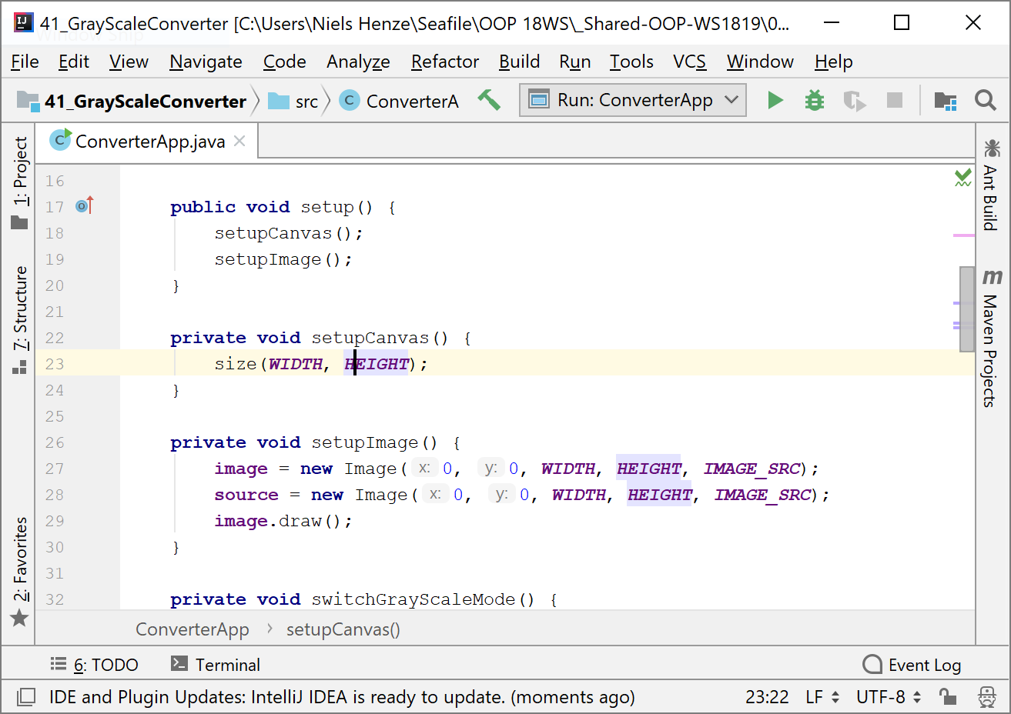
The Human-Centered Design (slow cycle)
Plan the human-centered design process
Design solution meets the user requirements
Understand and specify the context of use
iterate where appropriate
Evaluate designs against requirements
Specify the user and organizational requirements
very slow
Product design solutions to meet the user requirements
ISO 9241-210:2019(en) Human-centered design for interactive systems
Human-Centered Design (ISO 9241-210)

Slide 55
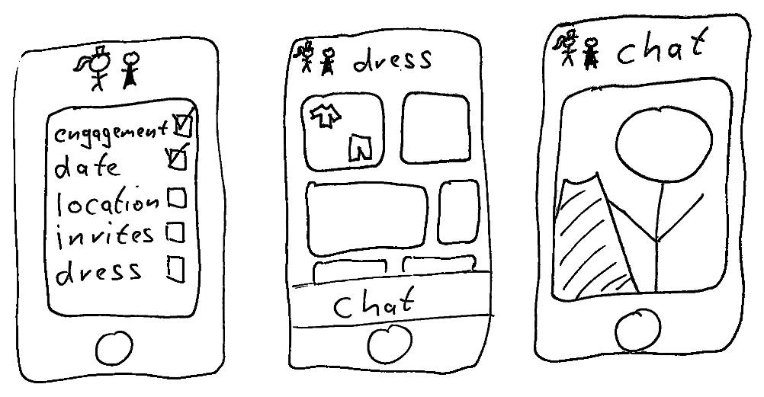
The Human-Centered Design (fast cycle)
Plan the human-centered design process
Design solution meets the user requirements
Understand and specify the context of use
iterate where appropriate
Evaluate designs against requirements
Specify the user and organizational requirements
very fast
Product design solutions to meet the user requirements
ISO 9241-210:2019(en) Human-centered design for interactive systems
Human-Centered Design (ISO 9241-210)

Slide 56
The Typical Separation
1st – Concept Development and Interaction Design (quick iterations)
Application and interaction concept
Interaction design
Prototypes to evaluate the concept and interaction design
2nd – Technical Realization (slow iterations)
Technical analysis
Technical specification (e.g. architecture, platform)
Implementation
Evaluation and Quality management
Human-Centered Design (ISO 9241-210)

Slide 57
Waterfall vs Human-Centered Design Process
Will the Human-Centered design process work well with the waterfall model?
1 Requirement
2 Design
3 Coding
5 Verification
4 Intergration
6 Maintenance
Human-Centered Design (ISO 9241-210)

Slide 58
v

Slide 59
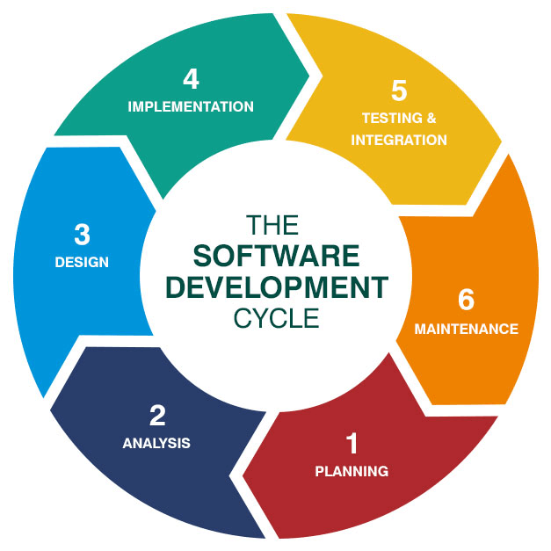
Agile/SDLC vs Human-Centered Design Process
Can it fit with Agile Development and Software Development Life Cycles (SDLC)?
Customers = Users
Agile developers believe in their design
no research
no requirement analysis (only the Product Backlog)
No Master in HCD
Image from https://saigontechnology.com/blog/6-stages-for-software-development-procedure-you-need-to-know
Human-Centered Design (ISO 9241-210)

Slide 60
Problems of Human-Centered Design
Users may
expect disadvantages (e.g., being replaced by software)
have conflicting views (e.g., Mike likes dark surfaces, Daisy likes pink)
be wrong (e.g., “I am quicker with my old mouse”)
be resistant to change (e.g., “I do that every time in this way”)
In a “business environment” you are expected to create a system with regards to the goals specified by stakeholders and this is unfortunately NOT necessarily the system users would like to have
More iterations are required, difficult to predict their outcomes, and the process lasts longer if the requirements are not satisfied (stakeholders hate that)
Difficult to find a trade-off between the goals of customer or stakeholders, the users, and the project developers (typically you)
Human-Centered Design (ISO 9241-210)

Slide 61
Working in Multidisciplinary Teams
Many people are involved in the process of designing and implementing an interactive product
Different background (e.g. design, business, CS, marketing, administration)
Different and conflicting high and low level objectives
Different views and opinions
Communication can be very difficult!
To be able to work in a team is essential!
Team work is a skill that can be learned
Competence of this course
Working remote vs onsite?
Human-Centered Design (ISO 9241-210)

Slide 62

Know your Users and their Tasks
Human-Computer Interaction Lecture
Image from: https://pxhere.com/de/photo/1451191
The following content is licensed under a Creative Commons Attribution 4.0 International license (CC BY-SA 4.0)

Slide 63
Who is the User? We need respect for…
Diversity of the individual
Each of you has inherently different requirements for their interaction with computers
Demographics (gender, age, nationality, culture):
goals, motivation, personality, …
education, cultural background, training, …
age, gender, physical abilities, …
Training and previous knowledge:
Novice users
Knowledgeable intermittent users
Expert frequent users
Users who think that they know how it works, but they didn’t
Know your Users and their Tasks

Slide 64
Where is the Average User?
In empirical research, we always assume an average user
However, there is no average user, and any number can lie!
Number game…
Creating a software that is appropriate for a very specific target group (e.g., 0,1% of the population) may still find a large user base, e.g., in Europe and the US this may be more than half a million people
Designing for 90% of the users will leave alone in Germany 8 million users out
Therefore, it is often better to focus on certain target groups. For a requirement analysis including target groups, HCI researchers of use Personas
Typical, representative users with individual needs – but not the average
Know your Users and their Tasks

Slide 65
Personas
Personas are fictional yet realistic representations of target user groups encapsulating their needs, goals, and pain points.
They allow interaction designers and developers to create more targeted and effective solutions as they often assume (implicitly) that users have the same goals and abilities.
For example, if a persona representing an elderly user highlights the need for simplified navigation, the design team can prioritize this feature, thereby making the product more accessible to that demographic.
Personas can serve as common reference that can be easily communicated across different departments in an organization (from design to customer support).
Employing personas minimizes the risk of developing features or products that do not resonate with the end-users.
If not well-crafted, they can lead to stereotypes and may not represent the user base accurately.
Know your Users and their Tasks

Slide 66
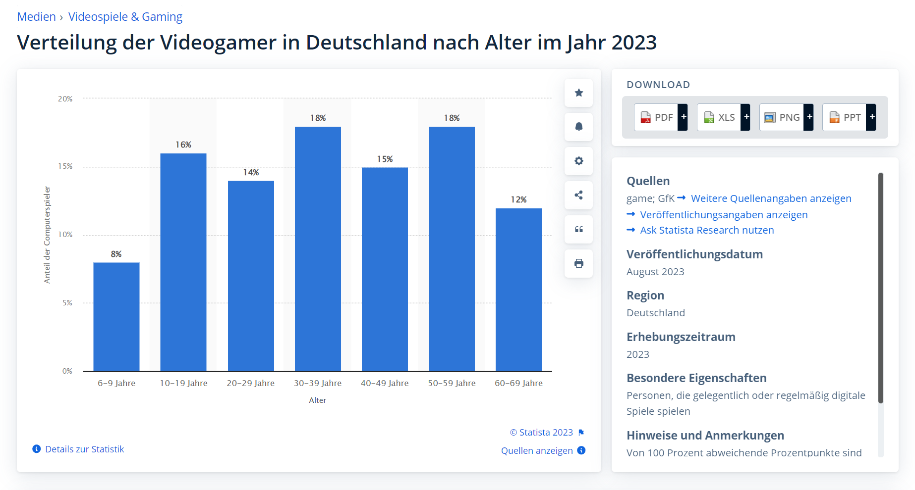
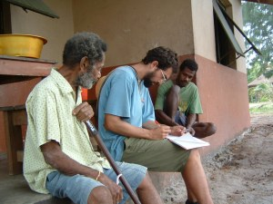
Ethnography?
Example: https://de.statista.com/
Image from https://mariamz.wordpress.com/2011/05/10/online-ethnography-for-social-media-research-and-reporting/
© Statista 2023
Know your Users and their Tasks

Slide 67
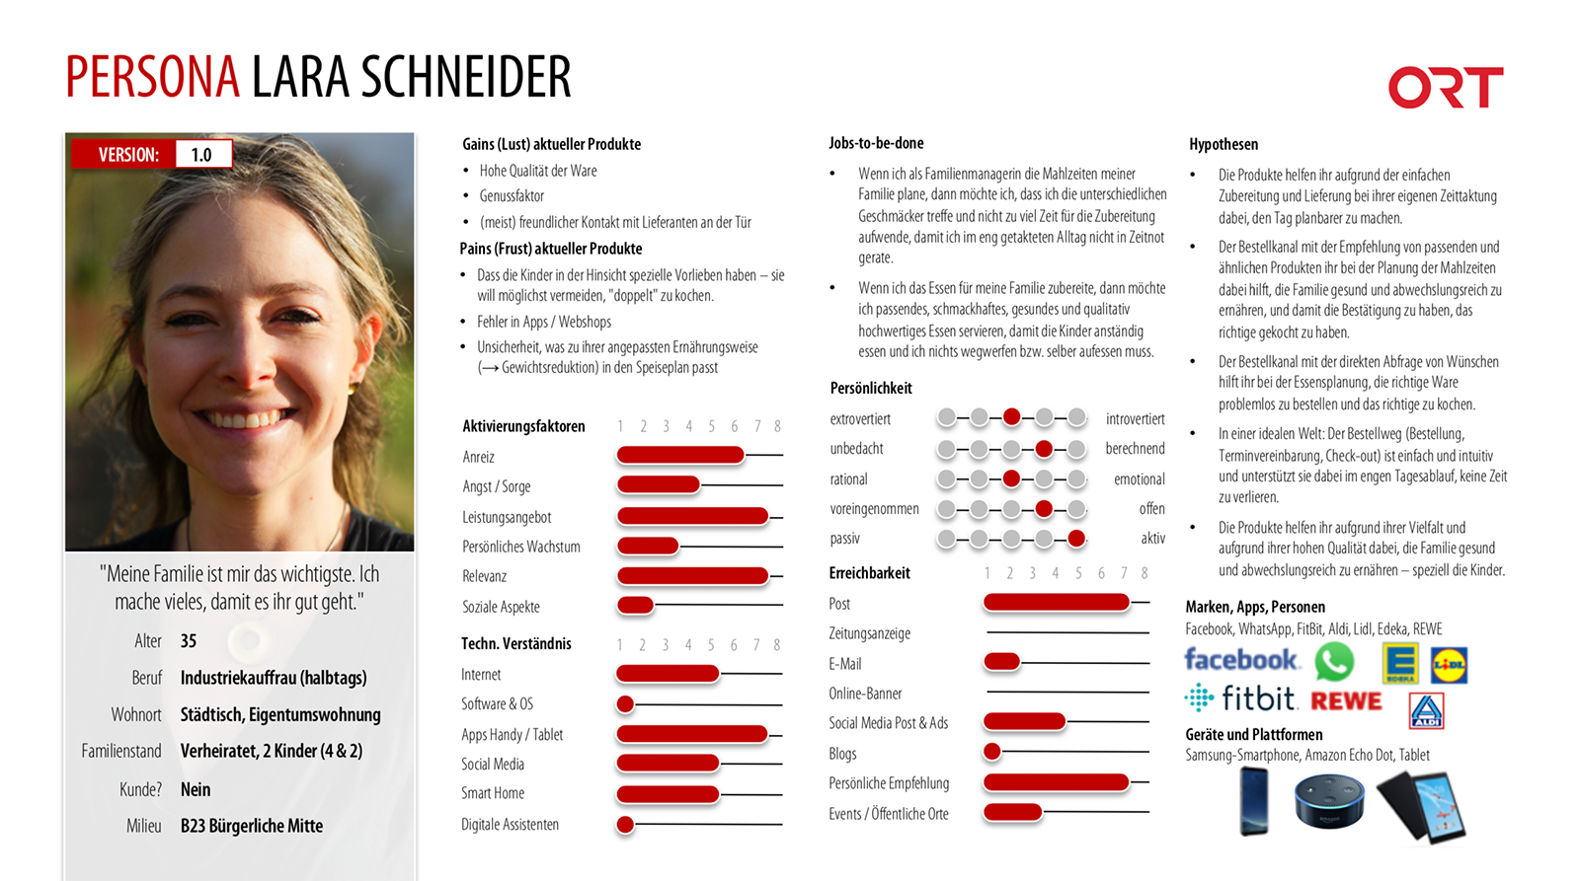
Image from https://www.ort-online.net/de/news/wie-wir-personas-verwenden.html ORT Medienverbund GmbH, veröffentlich am 10.04.2018
Know your Users and their Tasks

Slide 68
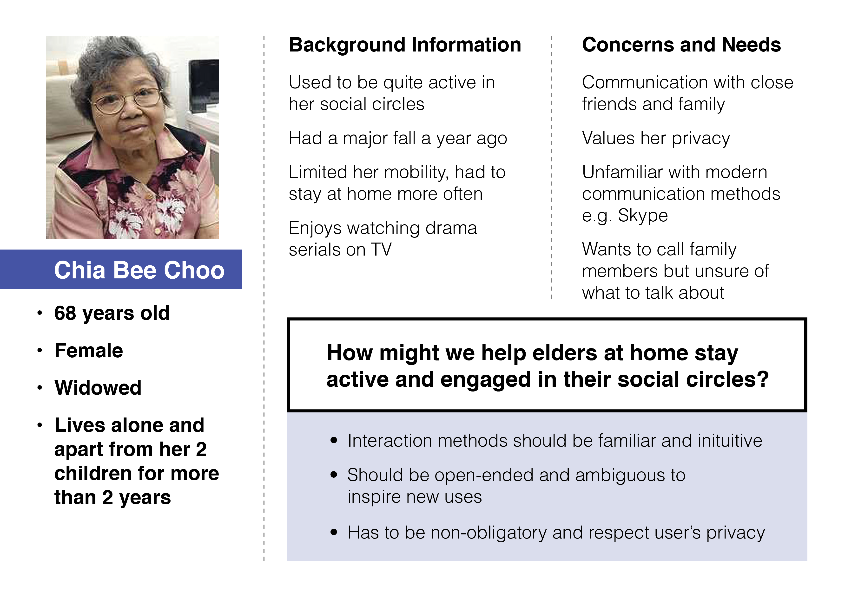
CHI 2015 Student Design Competition, Loh Zhide, Lim Zhiying, insight Designing intuitive interactions for the elderlyImage from https://edmundzhang.work/Designing-intuitive-interactions-for-the-elderly
Know your Users and their Tasks

Slide 69
How to create personas
Data Collection: Gather qualitative and quantitative data about the target audience through interviews, surveys, log data, or ethnography
Analysis and Segmentation: Analyze the collected data, cluster, and segment it to identify common characteristics or behaviors.
Drafting Personas: Create one or more personas based on the segmentation, each with a name, image, and detailed description.
Validation: Validate the personas with real users or stakeholders to ensure their relevance and accuracy.
Implementation: Integrate the validated personas into the development process as a reference or template for design decisions.
Know your Users and their Tasks

Slide 70
Personas for Car Design
Personas and goals
Alesandro (fast and fun)
Marge (safe, comfortable)
Dale (big loads, reliable)
Homer (automated driving, custom horn sounds, separate soundproof dome for kids, cup holders for soda cups from Kwik, easy entry)
Results in designs that differ, e.g.
Porsche
City SUV
Pick-up
Homer‘s custom car
Screenshots from https://www.wired.com/2014/07/homer-simpson-car/ Images from FOX STUDIOS
Know your Users and their Tasks

Slide 71
User-Needs vs Task Profiles
Find out what the user is trying to do!
the goal
what their needs are
resulting tasks
Supported tasks should be determined before the design starts
Functionality should only be added if identified to help solving tasks
Temptation: If additional functionality is cheap to include it is often done – this can seriously compromise the user interface concept (and potentially the whole software system)!
Frequency of tasks related to user profiles (personas)
Know your Users and their Tasks

Slide 72
Task Analysis
The process of analyzing the way people perform their jobs
the things they do, the things they act on, and the things they need to know
There are three different approaches to task analysis, which overlap but which lay their emphases on slightly different areas:
Task decomposition which looks at the way a task is split into subtasks, and theorder in which these are performed.
Knowledge-based techniques which look at what users need to know about the objects and actions involved in a task, and how that knowledge is organized.
Entity–relation-based analysis which is an object-based approach where the emphasis is on identifying the actors and objects, the relationships between them and the actions they perform.
Dix, A. J., Finlay, J., Abowd, G. D., & Beale, R. (2003). Human-computer interaction. Pearson Education https://hcibook.com/.
Know your Users and their Tasks

Slide 73
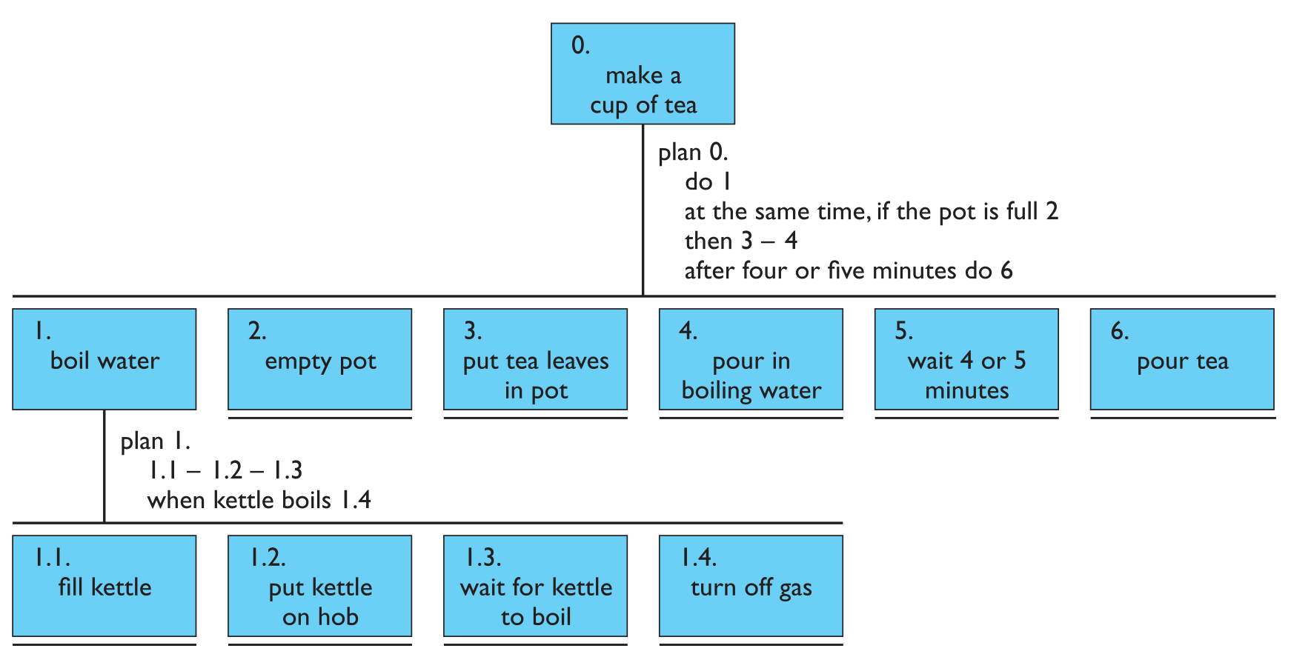
Task Decomposition
The top-level tasks of “make a cup of tea”:
0. make a cup of tea
1. boil water
2. empty pot
3. put thea leaves in pot
4. pour in boiling water
5. wait 4 or 5 minutes
6. pour tea
Plans help us to define conditions and sequences
Dix, A. J., Finlay, J., Abowd, G. D., & Beale, R. (2003). Human-computer interaction. Pearson Education https://hcibook.com/.
Know your Users and their Tasks

Slide 74

Task Decomposition
The top-level tasks of “making lots of cups of tea”:
0. make a cup of tea
1. boil water
2. empty pot
3. make pot
4. wait 4 or 5 minutes
5. pour tea
Dix, A. J., Finlay, J., Abowd, G. D., & Beale, R. (2003). Human-computer interaction. Pearson Education https://hcibook.com/.
Know your Users and their Tasks

Slide 75

Hierarchical Task Analysis
Adding Artifacts
William Hudson. HCI and the Web: a Tale of Two Tutorials: a Cognitive Approach to Interactive System Design and Interaction Design Meets Agility. ACM interactions 12(1), 2005, 49-51
Know your Users and their Tasks

Slide 76
Knowledge Based-Analysis
Listing all the objects and their functions involved in the task, and then building taxonomies with logical operators:
kitchenitem AND
/ shape XOR
| dished: (mixing bowl, casserole, saucepan, soup bowl, glass)
| flat: (plate, chopping board, frying pan)
/ function OR
preparation: {mixing bowl, plate, chopping board}
cooking: {frying pan, casserole, saucepan}
dining XOR
| forfood: plate, soup bowl, casserole
| fordrink: glass
→ kitchenitem/shape(flat)/function{preparation,dining(forfood)}/
Dix, A. J., Finlay, J., Abowd, G. D., & Beale, R. (2003). Human-computer interaction. Pearson Education https://hcibook.com/.
Know your Users and their Tasks

Slide 77

Entity–Relation-Based Analysis
Associated with data-base designs and more recently object-oriented programming
Not for tasks but for entities with an object-based approach
Can include physical objects, the actions performed on them and the people who perform them
Dix, A. J., Finlay, J., Abowd, G. D., & Beale, R. (2003). Human-computer interaction. Pearson Education https://hcibook.com/.
Know your Users and their Tasks

Slide 78

Respecting the Users‘ Diversity
Example: flight booking webpage
Travel agent booking many flights a day – everyday
A teacher organizing a field trip (once a year) and making bookings for a large group
A businessperson changing bookings while travelling
A family looking for a package holiday
Basic concepts to structure the problem
Usage profiles
Task profiles
Know your Users and their Tasks

Slide 79
Task Frequency Analysis
Another Example: Will one website fit all the users?
Task Frequency Analysis can be used in conjunction with Personas to provide a more comprehensive understanding of user behavior and needs.
Used to identify and evaluate how often specific tasks are performed by users or systems.
Prioritize features and functionalities based on their frequency of use.
Task | Group reservation | Change of itinerary | Booking child care | Sales agent
Persona
Sales agent | 0.2 | 0.1 | 0.1 | 0
Manager | 0 | 0 | 0 | 0.4
Family | 0.05 | 0.05 | 0.3 | 0
Business traveler | 0.01 | 0.2 | 0.01 | 0
Kirwan, B. and Ainsworth, L. (Eds.) (1992). A guide to task analysis. Taylor and Francis.
Know your Users and their Tasks

Slide 80
The User Journey
A visualization or narrative that describes the various stages and touchpoints a user goes through while interacting with a product, system, or service.
Map out the user's experience from initial contact through the interaction process of engagement, usage, and long-term relationship.
User Journeys can be particularly useful when used in conjunction with other UX tools like Personas or Task Frequency Analysis.
While Personas give you a sense of who your users are, and Task Frequency Analysis tells you what they do most often, the User Journey helps you understand the actions.
Be careful: It may oversimplify complex interactions or miss out on edge cases.
Designers and developers can identify potential pain points, opportunities for improvements, and areas where the user might experience delight, thereby creating a more user-centric product.
Know your Users and their Tasks

Slide 81

User Journey
https://www.nngroup.com/articles/user-journeys-vs-user-flows/
Know your Users and their Tasks

Slide 82

User Journey Map
Persona
User Journey
Critical points
https://www.nngroup.com/articles/user-journeys-vs-user-flows/
Know your Users and their Tasks

Slide 83

User Flows / Flow Diagrams / Flow Charts / Wireframes
A user flow is a set of granular interactions that describe the typical or ideal set of steps on needed to accomplish a common task performed with a product.
https://www.nngroup.com/articles/user-journeys-vs-user-flows/
Know your Users and their Tasks

Slide 84

Combining User Journeys and User Flows
https://www.nngroup.com/articles/user-journeys-vs-user-flows/
Know your Users and their Tasks

Slide 85
Stakeholder Analysis
Understanding stakeholders is key to many of the approaches to requirements capture, since in an organizational setting it is not simply the end-user who is affected by the introduction of new technology.
Example: An international airline is considering introducing a new booking system for use by associated travel agents to sell flights directly to the public. The stakeholders can be classified as follows:
Primary stakeholders: travel agency staff, airline booking staff
Secondary stakeholders: customers, airline management
Tertiary stakeholders: competitors, civil aviation authorities, customers’ traveling companions, airline shareholders
Facilitating stakeholders: design team, IT department staff
Dix, A. J., Finlay, J., Abowd, G. D., & Beale, R. (2003). Human-computer interaction. Pearson Education https://hcibook.com/.
Know your Users and their Tasks

Slide 86
CUSTOM Stakeholder Analysis
A socio-technical methodology based on the User Skills and Task Match (USTM) approach and designed to be practical to use in small organizations
All stakeholders are considered, not just the end-users, and its questions investigate:
What does the stakeholder have to achieve and how is success measured?
What are the stakeholder’s sources of job satisfaction / dissatisfaction and stress?
What knowledge and skills does the stakeholder have?
What is the stakeholder’s attitude toward work, design, and technology?
Are there any work-group attributes that will affect the acceptability to the stakeholder?
What are the characteristics of the stakeholder’s task?
Frequency, fragmentation, and choice of actions
Does the stakeholder have any issues relating to responsibility, security or privacy?
What are the physical conditions in which the stakeholder is working?
Know your Users and their Tasks

Slide 87
Stakeholder Analysis
Identify stakeholders, e.g.
Customers, team members, investors, management, suppliers, public, press, shareholders, government, community, sales partners, family, …
Categorize stakeholders
Interest in the project?
Influence on the team and project (Power)
Attitude (positive / negative)
Reasons for attitude
Force-field analysis
Place people in the diagram
Revisit throughout the project
High
Keep Satisfied
Engage Closely
Power
Monitor (minimum effort)
Keep Informed
Low
Low
Interest
High
Adapted with permission from Mendelow, A.L. (1981). 'Environmental Scanning - The Impact of the Stakeholder Concept,' ICIS 1981 Proceedings, 20.
Know your Users and their Tasks

Slide 88
Summary
User, Task, and Stakeholder Analysis help you to understand the roles and goals of the people involved in the development of your system.
They help your in understanding and balancing the needs and expectations of all parties involved.
They also help you to work in a multidisciplinary team
These techniques are often used in conjunction with Human-Centered Design (and Agile Development) using an iterative development cycle based on user feedback.
Know your Users and their Tasks

Slide 89
References (1)
B. Shneiderman (2002). Leonardo's Laptop: Human Needs and the New Computing Technologies. http://mitpress.mit.edu/main/feature/leonardoslaptop/index.html
B. Buxton (2010). Sketching user experiences: getting the design right and the right design. Morgan Kaufmann.
Harry Brignull (2006). Bad usability is like a leaky pipe. https://90percentofeverything.com/2006/11/13/bad-usability-is-like-a-leaky-pipe/
Paula Zuccotti (2015): Every Thing We Touch: A 24-hour Inventory of Our Lives. Penguin UK. https://www.theguardian.com/society/2015/nov/06/its-the-little-things-everything-i-touched-today
Nina Runge, Johannes Schöning, Rainer Malaka, and Alberto Frigo (2016): You Can Touch This: Eleven Years and 258218 Images of Objects. In Proceedings of the 2016 CHI Conference Extended Abstracts on Human Factors in Computing Systems (CHI EA '16). ACM, New York, NY, USA, 541-552. DOI: https://doi.org/10.1145/2851581.2892575
James J. Gibson (1977): The theory of affordances. Hilldale, USA 1.2 https://monoskop.org/images/2/2c/Gibson_James_J_1977_The_Theory_of_Affordances.pdf
Don Norman (2008): Affordances and Design, jnd.org https://jnd.org/affordances_and_design/
Norman, D. A. (2013): The design of everyday things: Revised and expanded edition. New York: Doubleday.
Maslow, A. H. (1943): A theory of human motivation. Psychological Review, 50(4), 370-396. https://doi.org/10.1037/h0054346
John M. Carroll. (1990): Infinite detail and emulation in an ontologically minimized HCI. In Proceedings of the SIGCHI Conference on Human Factors in Computing Systems (CHI ’90). Association for Computing Machinery, New York, NY, USA, 321–328. DOI:https://doi.org/10.1145/97243.97303
John M. Carroll.(2013): Human Computer Interaction - brief intro. In: Soegaard, Mads and Dam, Rikke Friis (eds.). "The Encyclopedia of Human-Computer Interaction, 2nd Ed.". Aarhus, Denmark: The Interaction Design Foundation. http://www.interaction-design.org/encyclopedia/human_computer_interaction_hci.html
Alan Cooper, Robert Reimann, and Hugh Dubberly (2003): About face 2.0: The essentials of interaction design. John Wiley & Sons, Inc.
References

Slide 90
References (2)
Kay, A. (1990). User interface: A personal view. In B. Laurel, (Ed.), The art of human computer interface design (pp. 191–207). Reading , MA : Addison‐Wesley.
Nardi, B. A., & Zarmer, C. L. (1993). Beyond models and metaphors: Visual formalisms in user interface design. Journal of Visual Languages & Computing, 4(1), 5-33.
William Hudson. Mental Models, Metaphor and Design (2003).UK UPA and HCI2003. http://www.syntagm.co.uk/design/articles/mmmad.pdf
Jakob Nielsen. Mental Models on October 17, 2010. https://www.nngroup.com/articles/mental-models/
Norman, D. A. (2013). The design of everyday things: Revised and expanded edition. New York: Doubleday.
Hudson, W. (2001). Toward unified models in user-centered and object-oriented design. Object Modeling and User Interface Design: Designing Interactive Systems, 313-362.
Frank Halasz and Thomas P. Moran. 1982. Analogy considered harmful. In Proceedings of the 1982 Conference on Human Factors in Computing Systems (CHI ’82). Association for Computing Machinery, New York, NY, USA, 383–386. DOI:https://doi.org/10.1145/800049.801816
https://www.interaction-design.org/literature/book/the-encyclopedia-of-human-computer-interaction-2nd-ed/personas
https://www.mindtools.com/pages/article/newPPM_07.htm
Mendelow, Aubrey L. "Environmental Scanning-The Impact of the Stakeholder Concept." ICIS. 1981
References

