Slide 1

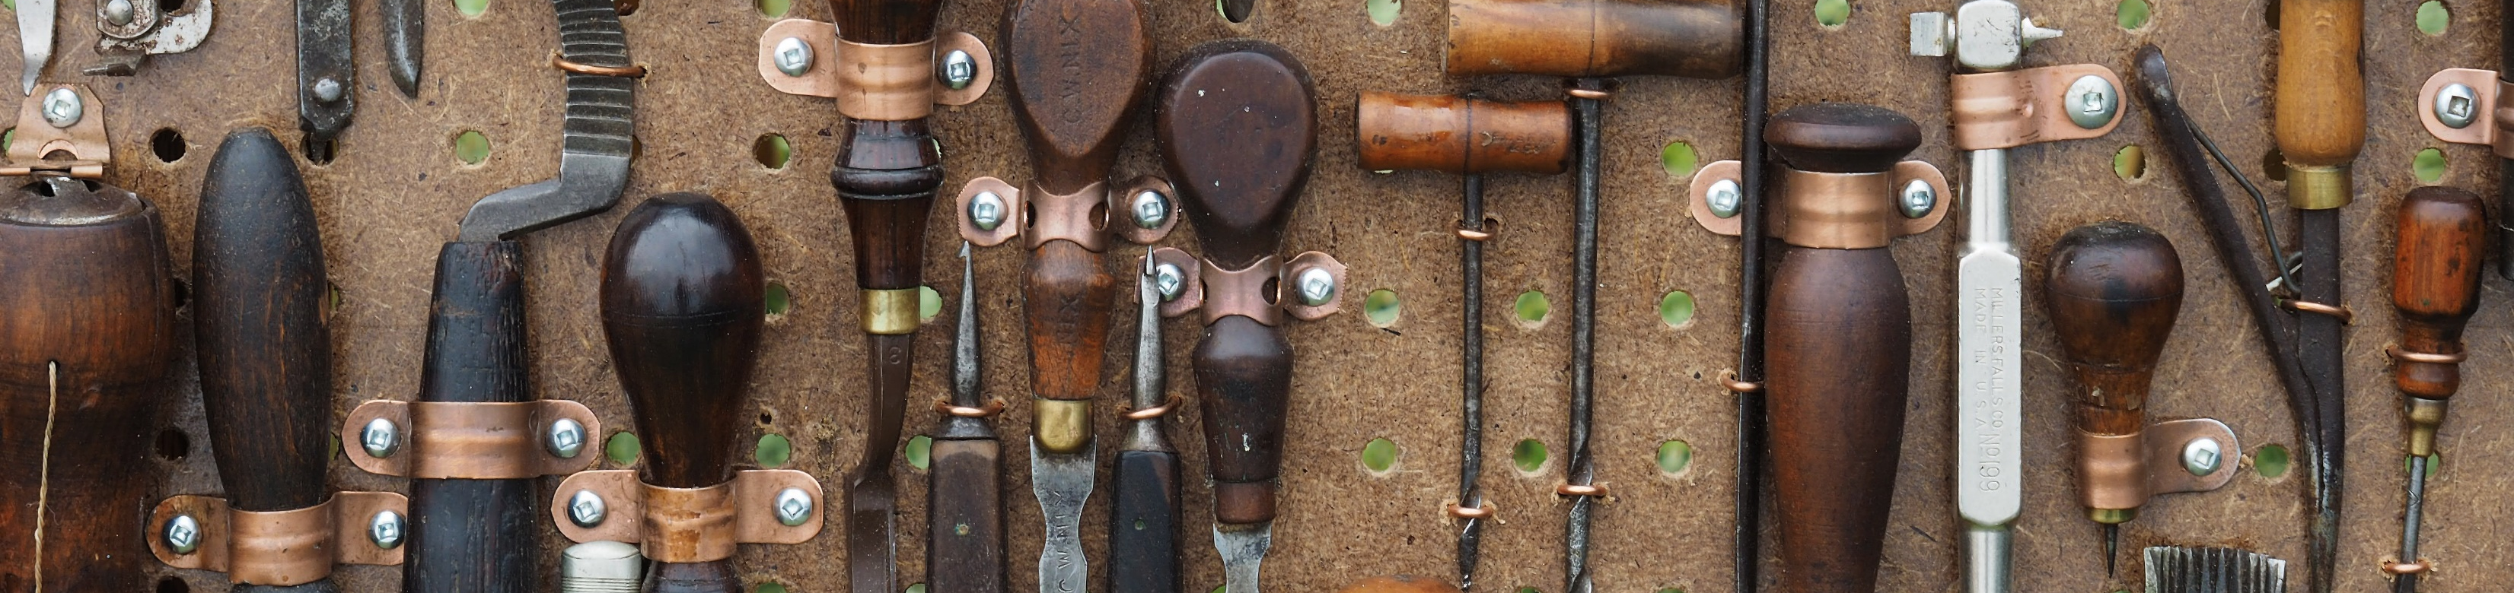

Prototyping
Human-Computer Interaction Lecture
Slides adapted from hci-lecture.org (A. Schmidt, N. Henze, K. Wolf, V. Schwind), Image from: https://pxhere.com/de/photo/669444
The following content is licensed under a Creative Commons Attribution 4.0 International license (CC BY-SA 4.0)

Slide 2
Learning Goals
Understand …
the process of prototyping and design approaches in HCI
understand why and when prototypes are useful
understand how to design prototypes
know techniques to develop prototypes with low functionality
Be able to explain …
to put different prototyping techniques into perspective
different ways to systemize prototypes
discuss user interface designs with regard to these principles
be able to select an appropriate prototyping technique
Prototyping

Slide 3

The Human-Centered Design Process
Plan the human-centered design process
Design solution meets the user requirements
Understand and specify the context of use
iterate where appropriate
Evaluate designs against requirements
Specify the user and organizational requirements
Product design solutions to meet the user requirements
ISO 9241-210:2019(en) Human-centered design for interactive systems
Prototyping

Slide 4
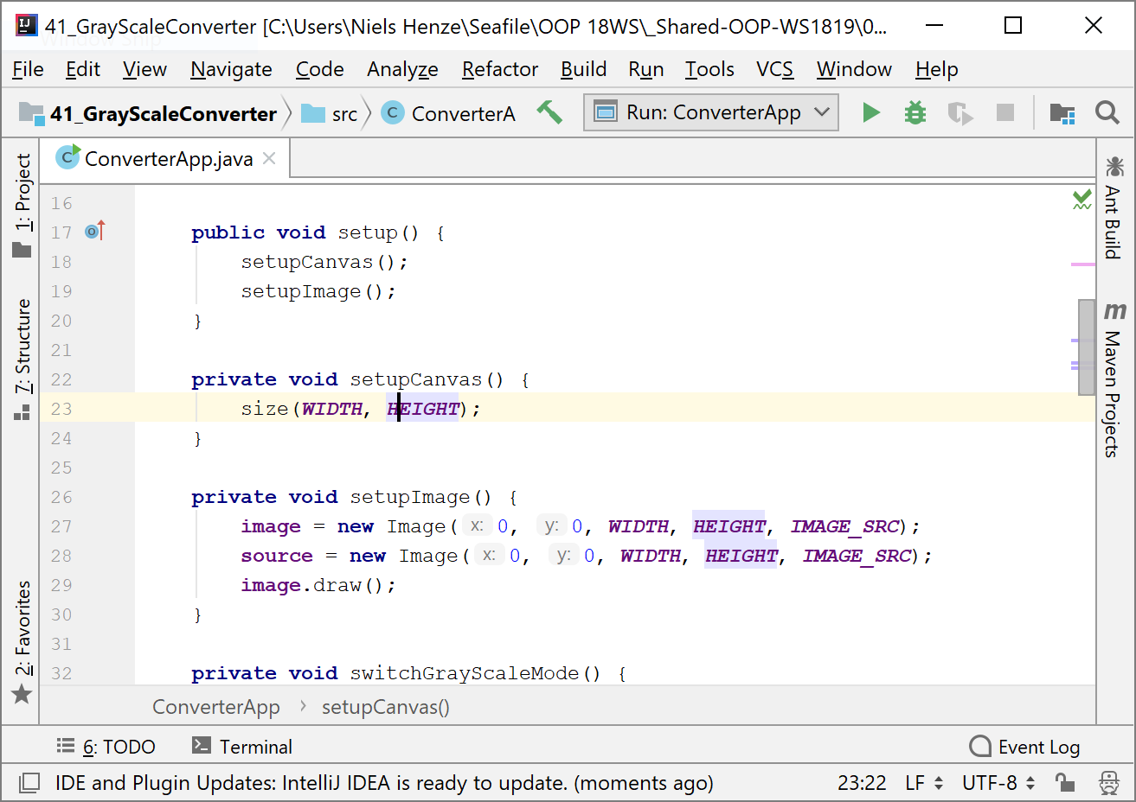
The Human-Centered Design Process (slow cycle)
Plan the human-centered design process
Design solution meets the user requirements
Understand and specify the context of use
iterate where appropriate
Evaluate designs against requirements
Specify the user and organizational requirements
very slow
Product design solutions to meet the user requirements
ISO 9241-210:2019(en) Human-centered design for interactive systems
Prototyping

Slide 5
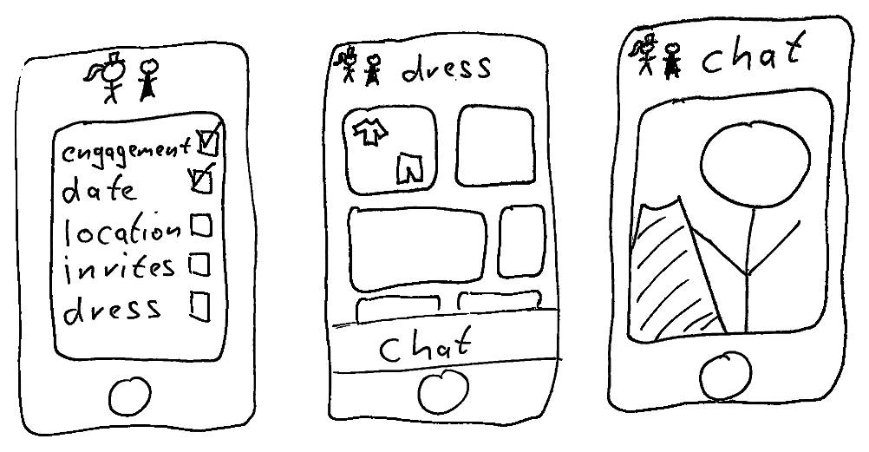
The Human-Centered Design Process (fast cycle)
Plan the human-centered design process
Design solution meets the user requirements
Understand and specify the context of use
iterate where appropriate
Evaluate designs against requirements
Specify the user and organizational requirements
very fast
Product design solutions to meet the user requirements
ISO 9241-210:2019(en) Human-centered design for interactive systems
Prototyping

Slide 6
The Human-Centered Design Process
Plan the human-centered design process
Design solution meets the user requirements
Understand and specify the context of use
iterate where appropriate
Evaluate designs against requirements
Specify the user and organizational requirements
Product design solutions to meet the user requirements
Can we involve participants here?
ISO 9241-210:2019(en) Human-centered design for interactive systems
Prototyping

Slide 7




Prototype Phases
Design/Creation
Co-Design/Co-Creation
Evaluation
Internal prototyping process
Fast and efficient
Specific/consistent style
Only rely on your own feedback
You involve users in the design of the prototype
Can take a lot of time
You get a lot of opinions
You need participants
Participants can be wrong
Evaluate your prototype with users
You get feedback
You can measure the effect of the prototype
You need a prototype
Prototyping

Slide 8

Image from Shutterstock.com / ID: 637095556
Prototyping

Slide 9
Prototype Creation
Creation Sessions: Generate ideas and concepts for the design.
Design Workshops: Organize collaborative sessions where all of you actively engage in the prototyping process, contributing ideas and feedback.
Card Sorting/Affinity Diagramming: Organize information into categories, which can be used to inform workflow design.
Personas/Journey Mapping: Requirement analysis and identifying pain points and opportunities for improvement.
Task Mapping: Design your prototype based on the requirement analysis based on the tasks of the users.
Design Workshops
Prototyping

Slide 10
Prototype Co-Creation with Users
Co-creation Sessions: Inviting users to contribute to the creative process of generating ideas and concepts for the design.
Participatory Design Workshops: Organizing collaborative sessions where users actively engage in the design process, contributing ideas and feedback.
Card Sorting/Affinity Diagramming: Asking users to organize information into categories, which can be used to inform information architecture or workflow design.
Custom Journey Mapping: Exploring and diagramming the steps users take to interact with a product, identifying pain points and opportunities for improvement.
Formative Evaluations
Prototyping

Slide 11
Evaluation of Prototypes
User Interviews: Conducting sessions where users design and interact with the prototype while observers (often researcher) take notes.
Focus Groups: Facilitating discussions among groups of users about the prototype to gain a broader understanding of user needs.
Think-Aloud Protocol: Asking users to verbalize their thoughts as they navigate through the prototype.
Contextual Inquiry: Observing and interviewing users in their own environment, which helps in understanding how the design fits into their everyday life and tasks.
Remote User Testing: Users test the prototype in their own environment, typically using their own equipment
…there are many more!
Summative Evaluation
Prototyping

Slide 12
Exploring Prototypes with Users
In prototype tests, researchers must often talk and improvise with participants
They need to explain the nature of the prototype
They may need to explain the state of the system
They may have to find out whether users are waiting for a response
Even with the above necessary interactions between the test facilitator and the user, the test facilitator’s ultimate goal should be to quietly observe the person interacting with the design, not to have a conversation with the participant.
Tips:
If users click an item for which there is no prepared response yet:
Don’t say: “That isn’t working.”
Ask: “What were you expecting to happen when you did that?”
Prototyping

Slide 13
Design Thinking
A formative, human-centered design approach with a set of cognitive, strategic and practical procedures use by designers in the process of designing
An iterative, non-linear process including problem finding and framing, context analysis, creative thinking, ideation and solution generating through sketching and drawing, prototyping, and evaluating through user testing.
Understanding
Observing
Defining
Ideating
Prototyping
Testing
Prototyping

Slide 14
Design Thinking
Understanding: At the beginning, the problem is identified with a team of several people. Getting everyone involved and aware of that problem
What should be newly developed? For whom should the development be relevant?
Observing: Observing is about being able to empathize with the user
An analysis of the user’s will, for example, through an interview or role-playing games
Defining: The results of the first two steps are combined to a point of view
Techniques such as personas or task analysis can be used to define the point of view
Ideating: In a brainstorming session, ideas, no matter how crazy or utopian they are, are brought together
The results are structured and sorted according to priorities
Prototyping: A prototype is created for demonstration purposes
Perfection and completion are typically irrelevant (e.g., paper prototypes). The simpler, the better.
Testing: The prototype will be tested, and feedback evaluated. Users are closely observed.
If an idea doesn't work, it can be discarded, and the process reiterated
Prototyping

Slide 15
Lean UX
Minimal effort to start implementation: the MVP, minimum viable product
When designing an experience, all decisions are made to maximize the impact of the whole user experience
Short, iterative cycles to collect quick feedback from all members
Collaborative design and evaluation
Concept
Prototype
External Evaluation
Learn from behavior
Internal Evaluation
Iterate if required
Prototyping

Slide 16
Arguments for not testing a prototype
In the very early stages of design, a prototype might be too conceptual or rudimentary to yield meaningful feedback from users.
There is no adjustment to be made to the Waterfall processes to accommodate UX and iterative design.
In some cases, the pressure to be the first to market can lead to skipping prototype testing
A team might rely on existing data or analytics from current users (if the prototype is a revision of an existing product) to inform design decisions instead of direct prototype testing.
Testing a prototype, especially in industries with high competition, might expose the concept to potential intellectual propert
Prototyping

Slide 17
IA-based Testing with Prototypes
Assumes the information architecture is complete and depends on how much of the features are implemented: horizontal, T, M, and semi-complete.
Model | Discoverability | Findability | Usability
Horizontal | People will realize a feature exists | People can navigate and find features | No functionality
T | Testers will learn to go to the prepared parts | Testers will learn to go to prepared areas | Collect feedback for the implemented feature
M | More options in the first few tasks | Difficult for testers to find implemented features | Collect feedback for the implemented feature(s)
Semi- complete | People will realize a feature exists | People can navigate and find features | Collect feedback for the implemented feature(s)
IA-Based View of Prototype Fidelity. (2018, February 21). Retrieved from https://www.nngroup.com/articles/ia-view-prototype
Prototyping

Slide 18
UX Prototyping
WHY
Approach
Competence
Safety
Entertainment
Experience
Needs & emotions
Connectedness
Recognition
Meaning
Stimulation
Independence
Aesthetics
WHAT
Product
Goal & function
Product character
UX Prototyping
Heruristische Evaluation
Cognitive Walkthrough
Prototype
HOW
Task & interaction
Micro Tasks
Based on Slides from Sarah Diefenbach (https://www.youtube.com/watch?v=0Q1umCBrvU4) and Diefenbach, S., & Hassenzahl, M. (2017). Psychologie in der nutzerzentrierten Produktgestaltung. Springer Berlin Heidelberg.
Prototyping

Slide 19
Prototype Definitions
An early sample, model, artifact, or release of a system built to test and to rate a concept or interaction
A tool in the design process that serve to bridge the gap between theoretical design and practical, functional product
It enables you to explore your ideas and show the intention behind a feature or the overall design concept to users before investing time and money into development
Can provide the “look and feel” of the product but do not necessarily include the functional elements
Can be discarded (throwaway prototypes) or improved (evolutionary prototypes)
[1] Beaudouin-Lafon, M., & Mackay, W. E. (2009). Prototyping tools and techniques. In Human-Computer Interaction (pp. 137-160). CRC Press.
[2] Horn, J. (1998). The usability methods toolbox handbook. San Jose State University: Industrial and Systems Engineering Department, San Jose, CA.
[3] Connell, J. L., & Shafer, L. (1989). Structured rapid prototyping: an evolutionary approach to software development. Yourdon Press.
Prototyping

Slide 20
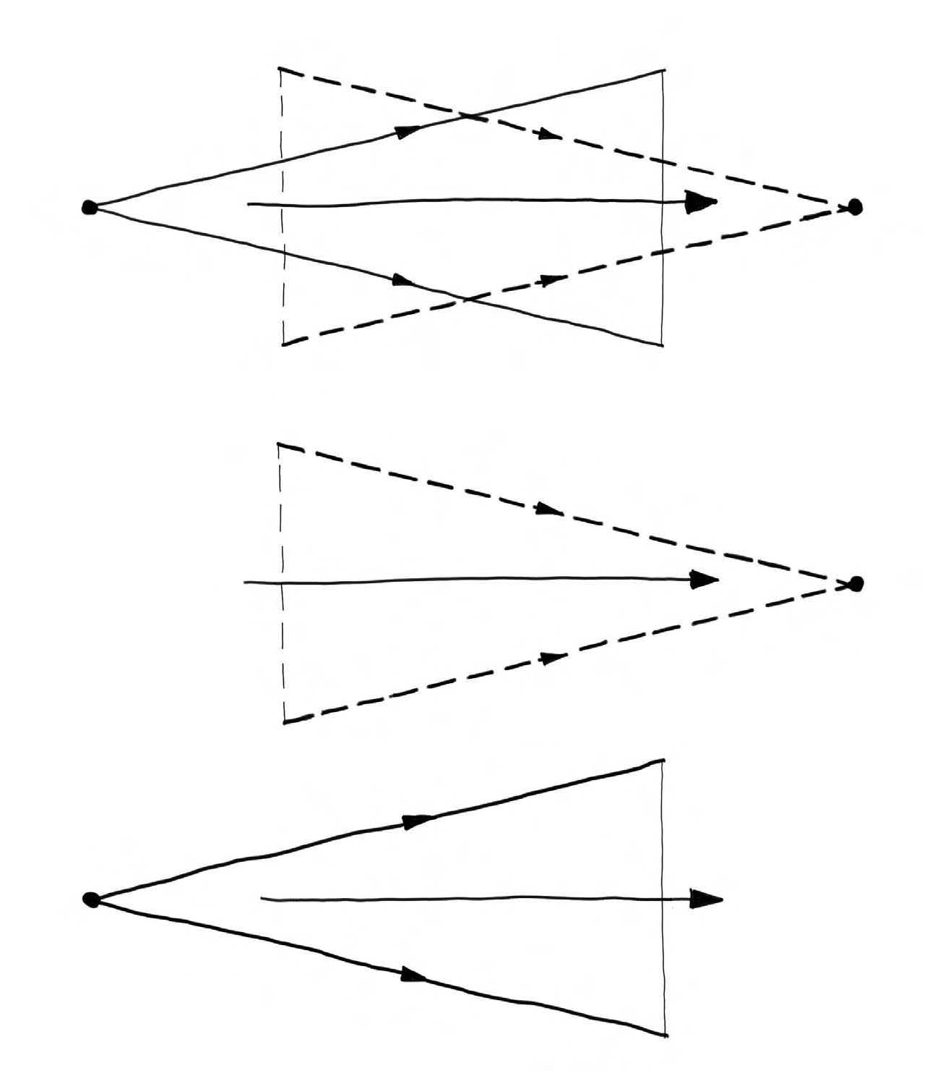
Exploring Design Spaces
Opportunity-Seeking:
From few to many possibilities
Decision making:
From many to few options
Overlapping funnels:
The reduction resulting from decision-making is balanced by the constant generation of new, creative ideas.
This constantly opens up new possibilities for improving a design.
Prototyping

Slide 21
The Problem with Prototypes
Release
MVP
This is the part where everything can go wrong…
Implementation
effort
Prototype
What can we do?
Idea
Sketches
fidelity
Prototyping

Slide 22
Functionality and Features
high
functionality
low
different features
“Scenario”
Prototyping

Slide 23
Functionality and Features
high
functionality
low
different features
Scenarios
Prototyping

Slide 24
Functionality and Features
high
functionality
low
different features
Scenarios
Prototyping

Slide 25
Scenarios
Scenarios are stories about people using the prototype. They providing context and meaning to the interactions by outlining specific instances of use.
Scenarios are helpful in the prototyping process for several reasons:
Contextualization: They ground the design process in real-world situations
Communication: Scenarios serve as a communication tool among stakeholders, including designers, developers, and users
Guidance: By outlining specific interactions, scenarios guide the design of the user interface and the system's functionality to support these interactions.
Focus: They help in maintaining the focus on user needs and experiences throughout the design and development process.
Problem Identification: They help identify potential problems and challenges in user interactions early in the design process, which can be addressed before costly development efforts are undertaken.
Prototyping

Slide 26
Scenario Development
Scenarios
Predictive „What will happen?“
Explorative „What could happen?“
Normative „How can a specific feature be realized?“
Forecasts
„What-If“
External
Strategic
Preserving
Transforming
the most likely development
events of great importance for future development
focus only on factors beyond the control of the relevant actors
incorporate policy measures to cope with the issue at stake
find out how a certain target can be efficiently met
a target, which is unreachable if the ongoing development continues
Forward / Problem Focused Approaches
Inverse / Solution Focused Approaches
Börjeson, L., Höjer, M., Dreborg, K. H., Ekvall, T., & Finnveden, G. (2006). Scenario types and techniques: towards a user's guide. Futures, 38(7), 723-739.
Prototyping

Slide 27
Scenario Development Examples
We take our personas and tasks to write scenarios and tell the story of how they use the prototype to accomplish their goals.
Scenario Forecast Examples: “Touchscreen Interface for a Smart Thermostat”
Scenario 1: “Emma comes home from work and finds her house too cold. She approaches the smart thermostat and uses the touchscreen interface to raise the temperature. The prototype includes visual feedback showing the temperature change and a timer once the desired temperature is set.”
Scenario 2: “On Sunday evening, Emma programs her heating schedule for the week. She interacts with a graphical interface on the touchscreen, setting different temperatures for different times of the day. The system provides a summary of her settings and asks for confirmation.”
Prototyping

Slide 28
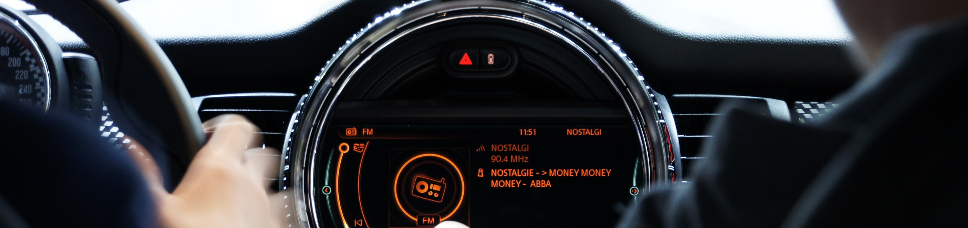
Prototype Taxonomies
Human-Computer Interaction Lecture
Slides adapted from hci-lecture.org (A. Schmidt, N. Henze, K. Wolf, V. Schwind), Image from: https://pxhere.com/de/photo/437662
The following content is licensed under a Creative Commons Attribution 4.0 International license (CC BY-SA 4.0)

Slide 29
Taxonomies of Prototypes
Prototypes are commonly categorized based on their fidelity, purpose, and the stage of the design process they are used in
Common taxonomies:
By representation: Horizontal vs vertical prototypes
By fidelity: Low- vs high-fidelity prototypes
By function: Non-functional vs functional prototypes
By purpose: Evolutionary prototypes vs throw-away prototypes
Prototype Taxonomies

Slide 30
By Representation
Horizontal Prototype
Vertical Prototype
not prototyped
prototyped
Prototype Taxonomies

Slide 31
Horizontal Prototype
Demonstrates the full feature spectrum without implementing them
Helps to evaluate/test
Navigation (e.g., finding a specific function)
Layout options
Overall user interface concept
Feature placement
Accessibility
User preferences
Applicable in low-fidelity prototyping and high-fidelity prototyping
Used in early design stages
To determine the set of features to include
To decide on the user interface concept
Prototype Taxonomies

Slide 32
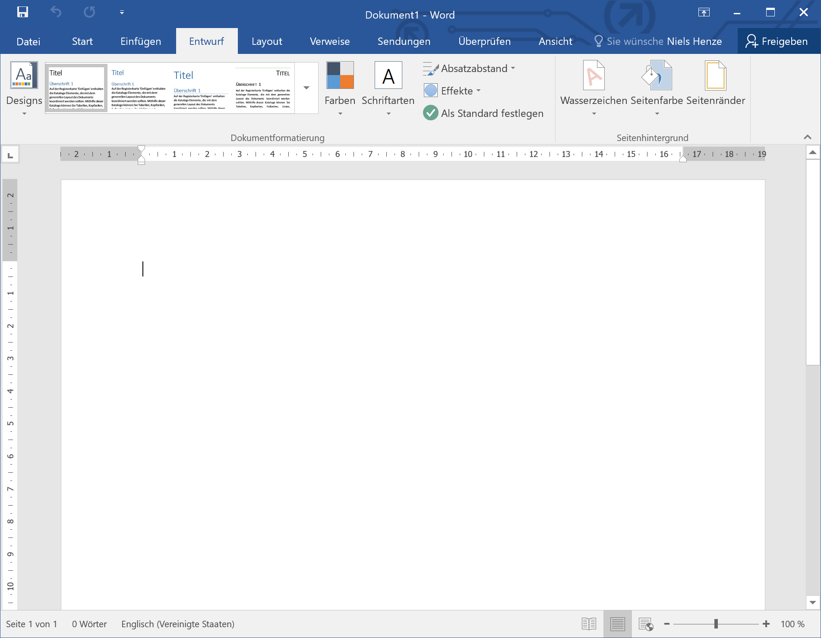
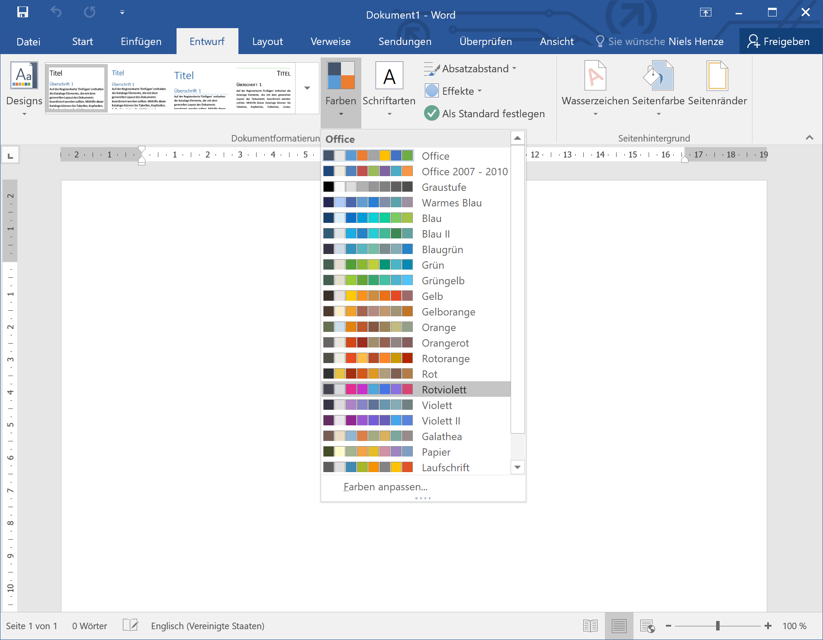
Horizontal Prototype
Prototype Taxonomies

Slide 33
Vertical Prototype
Demonstrate a specific feature and its implemented functionality
The details of the function/feature are shown/implemented
Helps to evaluate/test
The optimal design for a particular function
Optimize the usability of this function
User performance for this particular function
Applicable in low-fidelity prototyping but mostly used in high-fidelity prototyping
Prototype Taxonomies

Slide 34
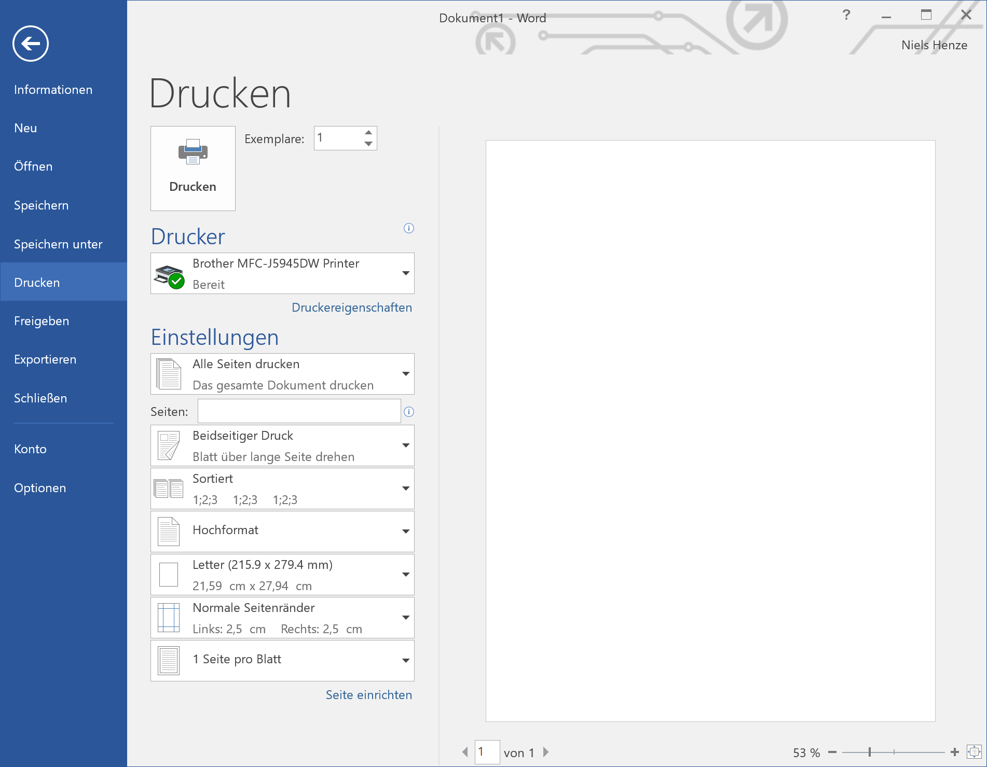
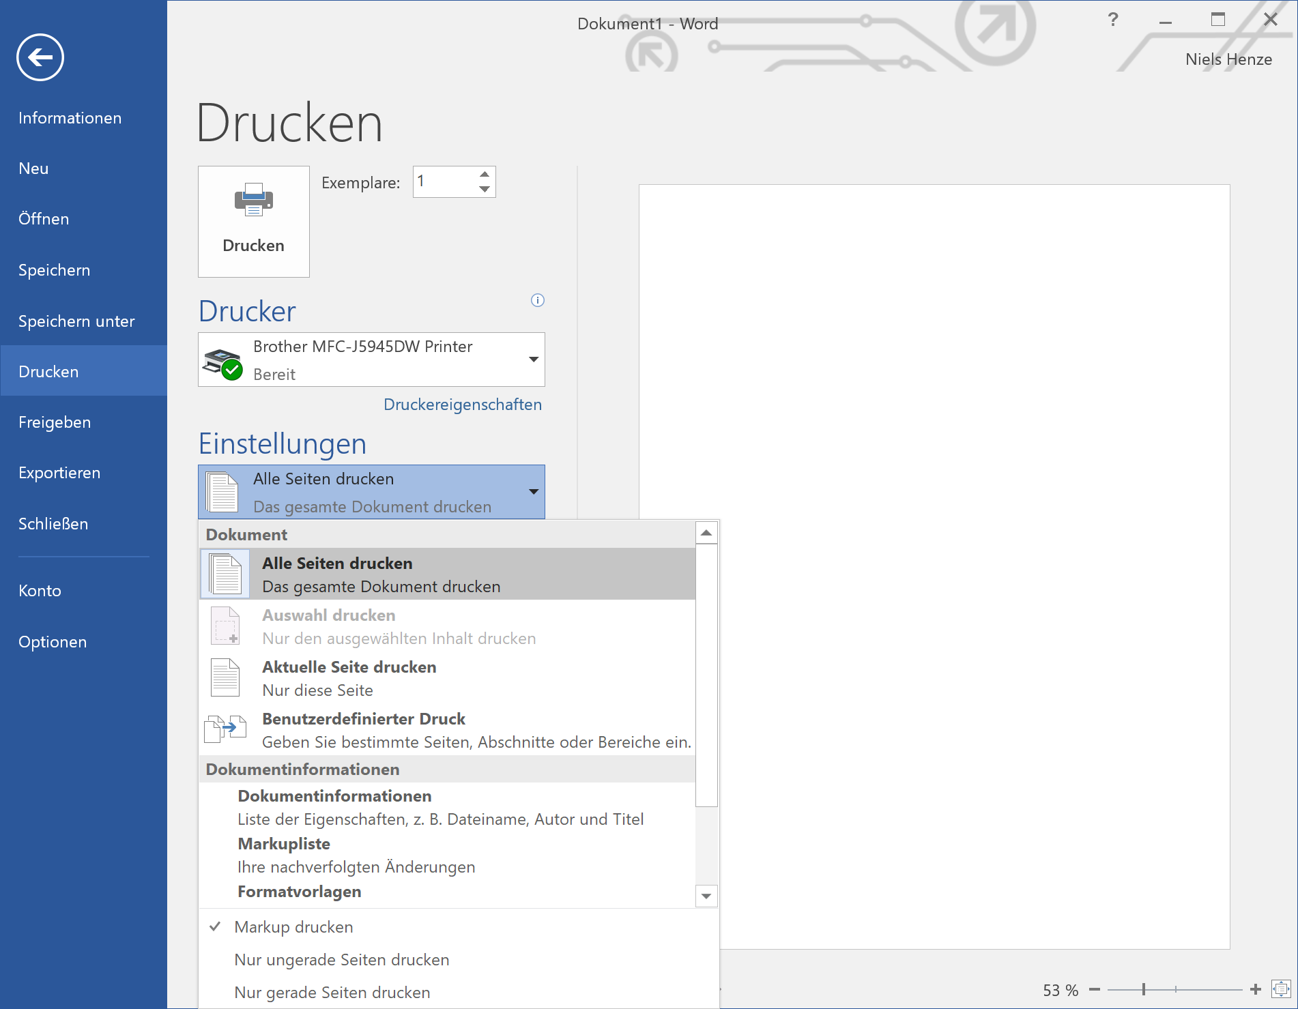

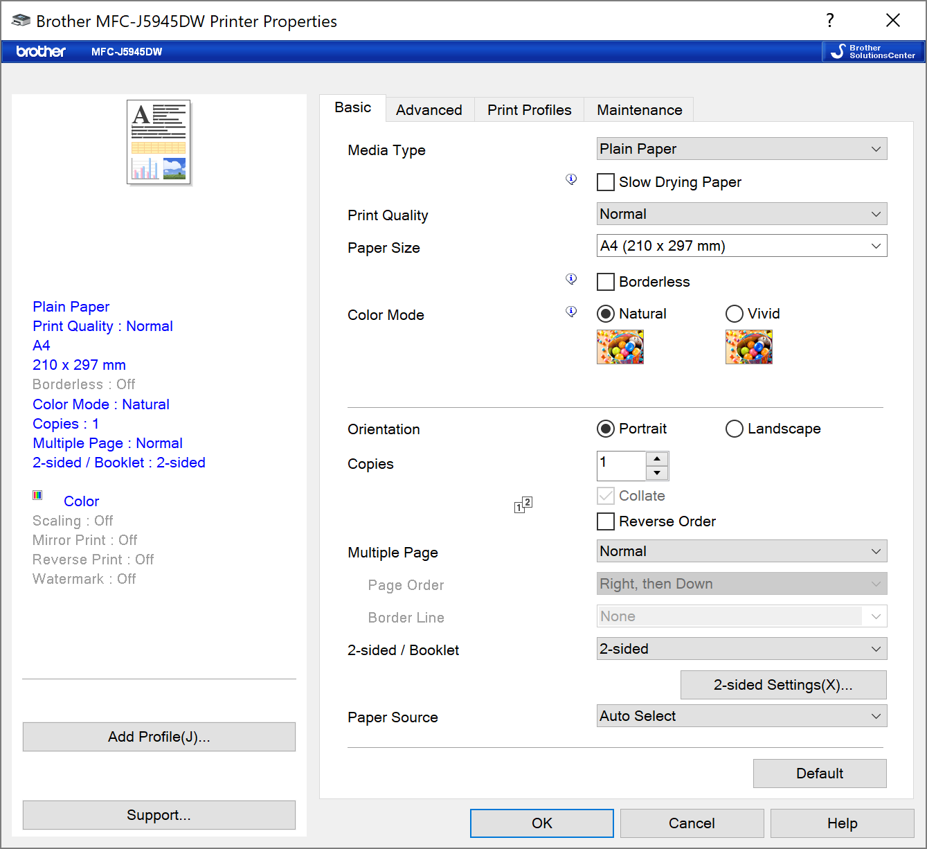
Vertical Prototype
Based on a photo by cottonbro from https://www.pexels.com/photo/man-using-a-printer-3201783 (PD)
Prototype Taxonomies

Slide 35
By Fidelity
Low-Fidelity Prototypes
Often paper-based or simple digital mock-ups.
Quick to create and useful for early-stage design to test broad concepts.
Examples: Sketches, paper models, wireframes.
Medium-Fidelity Prototypes
More detailed than low-fidelity, often digital, but not fully functional.
Used to get a more accurate feel for the final design without extensive coding.
Examples: Interactive wireframes, clickable prototypes.
High-Fidelity Prototypes
Very close to the final product in terms of detail and functionality.
Require more time and resources to create but are used for final testing before launch.
Examples: Fully interactive devices or applications, detailed and functional systems.
Prototype Taxonomies

Slide 36
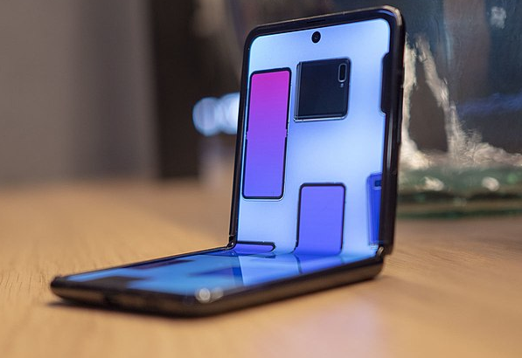
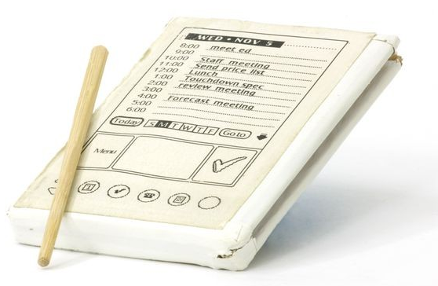
Low-/Medium/High-Fidelity Prototypes
Final
Interactivity
Content
Structure & Process
Idea
Functionality
Low-fidelity prototypes
Medium-fidelity prototypes
High-fidelity prototype
Photo by Mark Richards from https://www.computerhistory.org/revolution/mobile-computing/18/321/1648
Image by Grace R. Samson from https://commons.wikimedia.org/wiki/File:Samsung_Galaxy_Z_Flip_fold.jpg (CC-BY-SA 4.0)
Prototype Taxonomies

Slide 37
Low-Fidelity Prototype
Advantages
Cheap, easy and quick to implement
Users are keen to criticise
Disadvantages
No real functionality, difficult to identify errors
Reuse and extending difficult to impossible
Not all ideas can be realized
Photo by Mark Richards from https://www.computerhistory.org/revolution/mobile-computing/18/321/1648
Photo by Mark Richards from https://www.computerhistory.org/revolution/mobile-computing/18/321/1648
Prototype Taxonomies

Slide 38
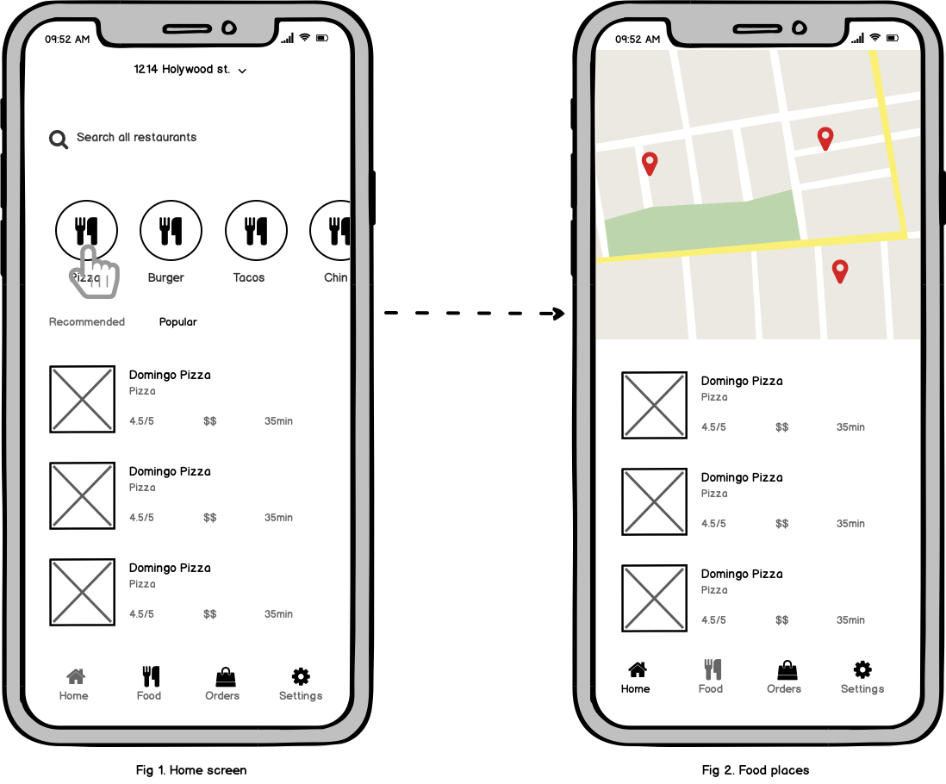
Medium-Fidelity Prototype
Advantages
Allow for some level of user interaction, which can yield valuable feedback on the usability
Communicate design concepts to stakeholders
Flexible enough for changes
Disadvantages
They may not fully convey the final look
The visual and interactive quality can lead to an attachment to elements that may not be optimal
They might give a false sense of completeness
Images by Nick Babich: https://balsamiq.com/learn/articles/mobile-app-wireframing-guide/
Photo by Mark Richards from https://www.computerhistory.org/revolution/mobile-computing/18/321/1648
Prototype Taxonomies

Slide 39
High-Fidelity Prototype
Advantages
Show how the finished product will look and feel
Behaves like the final product for selected tasks
Allows predicting efficiency
Disadvantages
Can be very time-consuming to implement
Users can only “use” the implemented functions
Feedback centered around look & feel
Managers may expect that “the product” is nearly ready
Prototype Taxonomies

Slide 40
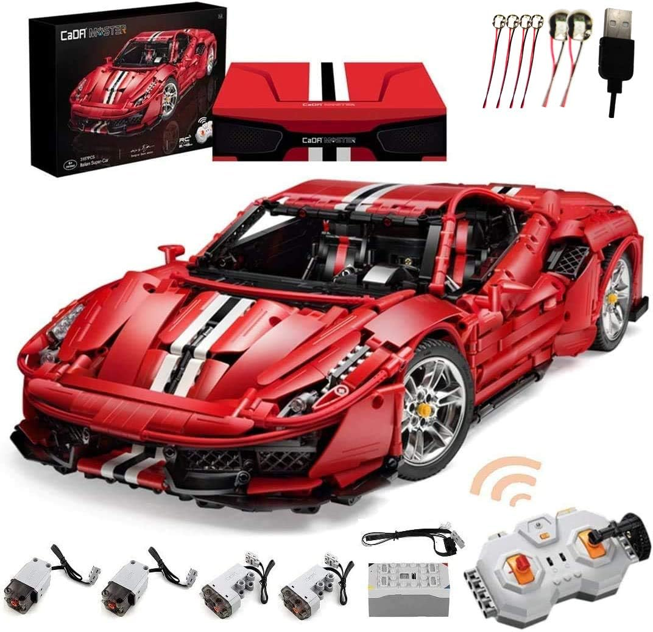
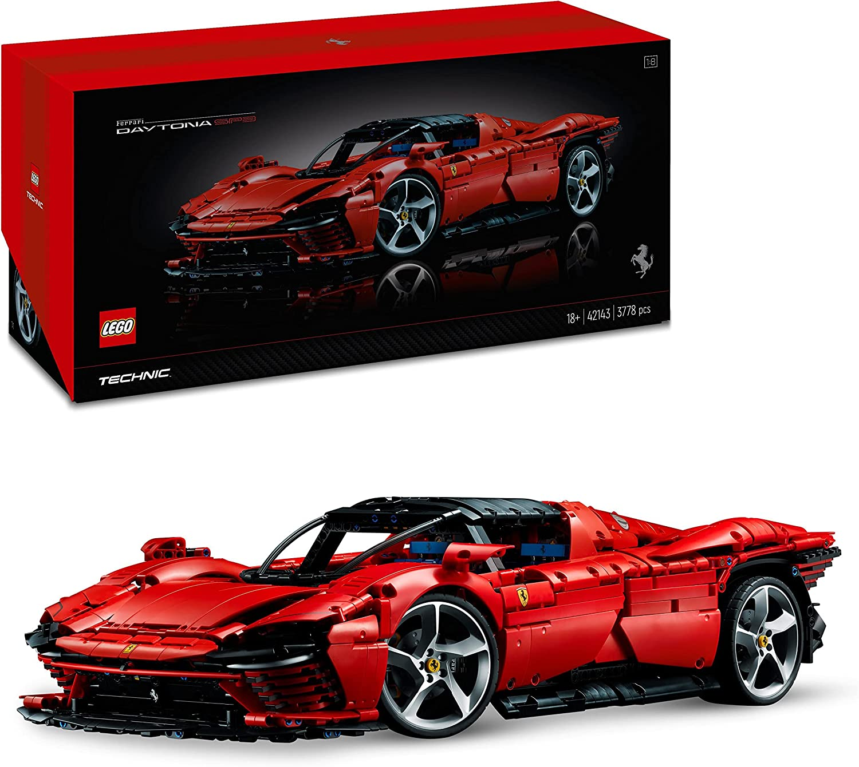
By Function
Images by Lego and CaDA
Prototype Taxonomies

Slide 41
By Function
Images by Lego and CaDA
Prototype Taxonomies

Slide 42
By Function and Fidelity
API, package, library,…
Click Prototype
Final Product
MVP
Click Dummy
functionality
Working Prototype
Rapid Prototyping
Paper Prototype
Video Prototype
Sketches
Wireframe Prototype
Mockup
fidelity
Prototype Taxonomies

Slide 43



By Purpose
Exploratory/rapid prototyping (rapid/throw-away prototyping)
Provides information about the design (capture requirements)
not part of the final solution
testing certain aspects
Incremental Prototype
There is a functional core
With each iteration, a new component is added to the core
When all components are present, the solution is complete
Evolutionary Prototype
The prototype undergoes a series of refinements and can become the solution
Useful when the exact requirements cannot be determined in advance
Customer / end user are often closely involved in the development
Can lead to an MVP
Prototype Taxonomies

Slide 44
By Stage of Development
Concept Prototypes
Used to validate and develop the initial concept behind a product.
Help in communicating the basic idea and main functionality.
Functional Prototypes
Include working parts and demonstrate the functionality of the product.
Used to test the technical aspects and user interaction with actual working elements.
Presentation Prototypes
Created to showcase the product to stakeholders, often resembling the final product in terms of aesthetics.
Used for marketing purposes and to gather feedback from a non-technical audience.
Production Prototypes
Final stage before mass production.
Used to test manufacturing processes and resolve any remaining issues.
Prototype Taxonomies

Slide 45
Summary
Which aspect do you want to test?
Focus on these aspects first
Horizontal/vertical prototype?
Low/high fidelity prototype?
What tools do I want to use for my prototype?
A prototype is bad if it cannot be tested
Evaluation does not necessarily mean conducting a user study
With UX or Lean UX, the focus is on the experience
Prototype Taxonomies

Slide 46

Designing Prototypes
Human-Computer Interaction Lecture
Slides adapted from hci-lecture.org (A. Schmidt, N. Henze, K. Wolf, V. Schwind), Image from: https://pxhere.com/de/photo/437662
The following content is licensed under a Creative Commons Attribution 4.0 International license (CC BY-SA 4.0)

Slide 47
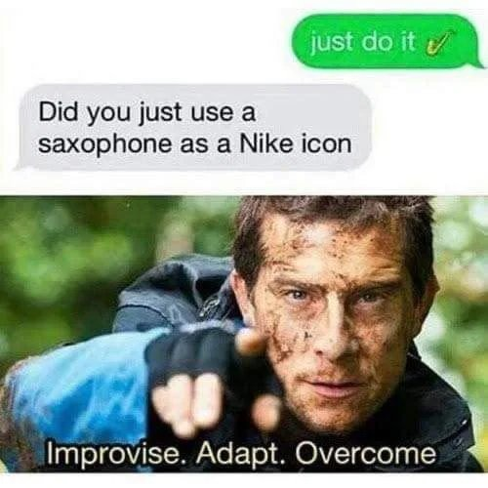
Just do it
Designing Prototypes

Slide 48
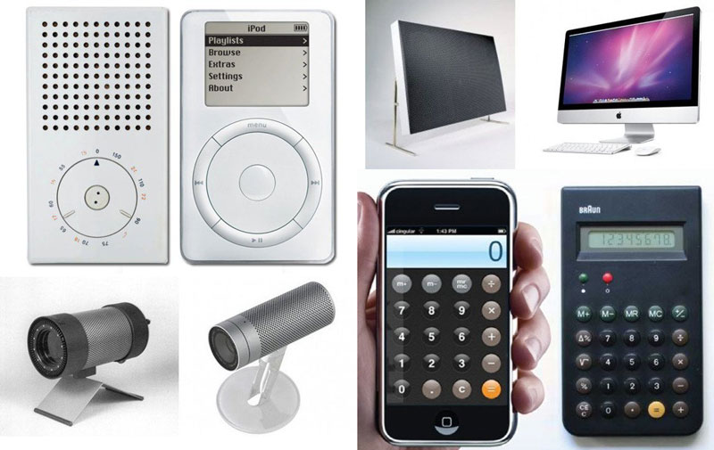
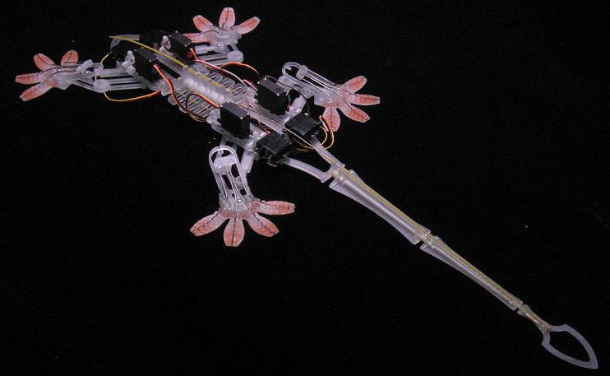

Influence versus Inspiration
Imaga Souce https://commons.wikimedia.org/wiki/File:Jon_Ive_and_Dieter_Rams_works.jpg by ArenysDep, https://en.wikipedia.org/wiki/Bio-inspired_robotics , https://pxhere.com/en/photo/833087 by annegordon
Designing Prototypes

Slide 49
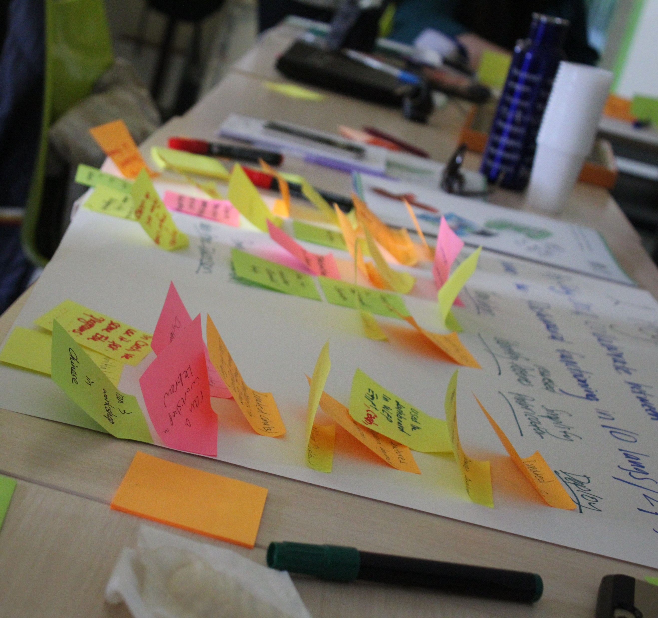
Brainstorming Designs
Start with a well-phrased question, e.g. “How can we help [group] to [benefit]?”
Use the 7 rules of brainstorming:
Defer judgement, engage participants
Encourage wild ideas, allow crazy ideas
Build on others’ ideas
Stay on topic
One conversation at a time
Be visual
Go for quantity
Interdisciplinary teams, select ideas, use simple tools, such as post-its to form idea clusters
Designing Prototypes

Slide 50
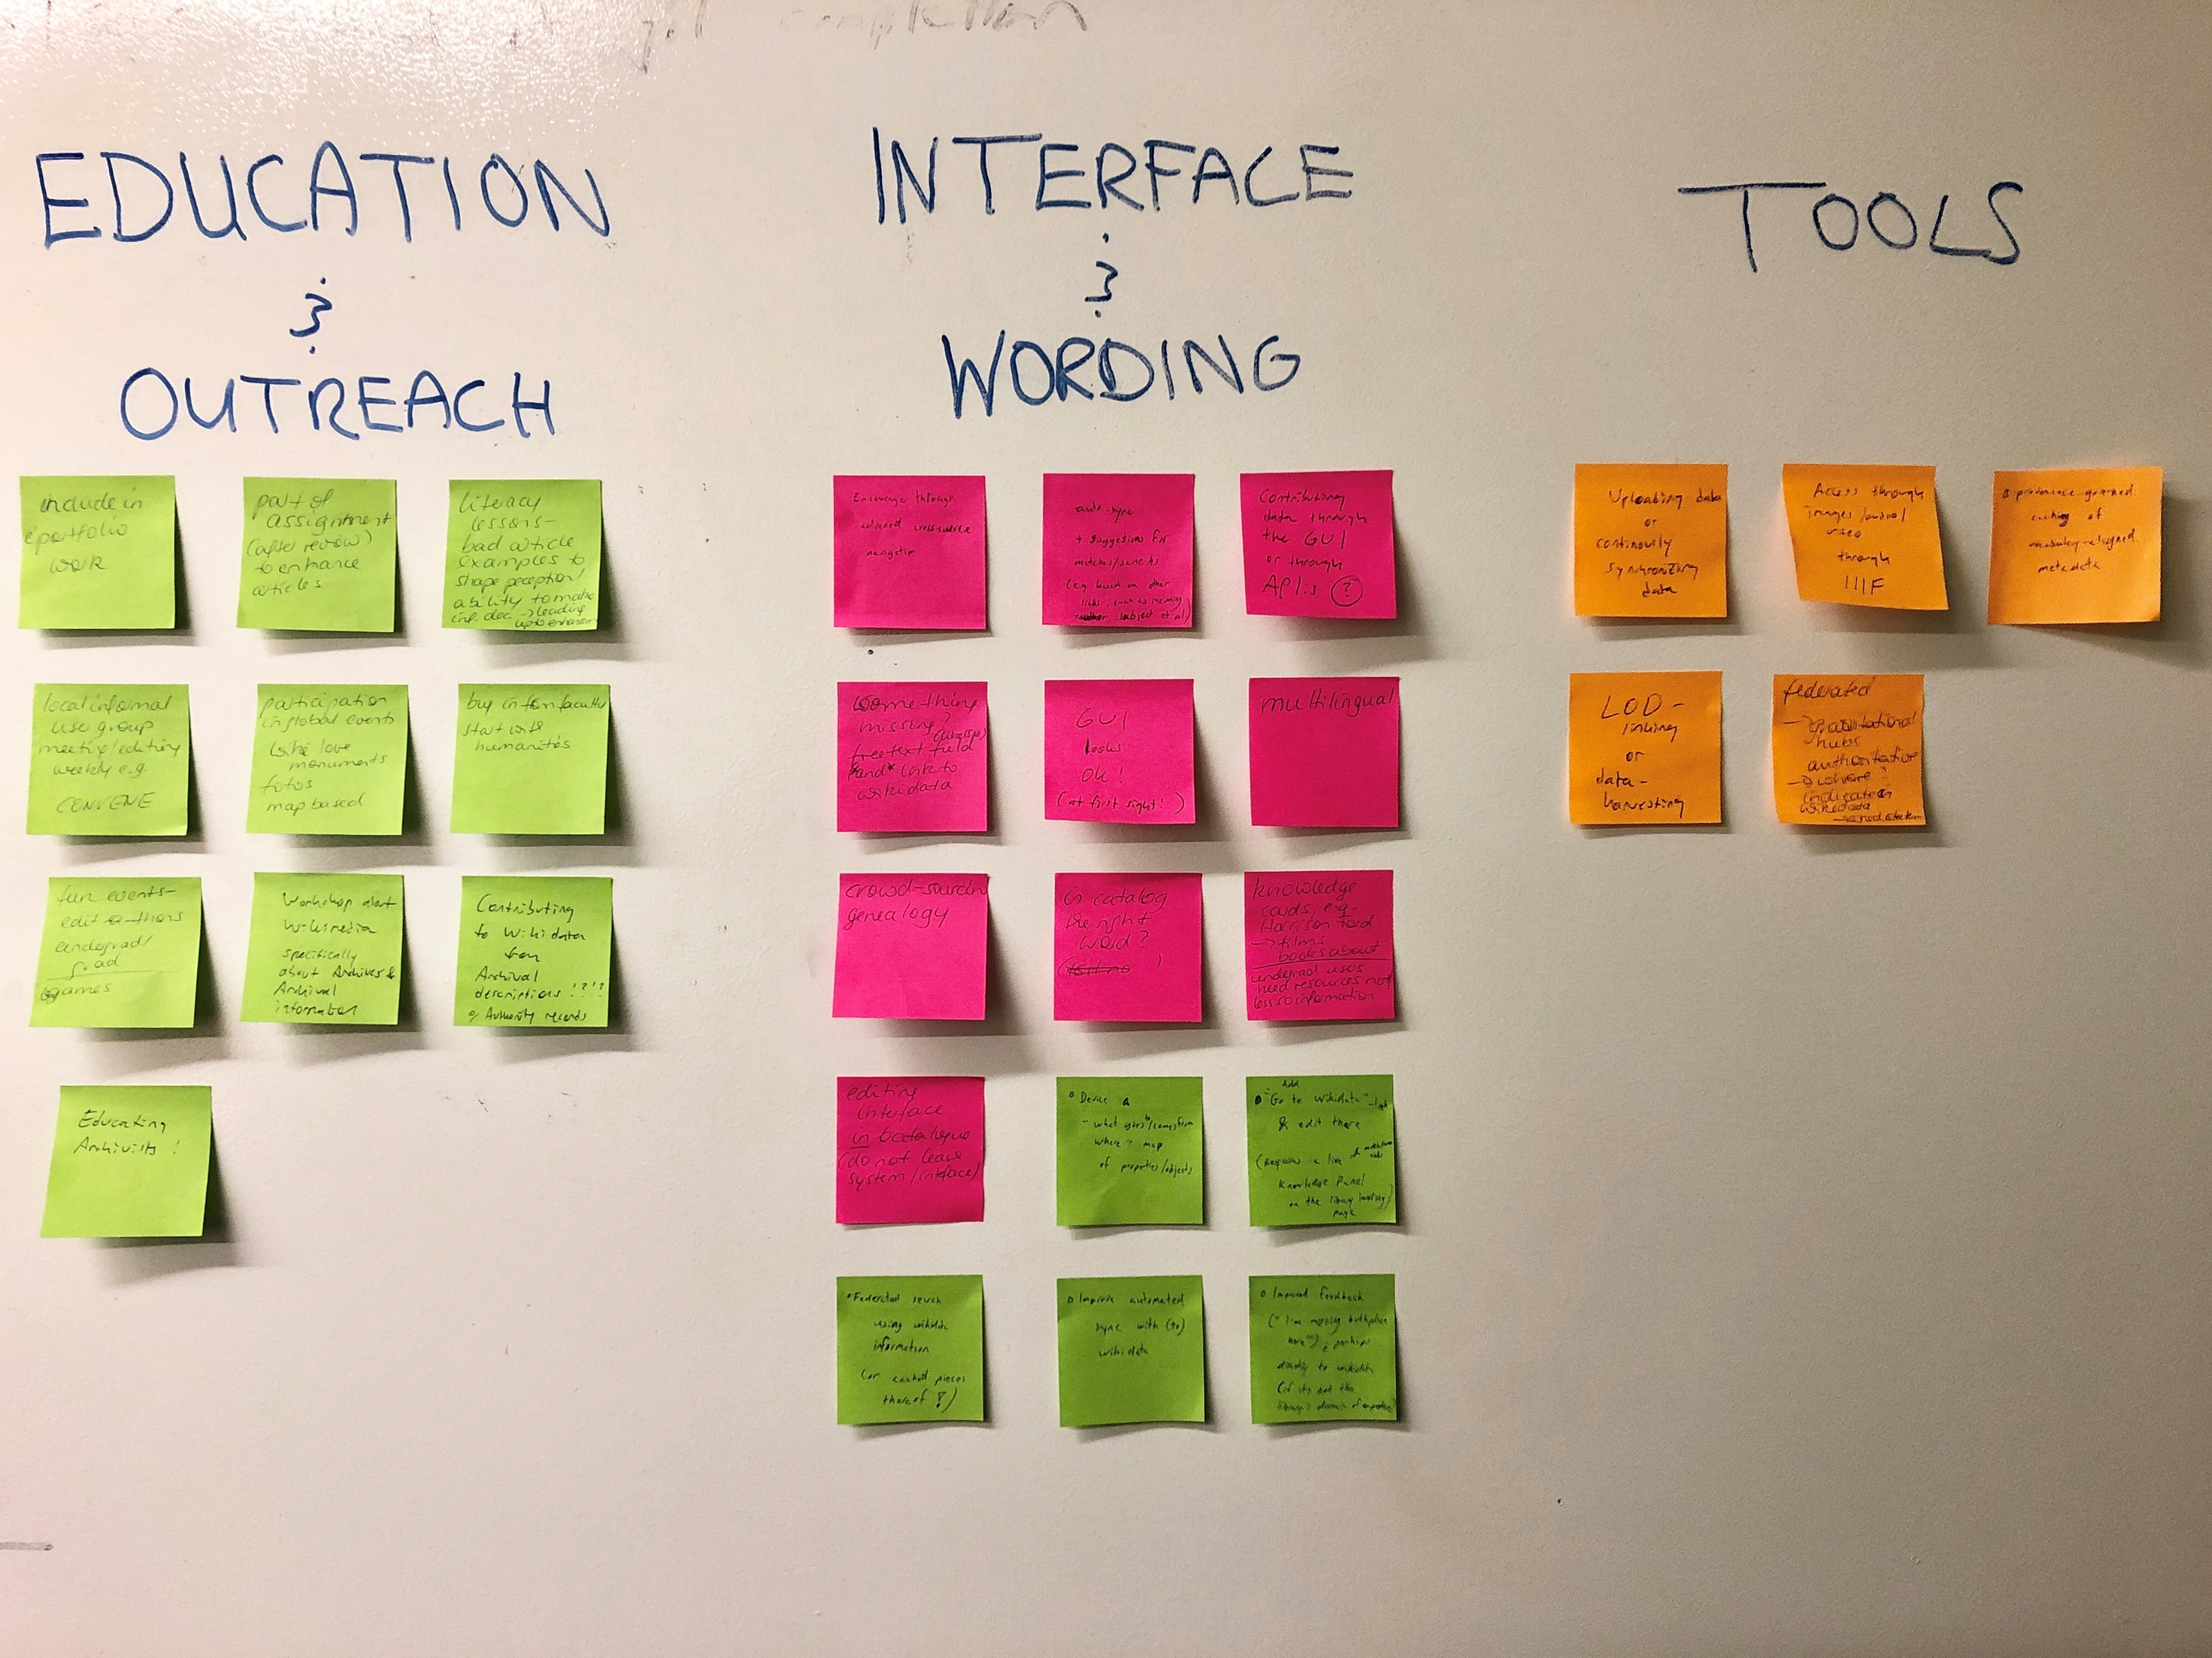
Brain-storming: Organizing & Documenting Designs
Identify similar ideas
Identify concepts and themes
Group the ideas accordingly
Conclude design & implementation concepts
Record the process (take a picture of the grouping result)
Designing Prototypes

Slide 51
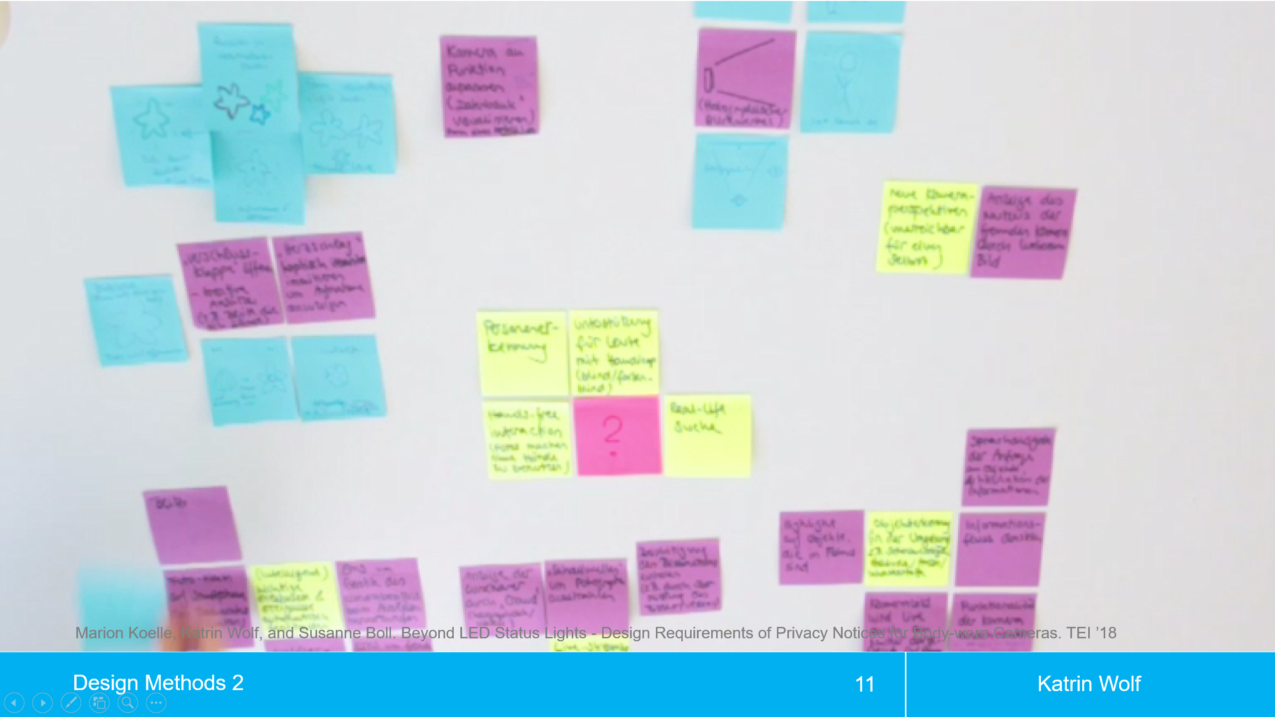
Lotus Flower/Blossom Method
Adds structure & focus to brainstorming
Walk through:
Write down the problem / question at a card
Search for 8 solutions
Place the solutions around the 1st card
Give more ideas more space
Find 8 more specific or modified descriptions around each of the 8 solution idea cards
1
2
3
1
2
3
1
2
3
4
1
5
4
2
5
4
3
5
6
7
8
6
7
8
6
7
8
1
2
3
1
2
3
1
2
3
4
4
5
4
?
5
4
5
5
6
7
8
6
7
8
6
7
8
1
2
3
1
2
3
1
2
3
4
6
5
4
7
5
4
8
5
6
7
8
6
7
8
6
7
8
Designing Prototypes

Slide 52
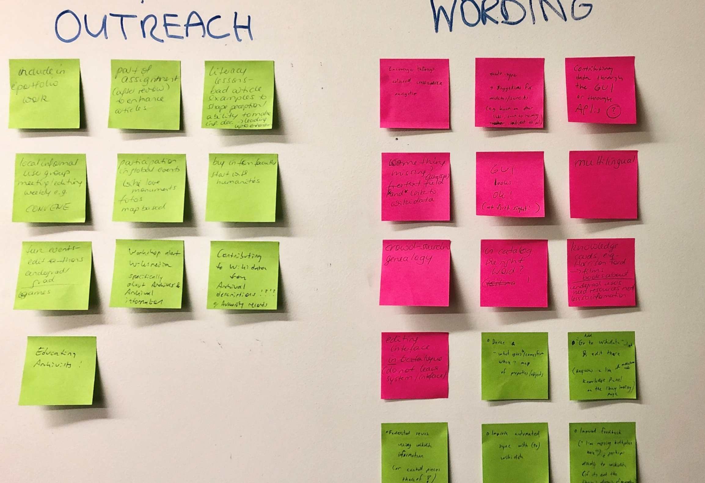
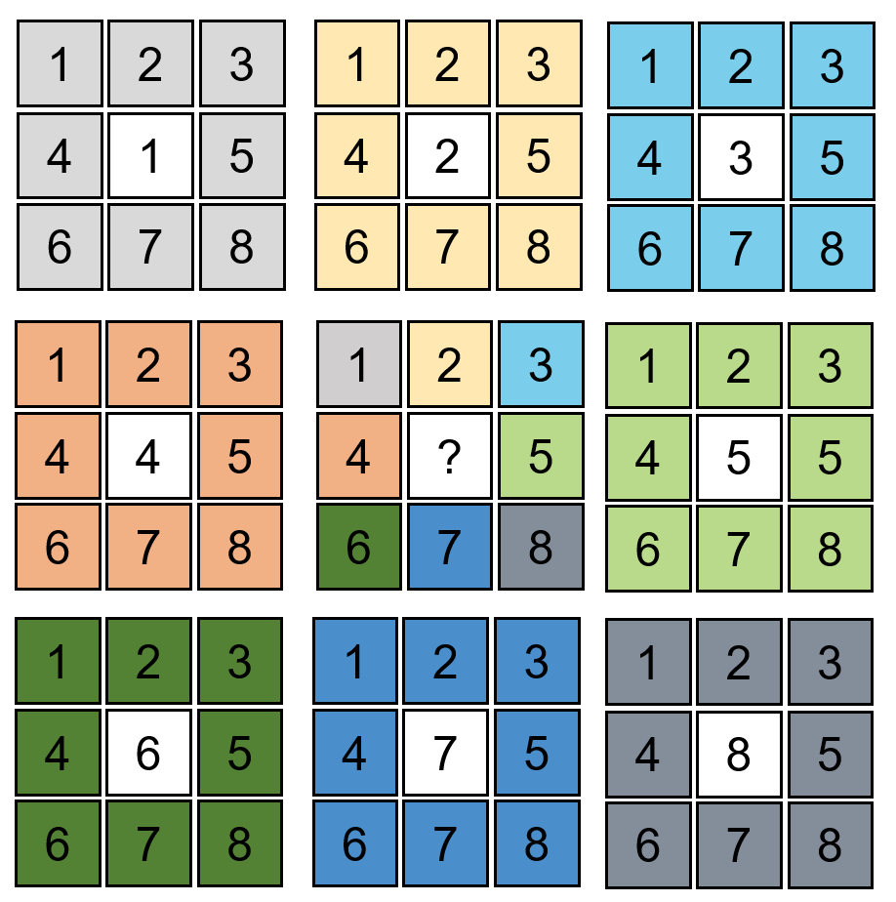
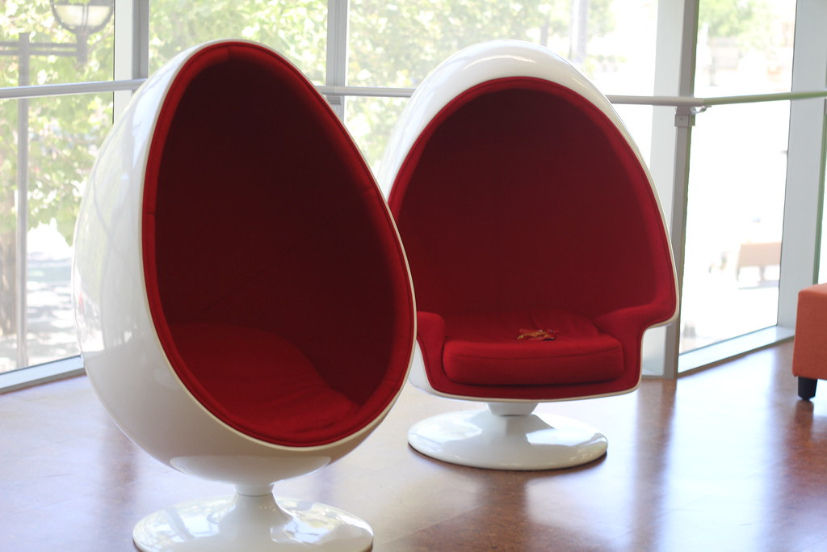
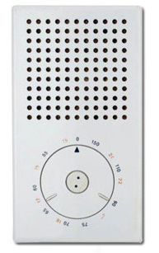
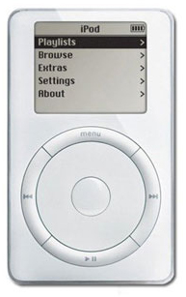
Overview of Ideation Techniques
Technique | Device | Description | Example
Brain-storming | Group interaction | Verbalize thoughts in a groupt so one person‘s idea prompts others
Lotus Blossom | Goal setting | Set goals/limits and provide structure
Input-Output | Translation | Conceptually convert one kind of thing into another
Focused-Object | Association | Mentally follow associative links among ideas in memory
Bionics | Analogy | Look for things similar to parts of the problem situation
Designing Prototypes

Slide 53
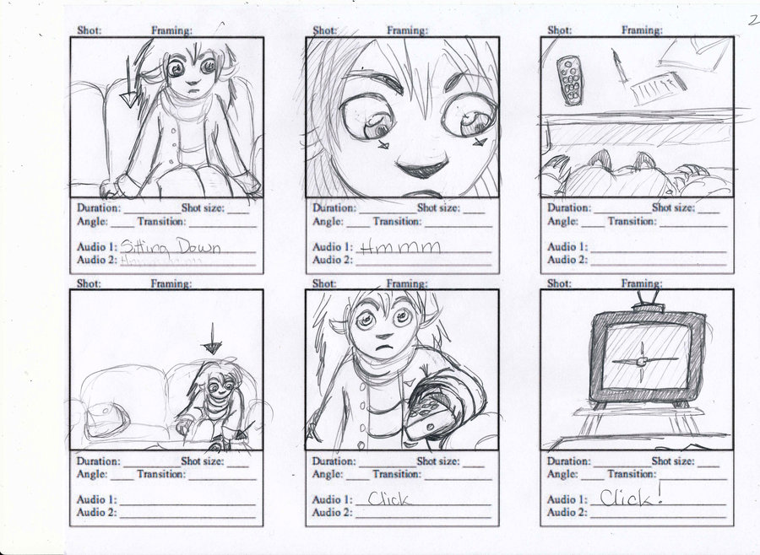
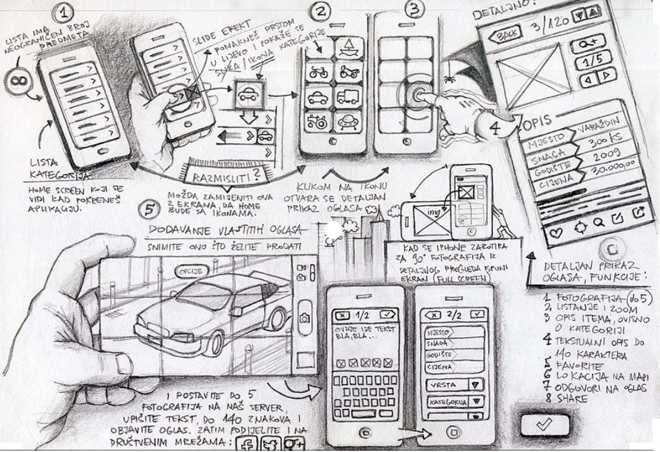
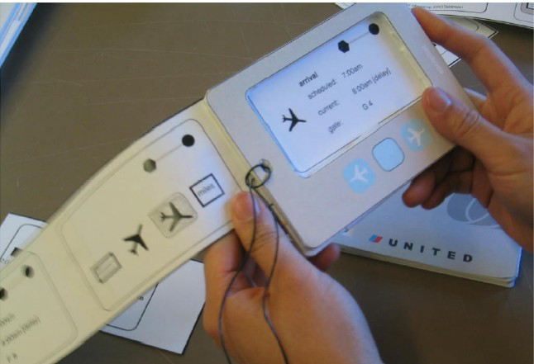
Sketches
Image by Rosengeist http://rosengeist.deviantart.com/art/hans-Storyboard-page-2-151521853 (CC BY-NC-ND 3.0)
From: Khai N. Truong, Gillian R. Hayes & Gregory D. Abowd: Storyboarding: An Empirical Determination of Best Practices and Effective Guidelines. Proc. DIS, 2006.
https://medium.com/@xinyicui/ui-ux-strategy-a-guide-to-paper-prototype-sketching-3c475ce560f9
Designing Prototypes

Slide 54
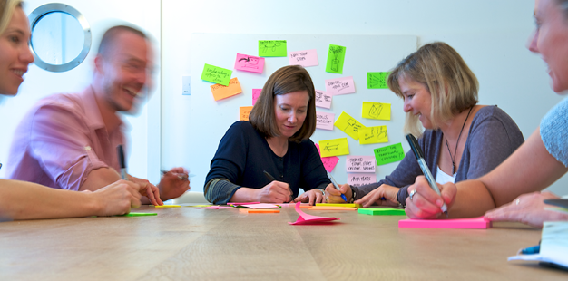
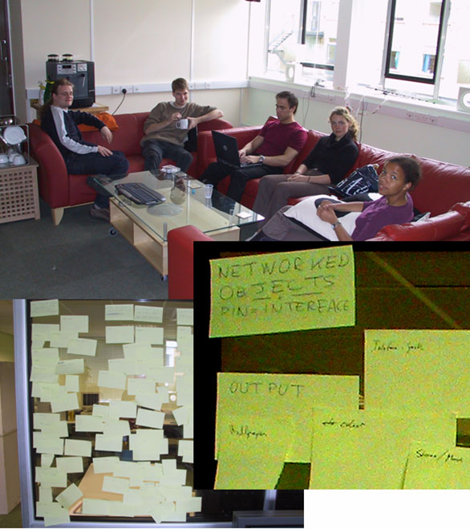
Why Sketches?
Designers invent while sketching
Many have no design in mind at all and only develop it while sketching
Aristotle: “There are things that we must learn before we can do them. And we learn them by doing them.”
Sketching supports the invention process
Ideas for solving design problems
Anyone can sketch
For collaboration and own investigations
No “artistic” needs, just be creative
http://www.ideo.com/images/uploads/work/slides/dt_hero_1_626px.png
Pin&Play Meeting, July 2002, Lancaster
Designing Prototypes

Slide 55
About Sketches
Quick: to produce, so can do many
Timely: provided when needed, done “in the moment”
Inexpensive: so doesn’t inhibit exploration early in the design process.
Disposable: no investment in the sketch itself
Plentiful: both multiple sketches per idea, and multiple ideas
Clear vocabulary: informal, common elements
Distinct Gesture: open, free, “sketchy”
Constrained Resolution: no higher than required to capture the concept
Appropriate Degree of Refinement: don’t imply more finished
Ambiguity: can be interpreted in different ways, and new relationships seen within them, even by the person who drew them.
Suggest & explore rather than confirm: foster collaborative exploration
Buxton, B. (2010). Sketching user experiences: getting the design right and the right design.
Designing Prototypes

Slide 56
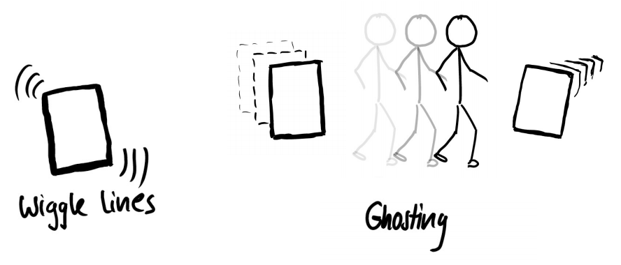
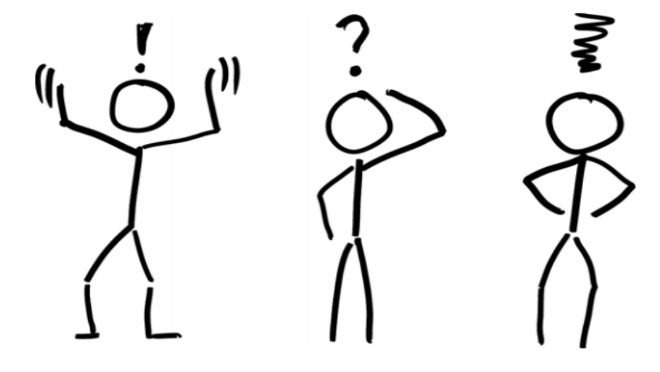
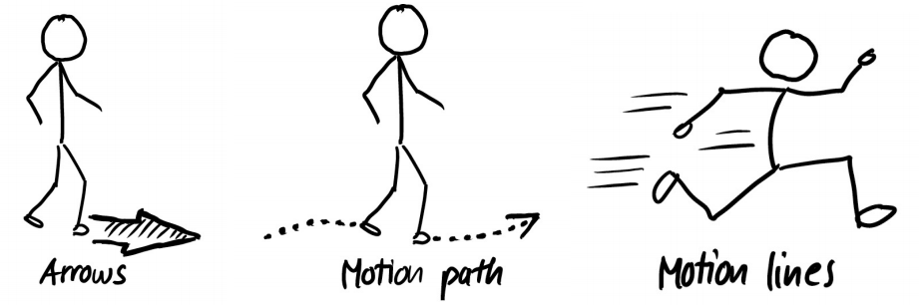
Sketches with Movements
Kaufmann M. (2011) Sketching User Experiences: The Workbook
Designing Prototypes

Slide 57
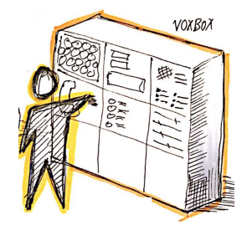


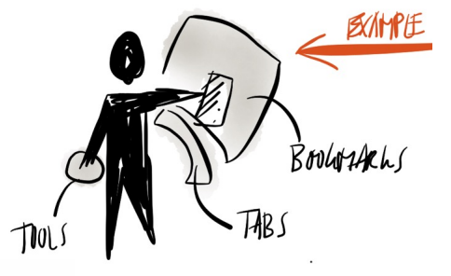
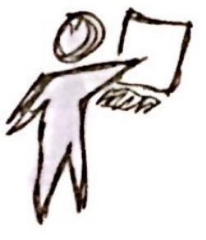
Stick Figures
Kaufmann M. (2011) Sketching User Experiences: The Workbook
Designing Prototypes

Slide 58
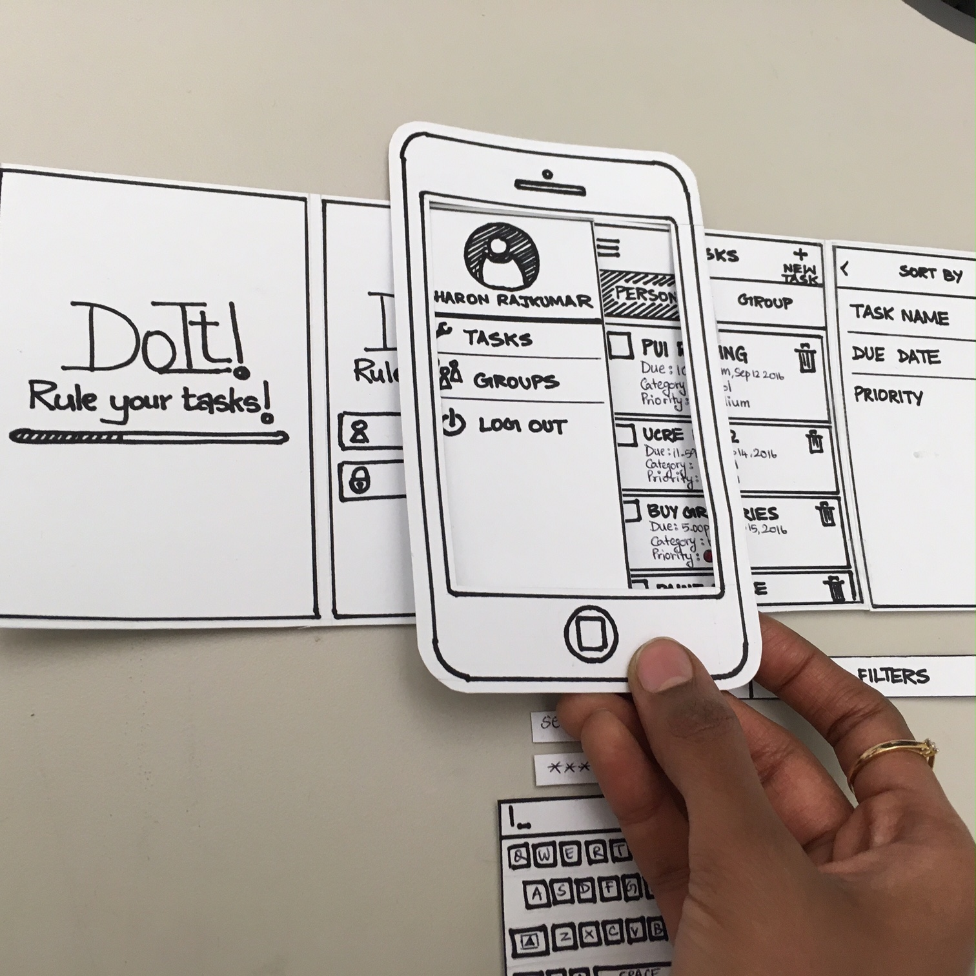
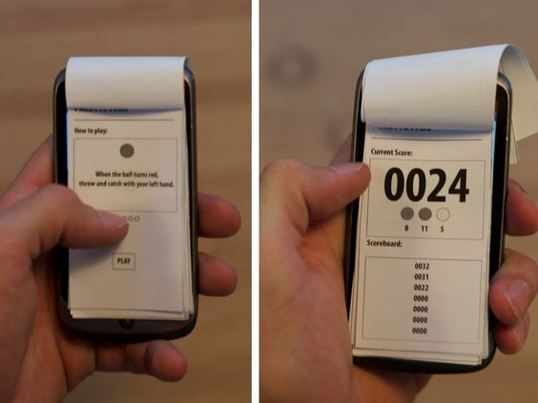
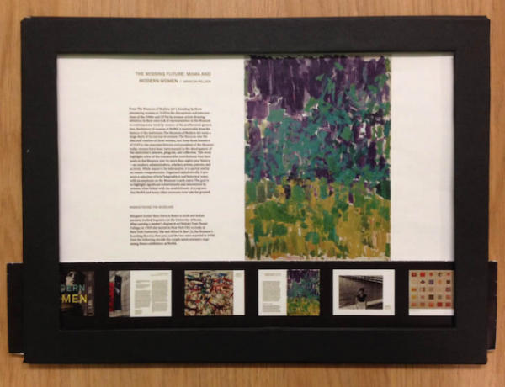
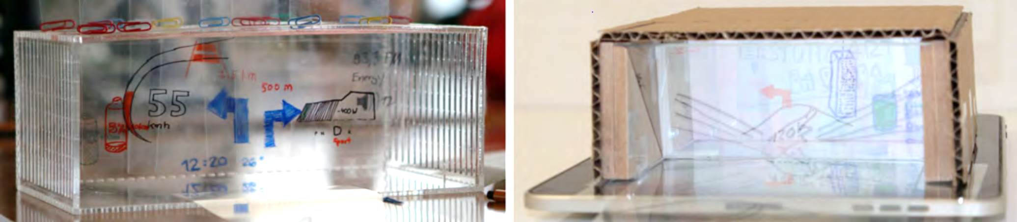
Paper Prototypes
Figures from: Nora Broy, Stefan Schneegass, Florian Alt, and Albrecht Schmidt. 2014. FrameBox and MirrorBox: tools and guidelines to support designers in prototyping interfaces for 3D displays. In Proceedings of the SIGCHI Conference on Human Factors in Computing Systems (CHI '14). ACM, New York, NY, USA, 2037-2046. DOI: https://doi.org/10.1145/2556288.2557183
https://www.corehf.com/role-of-paper-prototyping-in-product-development/?doing_wp_cron=1554718467.1168439388275146484375
https://www.nomensa.com/blog/2015/ux-design-5-reasons-use-paper-prototypes
Designing Prototypes

Slide 59
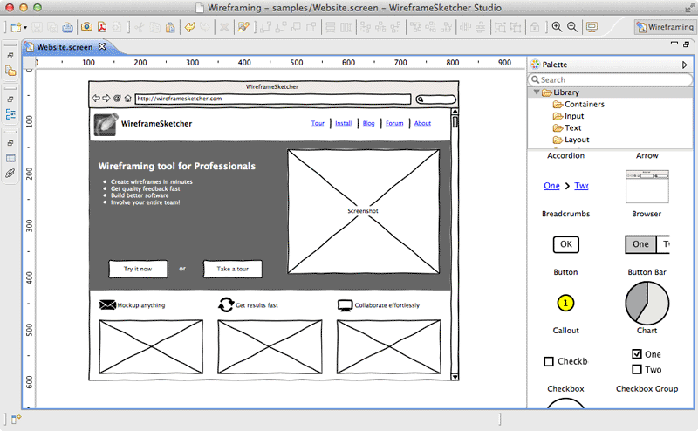
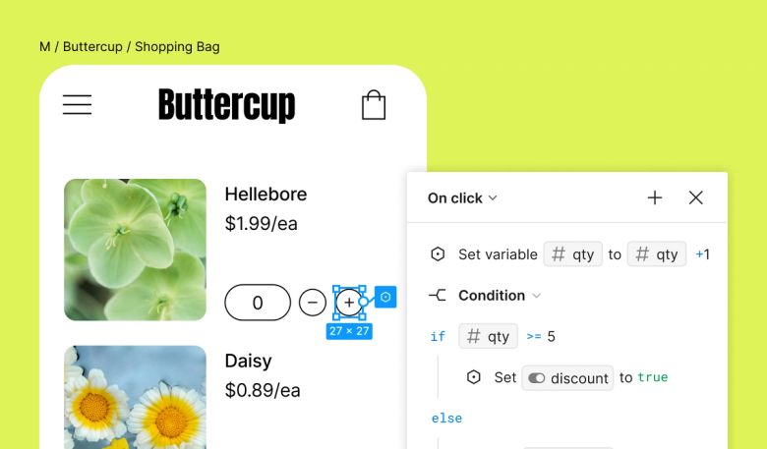
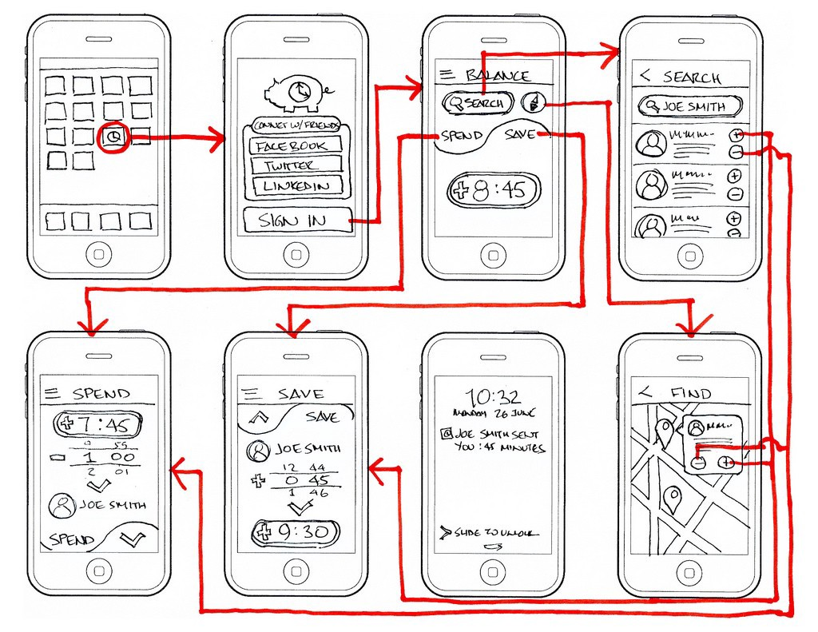
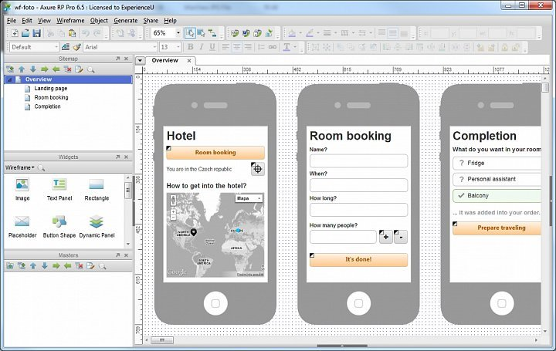
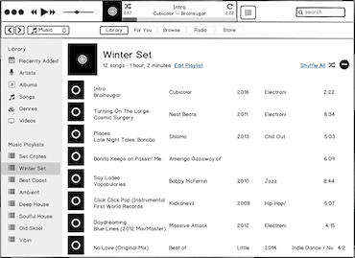
Wireframes
Wireframe Sketcher
Figma
https://medium.com/@ergomania_UX/wireframes-and-colors-541e92401538
Axure RP
Balsamiq
Designing Prototypes

Slide 60
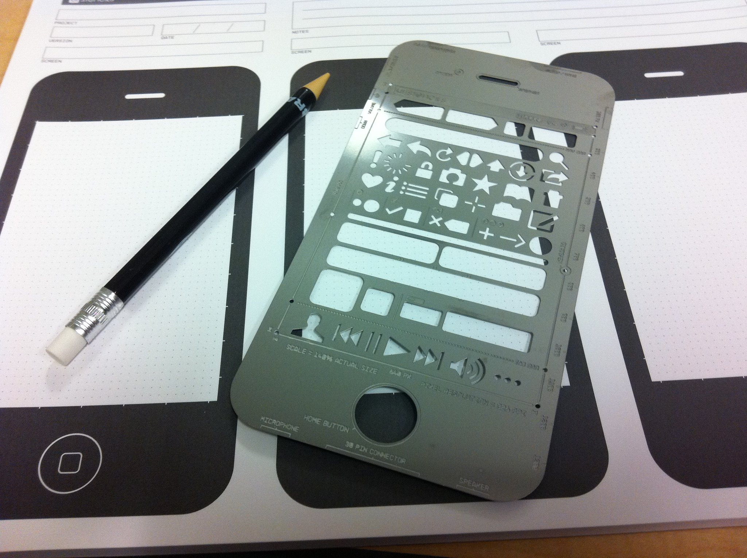
Paper/Slide Templates
By Betsy Weber from https://www.flickr.com/photos/betsyweber/5516971798 (CC-BY 2.0)
Designing Prototypes

Slide 61
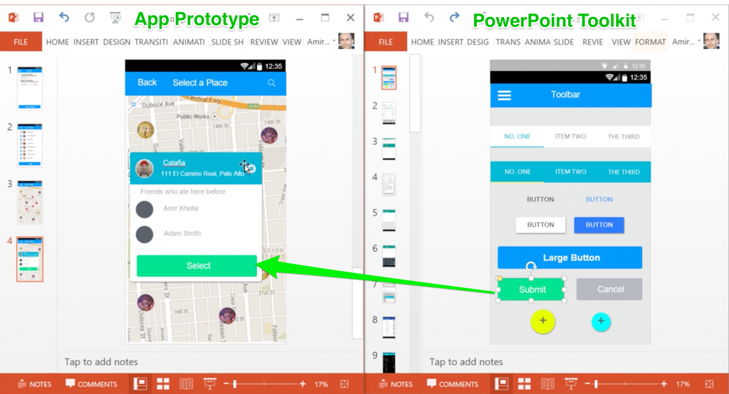

Click Prototypes with Powerpoint
Designing Prototypes

Slide 62
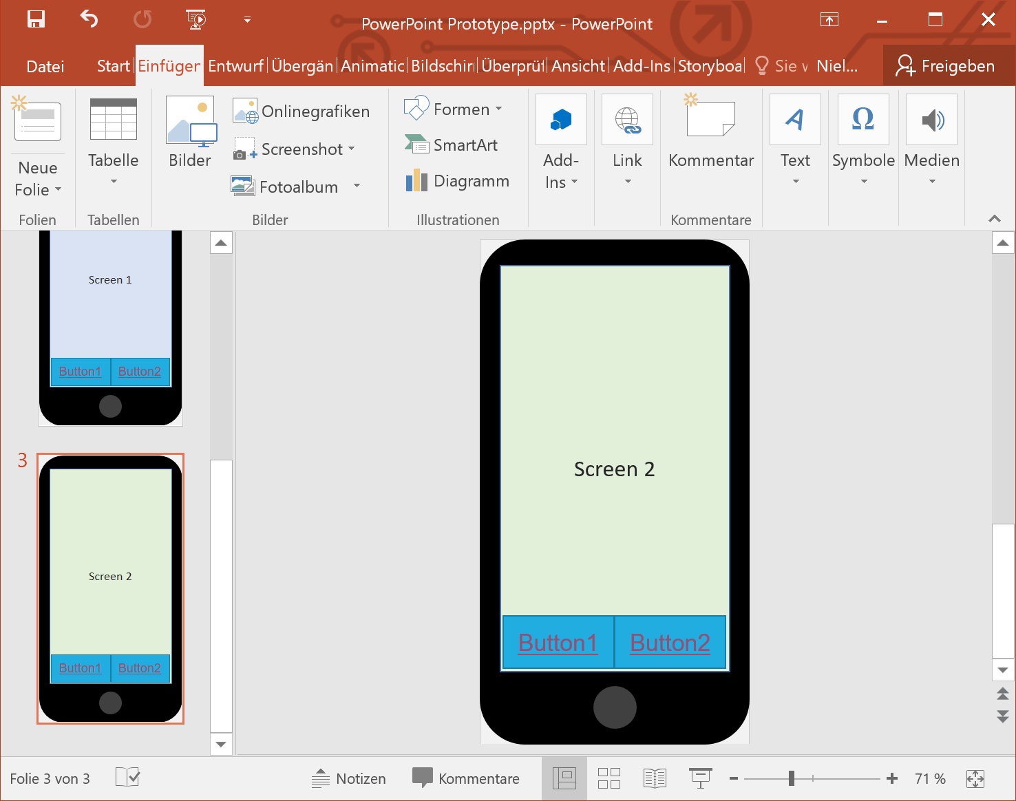
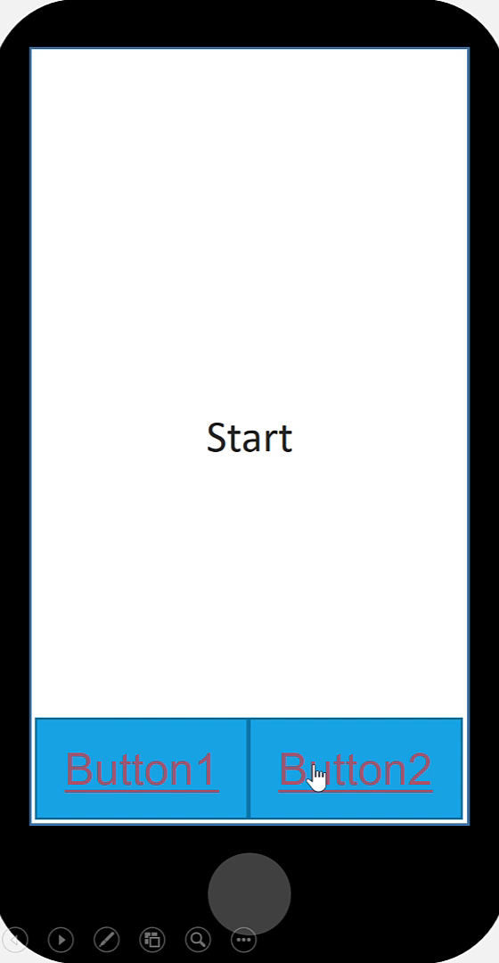
Click Prototypes with Powerpoint
Designing Prototypes

Slide 63


UI Prototyping Elements
Image by Rosenfeld Media from https://www.flickr.com/photos/rosenfeldmedia/3978127831 (CC-BY 2.0)
Designing Prototypes

Slide 64




From Scenario to App Prototype
Designing Prototypes

Slide 65




Mock-Up
Images from: https://www.shutterstock.com/image-photo/businessman-city-use-transparent-phone-latest-611026301, BMW iVision Dynamics https://europe.autonews.com, https://www.mockupworld.co/free/holding-a-coffee-cup-mockup/, https://www.archdaily.com/catalog/us/products/11884/3d-rendering-software-lumion
Designing Prototypes

Slide 66

Video MockUp
Video by Judith Amores from https://vimeo.com/76766231 (CC-BY-SA)
The World’s First Write and Erase Robot. https://scribit.design/
Designing Prototypes

Slide 67




Hardware Prototypes
Pielot, Martin & Henze, Niels & Heuten, Wilko & Boll, Susanne. (2008). Evaluation of Continuous Direction Encoding with Tactile Belts. 5270. 1-10. 10.1007/978-3-540-87883-4_1.
Erik-Oliver Blass, Kaoutar Elkhiyaoui, Refik Molva, Olivier Savry, and Cédric Vérhilac. 2011. Demo: the ff hardware prototype for privacy-preserving RFID authentication. In Proceedings of the 18th ACM conference on Computer and communications security (CCS '11). Association for Computing Machinery, New York, NY, USA, 737–740. https://doi.org/10.1145/2046707.2093481
Designing Prototypes

Slide 68



Sketching with Hardware
Huy Viet Le, Valentin Schwind, Philipp Göttlich, and Niels Henze. 2017. PredicTouch: A System to Reduce Touchscreen Latency using Neural Networks and Inertial Measurement Units. In Proceedings of the 2017 ACM International Conference on Interactive Surfaces and Spaces (ISS '17). Association for Computing Machinery, New York, NY, USA, 230–239. https://doi.org/10.1145/3132272.3134138
Designing Prototypes

Slide 69






Hardware Prototypes
Francisco Kiss, Valentin Schwind, Stefan Schneegass, and Niels Henze. 2017. Design and evaluation of a computer-actuated mouse. In Proceedings of the 16th International Conference on Mobile and Ubiquitous Multimedia (MUM '17). Association for Computing Machinery, New York, NY, USA, 261–271. https://doi.org/10.1145/3152832.3152862
Designing Prototypes

Slide 70



Hardware Prototypes
Bader, Patrick & Voit, Alexandra & Le, Huy Viet & Woz´niak, Paweł & Henze, Niels & Schmidt, Albrecht. (2019). WindowWall: Towards Adaptive Buildings with Interactive Windows as Ubiquitous Displays. ACM Transactions on Computer-Human Interaction. 26. 1-42. 10.1145/3310275
Designing Prototypes

Slide 71








Documentation: Prototypes always have value!
https://www.instructables.com/id/Making-Glove-One-a-3D-printed-wearable-cell-p/
http://objest.com
https://www.demilked.com/pac-man-original-drawings-toru-iwatani/
Designing Prototypes

Slide 72

Wizard of Oz Prototypes
Human-Computer Interaction Lecture
Slides adapted from hci-lecture.org (A. Schmidt, N. Henze, K. Wolf, V. Schwind), Image from: https://www.bbc.com/culture/article/20190808-the-subversive-messages-hidden-in-the-wizard-of-oz The Wizard of Oz, Copyright by Turner Classic Movies.
The following content is licensed under a Creative Commons Attribution 4.0 International license (CC BY-SA 4.0)

Slide 73

The Wizard of Oz Experiment
Kelley, J. F., “CAL – A Natural Language program developed with the OZ Paradigm: Implications for Supercomputing Systems”. First International Conference on Supercomputing Systems (St. Petersburg, Florida, 16–20 December 1985), New York, ACM, pp. 238–248.
Wizard of Oz Prototypes

Slide 74

The Mechanical Turk
A fake chess-playing machine from the late 18th century, which was actually concealed a human chess master inside
The Mechanical Turk was created by Wolfgang von Kempelen in 1770
A large wooden cabinet with a life-sized model of a human head and torso, dressed in Turkish robes and turban (hence the name "Turk").
Today, the term "Mechanical Turk" has been repurposed by Amazon for its crowdsourcing internet marketplace called Amazon Mechanical Turk (MTurk)
Engraving from the book: Freiherr Joseph Friedrich zu Racknitz, Ueber den Schachspieler des Herrn von Kempelen, Leipzig und Dresden 1789.
Wizard of Oz Prototypes

Slide 75
The Wizard of Oz Paradigm
Users interact with a system they believe to be autonomous, but which is actually being operated or partially controlled by an unseen human operator
Allows to simulate and explore the behavior of a system that has not yet been fully developed or that may require complex artificial intelligence (AI) which is not yet available
The WoZ paradigm is employed for several purposes:
To study how users interact with and react to a system before the actual system is built.
To gather user feedback on the design and functionality of a system without the need for complete backend development.
To explore how users might use and experience new technologies.
Wizard of Oz Prototypes

Slide 76

How fast would you build a prototype?
In an hour?
In a day?
In a week?
In a year?
Wizard of Oz Prototypes

Slide 77

Preferred Voices of Smart Agents
Example: We compared different voices and personalities
Participants got a set of tasks (“book a trip to Tokyo”)
Experimenter played pre-recorded sound files of humans
Participants did not even notice that no speech recognition or reasoning was involved
Participants preferred female voices for simple tasks, and male voices for complex tasks
Habler, F., Schwind, V., & Henze, N. (2019). Effects of Smart Virtual Assistants' Gender and Language. In MuC.
Wizard of Oz Prototypes

Slide 78

Wizard of Oz as a Rapid-Prototyping Technique
“Wizard of Oz is a rapid-prototyping method for systems costly to build or requiring new technology. A human ‘Wizard’ simulates the system’s intelligence and interacts with the user through a real or mock computer interface.”
“Pay no attention to that man behind the curtain ...," takes on a new meaning when the curtain is replaced by a computer terminal
Typical areas: Speech recognition, Speech synthesis, Annotation, Reasoning, Computer vision, Gaming, …
Maulsby, D., Greenberg, S., & Mander, R. (1993). Prototyping an intelligent agent through Wizard of Oz. In Proceedings of the INTERACT'93 and CHI'93 conference on Human factors in computing systems.
Wizard of Oz Prototypes

Slide 79
Wizard of Oz
Advantages
You receive early feedback
You can compare multiple design and prototype alternatives
High ecological validity when the operator’s performance can be reached, or the operator can simulate the system’ final performance
Disadvantages
Even implementing the soft parts requires some effort
You must hide the operator
Performance depends on the operator
Unclear if operator’s performance is equal to the system’s performance
Low external validity (when the operator’s performance cannot be reached or is worse)
Wizard of Oz Prototypes

Slide 80

Virtual Prototypes
Human-Computer Interaction Lecture
Slides adapted from hci-lecture.org (A. Schmidt, N. Henze, K. Wolf, V. Schwind), Image from: https://pxhere.com/de/photo/669444
The following content is licensed under a Creative Commons Attribution 4.0 International license (CC BY-SA 4.0)

Slide 81
Virtual Prototypes
CAD geometry that is used to construct the prototype can be used to simulate a prototype
3D Shape and unit function
Even interactivity can be realized
Identify problems prior to their implementation
Quickly test effect of changes
Testing behavior under simulated conditions (not part of this lecture)
A virtual prototype can be 3D-printed („rapid prototyping“)
Efficient and cost-effective
Requires trained developers in their methodology
Virtual Prototypes

Slide 82
Virtual Prototyping
Used for design evaluation, usability testing, and to visualize how a new product will look and function before it is built method in the process of product development.
It involves using 3D models to validate a design before committing to making a physical prototype.
Done by creating (usually 3D) computer generated geometrical shapes (parts) and either combining them into an "assembly" and testing different mechanical motions, fit and function.
The interaction can be simulated in AR/VR/MR
Very cheap, fast, and convincing
End-to-end prototyping accounts design decision during prototyping for the final product
Eliminate the need for physical materials and the labor to build them, reducing the cost of the prototyping phase significantly.
Virtual Prototypes

Slide 83
Virtual Prototyping
Physical Prototype
Physical Prototype
Physical Prototype
Physical Prototype
Virtual Prototype
Physical Prototype
Benefit
Decreased time
to test the prototype with improved quality
Virtual Prototypes

Slide 84

Virtual Prototyping Tools
MSC Adams/Chassis
Universal Mechanism
MatLab
DyMoLa
Webots
Simbad
ThreeDimWorks
OpenSim (for humans)
RoboWorks
Autodesk Fusion
Tinkercad (free, web-based)
Image from https://slideplayer.com/slide/13314860/
Virtual Prototypes

Slide 85

Example: Mechanics
Images from Web-Based Self-Paced Virtual Prototyping Tutorials Rajankumar Bhatt Graduate Student Chin Pei Tang Graduate Student https://slideplayer.com/slide/5013074/
Virtual Prototypes

Slide 86


Example: Virtual Prototypes
Aromaa, S., Viitaniemi, J., & Leino, S.-P. (2014). Virtual prototyping in human-machine interaction design. ResearchGate. Retrieved from https://www.researchgate.net/publication/275946481_Virtual_prototyping_in_human-machine_interaction_design/figures?lo=1

Slide 87

Image from: Frankfurt University of Applied Sciences
Virtual Prototypes

Slide 88










Ecological Validity of Virtual Prototyping
Online Survey
Virtual Reality
Augmented Reality
Lab Study
In-Situ Study
Apparatus
Artifact
Video
3D
Real and Projected
Real in Lab
Real and in-situ
Virtual Prototypes

Slide 89


Ecological Validity of Virtual Prototyping
Virtual Prototypes

Slide 90
Virtual Prototypes
Advantages
Cost-effective/Time-efficient: Reduces prototyping expenses and allows for rapid iterations
Safe testing: Simulates dangerous scenarios risk-free
Advanced visualization: 3D models from any perspective
Functional simulation: Tests under various conditions
Easily shareable: Facilitates remote collaboration
Eco-friendly: Minimizes waste from physical materials
Disadvantages
Tactile feedback: Difficult to replicate physical touch
Technical limitations: May miss real-world complexity
Resource-intensive: Requires high computational power/headsets
Potential for overreliance: Could ignore physical prototyping benefits
Risk of misinterpretation: May be seen as more complete than they are
Virtual Prototypes

Slide 91
Questions?
Prototyping

