Slide 1



Models
Human-Computer Interaction Lecture
Slides adapted from hci-lecture.org (A. Schmidt, N. Henze, K. Wolf, V. Schwind), Image from: https://pxhere.com/de/photo/956874
The following content is licensed under a Creative Commons Attribution 4.0 International license (CC BY-SA 4.0)

Slide 2
Image from: https://pxhere.com/de/photo/956874
Models

Slide 3
Learning Goals
Understand …
  what models are and why they are useful
  know about their limitations
  have a rough overview of models in HCI
Be able to explain …
  explain these models and give examples
  discuss implications and how models can be used to evaluate UIs
Models

Slide 4
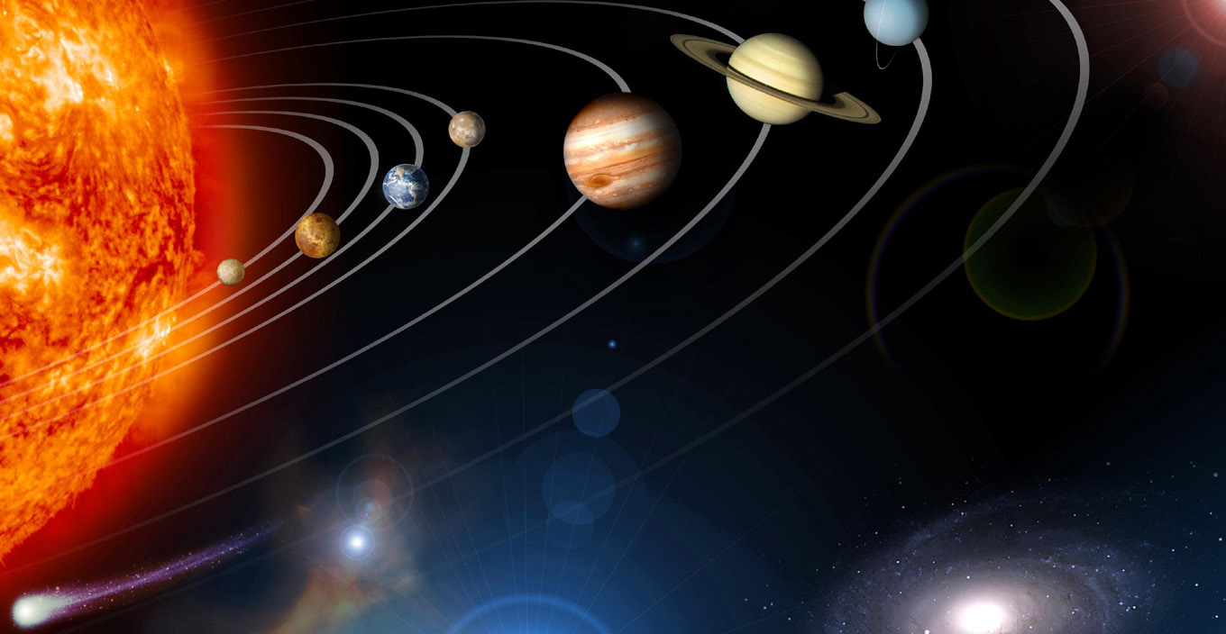

$$T^{2}=\left(\frac{4π²}{GM}\right)r³$$
From https://www.jpl.nasa.gov/spaceimages/details.php?id=PIA12114 (PD)
Models

Slide 5
Models
Are representations of phenomena that help us to understand how something works or how it will work.
  We need models for humans (e.g., Cognition, Mental Models,…)
  We need models for systems (e.g., Regression, Machine Learning,…)
  We need models how human interact with systems
Models are never perfect. There will always be one that is better for specific questions.
A model is only useful for specific phenomena but not is not useful for most phenomena.
Models

Slide 6
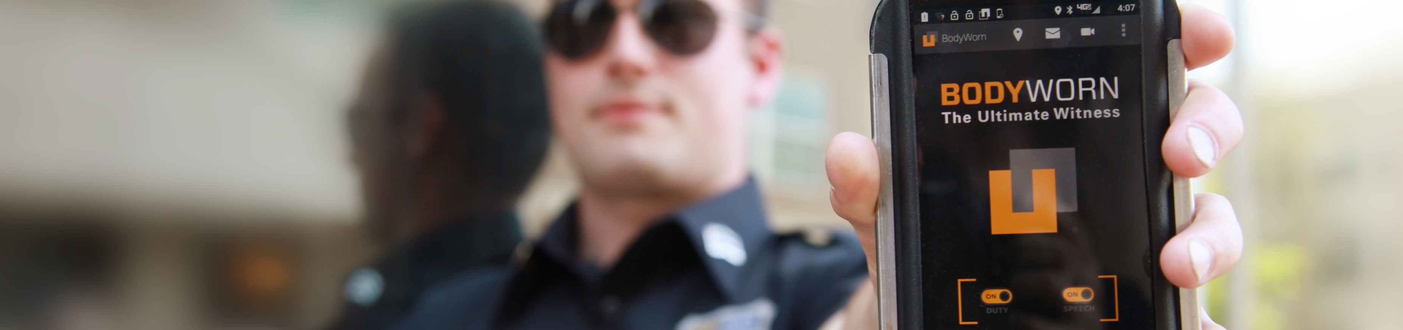
Fitts’ Law
Prediction of Target Selection
Slides adapted from hci-lecture.org (A. Schmidt, N. Henze, K. Wolf, V. Schwind), Image from: https://pxhere.com/de/photo/956874
The following content is licensed under a Creative Commons Attribution 4.0 International license (CC BY-SA 4.0)

Slide 7

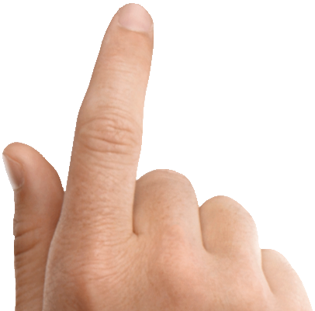
In- and Output
Fitts’ Law

Slide 8
In- and Output
distance
width
Fitts’ Law

Slide 9
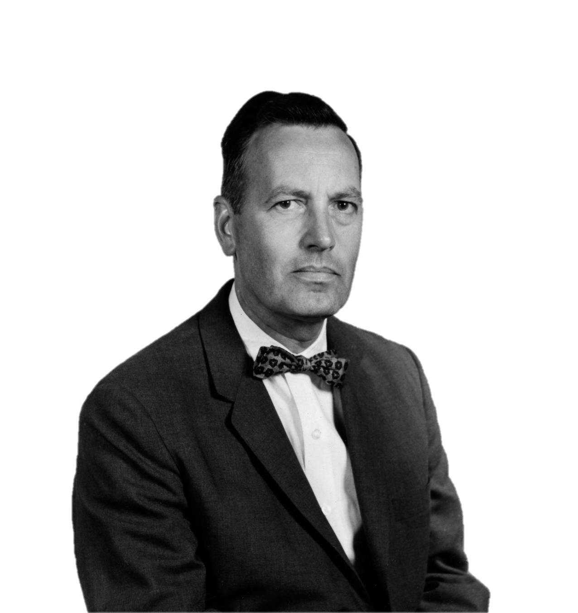
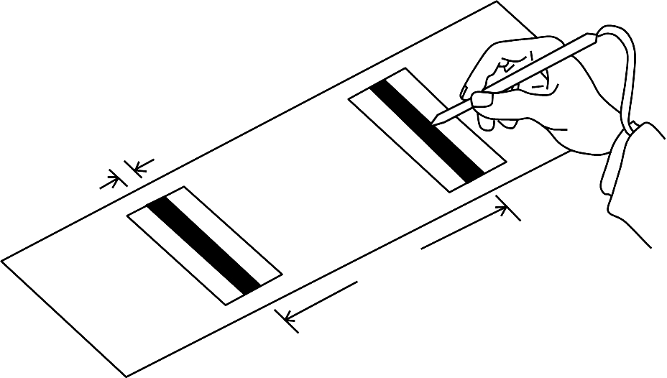
Paul Fitts‘ Experiment
Four distances: 2, 4, 8, 16 inch
Four widths: 0.25, 0.5, 1.0, 2.0 inch
From: U-M Library Digital Collections. Bentley Image Bank, Bentley Historical Library. Accessed: March 27, 2020. CC BY 4.0
Fitts’ Law

Slide 10
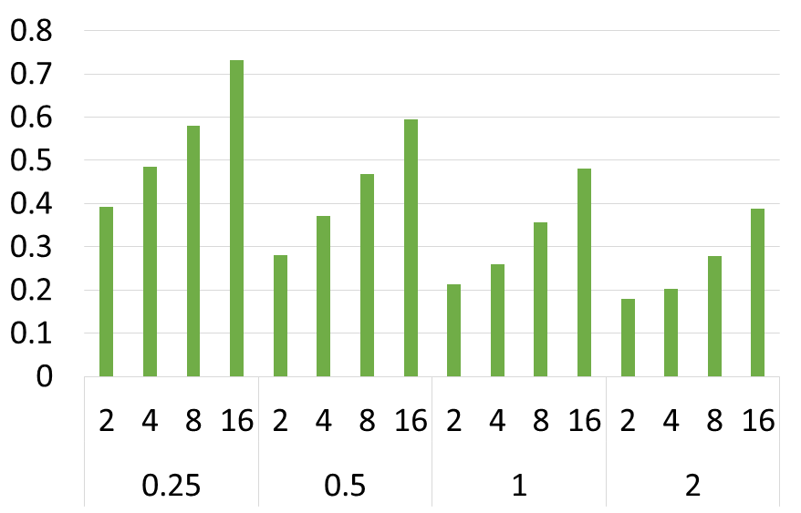
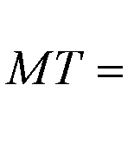
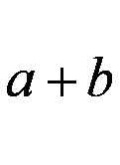
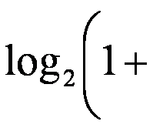


Fitts‘ Experiment
The movement time (MT) to select a target is a function of the target’s width (W) and distance (D). It depends on the input device.
W
movement time in seconds
D
start
target
MT: movement time
a & b: input device-dependent constants
D: distance to the target
W: width of the target
From: Fitts, P. M. (1954). The information capacity of the human motor system in controlling the amplitude of movement. Journal of experimental psychology, 47(6), 381.
distance & width
Fitts’ Law

Slide 11
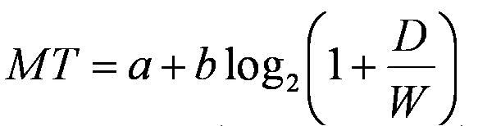
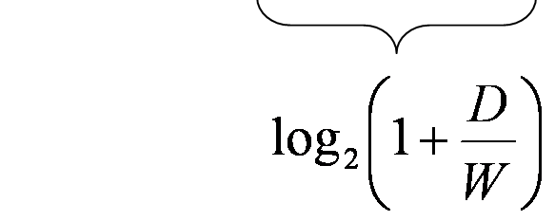
The Index of Difficulty
Index of Difficulty, ID =
  MT = a + b ·ID
  ID how difficult a task is independent from the input device
Units:
  a is measured in seconds
  b is measured in seconds per bit
  Index of Difficulty (ID) is described in bits
Fitts’ Law

Slide 12
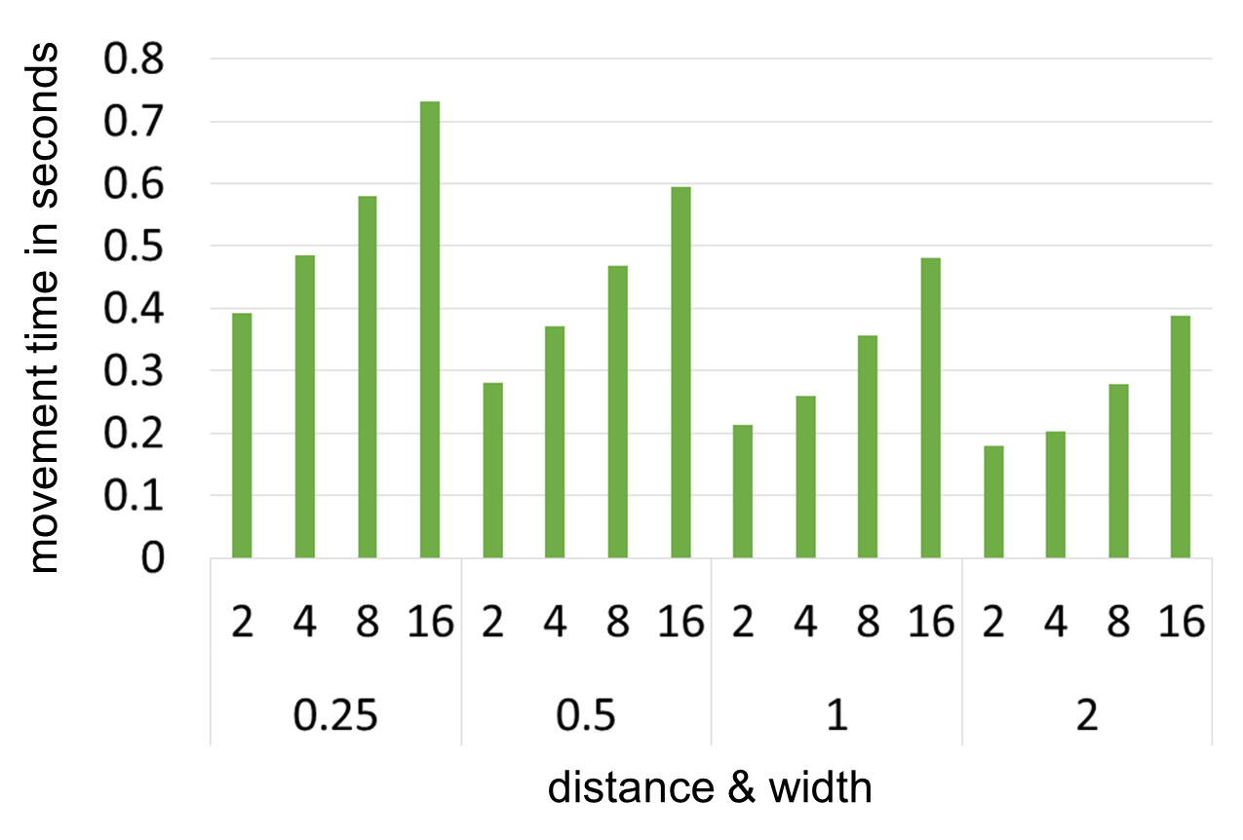

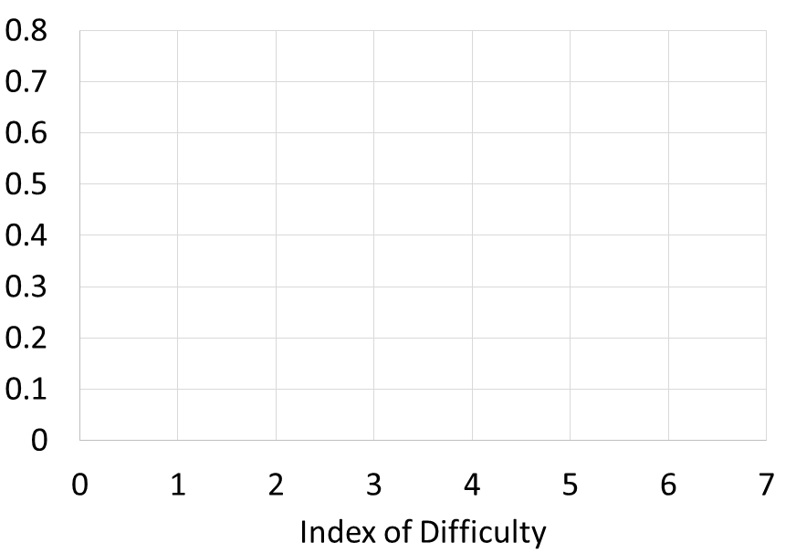
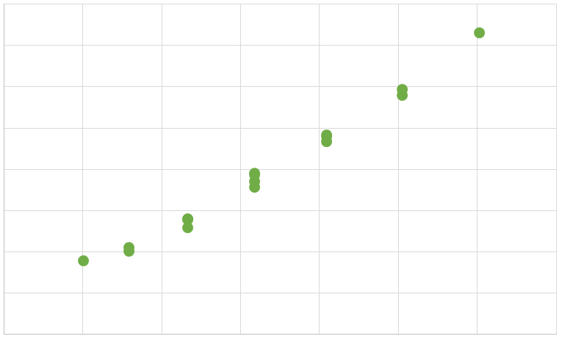
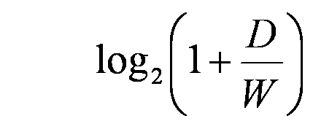
Determining a and b
a = 0.028 s
b = 0.112 s/bit
y = bx + a
y = 0.11 2x + 0.028
R² = 0.987
D = 16, W = 0.25
ID = log₂(1+64) = 6.02
ID =
Fitts’ Law

Slide 13
Predicting the Movement Time
a = 0.028s
b = 0.112s/bit
How long does it take to select a target that is 21 inch away and 3 inch wide?
MT = 0.028 + 0.112 * log2(1+7)
= 0.028 + 0.112 * log2(8)
= 0.028 + 0.112 * 3
= 0.364ms
Fitts’ Law

Slide 14
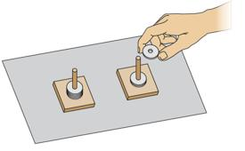
Determine a and b for another device / task
width | distance | MT
0,0625 | 4 | 0,697
0,0625 | 8 | 0,771
0,0625 | 16 | 0,896
0,0625 | 32 | 1,096
0,125 | 4 | 0,649
0,125 | 8 | 0,734
0,125 | 16 | 0,844
0,125 | 32 | 1,028
0,25 | 4 | 0,607
0,25 | 8 | 0,672
0,25 | 16 | 0,771
0,25 | 32 | 0,975
0,5 | 4 | 0,535
0,5 | 8 | 0,623
0,5 | 16 | 0,724
0,5 | 32 | 0,902
What are a and b for this?
a = 0,2234
b = 0,0926
Understanding Fitts' Law. (2024, November 14). Retrieved from https://us.humankinetics.com/blogs/excerpt/understanding-fitts-law
Fitts’ Law

Slide 15
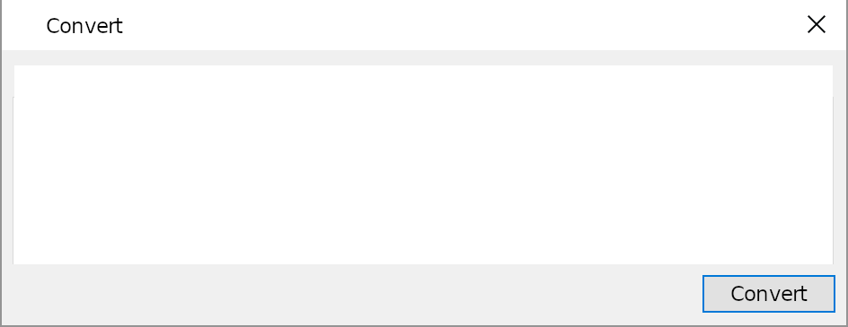

Fitts‘ in 2D
distance
width
Fitts’ Law

Slide 16
distance
width
What are width and distance?
Fitts’ Law

Slide 17
Fitts‘ in 2D
Fitts’ Law

Slide 18
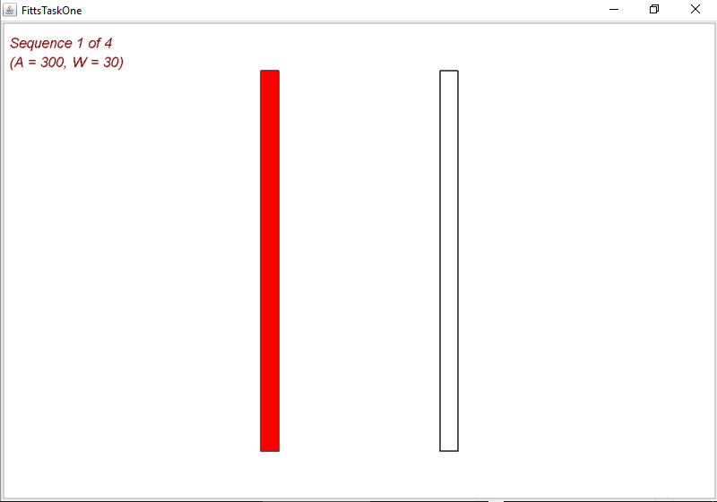
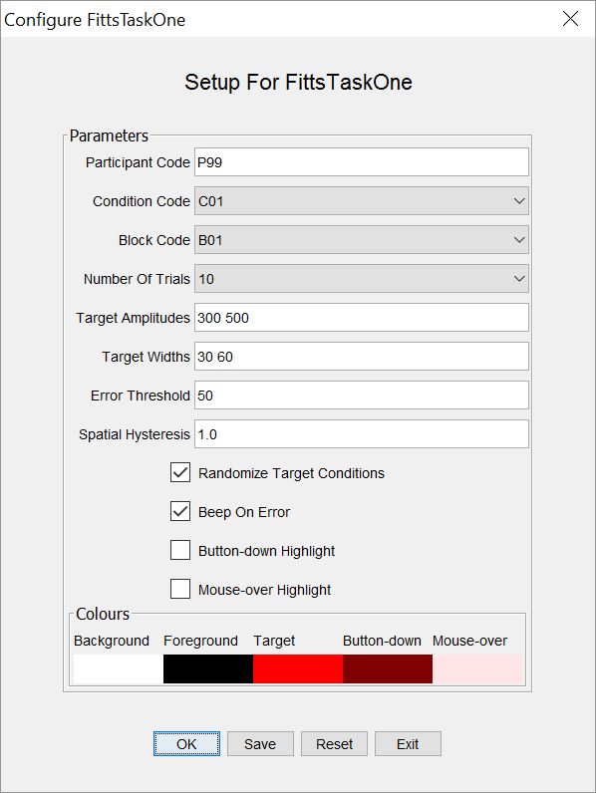
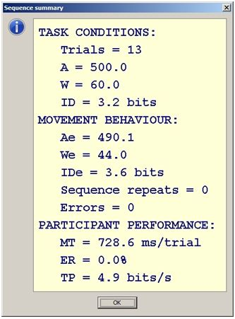
Standardized 1D Fitts‘ Task
Commonly using a fixed set of amplitudes and Widths, e.g.:
Amplitude (A): 64, 128, 256, 512 pixels
Width (W): 8, 16, 32, 64 pixels
Fitts’ Law

Slide 19
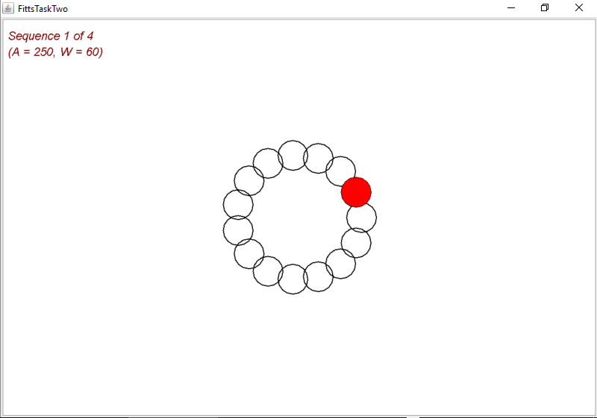
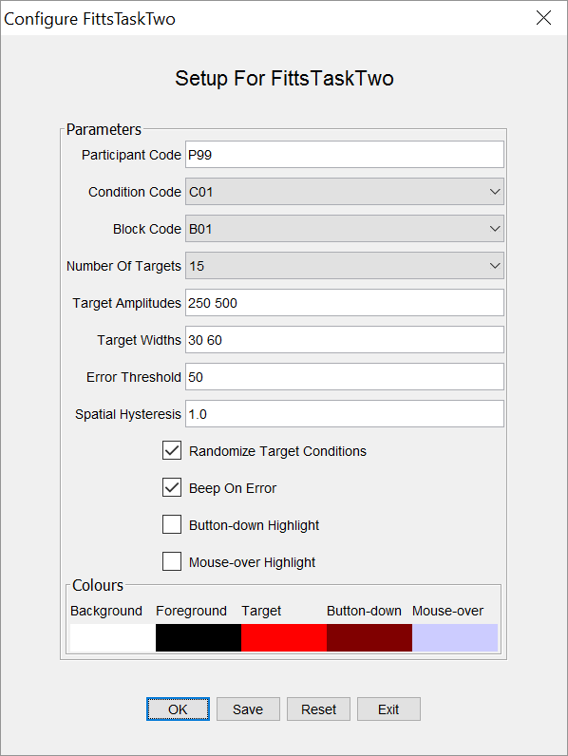
Standardized 2D Fitts‘ Task
Commonly using a fixed set of amplitudes and Widths, e.g.:
Amplitude (A): 64, 128, 256, 512 pixels
Width (W): 8, 16, 32, 64 pixels
Fitts’ Law

Slide 20
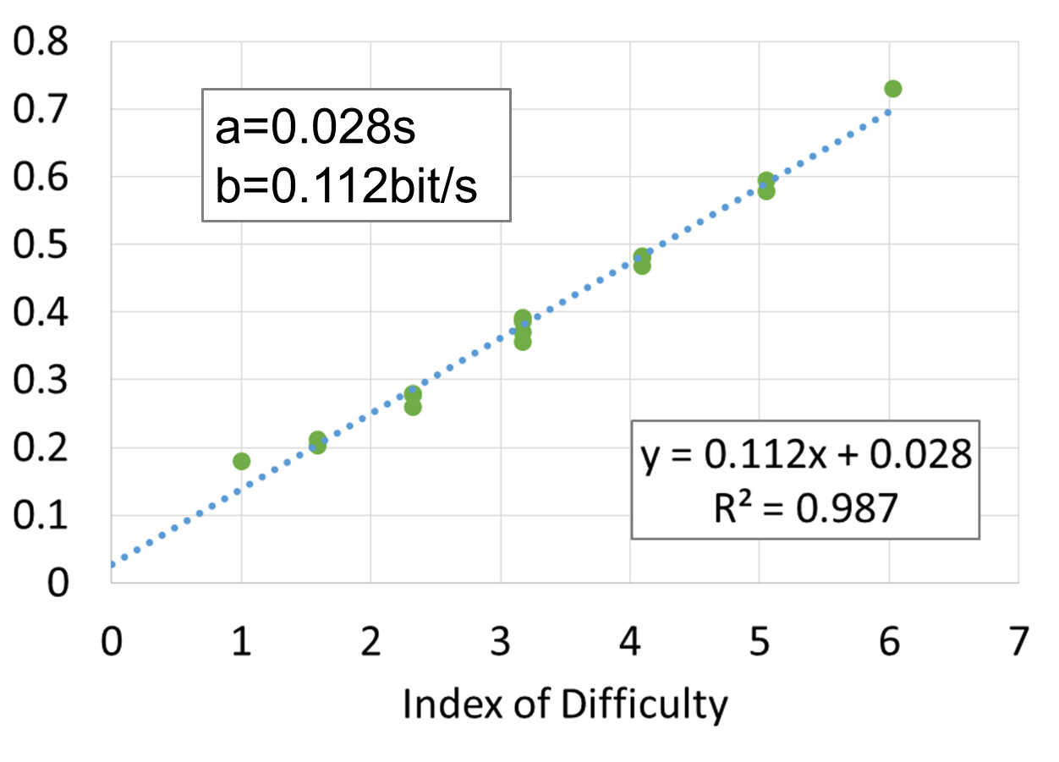
Throughput
A single metric for a pointing device
  Works with serial (a series of target selections)
  Works with discrete (single target selections)
Sufficient with six different IDs to determine the device-specific constants a and b
Fitts’ Law

Slide 21
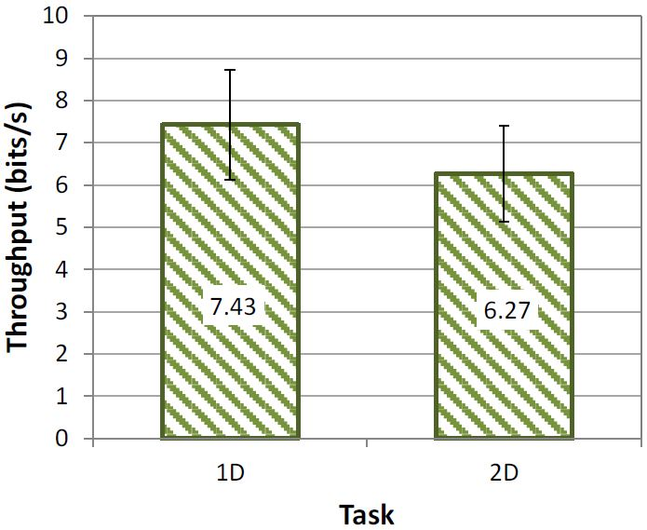
1D vs 2D
MacKenzie, I. S. (2018). Fitts' law. In K. L. Norman & J. Kirakowski (Eds.), Handbook of human-computer interaction, pp. 349-370. Hoboken, NJ: Wiley. doi:10.1002/9781118976005
Fitts’ Law

Slide 22
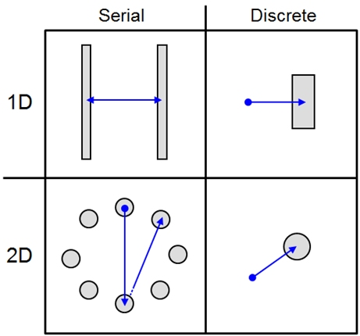
Serial vs Discrete
MacKenzie, I. S., and Isokoski, P. (2008). Fitts' throughput and the speed-accuracy tradeoff. Proceedings of the ACM Conference on Human Factors in Computing Systems – CHI 2008, pp. 1633-1636. New York: ACM.
Fitts’ Law

Slide 23
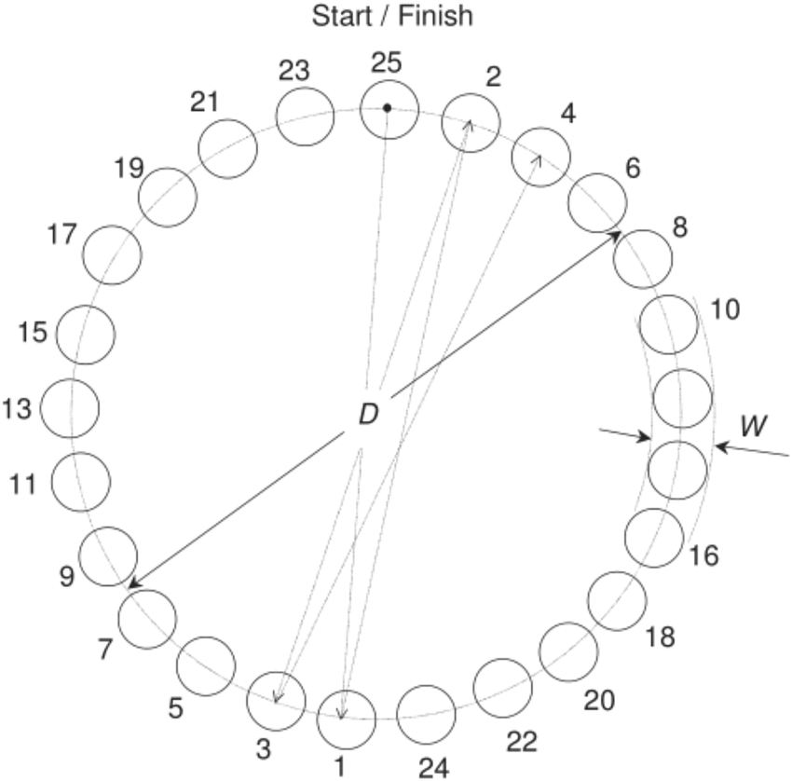
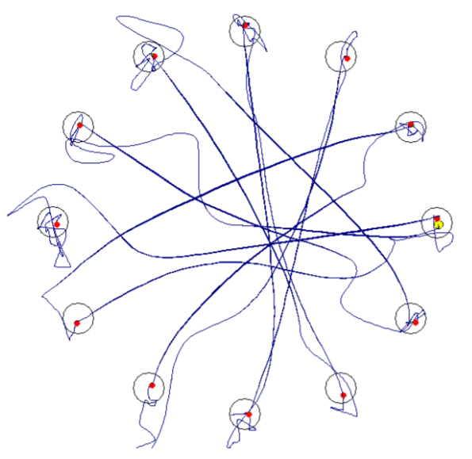
Fitts‘ in 2D (ISO 9241-9)
Guo, X. (2022). A Fitts' law evaluation and comparison for human and manipulator on touch task. Cognit. Comput. Syst., 4. doi: 10.1049/ccs2.12057
Fitts’ Law

Slide 24
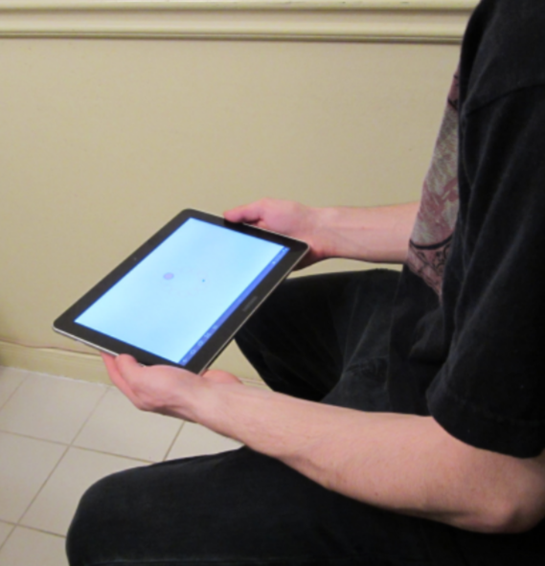
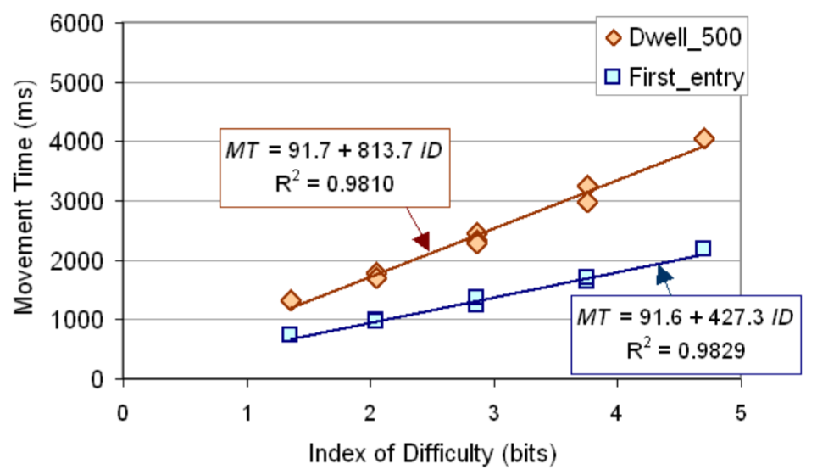
Fitts’ Law

Slide 25
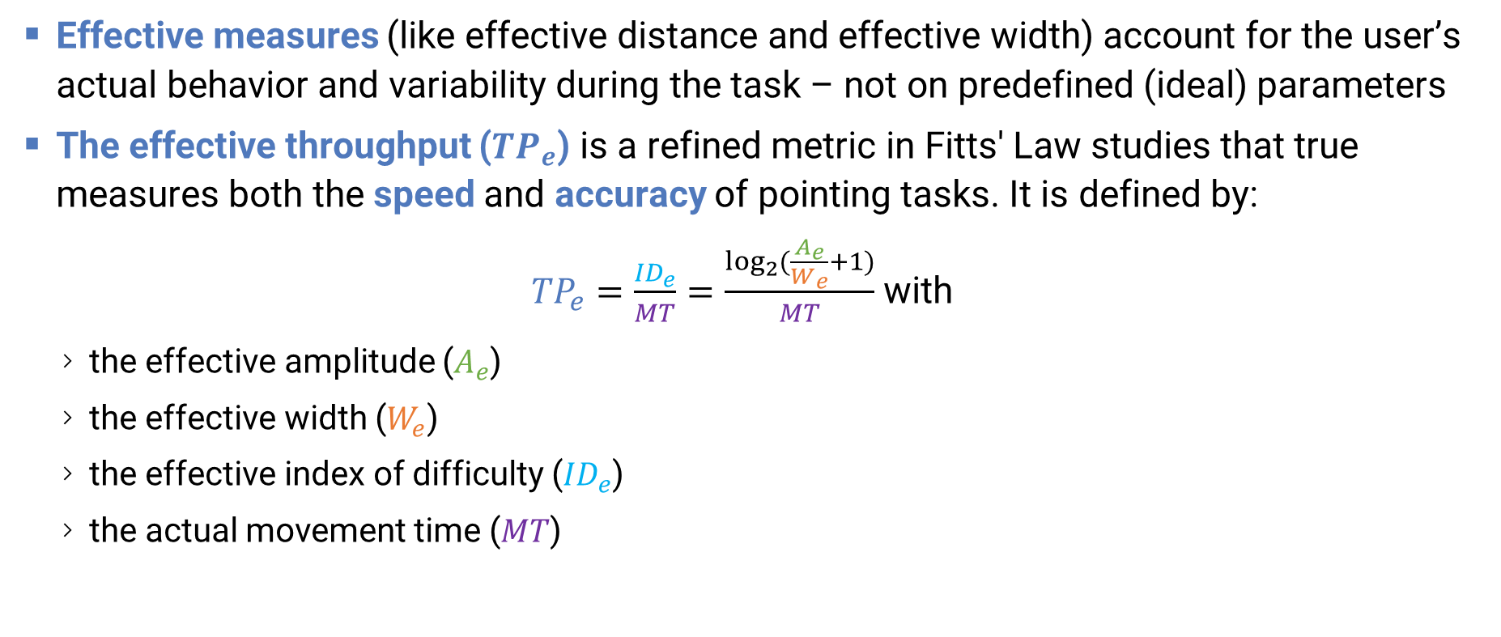
Effective Throughput
Effective measures (like effective distance and effective width) account for the user’s actual behavior and variability during the task – not on predefined (ideal) parameters
The effective throughput (${TP}_{e}$) is a refined metric in Fitts' Law studies that true measures both the speed and accuracy of pointing tasks. It is defined by:
${TP}_{e}=\frac{{ID}_{e}}{MT}=\frac{\log_{2}{(\frac{A_{e}}{W_{e}}+1)}}{MT}$with
  the effective amplitude ($A_{e}$)
  the effective width ($W_{e}$)
  the effective index of difficulty (${ID}_{e}$)
  the actual movement time ($MT$)
Fitts’ Law

Slide 26
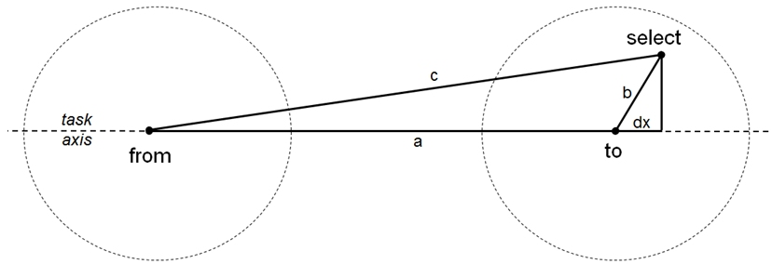
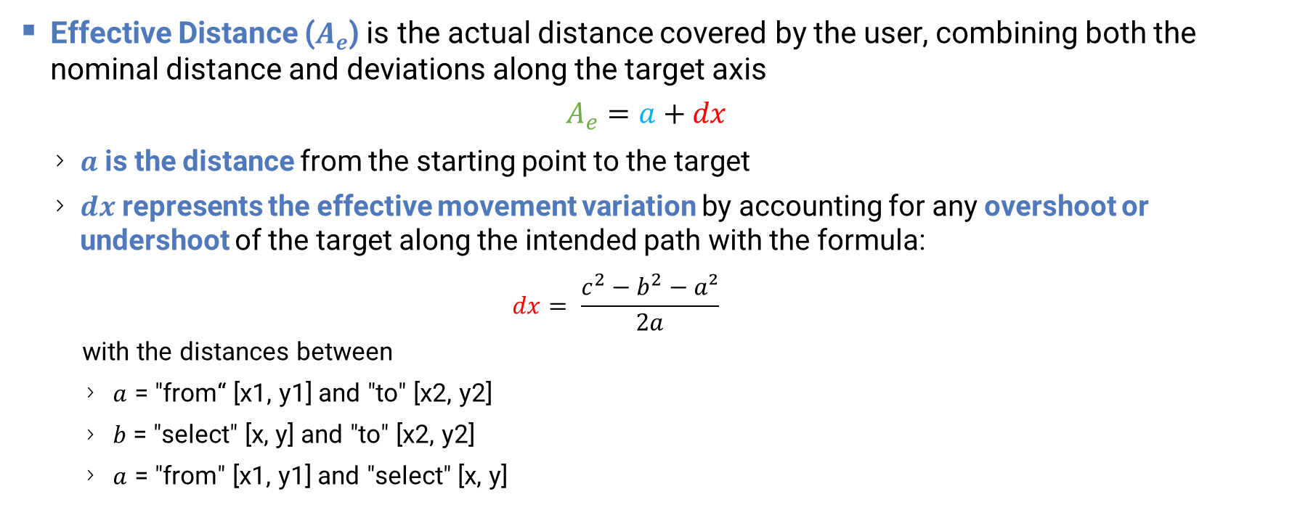
Effective Distance
Effective Distance ($A_{e}$) is the actual distance covered by the user, combining both the nominal distance and deviations along the target axis
$$A_{e}=a+dx$$
  $a$ is the distance from the starting point to the target
  $dx$ represents the effective movement variation by accounting for any overshoot or undershoot of the target along the intended path with the formula:
    $$dx= \frac{c^{2}−b^{2}−a²}{2a}$$
    with the distances between
    $a$ = "from“ [x1, y1] and "to" [x2, y2]
    𝑏 = "select" [x, y] and "to" [x2, y2]
    $a$ = "from" [x1, y1] and "select" [x, y]
MacKenzie, I. S., and Isokoski, P. (2008). Fitts' throughput and the speed-accuracy tradeoff. Proceedings of the ACM Conference on Human Factors in Computing Systems – CHI 2008, pp. 1633-1636. New York: ACM.
Fitts’ Law

Slide 27
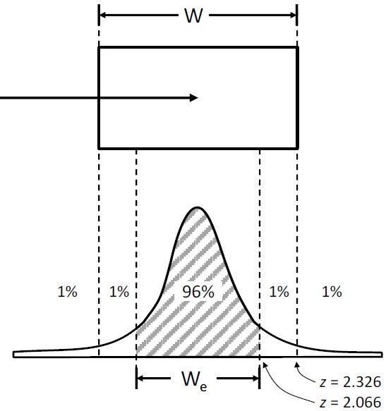
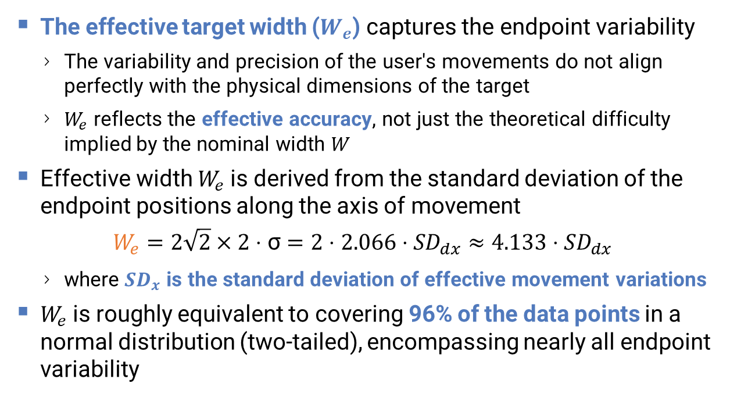
Effective Width
The effective target width ($W_{e}$) captures the endpoint variability
  The variability and precision of the user's movements do not align perfectly with the physical dimensions of the target
  $W_{e}$ reflects the effective accuracy, not just the theoretical difficulty implied by the nominal width $W$
Effective width $W_{e}$​is derived from the standard deviation of the endpoint positions along the axis of movement
$$W_{e}=2\sqrt{2}×2 \text{⋅} \text{σ}=2 \text{⋅} 2.066 \text{⋅} {SD}_{dx}≈4.133 \text{⋅}{ SD}_{dx}$$
  where ${SD}_{x}$ is the standard deviation of effective movement variations
$W_{e}$is roughly equivalent to covering 96% of the data points in a normal distribution (two-tailed), encompassing nearly all endpoint variability
MacKenzie, I. S., and Isokoski, P. (2008). Fitts' throughput and the speed-accuracy tradeoff. Proceedings of the ACM Conference on Human Factors in Computing Systems – CHI 2008, pp. 1633-1636. New York: ACM.
Fitts’ Law

Slide 28

Effective Throughput
$${TP}_{e}=\frac{{ID}_{e}}{MT}=\frac{\log_{2}{(\frac{A_{e}}{W_{e}}+1)}}{MT}=\frac{\log_{2}{(\frac{a+\frac{c^{2}−b^{2}−a²}{2a}}{4.133 \text{⋅} {SD}_{dx}}+1)}}{MT}$$
# Variables we need to solve Fitts' equation for 2D
data$a <- hypot(data$fromX - data$toX, data$fromY - data$toY) # distance between "from" and "to"
data$b <- hypot(data$selectX - data$toX, data$selectY - data$toY) # distance between "select" and "to"
data$c <- hypot(data$fromX - data$selectX, data$fromY - data$selectY) # distance between "from" and "select"
data$dx <- (data$c^2 - data$b^2 - data$a^2) / (2.0 * data$a)
data$AmpE <- data$a + data$dx
# Aggregate to get dxSD
means <- data %>% group_by(SubjectID, ID, Conditions) %>% summarize(
MT = mean(Duration), SD = sd(Duration), Ae = mean(AmpE), dxSD = sd(dx), Amp = mean(Amplitude),
Size = mean(Size), IDs = round(log2((mean(Amplitude) / mean(Size)) + 1), 2), .groups = 'drop‘)
# Aggregate to get TPe
finalTPs <- means %>% group_by(SubjectID, Conditions, IDs) %>% summarize(
MeanTime = mean(MT),
IDe = mean(log2((Ae/(4.133 * dxSD)) + 1)),
TPe = mean(log2((Ae/(4.133 * dxSD)) + 1) / (MT/1000)),
TPs = mean(log2(IDs) / (MT/1000)),
.groups = 'drop')
Code example in R
Fitts’ Law

Slide 29
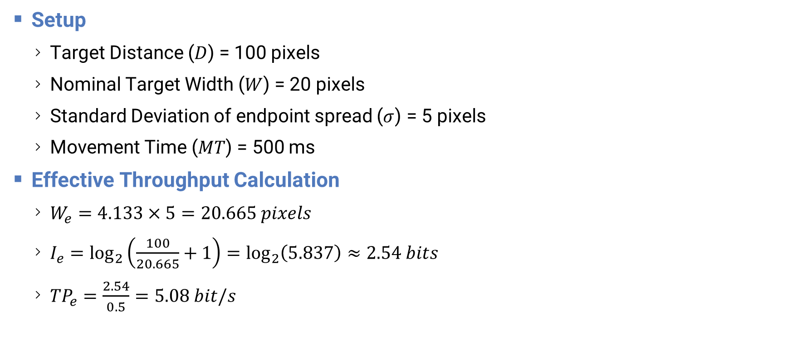
Example
Setup
  Target Distance ($D$) = 100 pixels
  Nominal Target Width ($W$) = 20 pixels
  Standard Deviation of endpoint spread ($σ$) = 5 pixels
  Movement Time ($MT$) = 500 ms
Effective Throughput Calculation
  $W_{e}=4.133×5=20.665 pixels$
  $I_{e}=\log_{2}\left(\frac{100}{20.665}+1\right)=\log_{2}\left(5.837\right)≈2.54 bits$
  ${TP}_{e}=\frac{2.54}{0.5}=5.08 bit/s$
20 px
5 px
100 px
Fitts’ Law

Slide 30
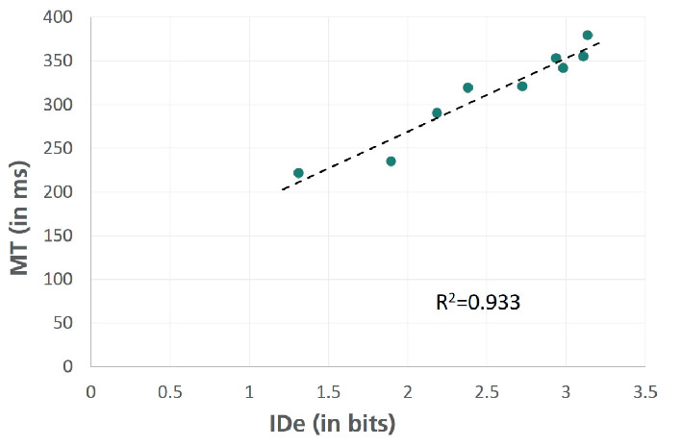
Regression Trend Examples
Static IDs
Effective IDs
Priya, K., & Joshi, A. (2023). Fitts’ Throughput Vs Empirical Throughput: A Comparative Study. Human-Computer Interaction – INTERACT 2023. Springer. doi: 10.1007/978-3-031-42280-5_28
Fitts’ Law

Slide 31
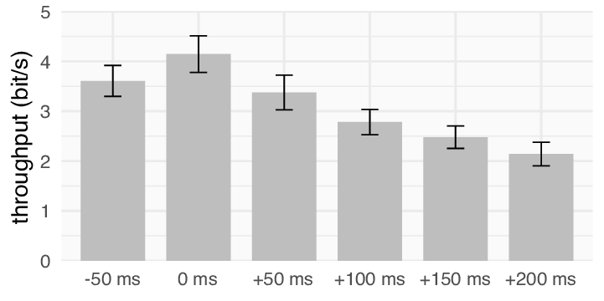
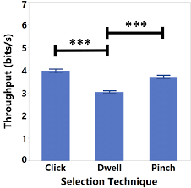
Throughput Measures Examples
Schwind, V., Halbhuber, D., Fehle, J., Sasse, J., Pfaffelhuber, A., Tögel, C., ...Henze, N. (2020). The Effects of Full-Body Avatar Movement Predictions in Virtual Reality using Neural Networks. ResearchGate, 1–11. doi: 10.1145/3385956.3418941
Mutasim, A., Batmaz, A., & Stuerzlinger, W. (2021). Pinch, Click, or Dwell: Comparing Different Selection Techniques for Eye-Gaze-Based Pointing in Virtual Reality. ResearchGate. doi: 10.1145/3448018.3457998
Fitts’ Law

Slide 32
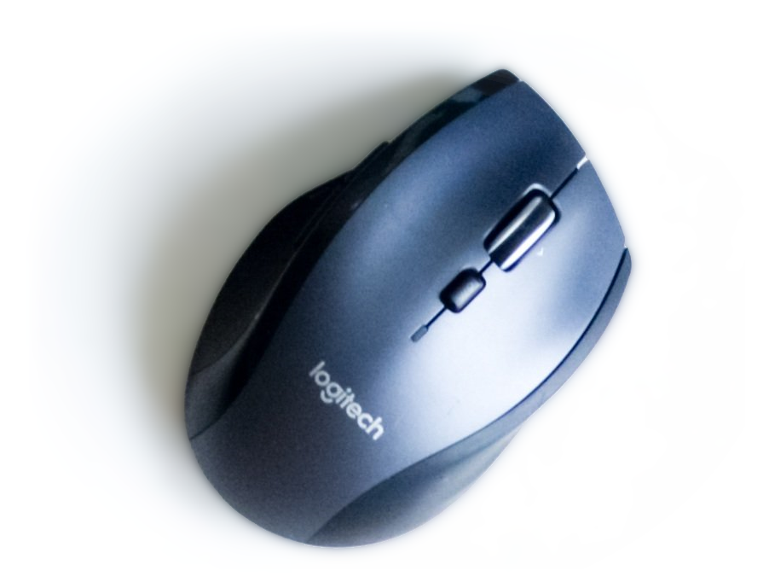
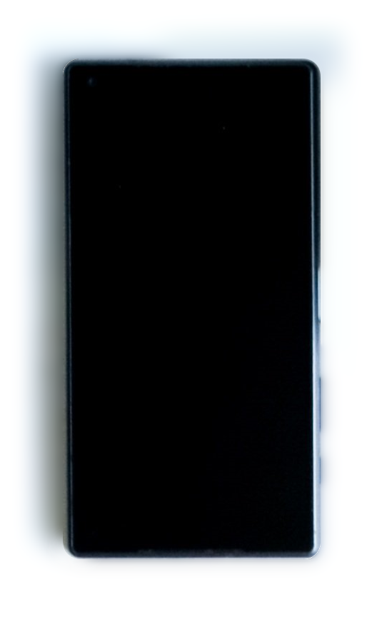


Which device has the highest throughput?
3.7 - 4.5 bit/s
2.3 - 3.0 bit/s
2.3 - 2.9 bit/s
2.55 bit/s
Fitts’ Law

Slide 33

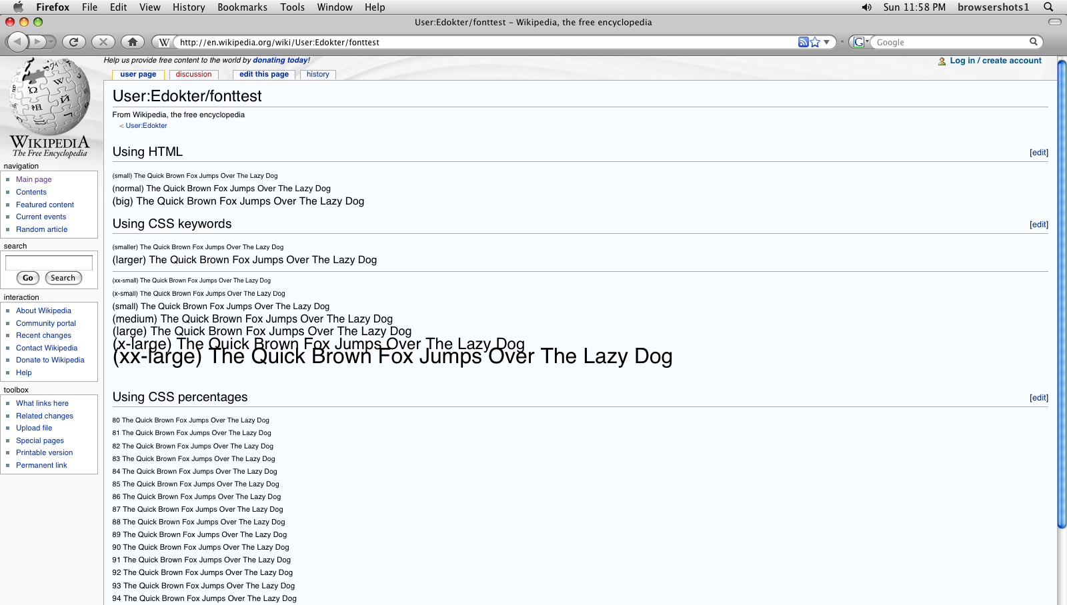
Fitts’ Law

Slide 34
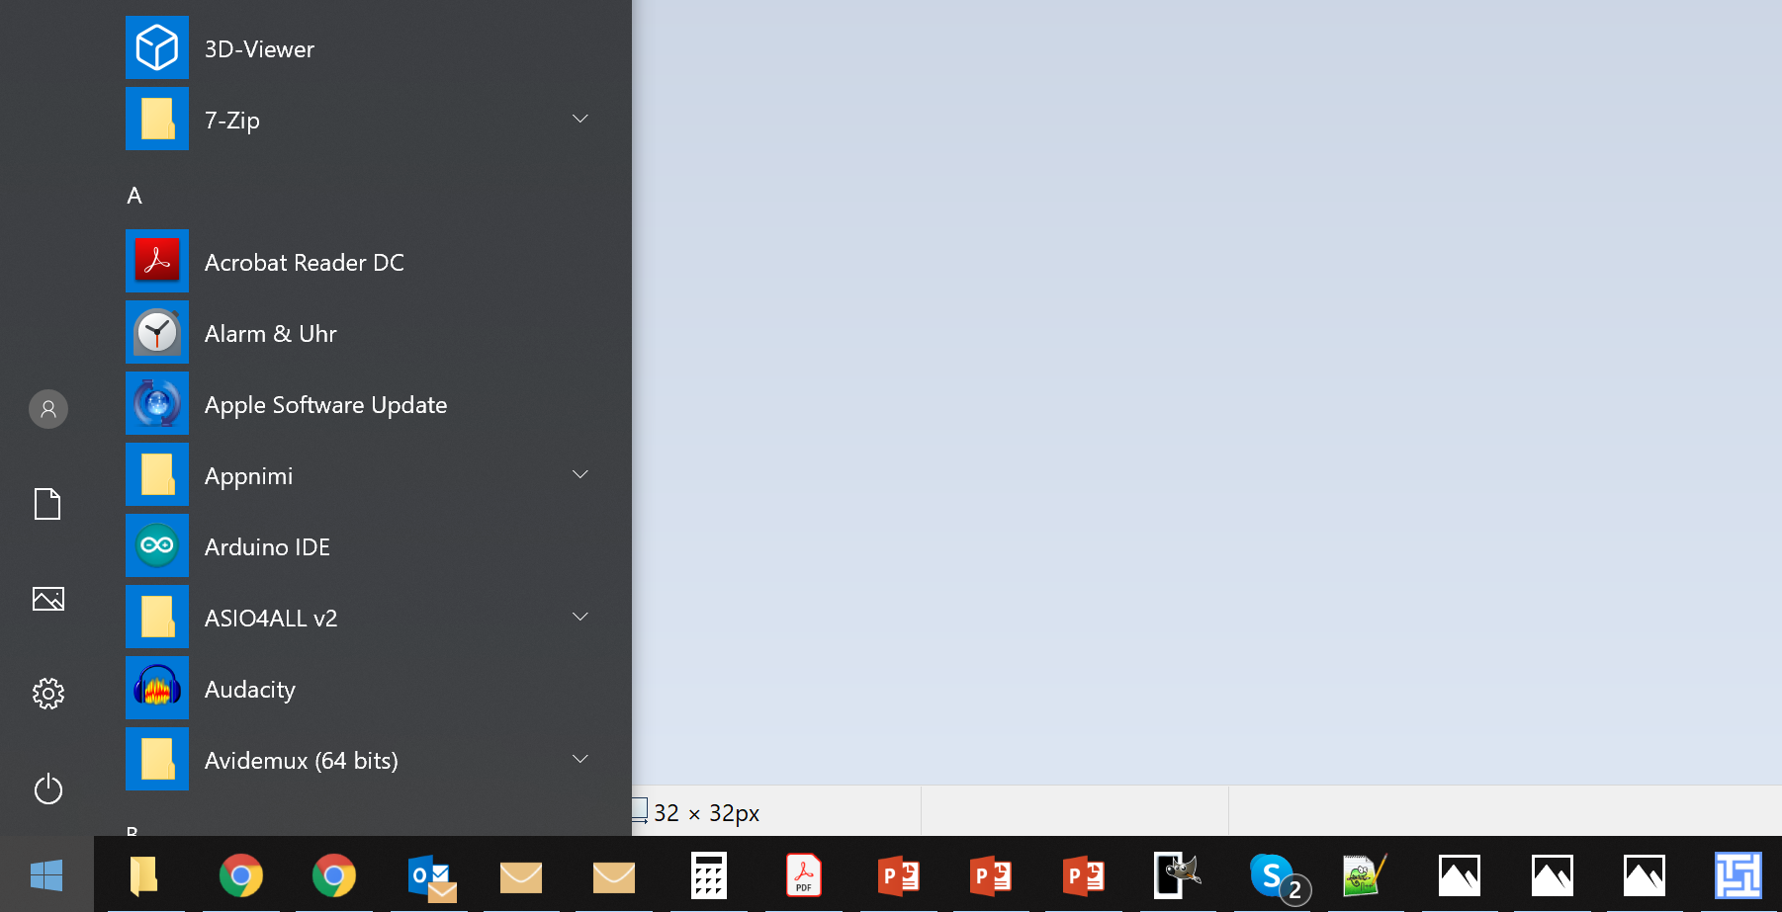
Fitts’ Law

Slide 35

Rule of Infinite Edges
∞
Edges and corners are the easiest to reach by a pointing device
  The width of a target edge is infinite large
  Only works in full screen
  Pages are scrollable
The coordinates of the corners are also called prime-pixels
∞
∞
∞

Slide 36
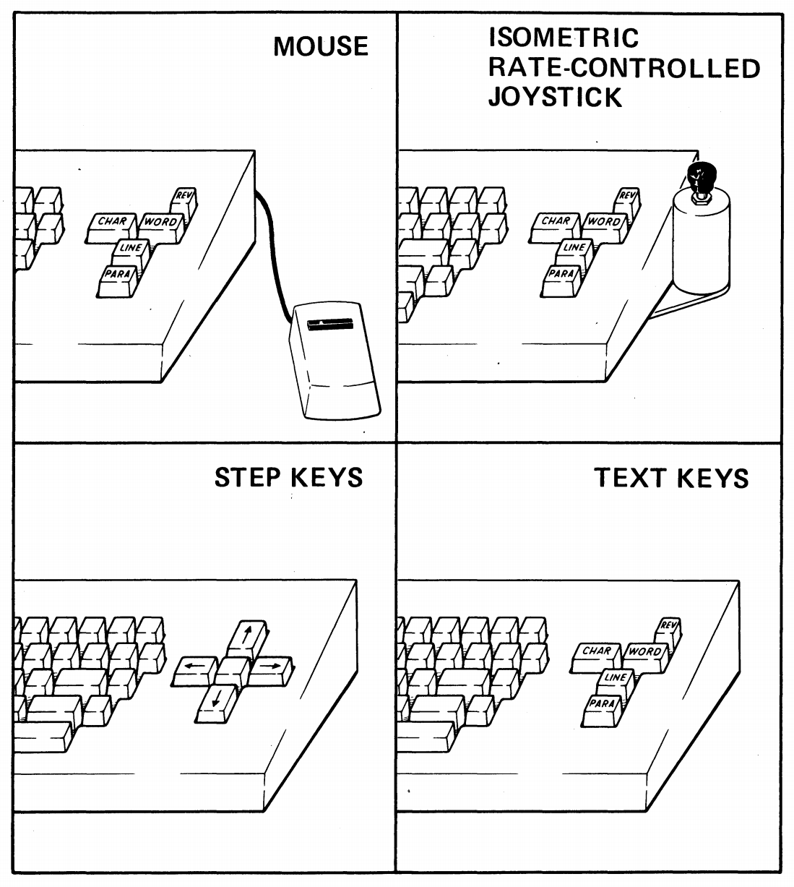
The Dominance of the Mouse
Using Fitts’ Law “was a major factor leading to the mouse's commercial introduction by Xerox”
http://www2.parc.com/istl/groups/uir/people/stuart/stuart.htm
Image from Card, S. K., English, W. K., & Burr, B. J. (1978). Evaluation of mouse, rate-controlled isometric joystick, step keys, and text keys for text selection on a CRT. Ergonomics, 21(8), 601-613.
Fitts’ Law

Slide 37
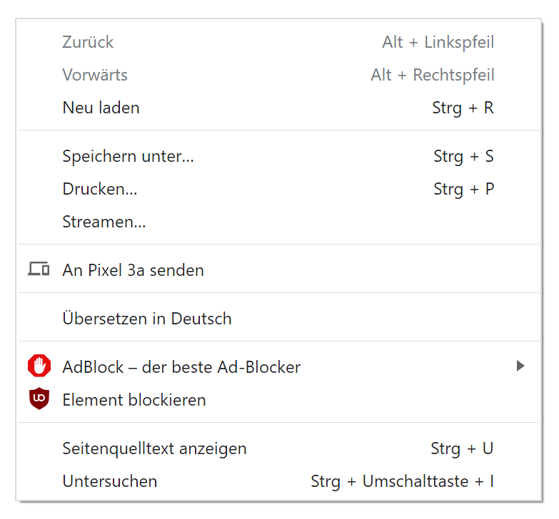
Complex UIs
Fitts’ Law

Slide 38

Steering Law
Pointing through tunnels
Slides adapted from hci-lecture.org (A. Schmidt, N. Henze, K. Wolf, V. Schwind), Image from: https://pxhere.com/de/photo/956874
The following content is licensed under a Creative Commons Attribution 4.0 International license (CC BY-SA 4.0)

Slide 39
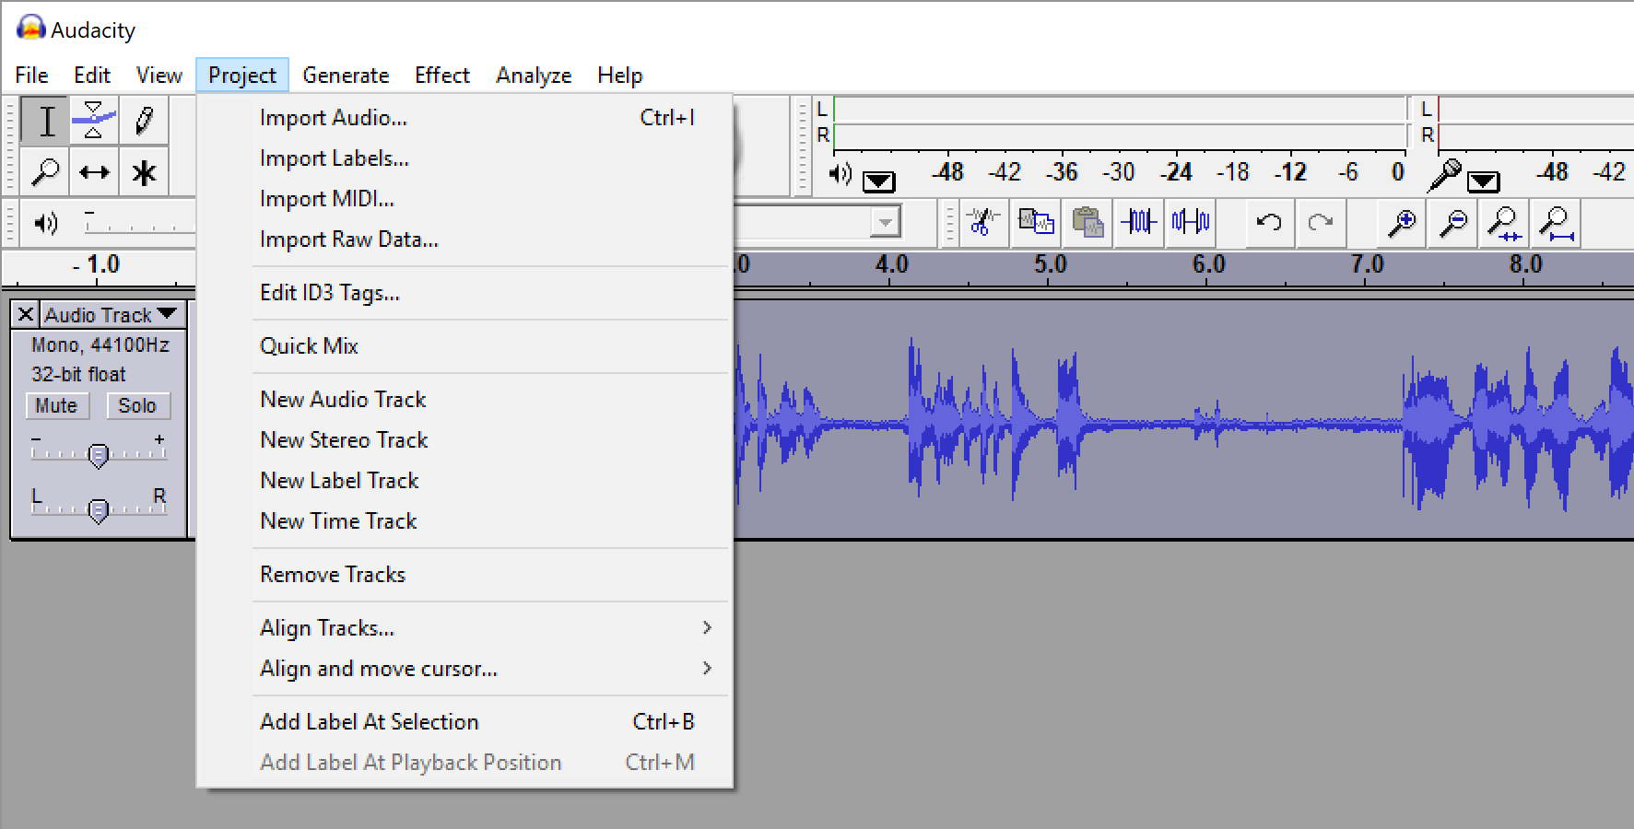
Steering Law

Slide 40
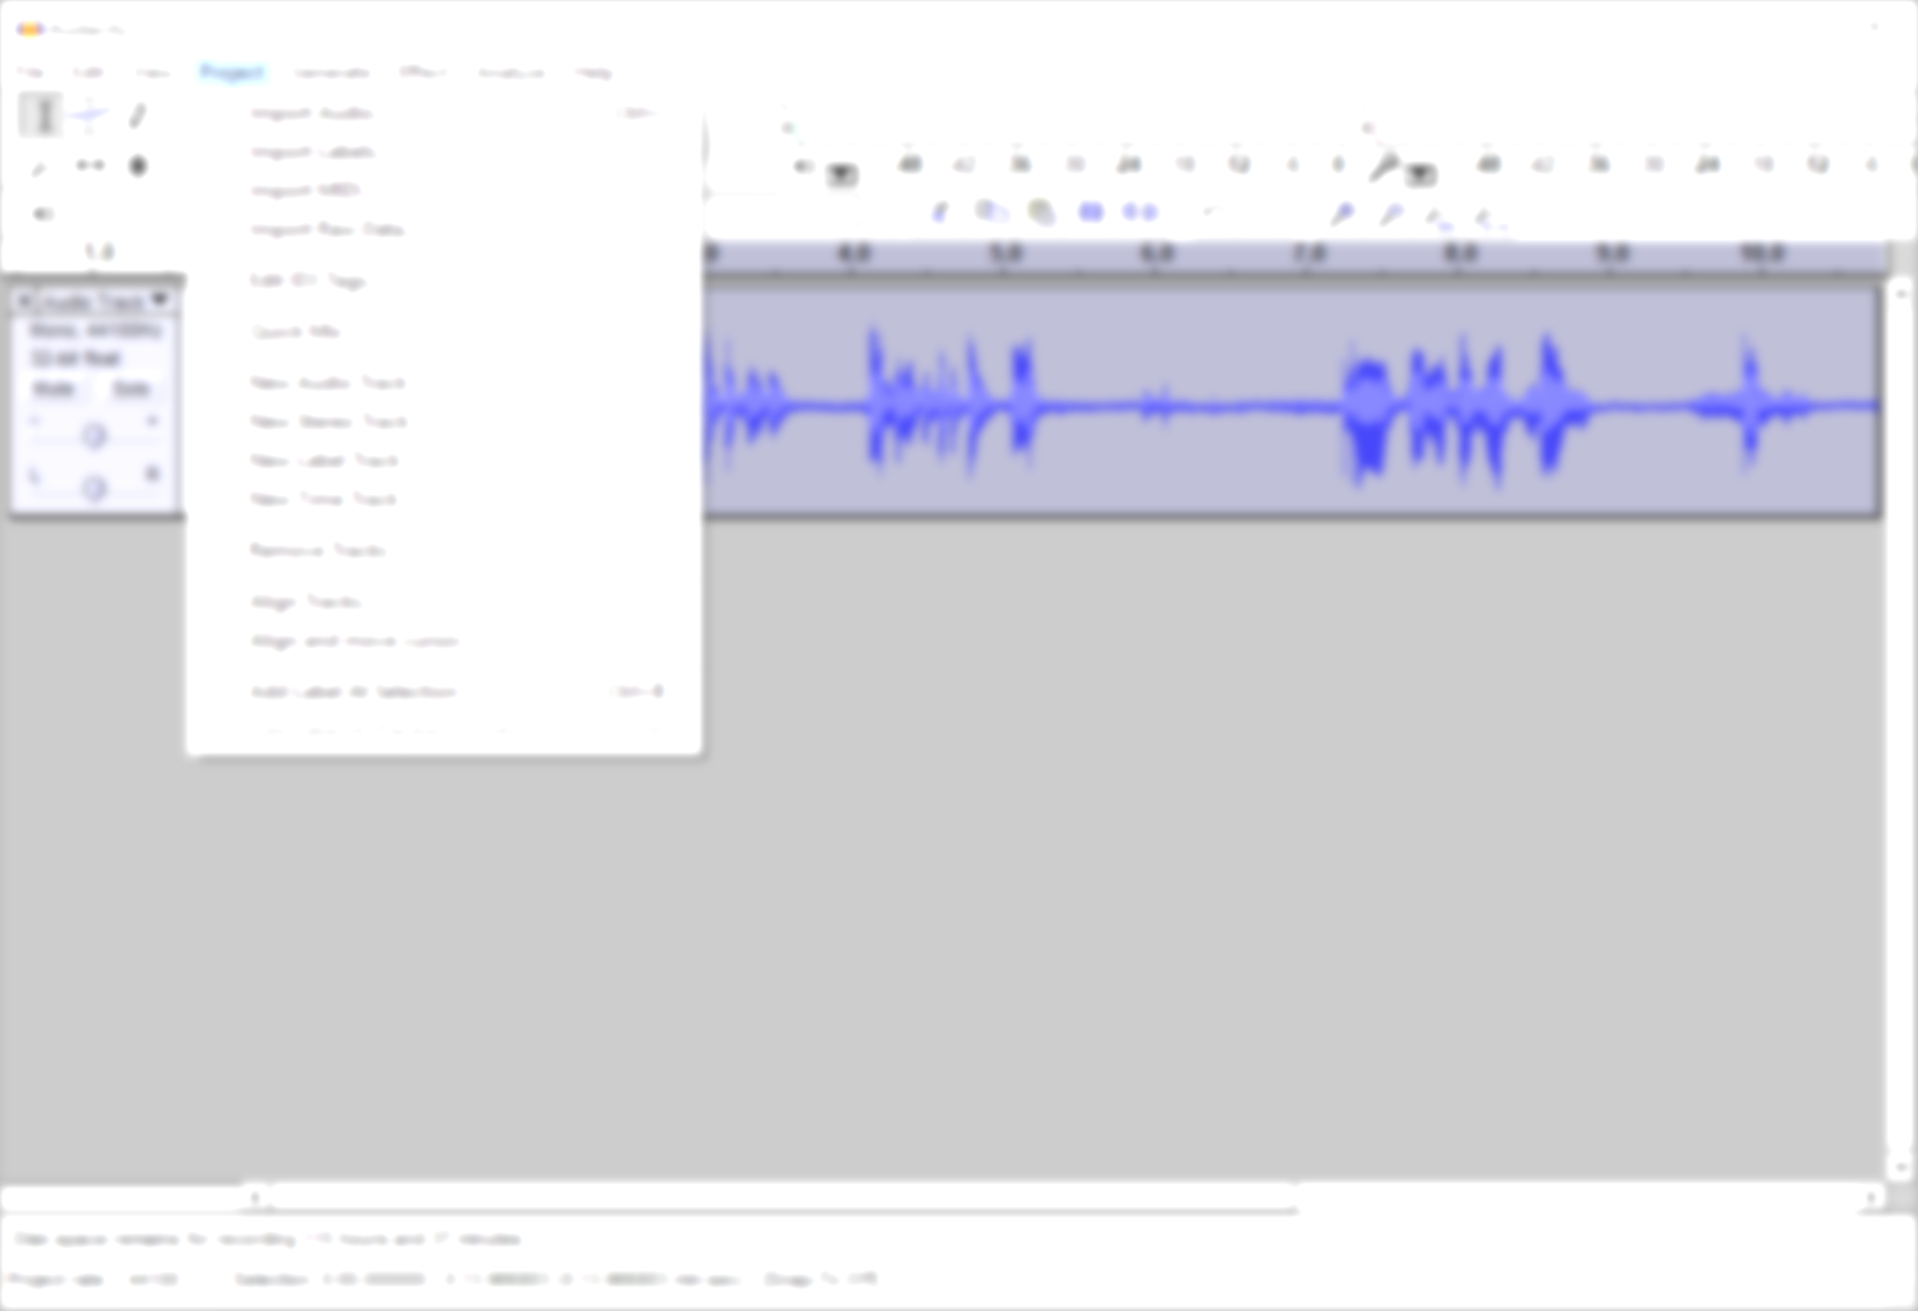
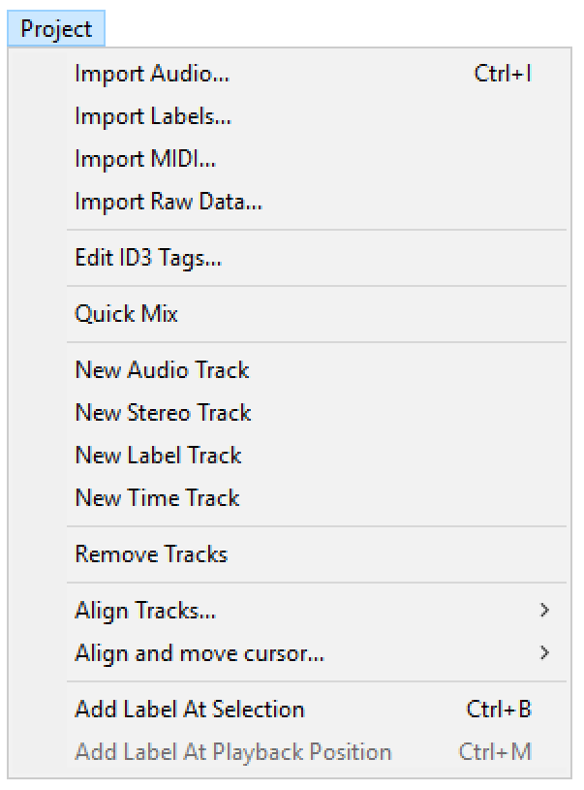
distance
width
Steering Law

Slide 41
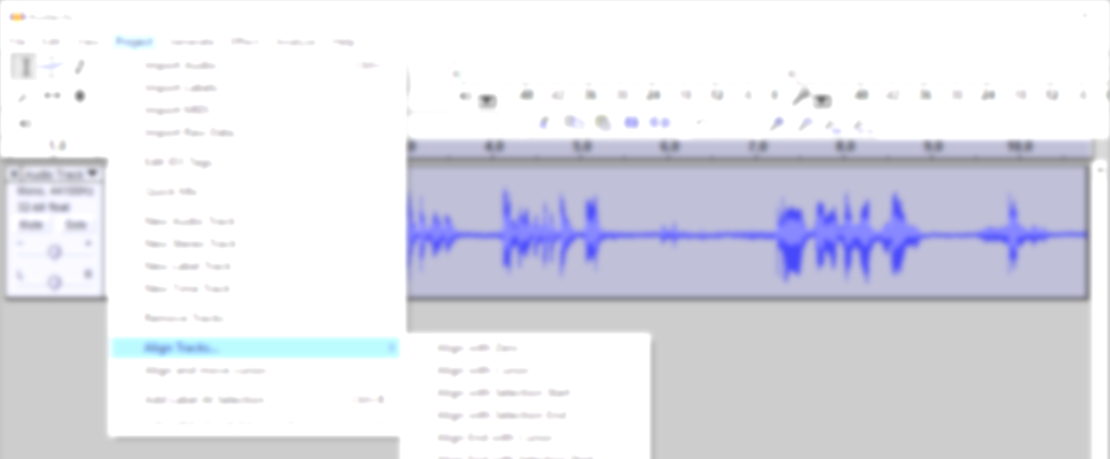
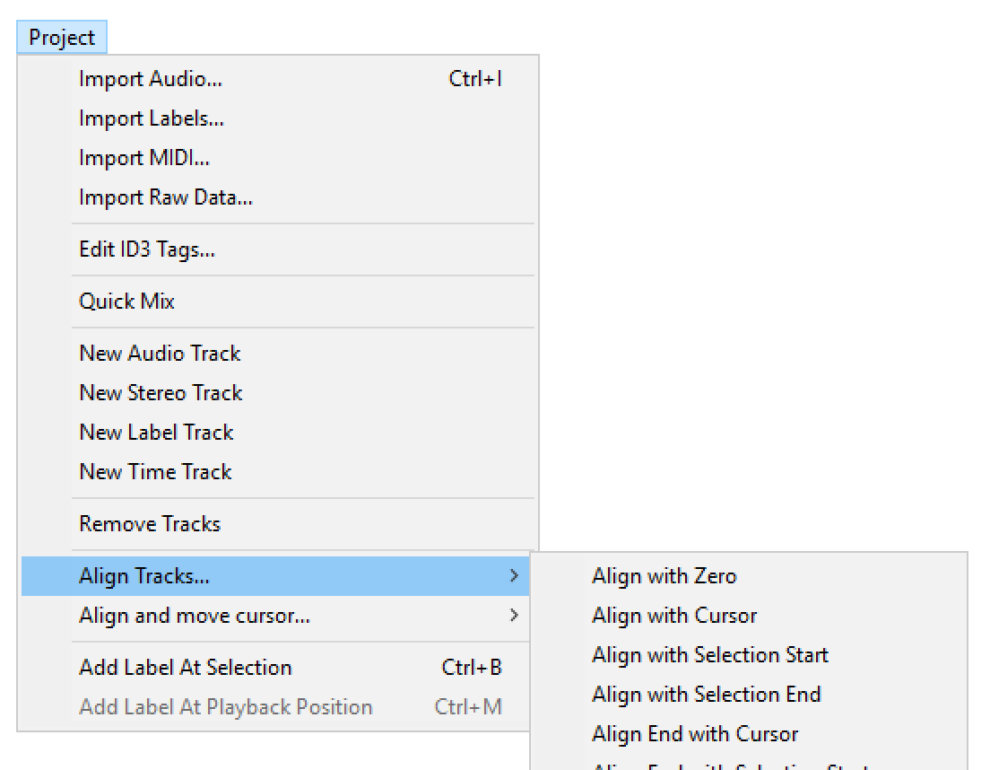
Steering Law

Slide 42



Tunnels
distance
width
Steering Law

Slide 43

Changing Fitts’ Law to model steering tasks?
distance
width
Steering Law

Slide 44


Steering Law Definition
ID=
The movement time (MT) to acquire a target through a tunnel is a function of the length (D) and width (W) of the tunnel. It depends on the input device and the number of tunnels.
  MT: movement time
  a and b: constants dependent on the pointing system
  D: distance, i.e., the length of the tunnel
  W: width of the tunnel (can have variable thickness)
  C: the parametrized path (any curvilinear shape)
Steering Law

Slide 45
Steering Law

Slide 46

Hick‘s Law
Visual Search Tasks
Image from: https://www.pexels.com/photo/grayscale-photography-of-assorted-shirts-hanged-on-clothes-rack-1884584/
The following content is licensed under a Creative Commons Attribution 4.0 International license (CC BY-SA 4.0)

Slide 47

Visual Search
10s
9s
8s
7s
6s
Find Denmark
5s
4s
3s
2s
1s
0s
Hick‘s Law

Slide 48
Visual Search
Russia
Ukraine
France
Spain
Sweden
Norway
Germany
Finland
Poland
Italy
United Kingdom
Romania
Belarus
Kazakhstan
Greece
Bulgaria
Iceland
Hungary
Portugal
Austria
Czechia
Serbia
Ireland
Lithuania
Latvia
Croatia
Bosnia and Herzegovina
Slovakia
Estonia
Denmark
Switzerland
Netherlands
Moldova
Belgium
Armenia
Albania
North Macedonia
Turkey
Slovenia
Montenegro
Kosovo
Cyprus
Azerbaijan
Luxembourg
Georgia
Andorra
Malta
Liechtenstein
10s
9s
8s
7s
6s
Find Denmark
5s
4s
3s
2s
1s
0s
Hick‘s Law

Slide 49
Time Complexity for Unordered Lists
We have a list with n items in an unknown order
  Time obviously increases with n
  What is the time complexity for an algorithm in Big O notation?
  O(n)
Hick‘s Law

Slide 50

Visual Search
10s
9s
8s
7s
6s
Find Denmark
5s
4s
3s
2s
1s
Hick‘s Law

Slide 51
Visual Search
Albania
Andorra
Armenia
Austria
Azerbaijan
Belarus
Belgium
Bosnia and Herzegovina
Bulgaria
Croatia
Cyprus
Czechia
Denmark
Estonia
Finland
France
Georgia
Germany
Greece
Hungary
Iceland
Ireland
Italy
Kazakhstan
Kosovo
Latvia
Liechtenstein
Lithuania
Luxembourg
Malta
Moldova
Montenegro
Netherlands
North Macedonia
Norway
Poland
Portugal
Romania
Russia
Serbia
Slovakia
Slovenia
Spain
Sweden
Switzerland
Turkey
Ukraine
United Kingdom
10s
9s
8s
7s
6s
Find Denmark
5s
4s
3s
2s
1s
0s
Hick‘s Law

Slide 52
Time Complexity for Ordered Lists
We have a list with n items in an known order
Time obviously increases with n
What is the time complexity for an algorithm in Big O notation?
O(log(n))
Hick‘s Law

Slide 53

Hick‘s Law
Given n equally probable choices, the average reaction time T required to choose among the choices is approximately:
  $$T = b∗log2(n + 1)$$
Common practical value: $b=150 ms/bit$
Hick’s Law is often used to motivate menu designs
  In an unordered list, search time is linear
  In an ordered list, search time becomes logarithmic
Hick‘s Law

Slide 54
Combining Models
Hick‘s Law

Slide 55

Power Law of Practice
Routine Tasks
Image generated with Midjourney
The following content is licensed under a Creative Commons Attribution 4.0 International license (CC BY-SA 4.0)

Slide 56

Cigar Roller in Cuba
Crossman, E. R. F. W. (1959). A theory of the acquisition of speed-skill. Ergonomics, 2(2):153–166.
Power Law of Practice

Slide 57


Practice vs TCT
McLaughlin, A., Simon, D., & Gillan, D. (2010). From Intention to Input: Motor Cognition, Motor Performance, and the Control of Technology. Reviews of Human Factors and Ergonomics, 6, 123–171. doi: 10.1518/155723410X12849346788741
Power Law of Practice

Slide 58

Learning by Doing
The more practice
  the easier a task becomes
  the faster a user becomes
How does a skill improves over time?
  General observation: User skills improve as power function of amount of practice
General formula:
$T=a∙P^{−b}$ or$log⁡(T)=−b⋅log⁡(P)+log⁡(a)$
with
  T = task completion time
  P = practice trials
  a,b = device specific constants
task completion time
practice trials
log(task completion time)
log(practice trials)
Power Law of Practice

Slide 59



The Three Stages of Learning and the Resting Debate
Johanson, C., Gutwin, C., Bowey, J., & Mandryk, R. (2019). Press Pause when you Play: Comparing Spaced Practice Intervals for Skill Development in Games. . doi: 10.1145/3311350.3347195
Power Law of Practice

Slide 60
The Power of Practice
Continuous practice lacks rest intervals, which are critical for the brain to generalize feedback and avoid getting “stuck in a rut“
Rest intervals may help break ineffective learning cycles, particularly in problem-solving scenarios
Debate exists on whether rest intervals should remain constant or adapt based on the learner's experience
Johanson, C., Gutwin, C., Bowey, J., & Mandryk, R. (2019). Press Pause when you Play: Comparing Spaced Practice Intervals for Skill Development in Games. . doi: 10.1145/3311350.3347195
Power Law of Practice

Slide 61

Keystroke-Level Model (KLM)
Learning and Reacting
Image from: https://pxhere.com/de/photo/779902
The following content is licensed under a Creative Commons Attribution 4.0 International license (CC BY-SA 4.0)

Slide 62


Currency Converter
Summe
Enter an amount
From this currency
To this currency
6
Task: Convert 12 Euro in US Dollar
one hand on the mouse, nothing selected
What do we need to know?
Keystroke-Level Model (KLM)

Slide 63
Currency Converter
select text field
delete value
enter value
select Euro
select Dollar
select Convert
Summe
Enter an amount
From this currency
To this currency
6
Keystroke-Level Model (KLM)

Slide 64
Keystroke-Level Model (KLM)
Simplified version of GOMS "Goals, Operators, Methods, and Selections rules"
KLM predicts how long it will take an expert (or trained) user to accomplish a routine task without errors using an interactive computer system
Execution of a task is decomposed into primitive operators
  Physical motor operators
    Pressing a button, pointing, drawing a line, …
  Mental operator
    Preparing for a physical action
  System response operator
    User waits for the system to do something
Card, Stuart K; Moran, Thomas P; Allen, Newell (1980). "The keystroke-level model for user performance time with interactive systems". Communications of the ACM. 23 (7): 396–410. doi:10.1145/358886.358895. S2CID 5918086.
Keystroke-Level Model (KLM)

Slide 65
Keystroke-Level Model (KLM)
Operator | Description | Associated Time
K | Keystroke, typing one letter, number, etc. or function key such as ‘CRTL’ or ‘SHIFT’
H | ‘Homing’, moving the hand between mouse and keyboard
B/BB | Pressing (B) or clicking (BB) a button
P | Pointing with a mouse to a target
D(n_{D}, l_{D}) | Drawing n_{D} straight line segments of length l_{D}
M | Subsumed time for mental acts; sometimes used as ‘look-at’
R(t) | System response time, time during which the user cannot act
Keystroke-Level Model (KLM)

Slide 66
Keystroke-Level Model (KLM)
Operator | Description | Associated Time
K | Keystroke, typing one letter, number, etc. or function key such as ‘CRTL’ or ‘SHIFT’ | Expert typist (90 wpm): 0.12s Averaged skilled typist (55 wpm): 0.20s Average non-secretarial typist (40 wpm): 0.28 Worst typist (unfamiliar with keyboard): 1.2s
H | ‘Homing’, moving the hand between mouse and keyboard
B/BB | Pressing (B) or clicking (BB) a button
P | Pointing with a mouse to a target
D(n_{D}, l_{D}) | Drawing n_{D} straight line segments of length l_{D}
M | Subsumed time for mental acts; sometimes used as ‘look-at’
R(t) | System response time, time during which the user cannot act
Keystroke-Level Model (KLM)

Slide 67
Keystroke-Level Model (KLM)
Operator | Description | Associated Time
K | Keystroke, typing one letter, number, etc. or function key such as ‘CRTL’ or ‘SHIFT’ | Expert typist (90 wpm): 0.12s Averaged skilled typist (55 wpm): 0.20s Average non-secretarial typist (40 wpm): 0.28 Worst typist (unfamiliar with keyboard): 1.2s
H | ‘Homing’, moving the hand between mouse and keyboard | 0.4s
B/BB | Pressing (B) or clicking (BB) a button
P | Pointing with a mouse to a target
D(n_{D}, l_{D}) | Drawing n_{D} straight line segments of length l_{D}
M | Subsumed time for mental acts; sometimes used as ‘look-at’
R(t) | System response time, time during which the user cannot act
Keystroke-Level Model (KLM)

Slide 68
Keystroke-Level Model (KLM)
Operator | Description | Associated Time
K | Keystroke, typing one letter, number, etc. or function key such as ‘CRTL’ or ‘SHIFT’ | Expert typist (90 wpm): 0.12s Averaged skilled typist (55 wpm): 0.20s Average non-secretarial typist (40 wpm): 0.28 Worst typist (unfamiliar with keyboard): 1.2s
H | ‘Homing’, moving the hand between mouse and keyboard | 0.4s
B/BB | Pressing (B) or clicking (BB) a button | 0.1s / 2*0.1s
P | Pointing with a mouse to a target
D(n_{D}, l_{D}) | Drawing n_{D} straight line segments of length l_{D}
M | Subsumed time for mental acts; sometimes used as ‘look-at’
R(t) | System response time, time during which the user cannot act
Keystroke-Level Model (KLM)

Slide 69
Keystroke-Level Model (KLM)
Operator | Description | Associated Time
K | Keystroke, typing one letter, number, etc. or function key such as ‘CRTL’ or ‘SHIFT’ | Expert typist (90 wpm): 0.12s Averaged skilled typist (55 wpm): 0.20s Average non-secretarial typist (40 wpm): 0.28 Worst typist (unfamiliar with keyboard): 1.2s
H | ‘Homing’, moving the hand between mouse and keyboard | 0.4s
B/BB | Pressing (B) or clicking (BB) a button | 0.1s / 2*0.1s
P | Pointing with a mouse to a target | 0.8s to 1.5s with an average of 1.1s Can also use Fitts’ Law
D(n_{D}, l_{D}) | Drawing n_{D} straight line segments of length l_{D}
M | Subsumed time for mental acts; sometimes used as ‘look-at’
R(t) | System response time, time during which the user cannot act
Keystroke-Level Model (KLM)

Slide 70
Keystroke-Level Model (KLM)
Operator | Description | Associated Time
K | Keystroke, typing one letter, number, etc. or function key such as ‘CRTL’ or ‘SHIFT’ | Expert typist (90 wpm): 0.12s Averaged skilled typist (55 wpm): 0.20s Average non-secretarial typist (40 wpm): 0.28 Worst typist (unfamiliar with keyboard): 1.2s
H | ‘Homing’, moving the hand between mouse and keyboard | 0.4s
B/BB | Pressing (B) or clicking (BB) a button | 0.1s / 2*0.1s
P | Pointing with a mouse to a target | 0.8s to 1.5s with an average of 1.1s Can also use Fitts’ Law
D(n_{D}, l_{D}) | Drawing n_{D} straight line segments of length l_{D} | 0.9s*n_{D} + 0.16*l_{D}
M | Subsumed time for mental acts; sometimes used as ‘look-at’
R(t) | System response time, time during which the user cannot act
Keystroke-Level Model (KLM)

Slide 71
Keystroke-Level Model (KLM)
Operator | Description | Associated Time
K | Keystroke, typing one letter, number, etc. or function key such as ‘CRTL’ or ‘SHIFT’ | Expert typist (90 wpm): 0.12s Averaged skilled typist (55 wpm): 0.20s Average non-secretarial typist (40 wpm): 0.28 Worst typist (unfamiliar with keyboard): 1.2s
H | ‘Homing’, moving the hand between mouse and keyboard | 0.4s
B/BB | Pressing (B) or clicking (BB) a button | 0.1s / 2*0.1s
P | Pointing with a mouse to a target | 0.8s to 1.5s with an average of 1.1s Can also use Fitts’ Law
D(n_{D}, l_{D}) | Drawing n_{D} straight line segments of length l_{D} | 0.9s*n_{D} + 0.16*l_{D}
M | Subsumed time for mental acts; sometimes used as ‘look-at’ | 1.35s
R(t) | System response time, time during which the user cannot act
Keystroke-Level Model (KLM)

Slide 72
Keystroke-Level Model (KLM)
Operator | Description | Associated Time
K | Keystroke, typing one letter, number, etc. or function key such as ‘CRTL’ or ‘SHIFT’ | Expert typist (90 wpm): 0.12s Averaged skilled typist (55 wpm): 0.20s Average non-secretarial typist (40 wpm): 0.28 Worst typist (unfamiliar with keyboard): 1.2s
H | ‘Homing’, moving the hand between mouse and keyboard | 0.4s
B/BB | Pressing (B) or clicking (BB) a button | 0.1s / 2*0.1s
P | Pointing with a mouse to a target | 0.8s to 1.5s with an average of 1.1s Can also use Fitts’ Law
D(n_{D}, l_{D}) | Drawing n_{D} straight line segments of length l_{D} | 0.9s*n_{D} + 0.16*l_{D}
M | Subsumed time for mental acts; sometimes used as ‘look-at’ | 1.35s
R(t) | System response time, time during which the user cannot act | Dependent on the system
Keystroke-Level Model (KLM)

Slide 73
Keystroke-Level Model (KLM)
select text field
delete value
enter value
select Euro
select Dollar
select Convert
P, BB
H, K
M, K, K
H, M, P, BB
M, P, BB
P, BB
Summe
Enter an amount
From this currency
To this currency
6
Operator Times:
P ≈ 1.1s B = 0.1s H = 0.4s
M = 1.35s K = 0.28s
Total time:
$4·P + 8·B+ 2·H + 3·M + 3·K = 10,89s$
Keystroke-Level Model (KLM)

Slide 74
Keystroke-Level Model (KLM)
select text field
delete value
enter value
select Euro
select Dollar
select Convert
P, BB
H, K
M, K, K
H, M, P, BB
M, P, BB
P, BB
Summe
Enter an amount
From this currency
To this currency
6
Operator Times:
P ≈ 1.1s B = 0.1s H = 0.4s
M = 1.35s K = 0.28s
Total time:
$4·P + 8·B+ 2·H + 3·M + 3·K = 10,89s$
Keystroke-Level Model (KLM)

Slide 75

Keystroke-Level Model (KLM)
Version 1
Version 2
Hand on mouse, nothing selected, go to photo:
Which is the fastest interface?
Which is the slowest?
Version 3
Version 4
Keystroke-Level Model (KLM)

Slide 76
Summary
The Keystroke-Level Model predicts task completion time for simple dialogs
Assumes a trained average user
Especially useful to compare alternatives
Using KLM by hand can become lengthy and complex
KLM is not useful for tasks that require reasoning
Keystroke-Level Model (KLM)

Slide 77

GOMS
A Human Information Processor Model
Image from: https://pxhere.com/de/photo/779902
The following content is licensed under a Creative Commons Attribution 4.0 International license (CC BY-SA 4.0)

Slide 78
GOMS
Goals
  (Verbal) description of what a user wants to accomplish
  Various levels of complexity possible
Operators
  Possible actions in the system
  Various levels of abstraction possible (sub-goals / ... / keystrokes)
Methods
  Sequences of operators that achieve a goal
Selection rules
  Rules that define when a user employs which method (among alternatives)
GOMS

Slide 79
GOMS
GOMS
(CMN-)GOMS
KLM
NGOMSL
CPM-GOMS
Plain GOMS
Pseudo-code
First introduced by Card, Moran and Newell
Keystroke-Level Model
Simplified version of GOMS
Natural GOMS Language
Stricter version of GOMS
Provides more well-defined, structured natural language
Estimates learning time
Cognitive Perceptual Motor analysis of activity
Critical Path Method
Based on the parallel multi-processor stage of human information processing
GOMS

Slide 80

GOMS

Slide 81

GOAL: GET-MONEY
  GOAL: USE-CASH-MACHINE
    INSERT-CARD
    ENTER-PIN
    SELECT-GET-CASH
    ENTER-AMOUNT
    COLLECT-MONEY
    outer goal satisfied
GOMS

Slide 82
GOAL: GET-MONEY
  GOAL: USE-CASH-MACHINE
    INSERT-CARD
    ENTER-PIN
    SELECT-GET-CASH
    ENTER-AMOUNT
    COLLECT-CARD
    COLLECT-MONEY
    outer goal satisfied
GOMS

Slide 83

GOMS

Slide 84

GOMS

Slide 85
GOMS Example: Closing a Window
GOAL: CLOSE-WINDOW
[select
GOAL: USE-MENU-METHOD
MOVE-MOUSE-TO-FILE-MENU
PULL-DOWN-FILE-MENU
CLICK-OVER-CLOSE-OPTION
GOAL: USE-ALT-F4-METHOD
HOLD-ALT-KEY
PRESS-F4-KEY]
VERIFY-CLOSE
For a particular user:
Rule 1: Select USE-MENU-METHOD unless
another rule applies
Rule 2: If the application is GAME,
select ALT-F4-METHOD
GOMS

Slide 86
Goals
GOAL: CLOSE-WINDOW
[select
GOAL: USE-MENU-METHOD
MOVE-MOUSE-TO-FILE-MENU
PULL-DOWN-FILE-MENU
CLICK-OVER-CLOSE-OPTION
GOAL: USE-ALT-F4-METHOD
HOLD-ALT-KEY
PRESS-F4-KEY]
VERIFY-CLOSE
For a particular user:
Rule 1: Select USE-MENU-METHOD unless
another rule applies
Rule 2: If the application is GAME,
select ALT-F4-METHOD
GOMS

Slide 87
Operators
GOAL: CLOSE-WINDOW
[select
GOAL: USE-MENU-METHOD
MOVE-MOUSE-TO-FILE-MENU
PULL-DOWN-FILE-MENU
CLICK-OVER-CLOSE-OPTION
GOAL: USE-ALT-F4-METHOD
HOLD-ALT-KEY
PRESS-F4-KEY]
VERIFY-CLOSE
For a particular user:
Rule 1: Select USE-MENU-METHOD unless
another rule applies
Rule 2: If the application is GAME,
select ALT-F4-METHOD
GOMS

Slide 88
Methods
GOAL: CLOSE-WINDOW
[select
GOAL: USE-MENU-METHOD
MOVE-MOUSE-TO-FILE-MENU
PULL-DOWN-FILE-MENU
CLICK-OVER-CLOSE-OPTION
GOAL: USE-ALT-F4-METHOD
HOLD-ALT-KEY
PRESS-F4-KEY]
VERIFY-CLOSE
For a particular user:
Rule 1: Select USE-MENU-METHOD unless
another rule applies
Rule 2: If the application is GAME,
select ALT-F4-METHOD
GOMS

Slide 89
Selection Rules
GOAL: CLOSE-WINDOW
[select
GOAL: USE-MENU-METHOD
MOVE-MOUSE-TO-FILE-MENU
PULL-DOWN-FILE-MENU
CLICK-OVER-CLOSE-OPTION
GOAL: USE-ALT-F4-METHOD
HOLD-ALT-KEY
PRESS-F4-KEY]
VERIFY-CLOSE
For a particular user:
Rule 1: Select USE-MENU-METHOD unless
another rule applies
Rule 2: If the application is a GAME,
select USE-ALT-F4-METHOD
GOMS

Slide 90
GOMS Summary
Characteristics
  Can be used to model complex tasks
  Clearly sets inner and outer goals
  Cannot predict completion times
  But the simpler KLM can
Predictions
  More operators, longer completion
  Deep depth of goal structure → high short term-memory load
  Users stop when goals are satisfied
GOMS

Slide 91

Seven Stages of Action
Human-Computer Interaction Lecture
Image from: Photo by Paolo Sacchi / Meet the media Guru from https://www.flickr.com/photos/meetthemediaguru/5553249364/ (CC BY-SA 2.0)
The following content is licensed under a Creative Commons Attribution 4.0 International license (CC BY-SA 4.0)

Slide 92
Image from: Photo by Paolo Sacchi / Meet the media Guru from https://www.flickr.com/photos/meetthemediaguru/5553249364/ (CC BY-SA 2.0)
Seven Stages of Action

Slide 93
Bridging the Gulfs
there should be light!
the gulf of execution
the gulf of evaluation
refers to unclear mapping between intention and execution
refers to the degree to which an artifact provides representations that can be directly perceived and interpreted
a brighter world
a dark world
Seven Stages of Action

Slide 94
Overcoming the Gulfs
Question: ”How to bridge the gulfs, especially the gulf of evaluation?”
  The solution to this problem is precisely the task of the designer of an interface – the cognitive effort of the user must be minimized.
  A good design should therefore assist the steps of action cycles and allow “a comfortable transition between the stages”.
Examples:
  Is it possible for the user to recognize the system status?
  Does the UI provide sufficient feedback on the consequences of an action that could be executed?
  Is the user able to understand the system feedback?
  Does the UI provide sufficient feedback for all interpretations that are possible?
  Can the user match his/her goal with the (changed) status of the system?
Seven Stages of Action

Slide 95
Seven Stages of Action
goals
intend to act
evaluate the interpretation
plan sequence of actions
interpret the perception
execute the action sequence
perceive the state of the world
Seven Stages of Action

Slide 96
Seven Stages of Action
goals
record long videos
clean up phone
evaluate the interpretation
intend to act
cannot record long videos
delete trash, cache, videos
interpret the perception
plan sequence of actions
clips are very short
perform actions on my phone
perceive the state of the world
execute the action sequence
some videos are not recording
Seven Stages of Action

Slide 97
Evaluation and Design Questions
Avoid the gulf of evaluation
  Can the user tell what state the system is in?
  Can the user tell if the system is in the desired state?
  Can the user map from the system state to an interpretation?
Avoid the gulf of execution
  Can the user tell what actions are possible?
  Does the device easily support required actions?
  Does the interface help with mapping from intention to physical movement?
Seven Stages of Action

Slide 98
Implications on Design
Critical points
  Forming inadequate goal
  Not knowing the appropriate action
  Not finding the correct action
  Receiving inappropriate feedback
Principles of good design
  System state and actions are always visible
  Good conceptual model with a consistent system image
  Interfaces include good mappings that show the relationship between stages
  Continuous feedback to the user
Seven Stages of Action

Slide 99
Watch
https://www.youtube.com/watch?v=ahtOCfyRbRg
https://www.youtube.com/watch?v=n4fCHYbRcKw
Seven Stages of Action

