Slide 1



Perception
Human-Computer Interaction Lecture
Slides adapted from hci-lecture.org (A. Schmidt, N. Henze, K. Wolf, V. Schwind), Image from: https://pxhere.com/de/photo/956874
The following content is licensed under a Creative Commons Attribution 4.0 International license (CC BY-SA 4.0)

Slide 2
Learning Goals
Understand …
  perception and sensual processes
  principles of human and multi-sensory perception
  perceptual channels such as vision, hearing, smell & taste, haptics
  how HCI addresses human perception
Be able to explain …
  explain human perceptual channels
  how HCI can utilize perception
Perception

Slide 3

What is perception?

Slide 4

Why do we need perception?
Image from https://pxhere.com/de/photo/971434
Perception

Slide 5

What is reality?

Slide 6
Reality
Requires existence of one‘s self
The aggregate of all that is real or existent
  opposed to that which is imaginary
Our understanding of “reality” includes physical objects
  However, reality is for humans fundamentally immaterial (e.g., idealism, some numbers, and hypothetical entities)
  The fields concerned with the real world belong to the empirical science as sources and methods to objectively investigate reality
Does reality truly exist?
  Quantum physicists would say: reality is defined when you measure it
In our everyday life, perception determines reality
Perception

Slide 7
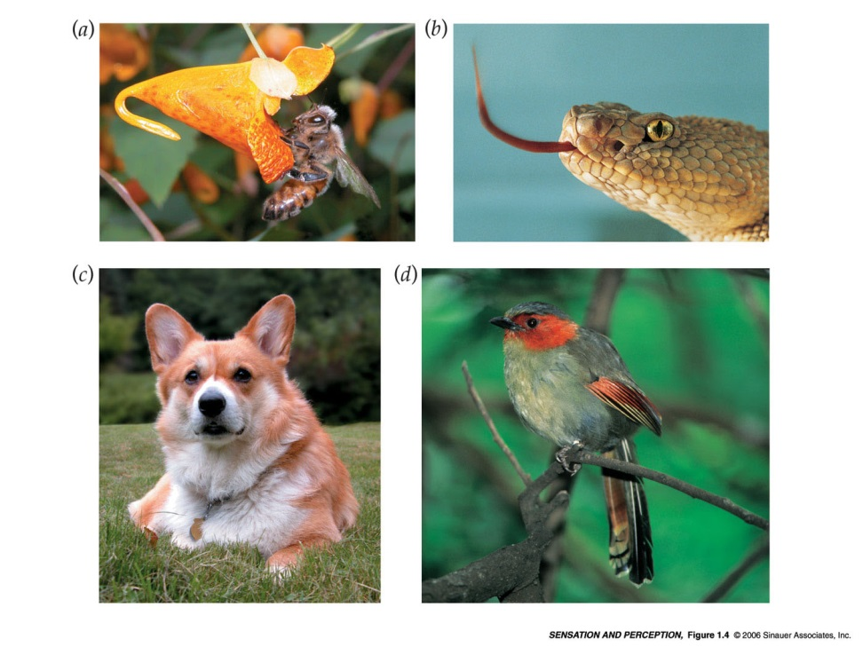
Animals
Some species sense energies that humans cannot perceive:
  Bees see ultraviolet lights
  Rattlesnakes sense infrared energy
  Dogs and cats can sense sounds with higher frequencies
  Birds, turtles, and amphibians use magnetic fields to navigate
  Elephants can hear very low-frequency sounds, which are used to communicate
Perception

Slide 8
Evolution and Perception
Biological systems do not have the mental capacity to fully perceive and process the physical world
  Creatures with a great breadth of perception are generally going to extinct
  To perceive reality as it is (all electromagnetic signals) would be an evolutionary disadvantage
The specialization and filtering by perception on certain electromagnetic waves is an essential part of evolution
  This is also one of the reasons for the diversity on the planet, as several species do not compete for the same resources
The relatively small range of perception has given humans an evolutionary advantage in the development of other mental processes (cognition)
Perception

Slide 9
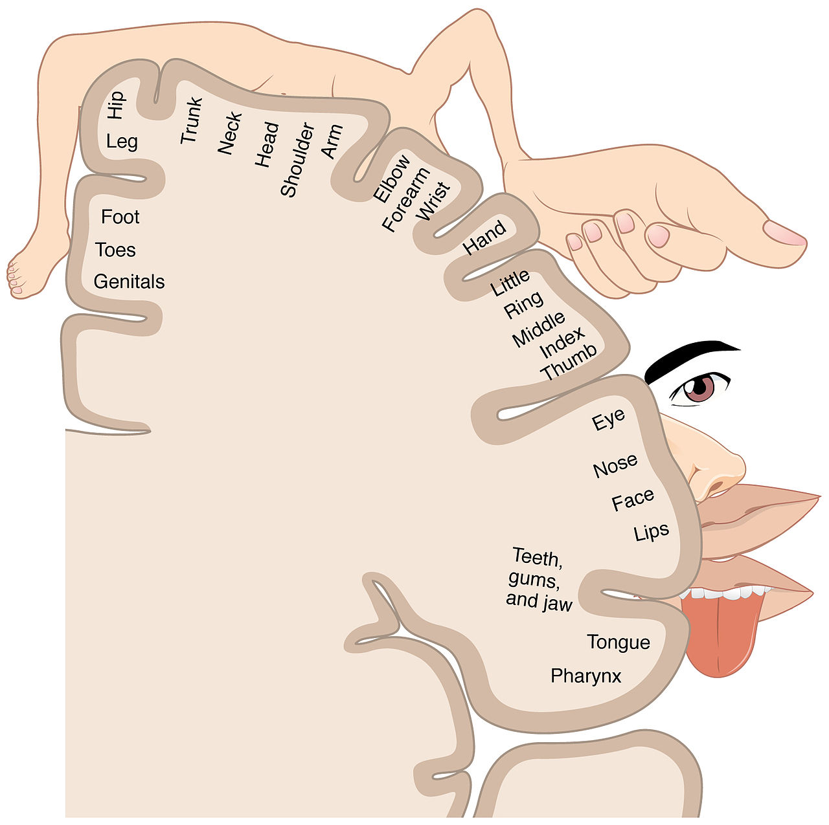
The Cortical Homunculus
Illustrates the concept of a representation of the human body lying within the brain
  The sensory homunculus represents dedicated sensory processing for different anatomical divisions of the
  The motor homunculus represents the processing for different anatomical divisions of the body
  The somatosensory homunculus also depicts erogenous stimulations or perception of genitals
Do perceptual channels perceive the world independently from each other?
OpenStax College - Anatomy & Physiology, Connexions Web site. http://cnx.org/content/col11496/1.6/, Jun 19, 2013.
Perception

Slide 10
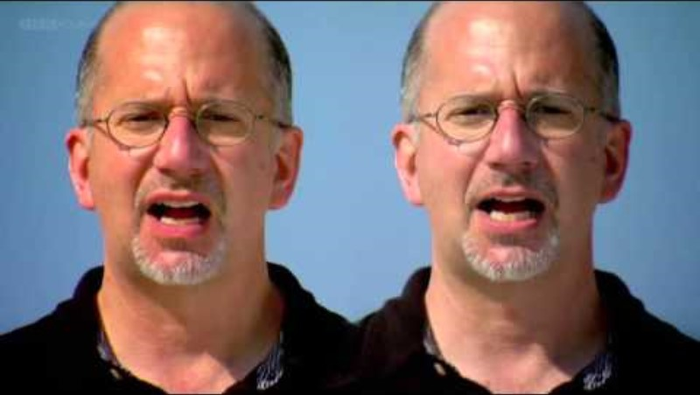
McGurk Effect
Perception

Slide 11

Image from https://pxhere.com/de/photo/46518
Perception

Slide 12
Senses
The ability to actively absorb, process, and extract information through senses
All perception involves signals coded and transmitted through the nervous system, which emerge from physical (e.g., light, sound) or chemical (molecules) stimulation
  Vision: Object identification/recognition for navigation, depth and motion perception through the eyes
  Sound: Object identification/recognition, object localization with the ears
  Touch: Object identification/recognition, pain (detection of tissue damage) with a somatosensory perception combined by the skin surface and proprioception
  Taste: Chemical detection/identification of flavor, nutrition, and poison using the tongue
  Smell: Chemical detection/identification of odors, pheromones, and hazards using the nose
Do we have more senses?
Perception

Slide 13
More Senses
Agency: The mind’s feeling of chosen an action and bodily control (making of a decision and free will)
Balance: The vestibular system maintains the centre of mass within minimal postural sway
Breath: The sensation of getting and removing air in the throat, nose, mouth, and lungs
Faces: A high-level cognitive process referring to identification and perceiving individuals
Gravity: Related to the proprioceptive and vestibular system of the human body
Hunger: Sensory cells in the stomach and GI tract (and hormones) motivate the consumption of food
Speech: A high-level cognitive process to extract words and meaning from phenomes in audio
Pain: Sensory (and emotional) experience that can be perceived all over the body (and beyond)
Posture: Mainly driven by the proprioceptive system through mechanoreceptors detecting pressure
Rectal: Part of the GI tract regulating defecation
Sexual arousal: A combined and complex response of mental and physical stimuli on sexual tissues
Temperature: Detected by thermoreceptors throughout the body
Time: The brain is governing the perception of time and the circadian rhythm (internal clock)
Urinary Bladder: Regulates urination and retention as part of the GI tract
Perception

Slide 14
More Senses
Agency: The mind’s feeling of chosen an action and bodily control (making of a decision and free will)
Balance: The vestibular system maintains the centre of mass within minimal postural sway
Breath: The sensation of getting and removing air in the throat, nose, mouth, and lungs
Faces: A high-level cognitive process referring to identification and perceiving individuals
Gravity: Related to the proprioceptive and vestibular system of the human body
Hunger: Sensory cells in the stomach and GI tract (and hormones) motivate the consumption of food
Speech: A high-level cognitive process to extract words and meaning from phenomes in audio
Pain: Sensory (and emotional) experience that can be perceived all over the body (and beyond)
Posture: Mainly driven by the proprioceptive system through mechanoreceptors detecting pressure
Rectal: Part of the GI tract regulating defecation
Sexual arousal: A combined and complex response of mental and physical stimuli on sexual tissues
Temperature: Detected by thermoreceptors throughout the body
Time: The brain is governing the perception of time and the circadian rhythm (internal clock)
Urinary Bladder: Regulates urination and retention as part of the GI tract
Require higher mental processing
(see Cognition)
Perception

Slide 15
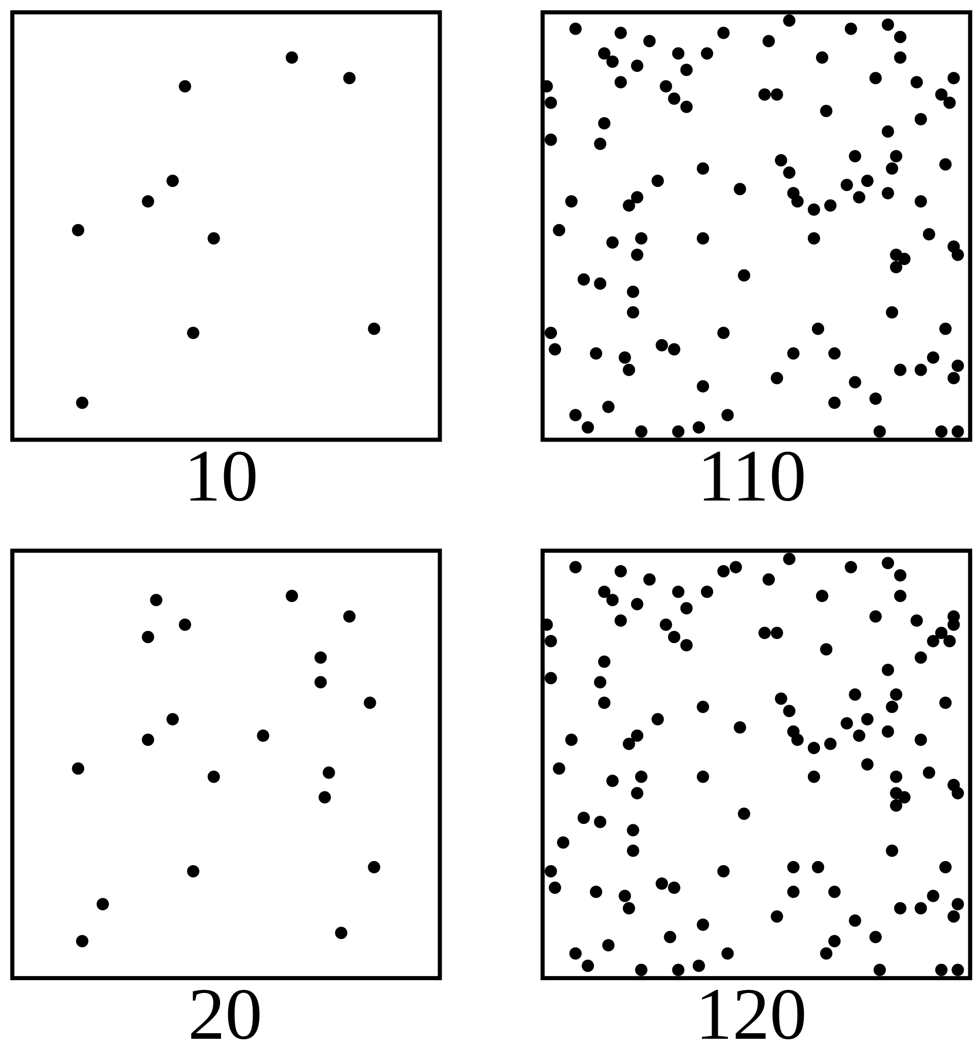
Sensual Acuity
Each sense requires a threshold of stimulation to extract information from noise
  The absolute threshold is the level at which a stimulus will be detected a specified percentage: often 50% of the time
Sensual acuity refers to a sensory threshold of a physiological response and determines the boundary of perception
  All senses have perceptual thresholds
  Scientist call they limen (difference threshold, or least perceptible difference)
  On one side of a limen (or threshold) a stimulus is perceivable, on the other side it is not
On each side, the lower square contains 10 more dots than the upper one. However the perception is different: On the left side, the difference between upper and lower square is clearly visible. On the right side, the two squares look almost the same.
Cognition

Slide 16
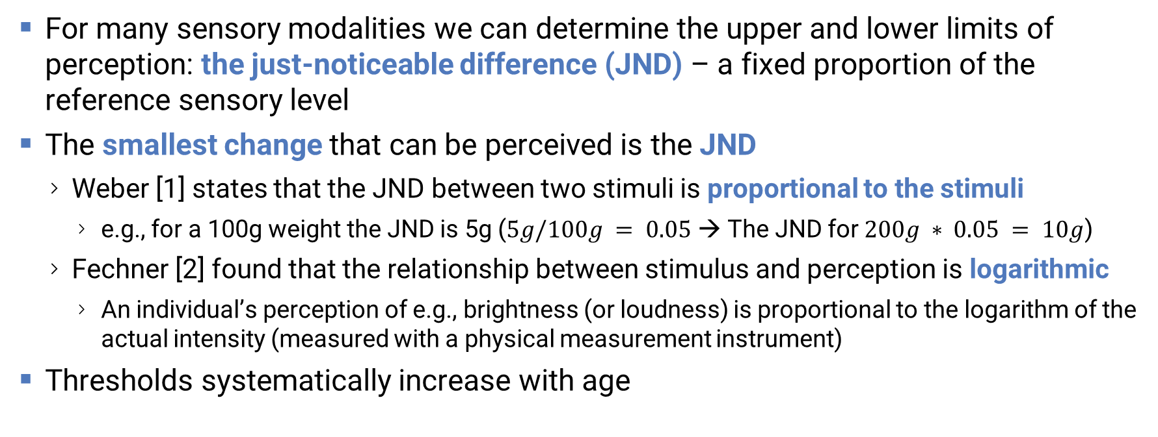
Senses have Thresholds
For many sensory modalities we can determine the upper and lower limits of perception: the just-noticeable difference (JND) – a fixed proportion of the reference sensory level
The smallest change that can be perceived is the JND
  Weber [1] states that the JND between two stimuli is proportional to the stimuli
    e.g., for a 100g weight the JND is 5g ($5g/100g = 0.05$ → The JND for $200g ∗ 0.05 = 10g$)
  Fechner [2] found that the relationship between stimulus and perception is logarithmic
    An individual’s perception of e.g., brightness (or loudness) is proportional to the logarithm of the actual intensity (measured with a physical measurement instrument)
Thresholds systematically increase with age
[1] Ross, H.E. and Murray, D. J.(Ed. and Transl.) (1996)E.H.Weber on the tactile senses. 2nd ed. Hove: Erlbaum (UK) Taylor & Francis;
[2] Fechner, Gustav Theodor (1966) [First published .1860]. Howes, D H; Boring, E G (eds.). Elements of psychophysics [Elemente der Psychophysik]. Vol. 1. Translated by Adler, H E. United States of America: Holt, Rinehart and Winston.
Perception

Slide 17

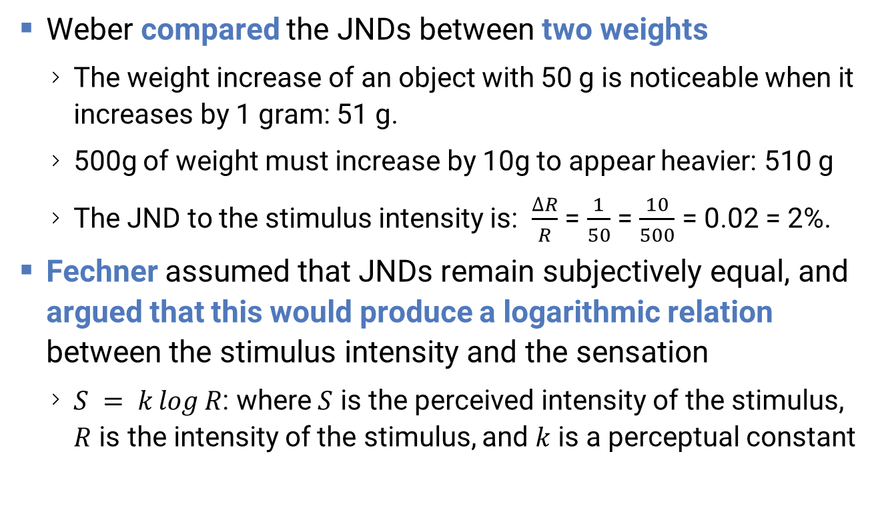
Weber-Fechtner-Law
Weber compared the JNDs between two weights
  The weight increase of an object with 50 g is noticeable when it increases by 1 gram: 51 g.
  500g of weight must increase by 10g to appear heavier: 510 g
  The JND to the stimulus intensity is: $\frac{∆R}{R}$ = $\frac{1}{50}$ = $\frac{10}{500}$ = 0.02 = 2%.
Fechner assumed that JNDs remain subjectively equal, and argued that this would produce a logarithmic relation between the stimulus intensity and the sensation
  $S = k\log{R}$: where $S$ is the perceived intensity of the stimulus, $R$ is the intensity of the stimulus, and $k$ is a perceptual constant
Perception

Slide 18
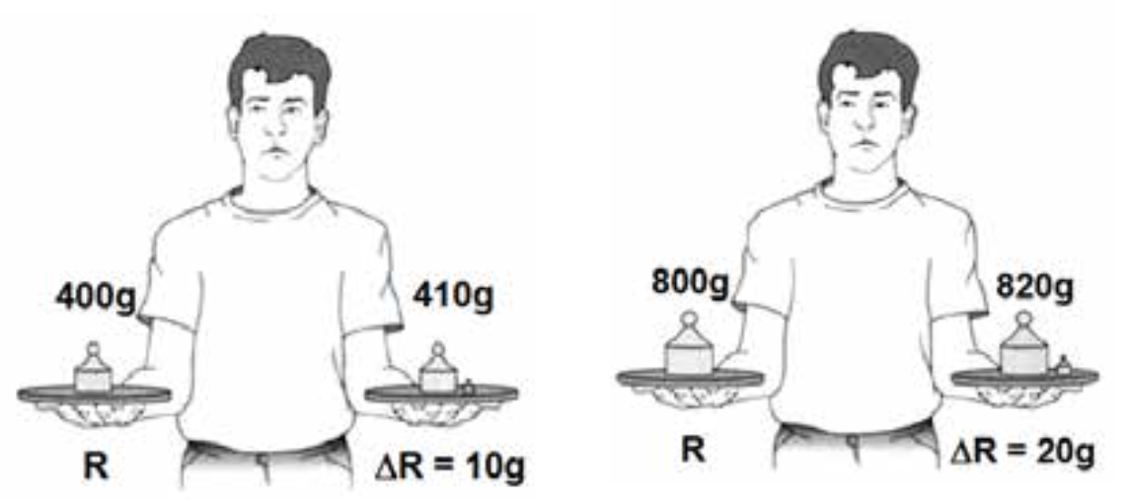
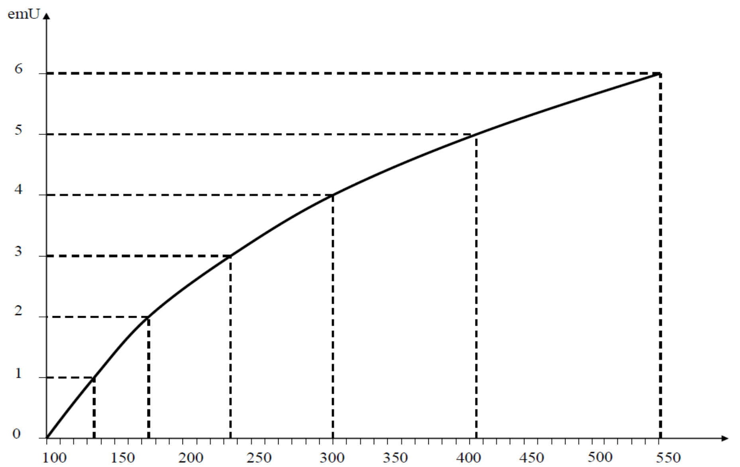









Weber Constants
Weber‘s Law
$$100g$$
$$105g$$
$$200g$$
$$210g$$
Dimension | c (Weber-Constant)
Electric Current | 0.013 (1.3%)
Weight | 0.050 (5.0%)
Brightness | 0.016 (1.6%)
Taste (of Salt) | 0.083 (8.3%)
Hearing | 0.048 (4.8%)
Pain (Thermal) | 0.033 (3.3%)
Touch | 0.030 (3.0%)
Loudness | 0.050 (5%)
$$∆R=5g$$
$$R$$
$$∆R=10g$$
$$R$$
Sensual Acuity/# of Differiantals
(R)
Fechner‘s Law
$$∆R$$
Image from J. Antonio Aznar Casanova, INTRODUCCION A LA PSICOFÍSICA
Any Physical Stimulus (S)
Perception

Slide 19
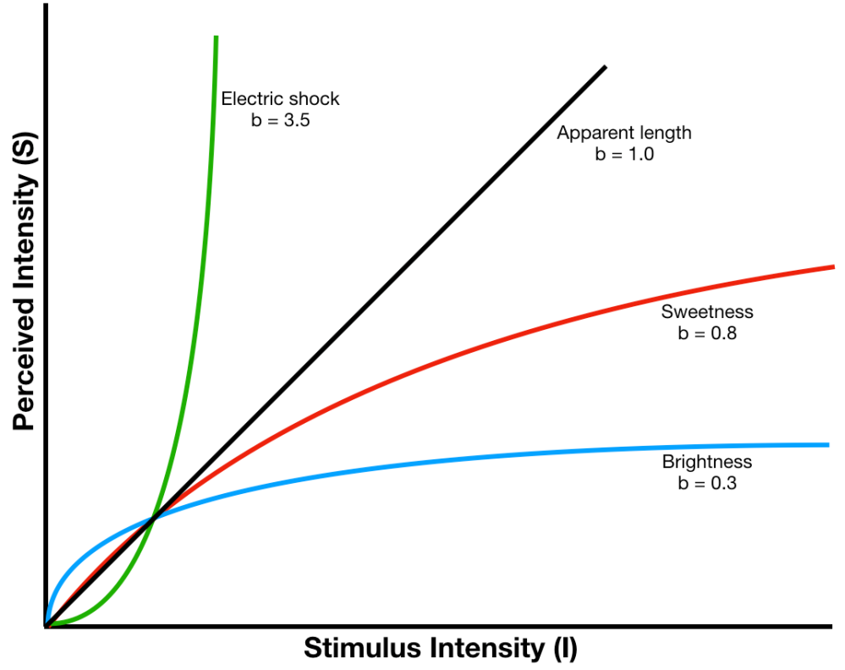
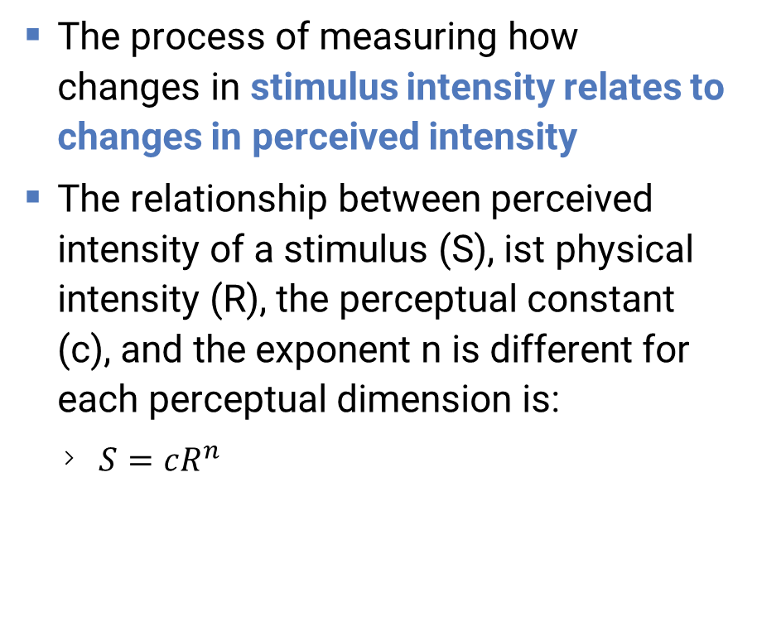
Stevens Law
The process of measuring how changes in stimulus intensity relates to changes in perceived intensity
The relationship between perceived intensity of a stimulus (S), ist physical intensity (R), the perceptual constant (c), and the exponent n is different for each perceptual dimension is:
  $S=cR^{n}$
Image from: https://deephci.wordpress.com/
Perception

Slide 20
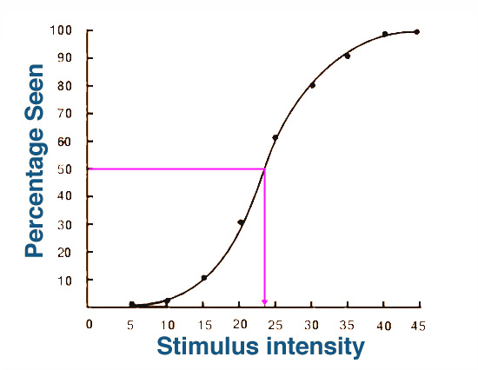
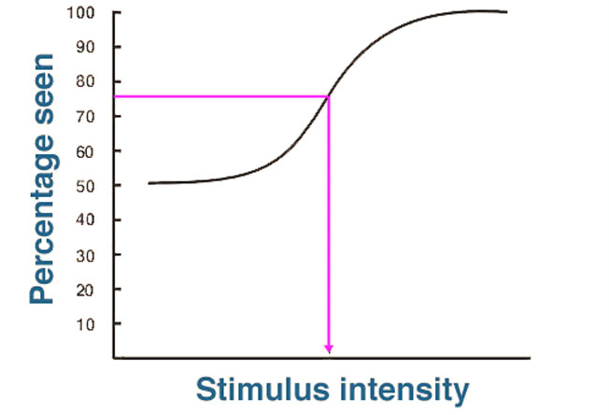
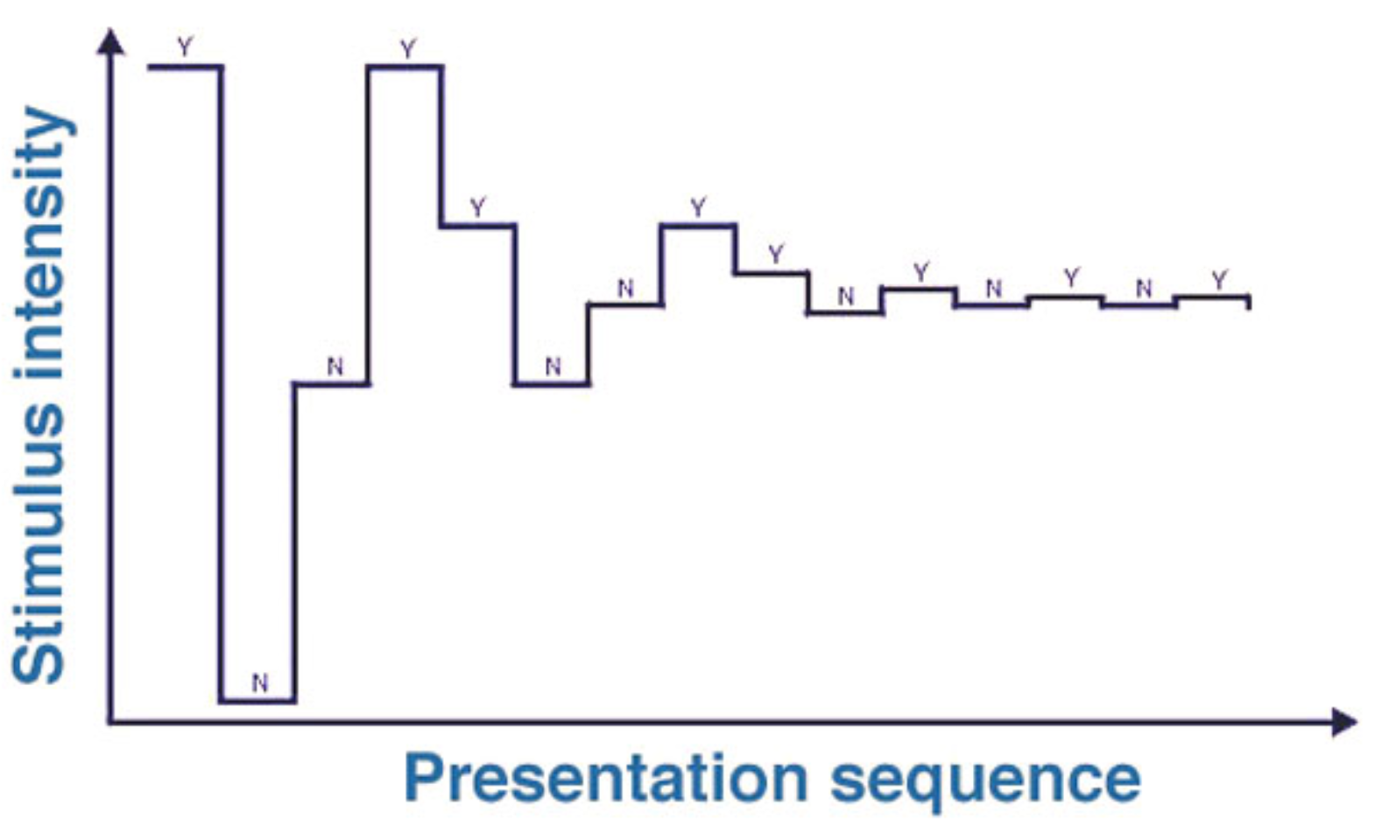
Measuring the JND
Yes-No
In a Yes-No Procedure the presence or absence of the signal must be detected (yes or no response).
  The correct response can range from 0% to 100%
In a Forced-Choice Procedure a subject is forced to choose from alternative choices, one of which contains the stimulus
  e.g., in a two-alternative forced choice (2AFC) describes a subject choosing between two alternative
  As there is already a 50% chance of a correct response with 2AFC, threshold is commonly considered as 75%
Parameter Esimtation by Sequential Testing (PEST) or Staircaise Test addresses the problem of step size and starting intensity
  Begins the session with large steps with the intensity progressively halved until the smallest noticeable step has been found
2AFC
PEST
Images from: https://webvision.med.utah.edu/book/part-viii-psychophysics-of-vision/psychophysics-of-vision/
Perception

Slide 21
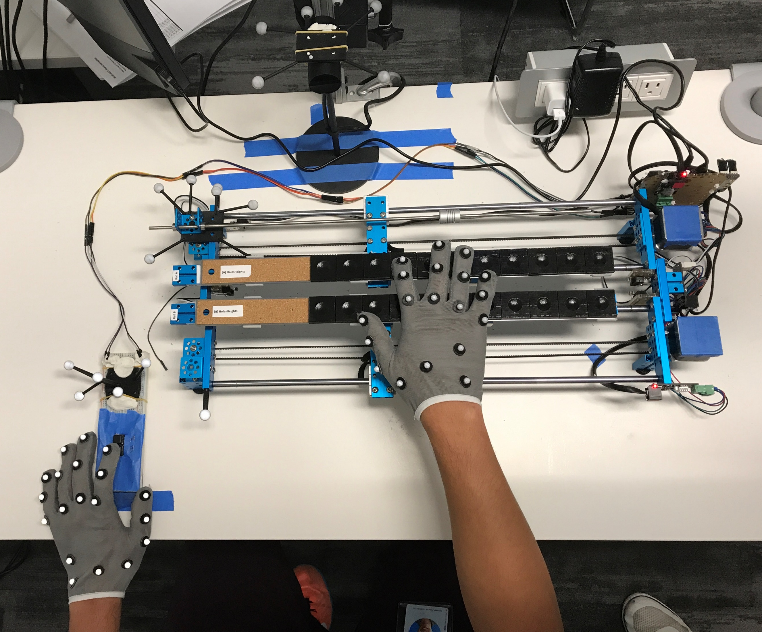
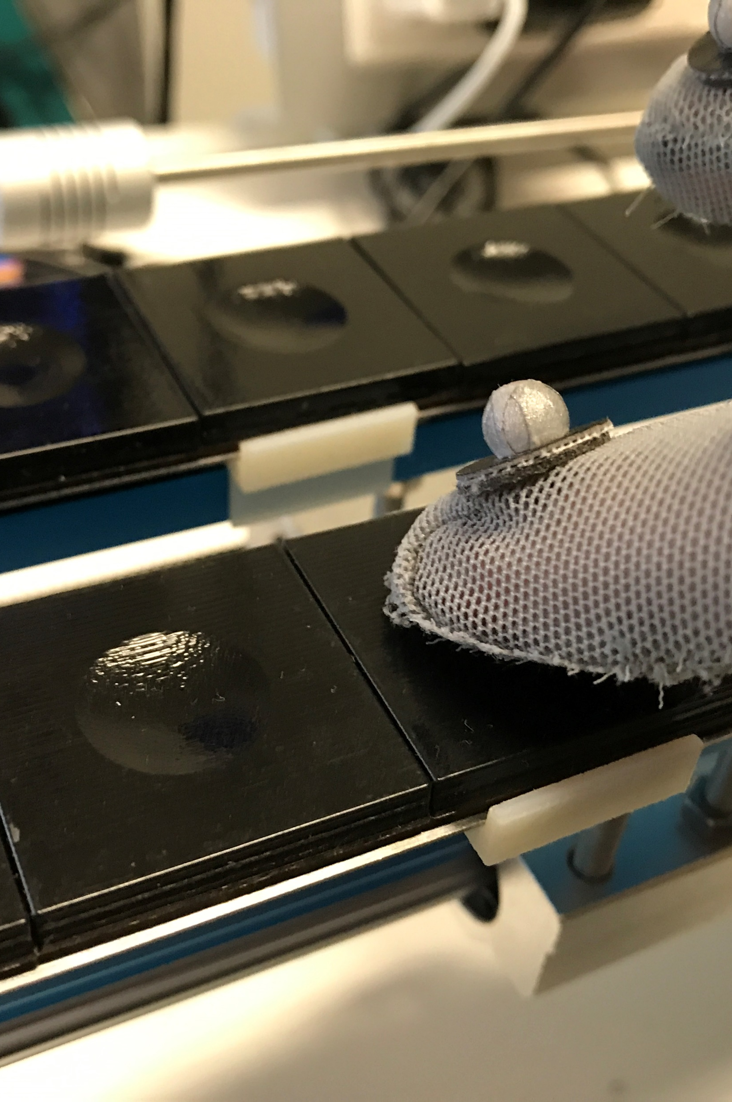
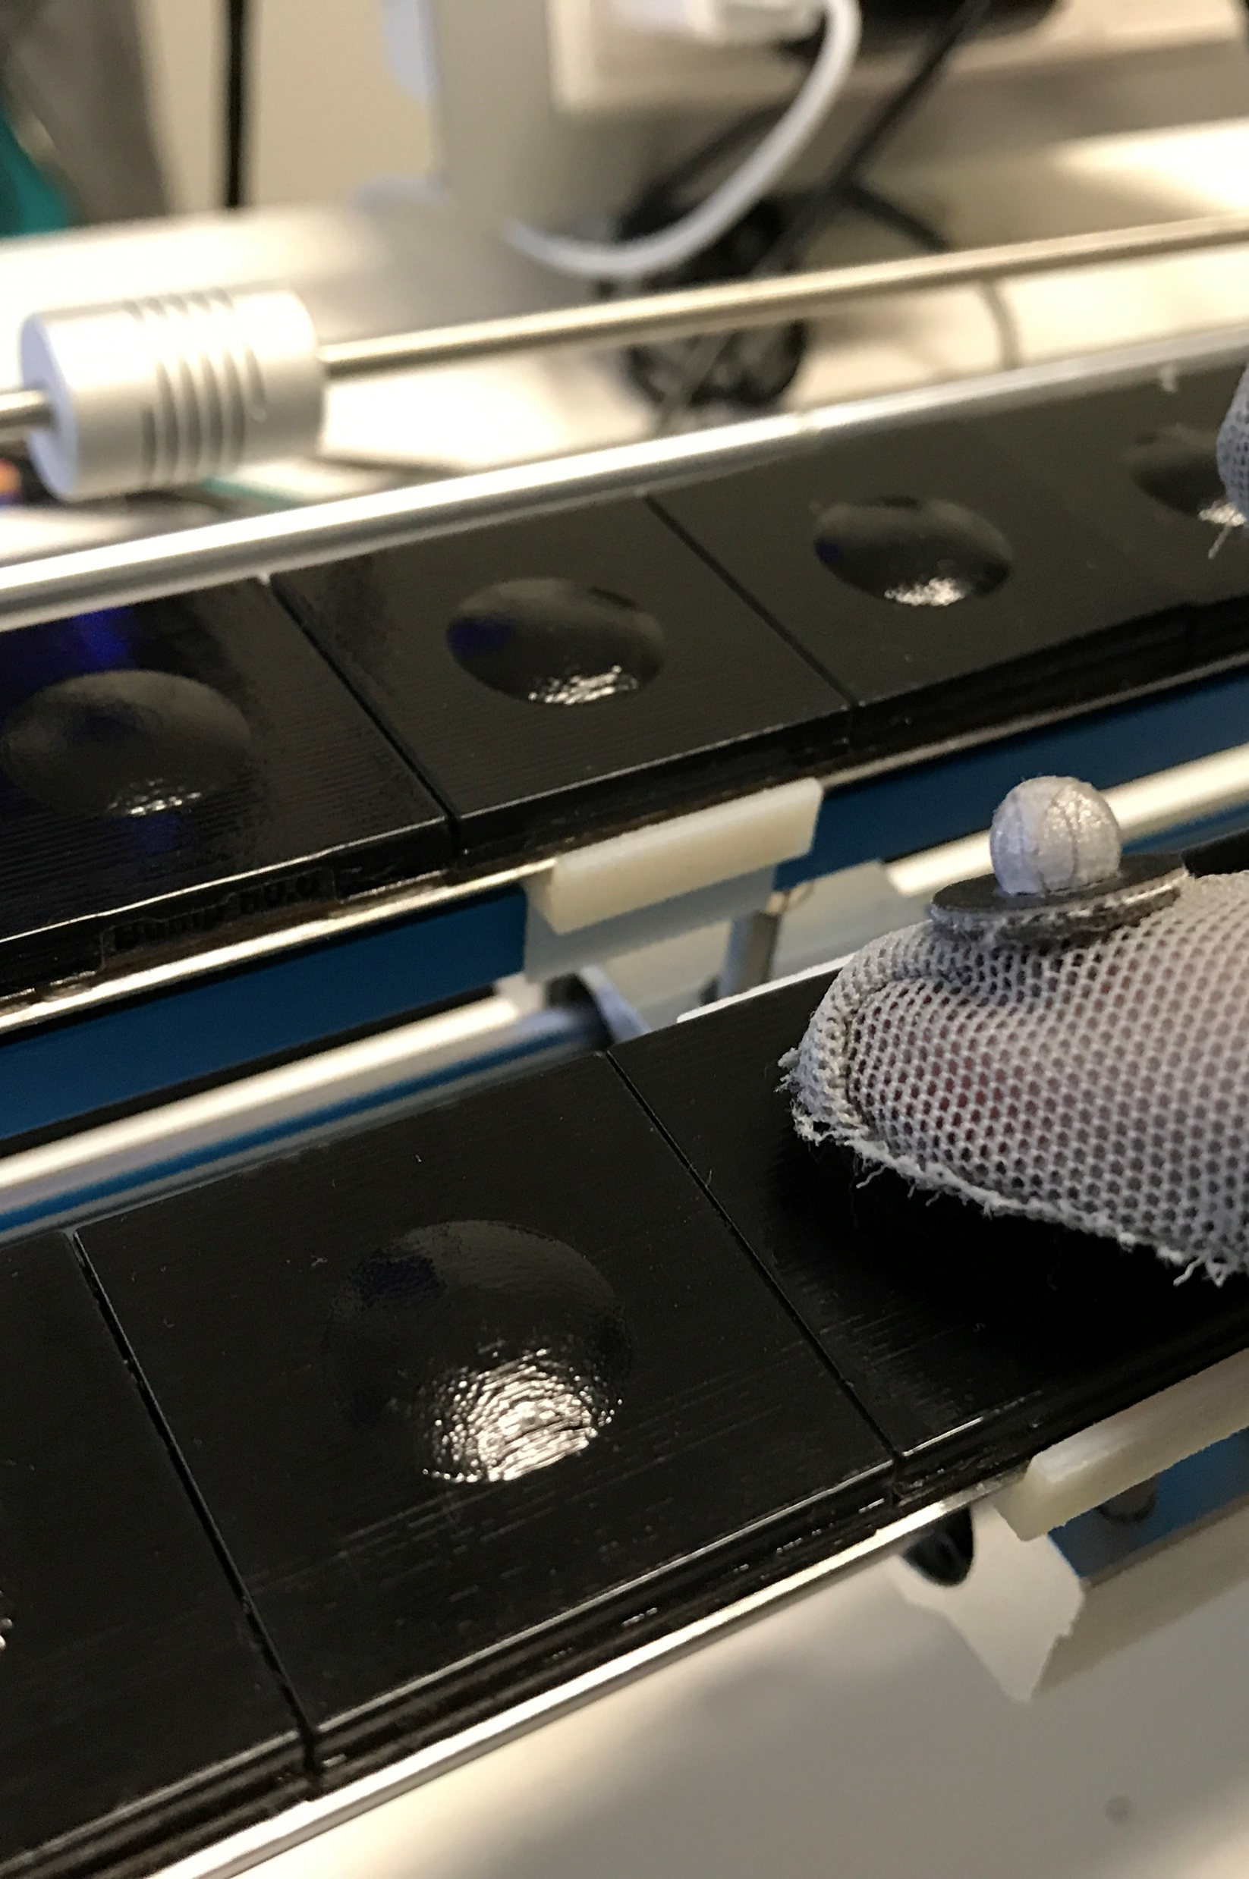
Example: Visual-Haptic Integration
Perception

Slide 22
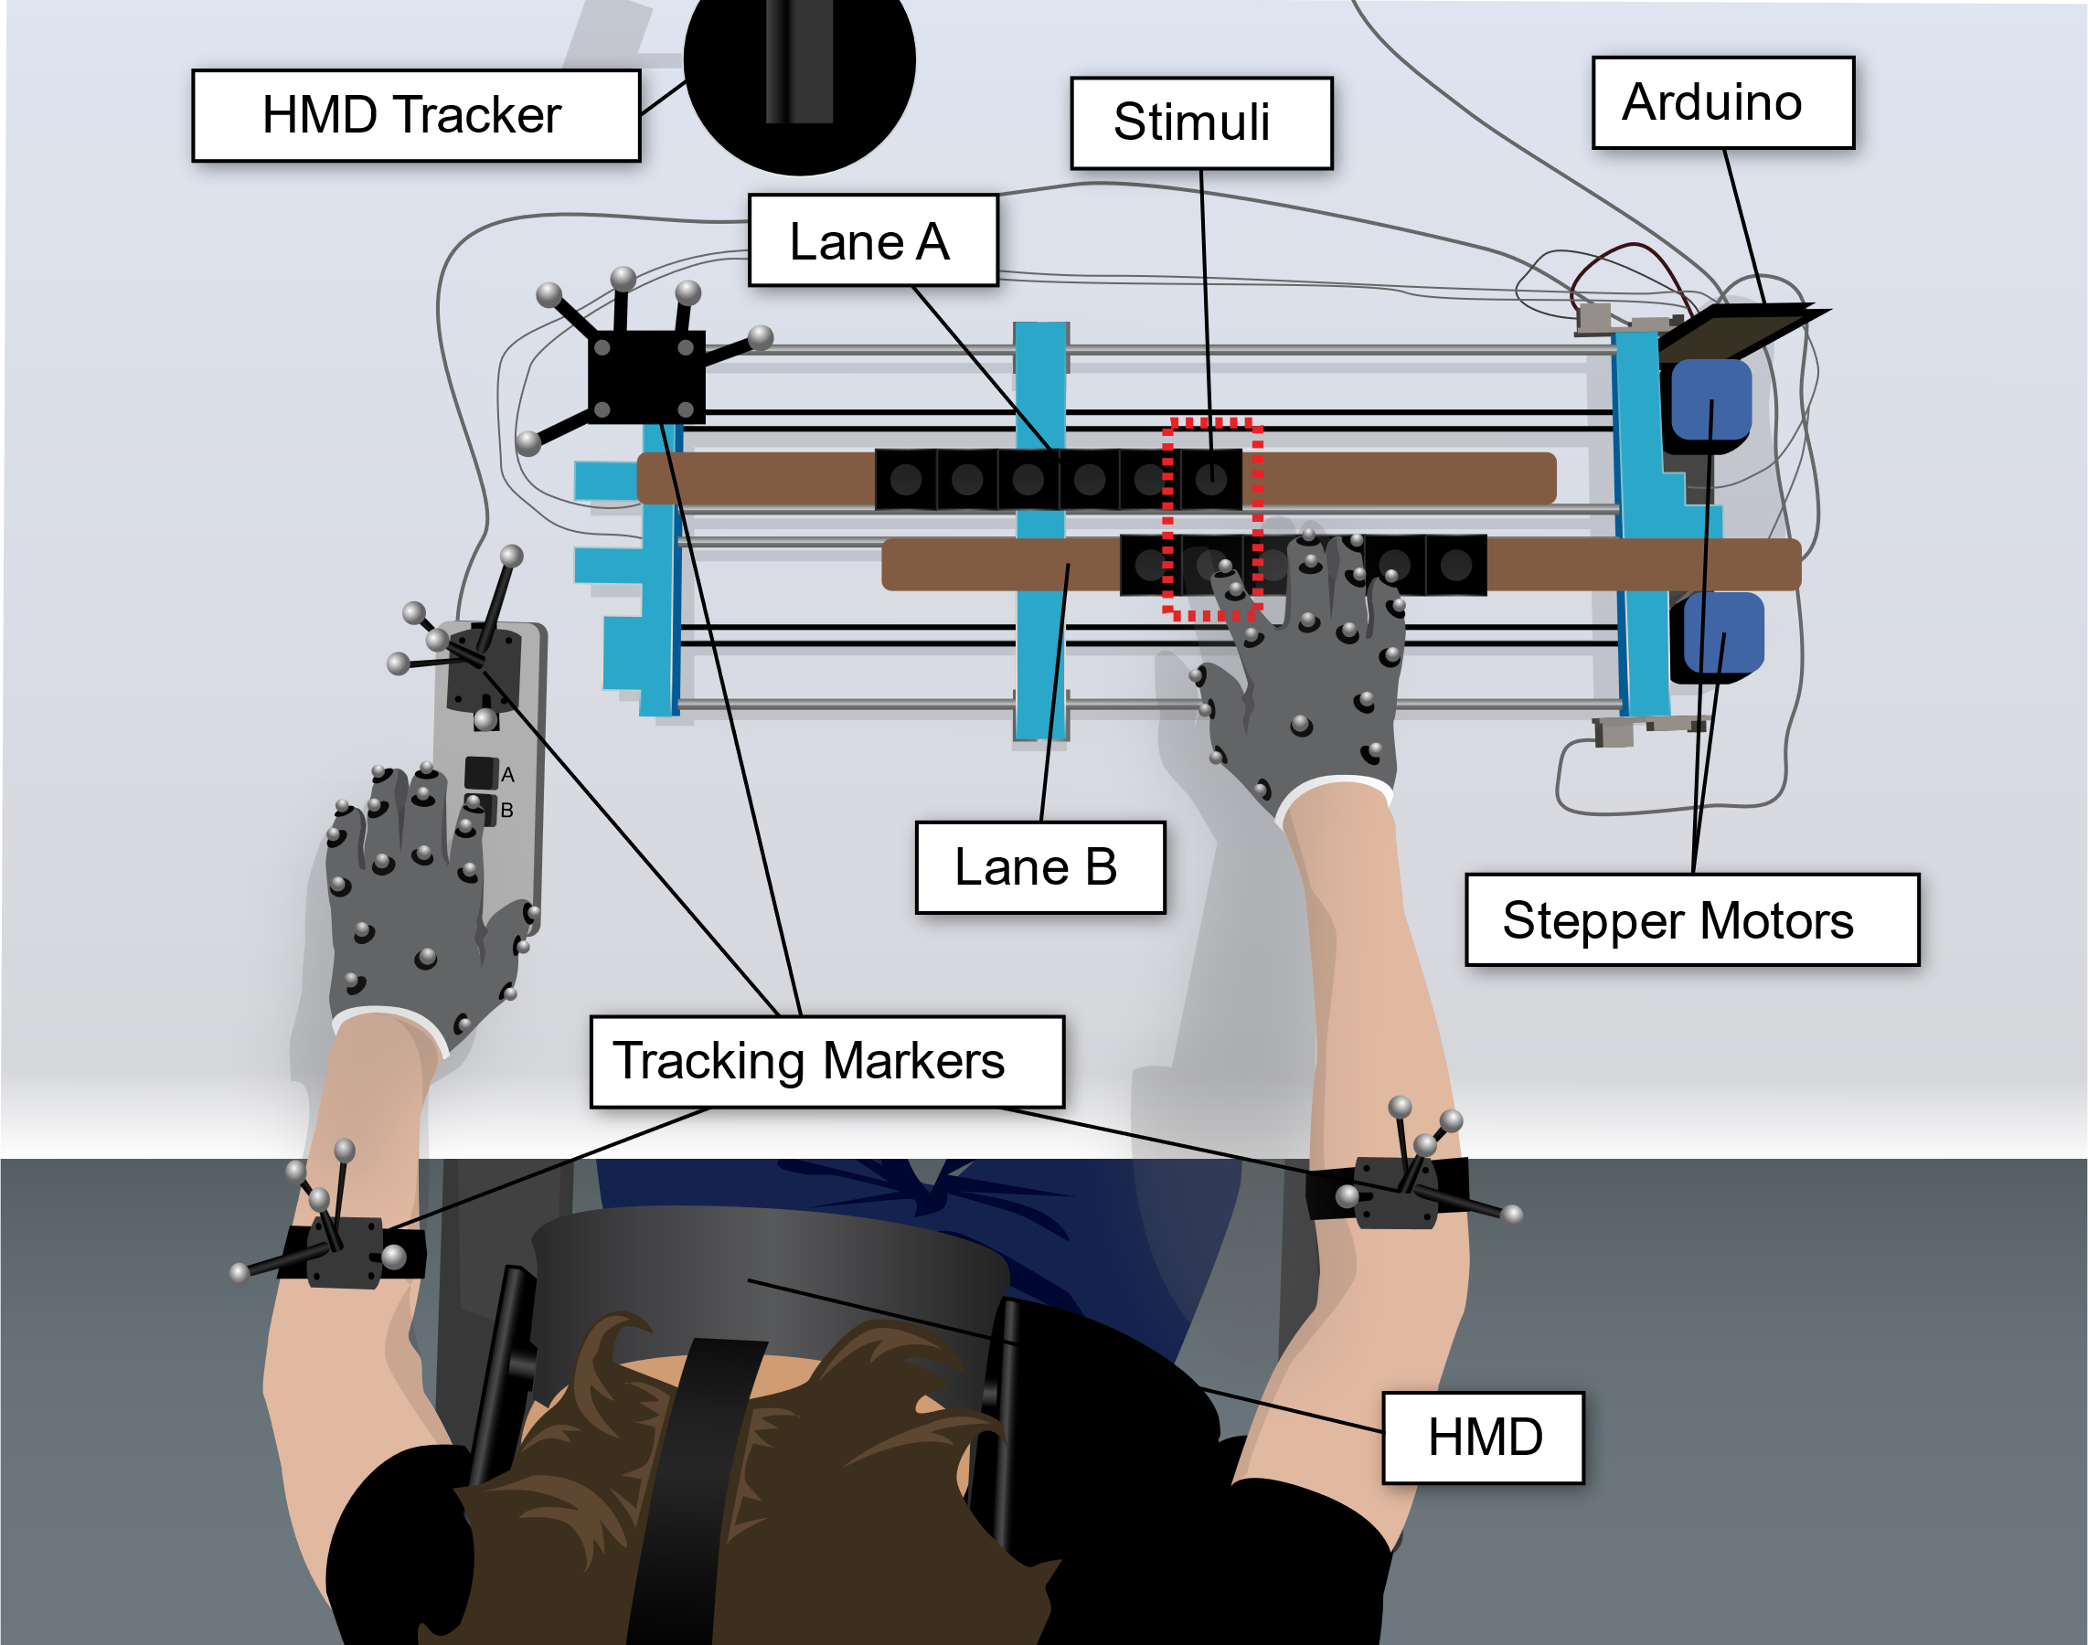
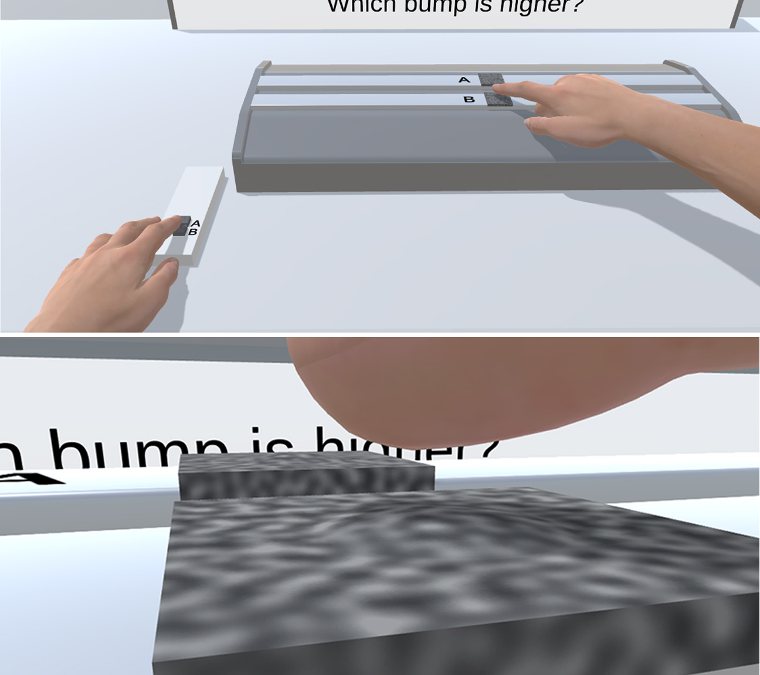
Measuring Tactile Sensitivity
Perception

Slide 23
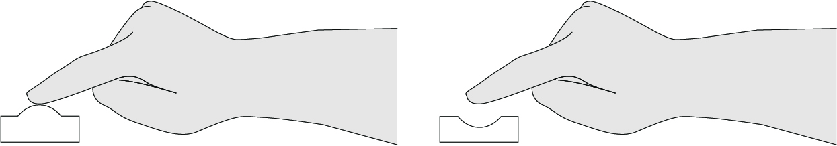
2AFC Task
A psychophysical experiment using a two-alternative forced choice (2AFC) task
Discrimination of height / depth differences
  Bumps: “is a bump higher?”
  Holes: “is a hole deeper?”
Perception

Slide 24
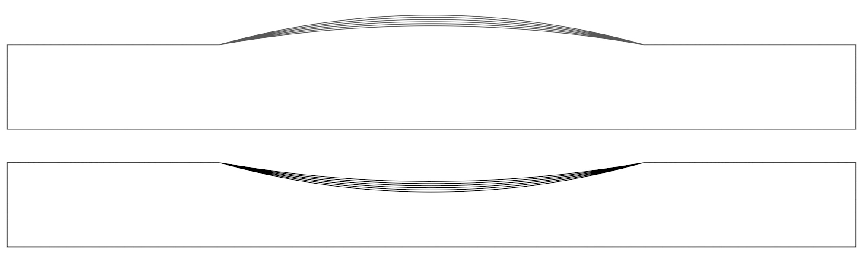
Just Noticable Differences (JNDs)
3d printed plates with bumps / holes from 0.675 to 1.05mm height / depth in
0.075mm steps
Perception

Slide 25
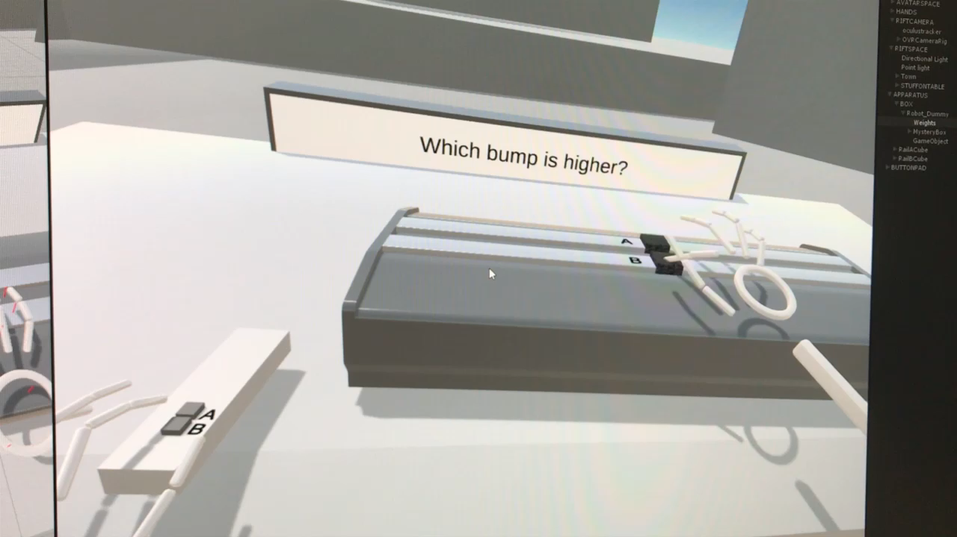

Slide 26
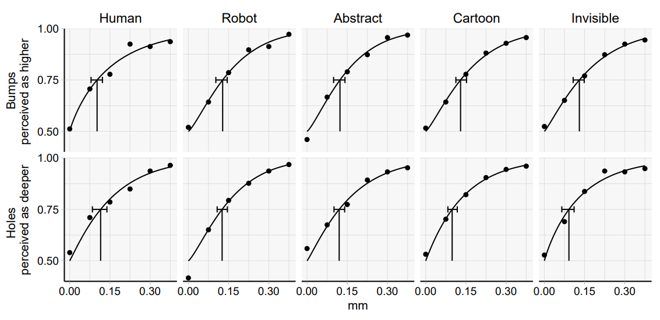
Effect of Hands on Tactile Sensitivity
Perception

Slide 27
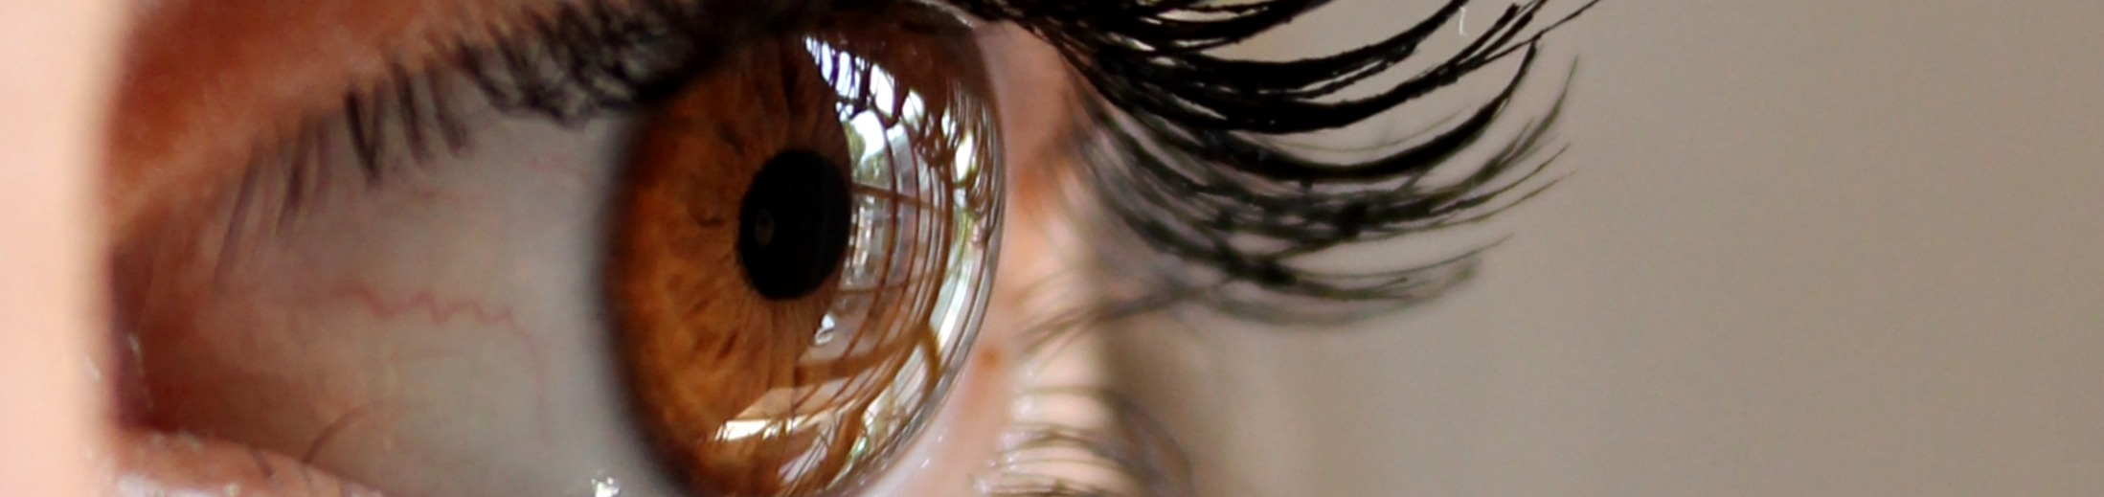
Vision
The Dominant Sense
Slides adapted from hci-lecture.org (A. Schmidt, N. Henze, K. Wolf, V. Schwind), Image from https://pxhere.com/de/photo/1007006
The following content is licensed under a Creative Commons Attribution 4.0 International license (CC BY-SA 4.0)

Slide 28
The Dominance of Vision
Information Processing: provides a substantial amount of information about our environment. The rich set of data helps us to navigate our environment, recognize objects and people, and perform complex tasks
Evolutionary Significance: spot predators and prey from a distance, navigate diverse environments, and identify edible plants and fruits has been essential for human ancestors.
Communication and Social Interaction: facial expressions, body language, and eye contact convey a wealth of social information.
Learning and Memory: human memory appears to be particularly adept at recalling visual information compared to other types of data.
Cultural and Technological Influences: The human-made environment and cultural artifacts heavily rely on visual elements. From reading and writing to the use of screens in various devices, modern society is structured around the visual processing of information.
Vision

Slide 29
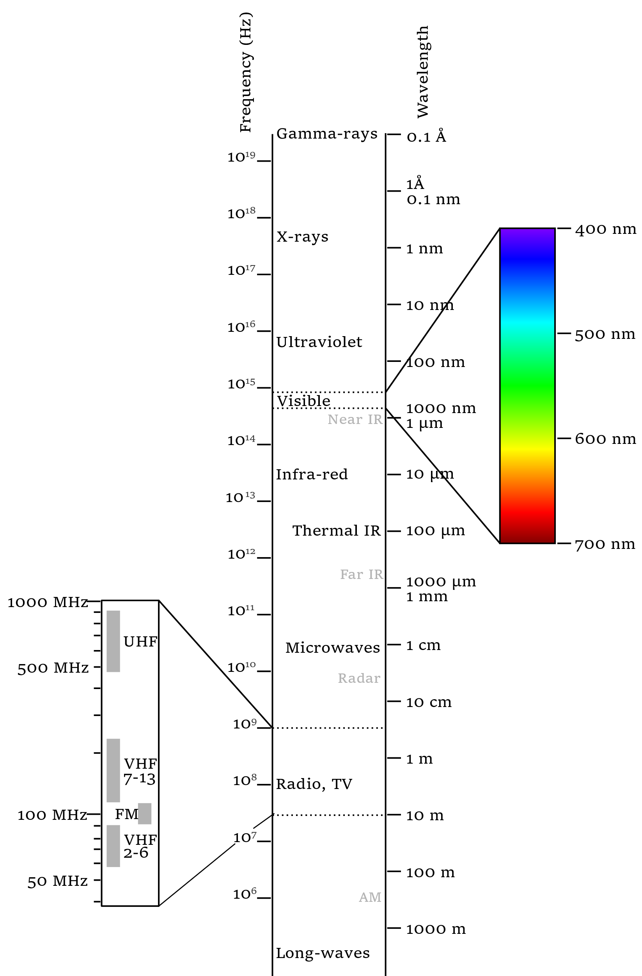
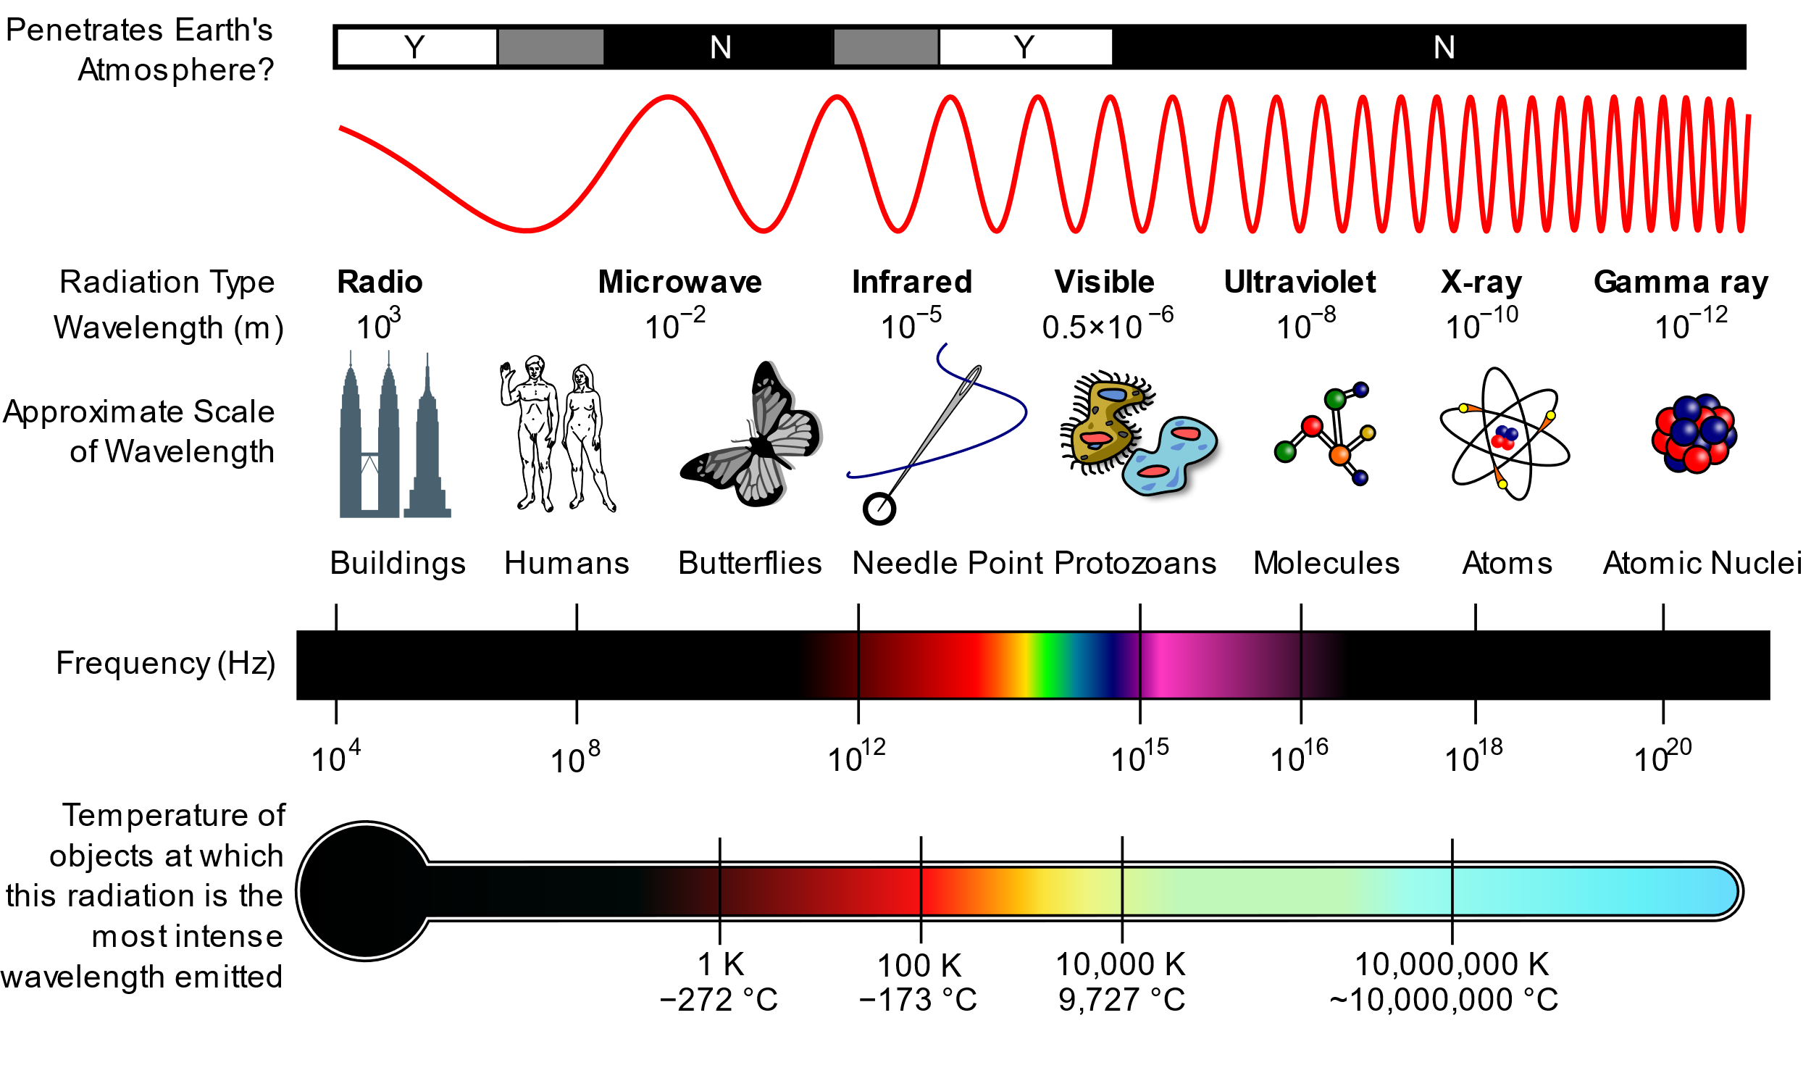
Electromagnetic Radiation
A diagram of the electromagnetic spectrum, showing various properties across the range of frequencies and wavelengths,
Inductiveload, NASA - self-made, information by NASA, CC BY-SA 3.0, Source: https://en.wikipedia.org/wiki/Electromagnetic_spectrum
The electromagnetic spectrum, Victor Blacus, CC BY-SA 3.0, https://en.wikipedia.org/wiki/Electromagnetic_spectrum
Vision

Slide 30


Facts about Visible Light
white
The visible light for humans has a wavelength between 280 nm (violet) and 740 nm (red)
  The sun emits a huge spectrum of electromagnetic radiation and includes all waveforms of visible light
Colors containing only one wavelength are also called pure colors
  Monochromatic light with high energy density is called laser
It is not possible to mix wave with different lengths to create a new color
Vision

Slide 31
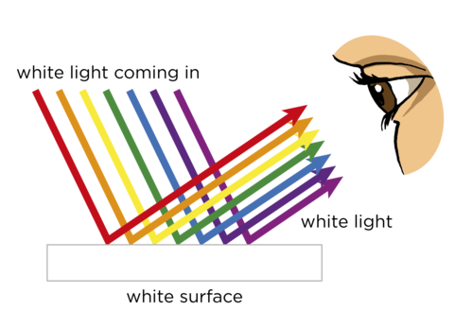
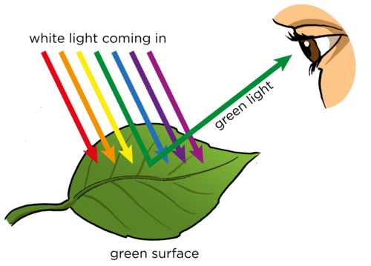
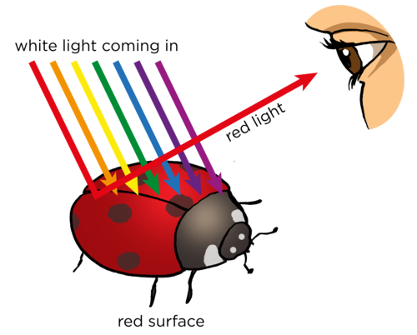
Light Absorption
Not every surface reflects every color
When light hits a surface, some of the light is absorbed and the rest is reflected
Based on their structure/material, surfaces only reflect color(s) in specific wavelengths
Vision

Slide 32
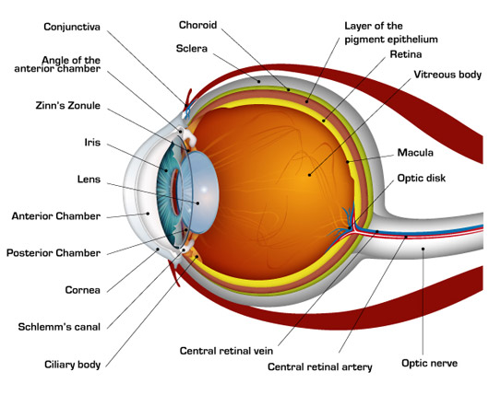
Eye Anatomy
The cornea (~43 dioptres) and lens (~18 dioptres) are responsible for the refraction of light
  The lens can change its shape with a focal length ~17 - 22 mm
  As the focal length is equal to the diagonal size the retina “sensor” the field of view is comparable with the focal length of a 50 mm lens
The iris and pupil (2 - 8 mm) control the brightness
The retina includes the photoreceptor cells
Each eye is controlled by seven extraocular muscles (six the movement, one the eyelid)
Image from: https://www.nkcf.org/about-keratoconus/how-the-human-eye-works/
Vision

Slide 33
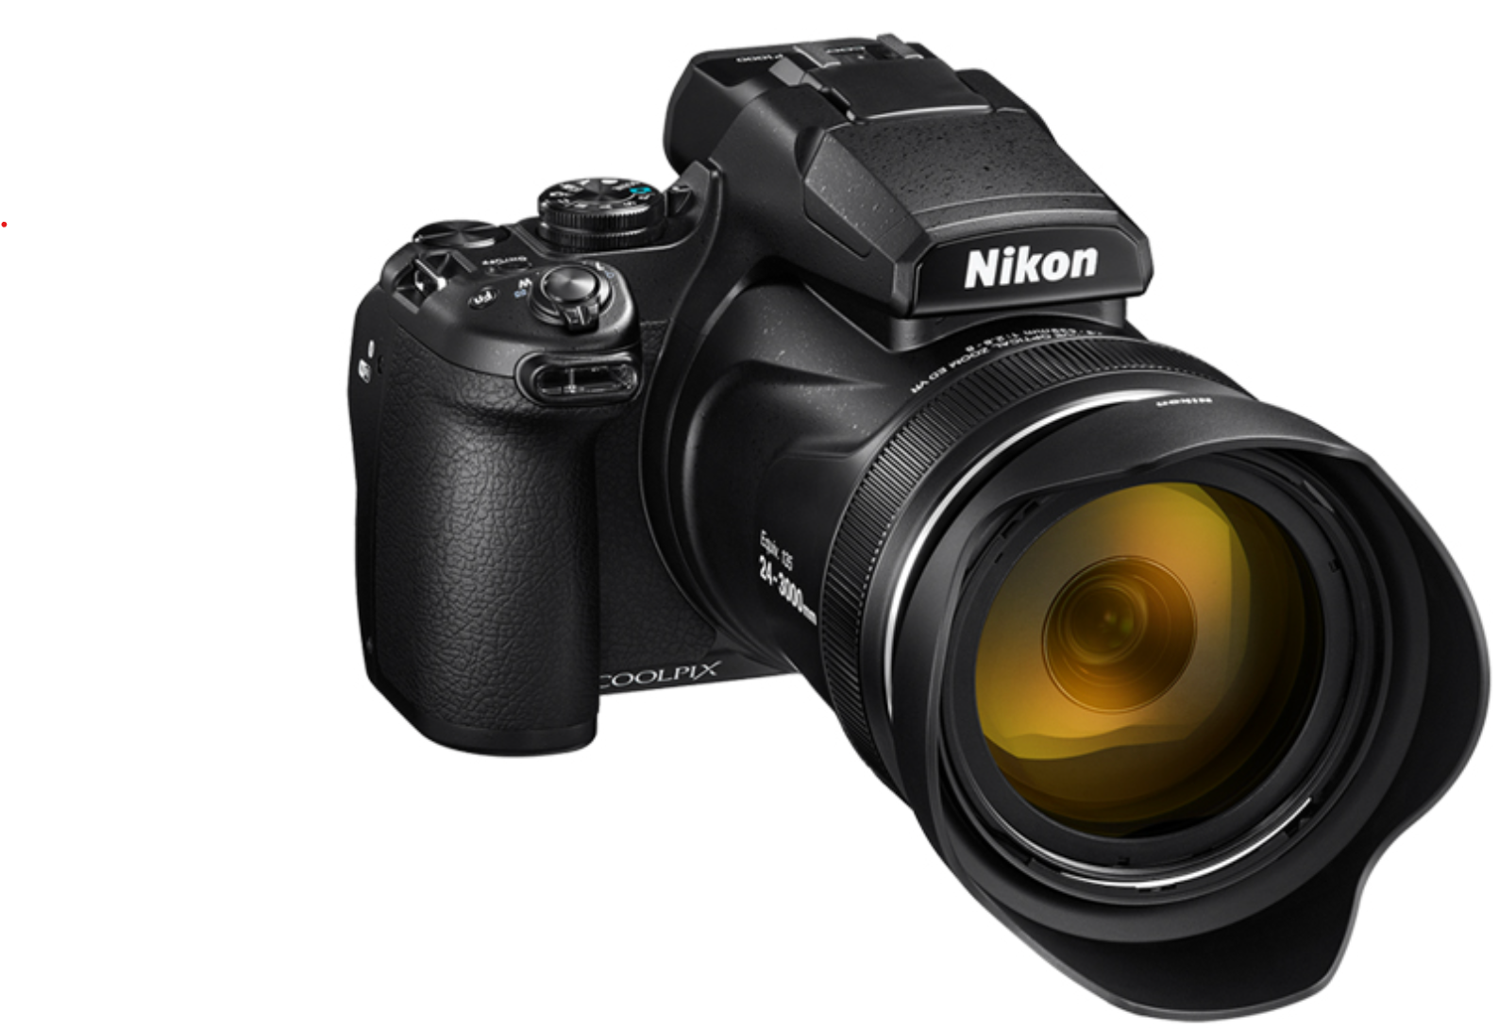
Eyes and Cameras
The f-number or f-stop describes the diameter of the aperture/iris
ISO speed describes the sensitivity of the photoreceptor cells
(Electrical) Shutter describes the time a camera needs to complete the cell charges of a complete image
Parameter | Nikon P1000 | Human Eye
f-stops | 15 | 21
ISO speed | 100 - 1600 | <1
El. Shutter | 1/125 – 4 | 1/100 – 1/200
Frame per second | 60 Hz | 60 Hz
Color Depth | 24 Bit | 20 Bit
Resolution | 16 MP | 576 MP
Focal Length | 24–3000 mm | 50 mm
https://www.nikon.de/de_DE/product/digital-cameras/coolpix/super-zoom-share/coolpix-p1000
Vision

Slide 34
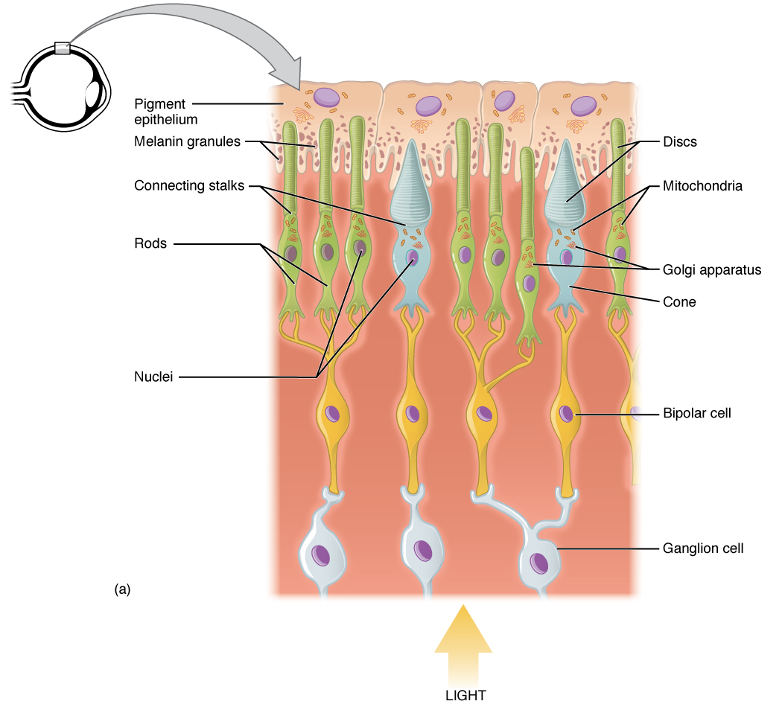
Photoreceptor Cells
Convert light into neurological signals (and stimulate other biological processes)
Rod, cone, and ganglion cells in the retina allow vision
  Rods (ca. 120 million per eye) and are responible for light intensity perception (actually the absence of light)
  Cone cells (ca. 6 million per eye) respond differently to light of different wavelengths, and are responsible for color vision
  Ganglion cells (ca 0.7 to 1.5 million) are photosensitive but mainly responsible for delegating and triggering signals
Illustration from Anatomy & Physiology, Connexions Web site. http://cnx.org/content/col11496/1.6/, Jun 19, 2013. https://commons.wikimedia.org/wiki/File:1414_Rods_and_Cones.jpg
Vision

Slide 35
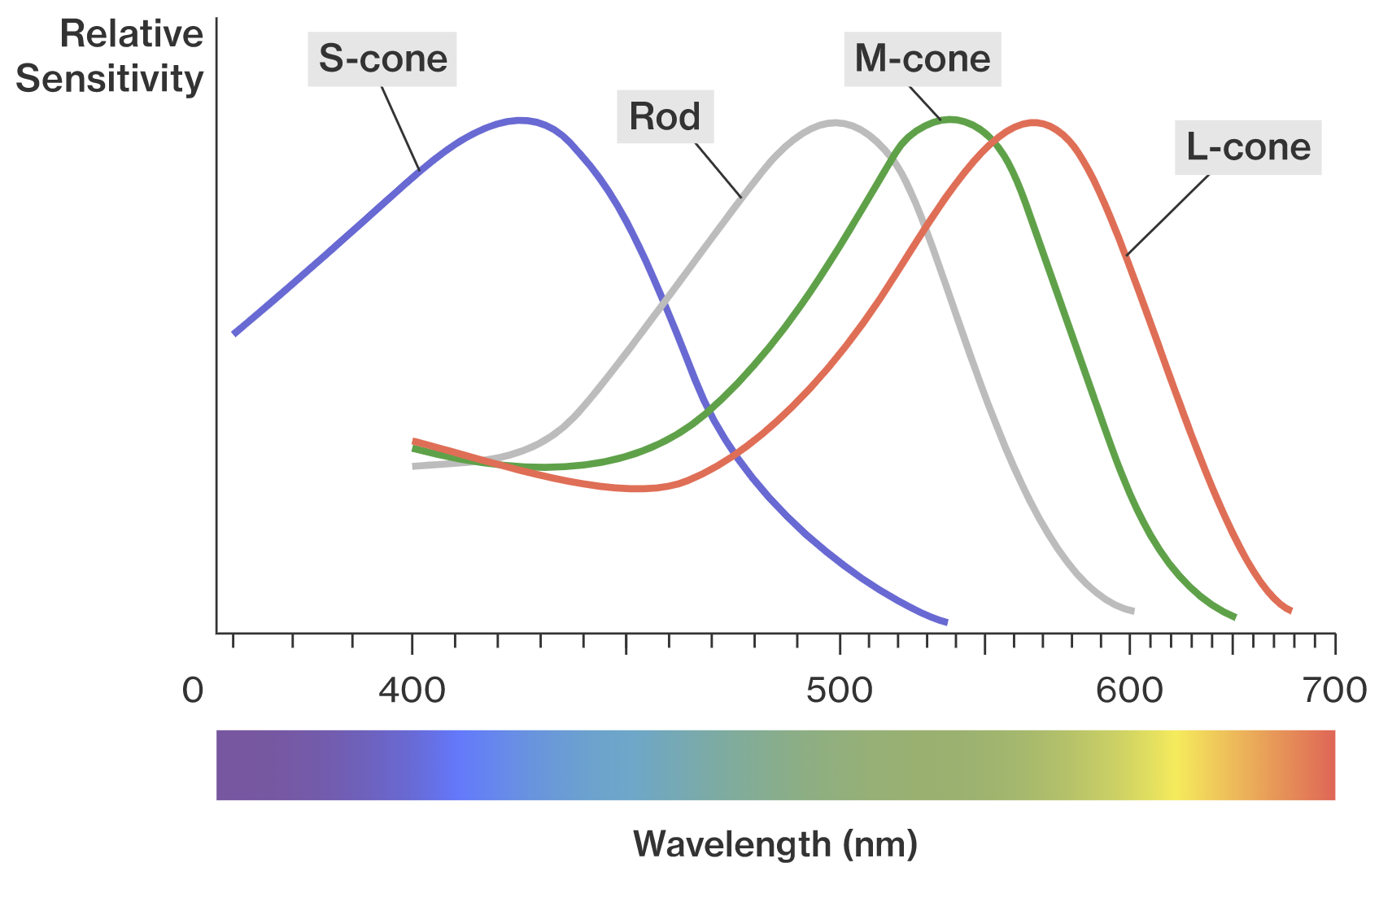
Rod Cells
Function well in lower light and have little role in color vision
  Can respond to a single photon of light
  Respond more slowly to light than cones
Mainly located at the outer edges of the retina
  Important for peripheral vision
Rod cells perceive
  Brightness
  Contrast
  Movements
Vision

Slide 36
Cone Cells
There are 3 types of cones
  Blue light cone receptors (S-cones, 420 nm)
  Green light cone receptors (M-cones, 533 nm)
  Red light cone receptors (L-cones, 564 nm)
  12% of the women in Europe have a 4th one (Tetrachromats)
Cone cells perceive
  Colors
  Details
  Movements
Humans can distinguish ~1 Mio color tones
Vision
Notes:
Ungefähr zwölf Prozent aller europäischen Frauen sind Tetrachromaten mit einem zusätzlichen anormalen L- oder M-Zapfen, allerdings können nur wenige dies zur genaueren Farbunterscheidung nutzen.

Slide 37

Color Blindness
Vision

Slide 38
Troxler‘s Fading
The sensitivity of rod and cones decreases when they are exposed to persistent stimuli of similar intensity
  Unvarying stimuli disappear from our awareness as neurons adapt and start to ignore the unimportant stimulus
Retinal photoreceptors mainly respond to changes in lighting conditions
  A fixated head and paralysis of the eye muscles lead to a temporary blindness
Micromotions/Microsaccades of the eye constantly shifts the light incident on the retina to stimulate receptors and, thereby, enable vision
Microsaccades prevent the blindness and usually occur 1 to 10 times per second
  → Depend on the task (e.g., while reading 3 per second)
The amplitude typically <15 arcmin. This angle corresponds to about 80 μm or ≈ 40 photoreceptors shift on the retina
Vision

Slide 39
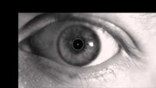
https://youtu.be/aQclvZpPWHQ

Slide 40

How we see colors…
We remember: it is not possible to mix waves with different lengths to create a new color (e.g., yellow)
Cone receptors only receive wavelengths of the light they are able to perceive
There are no receptors for yellow.
But how can we see yellow?
ignored!
???
R
G
B
Vision

Slide 41
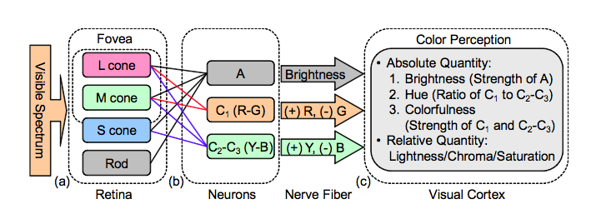
Trichromatic and Opponent Processes
+
=
=
Trichromatic (or Young–Helmholtz) Process
  Ganglions interpret an overlap of light with different wavelengths
  The system is not perfect and cannot distinguish yellow from a red-green mixture
Opponent Process
  The visual system codes pair differences instead
  of taking the raw signal
  Activation of one pair member inhibits
  the activity in the other pair member
    red blocks green
    blue blocks yellow
    black blocks white
Diagram of the opponent process, CC BY-SA 3.0, https://en.wikipedia.org/wiki/Opponent_process
Vision

Slide 42
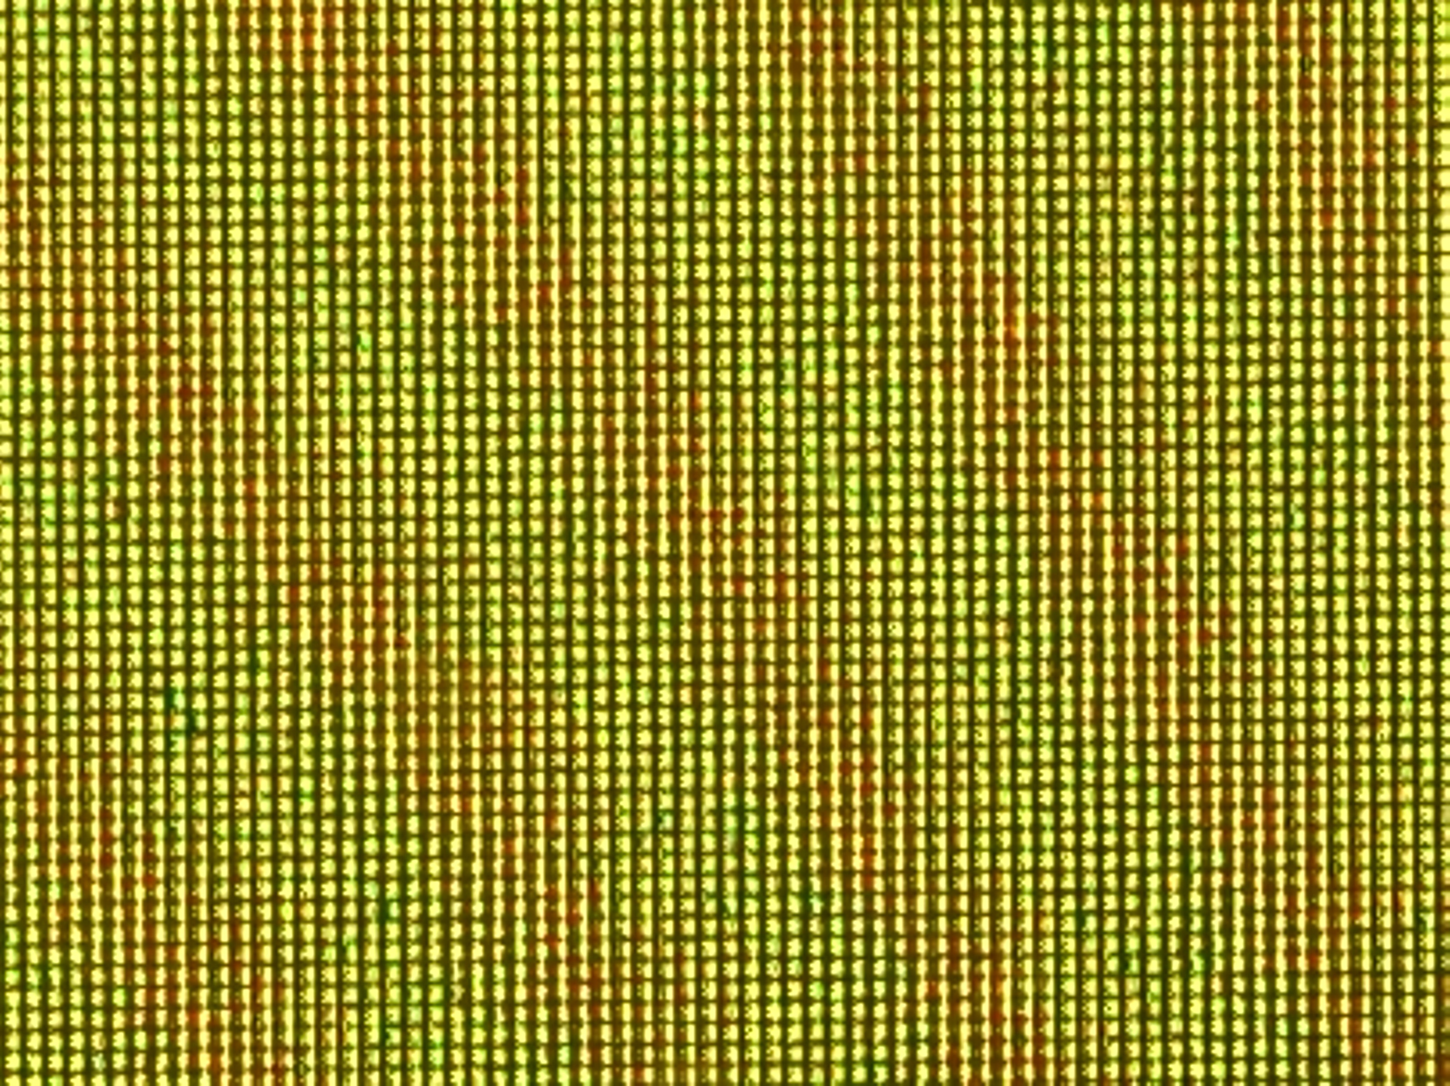
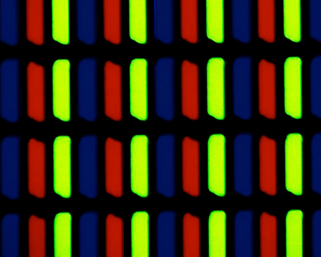
?s
Has it always been like this?

Slide 43

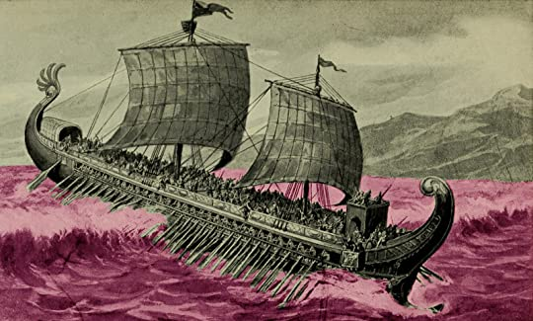
“And jealous now of me, you gods, because I befriend a man, one I saved as he straddled the keel alone, when Zeus had blasted and shattered his swift ship with a bright lightning bolt, out on the wine-dark sea.”
- Homer, The Odyssey, Book V
J. M. W. Turner - The Yorck Project (2002) 10.000 Meisterwerke der Malerei (DVD-ROM), distributed by DIRECTMEDIA Publishing GmbH. ISBN: 3936122202.
Image from https://www.goodreads.com/review/show/2163306189
Vision
Notes:
„Und jetzt seid ihr eifersüchtig auf mich, ihr Götter, weil ich mich mit einem Mann anfreunde, einem, den ich gerettet habe, als er allein auf dem Kiel saß, als Zeus sein schnelles Schiff mit einem hellen Blitz auf das weindunkle Meer gesprengt und zerschmettert hatte.“ - Homer, Die Odyssee, Buch V

Slide 44
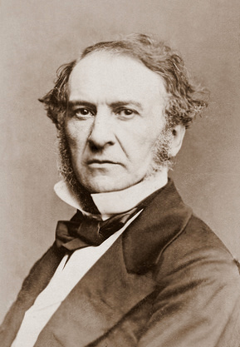
History of Color Perception
William E. Gladstone published a three-volume work on Homer around 1858
  He noticed that Homer had problems to describe colors
    200x the word black
    100x the word white
    15x the word red
    10x the word yellow
    10x the word red
    honey → green
    sky → bronze
  not a single word with the colors “blue” or “orange”
The color “blue” appears not even once in the New Testament
William Ewart Gladstone, Prime Minister of the United Kingdom, 1861
Vision

Slide 45



The Problem with Blue
Blue pigments cannot be found in nature
Do not absorb blue light, cancel out other colors
Vision

Slide 46

„hyacinthine purple„
„tyrian purple“
King James Bible (1611) translated both as “blue.” (because they were talking about the sky)

Slide 47
Linguistic Relativity
Color terms in a language are predictable by the number of color terms
All human cultures have terms for black/dark and white/bright. If a culture has three color terms, the third is red. If a culture has four, it has yellow or green, and so on…
!
or
Basic Color Terms: Their Universality and Evolution, (1969) Brent Berlin and Paul Kay, (ISBN 1-57586-162-3)
I
II
III
IV
V
VI
VII
Cultural development
Vision

Slide 48
Sapir-Whorf-Hypothesis
The structure of a language affects world view and perception of a person
The human perception is relative to the spoken language
There is a strong and weak version in linguistic relativity
  strong: “language determines thought and that linguistic categories limit and determine cognitive categories”
  weak: „linguistic categories and usage only influence thought and decisions”
Racists often use the number of words for categories as a measure of intellectual superiority over others (which is wrong)
Perception does not only emerge with experience but also from the cultural need to distinguish it
Vision

Slide 49

The Himba Tribe Example
Distinguishable by
Himba tribe
Distinguishable by
English speakers
Vision

Slide 50
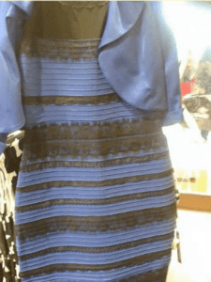

The Dress
A Tumblr user named “Swiked” posted a picture of a dress on the Internet on February 25, 2015
The dress was the subject of 4.4 million tweets within 24 hours
The actual colors were black and blue
However, many people do not agree and see white and gold
The image prompted many discussions on the colour and how they perceived the dress
The original dress picture, Roman Originals, https://en.wikipedia.org/wiki/The_dress
Vision

Slide 51
The Dress
57% see the dress as blue and black
30% see it as white and gold
11% see it as blue and brown
10% can switch between any of the color combinations
People either discount
  the blue side, in which case they end up seeing white and gold
  the gold side, in which case they end up with blue and black
Women and older people disproportionately see the dress as white and gold
The original dress picture, Roman Originals, https://en.wikipedia.org/wiki/The_dress
Vision

Slide 52
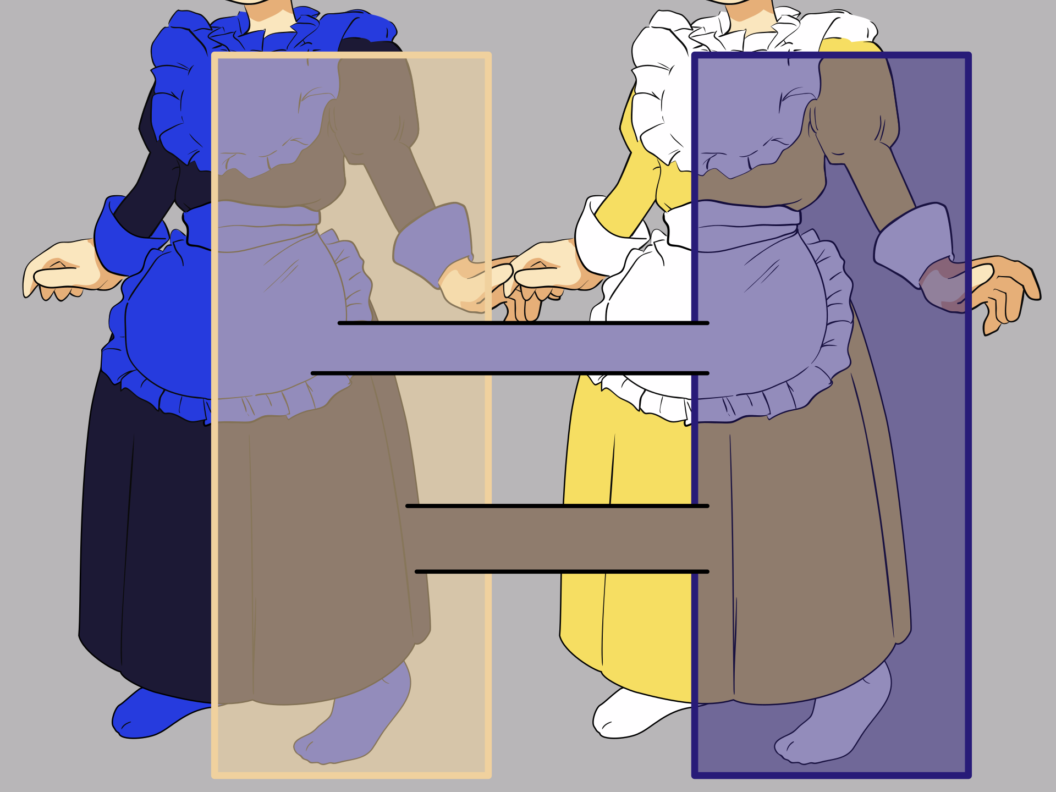
Chromatic Adaption
The biggest known individual difference in vision after the red-green blindness
The effect was unknown until „the dress“
  Mainly occurs with blue colors
The phenomenon has a connection to how the brain processes the various hues of a daylight sky and depends if someone is regularly exposed to the blue sky
  Vision is trying to discount the chromatic bias of the daylight axis
  People who see white and gold show increased activity in the frontal and parietal regions of the brain
  → Areas critical in higher cognition activities
Wikipe-tan wearing The Dress https://en.wikipedia.org/wiki/The_dress
Vision

Slide 53
Color Depth
1 Bit: 2 colors (Binary images, LCDs)
4 Bit: 16 colors (EGA-GPUs)
6 Bit: 64 colors (Amiga 64)
16 Bit: 65.536 colors (High Color Mode, Windows 95)
20 Bit: 1.048.576 colors (number of colors humans can distinguish)
24 Bit: 16.777.216 colors (True Color Mode, Windows 2000)
30 Bit: 1.073.741.824 colors (Deep Color, HDR)
36 Bit: 68.719.476.736 colors (Deep Color, HDR10+, Dolby Vision)
Vision

Slide 54
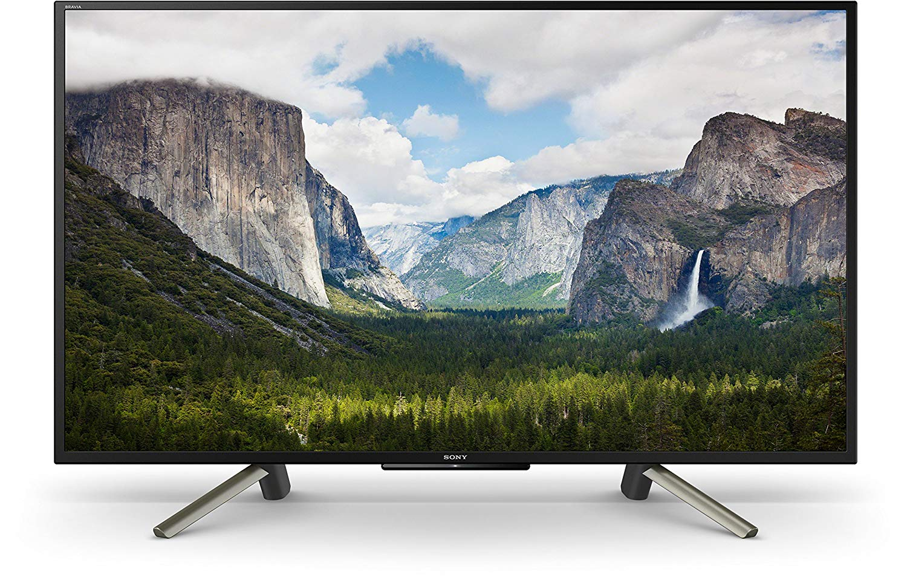
?
Vision

Slide 55
Dynamic Range
Human vision is capable of adapting to light conditions that range over nearly ten orders (10¹-10¹⁰)
Humans cannot perform these feats of perception at both extremes of the scale at the same time
  Up to about 1:1,000,000 are simultaneously visible (daylight conditions).
  Humans continually “record” images with different color ranges and combine them into one complete mental high dynamic range image of the scene
  A in a moonless night, humans perceive stars with 1:1,000,000,000 (90 dB) of the illumination they would have on a bright sunny day
    No camera has this dynamic range
    However, the eyes don't see more detail after staring at something > 10-15 seconds.
Vision

Slide 56




Dynamic Range & Tone Mapping
Digital Cinema Cameras (e.g., Red Weapon 8k) are able to capture multiple stops to capture a dynamic range
Some displays are able to map the dynamic range (15 stops) of the human eye (21 stops)
Images or videos need a downsampling of the dynamic range to fit the dynamic range of the display
Tone mapping uses a combination of multiple exposures of the same scene
Retains details in light and dark areas
© Bartłomiej Okonek https://www.easyhdr.com/examples/
Vision

Slide 57
Motion Perception
Detecting dangers: animals/humans recognize when an attacker moves
Create attention: attention is focused on motion. If you are in a large group, you can draw attention to yourself by waving
Detecting objects: an object can stand out from its background or helps to make its shape more recognizable
Information about environment: gestures, for example, can give hints about the intensity of a conversation
Spatial perception: our brain also uses the movement information for spatial perception (e.g. motion parallax)
Vision

Slide 58
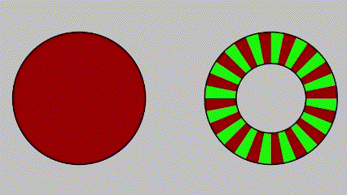
Flicker Fusion Threshold
The frequency at which an intermittent light stimulus appears to be steady
Cathode ray tube (CRT) displays are usually operated at a vertical scan rate of 60 Hz, which often resulted in noticeable flicker
  Many systems allowed increasing the rate to higher values such as 72, 75 or 100 Hz to avoid this problem
  Most people do not detect flicker above 400 Hz
  Depends on the wavelength and photoreceptor cells
Other display technologies do not flicker noticeably, so the frame rate is less important
  negligible for LEDs or TFT Displays
Vision

Slide 59
Motion Perception
Perception of movement distinguish between short-range and long-range distances of the movement jumps
Short-range distance (small viewing angles)
  first-order: movement derived directly from luminance changes
  second-order: movement derived from structural or contrast changes
Long-range distance (large viewing angles)
  third-order: The movement is derived from the change of any object features and do not depend on low but on a high-leveled order cognitive mechanism in the human brain
The exact causes and thresholds between short- and long-range distance are still unclear!
  There are two known motion percepts: the beta movement and the phi phenomenon
Vision

Slide 60


Beta Movement
Describes an apparent movement of an object, whose physical properties (shape, size, color) are identical to the properties of stationary targets
Two stimuli a + b appear in succession, but are perceived as the motion of a single object
  A series of static images on a screen creates the optical illusion of movement
Occurs when the frame rate is about 10 to 12 images per second
  Value must be above the number of microsaccades that can occur in 1 second
Does not fully explain the apparent motion in film
Image source: visual-memory.co.uk Beta movement
Vision

Slide 61
Phi Phenomenon
Occurs at faster frame rates, and if the distance between the stimuli is in a certain limit (with high individual differences)
Two stimuli a + b appear in succession, but are perceived as the motion of a vague shadowy something passing (a over b)
  An illusory ”object” with the same colour as the background is seen moving between the two stimuli
  Perceived as “pure” motion uncontaminated (as in beta movement) by form cues
The whole process is not well understood
Does not fully explain the apparent motion in film
Image source: visual-memory.co.uk Beta movement
Vision

Slide 62
Eye and Head Movement Correction
Two motion cues: The difference of an object location on an image seen by the left and right eye
  Retinal movement: when the image shifts on the retina and receptors are stimulated
    → the further the object is moving, the lower the retinal shift
  Eye Movement: retinal image remains the same retina because the object is being tracked with the eyes or even the entire head
    → inferring the speed and direction of objects based on vestibular and proprioceptive inputs
Efference copy: a copy of the motor signal sent to other areas of the brain instead of the eye muscles to differentiate between the movement of the own body (especially the eye movement) and an object’s movement
  → important for all movement-producing signals generated by the motor system
Vision

Slide 63

Motion and Depth Cues
Motion parallax: When an observer moves, the apparent relative motion of several stationary objects against a background gives hints about their relative distance
Depth from motion: When an object moves toward the observer, the retinal projection of an object expands over a period of time, which leads to the perception of movement in a line toward the observer
Kinetic depth effect: refers to the phenomenon whereby the three-dimensional structural form of an object can be perceived when the object is moving
The Spinning Dancer, CC BY-SA 3.0,
https://en.wikipedia.org/wiki/Kinetic_depth_effect
Vision

Slide 64
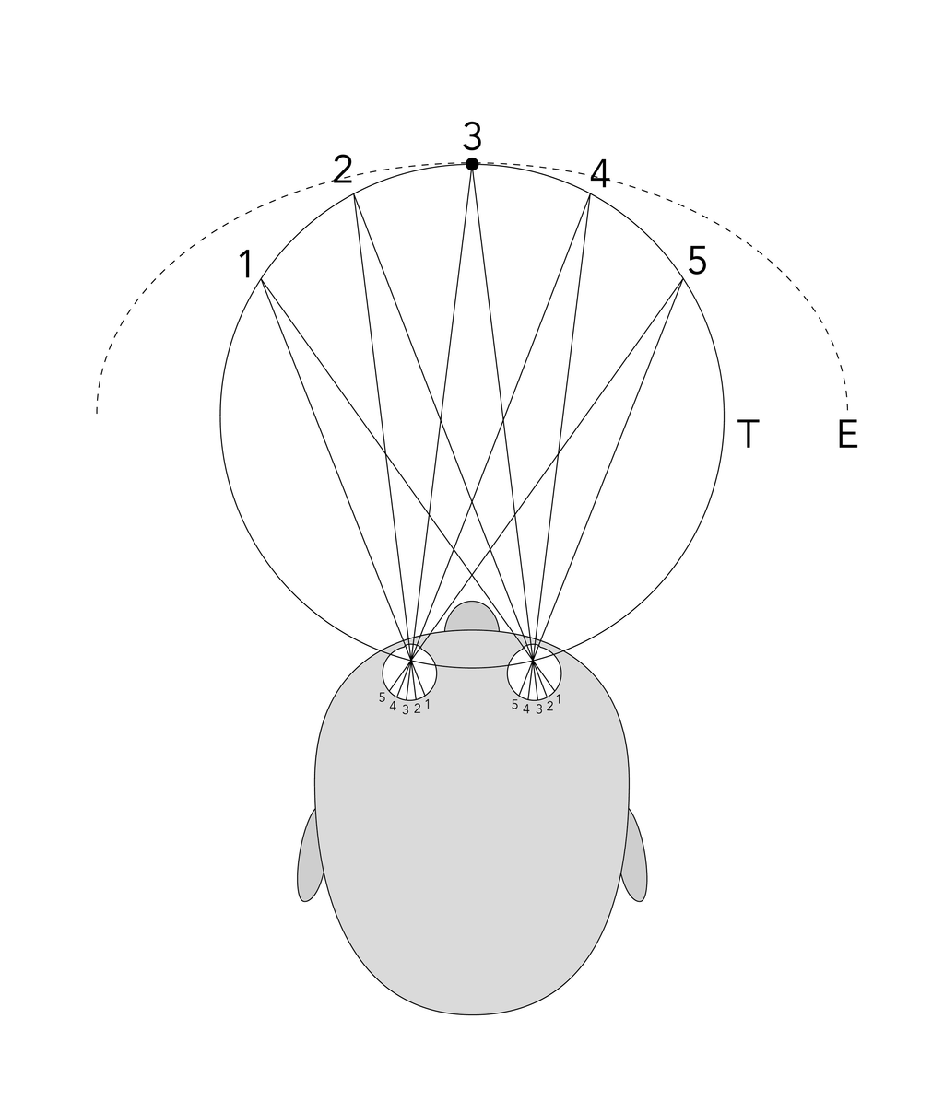
Stereo Vision
Binocular disparity (or parallax): different positions of the eyes provide precise depth perception
Binocular vision enables a maximum horizontal field of view of ~190°
  ~120° horizontal monocular
  the vertical range of the visual field in humans is around 150 degrees)
Determines the line of sight, relative to each other (vergence) and relative to a particular object (angle)
Allows to see more of an object behind an obstacle
Vision

Slide 65
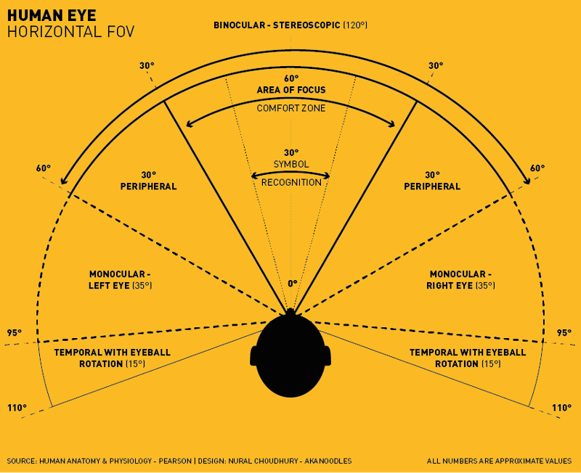
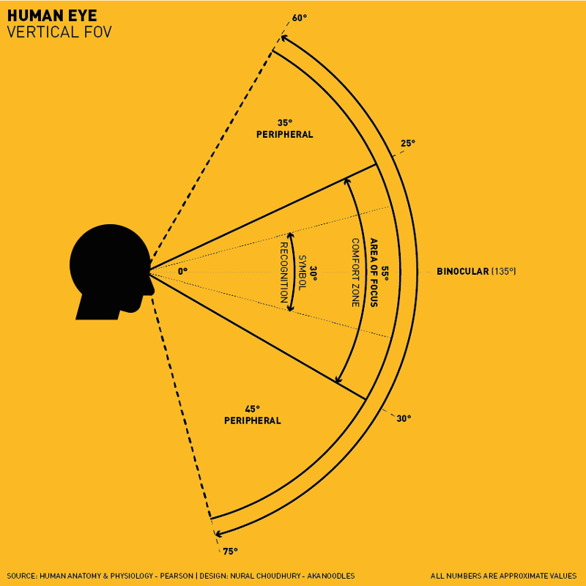
Vision

Slide 66
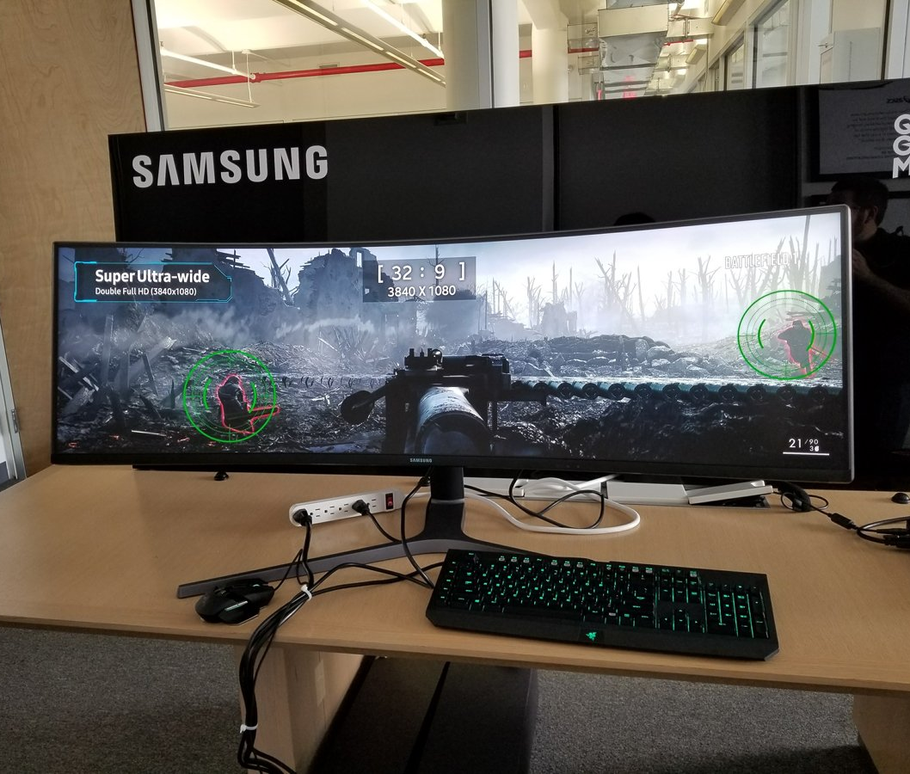
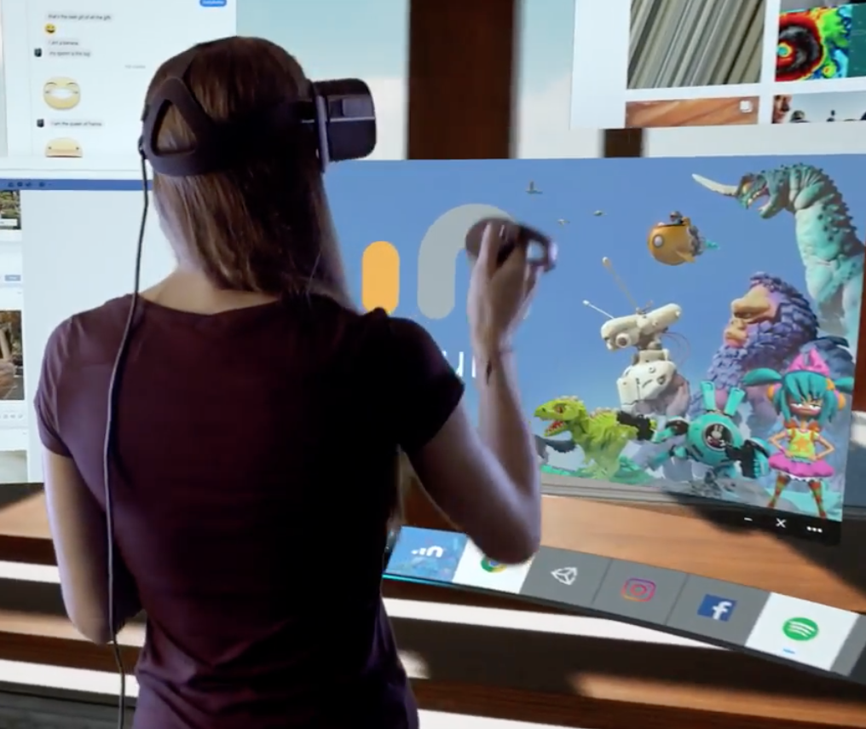
Wide Field Displays
Vision

Slide 67
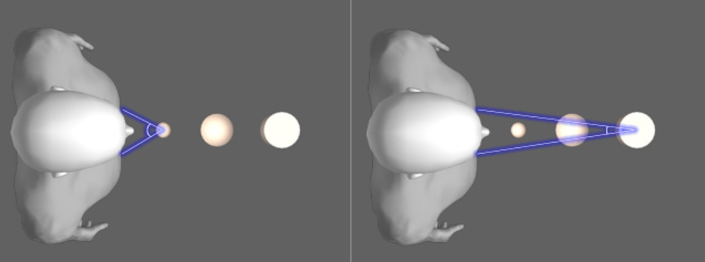
Parallax in Stereo Vision
High Convergence (near object)
Low Convergence (far object)
Vision

Slide 68
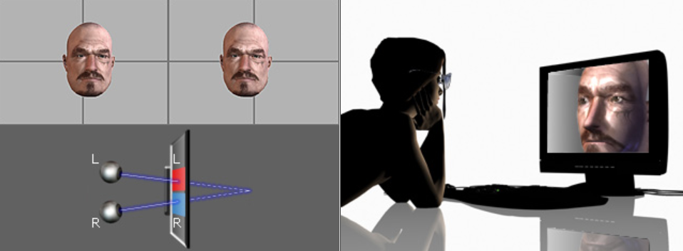
Positive Parallax
Convergence falls behind the display
All images from : http://www.reallusion.com/crazytalk/help/CrazyTalk6/09_3D_Vision/The_Concepts_of_Stereo_Vision.htm
Vision

Slide 69
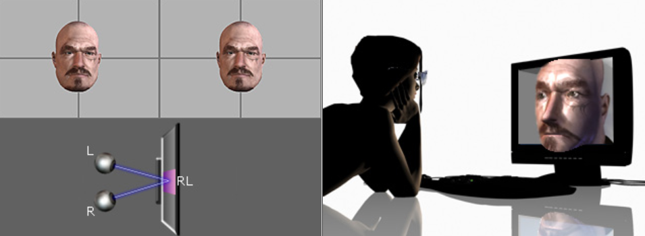
Zero Parallax
Convergence falls on the display
All images from : http://www.reallusion.com/crazytalk/help/CrazyTalk6/09_3D_Vision/The_Concepts_of_Stereo_Vision.htm
Vision

Slide 70

Negative Parallax
Convergence falls in front of the display
All images from : http://www.reallusion.com/crazytalk/help/CrazyTalk6/09_3D_Vision/The_Concepts_of_Stereo_Vision.htm
Vision

Slide 71

Depth Perception
Absolute and relative size: the known size of objects provide information about their distance
Convergence: parallel lines in a three-dimensional space appear to converge
Accomodation: perceived change in the thickness of the lens of the eyes
Light and shadow: patterns of light and shadow result in a 3D appearance
Occlusion: when one object blocks another, it appears to be closer
Defocus blur: depth of focus of the eye
Aerial: contrast and saturation of objects decreases due to smog, fog, dust, and fine particles in the atmosphere
Vision

Slide 72

Importance of Depth Cues
Vision

Slide 73


Negative Parallax
Depth Perception using stereoscopic glasses
Stereoscopic image by coloring the two pictures, Tamar Hayardeni תמר הירדני - Own workCC BY-SA 4.0 Wikipedia.org
Pocket Stereoscope, Joaquim Alves Gaspar - Own work (own photo) CC BY 2.5
Vision

Slide 74

Hearing
Sounds and the vestibular system
Image https://pxhere.com/en/photo/1428401 by mbpogue
The following content is licensed under a Creative Commons Attribution 4.0 International license (CC BY-SA 4.0)

Slide 75



Propagation of Sound Waves
Sound: changes of air pressure in the perceivable frequency range
Hearing: sensory perception of sound
C note 220Hz
Image Source https://commons.wikimedia.org/wiki/File:Standing.gif by Daniel A. Russell & https://commons.wikimedia.org/wiki/File:Ultrasound_range_diagram.svg by Mikhail Ryazanov
Hearing

Slide 76

Auditory Perception
Ears detect changes of pressure in the surrounding medium (not necessarily air)
The auditory system consists of
  the outer ear (the visible part)
    The asymmetry filters sound depending on the vertical location (enables vertical sound localization)
  the middle ear (known as hammer, anvil, stirrup)
    Transmission of vibrations and impedance matching from the eardrum to the inner ear
  the inner ear (cochlea and vestibular system)
    A fluid-filled spiral with a membrane in which frequencies are transformed into location-based signals
Hearing

Slide 77
Sound Localization
Inter-aural time differences are calculated in the brainstem (some cells are more directly connected to one ear than the other)
  Does not explain the precedence effect – sound followed by another sound is being separated after a short time delay (below a listener’s echo threshold)
  There are also neurons sensitive to inter-aural time differences inhibiting the stimulation of the other ear
Cues for sound source localization
  Time- and level-differences (or intensity-difference) between both ears
  Spectral information
  Timing
  Correlation analysis
  Pattern matching
Hearing

Slide 78

Hearing Range
From ~20 to ~20.000 Hz (laboratory conditions: 12 Hz and 28.000 Hz)
Humans are most sensitive in a range between 2.000 and 5.000 Hz
  Language
  Music
  Sound
Shrinks during life (men to a higher degree than women)
Hearing

Slide 79


Speech Perception
Acoustic cues are extracted and stored in sensory memory and then mapped onto linguistic information
Includes multiples processes
  Filtering (Cocktail party effect)
  Abstraction (ignoring individual differences)
  Identification (who is speaking?)
  Analysis (Context “I scream” = “ice cream”)
  Semantics (words, word combinations)
The average person can speak 125-150 words per minute
Hearing

Slide 80

McGurk Effect
Hearing

Slide 81


Head-Related Transfer Function (HRTF)
Image Source https://upload.wikimedia.org/wikipedia/commons/1/19/Binaural.gif by T.A.V. Multimedia. Andreu & Vila & https://www.flickr.com/photos/mitopencourseware/4809307652 by MIT OpenCourseWare
Hearing

Slide 82

Bone Conduction
Bones (mainly the skull) convey lower-frequency sounds to the inner ear
  Hard to locate
Reason why the own voice sounds different when it is recorded any played back
  people perceive their own voices to be lower and fuller than others
Bone conduction speaker work e.g. underwater and can consume audio content while maintaining situational awareness
Image Source https://upload.wikimedia.org/wikipedia/commons/1/19/Binaural.gif by T.A.V. Multimedia. Andreu & Vila & https://www.flickr.com/photos/mitopencourseware/4809307652 by MIT OpenCourseWare
Hearing

Slide 83
Audio and Video Quality
Video quality contribute significantly to the subjectively perceived audio quality
  The effect is about 1.2 x on a media quality scale
  The reversed effect is much smaller: 0.2 x on a media quality scale
A mapping from the audio and video quality to the overall audiovisual quality shows that the video quality dominates the overall perceived audiovisual quality
  Only applicable to non-conversational footage
Hearing

Slide 84


The Inner Ear
The horizontal semicircular canal corresponds to rotation of the head (rotations in the transverse plane)
The anterior and posterior semi-circular canals detect rotations in the sagittal plane (nodding) and in the frontal plane (cartwheeling)
  Working together and orientated at approximately 45° between frontal and sagittal planes
Hearing
Hearing

Slide 85

The Vestibular System
Balance is the result of a number of systems working together:
  the eyes (visual system),
  ears (vestibular system)
  the body's sense of where it is in space (proprioception)
The vestibulo-ocular reflex (VOR) of the vestibular system in the inner ear causes eye movement
  Stabilize images on the retinas
  Gaze is held steady on a location in the direction opposite to head movement
https://en.wikipedia.org/wiki/Vestibulo%E2%80%93ocular_reflex#/media/File:Simple_vestibulo-ocular_reflex.PNG
Hearing

Slide 86

Taste & Smell
Gustatory and Olfactory Sensations
Image https://pxhere.com/en/photo/1428401 by mbpogue
The following content is licensed under a Creative Commons Attribution 4.0 International license (CC BY-SA 4.0)

Slide 87

Olfactory Perception
Olfactory perception is mediated by specialized sensory cells called olfactory receptor cells, which are located in the olfactory epithelium, a small patch of tissue at the top of the nasal cavity
  These cells have tiny hair-like structures (cilia), on their surface that are sensitive to specific chemical compounds (odorants)
  When an odorant binds to a receptor, it triggers a cascade of chemical reactions that ultimately generates an electrical signal.
Odors are detected through two pathways:
  Orthonasal pathway (nose): Odors sniffed in through the nose
  Retronasal pathway (top of the throat): Aromas contained in food
Taste & Smell

Slide 88
Olfactory Perception
The olfactory bulbs are directly connected to the amygdala in the human brian and the limbic system
  The system is involved in the processing of our emotions, reinforcement, survival instincts, and memory formation
  Olfaction also has an important role in food selection and in detecting and avoiding spoiled or dangerous food.
Humans have between 10 and 20 million olfactory receptor neurons
Olfaction plays an important role in many aspects of behavior, including mating, foraging, and avoiding predators.
Humans can discriminate more than 1 trillion olfactory stimuli
Hundreds of different olfactory receptors outperform other senses in the number of physically different stimuli it can discriminate.
Taste & Smell

Slide 89
Gustatory Perception
Gustatory perception, also known as the sense of taste is the ability to perceive the basic taste qualities of sweet, sour, salty, and bitter (there is a fifth taste called Umami, which is the taste of Monosodium Glutamate (MSG) and is related to the taste of proteins).
  These tastes are detected by specialized taste receptors, called taste buds, which are located on the tongue, as well as in the roof of the mouth and the back of the throat
  The primary gustatory cortex, located in the brainstem, is responsible for processing taste information
    From there, the signals are sent to other brain regions such as the insular cortex, the amygdala, and the hypothalamus (involved in the perception and recognition of taste, as well as in the regulation of appetite and hunger)
Gustatory perception and olfactory perception are closely related.
  Together, they are responsible for the sense of flavor, which is the combination of taste and smell.
Taste & Smell

Slide 90

Touch
Proprioception, Haptics, and Tactile Perception
Image https://pxhere.com/en/photo/1428401 by mbpogue
The following content is licensed under a Creative Commons Attribution 4.0 International license (CC BY-SA 4.0)

Slide 91
The Sense of Touch
The sense of touch refers to: tactition, haptics, and proprioception
Tactition: the sense of touch in general, including the ability to perceive physical sensations such as pressure, temperature, and pain.
Haptics refers to the study of the sense of touch with the skin as it relates to the sense of touch in interaction with objects, specifically in the field of human-computer interaction and robotics.
Proprioception refers to the sense of the position and movement of the body and its parts. Proprioceptors are specialized receptors located in muscles, tendons, and joints that detect changes in muscle length and tension, as well as joint position and movement.
Touch

Slide 92
Tactition
Tactition, is the ability to perceive physical sensations such as pressure, temperature, and pain
It is mediated by specialized sensory receptors called mechanoreceptors, thermoreceptors and nociceptors, located in the skin and other tissues
  Mechanoreceptors are sensitive to mechanical pressure and vibrations. They are located in the skin, muscles, tendons, and joints, and are responsible for the sense of pressure, vibration, and texture
  Thermoreceptors are sensitive to temperature changes. They are located in the skin and are responsible for the sense of hot and cold. They send signals to the brain that help us to sense changes in temperature, such as the warmth of a hug or the chill of an ice cube.
  Nociceptors are specialized receptors that are sensitive to potentially damaging stimuli such as extreme heat, extreme cold, pressure, and chemicals. They send signals to the brain that help us to sense pain
Touch

Slide 93
Haptics
Modality | Sub Modality | Sub-sub Modality
Pain | sharp cutting pain
 | dull burning pain
 | deep aching pain
Temperature | warm/hot
 | cool/cold
Touch | itch/tickle & crude touch
 | discriminative touch | touch
 |  | pressure
 |  | flutter
 |  | vibration
Proprioception | position: static forces | muscle length
 |  | muscle tension
 |  | joint pressure
 | movement: dynamic forces (kinesthetic) | muscle length
 |  | muscle tension
 |  | joint pressure
 |  | joint angle
Haptics
Touch

Slide 94

Cutaneous (Haptic) Receptors
Merkel discs: shearing forces and Skin deformation (slow)
Meissner corpuscles: touch discrimination
Ruffini endings: xontinous pressure
Pacinian corpuscles: pressure
Free nerve endings: pain and temperature
Image from: https://quizlet.com/385317734/general-senses-diagram/
Touch

Slide 95


Tactile Sensation Resolution
Touch

Slide 96

Proprioception
Activated during distinct behaviors and encode types of information related to
  Limb velocity and movement
  Limb load on a limb
  Limb constraints (limits)
Integrated into vision and the vestibular system and important for the body schema e.g.:
  Upright walking (monitoring postures and balancing)
  Reaching and grooming
Image from https://link.springer.com/referenceworkentry/10.1007/978-1-4939-3474-4_3 1
Touch

Slide 97
Proprioceptive Receptors
Muscle spindles are located within the muscles that detect changes in muscle length.
  They are responsible for sensing the stretch of a muscle
Golgi tendon organs are located in tendons, where they detect changes in muscle tension.
  They are responsible for sensing the force of a muscle contraction
Joint receptors are located in the joints and detect changes in joint position and movement.
  They are responsible for sensing the position and movement of the bones that form the joint
All these proprioceptors work together to allow us to sense the position and movement of our body parts in space, and to coordinate our movements.
Schematics and images of limb proprioceptors in mammals and insects John Tuthill - wikimedia.org CC BY-SA 4.0
Touch

Slide 98

The Sense of Gravity
The perception of gravity through the sense of touch is mediated by the mechanoreceptors, which detect changes in pressure and force of the body (weight)
Send signals to the brain that determines the center of gravity
The center of gravity is mediated to the sense of balance (the vestibular system)
Image from: https://rehabshop.com.sg/why-understanding-your-center-of-gravity-is-key-to-fall-prevention
Touch

Slide 99
Somatosensory System and Touch
Somatosensory system: informs us about objects in our external environment through touch and about the position and movement of our body parts through the stimulation of muscle and joints. The somatosensory system differentiates between active and passive touch
  Active touch is mediated by both mechanoreceptors and proprioceptors and refers to the process of actively exploring an object (e.g., with the fingers). Active touch allows us to gather more detailed information about an object and to make more precise judgments about its properties (e.g., texture).
  Passive touch is mainly mediated by mechanoreceptors and thermoreceptors and refers to the perception of touch that occurs without being engaged in the process of touch. For example, feeling the pressure of another hand on the skin or sensing the temperature of a bath
Touch

Slide 100


Active touch
Passive touch
Touch

Slide 101


Passive and Active Touch in HCI
Massie, T. H., & Salisbury, J. K. (1994, November). The phantom haptic interface: A device for probing virtual objects. In Proceedings of the ASME winter annual meeting, symposium on haptic interfaces for virtual environment and teleoperator systems (Vol. 55, No. 1, pp. 295-300).
Touch

Slide 102

Body Schema
The collection of processes that registers the posture of one's body parts in space rising into consciousness
Sensorimotor representation of the body morphology used for planning and executing body movements
Updated during body movement and used for spatial organization of action
A representation of the body’s spatial properties including
  the length of limbs and limb segments
  their arrangement
  the configuration of the segments in space
  the shape of the body surface
The body schema is highly plastic, which means not necessarily limited to true morpholopgy of the body
Touch

Slide 103

Extended Body Schema (EBS)
Incorporates external objects into the mental conception of one's body
The experience of controlling external events through one’s own actions is crucial for determining an extended body schema
  Not necessary to be physically connected
  Needs at least one sensory experience (vision, haptics)
  Supported by multiple sensory experiences e.g. vision and haptics
Touch

Slide 104


Slide 105
Summary
Humans can see, hear, smell & taste, and feel touch
Human senses are limited
In human-computer interaction, we use address, use, and support perception to enable interaction
Supporting individual senses must be in the range of perception and must have the least possible effect on mental workload
Touch

