Slide 1



Usability
Human-Computer Interaction Lecture
Slides adapted from hci-lecture.org (A. Schmidt, N. Henze, K. Wolf, V. Schwind), Image from: https://pxhere.com/de/photo/956874
The following content is licensed under a Creative Commons Attribution 4.0 International license (CC BY-SA 4.0)

Slide 2
Learning Goals
Understand …
Principles to Support Usability
Eight Golden Rules
Usability Heuristics
Errors
Basic Usability Guidelines and Universal Design
Be able to explain …
these principles and give examples
user interface designs with regard to these principles
Usability

Slide 3
Revelant Work on Usability
“Principles to Support Usability”
According to Alan Dix
“Eight Golden Rules”
According to Ben Shneiderman
“Usability Heuristics”
According to Lauesen and Nielson
General Usability Design Guidelines
Universal Design
Usability

Slide 4
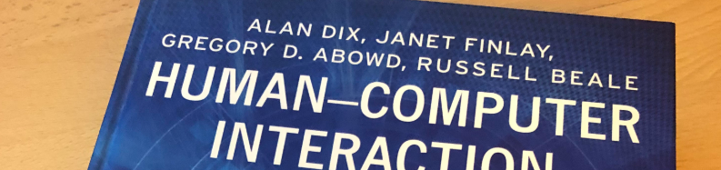
Principles to Support Usability
According to Alan Dix
The following content is licensed under a Creative Commons Attribution 4.0 International license (CC BY-SA 4.0)

Slide 5
Principles to Support Usability by Dix et al.
Principle 1: Learnability
Principle 2: Flexibility
Principle 3: Robustness
Dix, A. J., Finlay, J., Abowd, G. D., & Beale, R. (2003). Human-computer interaction. Pearson Education https://hcibook.com/.
Principles to Support Usability

Slide 6
Principle 1: Learnability
The ease with which new users can begin effective interaction and achieve maximal performance.
Predictability
Determining effect of future actions based on past interaction history
Visibility of operations and effects
Familiarity
Generalizability
Consistency
Synthesizability
Dix, A. J., Finlay, J., Abowd, G. D., & Beale, R. (2003). Human-computer interaction. Pearson Education https://hcibook.com/.
Principles to Support Usability

Slide 7

Principle 1: Learnability
The ease with which new users can begin effective interaction and achieve maximal performance.
Predictability
Familiarity
how prior knowledge applies to a new system
affordance (‘guessability’)
Generalizability
Consistency
Synthesizability
Dix, A. J., Finlay, J., Abowd, G. D., & Beale, R. (2003). Human-computer interaction. Pearson Education https://hcibook.com/.
Principles to Support Usability

Slide 8

Principle 1: Learnability
The ease with which new users can begin effective interaction and achieve maximal performance.
Predictability
Familiarity
Generalizability
extending specific interaction knowledge to new situations
Consistency
Synthesizability
Dix, A. J., Finlay, J., Abowd, G. D., & Beale, R. (2003). Human-computer interaction. Pearson Education https://hcibook.com/.
Principles to Support Usability

Slide 9
Principle 1: Learnability
The ease with which new users can begin effective interaction and achieve maximal performance.
Predictability
Familiarity
Generalizability
Consistency
likeness in input/output behavior arising from similar situations or task objectives
Synthesizability
Dix, A. J., Finlay, J., Abowd, G. D., & Beale, R. (2003). Human-computer interaction. Pearson Education https://hcibook.com/.
Principles to Support Usability

Slide 10

Principle 1: Learnability
The ease with which new users can begin effective interaction and achieve maximal performance.
Predictability
Familiarity
Generalizability
Consistency
Synthesizability
ability of the user to assess the effect of operations
the user should see the changes of an operation
Dix, A. J., Finlay, J., Abowd, G. D., & Beale, R. (2003). Human-computer interaction. Pearson Education https://hcibook.com/.
Principles to Support Usability

Slide 11
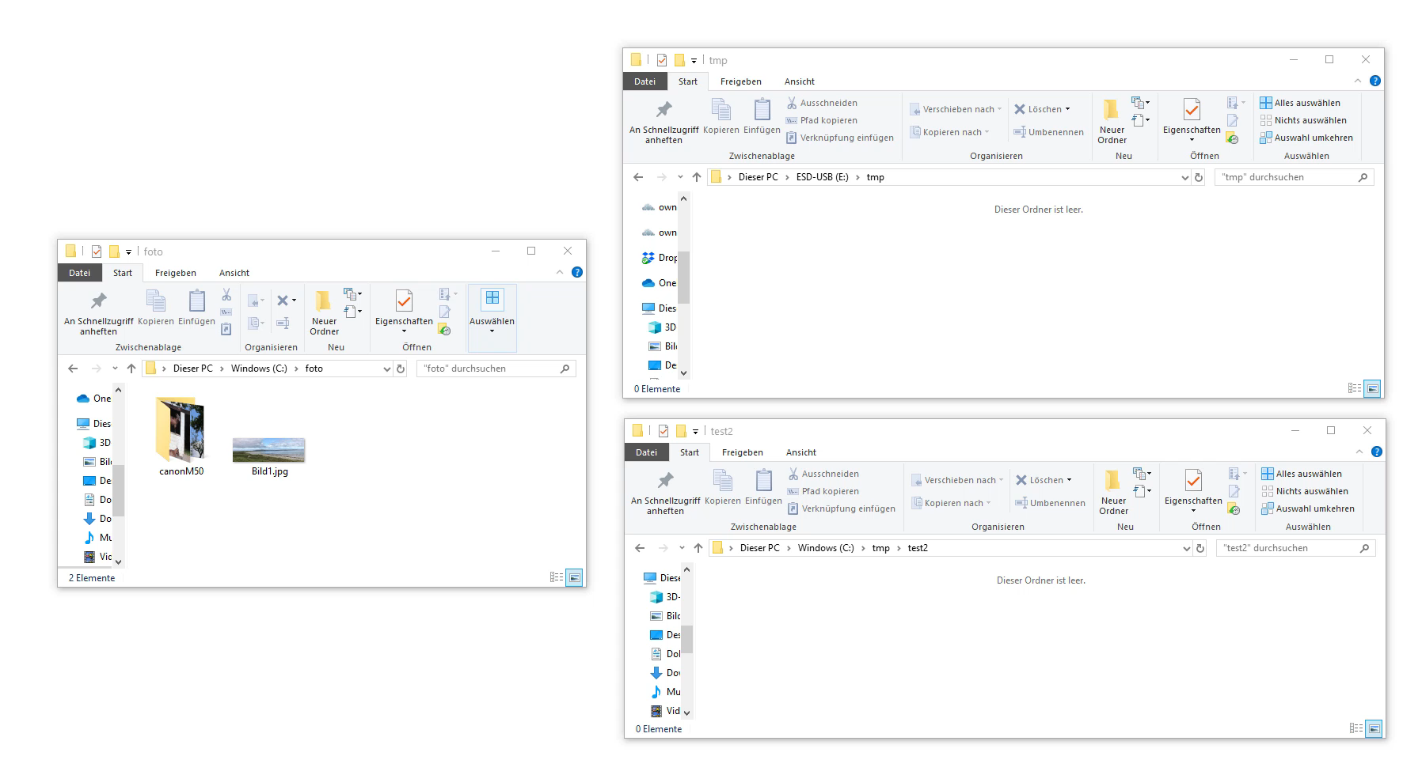

Slide 12
Principle 2: Flexibility
The multiplicity of ways the user and system exchange information.
Dialogue initiative
Multithreading
Task migratability
Substitutivity
Customizability
Dix, A. J., Finlay, J., Abowd, G. D., & Beale, R. (2003). Human-computer interaction. Pearson Education https://hcibook.com/.
Principles to Support Usability

Slide 13
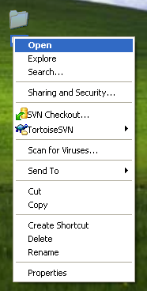
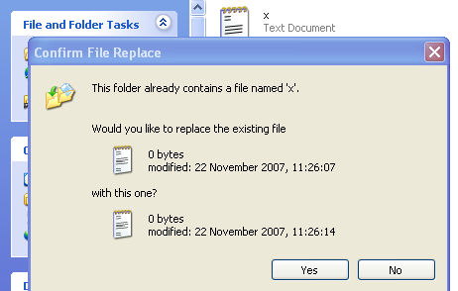
Principle 2: Flexibility
user preemptiveness
The multiplicity of ways the user and system exchange information.
Dialogue initiative
freedom from system-imposed constraints on input dialogue
user preemptiveness: user initiates dialog
system preemptiveness: system initiates dialog
Multithreading
Task migratability
Substitutivity
Customizability
system preemptiveness
Dix, A. J., Finlay, J., Abowd, G. D., & Beale, R. (2003). Human-computer interaction. Pearson Education https://hcibook.com/.
Usability Principles and Guidelines

Slide 14
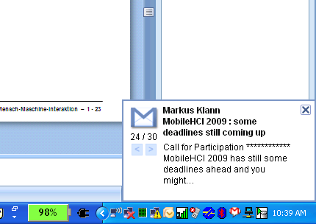
Principle 2: Flexibility
The multiplicity of ways the user and system exchange information.
Dialogue initiative
Multithreading
System supports user interaction for several tasks at a time
concurrent multimodality: simultaneous communication of information pertaining to separate tasks
interleaving multimodality: permits temporal overlap between separate tasks, dialog is restricted to a single task
Task migratability
Substitutivity
Customizability
Dix, A. J., Finlay, J., Abowd, G. D., & Beale, R. (2003). Human-computer interaction. Pearson Education https://hcibook.com/.
Principles to Support Usability

Slide 15
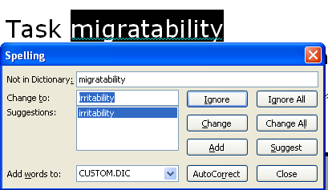
Principle 2: Flexibility
The multiplicity of ways the user and system exchange information.
Dialogue initiative
Multithreading
Task migratability
passing responsibility for task execution between user and system, e.g., spell checking
Substitutivity
Customizability
Dix, A. J., Finlay, J., Abowd, G. D., & Beale, R. (2003). Human-computer interaction. Pearson Education https://hcibook.com/.
Principles to Support Usability

Slide 16
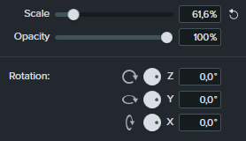
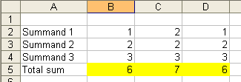
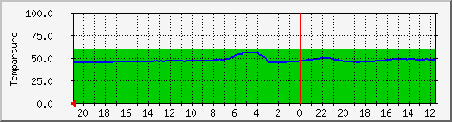
Principle 2: Flexibility
The multiplicity of ways the user and system exchange information.
Dialogue initiative
Multithreading
Task migratability
Substitutivity
allowing equivalent values of input and output to besubstituted for each other
representation multiplicity
equal opportunity: blurs the distinction between input and output
Customizability
Dix, A. J., Finlay, J., Abowd, G. D., & Beale, R. (2003). Human-computer interaction. Pearson Education https://hcibook.com/.
Principles to Support Usability

Slide 17
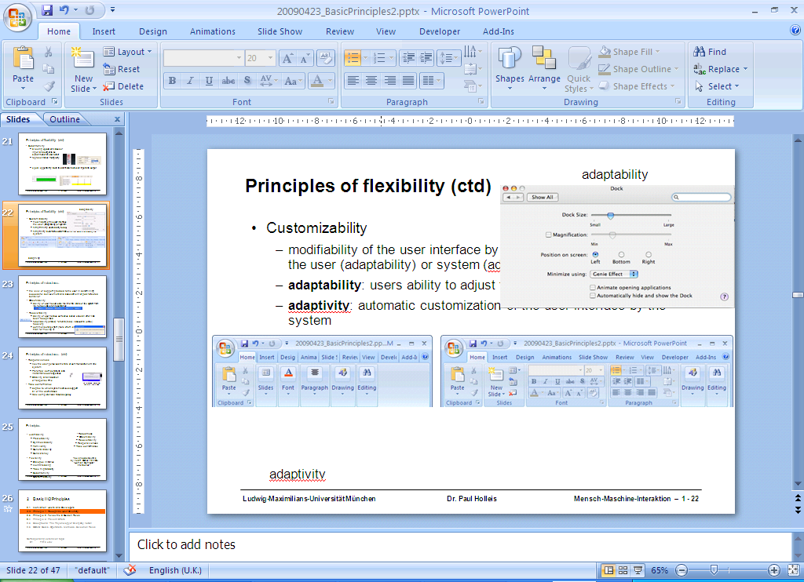
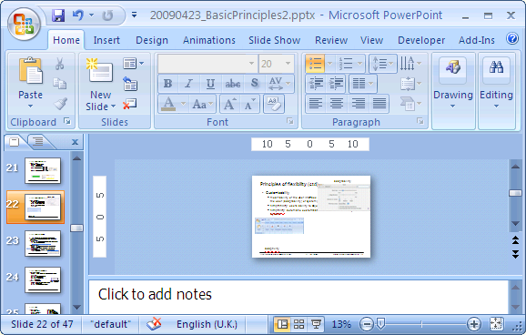
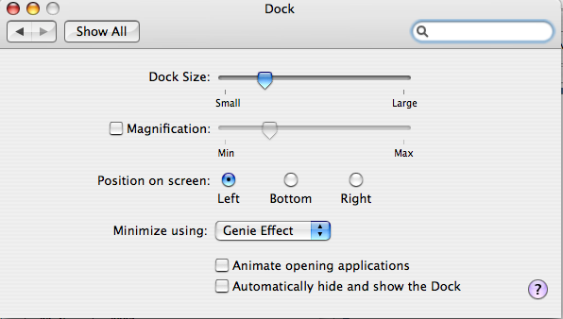
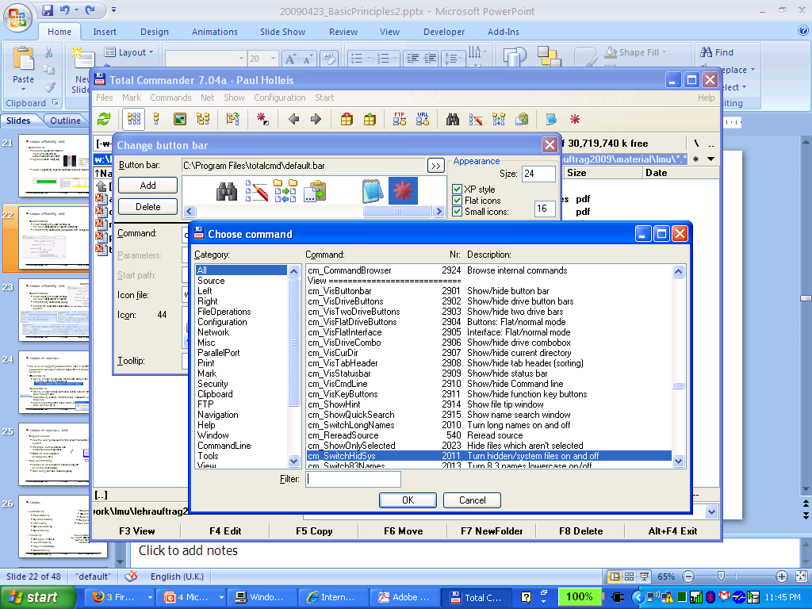
Principle 2: Flexibility
The multiplicity of ways the user and system exchange information.
Dialogue initiative
Multithreading
Task migratability
Substitutivity
Customizability
modifiability of the UI by the user (adaptability) or system (adaptivity)
adaptability (anpassbar): users' ability to adjust input and output
adaptivity (adaptive): automatic customization of the user interface by the system
Dix, A. J., Finlay, J., Abowd, G. D., & Beale, R. (2003). Human-computer interaction. Pearson Education https://hcibook.com/.
Principles to Support Usability

Slide 18
Principle 3: Robustness
The level of support provided to the user in determining successful achievement and assessment of goal-directed behaviour.
Observability
Recoverability
Task conformance
Responsiveness
Dix, A. J., Finlay, J., Abowd, G. D., & Beale, R. (2003). Human-computer interaction. Pearson Education https://hcibook.com/.
Principles to Support Usability

Slide 19
Principle 3: Robustness
The level of support provided to the user in determining successful achievement and assessment of goal-directed behaviour.
Observability
ability of the user to evaluate the internal state of the system from its perceivable representation
Recoverability
Task conformance
Responsiveness
Dix, A. J., Finlay, J., Abowd, G. D., & Beale, R. (2003). Human-computer interaction. Pearson Education https://hcibook.com/.
Principles to Support Usability

Slide 20
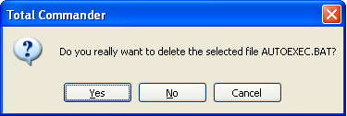
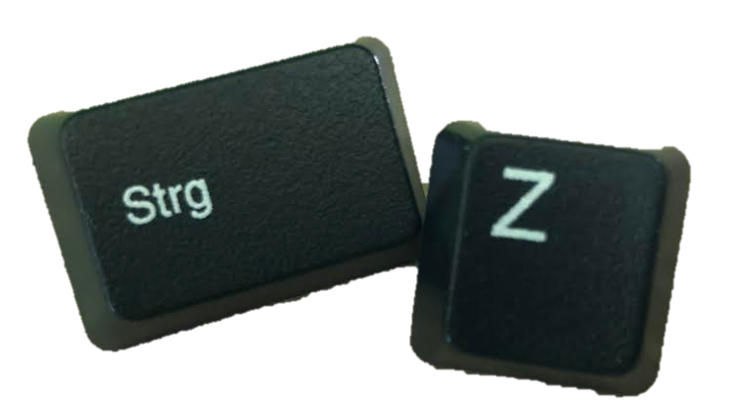
Principle 3: Robustness
The level of support provided to the user in determining successful achievement and assessment of goal-directed behaviour.
Observability
Recoverability
ability of the user to correct a recognized error
reachability (states): forward (redo) / backward (undo) recovery
commensurate effort (more effort / steps for deleting a file than for moving it)
Task conformance
Responsiveness
Dix, A. J., Finlay, J., Abowd, G. D., & Beale, R. (2003). Human-computer interaction. Pearson Education https://hcibook.com/.
Principles to Support Usability

Slide 21
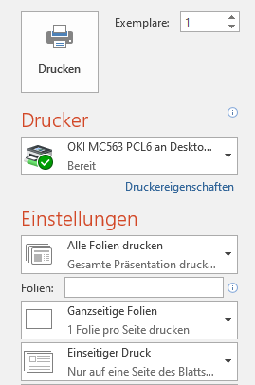
Principle 3: Robustness
The level of support provided to the user in determining successful achievement and assessment of goal-directed behaviour.
Observability
Recoverability
Task conformance
degree to which system services support all of the user's tasks
task completeness
task adequacy
Responsiveness
Dix, A. J., Finlay, J., Abowd, G. D., & Beale, R. (2003). Human-computer interaction. Pearson Education https://hcibook.com/.
Principles to Support Usability

Slide 22
Principle 3: Robustness
The level of support provided to the user in determining successful achievement and assessment of goal-directed behaviour.
Observability
Recoverability
Task conformance
Responsiveness
how the user perceives the rate of communication with the system
preferred: short durations and instantaneous responses
stability and indication of response time
Dix, A. J., Finlay, J., Abowd, G. D., & Beale, R. (2003). Human-computer interaction. Pearson Education https://hcibook.com/.
Principles to Support Usability

Slide 23

Usability Heuristics
According to Lauesen and Nielson
Slides adapted from C. Thomas, Image from: https://pxhere.com/de/photo/1434201
The following content is licensed under a Creative Commons Attribution 4.0 International license (CC BY-SA 4.0)

Slide 24
Usability by Lauesen and Nielson
6 Dimensions of Usability
Functional Requirements
Usability Requirements
Usability =
(1) fit for use
(2) ease of learning
(3) task efficiency (4) ease of remembering (5) subjective satisfaction (6) ease of understanding
Usability Heuristics

Slide 25
The 7 Usability Heuristics
Suitability for the Task
Self-descriptiveness
Controllability
Conformity with User Expectations
Error Tolerance
Suitability for Individualization
Suitability for Learning
Usability Heuristics

Slide 26
1. Suitability for the Task
The dialogue should be suitable for the user’s task and skill level
Examples:
On a website contact information can be found, so that a user / customer can directly contact that person via e-mail.
In a form no information is asked for that is not needed for the process.
In a form that must be corrected, the cursor is directly positioned to the correcting field.
Interim results of a longer online transaction can be stored.
For visitors that visit a website more often, short-cuts to the main pages are provided.
Usability Heuristics

Slide 27
2. Self-Descriptiveness
The dialogue should make it clear what the user should do next
Examples:
Links are named in a way that one directly can predict where they lead.
A Web application has an online help that are context-specific operating instructions.
Once a request has been sent to a database, a message "request is being processed, “please wait” should appear.
Usability Heuristics

Slide 28
3. Controllability
The user should be able to control the pace and sequence of the interaction
Examples:
A table has buttons with which the information can be sorted by column
A search engine offers the possibility to adjust the number of displayed hits
A tool that allows users to interrupt a file download and resume it later
Extensive graphics are first shown as "thumbnails", which may be extended by the user if required
Usability Heuristics

Slide 29
4. Conformity with Users Expectations
A user interface should be consistent
Examples:
The link to the home page is placed under the logo top left.
The "basket" in an online store is always and in all contexts named "basket".
Underlined words are always hyperlinks.
Pressing the tab key moves the cursor to the next input field
Usability Heuristics

Slide 30
5. Error Tolerance
The dialogue should be forgiving
Examples:
When going back in a web application with the Back button, the information is always updated to not falsely gives the impression processing steps have been reversed
About a script, the data of a form for plausibility, missing or incomplete entries are checked before they are sent
Error messages do not use technical terms user does not understand
Usability Heuristics

Slide 31
6. Suitability for Individualization
The dialogue should be able to be customized to suit the user needs
Example:
Customized keyboard short cut for often used commands
Customized menu for quick access
Custom gestures for mobile device usage
Usability Heuristics

Slide 32
7. Suitability for Learning
The dialogue should support learning
In a "guided tour", users are familiar with specific “tricks” to use an application.
In a booking system of a travel agent, it is possible to make a test reservation.
A Sitemap visualizes the logical structure of a site.
Usability Heuristics

Slide 33
5 Es by Nielson
Effective: How completely and accurately the work or experience is completed or goals reached
Efficient: How quickly this work can be completed
Engaging: How well the interface draws the user into the interaction and how pleasant and satisfying it is to use
Error Tolerant: How well the product prevents errors and can help the user recover from mistakes that do occur
Easy to Learn: How well the product supports both the initial orientation and continued learning throughout the complete lifetime of use
Usability Heuristics

Slide 34

Eight Golden Rules
According to Ben Shneiderman
The following content is licensed under a Creative Commons Attribution 4.0 International license (CC BY-SA 4.0)

Slide 35

Principles for UI-Design
Principle 1: Recognize User Diversity
Principle 2: Follow the Eight Golden Rules
Principle 3: Prevent Errors
Image from: https://www.designprinciplesftw.com/authors/ben-shneiderman
Shneiderman, B., Plaisant, C., Cohen, M., Jacobs, S., Elmqvist, N., & Diakopoulos, N. (2016). Designing the user interface: strategies for effective human-computer interaction. Pearson. http://www.cs.umd.edu/hcil/DTUI6/
Eight Golden Rules

Slide 36
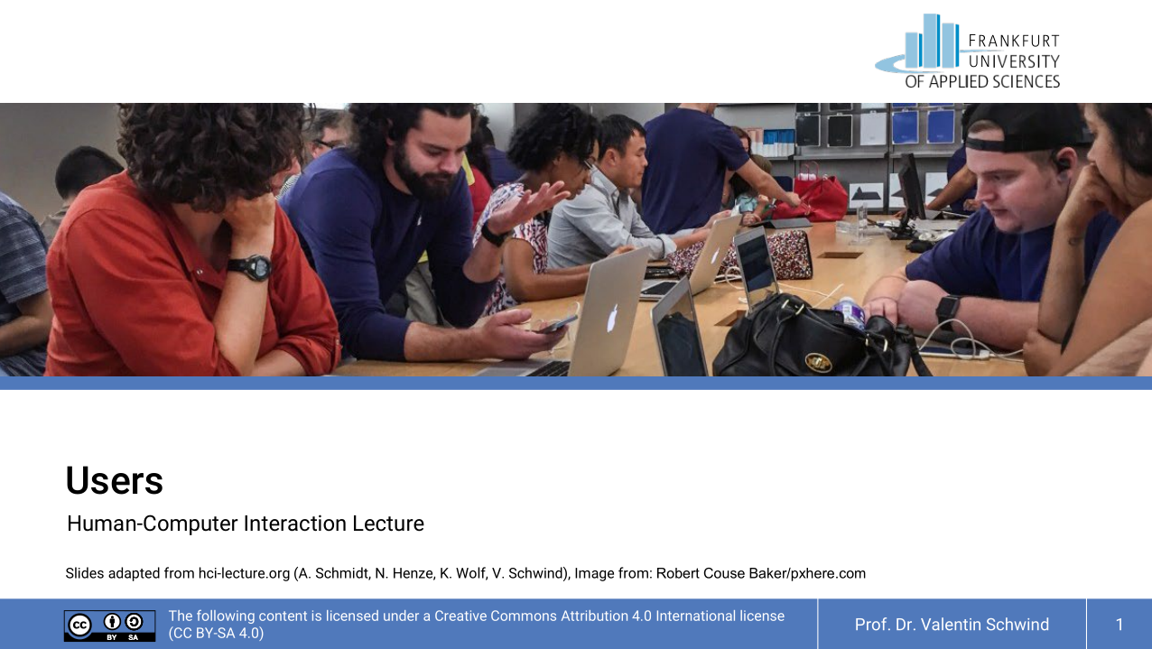
Principle 1: Recognize User Diversity
Shneiderman, B., Plaisant, C., Cohen, M., Jacobs, S., Elmqvist, N., & Diakopoulos, N. (2016). Designing the user interface: strategies for effective human-computer interaction. Pearson. http://www.cs.umd.edu/hcil/DTUI6/
Eight Golden Rules

Slide 37
Principle 2: Follow the 8 Golden Rules*
Strive for consistency
Seek universal usability
Offer informative feedback
Design dialogues to yield closure
Prevent errors
Permit easy reversal of actions
Keep users in control
Reduce short-term memory load
* Sometimes you will find a 9th: Enable frequent users to use shortcuts
Shneiderman, B., Plaisant, C., Cohen, M., Jacobs, S., Elmqvist, N., & Diakopoulos, N. (2016). Designing the user interface: strategies for effective human-computer interaction. Pearson. http://www.cs.umd.edu/hcil/DTUI6/
Eight Golden Rules

Slide 38
Strive for consistency
“Consistent sequences of actions should be required in similar situations;
identical terminology should be used in prompts, menus, and help screens;
and consistent color, layout, capitalization, fonts, and so on, should be employed throughout.
Exceptions, such as required confirmation of the delete command or no echoing of passwords, should be comprehensible and limited in number”
Eight Golden Rules

Slide 39

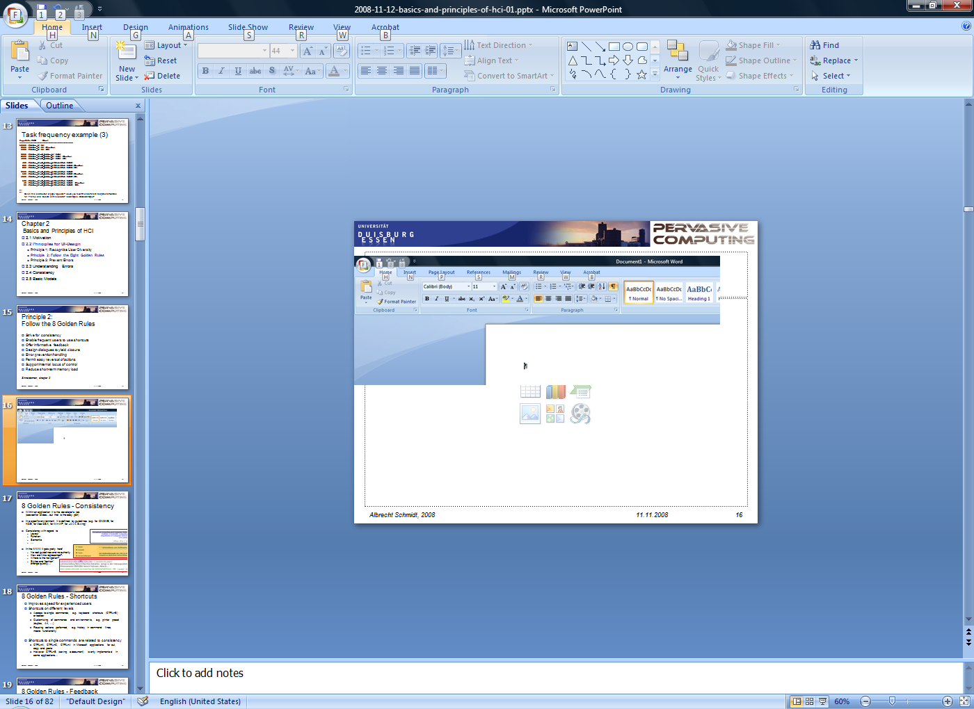
Strive for consistency
Eight Golden Rules

Slide 40
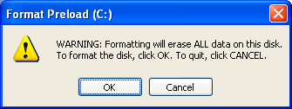

Inconsistencies
Dragging file operations?
folder on same disk vs. folder on different disk
file to trash can vs. disk to trash can
Bigger buttons for more often used operations?
Inconsistency across platforms, e.g.
MacOS vs. Windows
Websites on different platforms
Mobile device vs. TV vs. PC
Inconsistency can be used for attracting attention
Shneiderman, B., Plaisant, C., Cohen, M., Jacobs, S., Elmqvist, N., & Diakopoulos, N. (2016). Designing the user interface: strategies for effective human-computer interaction. Pearson. http://www.cs.umd.edu/hcil/DTUI6/
Eight Golden Rules

Slide 41
Seek universal usability
“Recognize the needs of diverse users and design for plasticity, facilitating transformation of content.
Novice to expert differences,
age ranges, disabilities, international variations,
technological diversity
[…] spectrum of requirements that guides design.”
Shneiderman, B., Plaisant, C., Cohen, M., Jacobs, S., Elmqvist, N., & Diakopoulos, N. (2016). Designing the user interface: strategies for effective human-computer interaction. Pearson. http://www.cs.umd.edu/hcil/DTUI6/
Eight Golden Rules

Slide 42
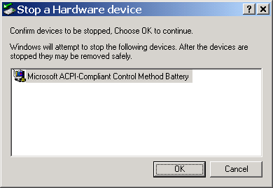
Offer informative feedback
“For every user action, there should be an interface feedback.
For frequent and minor actions, the response can be modest, whereas
for infrequent and major actions, the response should be more substantial.”
Shneiderman, B., Plaisant, C., Cohen, M., Jacobs, S., Elmqvist, N., & Diakopoulos, N. (2016). Designing the user interface: strategies for effective human-computer interaction. Pearson. http://www.cs.umd.edu/hcil/DTUI6/
Eight Golden Rules

Slide 43

Offer informative feedback
Question: Will ubiquitous computing change this?
Eight Golden Rules

Slide 44

Design dialogues to yield closure
“Sequences of actions should be organized into groups with a beginning, middle, and end.
Informative feedback at the completion of a group of actions gives users the satisfaction of accomplishment, a sense of relief […]
For example, e-commerce websites move users from selecting products to the checkout, ending with a clear confirmation page that completes the transaction.”
Important for actions that are not immediate and span over a longer time or multiple steps
Eight Golden Rules

Slide 45
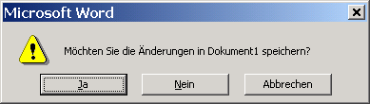
Prevent errors
As much as possible, design the interface so that users cannot make serious errors […]
If users make an error, the interface should offer simple, constructive, and specific instructions for recovery“
Detecting errors
Different options how to handle it:
Involve the user with dialogs (current practice)
Prevent the error or its consequences on system level (e.g. create backups/versions when a file is overwritten, keep all files that have been created by the user)
Eight Golden Rules

Slide 46
Permit easy reversal of actions
As much as possible, actions should be reversible.
This feature relieves anxiety, since users know that errors can be undone, and encourages exploration […]
The units of reversibility may be a single action, a data-entry task, or a complete group of actions”
Providing UNDO functions
Possibly with infinite depth
Over sessions
Not trivial (conceptually as well as technically)
write a text, copy it into the clipboard, undo the writing, the text is still in the clipboard…
Eight Golden Rules

Slide 47

Permit easy reversal of actions
As a basic rule – all actions should be reversible
When is this not possible?
Communication applications (e.g. email)
Smart environments
Machines
Cars
In certain settings processes and basic physical laws prevent reversal of actions. Here an interaction layer (buffering user interaction) may be possible – but not always (e.g. breaks, emergency stop)
What is the cost?
Memory?
Complexity?
Eight Golden Rules

Slide 48
Keep users in control
“Experienced users strongly desire the sense that they are in charge of the interface and that the interface responds to their actions.
They don’t want surprises or changes in familiar behavior”
Avoid non-causality
The system should be predictable
Current developments (AI, Ubicomp) are in contrast:
Intelligent agents
Smart environments
…or just feeling in control
Eight Golden Rules

Slide 49
Reduce short-term memory load
“Humans’ limited capacity for information processing in short-term memory requires that designers avoid interfaces in which users must remember information from one display and then use that information on another display.”
“rule of thumb is that people can remember ‘seven plus or minus two chunks’ of information”
The system should remember, not the user
Make information that is required visible
Recognition is easier than recall, use memory aids (visual or audio)
Eight Golden Rules

Slide 50
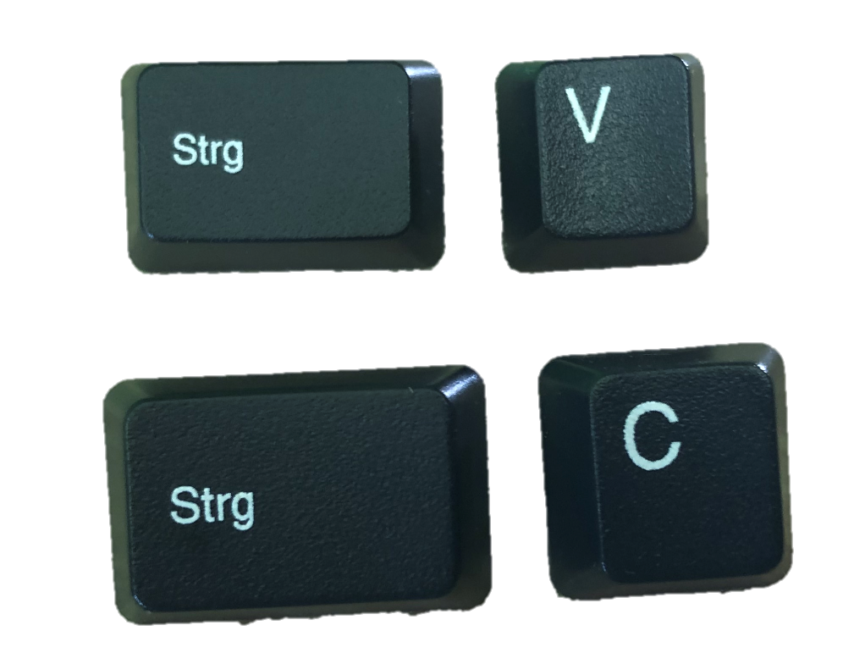
Enable frequent users to use shortcuts
Improves speed for experienced users
Shortcuts on different levels
Access to single commands, e.g. CTRL+S or toolbar
Customizing of commands and environments, e.g. printer pre-set (duplex, A4, …)
Reusing actions performed, e.g. history in command lines, macro functionality
Shortcuts to single commands are related to consistency
CTRL+X, CTRL+C, CTRL+V in Microsoft applications for cut, copy, and paste
However CTRL+S (saving a document) is only implemented in some applications…
Eight Golden Rules

Slide 51

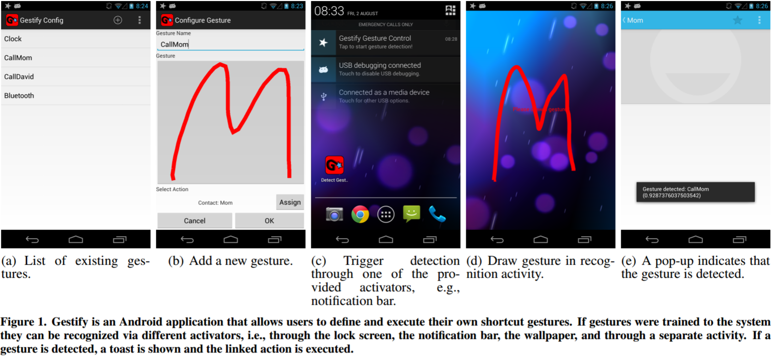
Shortcuts
Poppinga, B., Sahami Shirazi, A., Henze, N., Heuten, W., & Boll, S. (2014, September). Understanding shortcut gestures on mobile touch devices. In Proc. of the 16th int. conf. on Human-computer interaction with mobile devices & services (pp. 173-182). ACM.
Eight Golden Rules

Slide 52
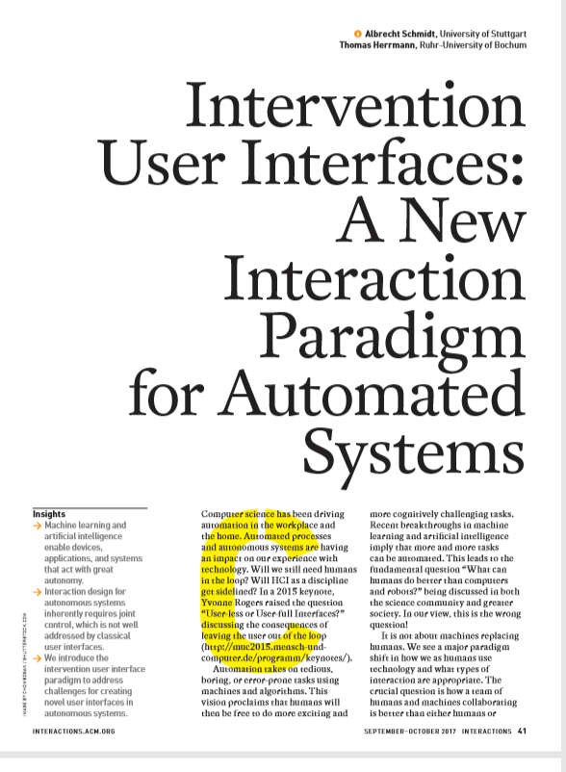
How can humans stay in control?
“In the future, we believe that a large class of automated and autonomous systems allow for joint control, where the majority of decisions are automated but where users can intervene.
Ensure expectability and predictability.
Communicate options for interventions.
Allow easy exploration of interventions.
Easy reversal of automated and intervention actions.
Minimize required attention.
Communicate how control is shared.
Schmidt, A., & Herrmann, T. (2017). Intervention user interfaces: a new interaction paradigm for automated systems. interactions, 24(5), 40-45.
Eight Golden Rules

Slide 53
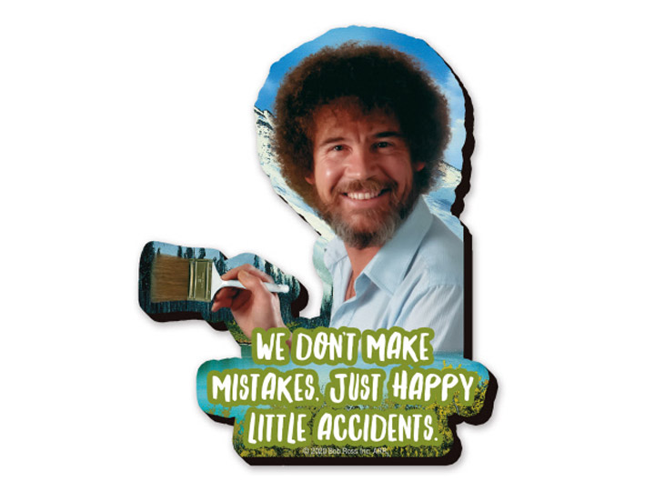
Principle 3: Prevent Errors
Question: What is an error?
Bob Ross Happy Little Accidents Mega Funky Chunky Magnet
BY AQUARIUS ENTERTAINMENT - BRAND THE JOY OF PAINTING, Image from: https://www.bigbadtoystore.com/Product/VariationDetails/138279
Eight Golden Rules

Slide 54

Human Errors
Constraints, Mappings and Aesthetics
Slides adapted from hci-lecture.org (A. Schmidt, N. Henze, K. Wolf, V. Schwind), Image from: https://pxhere.com/de/photo/956874
The following content is licensed under a Creative Commons Attribution 4.0 International license (CC BY-SA 4.0)

Slide 55
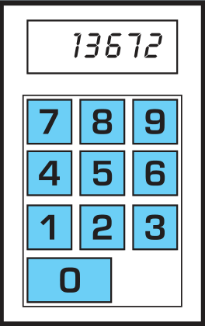
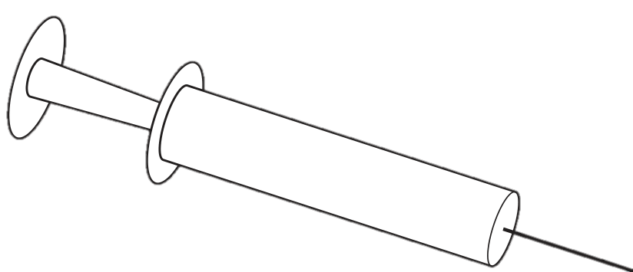
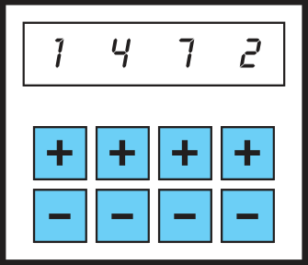
Involve the User
Mechanical syringe
What the programmers suggested
What the nurses suggested
Dix, A., Finlay, J., Abowd, G. D., & Beale, R. (2003). Human-computer interaction. Pearson Education.
Human Errors

Slide 56
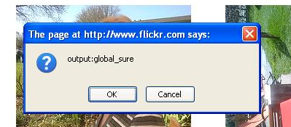

Communicating Systems Errors
What to do, if an error in the system occurs?
Will the user benefit from knowing about the error?
Can the user do something about the error?
What other solutions are available?
If the error is provided to the user it must be
Understandable (the user gets what the problem is)
Actionable (the user gets options to do things)
Human Errors

Slide 57
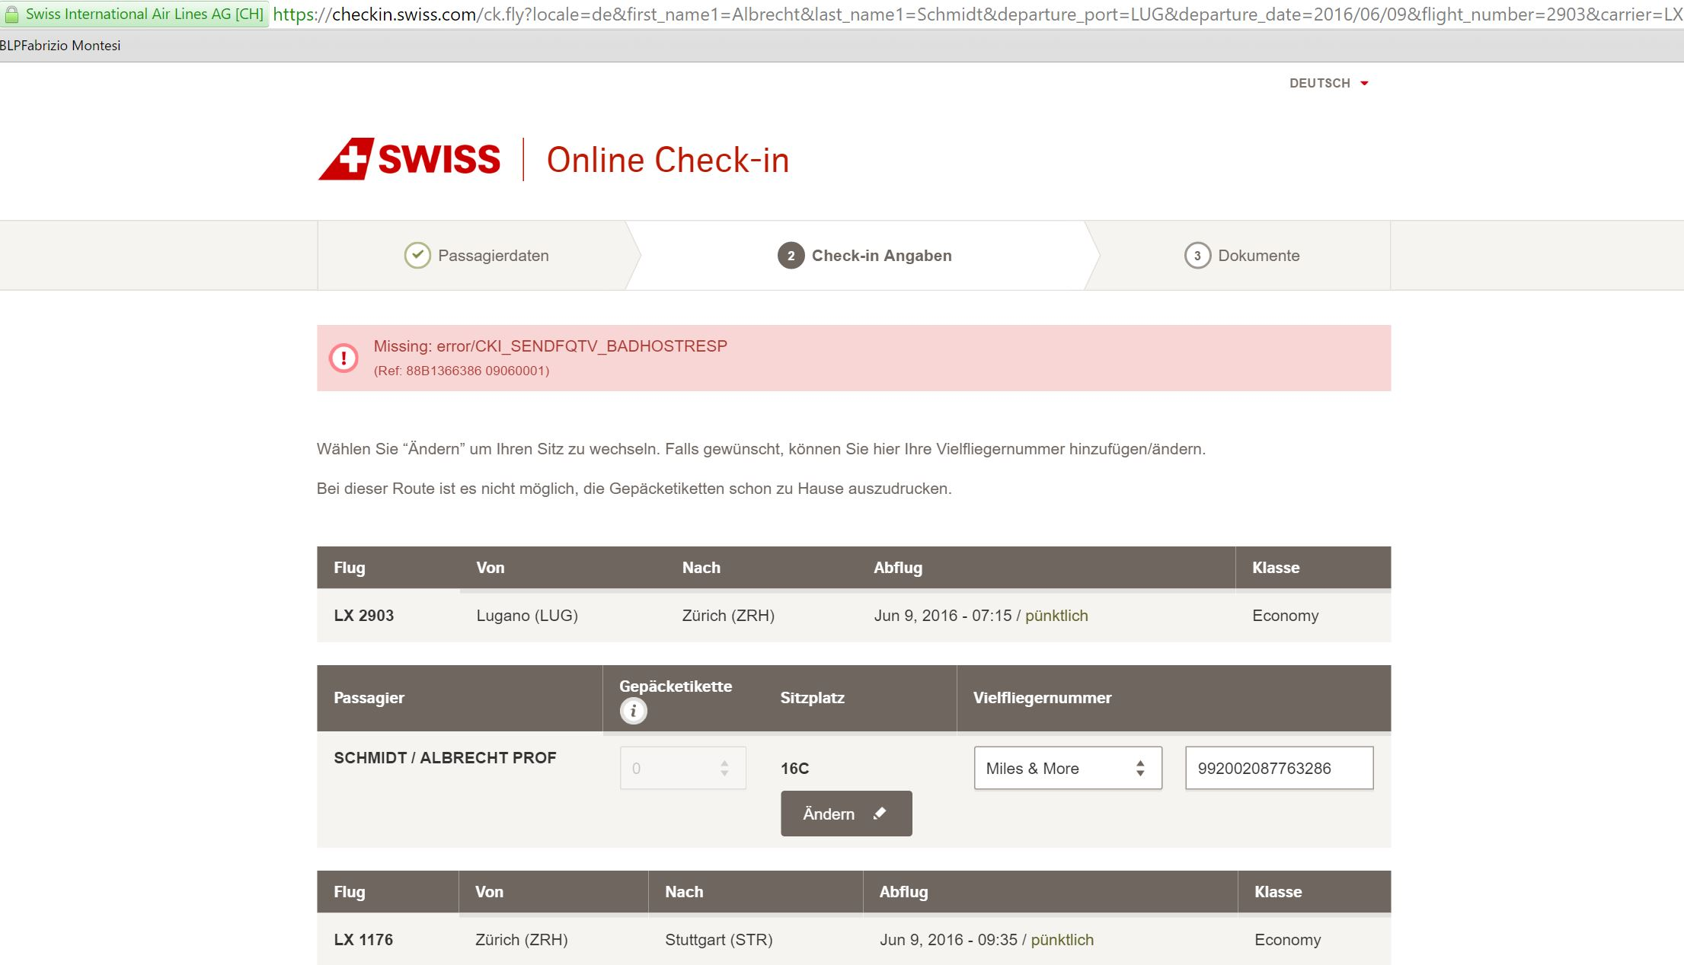
Human Errors

Slide 58
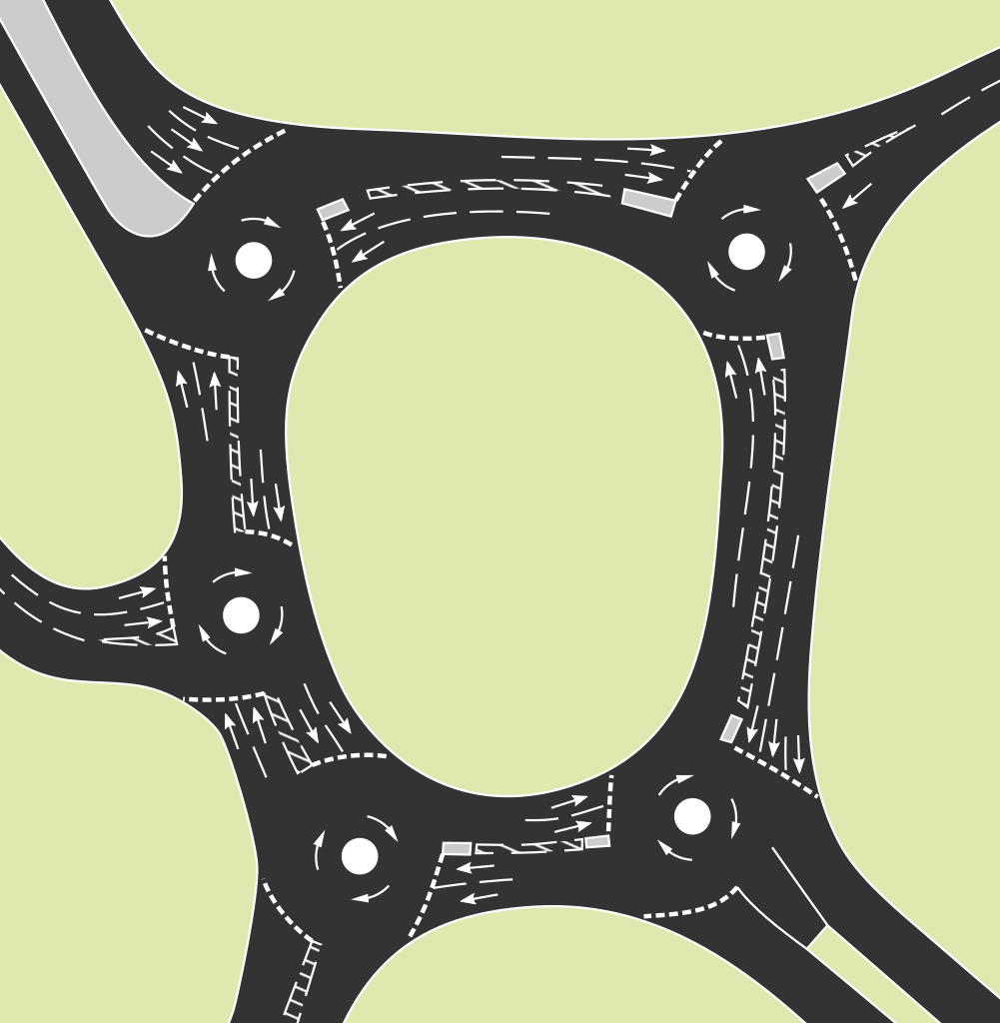
When do errors happen?
Who is responsible if an accident happens?
The program?
The user?
Another user?
The developer?
The product management?
Human Errors

Slide 59
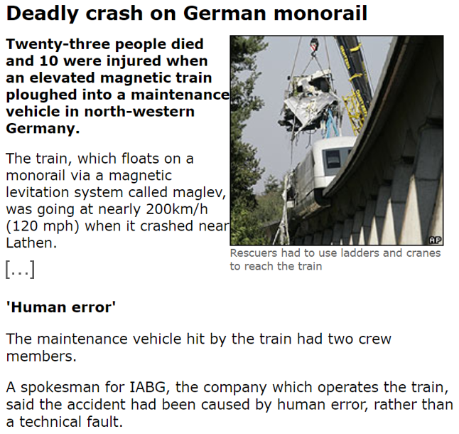
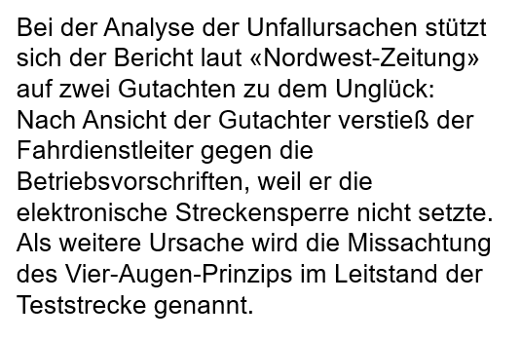
The “Human Error” as the Ultimate Explanation?
http://www.netzeitung.de/politik/deutschland/720674.html
http://news.bbc.co.uk/1/hi/world/europe/5370564.stm
Human Errors

Slide 60
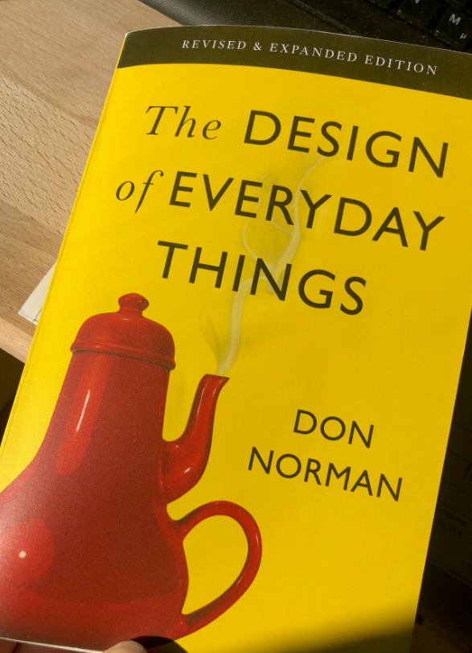
About (Human) Errors…
“If an error is possible, someone will make it” - Dan Norman
“Human Error” are a starting point to look for design problems.
Norman, D. A. (2013). The design of everyday things: Revised and expanded edition. New York: Doubleday.
Human Errors

Slide 61
About (Human) Errors…
Design implications
Assume all possible errors will be made
Minimize the chance to make errors (constraints)
Minimize the effect that errors have (is difficult!)
Include mechanism to detect errors
Attempt to make actions reversible
Prevent that users make errors in the first place
Make it impossible to enter wrong commands
Ensure that users can always recover
Human Errors

Slide 62
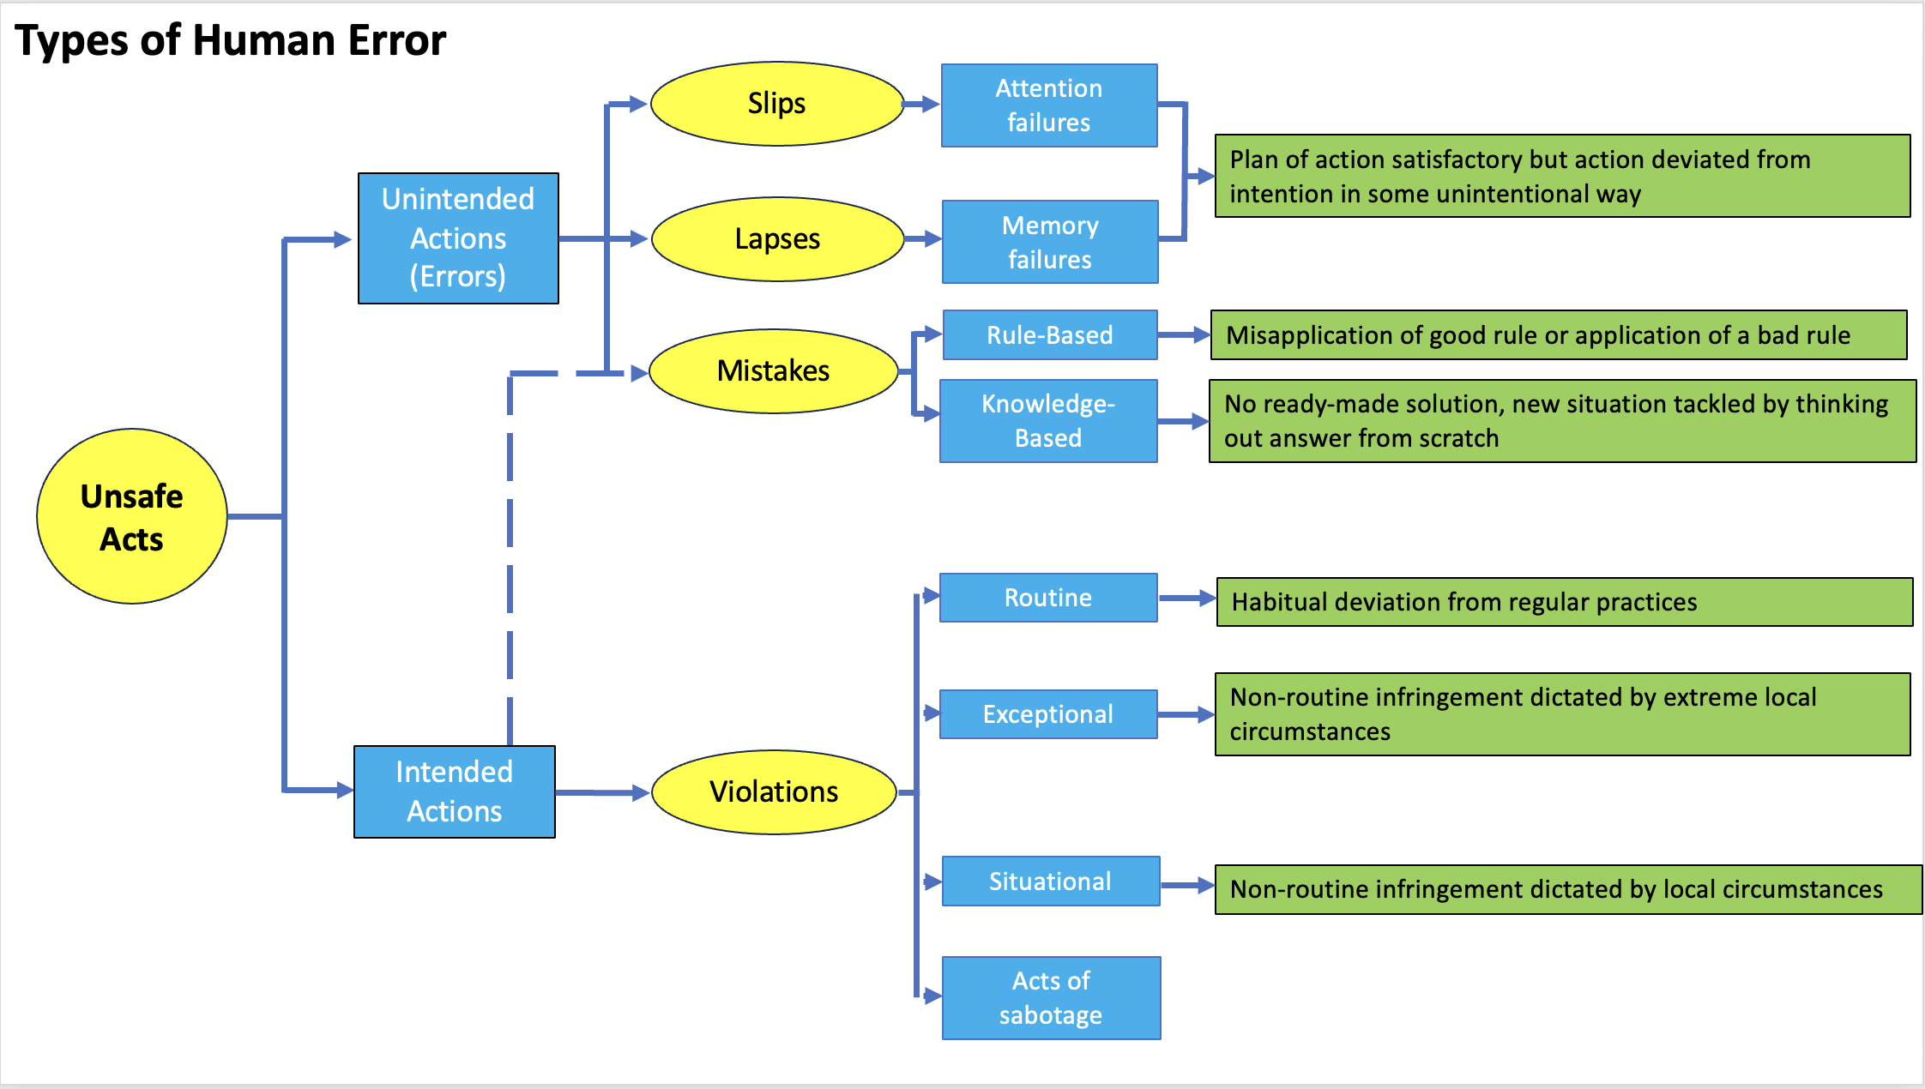
Human Failure Model (James Reason)
Human Errors

Slide 63
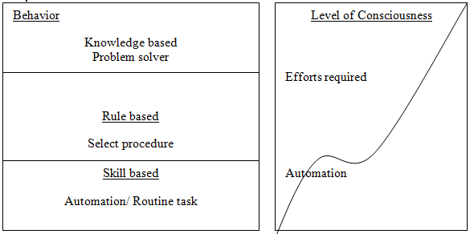
SKR Model (Rasmussen 1982)
Human Errors

Slide 64
Correcting Errors
If something goes wrong, we attempt corrections on the lowest level
A task includes action on different levels
Drive to University
Get into the car
Open the car door
Insert car key and turn
Apply pressure to the key
…
Human Errors

Slide 65
Preventing Errors
Example
User: “remove the file ‘most-important-work.txt’”
computer: “are you sure that you want to remove the file ‘most-important-work.txt’?”
User: “yes”
Computer: “are you certain?”
User: “yes of course”
Computer: “the file ‘most-important-work.txt’ has been removed”
User: Oops, damm
The user is not reconsidering the overall action – the users only prompts to think about the immediate action (clicking)
A solution is to make the action reversible
Human Errors

Slide 66
Mapping
Relationship between controls and action
Mappings should be
Understandable (e.g. moving the mouse up move the slider up)
Consistent
Recognizable or at least quickly learnable and easy to recall
Natural, meaning to be consistent with knowledge the user already has
Example: cooker
For these issues see also: Gestalt theory!
General Usability Design Guidelines

Slide 67

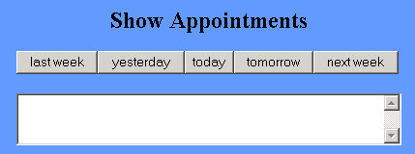
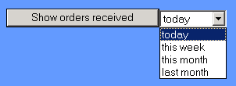
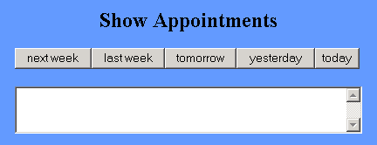
Mapping
“Natural” mappings can be found in many areas
It is not always obvious what the “natural” mapping is
Correlation with cultural constraints
General Usability Design Guidelines

Slide 68
Detecting and Handling Errors
When “human” errors are detected
get into an understandable dialog with the user (check your internet connection)
automatically correct the error (spell checker)
Force a function
Interlock (e.g., functions can only be done in a certain order)
Lock-Ins (e.g., you can not leave, before you have not done something)
Lock-Outs (e.g., you can get in, before you have not done something)
Put the user into contraint
Human Errors

Slide 69
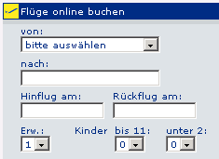
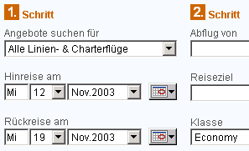
Constraints to prevent errors
GUI Example
Physical constraints
Basic physical limitations
Semantic constraints
Assumption to create something meaningful
Cultural constraints
Borders and context provided by cultural conventions
Logical constraints
Restrictions due to reasoning
Applying constraints is a design decision!
Practical way to realize the principle “prevent errors”
Date unconstrained
Date constrained
Human Errors

Slide 70
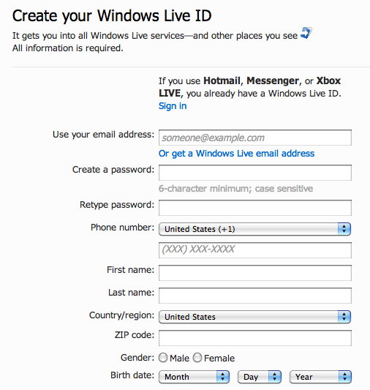
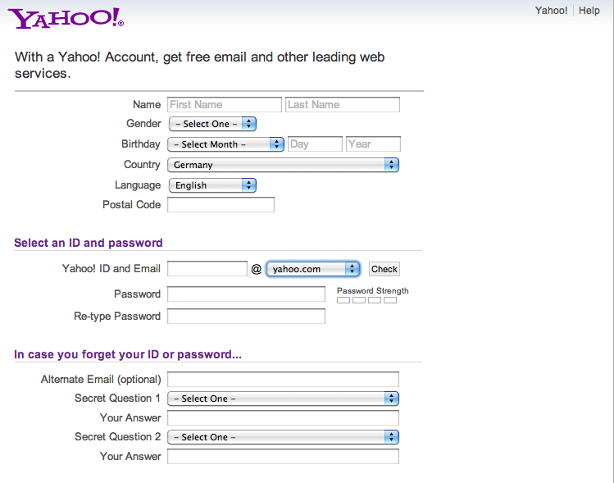
What errors do you expect?
Human Errors

Slide 71
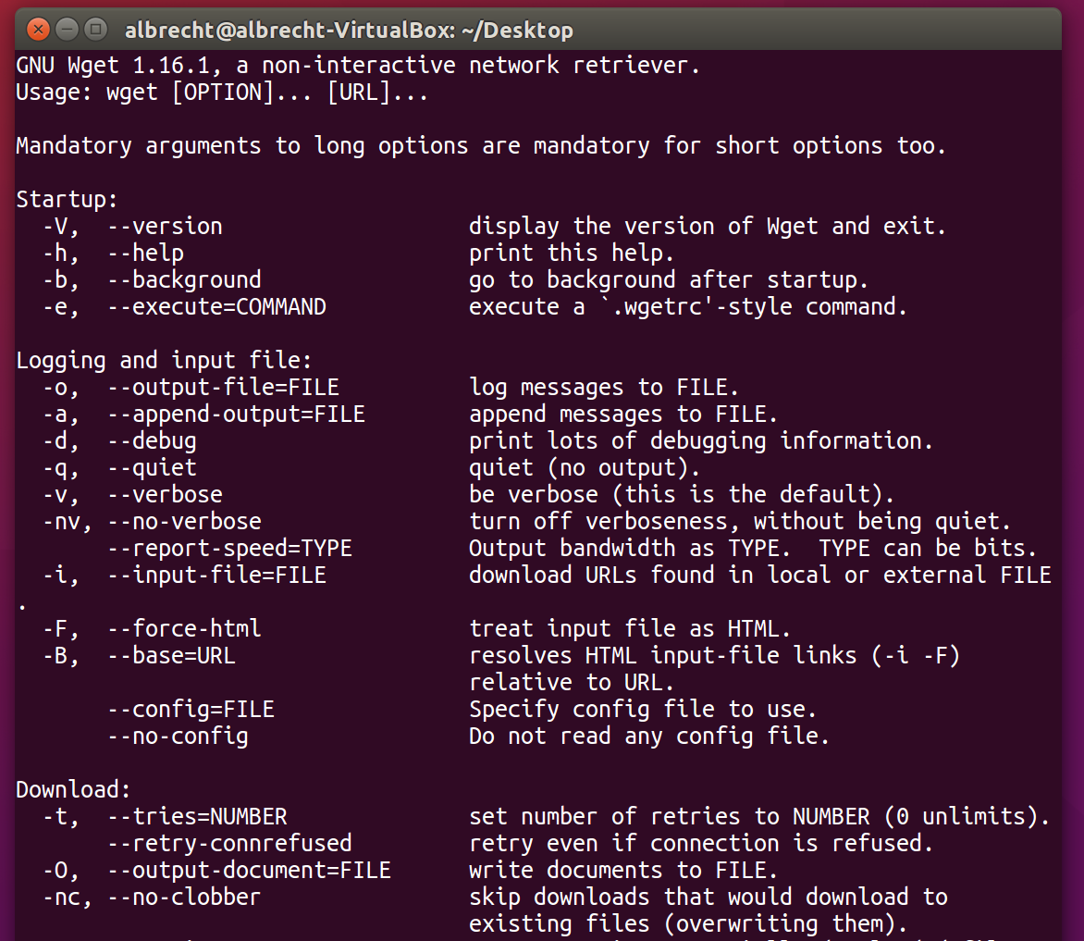
What errors do you expect?
Human Errors

Slide 72
General Usability Design Guidelines
Constraints, Mappings and Aesthetics
Slides adapted from hci-lecture.org (A. Schmidt, N. Henze, K. Wolf, V. Schwind), Image from: https://pxhere.com/de/photo/956874
The following content is licensed under a Creative Commons Attribution 4.0 International license (CC BY-SA 4.0)

Slide 73
Types of Design Principles
Principles
abstract design rules
Golden rules and heuristics
more concrete than principles
Standards
(very) detailed design rules
Design patterns
generic solution for a specific problem
Style guides
provided for devices, operating systems, widget libraries
Authority: whether or not a rule must be followed or whether it is just suggested
Generality: applied to many design situations or focused on specific application situation.
principles
golden rules
increasing generality
standards
design pattern
style guides
increasing authority
General Usability Design Guidelines

Slide 74

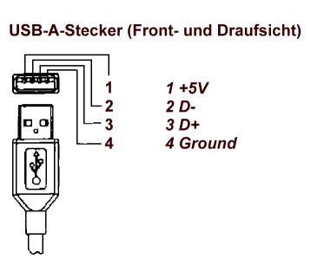
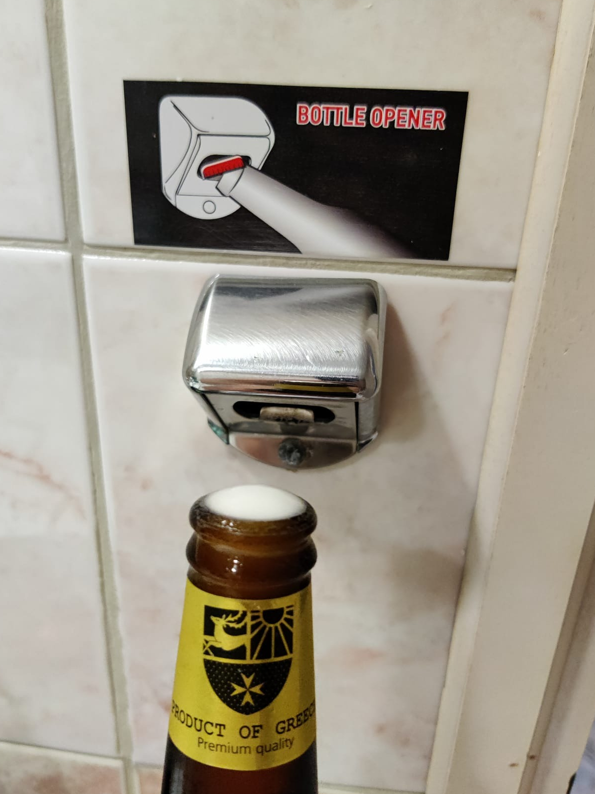
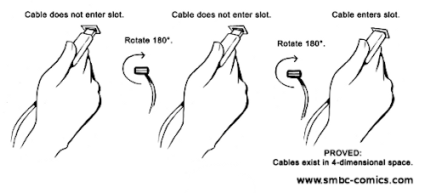
Physical Constraints
Image: Thomas Braun
General Usability Design Guidelines

Slide 75
Constraints
Physical constraints
Basic physical limitations
Semantic constraints
Assumption to create something meaningful
Cultural constraints
Borders and context provided by cultural conventions
Logical constraints
Restrictions due to reasoning
Applying constraints is a design decision!
A Practical way to realise the principle “prevent errors”
General Usability Design Guidelines

Slide 76

Cultural Constraints
Universal or culturally specific
Arbitrary conventions that have been learned
Users’ expectations build on cultural constraints
Example Colors
Red
Green
Blue
General Usability Design Guidelines

Slide 77
Guidelines? Guidelines!
User centered design
Know the user
Involve the user
Prevent user errors
Optimize user operation
Keep control with the user
Help the user to get started
Give a task-based mental model
Be consistent
Keep it simple
Design for memory limitations
Use recognition rather recall
Use cognitive directness
Draw on real world analogies
Use informative feedback
Give status indicators
Use user-centred wording
Use non-threatening wording
Use specific constructive advice
Make the system take the blame
Do not anthropomorphise
Use modes cautiously
Make user action reversible
Get attention judiciously
Maintain display inertia
Organize screen to manage complexity
Accommodate individual difference
General Usability Design Guidelines

Slide 78

ISO 9241 – Ergonomics of Human–system Interaction
Part 1: General introduction
Part 2: Guidance on task requirements
Part 3: Visual display requirements
Part 4: Keyboard requirements
…
Part 110: Dialogue principles
Part 151: Guidance on World Wide Web user interfaces
Part 171: Guidance on software accessibility
Part 210: Human-centered design for interactive systems
…
Part 420: Selection procedures for physical input devices
Part 910: Framework for tactile and haptic interaction
Part 920: Guidance on tactile and haptic interactions
General Usability Design Guidelines

Slide 79
Recommendations, Regulations & Laws
Verordnung über Arbeitsstätten (Arbeitsstättenverordnung - ArbStättV)
Allgemeine Anforderungen
Maßnahmen zum Schutz vor besonderen Gefahren
Arbeitsbedingungen
Sanitär-, Pausen- und Bereitschaftsräume, Kantinen, Erste-Hilfe-Räume und Unterkünfte
Ergänzende Anforderungen und Maßnahmen für besondere Arbeitsstätten und Arbeitsplätze
Maßnahmen zur Gestaltung von Bildschirmarbeitsplätzen
Allgemeine Anforderungen an Bildschirmarbeitsplätze
Allgemeine Anforderungen an Bildschirme und Bildschirmgeräte
Anforderungen an Bildschirmgeräte und Arbeitsmittel für die ortsgebundene Verwendung an Arbeitsplätzen
Anforderungen an tragbare Bildschirmgeräte für die ortsveränderliche Verwendung an Arbeitsplätzen
Anforderungen an die Benutzerfreundlichkeit von Bildschirmarbeitsplätzen
General Usability Design Guidelines

Slide 80
Arbeitsstättenverordnung – ArbStättV
6.5 Anforderungen an die Benutzerfreundlichkeit von Bildschirmarbeitsplätzen
Beim Betreiben der Bildschirmarbeitsplätze hat der Arbeitgeber dafür zu sorgen, dass der Arbeitsplatz den Arbeitsaufgaben angemessen gestaltet ist. Er hat insbesondere geeignete Softwaresysteme bereitzustellen.
Die Bildschirmgeräte und die Software müssen entsprechend den Kenntnissen und Erfahrungen der Beschäftigten im Hinblick auf die jeweilige Arbeitsaufgabe angepasst werden können.
Das Softwaresystem muss den Beschäftigten Angaben über die jeweiligen Dialogabläufe machen.
Die Bildschirmgeräte und die Software müssen es den Beschäftigten ermöglichen, die Dialogabläufe zu beeinflussen. Sie müssen eventuelle Fehler bei der Handhabung beschreiben und eine Fehlerbeseitigung mit begrenztem Arbeitsaufwand erlauben.
Eine Kontrolle der Arbeit hinsichtlich der qualitativen oder quantitativen Ergebnisse darf ohne Wissen der Beschäftigten nicht durchgeführt werden.
General Usability Design Guidelines

Slide 81
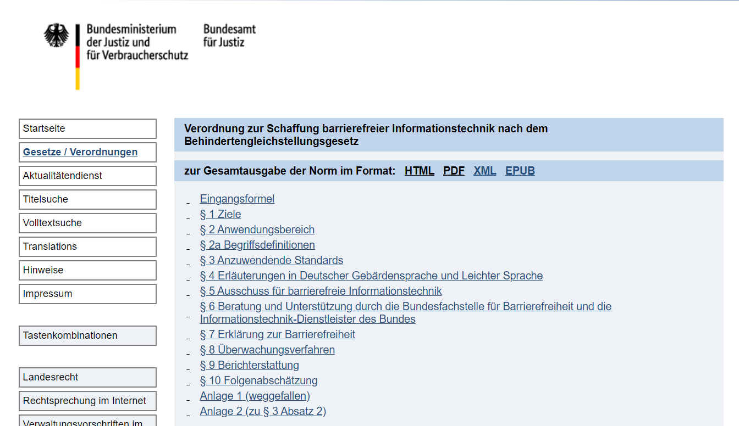
Recommendations, Regulations & Laws
General Usability Design Guidelines

Slide 82
Recommendations, Regulations & Laws
§ 1 Ziele
(1) Die Barrierefreie-Informationstechnik-Verordnung dient dem Ziel, eine umfassend und grundsätzlich uneingeschränkt barrierefreie Gestaltung moderner Informations- und Kommunikationstechnik zu ermöglichen und zu gewährleisten.
(2) Informationen und Dienstleistungen öffentlicher Stellen, die elektronisch zur Verfügung gestellt werden, sowie elektronisch unterstützte Verwaltungsabläufe mit und innerhalb der Verwaltung, einschließlich der Verfahren zur elektronischen Aktenführung und zur elektronischen Vorgangsbearbeitung, sind für Menschen mit Behinderungen zugänglich und nutzbar zu gestalten
General Usability Design Guidelines

Slide 83
Web Content Accessibility Guidelines (WCAG) 2.1
Perceivable
Provide text alternatives for non-text content,
Provide captions and other alternatives for multimedia.
Create content that can be presented in different ways, including by assistive technologies, without losing meaning.
Make it easier for users to see and hear content.
Operable
Make all functionality available from a keyboard.
Give users enough time to read and use content.
Do not use content that causes seizures or physical reactions.
Help users navigate and find content.
Make it easier to use inputs other than keyboard.
Understandable
Make text readable and understandable.
Make content appear and operate in predictable ways.
Help users avoid and correct mistakes.
Robust
Maximize compatibility with current and future user tools.”
General Usability Design Guidelines

Slide 84
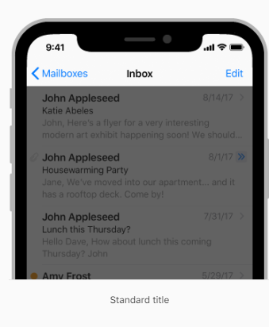
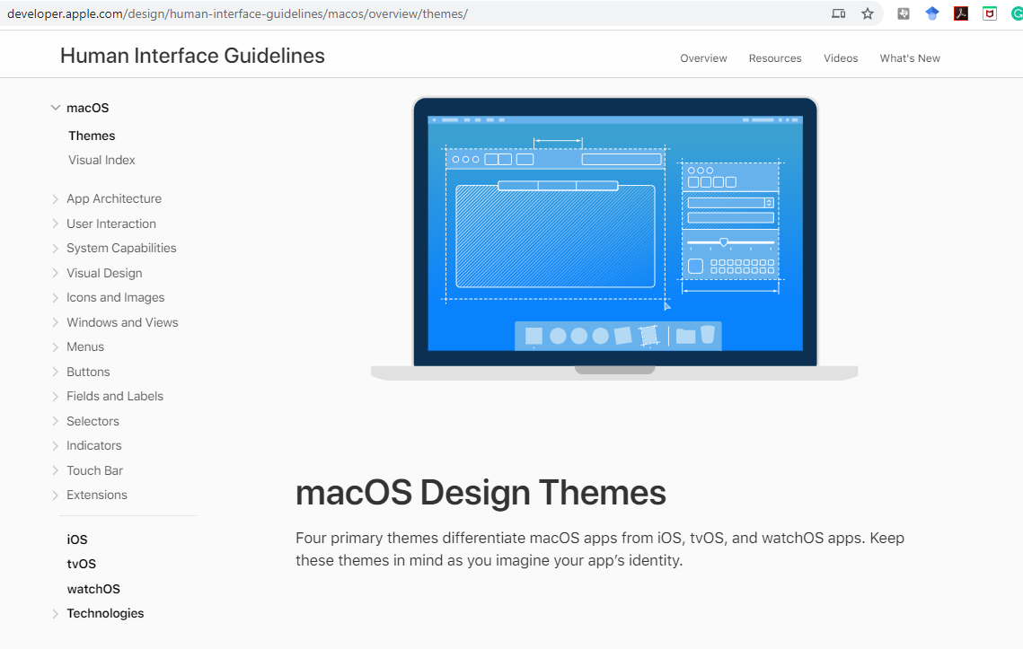


User Interface Guidelines
Define how the user interface
looks
is being operated
reacts
feels
Usually most is “encoded” in the libraries, frameworks and corresponding UI builder
Need to learn, how to find it and how to read it
General Usability Design Guidelines

Slide 86


General Usability Design Guidelines

Slide 87

General Usability Design Guidelines

Slide 88

General Usability Design Guidelines

Slide 89

https://webstyleguide.com/
General Usability Design Guidelines

Slide 90


Apple Human Interface Guidelines (2005)
Apple Human Interface Guidelines (2005), Apple Computer, Inc., p55
General Usability Design Guidelines

Slide 91





General Usability Design Guidelines

Slide 92

General Usability Design Guidelines

Slide 93

Gnome User Interface Checklist
General Usability Design Guidelines

Slide 94
References
Shneiderman, B. The Eight Golden Rules of Interface Design. https://www.cs.umd.edu/~ben/goldenrules.html
Shneiderman, B., Plaisant, C., Cohen, M., Jacobs, S., Elmqvist, N., & Diakopoulos, N. (2016). Designing the user interface: strategies for effective human-computer interaction. Pearson. http://www.cs.umd.edu/hcil/DTUI6/
Urban Stress: Experiments on Noise and Social Stressors. DC Glass, JE Singer - 1972 - Academic Press
Euphemia Wong. Shneiderman’s Eight Golden Rules Will Help You Design Better Interfaces. https://www.interaction-design.org/literature/article/shneiderman-s-eight-golden-rules-will-help-you-design-better-interfaces
Poppinga, B., Sahami Shirazi, A., Henze, N., Heuten, W., & Boll, S. (2014, September). Understanding shortcut gestures on mobile touch devices. In Proc. of the 16th int. conf. on Human-computer interaction with mobile devices & services (pp. 173-182). ACM.
Schmidt, A., & Herrmann, T. (2017). Intervention user interfaces: a new interaction paradigm for automated systems. interactions, 24(5), 40-45.
Norman, D. A. (2013). The design of everyday things: Revised and expanded edition. New York: Doubleday.
Shneiderman, B., Plaisant, C., Cohen, M., Jacobs, S., Elmqvist, N., & Diakopoulos, N. (2016). Designing the user interface: strategies for effective human-computer interaction. Pearson. http://www.cs.umd.edu/hcil/DTUI6/
References

Slide 95
References
Hix and Hartson, Developing User Interfaces, Wiley, 1993
ISO 9241 Ergonomics of human–system interaction
Verordnung über Arbeitsstätten (Arbeitsstättenverordnung - ArbStättV) https://www.gesetze-im-internet.de/arbst_ttv_2004/anhang.html
Verordnung zur Schaffung barrierefreier Informationstechnik nach dem Behindertengleichstellungsgesetz https://www.gesetze-im-internet.de/bitv_2_0/index.html
Web Content Accessibility Guidelines (WCAG) 2.1 www.w3.org/TR/WCAG21
https://developer.apple.com/design/human-interface-guidelines/macos/
https://developer.apple.com/design/human-interface-guidelines/ios/views/
https://developer.apple.com/design/human-interface-guidelines/watchos/overview/themes/
https://material.io/design
https://docs.microsoft.com/en-us/windows/uwp/design/
https://webstyleguide.com/
Apple Human Interface Guidelines (2005), Apple Computer, Inc
https://people.gnome.org/~fpeters/hig3.pdf
https://developer.gnome.org/hig/stable/pointer-and-touch-input.html.en
https://developer.gnome.org/accessibility-devel-guide/stable/gad-checklist.html.en
References

