Slide 1

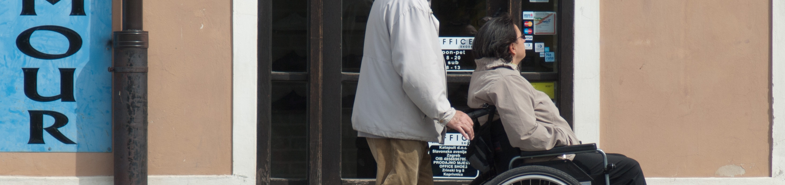

Accessibility
Guidelines for Accessible Interfaces and Universal Design
Slides adapted from A. Schmidt, Image from: https://pxhere.com/de/photo/700394
The following content is licensed under a Creative Commons Attribution 4.0 International license (CC BY-SA 4.0)

Slide 2
Learning Goals
Understand …
Why accessibility is important in HCI
That there are legal and usability requirements
Different types of disabilities
Principles of universal design
Be able to explain …
Universal design principles
Soft- and hardware for people with disabilities

Slide 3
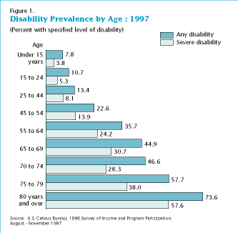
Why Accessibility?
In 1997, 52.6 million people (19.7 percent of the population) had some level of disability
33.0 million (12.3 percent of the population) had a severe disability.
About 10.1 million individuals (3.8 percent of the population) needed personal assistance
2.2 million used a wheelchair.
Another 6.4 million used some other ambulatory aid such as a cane, crutches, or a walker. A
About 7.7 million individuals and letters in ordinary newspaper print; of them, 1.8 million were unable to see.
Accessibility and Universal Design

Slide 4
Why Accessibility?
Numbers from Germany
155.000 blind people, 500.000 visually impaired
1,1 Million have motor deficiencies (movement and control of body parts)
236.000 are hard of hearing or deaf
Assistive technologies
Usage of associative technologies is widespread in these groups (~30%)
Large screens and magnified presentation
Braille Displays
Text to speech (screen readers)
Speech input and speech control
Special keyboards and input devices (if motor control for standard mouse and keyboard is not sufficient)
Accessibility and Universal Design

Slide 5
Legal Requirements
In Germany:
Behindertengleichstellungsgesetz http://www.behindertenbeauftragter.de/gesetzgebung/behindertengleichstellungsgesetz
Verordnung zur Schaffung barrierefreier Informationstechnik nach dem Behindertengleichstellungsgesetz http://www.behindertenbeauftragter.de/gesetzgebung/behindertengleichstellungsgesetz/rechtsverordnung/rvo11bgg
It is required by law (Germany)
Since 31. December 2005 for general information
Since 31. December 2003 for information that is targeted at people with disabilities
In USA
Section 508: http://www.section508.gov/
Accessibility and Universal Design

Slide 6
Types of Disabilities
Physical Disabilities
Motor impairments
Visual impairments
Blindness (users cannot see visual content)
Low vision (Poor vision quality, Very common in seniors)
Color blindness (10% of all males – red green)
Hearing impairments
…
Cognitive/Mental Disabilities
Reading/Learning disorders
Attention disorders
Memory impairments
…
Accessibility and Universal Design

Slide 7


Blindness / Low Vision / Color Blindness
Blindness
Provide structure to text for easy navigation
Add text or audio descriptions to images/video
Follow standards for maximum compatibility with screen readers
Low Vision
Allow font resizing
Allow color schemes to be changed
Add text or audio descriptions to images/video
Color Blindness
Allow color schemes to be changed
Don’t differentiate on hue alone: include saturation, value, shape
From: http://portal.cs.umass.edu/fundamentals/Usability_05_Accessibility.pdf Brandon Goldsworthy, Shaun Kane, Tony Sindelar
Accessibility and Universal Design

Slide 8
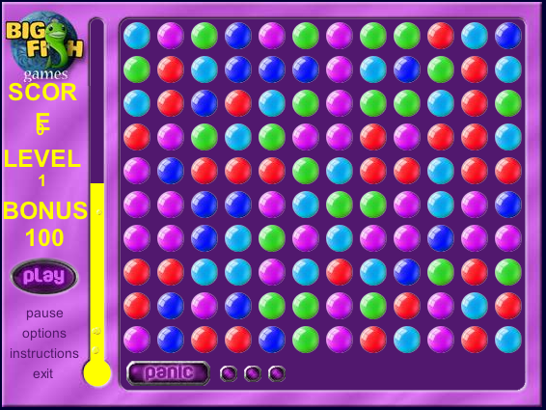
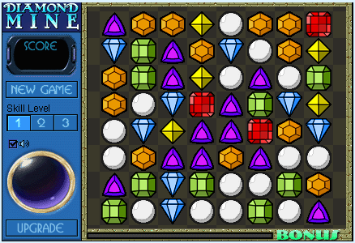
Provide more cues!
From: http://portal.cs.umass.edu/fundamentals/Usability_05_Accessibility.pdf Brandon Goldsworthy, Shaun Kane, Tony Sindelar
Accessibility and Universal Design

Slide 9
Screenreader
Software that reads what is on the screen
Provides navigation
Integrates with application software
Example: JAWS
Includes a software speech synthesizer
Can output to Braille display
Demo: http://www.freedomscientific.com/fs_downloads/jaws.asp
Example: IBM Home page reader
Especially designed for web browsing
Reads text, table, frames, forms, ALT-tags
Works with selected JavaScript code and Plug-Ins
Demo: http://www-5.ibm.com/de/accessibility/hpr.html
Accessibility and Universal Design

Slide 10
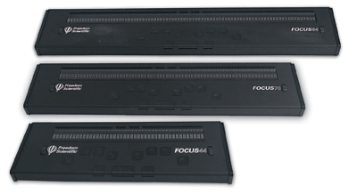
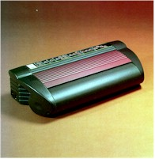
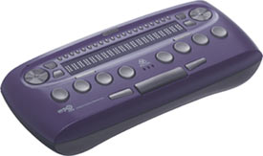
Braille Displays / Printer
Displays
Used with a JAWS screen reader
refreshable Braille cells act as a tactile monitor (e.g. 44-, 70- and 84-cells)
Unidirectional advance bars and Whiz Wheels for navigation
buttons are individually (Navigation controls are on the display)
>5000 €
Printer
150 PPH (pages per hour) or 39 CPS (characters per second).
6 High quality hardened hammers forming against hardened steel anvils
Images from: http://www.sightandsound.co.uk, http://www.accesstech.ch/, http://www.sightandsound.co.uk/
Accessibility and Universal Design

Slide 11
Hearing Impairments
User cannot hear audio content
Easy to test for (turn off your speakers)
Solution
Provide labeling captioning for all audio content
Use automatic labeling whenever possible
Recheck
Hearing aids
Accessibility and Universal Design

Slide 12
Impaired Motor Skills
Difficulty using physical input devices e.g., mouse and keyboard
Inaccuracy while clicking
Slow input
May use specialized input device
Solutions
Do not require precise clicking
Allow alternate input methods
Keyboard
Mouse
Voice
Accessibility and Universal Design

Slide 13
Cognitive Disabilities
Many types
Learning disabilities
Attention deficit disorder
Memory impairments
Impairments of intelligence
May have difficulty focusing on processing information
Solutions
Clear, simple design
Simple navigation
Avoid distracting elements (video, navigation)
Accessibility and Universal Design

Slide 14
Universal Design Principles
Tolerance for Error
The design minimizes hazards and the adverse consequences of accidental or unintended actions
Low Physical Effort
The design can be used efficiently and comfortably and with a minimum of fatigue
Size and Space for Approach and Use
Appropriate size and space is provided for approach, reach, manipulation, and use regardless of user's body size, posture, or mobility
Accessibility and Universal Design

Slide 15
Universal Design Principles
Equitable Use
The design is useful and marketable to people with diverse abilities
Flexibility in Use
The design accommodates a wide range of individual preferences and abilities
Simple and Intuitive Use
Use of the design is easy to understand, regardless of the user's experience, knowledge, language skills, or current concentration level.
Perceptible Information
The design communicates necessary information effectively to the user, regardless of ambient conditions or the user's sensory abilities.
Accessibility and Universal Design

Slide 16
Web Accessibility Evaluation
Guidelines are divided into three categories of success criteria:
Level 1 success criteria:
do not specify how information is presented
are reasonably applicable to all Web sites
some are machine-testable. Others require human judgment. Success criteria that require human testing yield consistent results among multiple testers.
Level 2 success criteria:
may require an author to present content in particular ways
are reasonably applicable to all Web sites
some are machine-testable. Others require human judgment. Success criteria that require human testing yield consistent results among multiple testers.
Level 3 success criteria:
are additional criteria that go beyond Level 1 and 2 that may be applied to make sites accessible to more people with all or particular types of disability
Accessibility and Universal Design

Slide 17
Quick Tips to make Accessible Web Site
For Complete Guidelines & Checklist: www.w3.org/WAI
Images & animations: Use the alt attribute to describe the function of each visual.
Image maps : Use the client-side map and text for hotspots.
Multimedia : Provide captioning and transcripts of audio, and descriptions of video.
Hypertext links. Use text that makes sense when read out of context. E.g., avoid "click here."
Page organization Use headings, lists, and consistent structure, use HTML5/CSS
Graphs & charts : Summarize or use the longdesc attribute.
Scripts, applets, & plug-ins: Provide alternative content in case active features are inaccessible
Frames: Use the no-frames element and meaningful titles.
Tables: Make line-by-line reading sensible. Summarize.
Check your work: Validate. Use tools, checklist, and guidelines at http://www.w3.org/TR/WCAG
Accessibility and Universal Design

Slide 18
Guideline Checker
Bobby: http://bobby.watchfire.com/bobby/html/en/index.jsp “This free service will allow you to test web pages and help expose and repair barriers to accessibility and encourage compliance with existing accessibility guidelines, such as Section 508 and the W3C's WCAG. To learn about products to test websites of all sizes for accessibility issues, please visit the accessibility section on www.watchfire.com.”
A-promt: http://aprompt.snow.utoronto.ca/ “Web authors can use A-Prompt to make their Web pages accessible to people with disabilities. The A-Prompt software tool examines Web pages for barriers to accessibility, performs automatic repairs when possible, and assists the author in manual repairs when necessary. These enhanced Web pages are available to a larger Internet audience. “
http://www.anybrowser.com/
http://www.barrierekompass.de/
http://validator.w3.org/
Accessibility and Universal Design

