Slide 1



Games
Human-Computer Interaction Lecture
Slides adapted from the Game Design Workshop by V. Schwind, Image from: https://pxhere.com/de/photo/764632
The following content is licensed under a Creative Commons Attribution 4.0 International license (CC BY-SA 4.0)

Slide 2
Learning Goals
Understand …
what a games is and why video games are important subject in HCI
game types and classifications
principles of a meaningful game
the player-centered development process
gameplay and flow mechanics
technology-related questions
Be able to explain …
game principles and game development processes
game types and technologies
Games

Slide 3

WHAT IS A GAME?
“Games are the voluntary attempt to overcome unnecessary obstacles”.
- Bernard Suits [42]

Slide 4
What is a Game?
An interactive piece of entertainment
Structured form of play and governed by rules
Uncertain, unforeseeable, quantified outcome
Circumscribed in time and “place”
Undertaken for fun and non-productive
Exceptions: serious games, gamification
Accompanied by the awareness of being in another reality
Simulating an artificial conflict
Solving an artificial problem
Games

Slide 5
WHY DO PEOPLE PLAY GAMES?

Slide 6
Game Classfication
Cooperation
Cooperative or non-cooperative (alone or together)
Symmetry
Symmetric or asymmetric (identity based payoff or all equal)
Sum of Choice
Zero-sum / Non-zero sum or constant-sum (+ sum of all wins - sum of all losses = 0)
Simultaneous / Sequential (Dynamic)
Moves / Prior Knowledge / Time Axis
Information
Perfect (all moves are known)
Imperfect (some moves are unknown)
Games

Slide 7
Video Game Classfication
View
Side-Scroller
First-Person / Ego
Third-Person
Top-Down
2D
3D
...
Type
Action
Adventure
Role-Play-Game
Puzzle
Party
Racing
…
Genre
Fantasy
Science-Fiction
Sport
Party
Medieval
Horror
…
Games

Slide 8
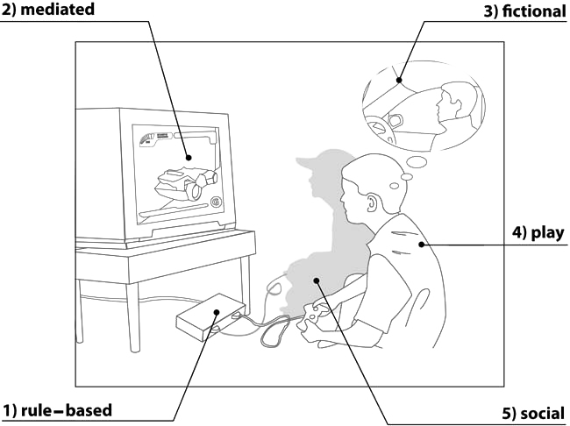
Five Planes
M. Nietsche, Video game spaces: image, play, and structure in 3D worlds. MIT Press. (2008)
Games

Slide 9

HOW TO CREATE A GAME?

Slide 10
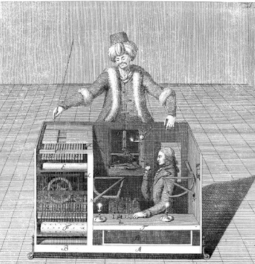
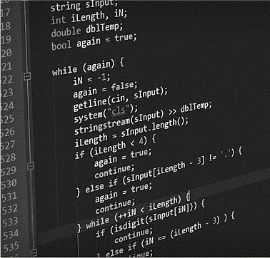
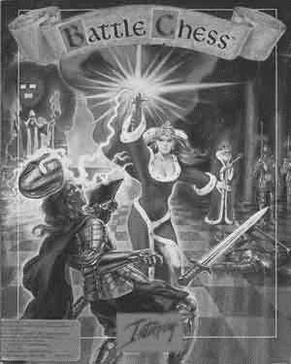
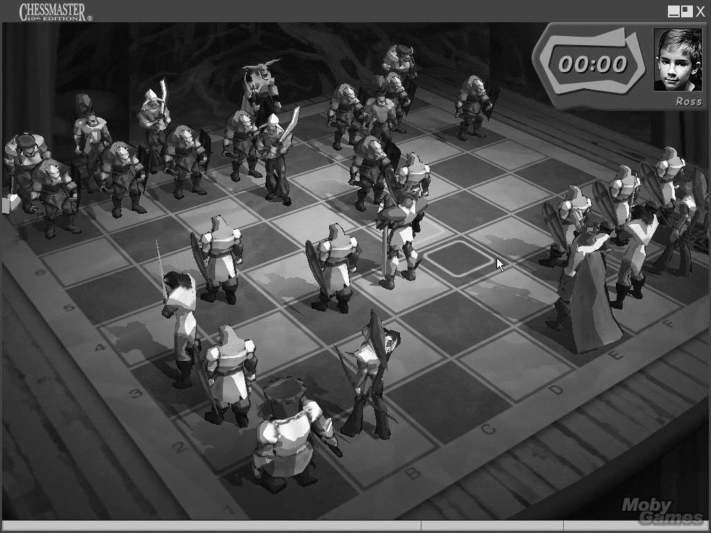
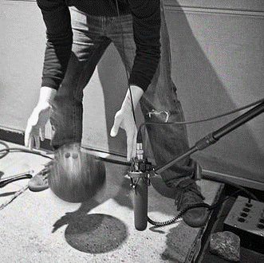
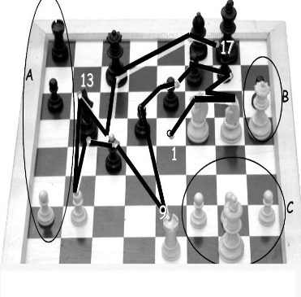
Who makes a game?
„they“
Game Producer
Project Manager
Technical Director(s)
Public Relations
Game Design
Developer
Art
Visual
Sound
Quality Assurance
Product Designer
Community Manager
People who obtain the infrastructure
Games
Image references from left to right: [6,7,8,9,10,11]

Slide 11
Development Process
Pre Production
Production
Content Creation
Idea
Proposal
Design
Prototype
Testing
Release
Coding

Slide 12
Game Design
A designer creates a context to be encountered by a player, from which meaning emerges [1].
Meaning is an interpretation of context based on
Semiotics: The study of signs and symbols and their interpretation
System: A set of interconnected components working together to achieve a common goal or purpose
Interactivity: The ability of a system or technology to respond to user input or actions in a meaningful way
Choice: The act of selecting or making a decision between two or more options
[1] Peter Shankar - CSE 497 – Topics on AI & Computer Game Programming
Games

Slide 13
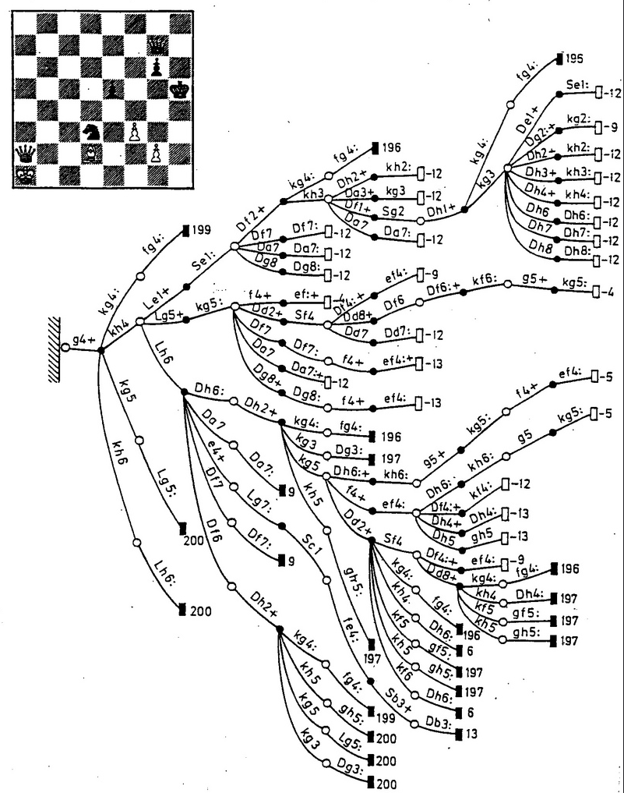

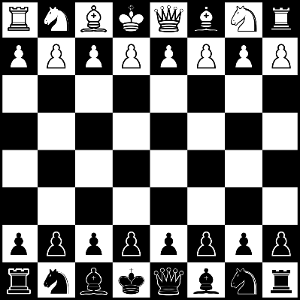
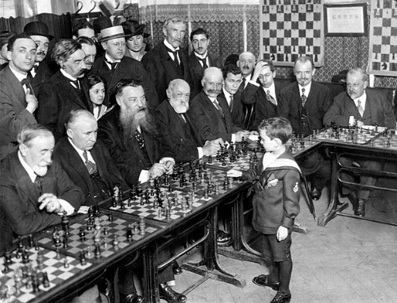
Meaning in Games
Semiotic
System
Interactivity
Choice
A symbol (or icon) represents something other than itself
Symbols are interpreted
Meaning results when a symbol is interpreted
Context shapes interpretation
Games

Slide 14
Meaning in Games
Semiotic
System
Interactivity
Choice
Objects are the parts, elements, or variables within the system
Attributes are qualities or properties of the system and its objects
Internal relationships are relations among the objects
Environment is the context that surrounds the system
Games

Slide 15
Meaning in Games
Semiotic
System
Interactivity
Choice
Cognitive: interpretive participation
Functional: utilitarian participation
Explicit: participation with designed choices and procedures
Beyond-the-object: participation within the culture of the project
Games

Slide 16
Meaning in Games
Semiotic
System
Interactivity
Choice
Choices at micro level: each decision at it’s smallest level
Choices at macro level: aggregated choices form a larger outcome
A cluster of choices is a player’s tactic (local planning)
The sum of choices is a player's strategy (global planning)
The outcome also depends on the action of others.
Games

Slide 17
Choices in Games
A choice is a non-trivial, two-sided question to the player
upside, one step closer to victory
downside, hurts the player's chances of winning
A choice has consequences
The player can not go back after exploring the consequences
Simple risk management: low risk / low rewards – high risk / high reward
Avoid dominant strategies
Avoid trivial choices
The player must be aware of making a choice.
Choices have consequences
Games

Slide 18
life or death
direct and immediate impact
indirect or delayed impact
small impact, direct as well as indirect
no impact, no outcome
critical
important
necessary
minor
without consequences
Games

Slide 19

Is the illusion of having a choice more meaningful than the choice itself?

Slide 20
Human Player-centered Game Design
Plan the human-centered design process
Design solution meets the user requirements
Understand and specify the context of use
iterate where appropriate
Evaluate designs against requirements
Specify the user and organizational requirements
Product design solutions to meet the user requirements
Games

Slide 21
Design Thinking
Understand
Observe
Define
Find an Idea
Develop a
Prototype
Test
The Design Thinking process, referring to an Anja Wölbling, Kira Krämer, Clemens N. Buss, Katrin Dribbisch, Peter LoBue, and Abraham Taherivand 2012. “Design Thinking: An Innovative Concept for Developing User-Centered Software”, in Software for People, Mädche, Alexander (eds.), Berlin: Springer, pp. 121ff.
Games

Slide 22

MDA Framework
Mechanics: Rules and algorithms define the actions
Dynamics: Behavior arising while players interact
Aesthetics: Visual qualities, Experiences, emotions
M
D
A
DESIGNER
PLAYER
Games

Slide 23
Players‘ Demographics
0-3 Infant/Toddler: Interested in Toys. The target group in this age are the parents!
4-6 Preschooler: First interest in simple video games
7-9 Kids: Age of reason, Childrens are able to solve complex problems
10-13 Pre-Teen: Age of obsession, neurological growth with the ability to think deeply
13-18 Teen: First gap - boys interested in competition / girls on real-world issues
18-24 Young Adult: The main game consumer group: have both time and money
25-35 Twenties and Thirties: Family formation and hardcore gamers
35-50 Thirties and Forties: decisions about expensive games (for children or themselves)
50+ Fifties and Up: Empty nesters have a lot of time, children's have moved out
Games

Slide 24
Players‘ Demographics
Gender Gaps
Males: Mastery, Action, Competition, Destruction, Spatial Puzzles, Trial & Error
Females: Emotion, Link to Real World, Dialogues & Verbal Puzzles, Learning by Example
Cultural Differences
Eastern: Strategic affinity, prefer young figures, female protagonists, androgyny, colors
Europe: High diversity, lowest religious affinity for video games.
Western: Patriotic, but strong restriction of sexual and homosexual representations
Many subcultures
India: High affinity for polytheism religious content.
Games

Slide 25
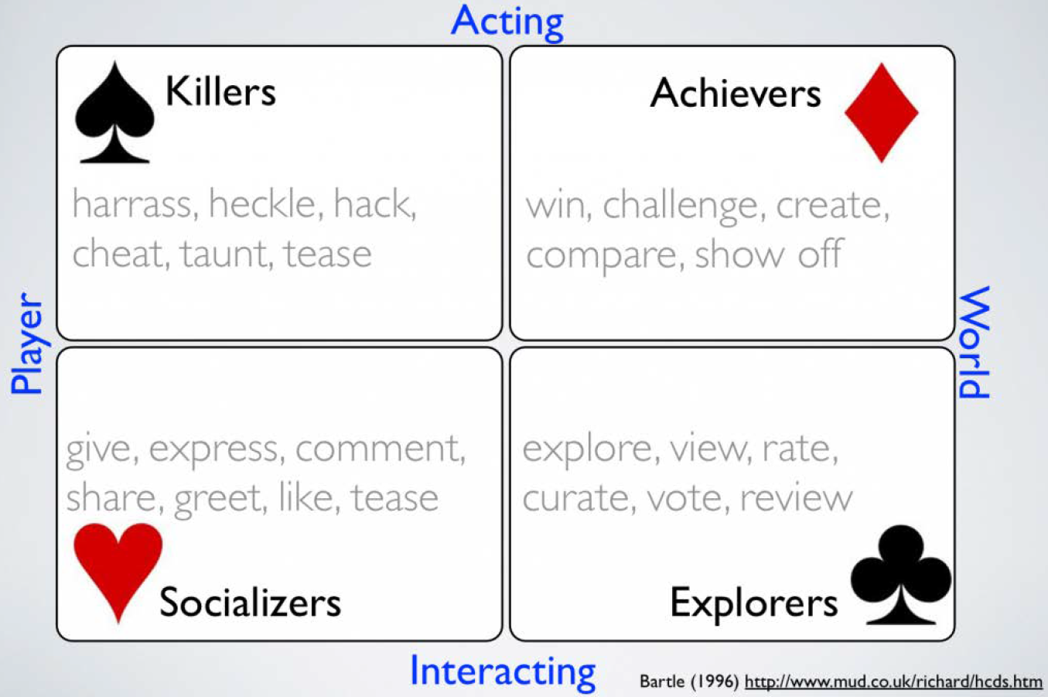
Bartle‘s Taxonomy of Players
Games

Slide 26

Players‘ Expectations
Create what players expect…
Meaning
Consistence
Tasks
Immersion
Solutions
Challenges
Rewards
Aesthetics
… and what not!
Dynamics
Curiosities
Surprisings
Changing game states
Increase the pace
Details
Limits
Subgames
Games

Slide 27
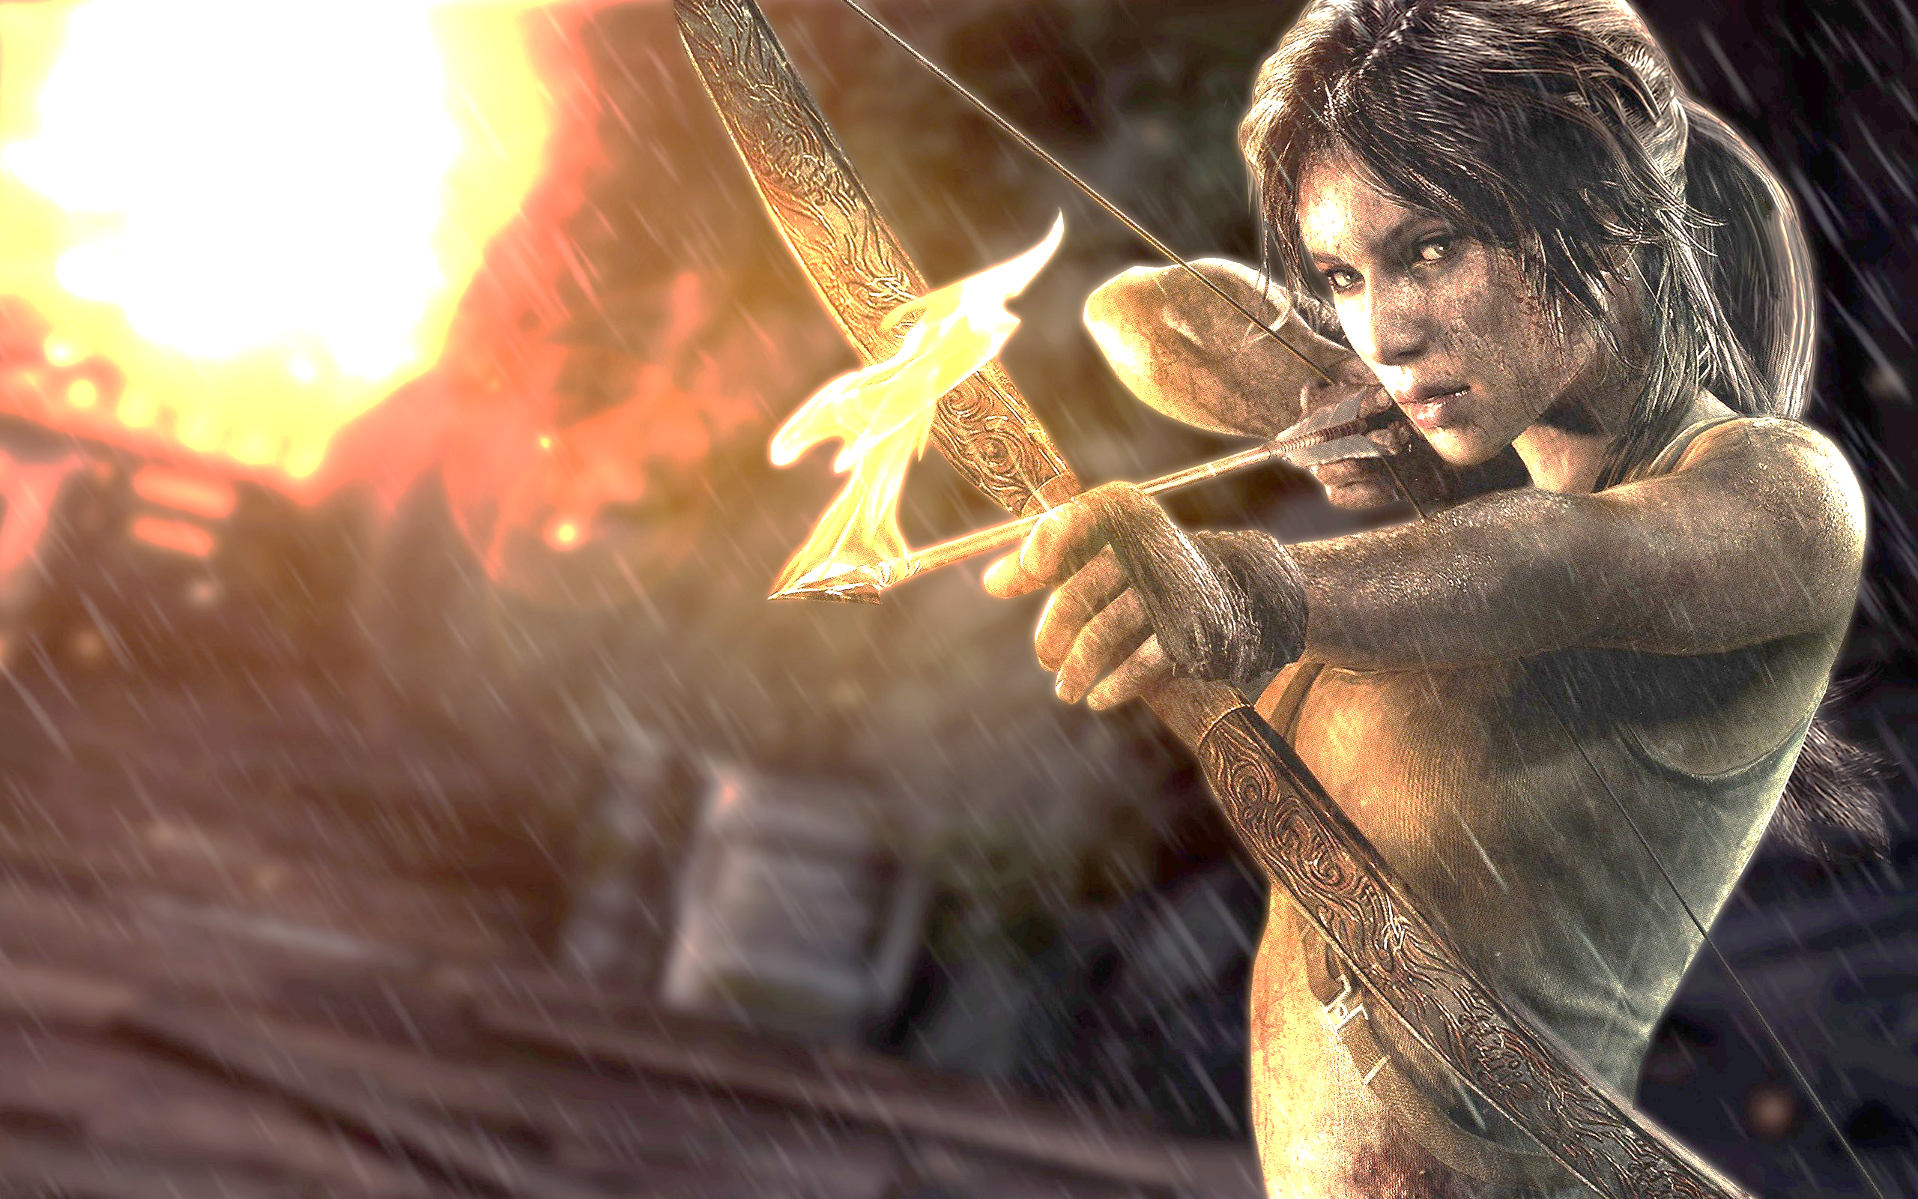
But what players really want is an experience!

Slide 28
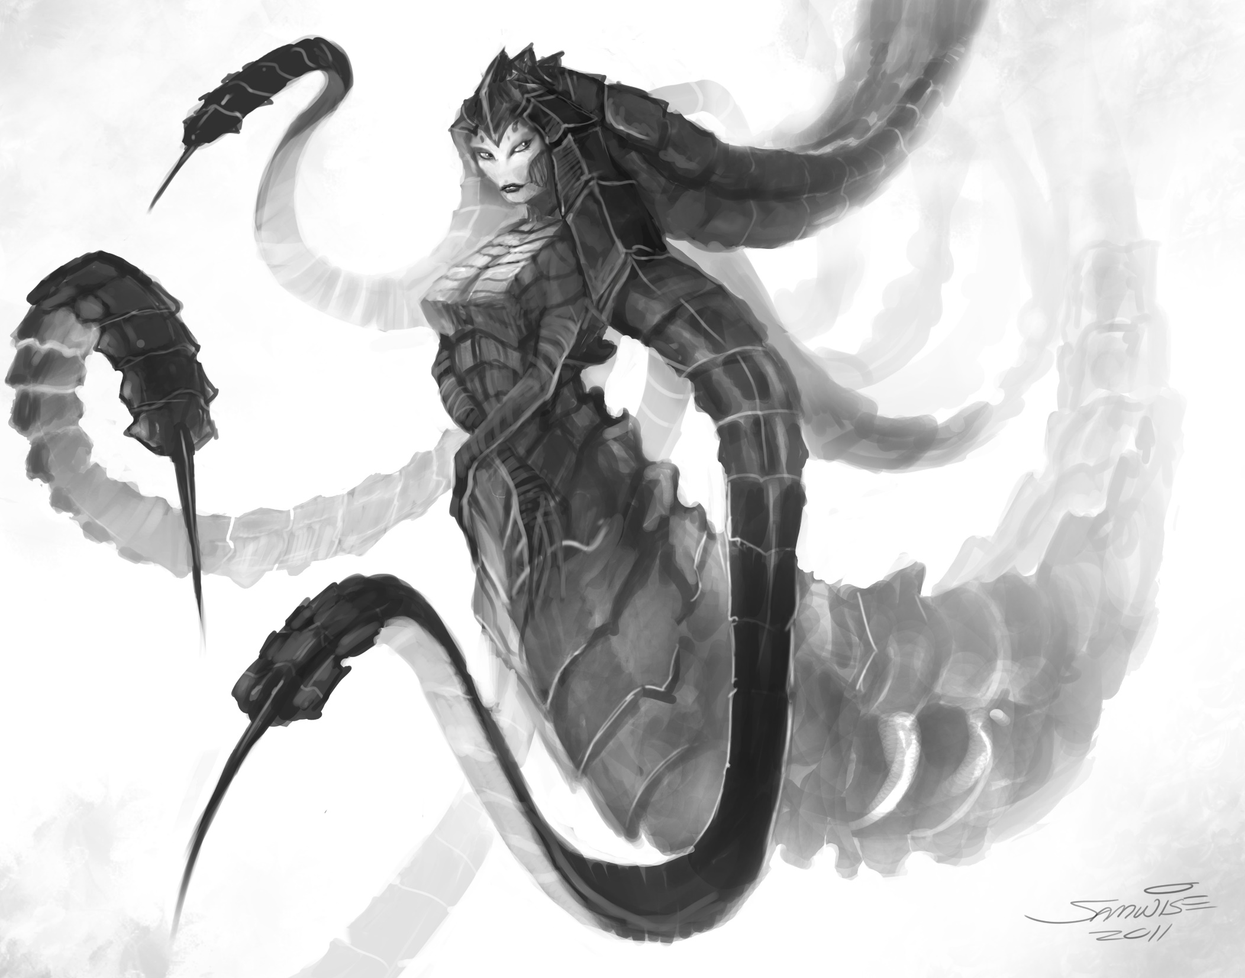
Create…
listen
observe
consider
analyze
dissect
select
abstract
recombine
mutate
…napkins!
Games

Slide 29
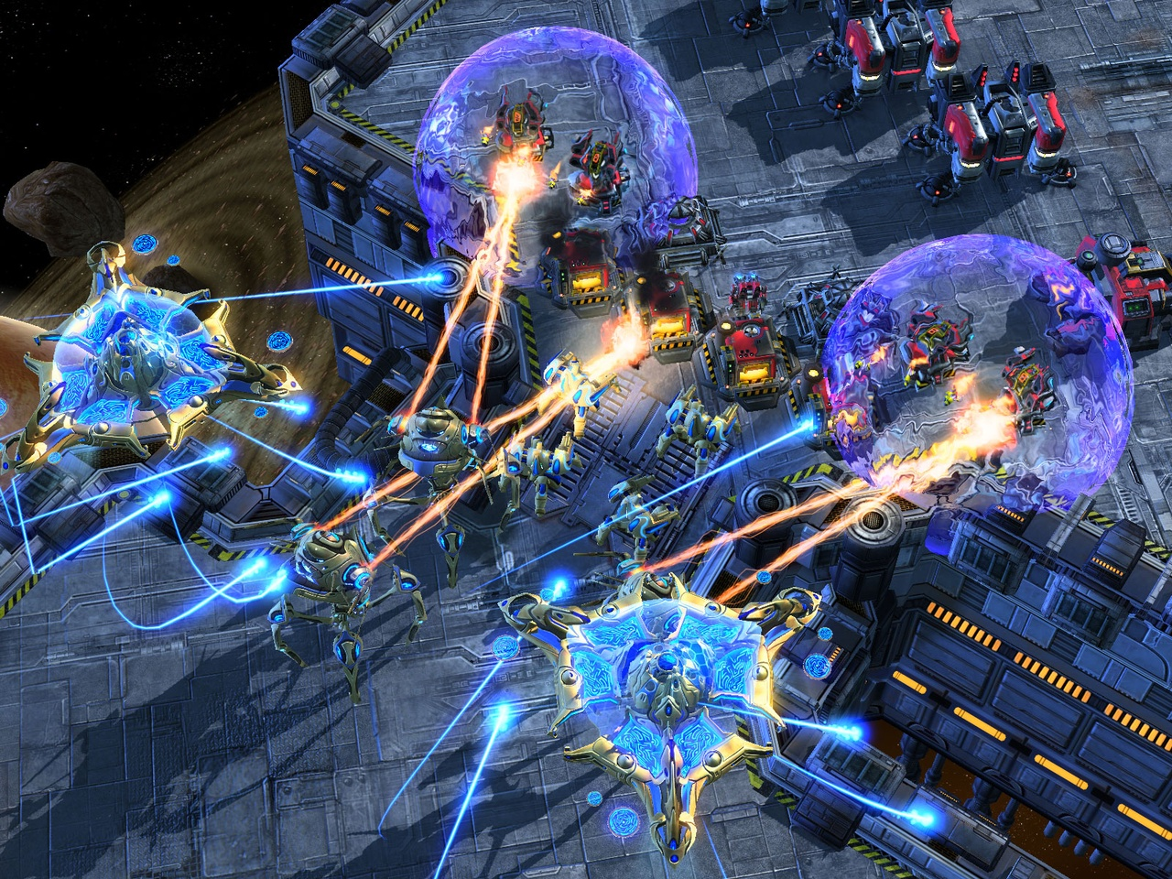
…a game…
Goals
Constraints
Mechanics
Obstacles
Rules
Rewards
Interfaces
Styles
Games

Slide 30
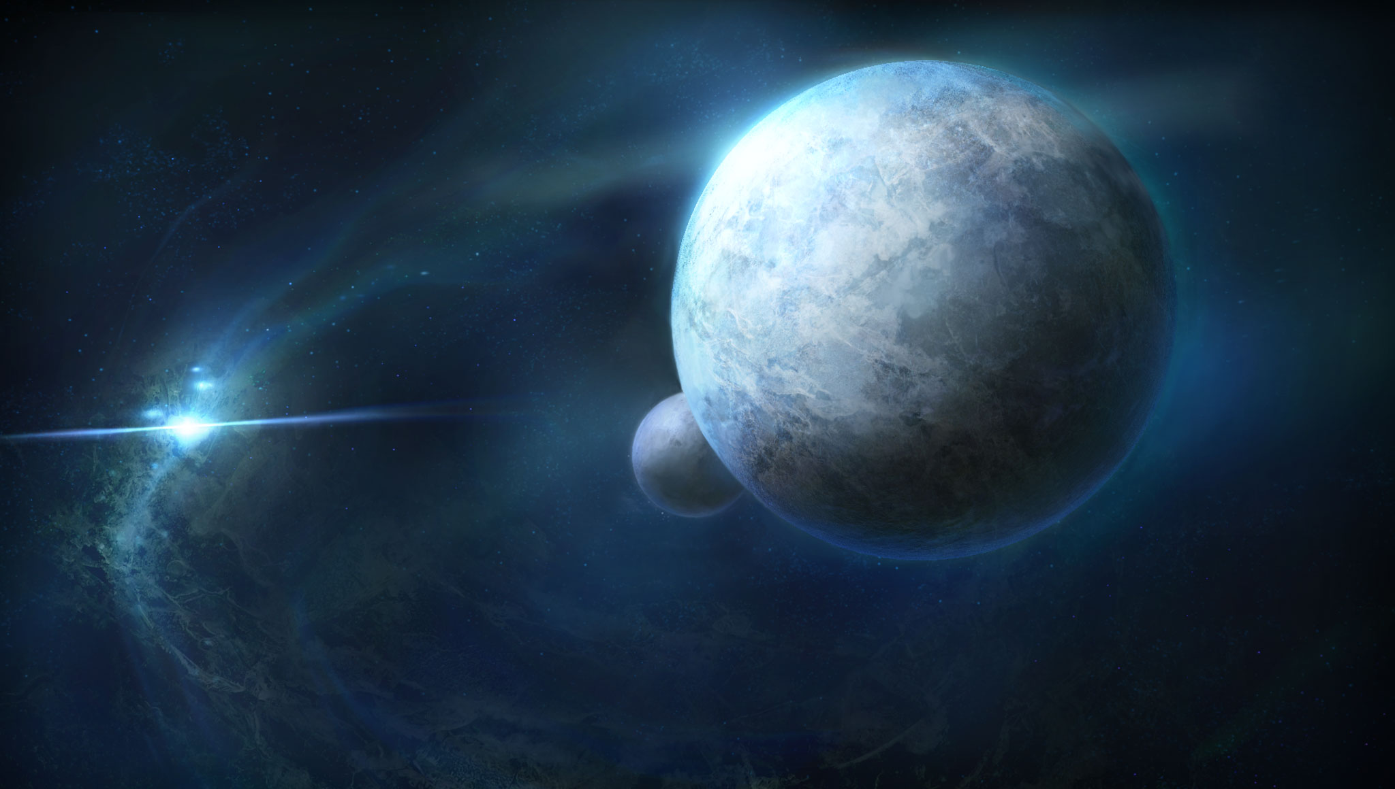
…with a meaningful…
Protagonist
Challenge
Conflict
Circumstance
Location
Age
World
Universe
Games

Slide 31
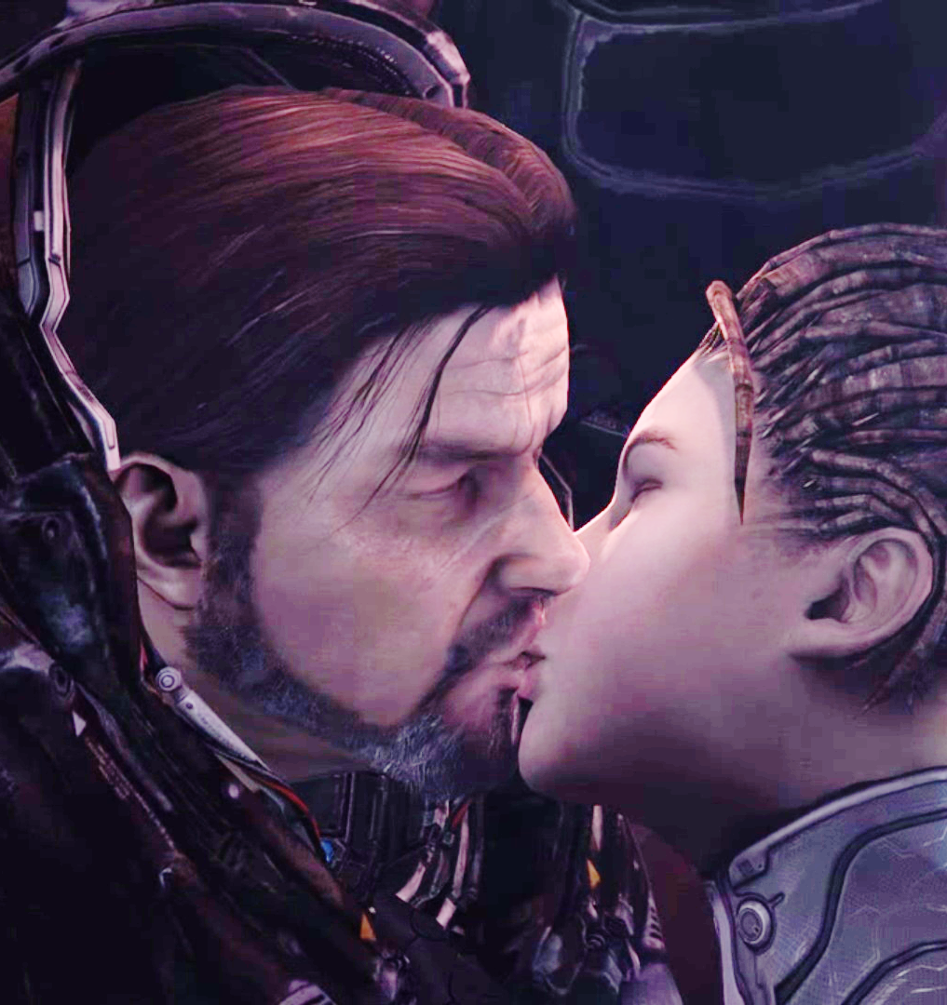
…plot…
Overcoming the monster
Rags to riches
Quest
Voyage
Comedy
Tragedy
Rebirth
Romance
Games

Slide 32
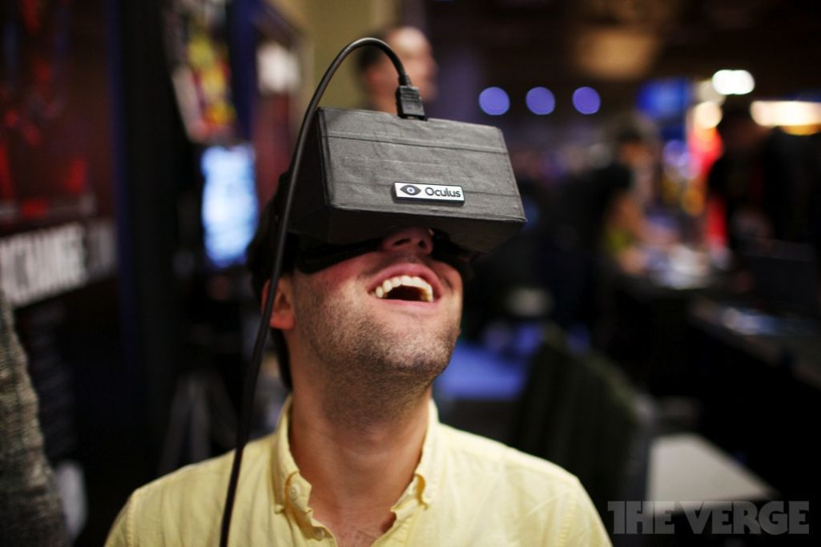
…to convey…
Impression
Perspective
Learning
Sensation
Stimulation
Reaction
Feedback
Games

Slide 33
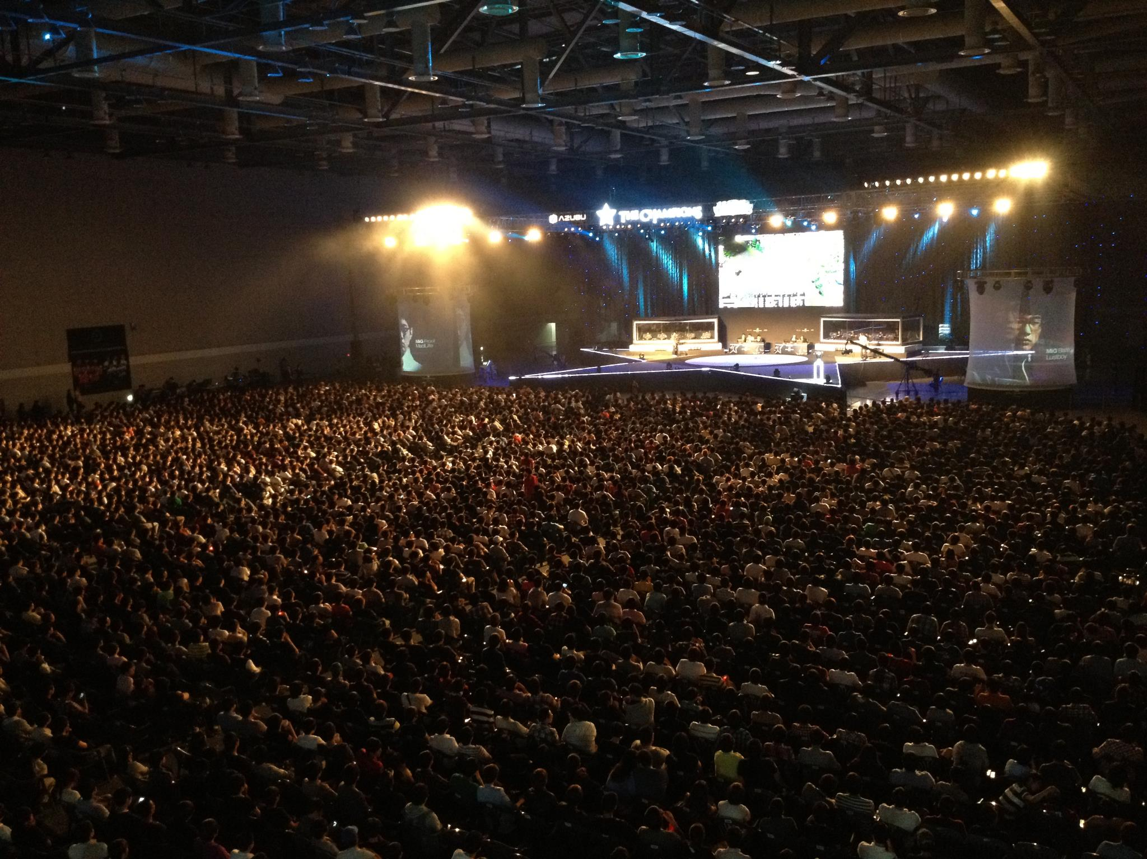
… an experience!
Internal Value
Satisfaction
Membership
Community
Message
Thrill
Immersion
Transformation
Rethinking
or in other words….
Games

Slide 34
The Plot
Experiences shouldn‘t be linear
People get used to external stimuli and require changes and more stimuli to be as satisfied as before
Alternations between action and resting
ACT 1: SETUP
ACT 2 CONFRONTATION
ACT 3: RESOLUTION
Obi-Wan killed
„Use the force!“
Arriving Death Star
%
Luke‘s Parents Killed
Alderaan destroyed
Rebel Captured
Climax
Games

Slide 35
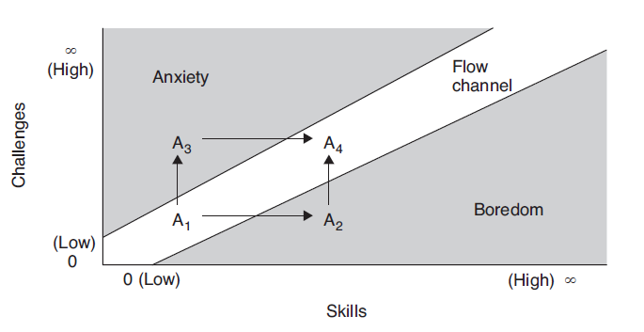
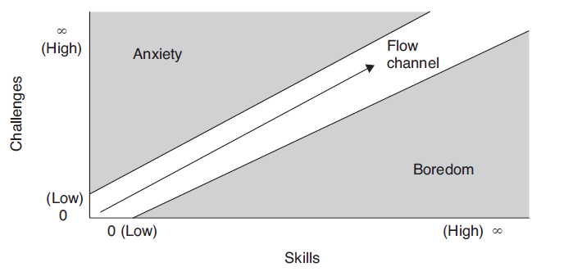
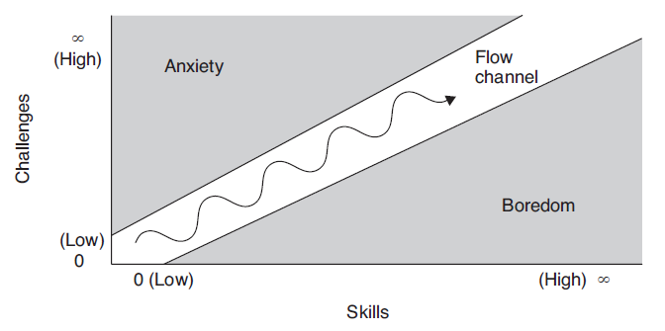
The Flow
Clear goals
No distractions
Direct feedback
Continuously challenge
Distractions, no flow
Flow, but too linear “run”
Most interesting flow
The Art of Game Design: A Book of Lenses, Second Edition, Jesse Schell, CRC Press, 2014, ISBN 9781466598645
Games

Slide 36
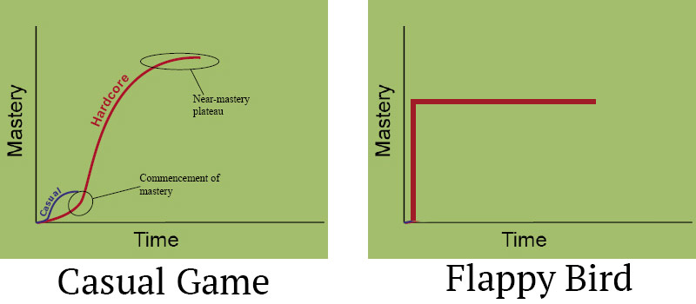
The Learning Curve
Games

Slide 37
Gameplay Variations
Asymmetric: Different Players can play the same game simultaneously in a different way (e.g. Rayman Legends for Wii U GamePad).
Asynchronous: Players can play the same game at different times.
Cooperative :A gameplay feature that allows players to work together as team to reach a goal (e.g. Gears of War)
Deathmatch: Kill the other player until a certain condition (e.g. Quake).
Emergent: Complex simulations in video games with relatively simple game machanics (e.g. The Sims ).
Hack and slash: The usage specifically implies a focus on combat with hand-to-hand weapons (e.g. Diablo)
Leveled: The process of automatically changing parameters, scenarios, and behaviors based on the player's skills. (e.g. Homeworld).
Micromanagement: Describes detailed gameplay elements that must be manually addressed by the player (e.g. Anno).
Nonlinear: Multiple sequences to finish the game, a choice between paths to victory, or optional side-quests and subplots (e.g. Mass Effect).
Twitch: Tests a player's reaction time. Keeps players actively engaged with quick feedback to their actions (e.g. Quake III).
Games

Slide 38
Motivation & Playability
Intrinsic: Game rules, goals, objectives, rhythm and other design mechanics.
Mechanical: Quality as a software system. Fluency of the movie scenes, correct lights, shadows and rendering, sound and music, graphics motions, character personality implementation and communication systems.
Interactive: Player interaction and video game user interface development, for example interaction dialog and game controls. This playability is easily visible in the Game Interface.
Artistic: Arts and aesthetics in the game elements: visual graphics, sound effects, music and melodies, storyline and storytelling.
Personal: Individual vision, perception, and feelings that the video game produces in each player when they play the game. It has a highly subjective value.
Social: The group consciousness and different user perceptions when the player plays with other player in a competitive, cooperative or collaborative way.
Games

Slide 39

Balancing
Mechanics
Turns / Time-keeping systems
Action points
Bidding / Auction
Cards
Capture / Eliminate
Catch-up
Movement
Resource Management
Role-playing
Tile-laying
Worker Placements
Game Modes
Rewards
Praise
Points
Prolonged Play
A Gateway
Spectacle
Expression
Powers
Resources
Completion
Punishments
Shaming
Loss of points
Shortened Play
Terminated Play
Setback
Removal Powers
Resource Depletion
Balancing
Games

Slide 40
Rules & Goals
Rules
What are the foundational rules of my game?
What are the operational rules of my game?
Who enforces the rules?
Are the rules easy to understand, or is there confusion about them?
If there is confusion, should I fix it by changing the rules or by explaining them more clearly?
Are there “laws” or “house rules” that are forming as the game develops?
Goals
What is the ultimate goal of my game?
Is that goal clear to players?
Is there a series of goals?
Are the different goals related to each other?
Are they concrete, achievable, and rewarding?
Do I have a good balance of short- and long-term goals?
Do players have a chance to decide on their own goals?
Note: Only the rules lead to the goals….
Games

Slide 41

… and the rules have to cover all circumstances!

Slide 42

Gameplay & Game Mechanics
Gameplay ≠ Game Mechanics
“Gameplay is the specific way in which players interact with a game.” Wikipedia.org
“A series of interesting choices.” Sid Meier
“One or more causally linked series of challenges in a simulated environment.” Andrew Rollings und Ernest Adams
Games

Slide 43
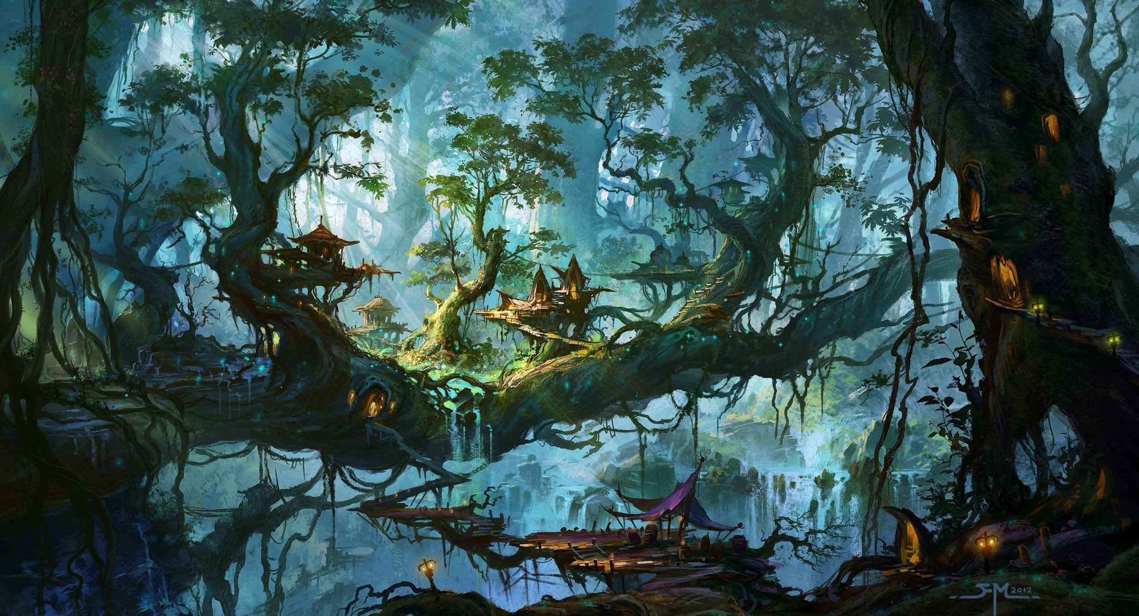
Game Art

Slide 44

Aesthetics
Look and Feel of a game is defined by its style guide.
Documents are abstract, illustrations are concrete.
A well-rendered image of a good idea is compelling in a way that few people can resist (but also increases expectations).
Microsoft Flight Simulator X: DirectX 10-Screenshots, 2011, http://www.pcgames.de/Flight-Simulator-X-PC-123220/News/Microsoft-Flight-Simulator-X-Erste-grandiose-DirectX-10-Screenshots-veroeffentlicht-PC-Games-vor-5-Jahren-841187/
Games

Slide 45
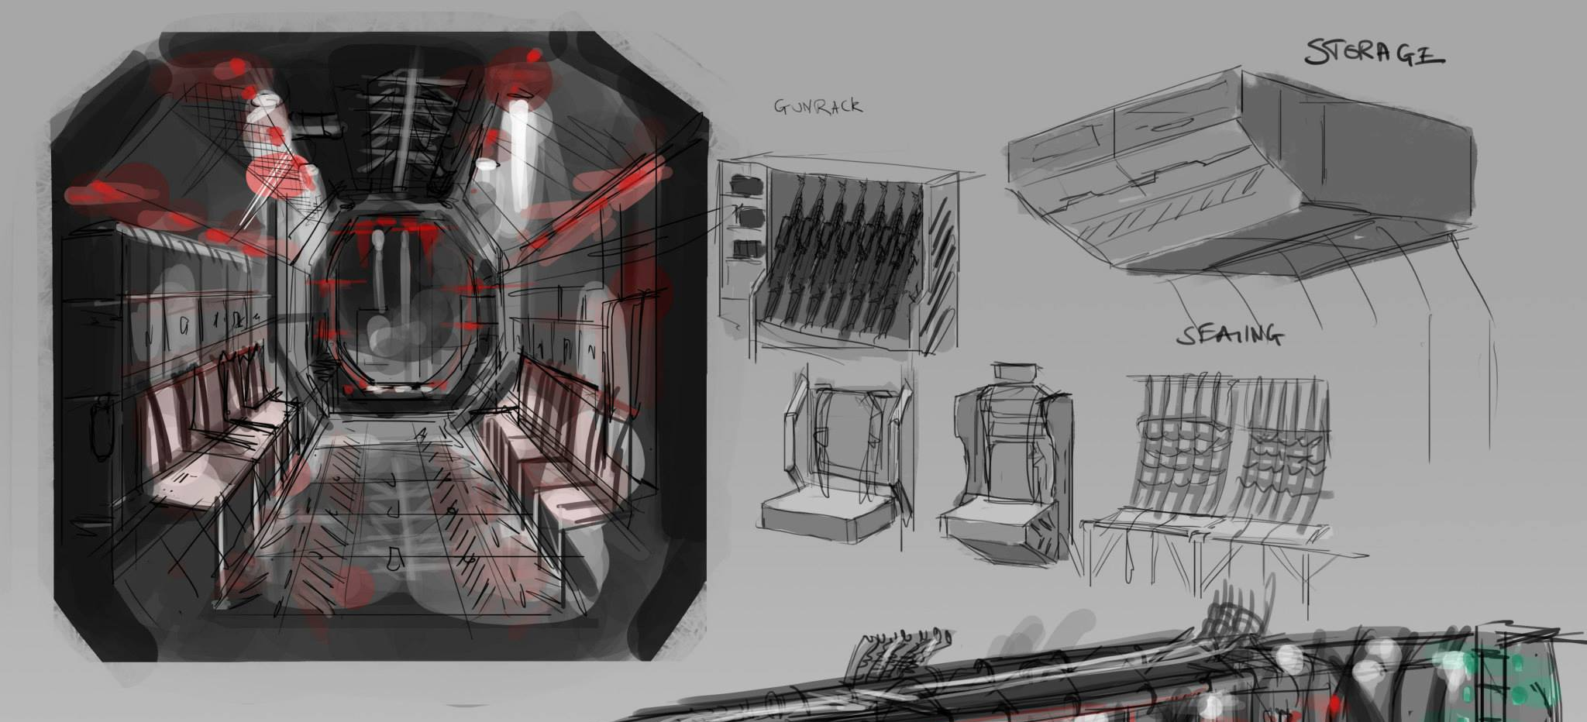
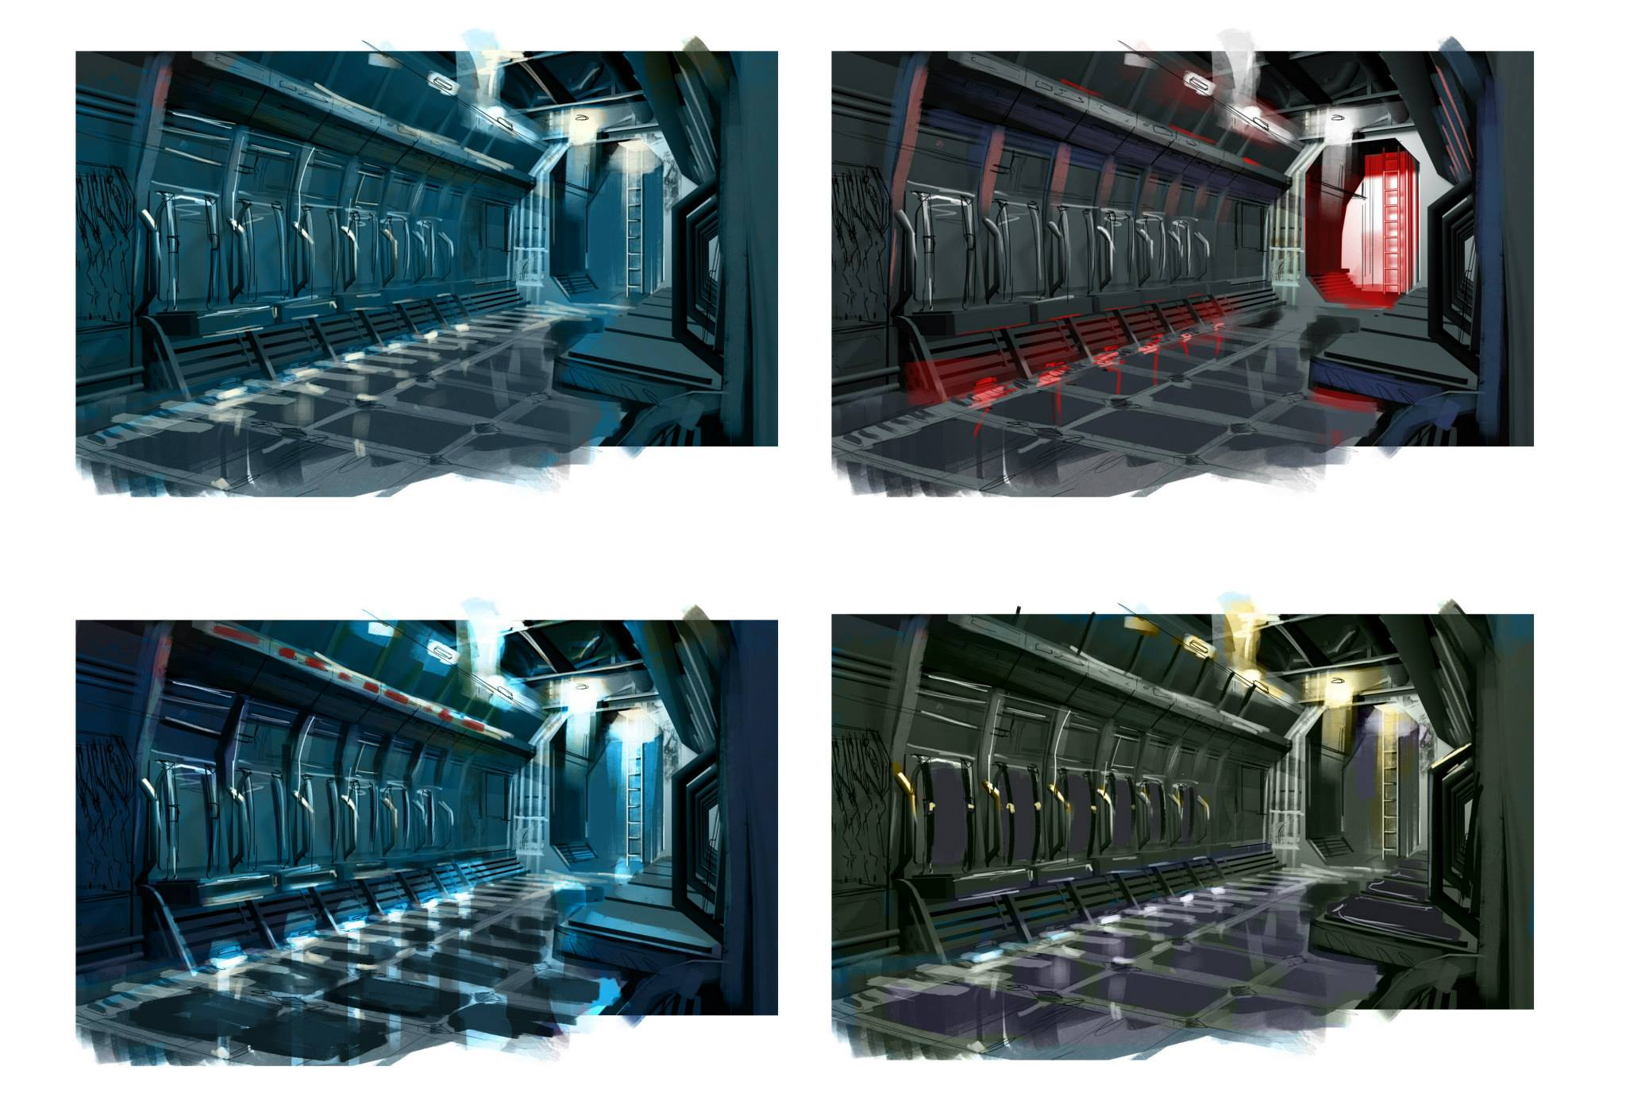
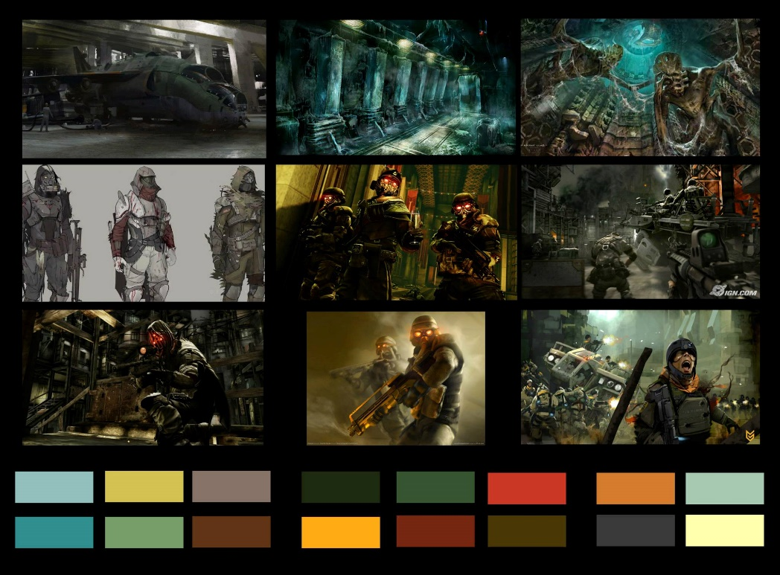
Concepts and Moodboard
Games

Slide 46
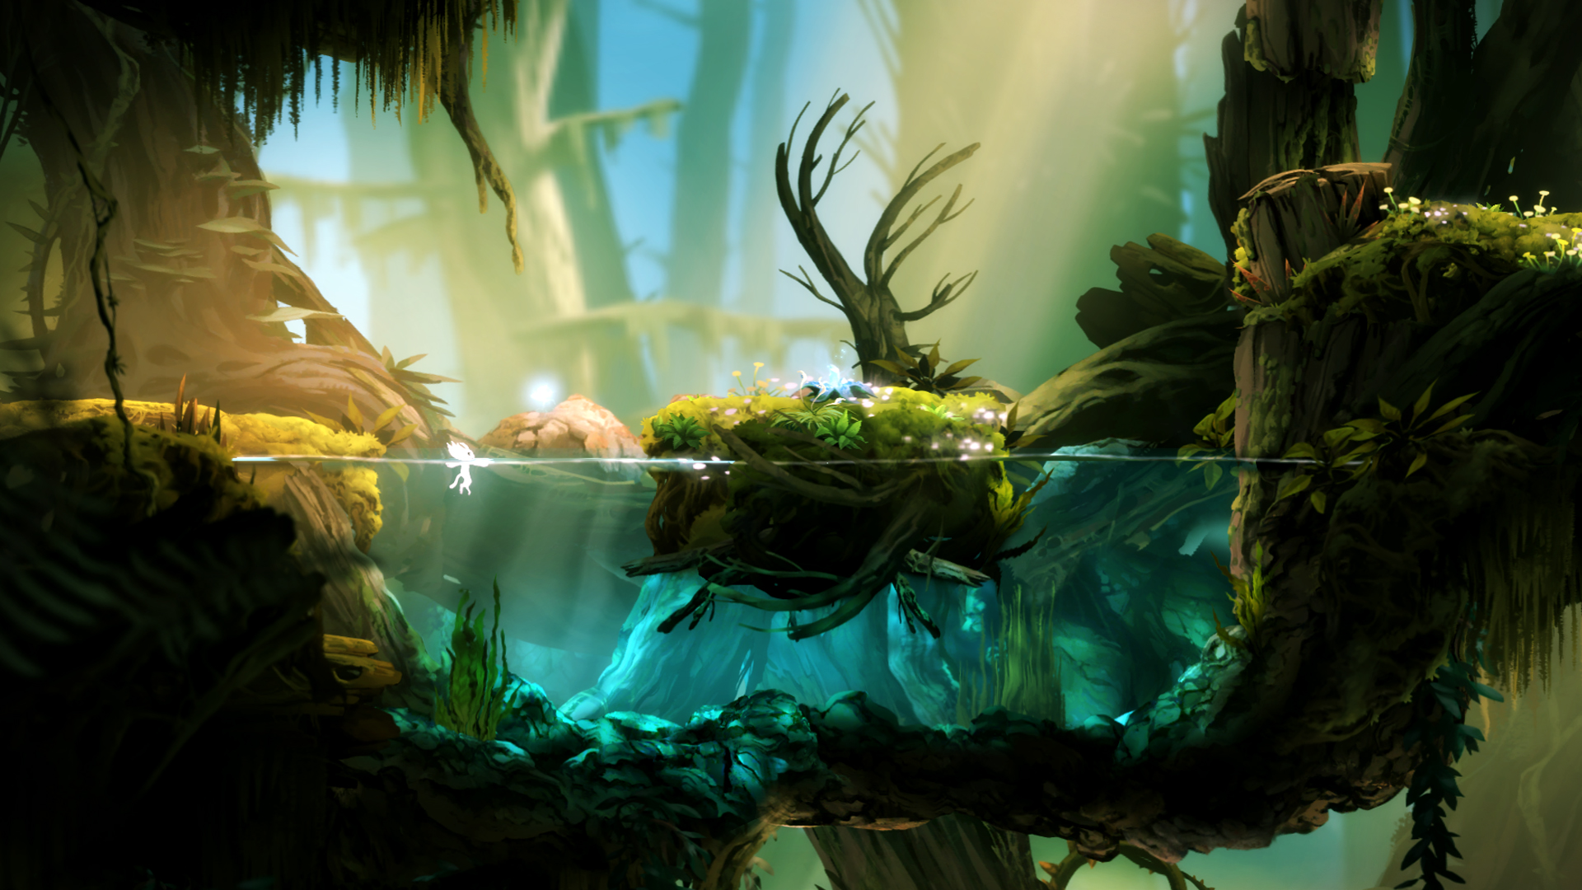

Slide 47
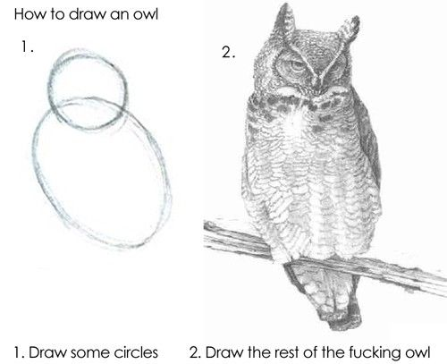
Drawing
Games

Slide 48
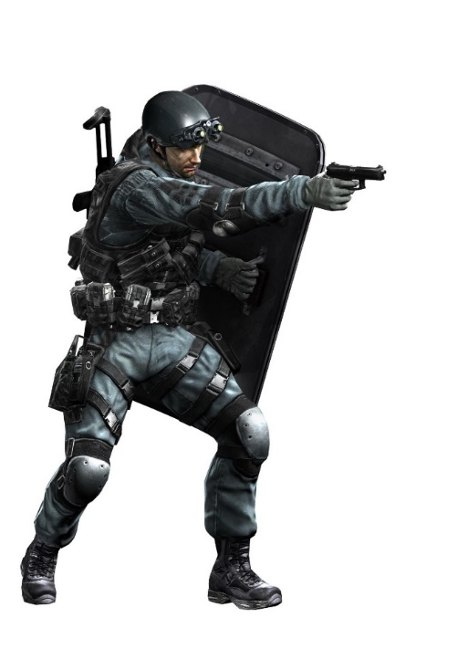


Realism
Games

Slide 49

Technology

Slide 50
Game Technologies
Hardware
PC, [x] GHz, [y] RAM, [z] graphics card…
Playstation [x]
Xbox [x]
…
Software
Unity3D
Unreal Engine
CryEngine
LibGDX
OGRE
RED
….
Games

Slide 51
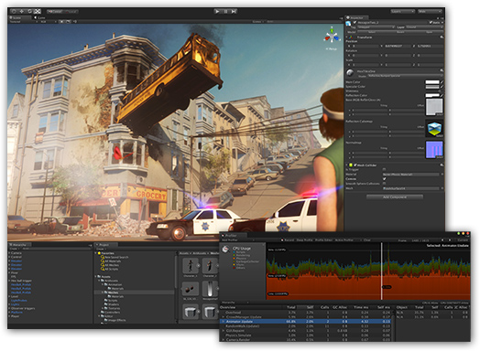
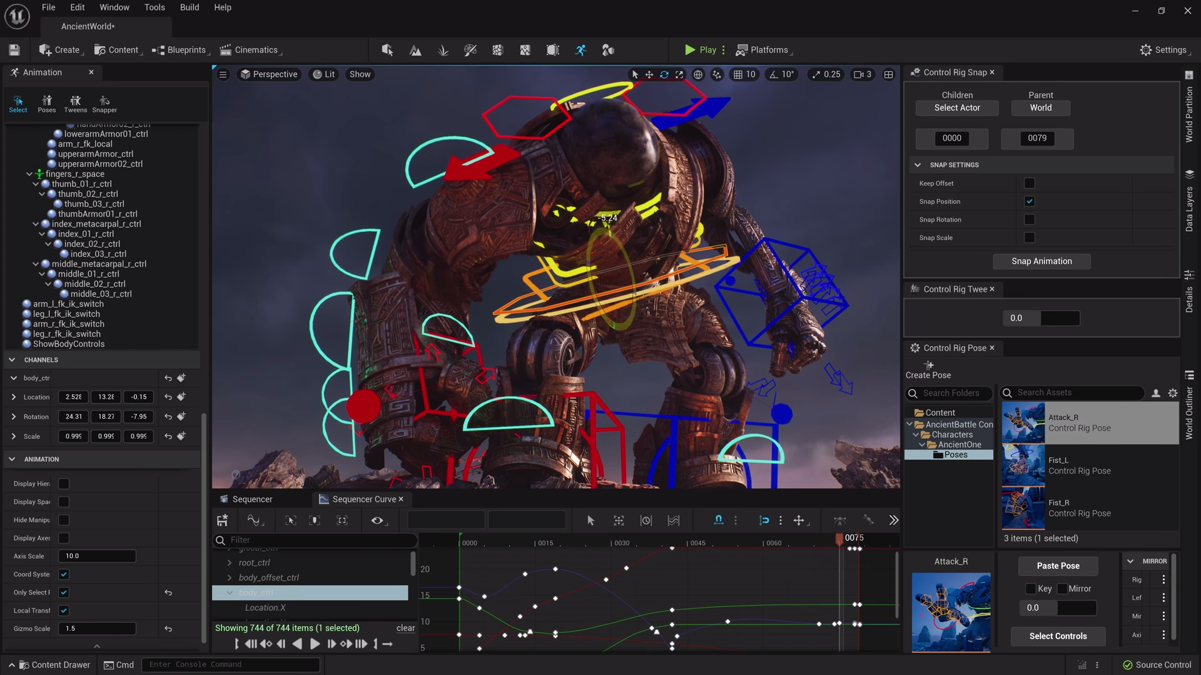
Game Engines
Unity Game Engine (C#)
Unreal Game Engine (Blueprint, C++)
https://www.dice.com/career-advice/how-unity3d-become-a-game-development-beast
https://beforesandafters.com/2021/05/27/you-can-get-early-access-to-unreal-engine-5-now/
Games

Slide 52

Technologies/Features
What technologies will help deliver the experience I want to create?
Am I using these technologies in ways that are foundational or decorational?
If I’m not using them foundationally, should I be using them at all?
Is this technology as cool as I think it is?
Is there a “disruptive technology ” I should consider instead?
Decorational (nice graphics, multiple interfaces)
Foundational
(story, fun, immersion)
Platform (PC, PS4, X-Box, Mobile,…)
Games

Slide 53
Technology in Games
Every game is a simulation!
It runs in discrete time steps
There is an initial state
A new state is calculated based on the current state
The new state gets displayed / visualized
The changes leading to the new state are based on
the game logic (which implements the game mechanic)
the input of the user
Is every simulation a game?
Games

Slide 54
The Game Loop
Update
Init
Input Handle
Shutdown
Draw
void main() {
initialize();
while(running) {
handleInput();
update();
draw();
}
shutdown();
}

Slide 55
Games

Slide 56
Rendering
Rendering is the process where your game throws graphics on your screen.
The rendering process can be computed 2 or 3 dimensions.
Calculations of graphics need very much computational power, thus we often need additional hardware.
At this point we are talking about hardware acceleration (e.g. through GPUs)
3D games need more computational power but they are not easier to realize than 2D games!
Games

Slide 57
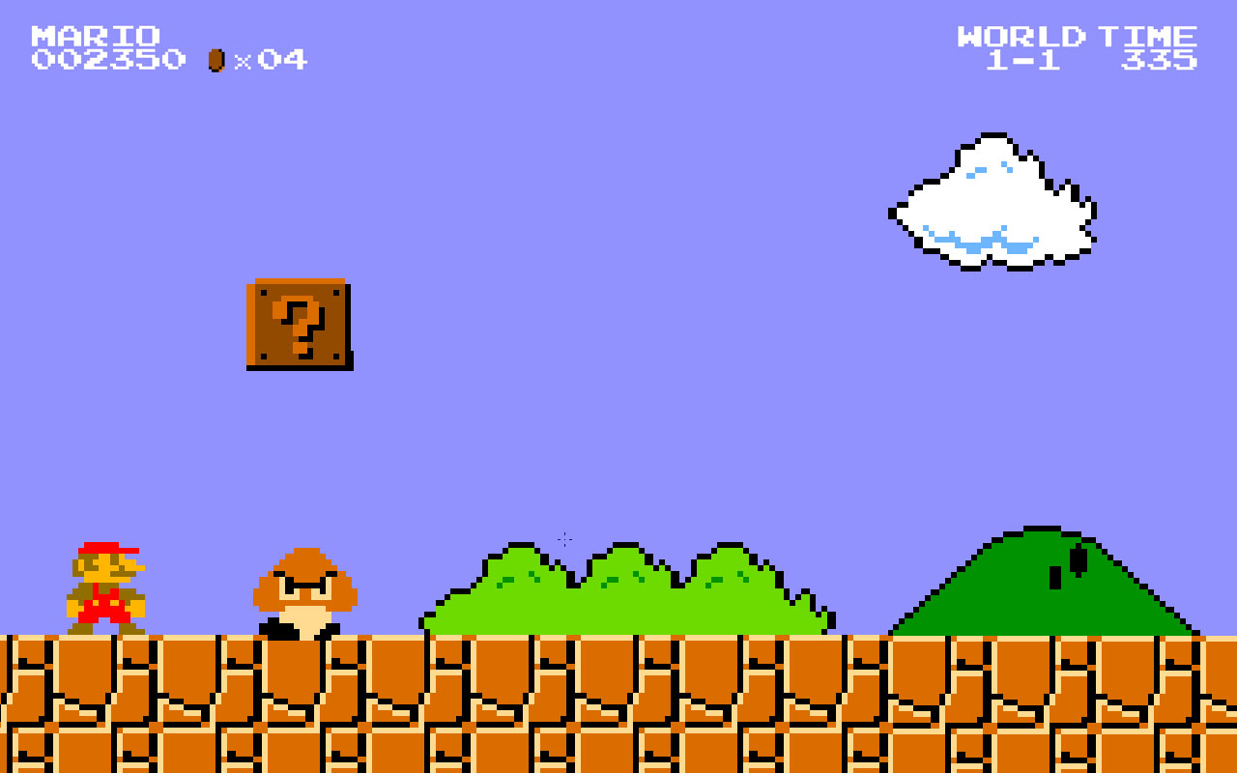
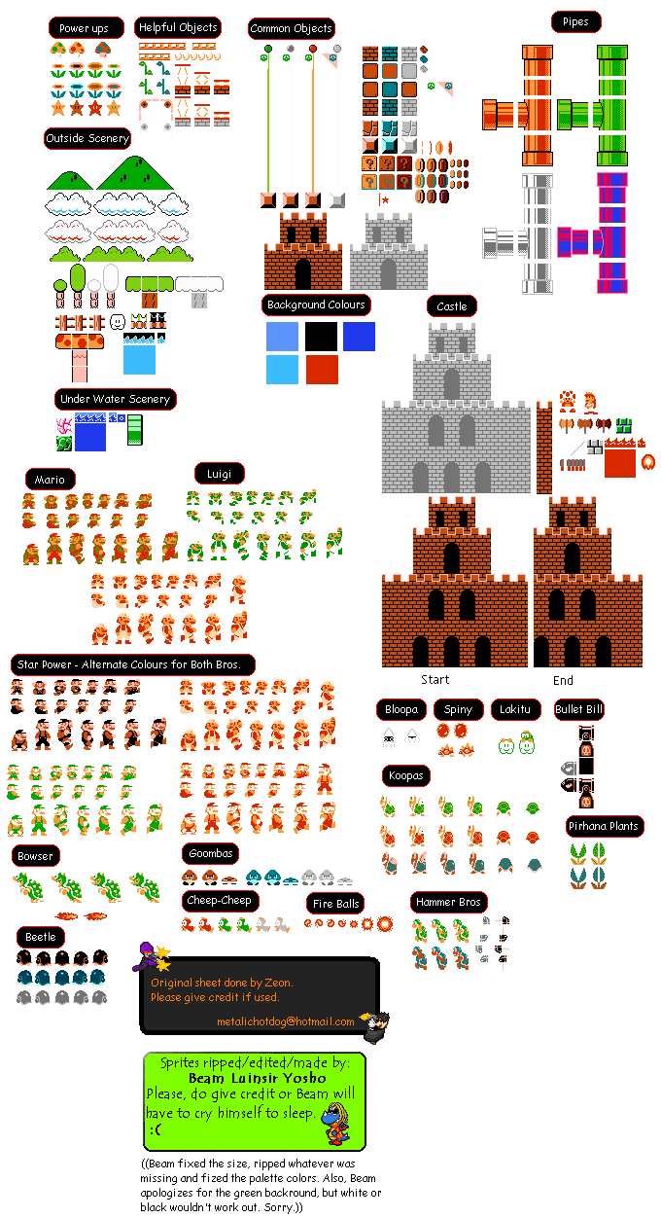
2D
Games

Slide 58
The Dimensions
 | 2D | 3D | Virtual Reality
Ego / First-Person View | Nur bedingt | Ja | Ja
Third-Person View | Nein | Ja | Nein *
Fahrzeug / Cockpit | Nur bedingt | Ja | Ja
Side Scroller | Ja | Ja | Nein *
Top Down | Ja | Ja | Nein *
Isometric | Ja | Ja | Nein **

Slide 59

Animations and Physics
Using physics adds realism and (some kind of) predictability
Objects usually have mass, friction, and volume.
Objects only move when forces applied to them.
Motion is not linear, its curved.
Interaction must be responsive.
States change with transitions.
Sounds can support animation.
Physics can support animation.
Disney’s 12 Principles of Animation
Games

Slide 60
Collisions
Collision Detection
Generate contact details for interpenetrating /touching bodies
Contact Solver
Resolve contacts to separate any interpenetrating bodies and produce resultant forces/impulses.
Integrator
Forces (e.g. Gravity)
Apply accumulated forces/impulses to bodies to produce updated positions and velocities
Collision Objects =
Simple Geometry
Games

Slide 61
Invent or Pick Up?
INVENT
Draws much attention
All players have the same pre-knowledge
You can be much more creative
Very hard to realize
Designing new rules can be incredibly complex and time-consuming
PICK UP
Existing game concepts are well explored
Tower Defense
Turn-based Strategy
…
You can learn from others (Mechanics, Balancing)
People are (fast) familiar with your interface
Games

Slide 62
Create Your First Game
Conceptualize!
Keep your first game small
Hold back larger ideas for the 2nd, 3rd, …game you make
Every idea, content and/or technology you plan takes time (and experience and manpower) to implement!
Learn the technology while you go
Technology shapes your idea
Your idea shapes technology
Keep it simple!
Don’t explain everything, leave enough space for the player’s interpretations
Games

Slide 63
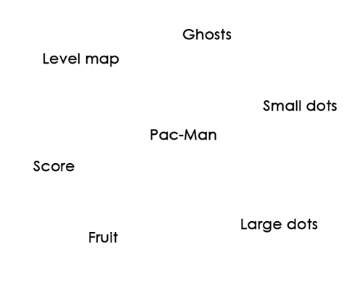
Flow Chart
Image from: http://livelyivy.com/gravityghost-com/5-alternatives-to-a-game-design-doc/
Games

Slide 64
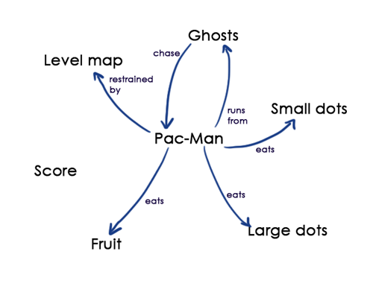
Flow Chart
Image from: http://livelyivy.com/gravityghost-com/5-alternatives-to-a-game-design-doc/
Games

Slide 65
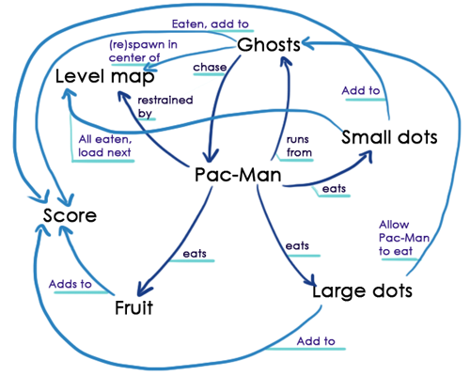
Flow Chart
Image from: http://livelyivy.com/gravityghost-com/5-alternatives-to-a-game-design-doc/
Games

Slide 66
About Randomness
Random Number Generators (Dice, Coins, etc.)
Adds (re-)playability
Situations are less predictable
Randomness should not appear random
Randomness should be part of an unpredictable world
Pseudo-Randomness
Chess has no random factors but…
…more unique games than estimated number of atoms in the Universe
Pseudo-Randomness (seed number) is used to generate procedural content
e.g. the seed number of the universe in Elite Dangerous is the telephone number of the main developer
Games

Slide 67
Final Questions of Game Design
Does this game meet our social and community goals?
Will the intended audience like this game enough?
Is it technically possible to build this game?
Do the testers enjoy this game enough?
Is this a well-designed game?
Does this game feel right?
Is this game novel enough?
Will this game sell?
Games

Slide 68
Game Design Document
The GDD has no standard form and is a living document created by several iterations.
Starts with the basic concept
Explains detailly every game part
Varies from game to game
It will be revised.
It will be approved.
It will be expanded.
If often includes the following sections:
Selling points
Target audience
Gameplay & Mechanics
Rules & Goals
Technologies (Platform & Engine)
Characters
Ambience & Environment
Level Design
Art & Style
Sound and Music
User Interface
Game Controls
Studies
Games

Slide 69
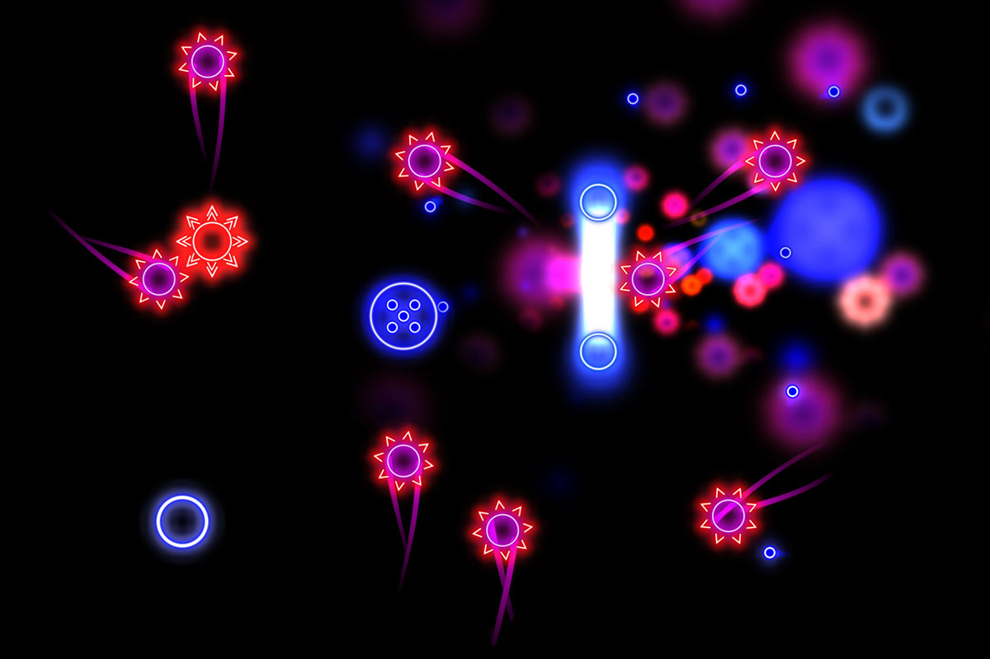
Some Interesting Game Designs

Slide 70
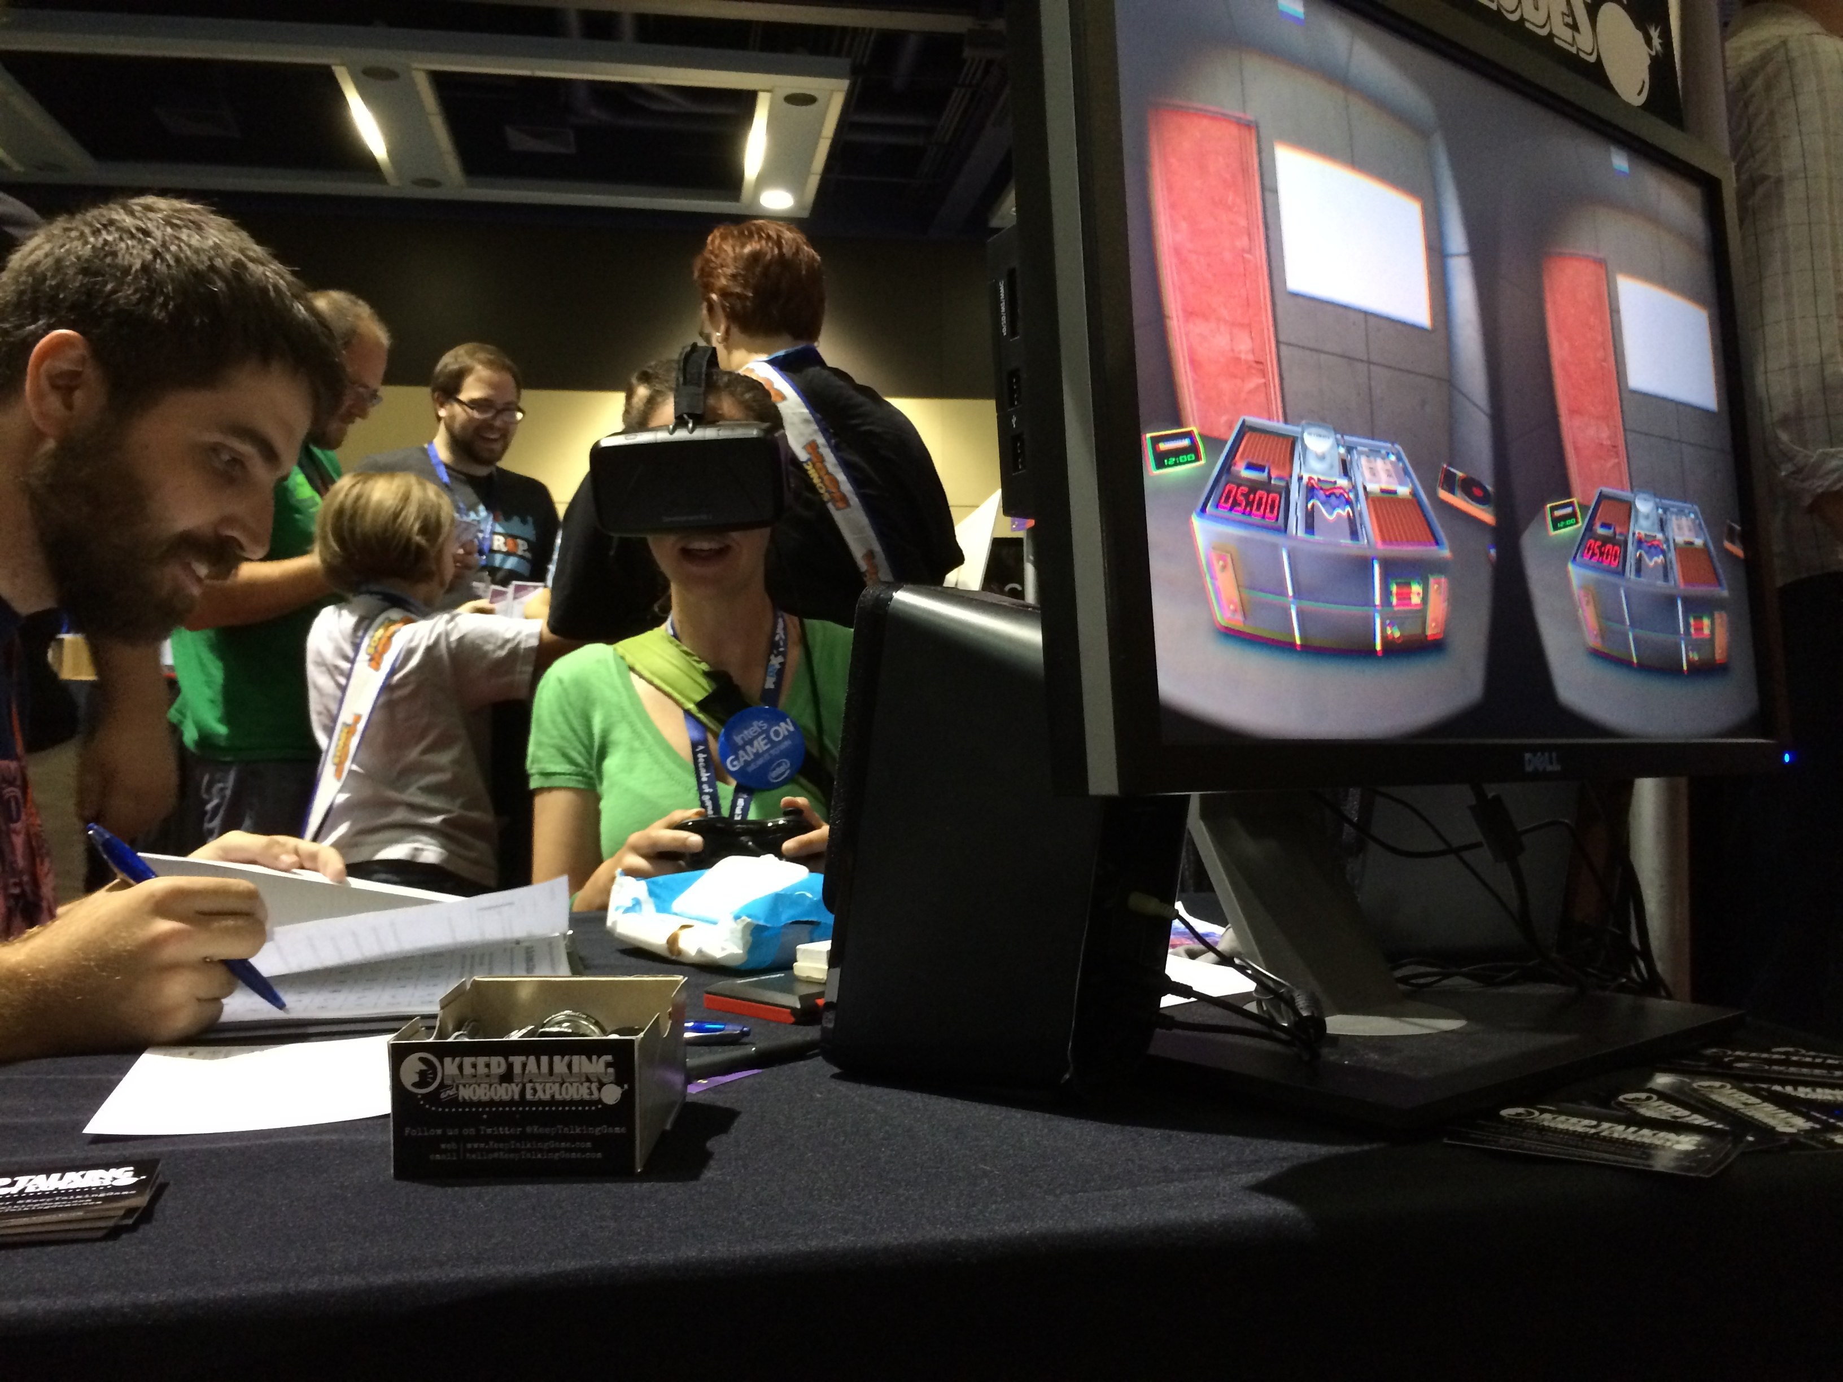

Slide 71
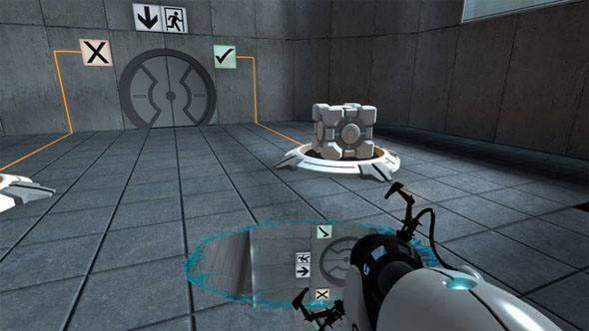

Slide 72
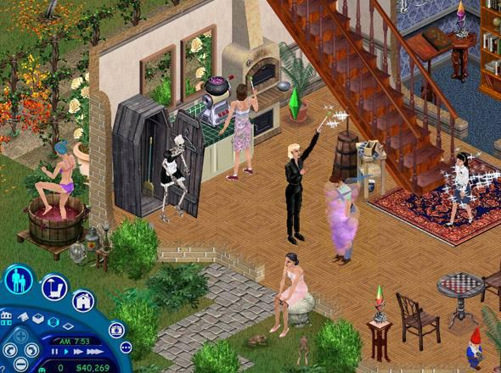
Games

Slide 73
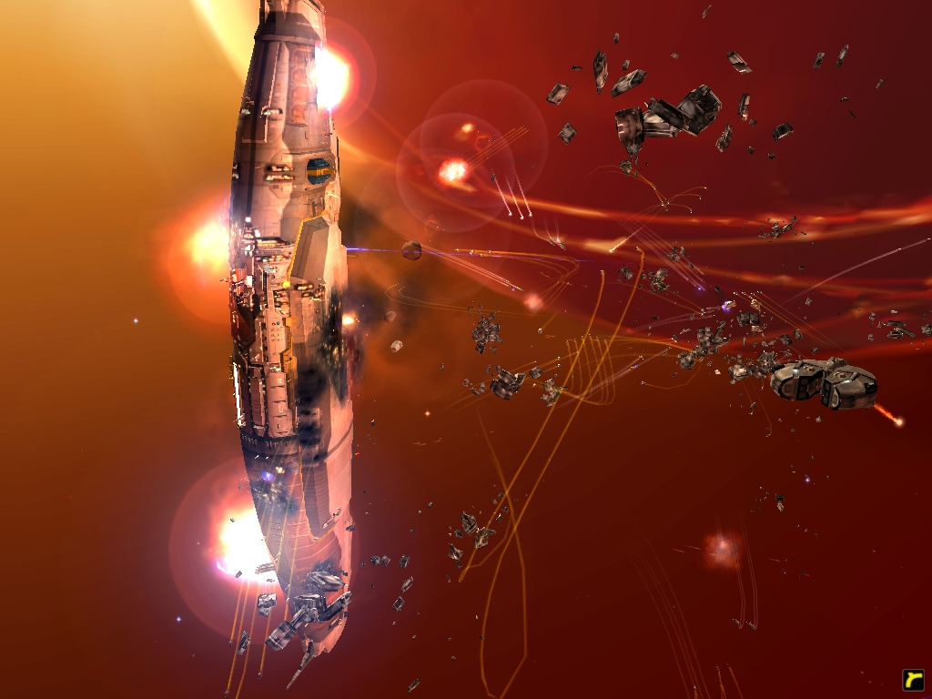

Slide 74
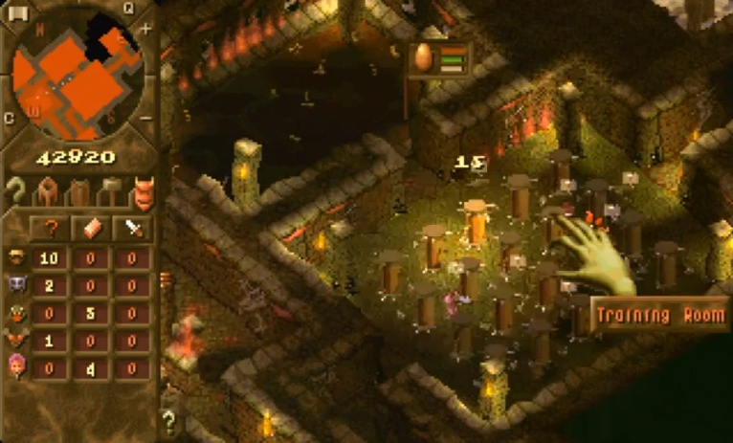

Slide 75
Take Home Messages
Games are entered willfully.
Games have goals.
Games have conflicts.
Games have rules.
Games can be won and lost.
Games are interactive.
Games have challenge.
Games can create their own internal value.
Games engage players.
Games are closed, formal systems.
Games are simulations.
Games

Slide 76
References
Game Design
Jane McGonigal: Reality is Broken. Vintage, 2011
Jesse Schell: The Art of Game Design. 2008
Tracy Fullerton: Game Design Workshop. 2008
Scott Rogers: Level Up! Wiley, 2010
Game Engines (free for educational puposes)
Unreal Engine: https://www.unrealengine.com
CryEngine: http://cryengine.com/
Unity: http://unity3d.com/
Ogre3D: http://www.ogre3d.org
Games

Slide 77
References
[1] Peter Shankar - CSE 497 – Topics on AI & Computer Game Programming
[2, 3] Chessboard, Grafik: Ilaboy, (2008), GFDL 1.2, CC BY-SA 3.0, Quelle: http://commons.wikimedia.org/wiki/File:AAA_SVG_Chessboard_and_chess_pieces_06.svg?uselang=de
[4] Foto: Unbekannt, CC0 Public Domain Quelle: http://pixabay.com/static/uploads/photo/2012/11/28/10/48/chess-67660_640.jpg
[5] BOTVINNIK, M.M. (1970). Computers, Chess and Long-Range Planning. Springer-Verlag, New York/Heidelberg. LC 75-85203
[6] Foto: Unbekannt, CC0 Public Domain Quelle: http://pixabay.com/en/source-code-code-programming-c-583537/
[7] Racknitz, Kupferstich, Der spielende Schachtürke (1789), mit freundlicher Genehmigung der Humboldt University, Berlin (Die Wissenschaftlichen Sammlungen)
[8] Cover Art of Battle Chess (1988), coypright by Interplay Entertainment, Fair Use Rationale, Quelle: http://en.wikipedia.org/wiki/File:Battle_Chess.png
[9] Screenshot of Chessmaster (Moby Games), http://www.mobygames.com/images/shots/l/409746-chessmaster-10th-edition-windows-screenshot-animated-piece.jpg
[10] Foley Room at the Sound Design Campus Vancouver Film School Flickr, CC BY-SA 3.0 ,Quelle http://commons.wikimedia.org/wiki/File:Foley_Room_at_the_Sound_Design_Campus.jpg
[11] Hans-Werner Hunziker, (2006), CC BY-SA 3.0, Quelle: http://en.wikipedia.org/wiki/File:Eye_movements_of_a_chess_champion_nc.jpg
[12] Rise of the Tomb Raider - Rise of the Tomb Raider Reactions - E3 2014 - ign.com
[13] Samwise Didier, Izsha, StarCraft II Game Concept, Quelle: http://www.videogamesartwork.com/games/starcraft-ii/izsha
[14] Starcraft-II.eu - artworks, avatars, screenshots, vidéos et wallpapers pour Starcraft 2 - © 2007 www.starcraft-II.eu http://www.starcraft2.gamemasters.fr/screen-wall/starcraft-2-05.jpg
[15] The Art of Game Design: A Book of Lenses, Second Edition, Jesse Schell, CRC Press, 2014, ISBN 9781466598645
[16] Arrangement of equal-sized circles at a distance of the golden angle Ψ = 137.5077°, Andree Stephan, CC BY-SA 3.0 http://commons.wikimedia.org/wiki/File:Fibonacci_numbers.jpg
[17] Luc Fontenoy / Game Art Design, http://lucfonz.blogspot.de/2013/05/interiors.html
[18] Die erfolgreiche Konstruktion virtueller Spielfiguren, Jäger, Solveigh (2012)
{19] Activision Publishing, Character Demo (2014) http://www.gamespot.com/articles/activision-shows-off-next-gen-visuals/1100-6406090/
[20] The Incredibles / Mars needs Mom; Image Property Disney Animation Studios / Pixar (2010)
[21] Maslow's hierarchy of needs. Salenger Incorporated, 1987.
[22] “Nico Bellic”, Artwork of “GTA IV”, Rockstar Games, http://www.theapricity.com/forum/showthread.php?139378-Classify-Niko-Bellic
[22] Image on p 23: Screenshot from “Hitman Absolution”, IO Interactive / Square Enix, 2013
[23] Image on p. 19: Artwork, Tomb Raider , Crystal Dynamics / Core Design / Eidos Montreal / Square Enix, 2013. http://cdn.collider.com/wp-content/uploads/lara-crof-tomb-raider.jpg
[24] Screenshot / Kaldir Artwork, StarCraft II – Wings of Liberty, Blizzard Entertainment (2012), http://starcraft.wikia.com/wiki/Category:Kaldir_images
[25] Screenshot StarCraft II – Wings of Liberty, Blizzard Entertainment (2012)
[26] Gamer with Oculus Rift, Quelle. TheVerge.com, Quelle: http://www.theverge.com/2013/3/9/4081912/oculus-rift-at-sxsw-is-virtual-reality-the-holy-grail-of-gaming
[27] OGN 3rd place match: Champion 2014, by Kacper Smigiel , 2014, https://sg.news.yahoo.com/ogn-3rd-place-match-skt-t1-vs-samsung-054426726.html
[28] Microsoft Flight Simulator X: DirectX 10-Screenshots, 2011, http://www.pcgames.de/Flight-Simulator-X-PC-123220/News/Microsoft-Flight-Simulator-X-Erste-grandiose-DirectX-10-Screenshots-veroeffentlicht-PC-Games-vor-5-Jahren-841187/
[29] “Jumpman” from Donkey Kong, Nintendo 1981, http://mygaming.co.za/news/features/41949-mario-the-first-15-years.html
[30] Lara Croft: Tomb Raider Screenshot, Design by Toby Gard, 1996, Core Design, Crystal Dynamics
[31] Tom Clancy’s Rainbow Six Las Vegas 2006, Ubisoft, IGN Game Guides, http://www.ign.com/wikis/tom-clancys-rainbow-six-vegas/File:Shield_animation.jpg
[32] Artwork from “The Incredibles”, Directed by Brad Bird, Pixar Animation Studios / Disney Animation Studios, 2004
[33] Mars needs Mom, Directed by Simon Wells, Disney Animation Studios, 2011
[34] Human like robot from Hiroshi Ishiguro, © 2013 by Max Braun, Lizenz: CC BY-NC-SA 2.0 / flickr.com.
[35] Human like robot, © 2013 by Max Braun, Lizenz: CC BY-NC-SA 2.0 / flickr.com.
[36] Clu from Tron Legacy, “Tron: Legacy” (USA 2010), Directed by J. Kosinski, © 2013 Walt Disney Pictures, TC: 01:53:54.
[37] Lauren Winter from Heavy Rain, © 2010 Sony Computer Entertainment America LLC / Quantic Dream.
[38] Wax figure of Naomi Campbell, © 2013 by dreistreifen, Lizenz: CC BY-NC-SA 2.0/ flickr.com.
[39] Real human, © 2013 by lev dolgachov / shutterstock.com
[40] Mori, M. (1970). The Uncanny Valley. Energy.
[41] Image on p. 38: Screenshot from Mass Effect 2, BioWare / Electronic Arts (2012)
[42] Suits,B.(1978):TheGrasshopper:Games,LifeandUtopia
Games

